Slide 1
Sales Data Set
ADVANCED EXCEL

Slide 2
Project Overview
This project analyzes transactional data from a Product sales to uncover business performance insights across products, regions, and time periods. My aim to transform raw data into decision-ready visuals.
Key Objective
Track Sales Performance
Analyze Product & Category Performance
Measure Profitability & Discounts Impact
Develop an Interactive Dashboard

Slide 3
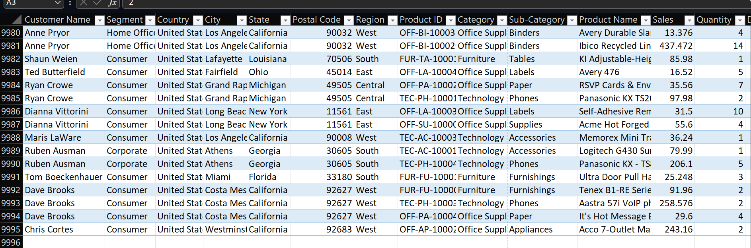
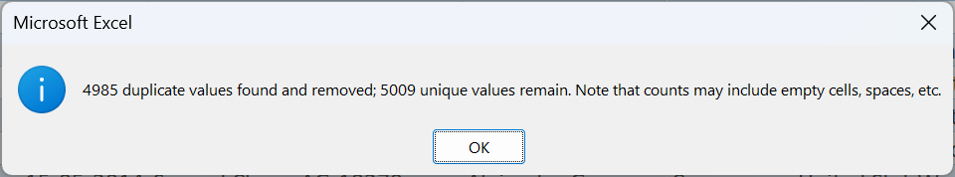
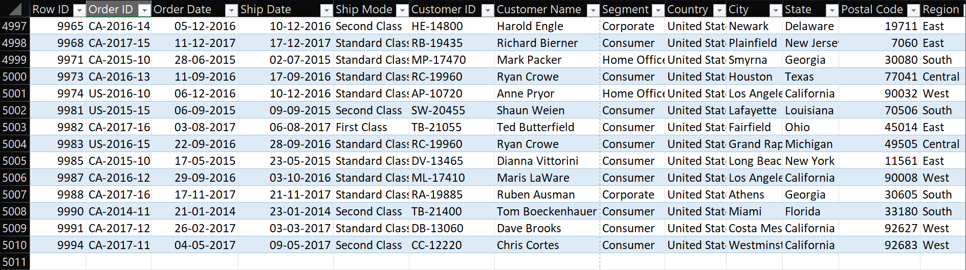
Used Excel’s AVERAGEIFS or region-based logic to estimate missing values where appropriate
Data Description and Preparation
Remove Duplicate: Used the Remove Duplicates tool on key identifiers like Order ID and Sales ID to eliminate repeat entries.AVERAGEIFS to estimate missing values (0) to fill it.

Slide 4
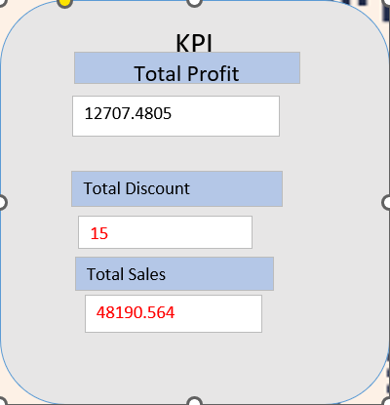
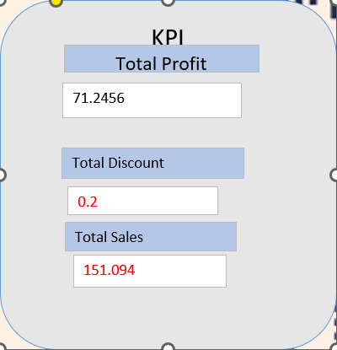
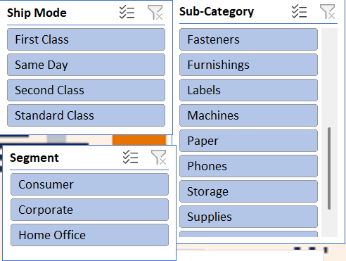
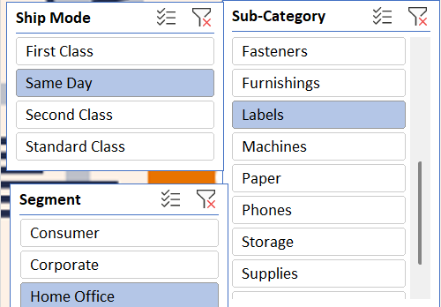
Key Metrics Calculation and Data Analysis
Key metrics, often used as Key Performance Indicators (KPIs), are quantifiable measurements that track progress towards specific objectives.
They are few key matrics in my data Set.
Total sales
Discount rates
Total Profit

Slide 5
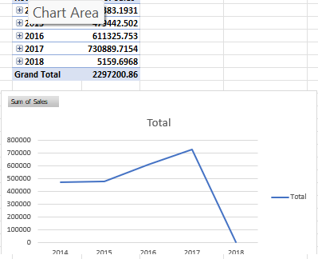
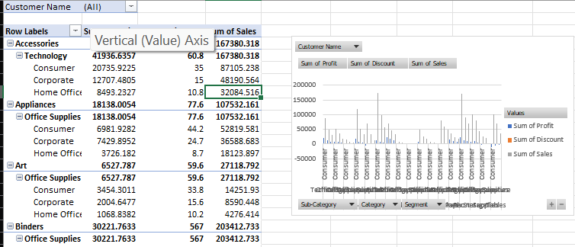
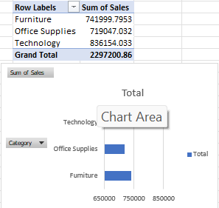
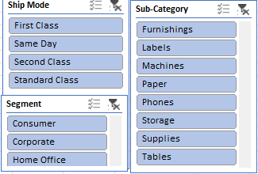
Pivot Tables and Pivot Charts
Pivot tables and pivot charts are powerful tools for summarizing, analyzing, and visualizing data. Pivot tables allow you to rearrange and summarize data in a structured way.
pivot charts provide a graphical representation and making it easier to identify trends and patterns.

Slide 6
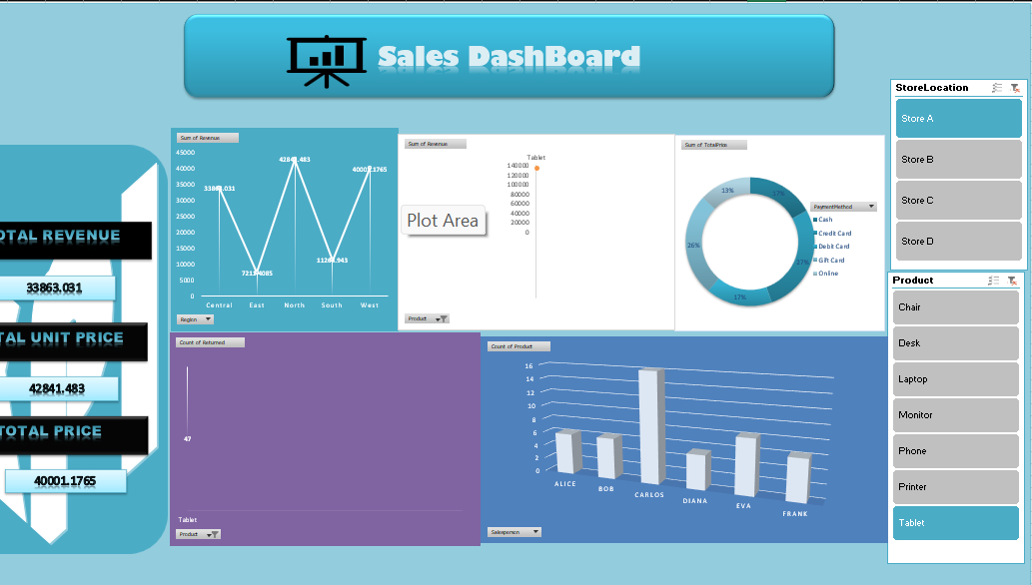
Dashboard Overview
The dashboard overview refers to a single page summary that visually presents key information and metrics, often including charts, graphs, and tables
It has Various Types of Charts such as Pie Chart,Bar Chart,Line Chart.

Slide 7

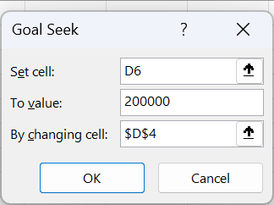

What-If Analysis (Goal Seek)
Goal Seek in Excel is a "what-if analysis" tool that helps you determine the input value needed to achieve a specific result in a formula. Essentially, it allows you to work backward from a desired outcome to find the required input.
Formula:
Total Amount=Phone sold*Quantity

Slide 8
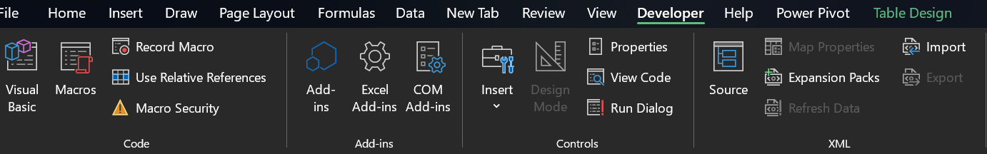
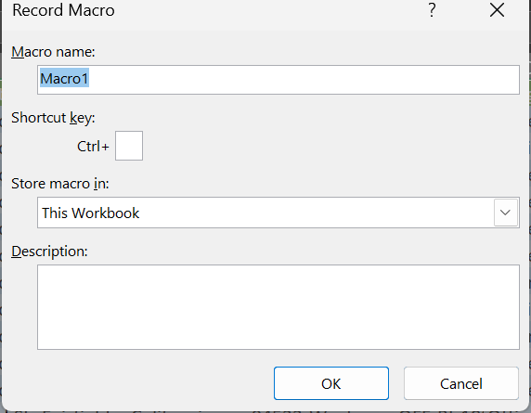
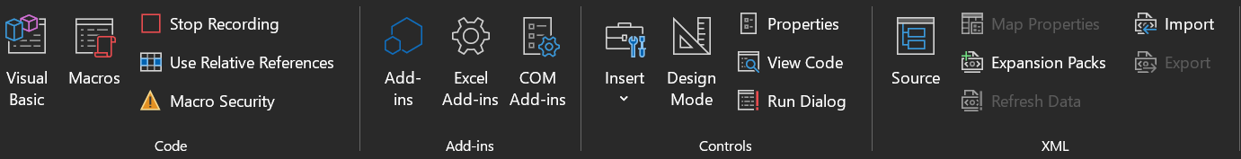
Macros and Automation
Macros are recorded sequences of actions in Excel that can be replayed to automate repetitive tasks
Common Uses:
Formatting cells and charts
Generating pivot tables
Applying filters or sorting data
Automating report generation
Updating dashboards with new data

Slide 9
Insights and Recommendations
Key Insights
Top Sales Channel:Standard Class leads with ₹12.62L
Profit Trend: High profit aligned store C,some remain,profitable despite moderate sales.
North is the highest contributing region for Tablet sales revenue.
East is the lowest among the five standard regions.
Recommendations:
Promote Same Day Delivery: High avg. The sale value makes it a growth
area.
Monitor Margins: Keep evaluating the profit-to-sales ratio for smarter
decisions

Slide 10
Conclusion
Summary
Sales peaked in Store A and Store C, with strong profits and adjusted sales.
Credit Card generated the highest revenue from tablet sales.
Gift Card and Cash also represent significant shares.Online payments, though convenient, produced the lowest tablet revenue.

