Slide 1
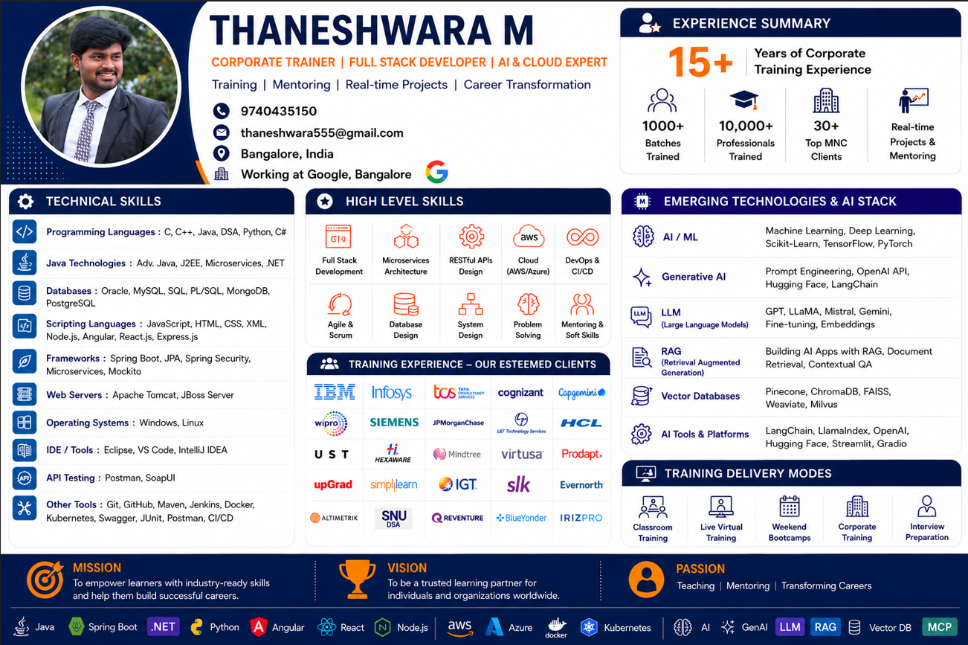

Slide 2
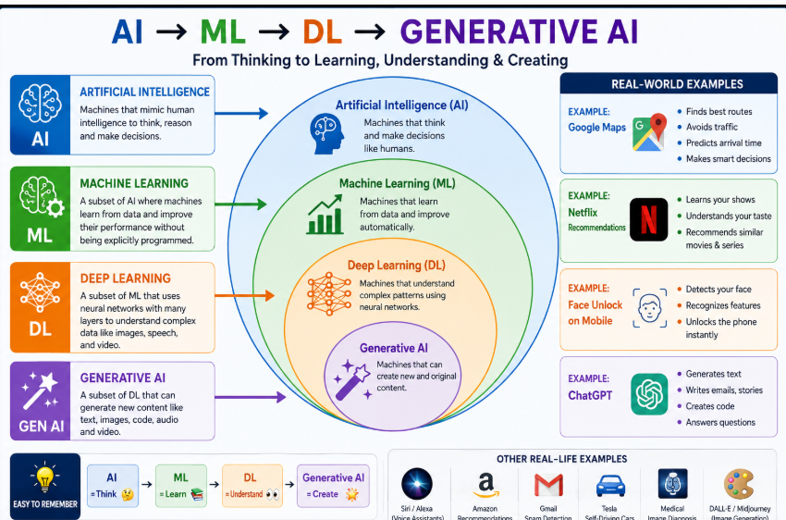

Slide 3
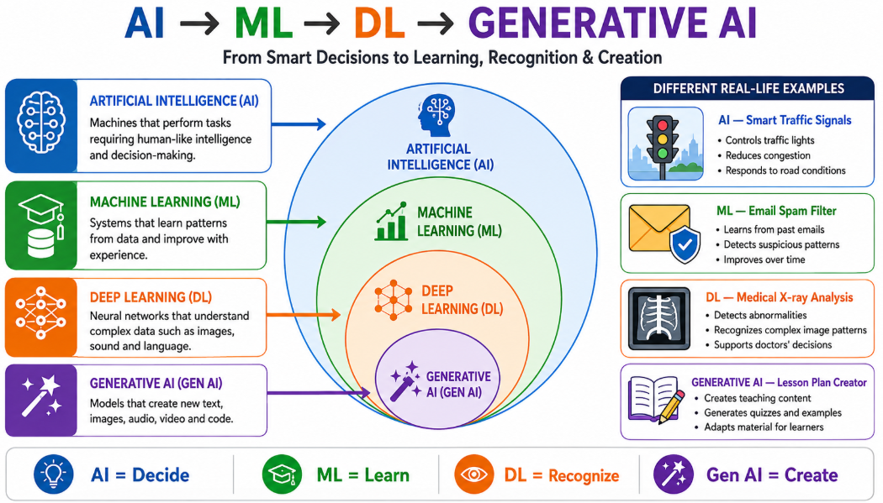

Slide 4
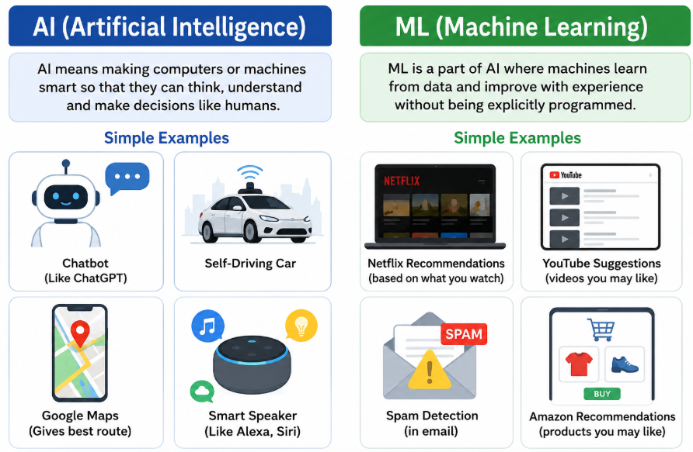
Artificial Intelligence makes machines smart, while Machine Learning is the technique that teaches machines how to become smart by learning from data.

Slide 5
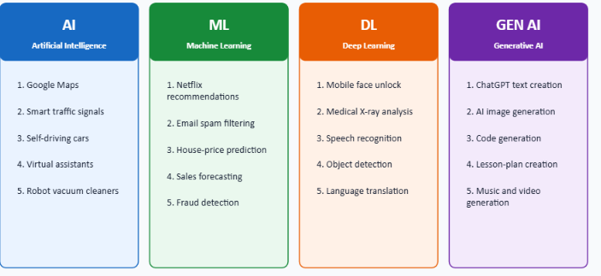

Slide 6
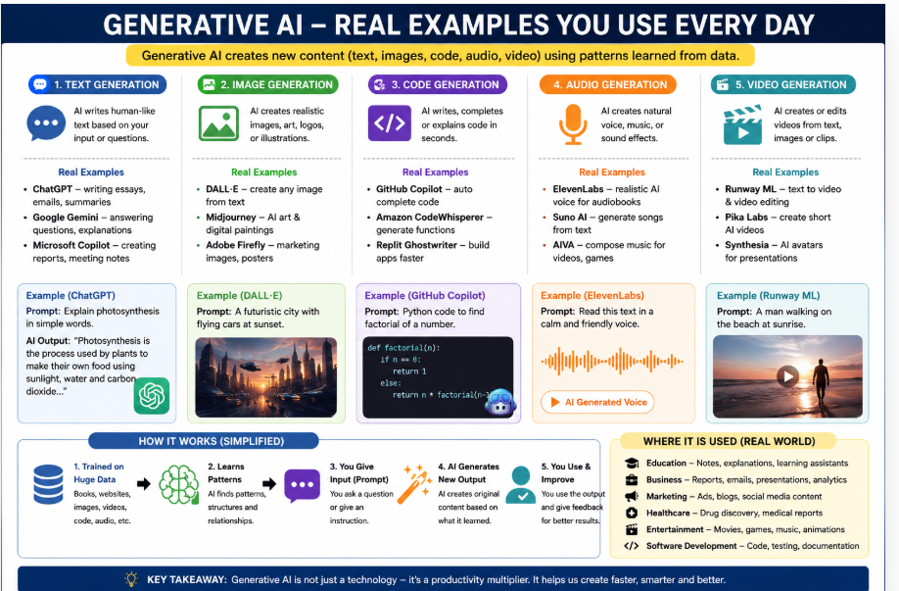

Slide 7
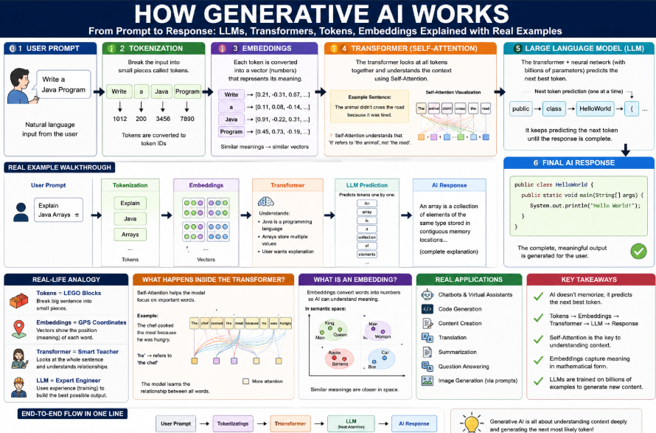

Slide 8
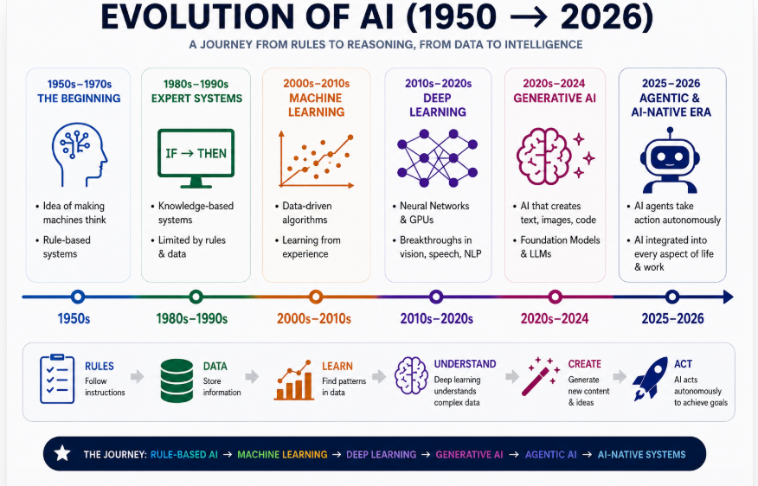

Slide 9
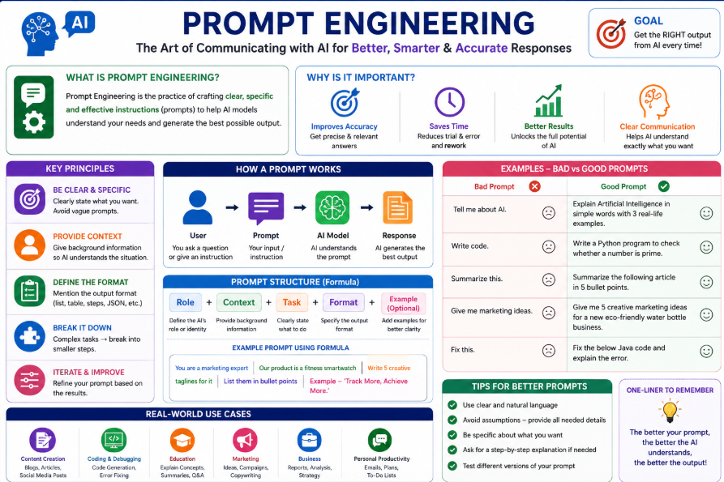
Prompt Engineering is the process of writing clear, structured, and effective instructions (prompts) so that an AI model (LLM) like ChatGPT, GPT-5.5, or Gemini gives the desired output.

Slide 10
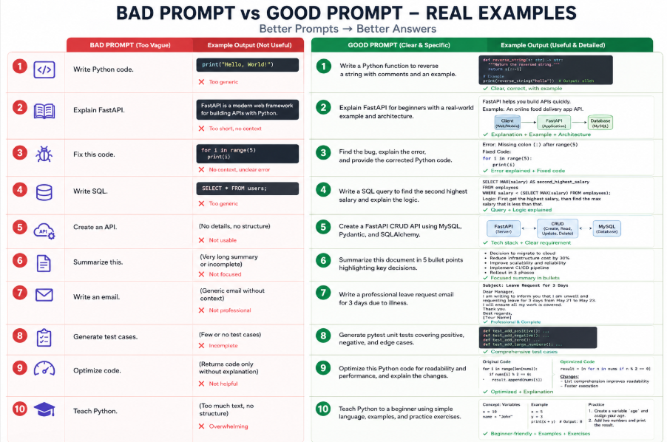
Simple Rule to Remember
❌ Bad Prompt = Vague + No Context + No Goal
✅ Good Prompt = Role + Task + Context + Constraints + Expected Output

Slide 11
Bad Prompt | Good Prompt
Write Python code. | Write a Python function to reverse a string with comments and an example.
Explain FastAPI. | Explain FastAPI for beginners with a real-world example and architecture.
Fix this code. | Find the bug, explain the error, and provide the corrected Python code.
Write SQL. | Write a SQL query to find the second highest salary and explain the logic.
Create an API. | Create a FastAPI CRUD API using MySQL, Pydantic, and SQLAlchemy.
Summarize this. | Summarize this document in 5 bullet points highlighting key decisions.
Write an email. | Write a professional leave request email for 3 days due to illness.
Generate test cases. | Generate pytest unit tests covering positive, negative, and edge cases.
Optimize code. | Optimize this Python code for readability and performance, and explain the changes.
Teach Python. | Teach Python to a beginner using simple language, examples, and practice exercises.

Slide 12
Real-World Scenario | Bad Prompt | Good Prompt
Customer Support Bot | Reply to customer. | Reply politely, apologize if needed, provide the solution, and keep the response under 100 words.
HR Resume Screening | Check this resume. | Evaluate this resume for a Python Developer role with 5 years of experience and list strengths, weaknesses, and a recommendation.
Bank Chatbot | Answer this question. | Act as a banking assistant. Explain the account opening process in simple language without providing financial advice.
Healthcare | Explain diabetes. | Explain Type 2 Diabetes to a patient using simple, non-technical language and include lifestyle tips.
E-commerce | Describe this product. | Write a persuasive product description with features, benefits, and SEO-friendly keywords.
Software Development | Generate code. | Generate a FastAPI CRUD API with authentication, validation, and proper project structure.
Testing (QA) | Write test cases. | Generate Selenium test cases for the login page, including valid, invalid, and boundary scenarios.
Education | Teach Python. | Teach Python to beginners using simple examples, quizzes, and hands-on exercises.

Slide 13
Technique | Description | Example
Zero-Shot Prompting | Give only the task without examples. | Translate "Hello" to Kannada.
One-Shot Prompting | Give one example, then ask for a similar output. | Apple → Fruit\nCarrot → Vegetable\nPotato → ?
Few-Shot Prompting | Give multiple examples to teach the pattern. | Cat → Animal\nRose → Flower\nMango → Fruit\nLion → ?
Role Prompting | Tell the AI what role to play. | Act as a Senior Python Developer.
Instruction Prompting | Give clear step-by-step instructions. | Explain FastAPI with examples, diagrams, and interview questions.
Chain of Thought (CoT) | Ask the AI to reason step by step. | Solve this problem step by step.
Contextual Prompting | Provide background information before asking the question. | This API is used for banking. Explain the security risks.
Output Formatting | Specify how the answer should be formatted. | Return the output as a JSON object.
Constraint Prompting | Set rules or limitations. | Answer in less than 100 words.
Persona Prompting | Ask the AI to respond as a specific type of person. | Explain Python as a college professo

Slide 14
What is an LLM (Large Language Model)? An LLM (Large Language Model) is an Artificial Intelligence model trained on a massive amount of text data to understand and generate human-like language LLM = An AI brain that can read, understand, and generate human language.
Company | LLM
OpenAI | GPT-5.5, GPT-4.1
Google | Gemini
Anthropic | Claude
Meta | Llama
Mistral AI | Mistral
DeepSeek | DeepSeek
Alibaba | Qwen

Slide 15
What Can an LLM Do?
✅ Answer questions
✅ Generate code
✅ Explain concepts
✅ Summarize documents
✅ Translate languages
✅ Write emails
✅ Create reports
✅ Generate SQL queries
✅ Build APIs
✅ Help with debugging

Slide 16
ATM Example
🏦 Bank = LLM (stores knowledge)
💳 ATM Card = Your Application
🔑 PIN = API Key
🗣️ Question = Prompt
💵 Cash = AI Response

Slide 17
1. 🍕 Pizza Shop Example (Best for Beginners)
🍕 Pizza Shop = LLM 🙋 Customer = Your Application 📝 Order = Prompt 🎟️ Token/Bill = API Key 🍕 Pizza = AI Response
Flow
Customer ↓ "I need a Large Veg Pizza" ↓ Pizza Shop (LLM) ↓ Makes Pizza ↓ Returns Pizza (Response)

Slide 18
2. 👨‍🍳 Restaurant Example
👨‍🍳 Chef = LLM 🙋 Customer = Application 🍽️ Food Order = Prompt 💳 Payment = API Key 🍝 Food = Response
Example:
Customer:
One Masala Dosa. Chef prepares it. Customer receives Masala Dosa.
Just like that:
Application: Explain FastAPI. LLM: Returns explanation.

Slide 19
5. 🚕 Uber Example
🚕 Uber Driver = LLM 📱 Uber App = Your Application 📍Destination = Prompt 🔐 Login = API Key 🏠 Reached Destination = Response
Example
Destination: Airport Driver takes you there.
Similarly
Prompt: Explain Python. LLM returns explanation.

Slide 20
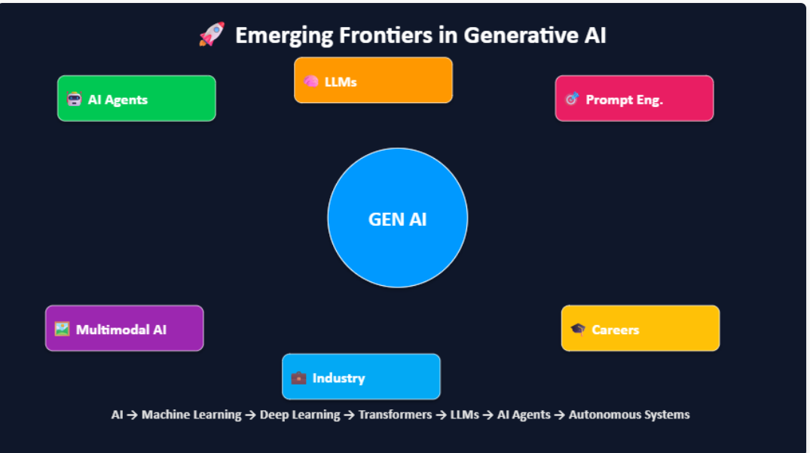

Slide 21
