Slide 1
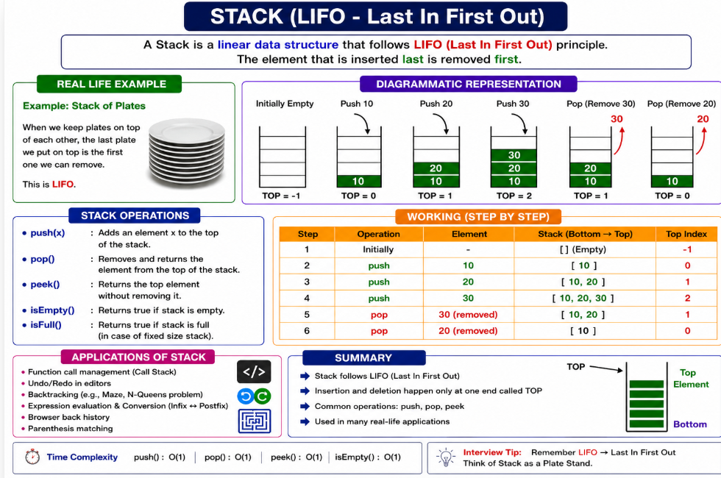

Slide 2
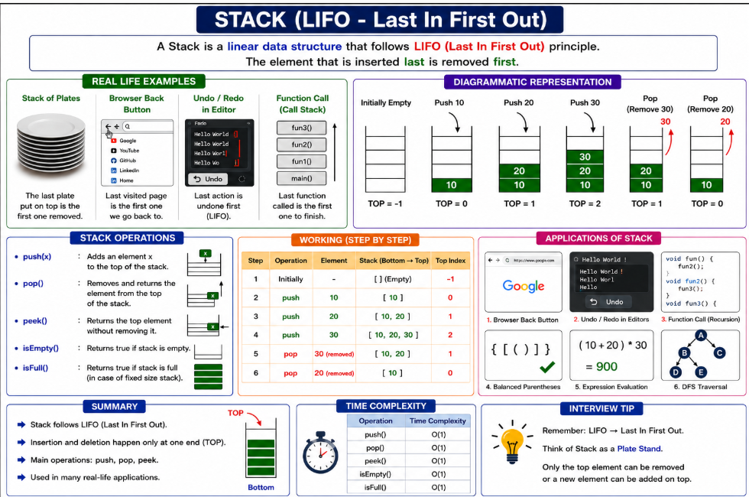

Slide 3
Definition: A stack is a linear data structure that follows the LIFO (Last In, First Out) principle.
Insertion: push()
Deletion: pop()
View top element: peek()
Check empty: isEmpty()
Time Complexity: O(1) for push, pop, and peek.
Common Applications: Browser back button, Undo/Redo, expression evaluation, bracket validation, recursion (call stack), and DFS traversal.

Slide 4
Operation | Purpose
Push(x) | Insert element at TOP
Pop() | Remove TOP element
Peek() | View TOP element
Step | Operation | Stack
1 | Initially | []
2 | Push(10) | [10]
3 | Push(20) | [10,20]
4 | Push(30) | [10,20,30]
5 | Pop() | [10,20]
6 | Pop() | [10]

Slide 5
Question 1 : Problem Statement
A university has developed an Online Examination System where students answer questions one by one. Every time a student submits an answer, the system stores it in the order it was answered.
Just before submitting the final exam, the student realizes that the last answered question was incorrect and clicks the "Undo Last Answer" button. The system should remove only the most recently answered question, while keeping all the previous answers unchanged.
Design a Java program to simulate this Undo functionality using an appropriate data structure.
Requirements
Store each answered question in the order it is submitted.
Display all the submitted answers.
Display the latest answered question.
When the student clicks Undo, remove only the last answered question.
Display the updated list of answers after the undo operation.
Display the current latest answered question.
Use Java's built-in Stack class to implement the solution.

Slide 6
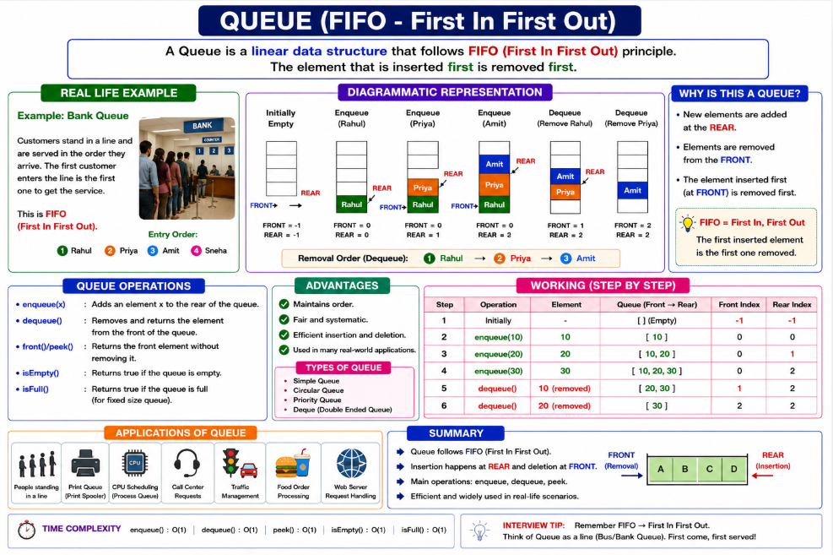

Slide 7
Operation | Description
➕ Enqueue(x) | Insert element at Rear
➖ Dequeue() | Remove element from Front
👀 Peek()/Front() | Returns first element
❓ isEmpty() | Queue empty?
📦 isFull() | Queue full? (Array Queue)

Slide 8
Advantages
✔ Maintains Order
✔ Fair (First Come First Served)
✔ Fast Insertion & Deletion (O(1))
✔ Simple and Efficient

Slide 9
Problem Statement: Movie Ticket Booking Queue
A newly released Avengers movie has become extremely popular, and a large number of customers are waiting at the movie ticket counter to purchase tickets. Since there is only one ticket counter, customers must wait in a queue and are served one at a time.
The ticket booking system follows the FIFO (First In, First Out) principle, where the customer who joins the queue first receives the ticket first. After a customer receives the ticket, they leave the queue, and the next customer is served.
Write a Java program using the Queue interface to simulate the movie ticket booking process. Add customers to the queue using the offer() method and continue serving customers using the poll() method until the queue becomes empty. After each ticket is issued, display the name of the customer who received the ticket and print the list of customers still waiting in the queue.

Slide 10
Rahul received the movie ticket. Waiting: [Priya, Amit, Sneha] Priya received the movie ticket. Waiting: [Amit, Sneha] Amit received the movie ticket. Waiting: [Sneha] Sneha received the movie ticket. Waiting: []

Slide 11
