Slide 1






GENETIC ALGORITHM VISUALIZER
Le Tran Thang 20204926
Nguyen Phuc Thanh 20200594
Le Thanh Thang 20194451
Hoang Van Thang 20204892

Slide 2
Problem: Visualize genetic algorithm to solve traveling salesman problem
REQUIREMENTS
Design: Design an UI for the problem with some functions
Aims: Make the algorithm more understandable for users

Slide 3

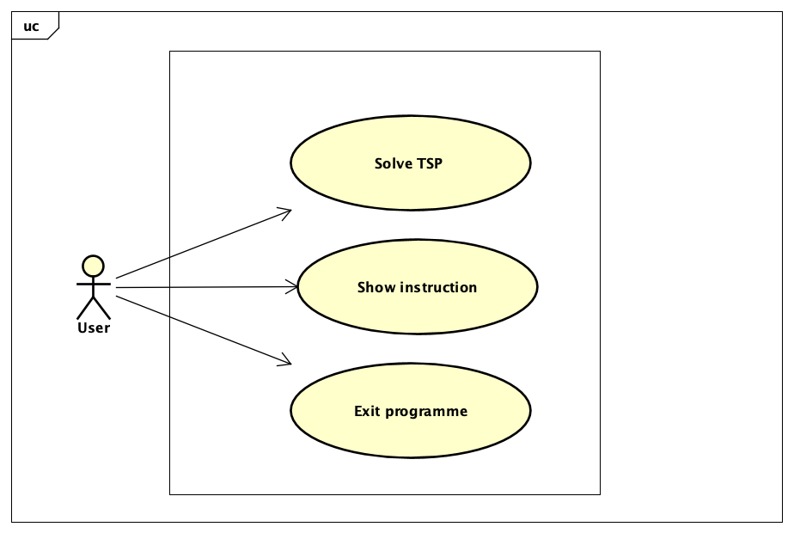
Use case diagram
User can start the visualization
Takes all user command from the GUI
Notifies the user if there is any problem with the input
Runs the algorithm and visualizes it to the user on the GUI
Wait for the command of the user to control the process of the algorithm
User can view help menu
User can quit the program

Slide 4
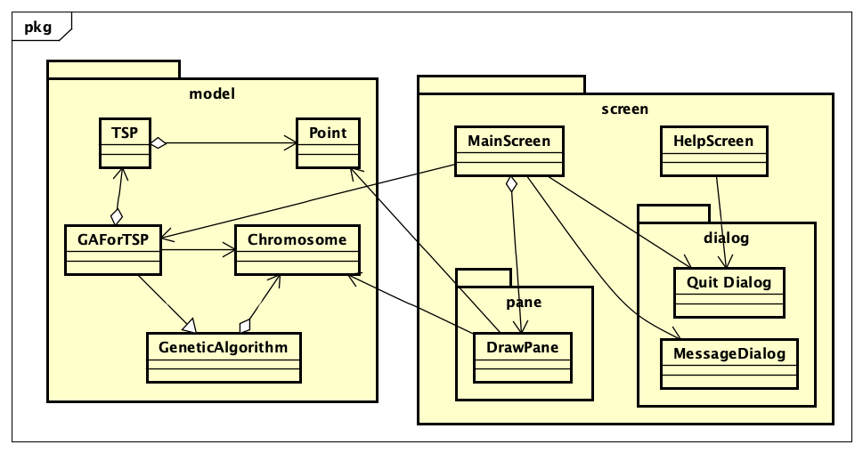
General class diagram
Package “model”: Stores all basic data structures and objects to implement the genetic algorithm on traveling salesman problem
Package “screen”: Stores the main screen class, dialog class, DrawPane class, and controllers to visualization in GUI

Slide 5
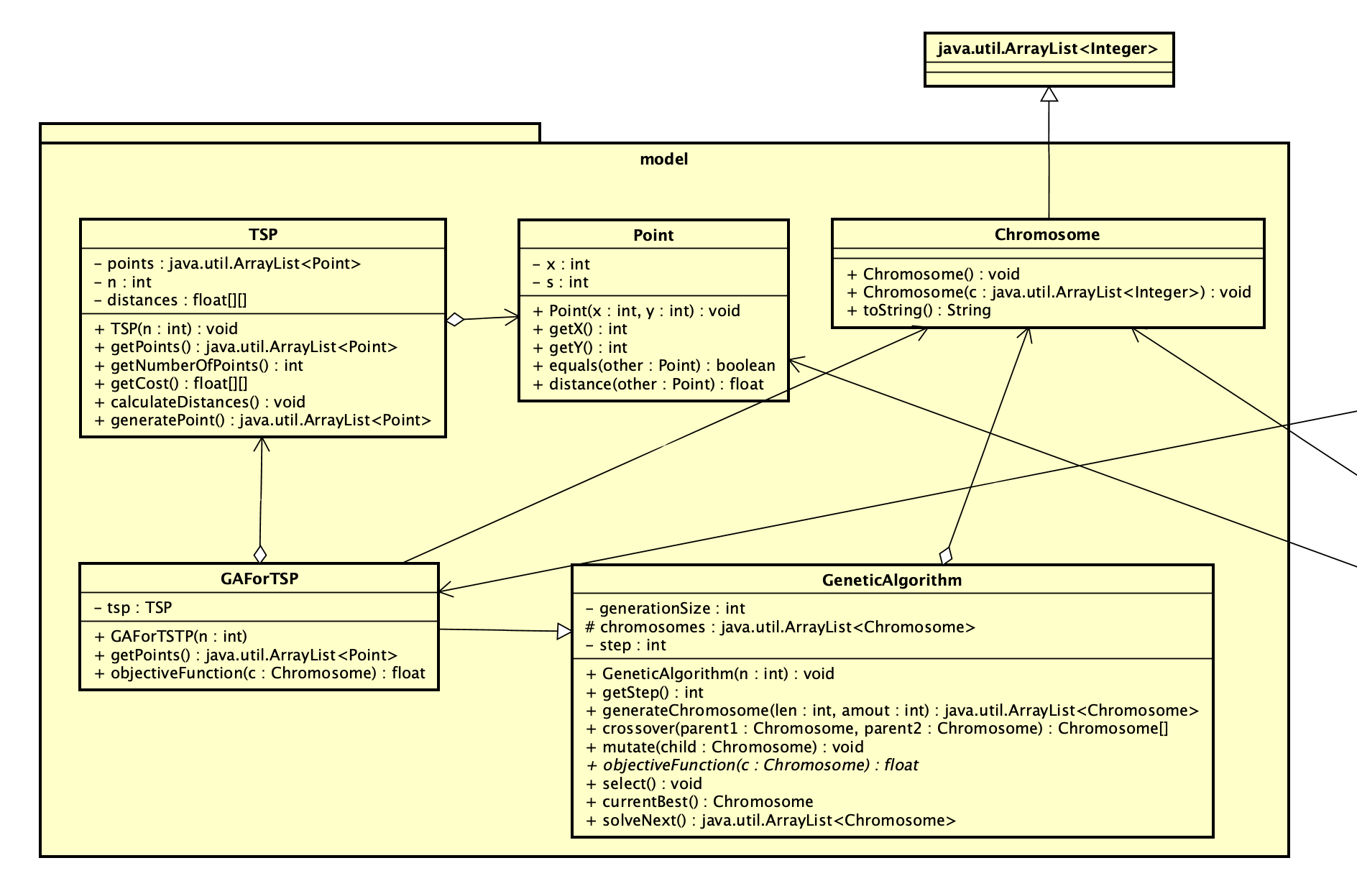


Slide 6

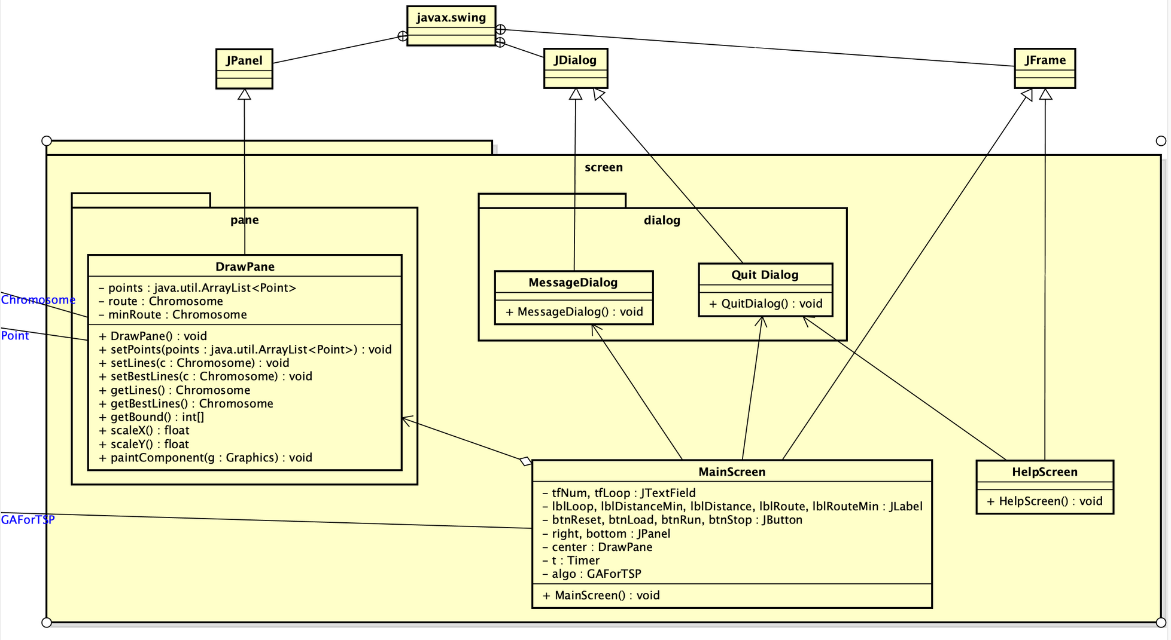


Slide 7

OOP TECHNIQUE
Inheritance
In package model: GAForTSP class inherits from GeneticAlgorithm class to implement genetic algorithm to solve traveling salesman problem

Slide 8
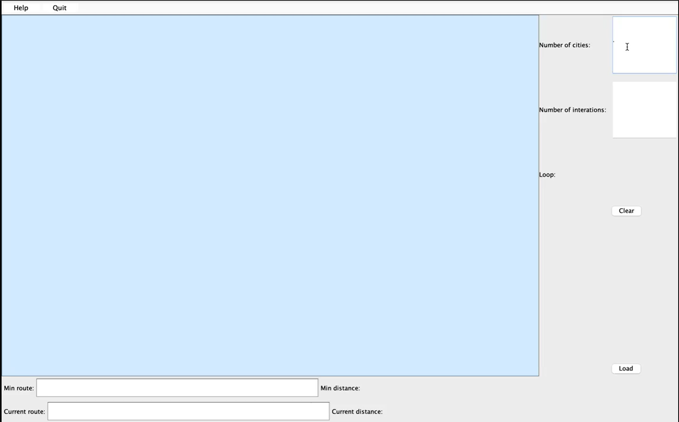
Demo

