Slide 1
Brute Force
Seminar 04/13/2021

Slide 2
Members
Nguyễn Lê Anh Quân - 19522081
Cát Văn Tài - 19522147
Dương Đình Thắng - 19522195

Slide 3
Table of contents
Brute Force Introduction
Pattern Recognition
Pros and cons
Applications
Illustrated problems
Conclusion

Slide 4

Brute Force Introduction
“Doing a thing well is often a waste of time.”
— Robert Byrne, a master pool and billiards player and a writer
¹ “Robert Byrne (author),” Wikipedia, 26-Feb-2021. [Online]. Available: https://en.wikipedia.org/wiki/Robert_Byrne_(author). [Accessed: 06-Apr-2021]
Robert Byrne ¹

Slide 5
Brute Force Introduction: What is Brute Force?
According to page 97 - Introduction to the Design and Analysis of Algorithms [1], Brute Force can be described as follows:
A straightforward approach to solving a problem based on problem statement
Trying every possibilities
Depends on sheer computing power

Slide 6
II. Pattern Recognition
Assume we have a problem P:
⤷ How Brute Force will solve it?
☞ Step by step:
In order candidate for P after the current one c :
Valid (P, c): whether candidate c is a solution for P
Output (P, c): use the solution c of P as appropriate to the application

Slide 7
II. Pattern Recognition
Pseudocode: Two approaches
// Input: A problem P
// Output: A solution c
c ← first(P)
while c ≠ Λ do
if valid(P,c) then
output(P, c)
c ← next(P, c)
end while
for c in candidates:
if valid(P, c):
Output(P, c)
break
Có sẵn các ứng cử viên
Tự phát các ứng cử viên [2]

Slide 8
II. Pattern Recognition: Example
C | C | h | C | h | à | o
C | h | à | o
C | C | h | C | h | à | o
C | C | h | C | h | à | o
C | h | à | o
C | h | à | o
C | C | h | C | h | à | o
C | h | à | o
String Matching problem

Slide 9
III. Pros and Cons
Pros | Cons
Straightforward: easy to implement For some important problems, with no limitation on instance size, brute force could achieve a result with absolute accuracy. | Take too much time to execute Brute force can not applied to most real-world problems. (Ex: In real-life, we cannot try all solutions to find the suitable answer for our problem)

Slide 10
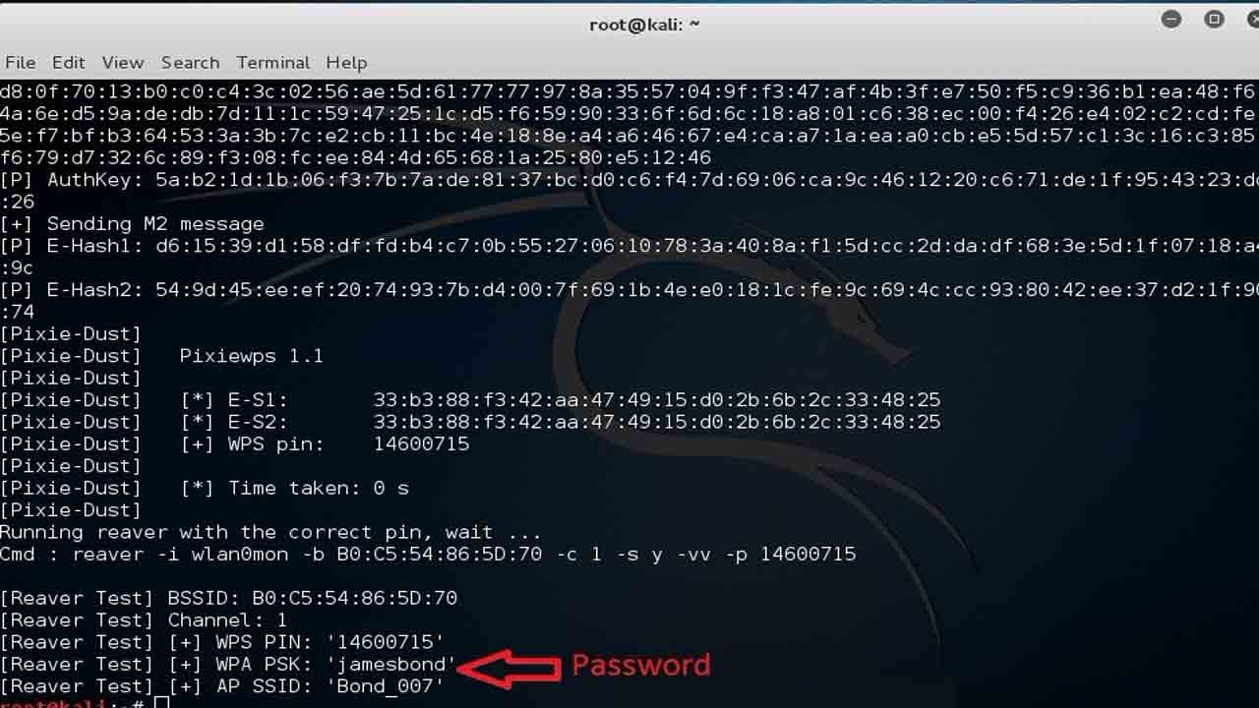
IV. Applications
Crack wifi password
Crack Wi-Fi password on Kali Linux using Brute Force ¹
¹ V. Kumar et al., "How To Hack WPA2-PSK Secured Wi-Fi Password Using Kali Linux", Pro Hacker, 2021. [Online]. Available: https://www.prophethacker.com/2016/09/hack-wpa2-secured-wifi-password-using-kali-linux.html. [Accessed: 07- Apr- 2021].

Slide 11
IV. Applications
Hyperparameter Tuning using Exhaustive Grid Search
Suggest Hyperparameters
Model
Grid Search
Training
Evaluate
Data

Slide 12
IV. Applications
Hyperparameter Tuning using Exhaustive Grid Search
An example in SVM model:
'C': [25, 50, 100, 1000],
'kernel': ['linear', 'rbf', 'sigmoid']
Kernel | 0.87 | 0.84 | 0.89 | 0.80
 | 0.83 | 0.81 | 0.94 | 0.86
 | 0.85 | 0.90 | 0.82 | 0.86
 | C

Slide 13
V. Illustrated problems: Suitable case
Problem: Given a string less than 20 elements, including numbers (0-9) and uppercase alphabet (A-Z). Print all possible combination of characters of the string.
Example:
. Input: A46
. Output: 6 4 46 A A6 A4 A46

Slide 14
V. Illustrated problems: Suitable case
Case study appoarch: Using Brute-Force to generate all posibilities. Each element will have two cases that can happen, either it will appear or not – and we will encode this into 1 and 0. Therefore, we can utilize recursive with backtracking to produce word combinations from elements in the array.

Slide 15
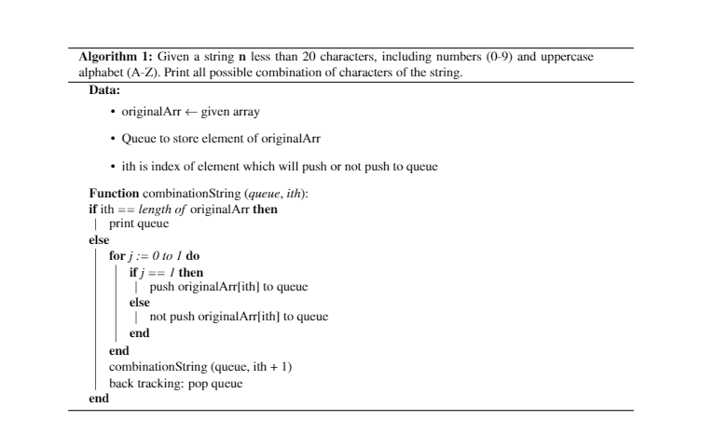
V. Illustrated problems: Suitable case

Slide 16
V. Illustrated problems: Suitable case
Algorithm complexity: With each element, there are two possible cases 0 and 1. Hence, when applying to recursive, it will iterate n times with them.
=> So O(2^{n})

Slide 17
V. Illustrated problems: Unsuitable case
Problem: Given a sequence A of N positive integers (1≤ N ≤1000), A[1,...,N] and a number X < 1000. Find the longest subsequence of A such that the sum of all elements in the subsequence is divisible by X.
Example:
. Input: 1 6 11 5 10 15 20 2 4 9
5
. Output: Length of the longest subsequence: 8
Sum: 80
Subsequence: 6 11 5 10 15 20 4 9

Slide 18
V. Illustrated problems: Unsuitable case
Case study appoarch: The idea is similar to the previous problem. We will try all cases (subsequences) and consider these statements:
Is the sum of all elements divisible by X or not?
Is it the longest subsequence?
If two conditions above are satisfied, we save this subsequence and move to the next case.
Algorithm complexity: The same as the previous one, hence O(2^{n}).

Slide 19
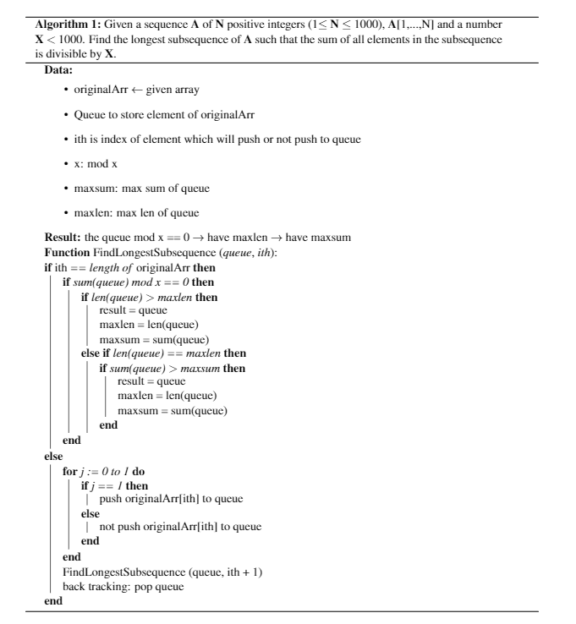
V. Illustrated problems: Unsuitable case

Slide 20
VI. Conclusion
Brute-force approach should not be overlooked as an important algorithm design strategy.
Applicable to a very wide variety of problems.
In sorting, searching, string matching,… it yields reasonable algorithms of at least some practical value with no limitation on instance size.
The expense of designing a more efficient algorithm may be unjustifiable if only a few instances of a problem need to be solved.
Serve an important theoretical or educational purpose as a yardstick with which to judge more efficient alternatives for solving a problem.
Useful for solving small-size instances of a problem.

Slide 21
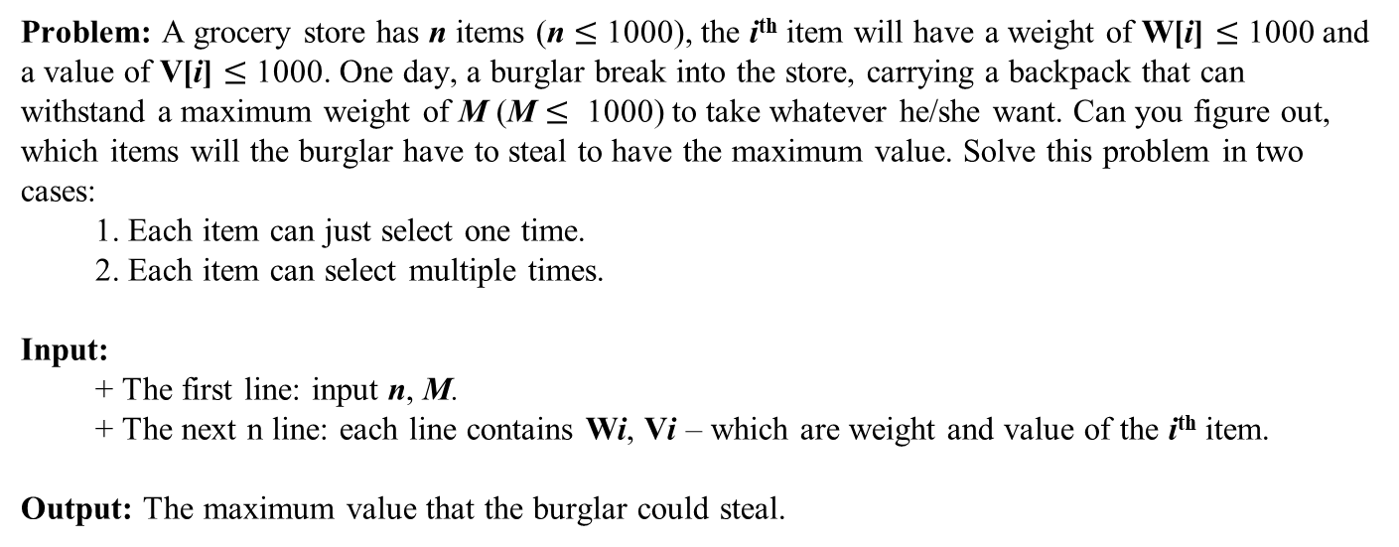
Homework
Problem: A grocery store has n items (n $≤$ 1000), the i^{th} item will have a weight of W[i] $≤$ 1000 and a value of V[i] $≤$ 1000. One day, a burglar break into the store, carrying a backpack that can withstand a maximum weight of M (M $≤$ 1000) to take whatever he/she want. Can you figure out, which items will the burglar have to steal to have the maximum value. Solve this problem in two cases:
1. Each item can just select one time.
2. Each item can select multiple times.
Input:
+ The first line: input n, M.
+ The next n line: each line contains Wi, Vi – which are weight and value of the i^{th} item.
Output: The maximum value that the burglar could steal.

Slide 22
References
[1] R. Lee, S. Tseng, R. Chang and Y. Tsai, Introduction to the design and analysis of algorithms. London: McGraw Hill Higher Education, 2005.
[2] "Brute-force search - Wikipedia", En.wikipedia.org, 2021. [Online]. Available: https://en.wikipedia.org/wiki/Brute-force_search. [Accessed: 20- Apr- 2021].

Slide 23

The end

