Slide 1
Brute Force
Seminar 04/13/2021
Instructor: M.S. Nguyễn Thanh Sơn
Class: CS112.L23.KHCL

Slide 2
Members
Nguyễn Lê Anh Quân - 19522081
Cát Văn Tài - 19522147
Dương Đình Thắng - 19522195

Slide 3
Task completion
Number | Member | Tasks | Completion
1 | Nguyễn Lê Anh Quân | Điều hành nhóm + thuyết trình chính | 100%
2 | Dương Đình Thắng | Chuẩn bị slide + chuẩn bị câu hỏi kahoot + take notes buổi thảo luận | 100%
3 | Cát Văn Tài | Chuẩn bị bài toán + test cases + bài tập về nhà + thuyết trình | 100%

Slide 4
Table of contents
Brute Force Introduction
Pattern Recognition
Pros and cons
Applications
Illustrated problems
Conclusion

Slide 5
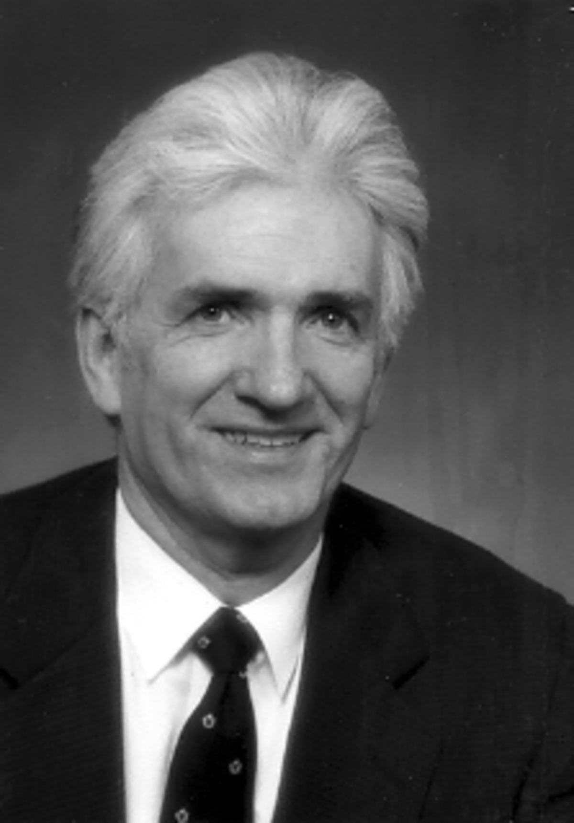
Brute Force Introduction
“Doing a thing well is often a waste of time.”
— Robert Byrne, a master pool and billiards player and a writer
¹ “Robert Byrne (author),” Wikipedia, 26-Feb-2021. [Online]. Available: https://en.wikipedia.org/wiki/Robert_Byrne_(author). [Accessed: 06-Apr-2021]
Robert Byrne ¹

Slide 6
Brute Force Introduction: What is Brute Force?
According to page 97 - Introduction to the Design and Analysis of Algorithms [1], Brute Force can be described as follows:
A straightforward approach to solving a problem based on problem statement
Trying every possibilities
Depends on sheer computing power

Slide 7
II. Pattern Recognition
Assume we have a problem P:
⤷ How Brute Force will solve it?
☞ Step by step:
In order candidate for P after the current one c :
Valid (P, c): whether candidate c is a solution for P
Output (P, c): use the solution c of P as appropriate to the application

Slide 8
II. Pattern Recognition
Pseudocode: Two approaches
// Input: A problem P
// Output: A solution c
c ← first(P)
while c ≠ Λ do
if valid(P,c) then
output(P, c)
c ← next(P, c)
end while
for c in candidates:
if valid(P, c):
Output(P, c)
break
Candidates available
Self-generate candidates [2]

Slide 9
II. Pattern Recognition: Example
C | C | h | C | h | à | o
C | h | à | o
C | C | h | C | h | à | o
C | C | h | C | h | à | o
C | h | à | o
C | h | à | o
C | C | h | C | h | à | o
C | h | à | o
String Matching problem

Slide 10
III. Pros and Cons
Pros | Cons
Straightforward: easy to implement For some important problems, with no limitation on instance size, brute force could achieve a result with absolute accuracy. | Take too much time to execute Brute force can not applied to most real-world problems. (Ex: In real-life, we cannot try all solutions to find the suitable answer for our problem)

Slide 11
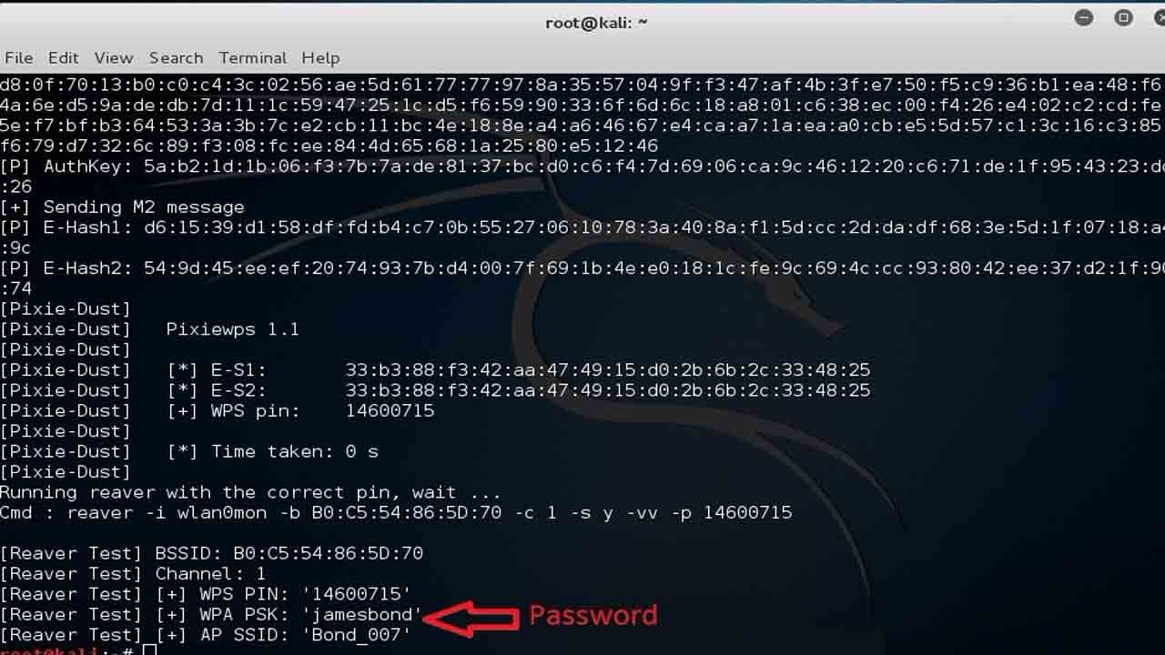
IV. Applications
Crack wifi password
Crack Wi-Fi password on Kali Linux using Brute Force ¹
¹ V. Kumar et al., "How To Hack WPA2-PSK Secured Wi-Fi Password Using Kali Linux", Pro Hacker, 2021. [Online]. Available: https://www.prophethacker.com/2016/09/hack-wpa2-secured-wifi-password-using-kali-linux.html. [Accessed: 07- Apr- 2021].

Slide 12
IV. Applications
☞ Hyperparameter Tuning using Exhaustive Grid Search
Suggest Hyperparameters
Model
Grid Search
Training
Evaluate
Data

Slide 13
IV. Applications
☞ Hyperparameter Tuning using Exhaustive Grid Search
An example in SVM model:
'C': [25, 50, 100, 1000],
'kernel': ['linear', 'rbf', 'sigmoid']
Kernel | 0.87 | 0.84 | 0.89 | 0.80
 | 0.83 | 0.81 | 0.94 | 0.86
 | 0.85 | 0.90 | 0.82 | 0.86
 | C

Slide 14
V. Illustrated problems: Suitable case
Problem: Given a string less than 20 elements, including numbers (0-9) and uppercase alphabet (A-Z). Print all possible combination of characters of the string.
Example:
. Input: A46
. Output: 6 4 46 A A6 A4 A46

Slide 15
V. Illustrated problems: Suitable case
Case study appoarch: Using Brute-Force to generate all posibilities. Each element will have two cases that can happen, either it will appear or not – and we will encode this into 1 and 0. Therefore, we can utilize recursive with backtracking to produce word combinations from elements in the array.

Slide 16
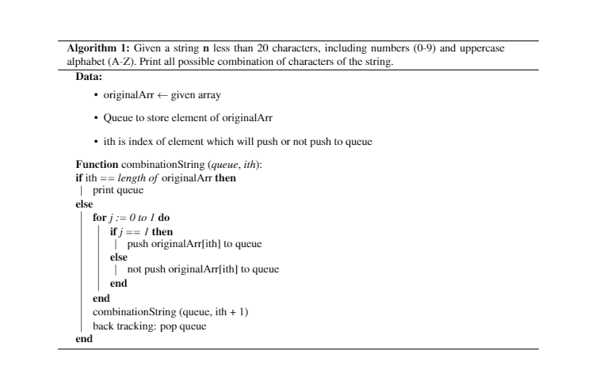
V. Illustrated problems: Suitable case

Slide 17
V. Illustrated problems: Suitable case
Algorithm complexity: With each element, there are two possible cases 0 and 1. Hence, when applying to recursive, it will iterate n times with them.
=> So O(2^{n})

Slide 18
V. Illustrated problems: Unsuitable case
Problem: Given a sequence A of N positive integers (1≤ N ≤1000), A[1,...,N] and a number X < 1000. Find the longest subsequence of A such that the sum of all elements in the subsequence is divisible by X.
Example:
. Input: 1 6 11 5 10 15 20 2 4 9
5
. Output: Length of the longest subsequence: 8
Sum: 80
Subsequence: 6 11 5 10 15 20 4 9

Slide 19
V. Illustrated problems: Unsuitable case
Case study appoarch: The idea is similar to the previous problem. We will try all cases (subsequences) and consider these statements:
Is the sum of all elements divisible by X or not?
Is it the longest subsequence?
If two conditions above are satisfied, we save this subsequence and move to the next case.
Algorithm complexity: The same as the previous one, hence O(2^{n}).

Slide 20
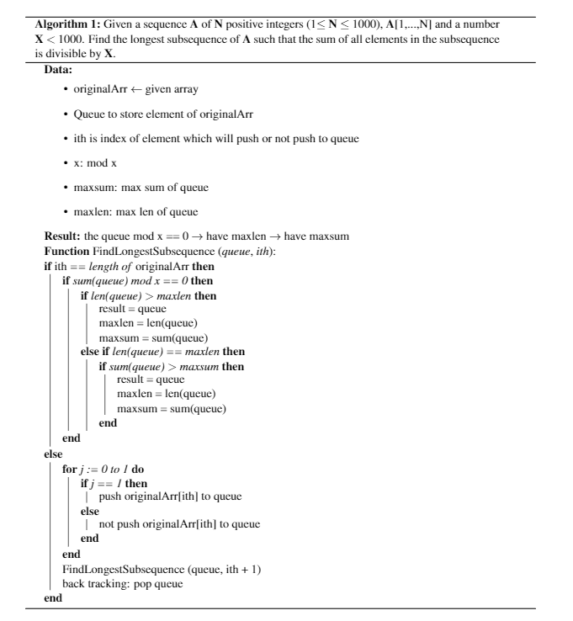
V. Illustrated problems: Unsuitable case

Slide 21
VI. Conclusion
Brute-force approach should not be overlooked as an important algorithm design strategy.
Applicable to a very wide variety of problems.
In sorting, searching, string matching,… it yields reasonable algorithms of at least some practical value with no limitation on instance size.
The expense of designing a more efficient algorithm may be unjustifiable if only a few instances of a problem need to be solved.
Serve an important theoretical or educational purpose as a yardstick with which to judge more efficient alternatives for solving a problem.
Useful for solving small-size instances of a problem.

Slide 22
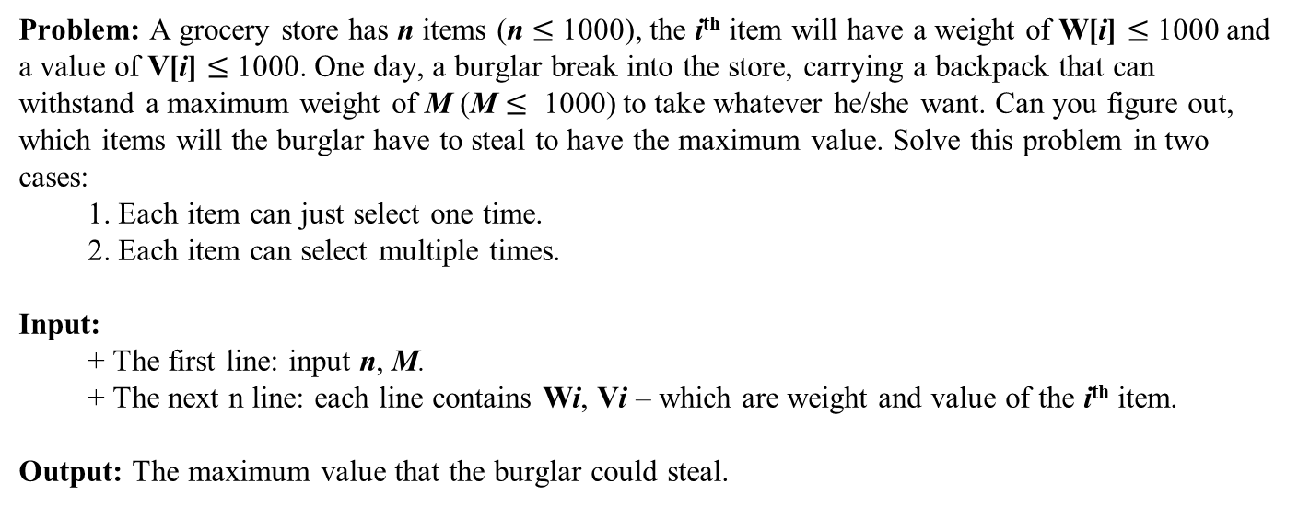
Homework
Problem: A grocery store has n items (n $≤$ 1000), the i^{th} item will have a weight of W[i] $≤$ 1000 and a value of V[i] $≤$ 1000. One day, a burglar break into the store, carrying a backpack that can withstand a maximum weight of M (M $≤$ 1000) to take whatever he/she want. Can you figure out, which items will the burglar have to steal to have the maximum value. Solve this problem in two cases:
1. Each item can just select one time.
2. Each item can select multiple times.
Input:
+ The first line: input n, M.
+ The next n line: each line contains Wi, Vi – which are weight and value of the i^{th} item.
Output: The maximum value that the burglar could steal.

Slide 23
References
[1] R. Lee, S. Tseng, R. Chang and Y. Tsai, Introduction to the design and analysis of algorithms. London: McGraw Hill Higher Education, 2005.
[2] "Brute-force search - Wikipedia", En.wikipedia.org, 2021. [Online]. Available: https://en.wikipedia.org/wiki/Brute-force_search. [Accessed: 20- Apr- 2021].

Slide 24

The end

