Slide 1
Adaptive Optimization Simulated Annealing
Prof. Byung Soo Kim
(bskim@Incheon.ac.kr)
Industrial & Management Engineering, INU

Slide 2
3.3 Simulated Annealing (SA)
Simulated Annealing
1953, Journal of Chemical Physics, Metropolis et al., “Equation of state calculations” by fast computing machines”, Los Alamos National Lab. → Metropolis Algorithm
In annealing, a material is heated to high energy where there are frequent state changes. It is then gradually cooled to a low energy state where state changes are rare.
The paper describes a Monte Carlo simulation of interacting molecules

Slide 3
3.3 Simulated Annealing (SA)
Simulated Annealing
1983, Science, “Optimization by simulated annealing”, by Kirkpatrick, Gelatt, and Vecchi
Used the Metropolis algorithm to optimization problems – spin glasses analogy, computer placement and wiring, and traveling salesman, the last two are both difficult and classical combinatorial problems
Basically it is a “hill-climbing” procedure occasionally allowing it to “Uphill(Non-improving)” moves. (Minimization Case)

Slide 4
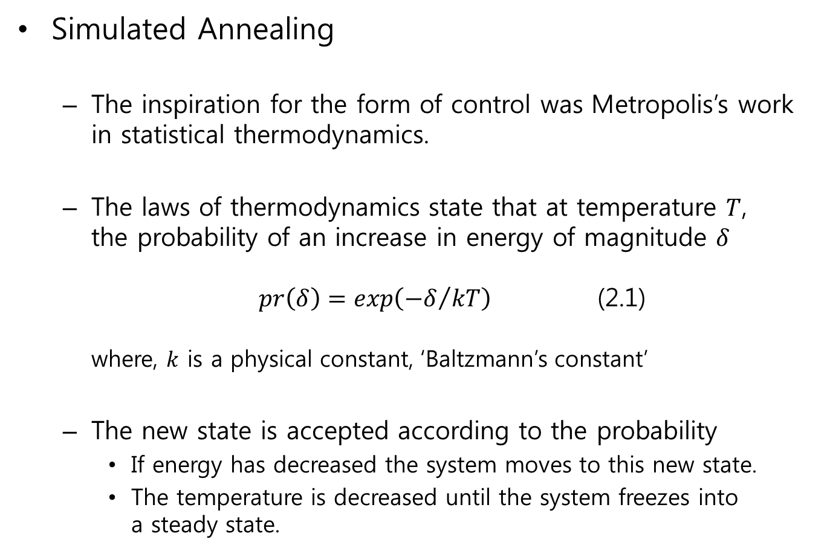
3.3 Simulated Annealing (SA)
Simulated Annealing
The inspiration for the form of control was Metropolis’s work in statistical thermodynamics.
The laws of thermodynamics state that at temperature $T$, the probability of an increase in energy of magnitude $δ$ $pr\left(δ\right)=exp\left({−δ}/{kT}\right)$ (2.1) where, $k$ is a physical constant, ‘Baltzmann’s constant’
The new state is accepted according to the probability
If energy has decreased the system moves to this new state.
The temperature is decreased until the system freezes into a steady state.

Slide 5

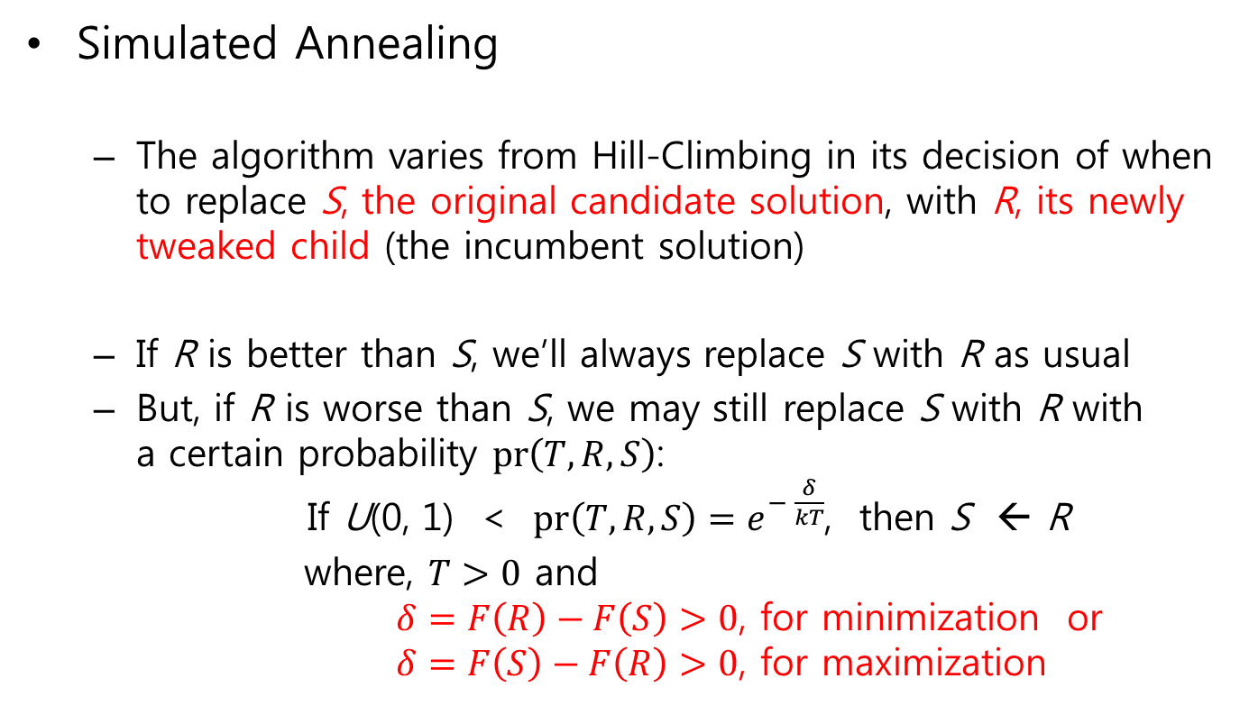

3.3 Simulated Annealing (SA)
Simulated Annealing
The algorithm varies from Hill-Climbing in its decision of when to replace S, the original candidate solution, with R, its newly tweaked child (the incumbent solution)
If R is better than S, we’ll always replace S with R as usual
But, if R is worse than S, we may still replace S with R with a certain probability $pr\left(T, R, S\right)$: If U(0, 1) < $pr\left(T, R, S\right)=e^{− \frac{δ}{kT}}$, then S ← R
where, $T>0$ and $δ=F\left(R\right)−F\left(S\right)>0$, for minimization or $δ=F\left(S\right)−F\left(R\right)>0$, for maximization
$$1$$
$$e^{−x}$$
𝑥

Slide 6
3.3 Simulated Annealing (SA)
Simulated Annealing
The SA algorithm could be applied to combinatorial optimization:
Thermodynamic simulation | Combinatorial optimization
System states | Feasible solutions
Energy | Cost
Change of state | Moving to a neighborhood solution
Temperature | Control parameter
Frozen state | Final solution

Slide 7
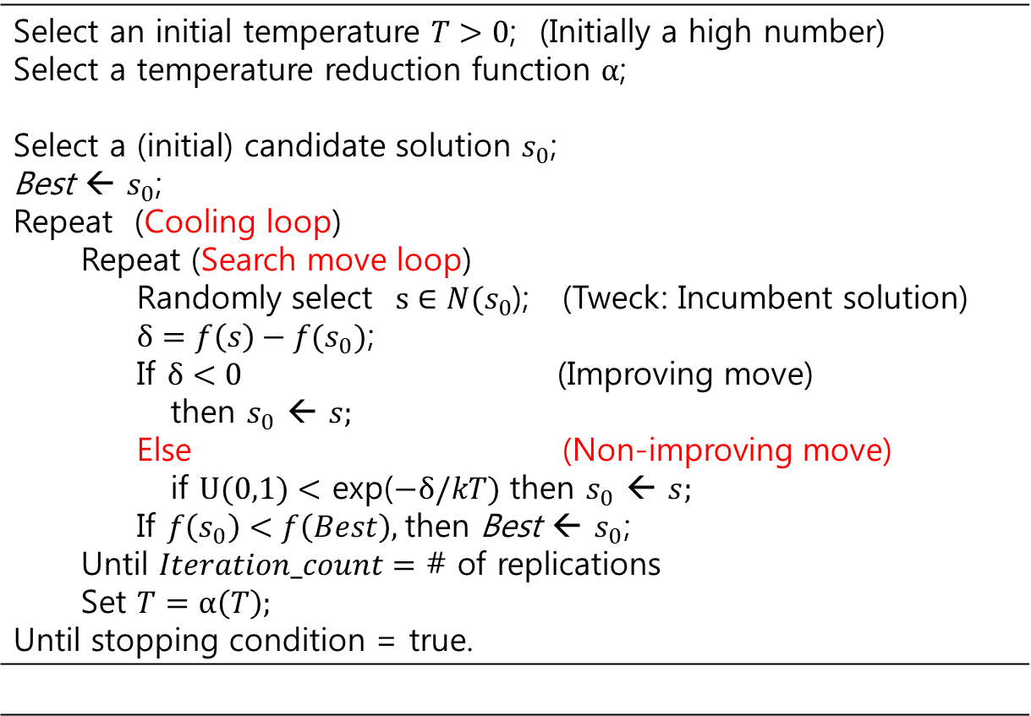
3.3 Simulated Annealing (SA)
Simulated Annealing Algorithm (For minimization case)
Select an initial temperature $T>0$; (Initially a high number) Select a temperature reduction function $α$; Select a (initial) candidate solution $s_{0}$; Best ← $s_{0}$; Repeat (Cooling loop) Repeat (Search move loop) Randomly select $s∈N(s_{0}$); (Tweck: Incumbent solution) $δ=f\left(s\right)−f(s_{0})\text{;}$ If $δ<0$ (Improving move) then $s_{0}$ ← $s;$ Else (Non-improving move) if $U(0,1)<$ exp($−δ/kT)$ then $s_{0}$ ← $s;$ If $f\left(s_{0}\right)<f\left(Best\right)\text{, }$then Best$\text{← }s_{0}\text{;}$ Until $Iteration_count=$ # of replications Set $T=α\left(T\right);$ Until stopping condition = true.

Slide 8
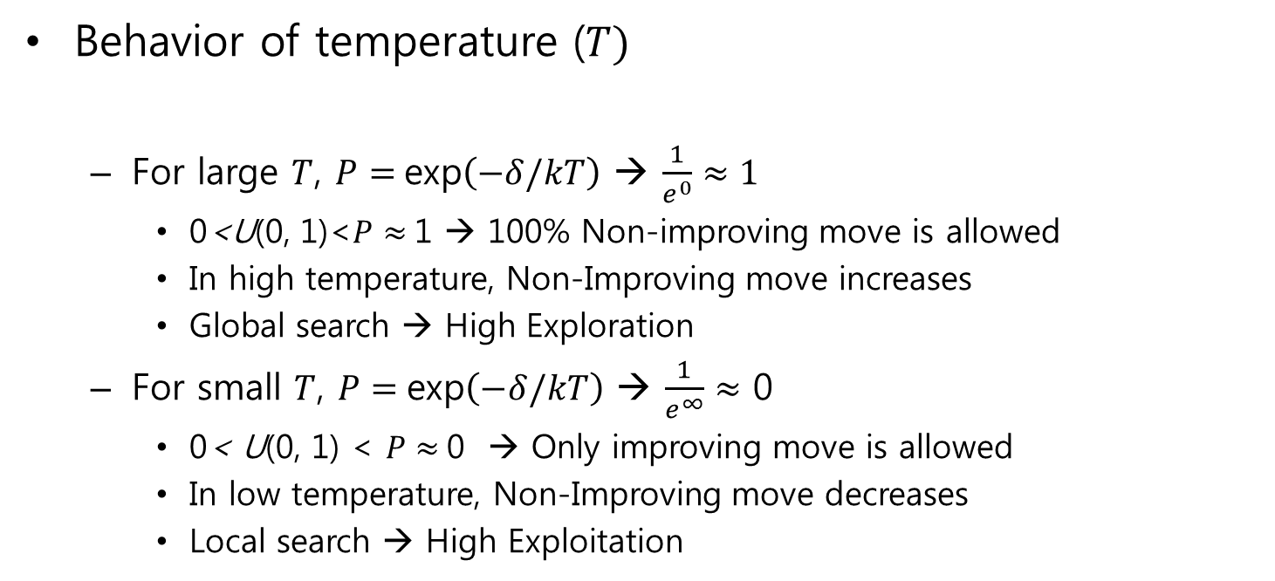
3.3 Simulated Annealing (SA)
Behavior of temperature ($T)$
For large $T$, $P=$exp$\left(−δ/kT\right)$ → $\frac{1}{e^{0}}≈1$
0<U(0, 1)<$P$ $≈$1 → 100% Non-improving move is allowed
In high temperature, Non-Improving move increases
Global search → High Exploration
For small $T$, $P=$exp$\left(−δ/kT\right)$ → $\frac{1}{e^{∞}}≈$ 0
0< U(0, 1) < $P≈$0 → Only improving move is allowed
In low temperature, Non-Improving move decreases
Local search → High Exploitation

Slide 9
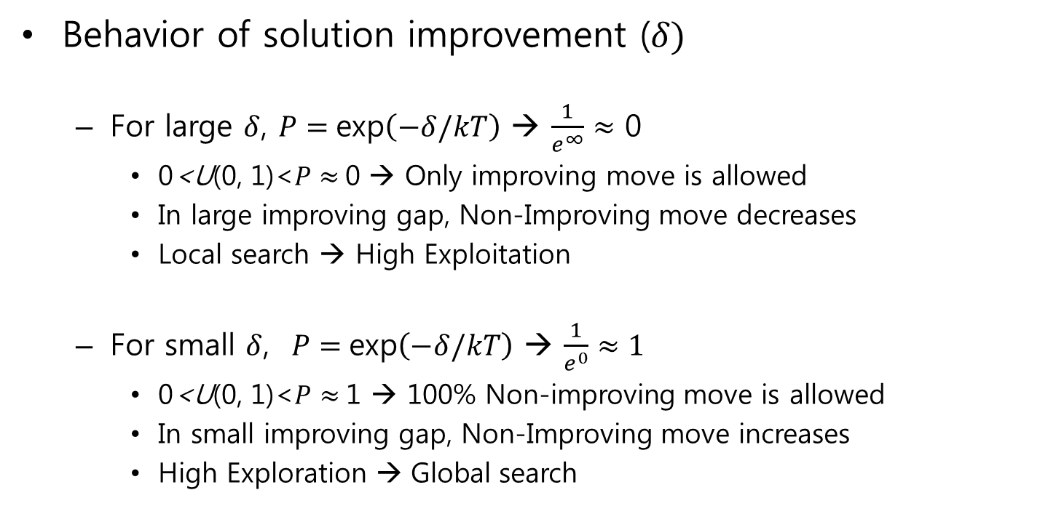
3.3 Simulated Annealing (SA)
Behavior of solution improvement ($δ)$
For large $δ$, $P=$exp$\left(−δ/kT\right)$ → $\frac{1}{e^{∞}}≈$ 0
0<U(0, 1)<$P≈$0 → Only improving move is allowed
In large improving gap, Non-Improving move decreases
Local search → High Exploitation
For small $δ$, $P=$exp$\left(−δ/kT\right)$ → $\frac{1}{e^{0}}≈1$
0<U(0, 1)<$P$ $≈$1 → 100% Non-improving move is allowed
In small improving gap, Non-Improving move increases
High Exploration → Global search

Slide 10
3.3 Simulated Annealing (SA)
The Cooling Schedule I
Initial temperature (IT)
IT must be “hot” enough to allow an almost free exchange of neighborhood solutions, if the final solution is to be independent of the starting one
Simulating the heating process:
A system can be first heated rapidly until the proportion of accepted moves to rejected moves reaches a given value: e.g., when 80% of moves leading to higher costs will be accepted
Cooling will then start

Slide 11
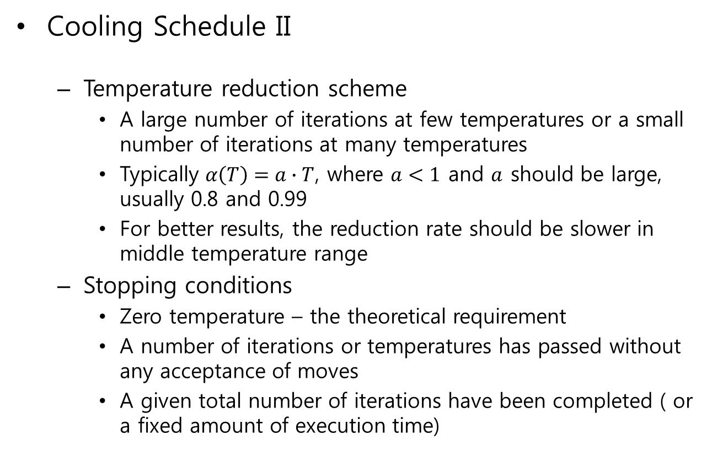
3.3 Simulated Annealing (SA)
Cooling Schedule II
Temperature reduction scheme
A large number of iterations at few temperatures or a small number of iterations at many temperatures
Typically $α\left(T\right)=a∙T$, where $a<1$ and $a$ should be large, usually 0.8 and 0.99
For better results, the reduction rate should be slower in middle temperature range
Stopping conditions
Zero temperature – the theoretical requirement
A number of iterations or temperatures has passed without any acceptance of moves
A given total number of iterations have been completed ( or a fixed amount of execution time)

Slide 12
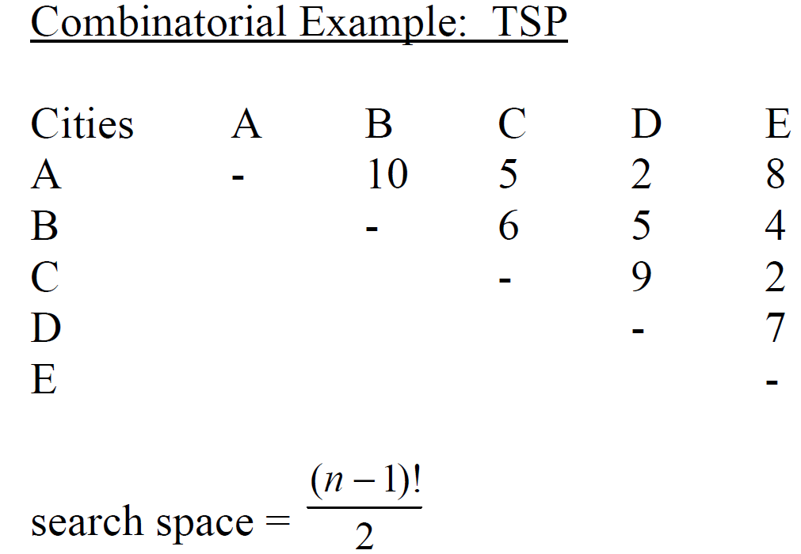
3.3 Simulated Annealing (SA)
Simulated Annealing: Combinatorial Example: TSP

Slide 13
3.3 Simulated Annealing (SA)
Simulated Annealing: Combinatorial Example: TSP

Slide 14
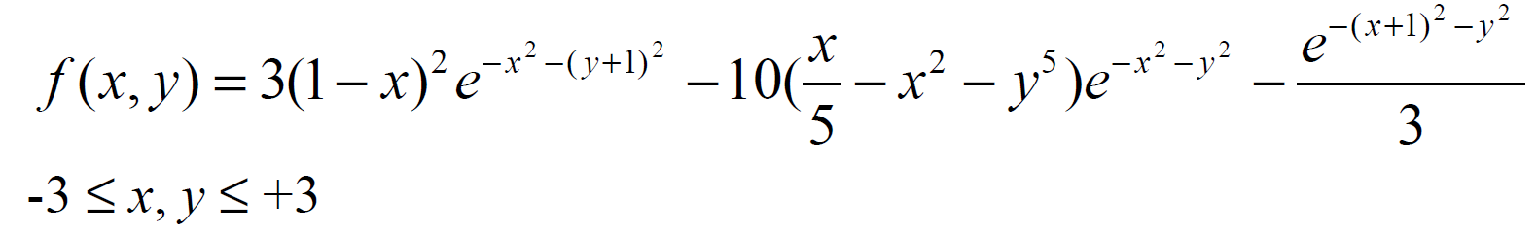
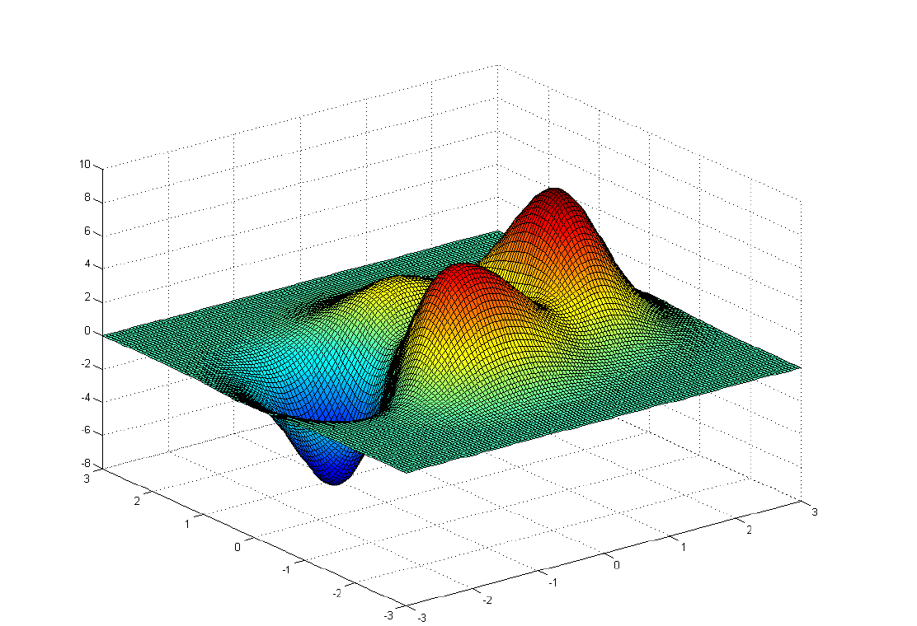
3.3 Simulated Annealing (SA)
Simulated Annealing: 2 dimensional multimodal function

Slide 15
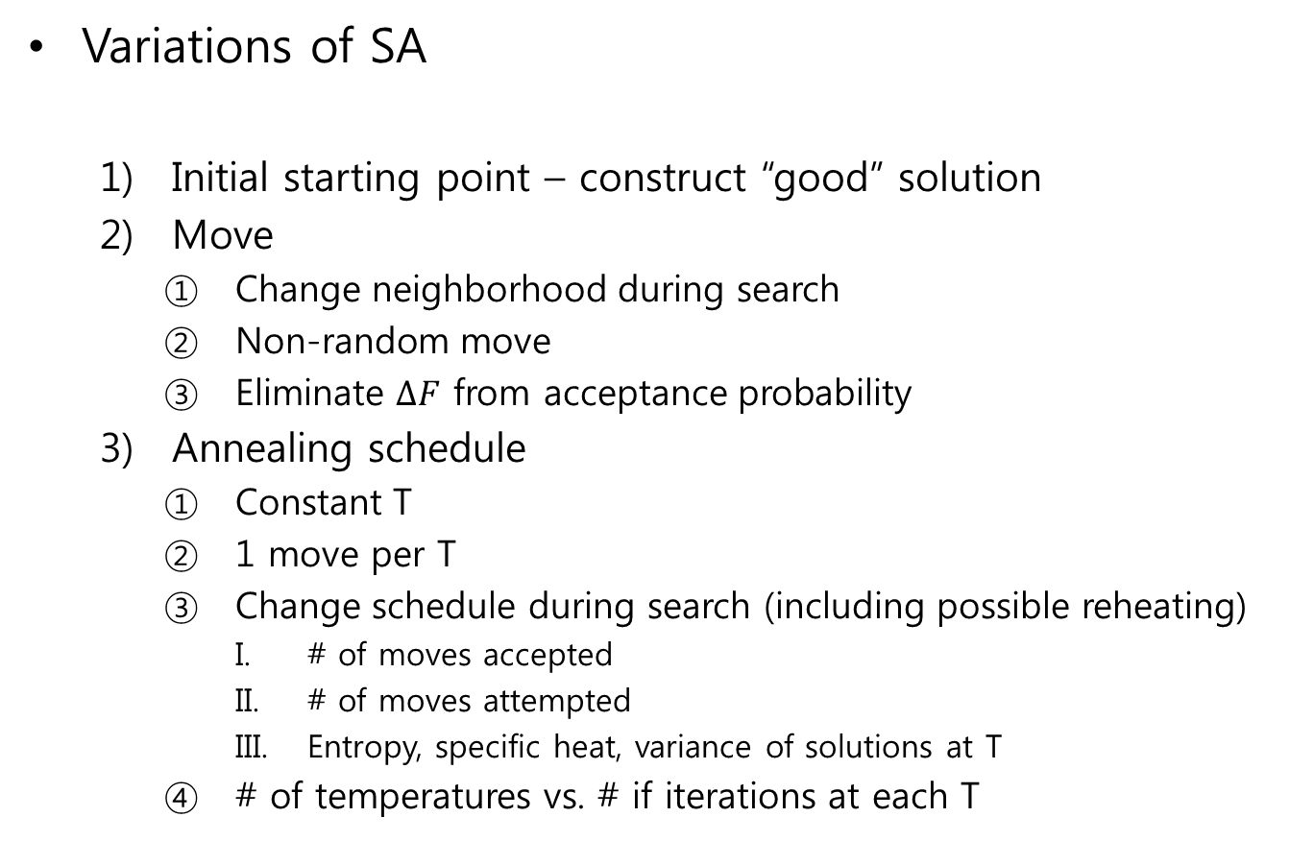
3.3 Simulated Annealing (SA)
Variations of SA
Initial starting point – construct “good” solution
Move
Change neighborhood during search
Non-random move
Eliminate $∆F$ from acceptance probability
Annealing schedule
Constant T
1 move per T
Change schedule during search (including possible reheating)
# of moves accepted
# of moves attempted
Entropy, specific heat, variance of solutions at T
# of temperatures vs. # if iterations at each T

Slide 16
3.3 Simulated Annealing (SA)
Variations of SA
Stopping criteria
Total moves attempted
# of improvement over n attempts
# of accepted moves over m attempts
Other
Finish with local search
Multi-starts
Parallel implementations
Multiple iterations (1 per processor) at given T
Multiple potential moves (1 per processor) at given iteration

