Slide 1
COMPUTER COMPONENTS SALES SYSTEM
Presenter Name

Slide 2
Agenda
Introduction
About our project
Analyze and Design Database
Use case and solutions
Dashboard report

Slide 3

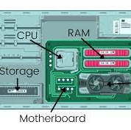
Introduction
With the aim of mastering the knowledge gained in the Database Systems course, we have carried out this project.
We designed and built a database management system for the computer components business model.

Slide 4
About our project
COMPUTER COMPONENTS SALES SYSTEM

Slide 5
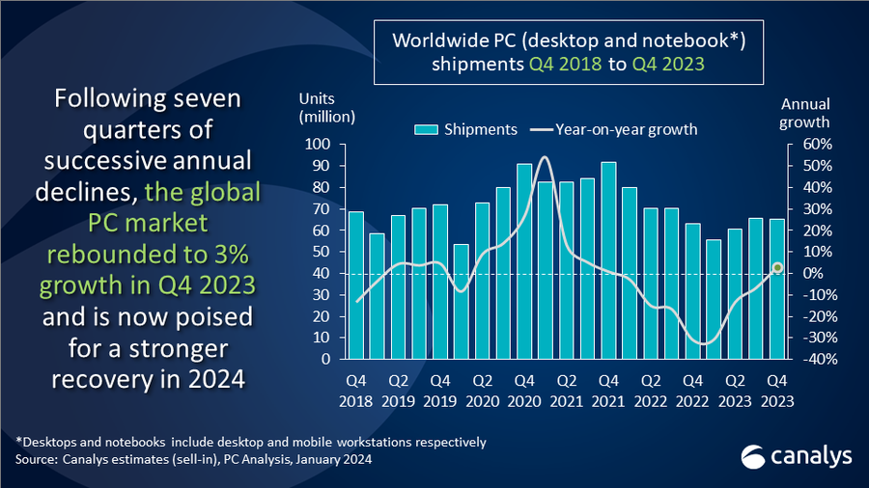
Research on business operations
We conducted research on the business operations within this sector through information provided by existing market vendors, statistical websites, e-commerce platforms, media outlets, and public databases
And identified three computer component products CPU, GPU, and RAM that exhibit stable demand, a minimal decrease in prices, and a tendency to increase in price due to the impact of the chip crisis.
=> Business model: Computer components sales

Slide 6
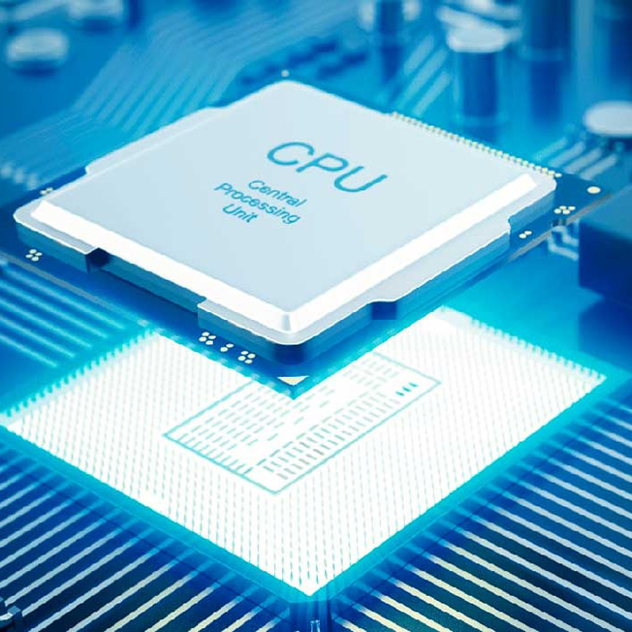


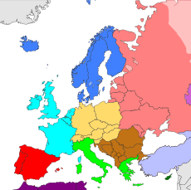


Identifying the management entities.
REGION
SALES PRICE
Crypto Makets
SALES TIME
PRODUCTS
MERCHANT

Slide 7
Analyze and Design Database
COMPUTER COMPONENTS SALES SYSTEM

Slide 8
Lists of Data Table
DIM_CPU_PROD
DIM_GPU_PROD
DIM_RAM_PROD
DIM_CRYPTO_DATA
DIM_MERCHANT
DIM_REGION
DIM_TIME
FACT_CPU_PRICE
FACT_GPU_PRICE
FACT_RAM_PRICE
FACT_CRYPTO_RATE

Slide 9
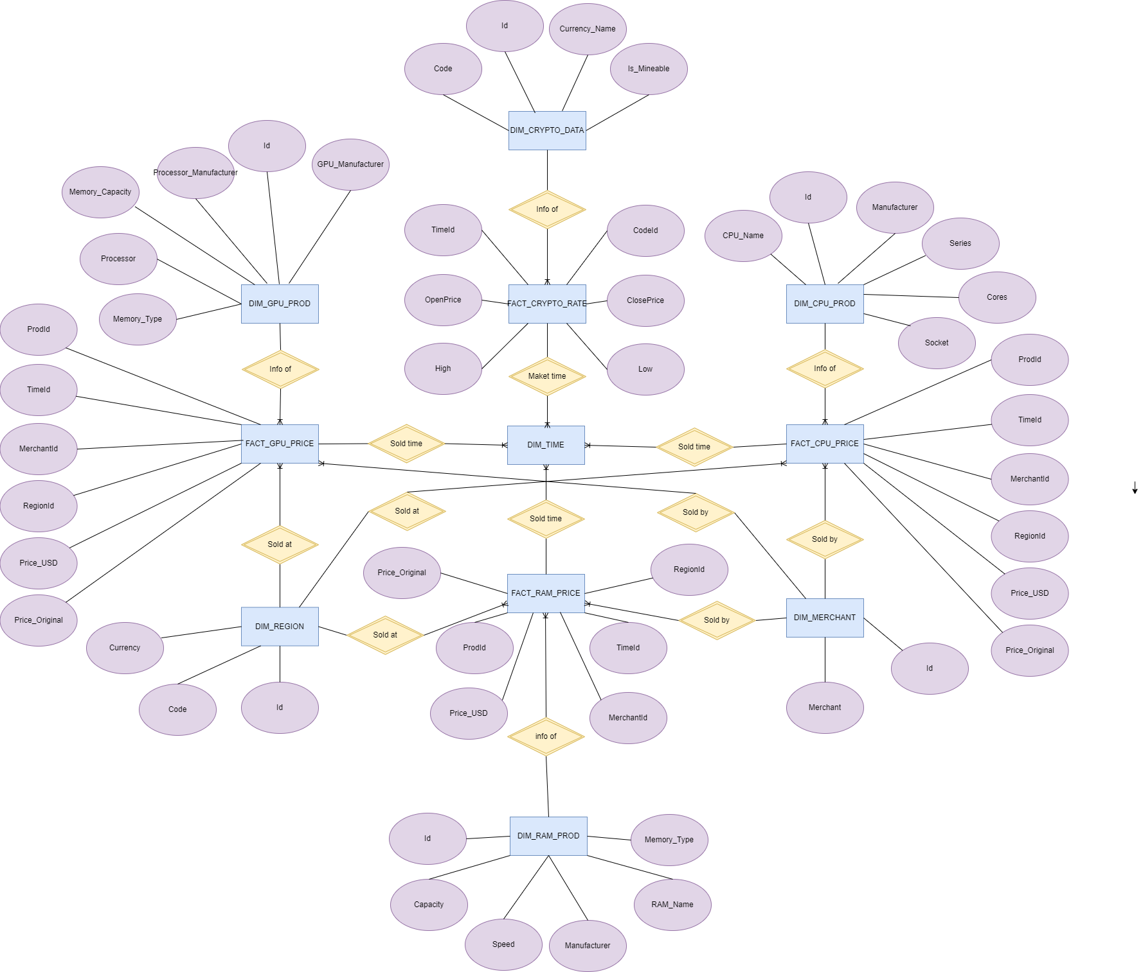
Entity Relation Diagram

Slide 10
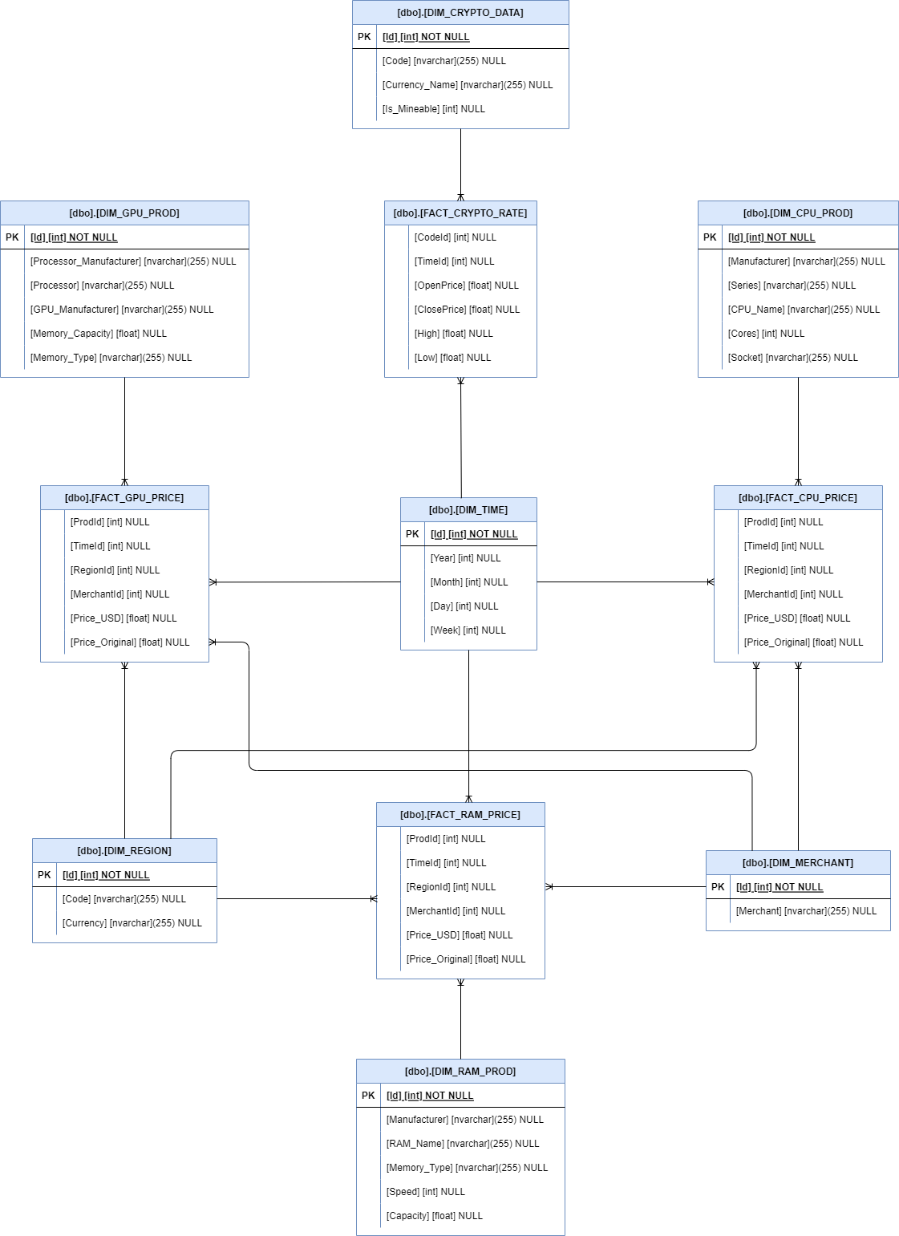
Relations Scheme

Slide 11
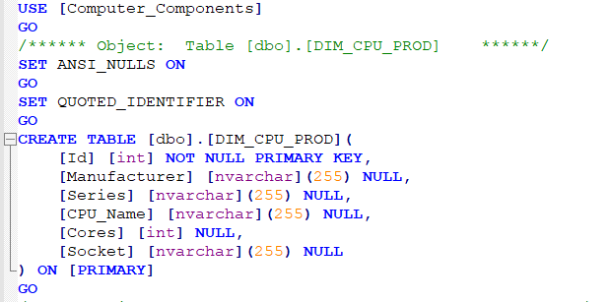
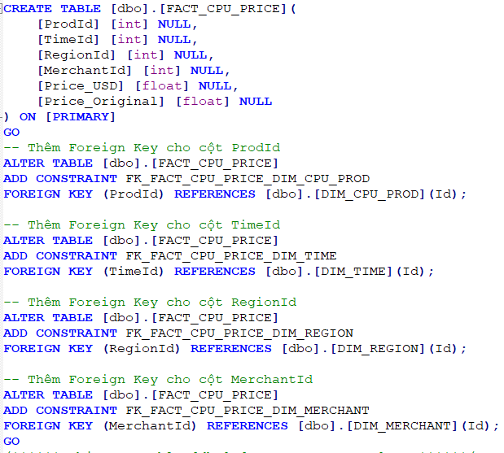
SQL scripts to create table

Slide 12
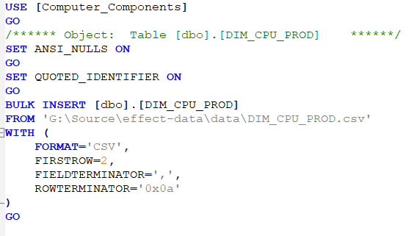
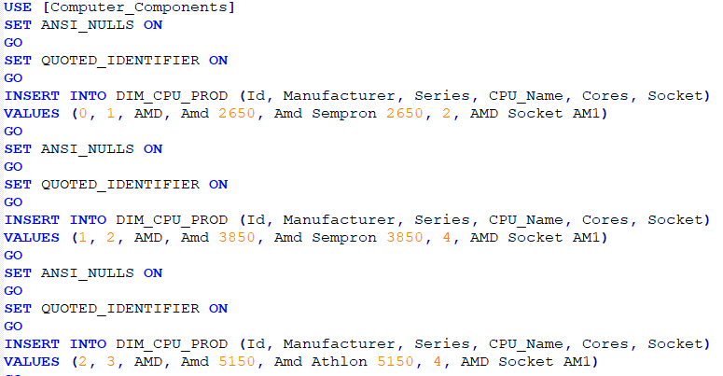
Insert data use SQL script
BULK INSERT
INSERT INTO

Slide 13
Use case and solutions
COMPUTER COMPONENTS SALES SYSTEM

Slide 14
Use cases
What are the highest-priced GPUs in each region?
What is the total revenue from RAM sales per month in a specific region?
How many mineable CPUs are there, and what are their prices?
Which regions have a total CPU price exceeding a specific threshold of 5 million currency units?
When there is a new GPU price, what details are recorded in the log table?
What are the details of prices and technical specifications for CPUs available in the view?
How is the stored procedure used to retrieve RAM prices based on a specific region and time
Which RAM has the highest price in history?
What are the details of prices and technical specifications for the CPU with the highest price of all time?

Slide 15
Solutions
We write a SQL script to solve list of use case
Details in report file

Slide 16
Dashboard report
COMPUTER COMPONENTS SALES SYSTEM

Slide 17
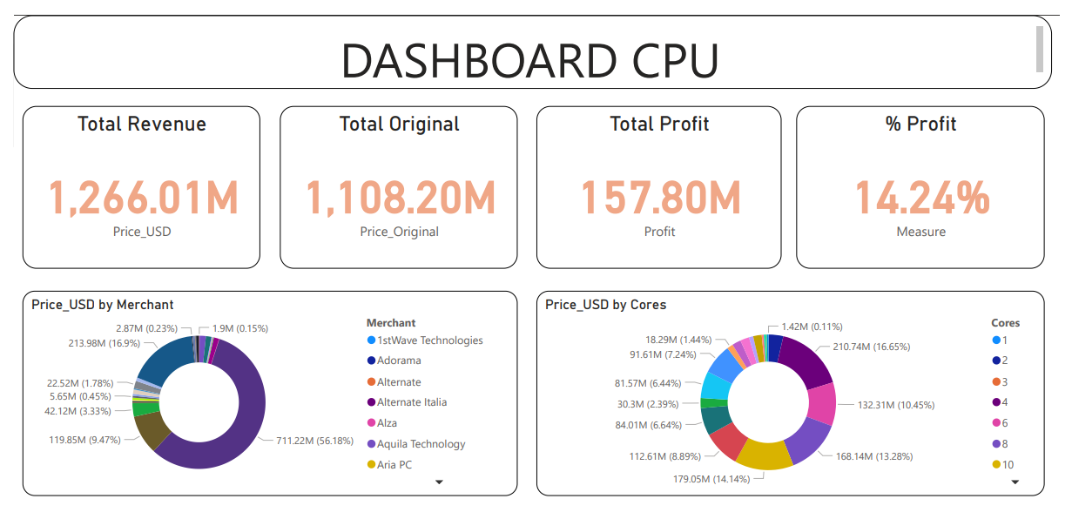
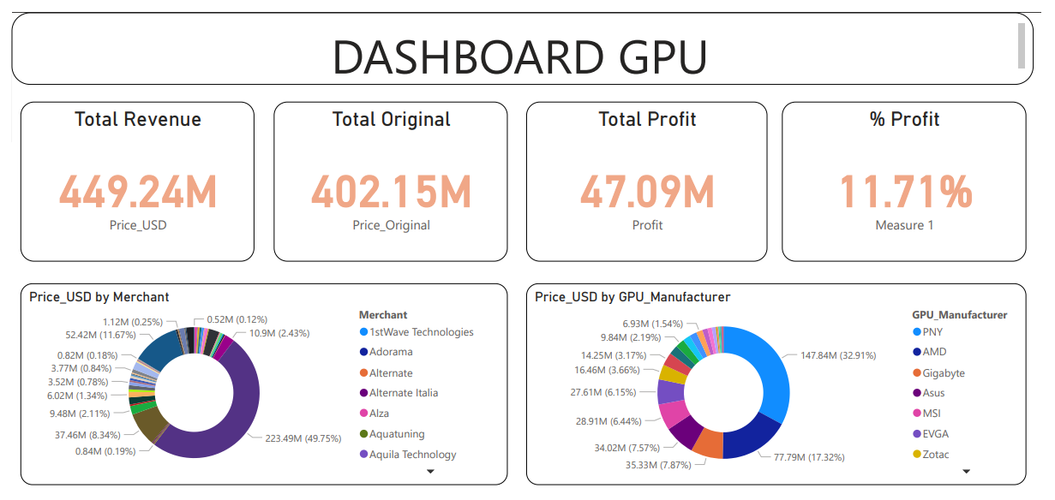
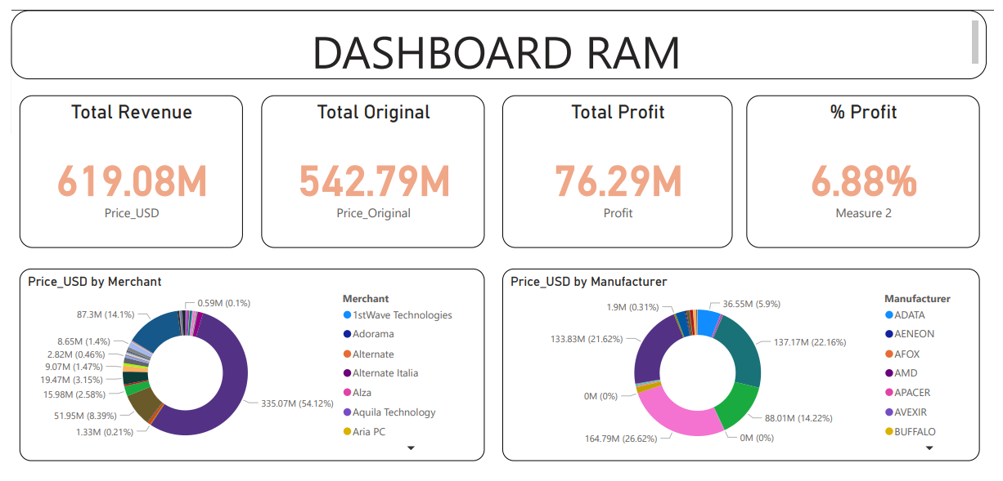
Dashboard report

Slide 18
Team
Name Title
Name Title
Name Title
Name Title

Slide 19
Timeline
To start a presentation, go to the Slide Show tab, and select From Beginning.
1
To display Presenter view, in Slide Show view, on the control bar at the bottom left select the three dots, and then Show Presenter View.
2
During your presentation, the speaker notes are visible on your monitor, but aren't visible to the audience.
3
The Notes pane is a box that appears below each slide. Tap it to add notes.
4
If you don’t see the Notes pane or it is completely minimized, click Notes on the task bar across the bottom of the PowerPoint window.
5

Slide 20
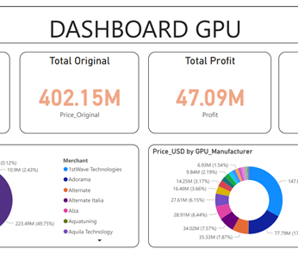
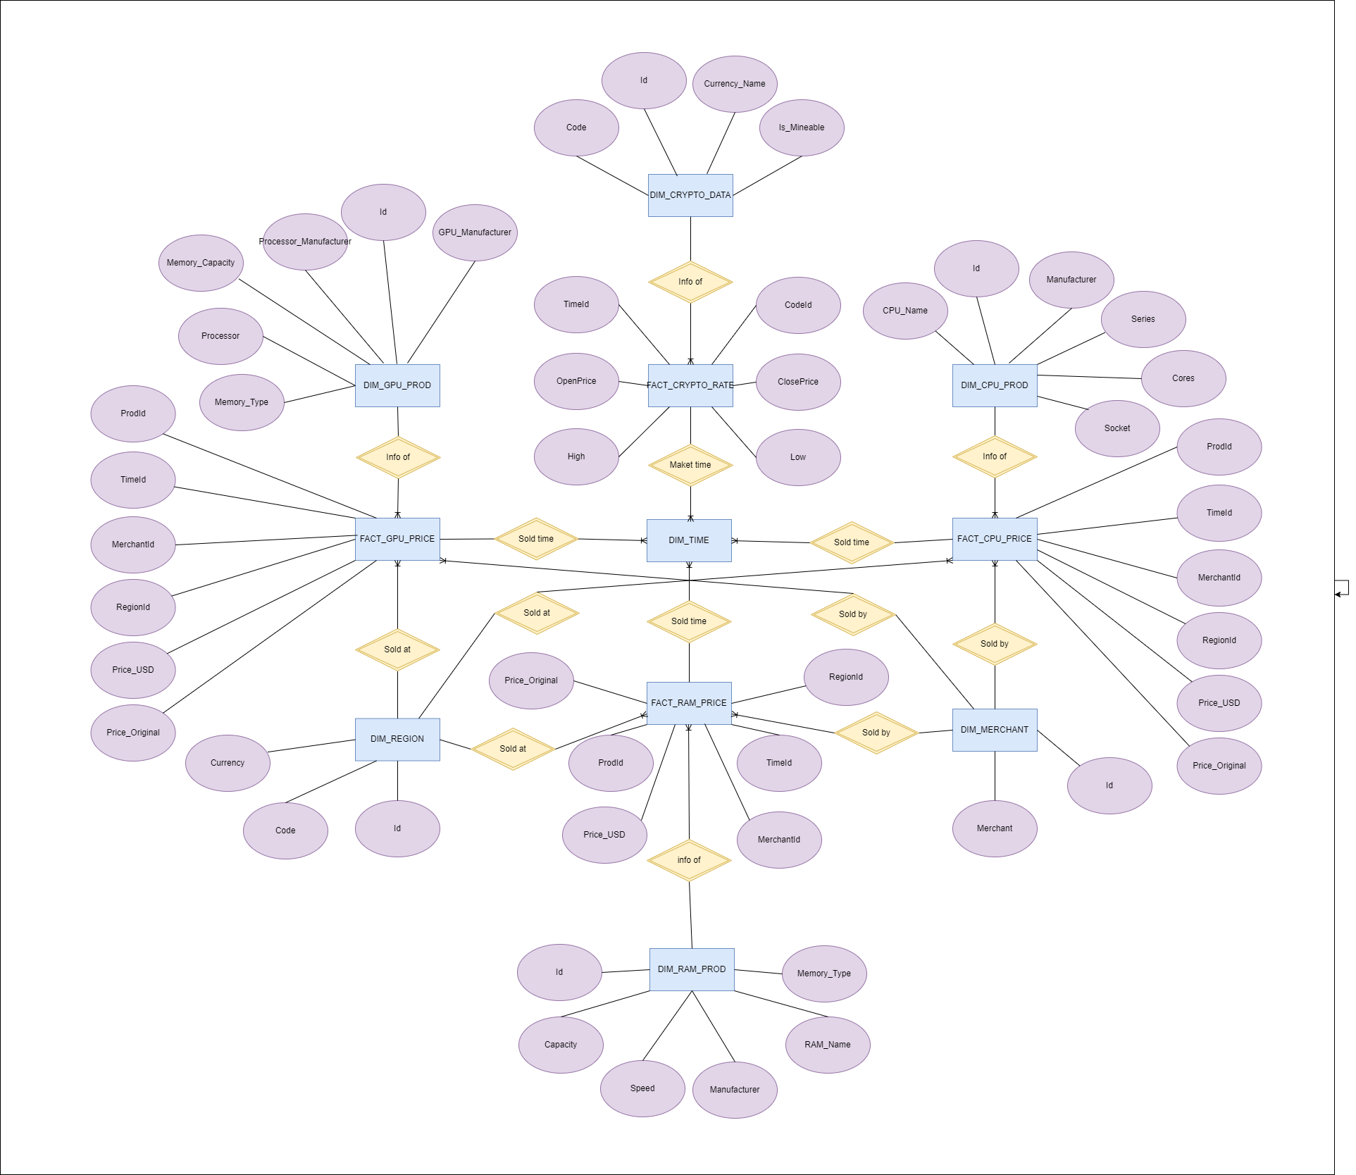
Conclusion
Through the execution of this project, it has helped us reinforce our knowledge in the field of database systems.
Can apply this knowledge to construct a database serving a specific business model.

Slide 21
Thank you
Presenter name
Email address
Website

