Slide 1

TEAM BRAISE
KFC Commerce
Agent
For KFC customers, we turn natural
conversations into completed orders
by coordinating commerce systems, requesting
approval, and verifying the result.
Commerce execution × Agent engineering × Product experience
THANG / PRESENTER

Slide 2
02 / THE CUSTOMER PROBLEM
02
High-intent customers are already in chat—
but ordering sends them elsewhere.
TODAY
THE CUSTOMER HAS TO
WITH KFC COMMERCE AGENT
Switch from Messenger or Zalo to another app or site
STAY
Complete the ordering journey in chat
Leave chat to order, apply vouchers, or check loyalty
CONNECT
Coordinate ordering, vouchers, loyalty, and fulfillment
Wait for staff to carry the journey forward
HAND OFF
Bring in staff when human help is needed
One conversation. One channel. One completed order.
TEAM BRAISE / KFC COMMERCE AGENT

Slide 3
03 / THE AGENT AT WORK
03
Our agent runs a guarded
commerce loop.
One agent keeps planning until the order is verified, clarified, or handed off.
01
CONTEXT / GOAL
02
PLAN
03
SELECT TOOLS
→
→
Message + recent turns + verified state
Intent + entities + next actions
Bounded commerce operations
04
GUARD
05
ACT
06
VERIFY + ADAPT
→
→
Items + fulfillment + approval + evidence
Execute typed tool calls
Persist state; replan, respond, or hand off
Only verified tool results become customer-visible commerce state.
TEAM BRAISE / KFC COMMERCE AGENT

Slide 4
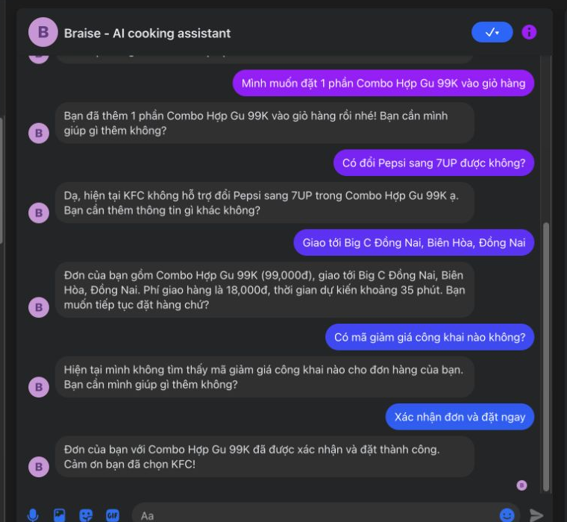
04A / COMPLETE THE JOURNEY
04
Complete the order
without leaving chat.
SOLVES
Channel switching, broken ordering journeys,
and unnecessary manual handling.
WHAT THE PRODUCT CONNECTS
Messenger → cart → fulfillment → confirmation
SIMULATED / REPLACEABLE OMS ADAPTER
MESSENGER PROOF / CONFIRMED ORDER
One customer journey—coordinated across the systems needed to finish it.
TEAM BRAISE / KFC COMMERCE AGENT

Slide 5
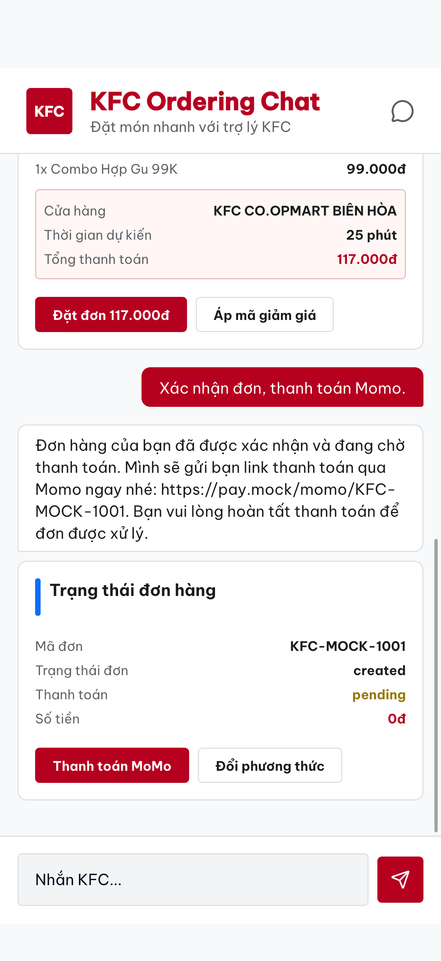
04B / CLEAR CUSTOMER ACTIONS
04
Turn complex choices into
clear customer actions.
SOLVES
Ambiguous text threads and difficult
multi-step decisions.
STRUCTURED GenUI
Verified store, ETA, fee, and address become a clear next action.
MOBILE GenUI / VERIFIED ORDER
TEAM BRAISE / KFC COMMERCE AGENT

Slide 6
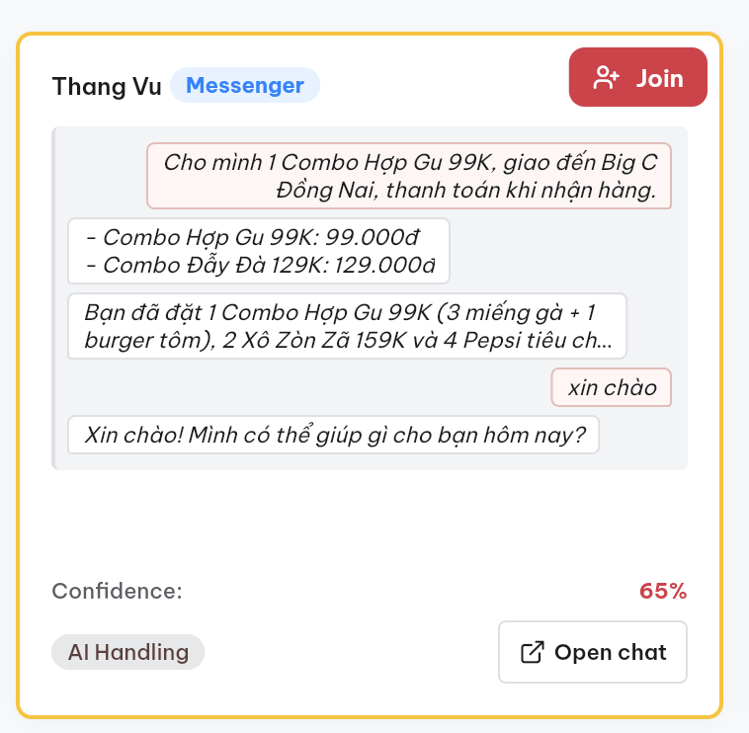
04C / SAFE EXECUTION + RECOVERY
04
Execute safely—and recover
when needed.
SOLVES
Unintended actions, invalid orders, unsupported claims,
and exceptions that require staff.
MONITOR
See live channel, context, confidence, and control state
TAKE OVER
A human can join when the session needs help
RESUME
Return control to AI with explicit operator action
Customer control stays explicit—even when the happy path breaks.
OPERATIONS MONITOR / AI HANDLING
TEAM BRAISE / KFC COMMERCE AGENT

Slide 7
05 / EVIDENCE
05
We evaluated nine complete
customer outcomes.
Representative scenario evaluation—not a measured business result
OUTCOME COMPLETED
COMMERCE STATE VALID
APPROVAL ENFORCED
FAILURE RECOVERED OR HANDED OFF
ORDERING
FULFILLMENT
PAYMENT
RECOVERY
01 Clear order + confirmation
03 Inventory + address + store
08 Payment failure + anomaly
04 Post-order support
02 Combo recommendation + upsell
09 Payment method
05 Complaint + human handoff
06 Natural-language safety
07 Personalization + loyalty
CONTINUOUS QUALITY LOOP
OBSERVE LOGS
→
FIND GAPS
→
IMPROVE BEHAVIOR
→
RE-EVALUATE
Every journey produces logs and outcome data that feed the next quality cycle.
TEAM BRAISE / KFC COMMERCE AGENT

Slide 8
06 / LIVE DEMO
06
Improve the basket—
without taking control away.
GOAL
TRIGGER
AGENT ACTS
OUTCOME
PROOF
Feed four
within 300K
10 chicken pieces
+ 4 Pepsi
2 verified combos
+ priced upsize
Customer approves
both changes
304K confirmed
COD order
No combo conversion or upsize happens before customer approval.
Loose items → better-fit combo → priced upsize → verified order
TEAM BRAISE / KFC COMMERCE AGENT

