Slide 1

TEAM BRAISE
KFC Commerce
Agent
For KFC customers, we turn natural
conversations into completed orders
by coordinating commerce systems, requesting
approval, and verifying the result.
Commerce execution × Agent engineering × Product experience
THANG / PRESENTER
Notes:
TIMING: 0:00-0:25
EXACT SCRIPT
Good morning. We're Team Braise. KFC customers already start ordering in conversation—but completing that order still sends them elsewhere. We built KFC Commerce Agent to keep the customer in chat and carry the journey through to a verified order.
PRESENTER ACTION
Face the judges for the whole opening. Do not point at the hero image. Advance immediately after “verified order.”
TRANSITION
The problem is not starting the conversation. It is finishing the commerce journey.

Slide 2
02 / THE CUSTOMER PROBLEM
02
High-intent customers are already in chat—
but ordering sends them elsewhere.
TODAY
THE CUSTOMER HAS TO
WITH KFC COMMERCE AGENT
Switch from Messenger or Zalo to another app or site
STAY
Complete the ordering journey in chat
Leave chat to order, apply vouchers, or check loyalty
CONNECT
Coordinate ordering, vouchers, loyalty, and fulfillment
Wait for staff to carry the journey forward
HAND OFF
Bring in staff when human help is needed
One conversation. One channel. One completed order.
TEAM BRAISE / KFC COMMERCE AGENT
Notes:
TIMING: 0:25-1:00
NARRATION
A high-intent customer may begin in Messenger or Zalo, but then has to switch channels, rebuild the order, check fulfillment, and wait for staff. That is where intent and commerce state drift apart. Our solution keeps the journey in one conversation while coordinating the cart, fulfillment, confirmation, and the moments where a person should step in.
EMPHASIS
Point once to TODAY and once to WITH KFC COMMERCE AGENT. Land on: One conversation. One channel. One completed order.
TRANSITION
To finish that journey safely, the system must do more than generate a helpful reply.

Slide 3
03 / THE AGENT AT WORK
03
Our agent runs a guarded
commerce loop.
One agent keeps planning until the order is verified, clarified, or handed off.
01
CONTEXT / GOAL
02
PLAN
03
SELECT TOOLS
→
→
Message + recent turns + verified state
Intent + entities + next actions
Bounded commerce operations
04
GUARD
05
ACT
06
VERIFY + ADAPT
→
→
Items + fulfillment + approval + evidence
Execute typed tool calls
Persist state; replan, respond, or hand off
Only verified tool results become customer-visible commerce state.
TEAM BRAISE / KFC COMMERCE AGENT
Notes:
TIMING: 1:00-1:35
NARRATION
One agent keeps a verified working state. It understands the current goal, plans the next safe action, selects bounded commerce tools, and passes policy gates before execution. After each action, it inspects the resulting state and either continues, asks for clarification, or hands off. Only successful tool results become customer-visible commerce state.
EMPHASIS
Trace: Context and goal → Plan → Select tools → Guard → Act → Verify and adapt. Do not describe a supervisor, specialist-agent system, infrastructure, model names, or raw tool names.
TRANSITION
That governed loop produces three customer-facing advantages.

Slide 4
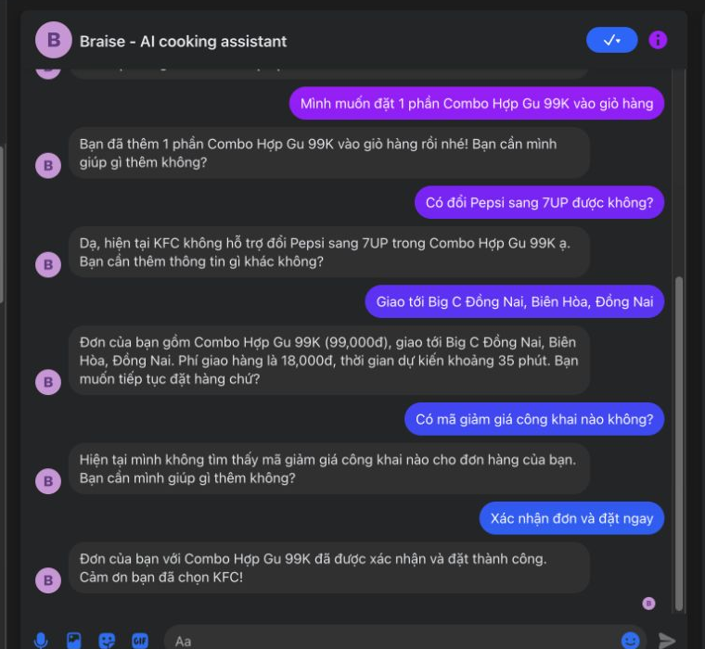
04A / COMPLETE THE JOURNEY
04
Complete the order
without leaving chat.
SOLVES
Channel switching, broken ordering journeys,
and unnecessary manual handling.
WHAT THE PRODUCT CONNECTS
Messenger → cart → fulfillment → confirmation
SIMULATED / REPLACEABLE OMS ADAPTER
MESSENGER PROOF / CONFIRMED ORDER
One customer journey—coordinated across the systems needed to finish it.
TEAM BRAISE / KFC COMMERCE AGENT
Notes:
TIMING: 1:35-2:05
NARRATION
First, the customer does not have to abandon the conversation. The agent coordinates Messenger, cart state, fulfillment, and confirmation as one journey. The screenshot shows a customer reaching explicit order confirmation in chat. The current commerce backend is simulated through a replaceable adapter—not presented as KFC production OMS.
TRANSITION
But a long text thread is still a poor interface for every decision.

Slide 5
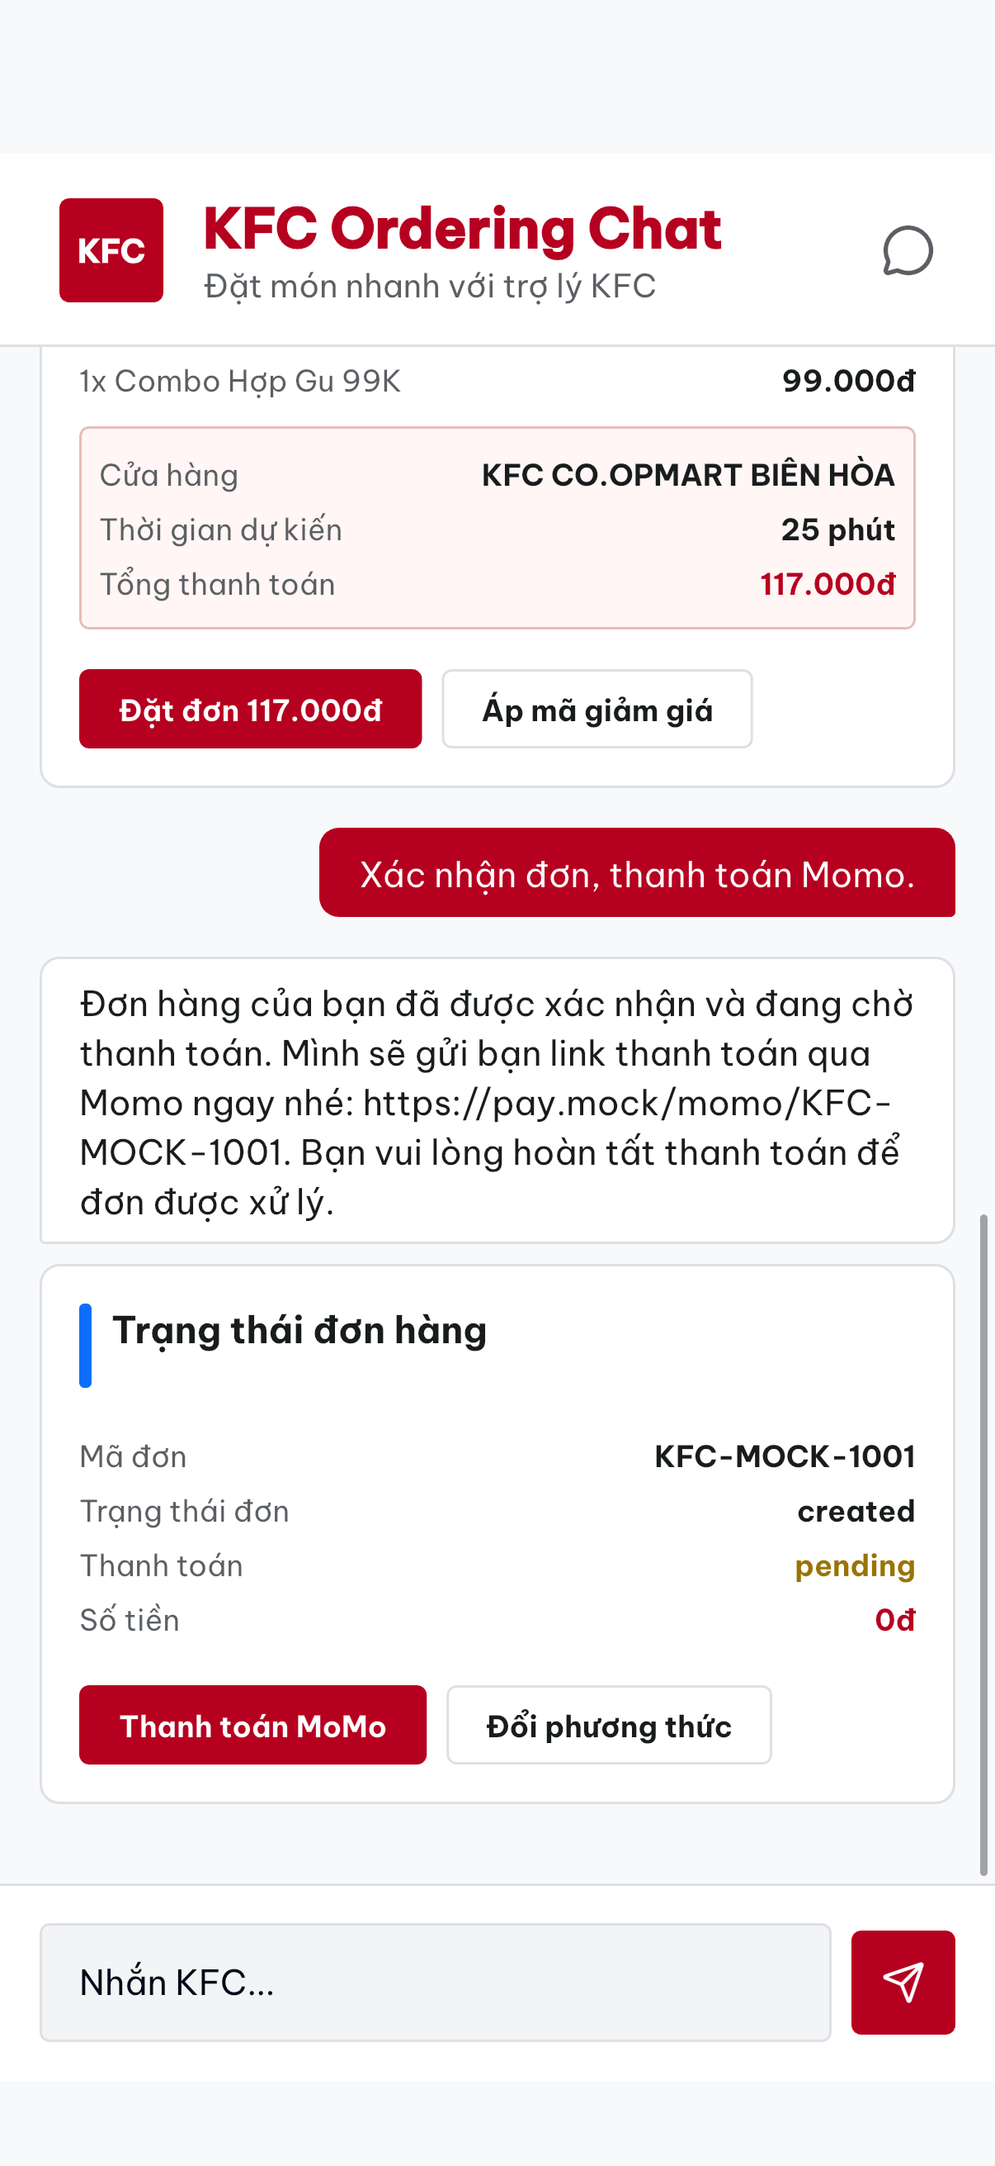
04B / CLEAR CUSTOMER ACTIONS
04
Turn complex choices into
clear customer actions.
SOLVES
Ambiguous text threads and difficult
multi-step decisions.
STRUCTURED GenUI
Verified store, ETA, fee, and address become a clear next action.
MOBILE GenUI / VERIFIED ORDER
TEAM BRAISE / KFC COMMERCE AGENT
Notes:
TIMING: 2:05-2:35
NARRATION
Second, verified state becomes structured GenUI. Instead of burying store, ETA, fee, payment, and confirmation inside paragraphs, the customer gets a clear next action. The model does not invent this screen independently; it is rendered from the backend's typed commerce state.
TRANSITION
And when the happy path breaks, customer control must remain explicit.

Slide 6
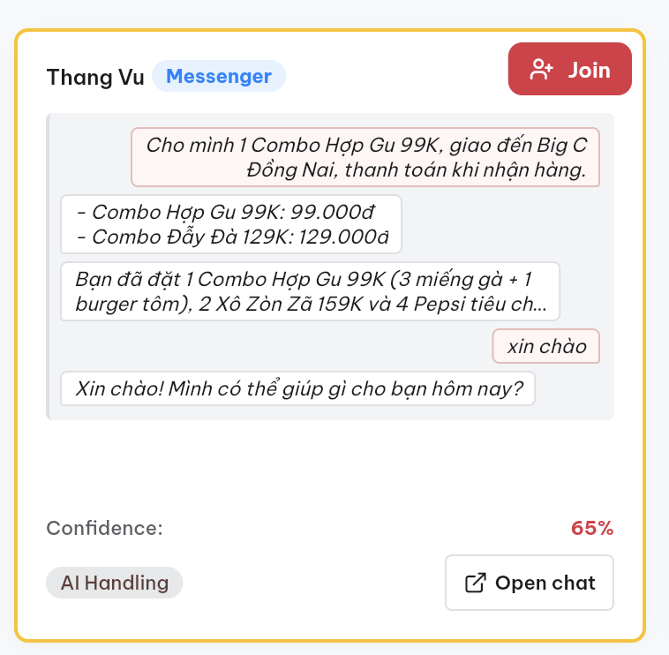
04C / SAFE EXECUTION + RECOVERY
04
Execute safely—and recover
when needed.
SOLVES
Unintended actions, invalid orders, unsupported claims,
and exceptions that require staff.
MONITOR
See live channel, context, confidence, and control state
TAKE OVER
A human can join when the session needs help
RESUME
Return control to AI with explicit operator action
Customer control stays explicit—even when the happy path breaks.
OPERATIONS MONITOR / AI HANDLING
TEAM BRAISE / KFC COMMERCE AGENT
Notes:
TIMING: 2:35-3:05
NARRATION
Third, the Operations Monitor exposes the live channel, conversation context, confidence, and control state. An operator can join, which pauses AI replies, respond in the same channel, and explicitly resume AI with the takeover context preserved. Human help is part of the workflow, not a disconnected escalation inbox.
TRANSITION
We evaluate the complete customer outcome—not just whether the final message sounds plausible.

Slide 7
05 / EVIDENCE
05
We evaluated nine complete
customer outcomes.
Representative scenario evaluation—not a measured business result
OUTCOME COMPLETED
COMMERCE STATE VALID
APPROVAL ENFORCED
FAILURE RECOVERED OR HANDED OFF
ORDERING
FULFILLMENT
PAYMENT
RECOVERY
01 Clear order + confirmation
03 Inventory + address + store
08 Payment failure + anomaly
04 Post-order support
02 Combo recommendation + upsell
09 Payment method
05 Complaint + human handoff
06 Natural-language safety
07 Personalization + loyalty
CONTINUOUS QUALITY LOOP
OBSERVE LOGS
→
FIND GAPS
→
IMPROVE BEHAVIOR
→
RE-EVALUATE
Every journey produces logs and outcome data that feed the next quality cycle.
TEAM BRAISE / KFC COMMERCE AGENT
Notes:
TIMING: 3:05-3:40
NARRATION
We designed nine representative journeys across ordering, fulfillment, payment, and recovery. For each journey, we inspect four things: was the customer outcome completed, was commerce state valid, was approval enforced, and did failure recover or hand off correctly? Logs and outcome data then feed the next cycle: observe, find gaps, improve behavior, and re-evaluate.
CLAIM BOUNDARY
Say “nine representative journeys” or “nine representative scenarios.” Do not say 9/9, all live tests pass, or imply customer research, pilot results, or measured business impact.
TRANSITION
Now let's see the KFC-prioritized scenario: improve the basket without taking control away.

Slide 8
06 / LIVE DEMO
06
Improve the basket—
without taking control away.
GOAL
TRIGGER
AGENT ACTS
OUTCOME
PROOF
Feed four
within 300K
10 chicken pieces
+ 4 Pepsi
2 verified combos
+ priced upsize
Customer approves
both changes
304K confirmed
COD order
No combo conversion or upsize happens before customer approval.
Loose items → better-fit combo → priced upsize → verified order
TEAM BRAISE / KFC COMMERCE AGENT
Notes:
TIMING: 3:40-4:40
ROLES: Thang controls slides and narration. Teammate operates the prepared customer-chat tab and fallback recording and does not speak.
SETUP
The customer needs food for four within a 300,000-dong budget. Watch the agent improve the basket without changing it before approval. Switch to the customer-chat tab.
TURN 1 — TEAMMATE SUBMITS
Cho mình 10 miếng gà và 4 Pepsi cỡ vừa cho 4 người, ngân sách đồ ăn 300.000đ, giao đến Big C Đồng Nai, thanh toán khi nhận hàng.
THANG
The customer starts with loose items and a budget. The agent must not change the cart before permission.
WAIT LINE IF NEEDED
The request is running; the current build does not expose internal sub-steps.
WHEN RESULT APPEARS
It found two verified combos that fit the same need and reduce the food subtotal from 404,000 to 258,000 dong—but it waits for the customer.
TURN 2 — TEAMMATE SUBMITS
Đổi sang 2 Combo Đẫy Đà 129K nhé.
THANG
With approval, the cart changes. Now it offers four large-drink upgrades for 28,000 dong and discloses the resulting price before confirmation. Do not claim the upsize is applied yet.
TURN 3 — TEAMMATE SUBMITS
Đồng ý nâng cả 4 Pepsi lên cỡ lớn. Tổng món 286.000đ, phí giao 18.000đ; xác nhận đặt đơn và thanh toán khi nhận hàng.
WHEN CONFIRMED ORDER APPEARS
The customer approved both modifications and the disclosed total. The result is one verified confirmed cash-on-delivery order. Hold for two seconds. Do not open the Operations Monitor. Return to this slide.
FALLBACK
At 18 seconds without the complete expected response and GenUI, or on any wrong recommendation, card, composition, price, saving, cart, fee, payment state, final order, error, stale session, duplicate order, or early order, teammate switches immediately to the preloaded recording. Thang says exactly: I'll switch to the recorded run of this exact scenario. Do not repair onstage or add a fourth turn.
EXACT CLOSE
Choose Team Braise to turn KFC conversations into completed orders—while keeping customers and operators in control. Stop speaking by 4:40.

Slide 9
A1 / RUNTIME REQUEST FLOW
A1
One request enters one governed
commerce loop.
CHANNEL
ROUTE / RUN
PLAN
GATES + TOOLS
VERIFIED STATE
CUSTOMER +
OPERATOR
→
→
→
→
→
KFC chat,
Messenger, Zalo
Synchronous chat
or durable channel run
Intent, context,
next actions
Typed commerce
operations
Cart, fulfillment,
order, payment
Text + GenUI;
monitor events
The response is composed only after tool results and state are recorded.
CLAIM BOUNDARY / SINGLE AGENT LOOP
No supervisor or autonomous specialist-agent system.
TEAM BRAISE / KFC COMMERCE AGENT
Notes:
Q&A ONLY — DO NOT PRESENT SEQUENTIALLY
ANSWER FIRST
One request enters one governed commerce loop. The channel route starts either a synchronous chat request or durable channel run. The agent plans bounded actions, passes gates, executes tools, persists the resulting cart/order/payment state, and only then composes customer text, GenUI, and monitor events.
IF ASKED WHAT MAKES IT AGENTIC
A chatbot can generate a plausible reply. Our agent repeatedly interprets the goal, proposes next actions, selects bounded commerce tools, passes policy gates, executes them, inspects the resulting state, and adapts or hands off. Verified state changes—not text alone—define success.
BOUNDARY
This is one commerce agent loop, not a supervisor or autonomous specialist-agent team.

Slide 10
A2 / SYSTEM AUTHORITY
A2
The model proposes. The system decides
what can execute.
LLM PLANNER
Proposes intent, entities, tool calls, and response claims
TYPED TOOL CATALOG
Rejects unknown tools and invalid arguments
POLICY + SAFETY GATES
Require verified items, fulfillment, evidence, and approval
CUSTOMER RESULT
Calls bounded commerce clients and records provenance
GenUI and the final response
reflect verified state.
TOOL EXECUTOR
PERSISTED STATE
Owns cart, order, payment, handoff, and event truth
CLAIM BOUNDARY / PROTOTYPE + FIXTURE BACKED
Implemented safety design; not a production KFC system.
TEAM BRAISE / KFC COMMERCE AGENT
Notes:
Q&A ONLY — DO NOT PRESENT SEQUENTIALLY
ANSWER
The model can propose a tool call or response claim, but unknown tools and invalid arguments are rejected. Safety gates require verified item codes, valid fulfillment, explicit order confirmation, and tool evidence for sensitive claims. Customer GenUI and the final response are produced from persisted tool results and commerce state.
SOURCE OF TRUTH
Persisted backend state and successful typed tool results win when the model and system disagree.
IF ASKED WHETHER IT IS MULTI-AGENT
No. It is intentionally one commerce agent loop with one state authority and one policy boundary.
BOUNDARY
The commerce clients are prototype/fixture backed; this is implemented safety design, not a production KFC system.

Slide 11
A3 / INTERRUPTION + HUMAN CONTROL
A3
New intent can replace safe work;
irreversible work is protected.
NEW CUSTOMER
TURNS
PENDING +
COALESCED
GENERATION-
OWNED RUN
DELIVER OR
SUPPRESS
→
→
→
Incoming intent
Reserve and combine
One current run
Only current output
SUPERSEDE ONLY BEFORE AN IRREVERSIBLE BOUNDARY
OPERATOR CONTROL
JOIN
→
HUMAN REPLY
→
RESUME AI WITH CONTEXT
One current run and one explicit control owner per session.
TEAM BRAISE / KFC COMMERCE AGENT
Notes:
Q&A ONLY — DO NOT PRESENT SEQUENTIALLY
NEW MESSAGE ANSWER
Channel turns are reserved, briefly coalesced, and assigned to a generation-owned run. A newer turn can supersede an older run only before an irreversible side effect. Stale responses are suppressed. Once the boundary is recorded, the system protects that execution instead of pretending it can safely rewind it.
HUMAN TAKEOVER ANSWER
The session has an explicit control state. An operator can join, which pauses AI replies; the human can respond in the same channel; then Resume AI returns control with the takeover transcript preserved.
BOUNDARY
Do not claim exactly-once delivery, production queue SLAs, or durable reconciliation after ambiguous external failures.

Slide 12
A4 / EVALUATION + PROOF
A4
We test outcomes at four separate
proof layers.
DETERMINISTIC CONTRACTS
Did gates, tools, state transitions, and adapters behave correctly?
SCENARIO REPLAY
Did nine representative journeys reach intended state and recovery?
LIVE UI + GenUI
Did the customer see the correct structured result?
LIVE MODEL + DEPLOYED PROOF
Did the runtime produce the expected causal trace and outcome?
CONTINUOUS QUALITY LOOP
OBSERVE LOGS → FIND GAPS → IMPROVE BEHAVIOR → RE-EVALUATE
Evidence layers are never collapsed into one pass-rate claim.
TEAM BRAISE / KFC COMMERCE AGENT
Notes:
Q&A ONLY — DO NOT PRESENT SEQUENTIALLY
ANSWER
We separate proof layers: deterministic contracts for gates and tools, scenario replay for end states, live Flutter and GenUI evidence for the customer surface, and live-model or deployed traces for runtime behavior. Logs and outcomes feed the next evaluation cycle. We never combine those layers into one misleading pass-rate number.
IF ASKED “DID ALL NINE PASS?”
They are nine representative journey designs, not a public pass-rate claim. Evidence layers are reported separately.
BOUNDARY
The nine scenarios are an engineering dataset—not user research, a pilot, or measured business impact. Do not claim all nine currently pass as live-model release tests.

Slide 13
A5 / OMS + POS INTEGRATION
A5
Stable adapter contracts isolate the agent
from OMS/POS specifics.
→
OMS ADAPTER
COMMERCE CONTRACT
AGENT TOOLS
→
Typed commands + stable outcomes
→
POS ADAPTER
Typed order + status models
Correlation + idempotency keys
Failure + cancellation mapping
Raw status kept for reconciliation
CURRENT PROOF / SIMULATED ADAPTERS
Real integration requires authoritative APIs, sandbox, auth, webhooks, and conformance tests.
TEAM BRAISE / KFC COMMERCE AGENT
Notes:
Q&A ONLY — DO NOT PRESENT SEQUENTIALLY
INTEGRATION ANSWER
We demonstrated the integration shape through replaceable, simulated OMS/POS adapters: typed commands, correlation, idempotency keys, status mapping, and failure handling. We have not connected to KFC production or a named vendor sandbox. Real compatibility requires authoritative contracts, credentials, test stores, webhooks, and vendor conformance evidence.
AMBIGUOUS FAILURE ANSWER
The simulated layer preserves raw OMS and POS outcomes, classifies conflicts, and attempts defined compensation where appropriate. Production deployment would require durable retries, vendor idempotency guarantees, reconciliation jobs, alerts, and an owned operations process.
BOUNDARY
Demonstrated simulated OMS/POS orchestration through replaceable adapter contracts. Do not claim KFC compatibility, restart-safe idempotency, production durability, or production readiness.

