Slide 1

TEAM BRAISE
KFC Commerce
Agent
From conversation
to confirmed order
Agent engineering x Commerce execution x Product experience
THANG / PRESENTER

Slide 2
02 / PROBLEM INSIGHT
A helpful reply is not
a completed order
CHAT
≠
The workflow breaks when natural intent is separated from commerce state.
ORDER
01
02
03
04
INTENT
CART
FULFILLMENT
ORDER
What the customer means
What they approved
What can be delivered
What was confirmed
TEAM BRAISE / KFC COMMERCE AGENT

Slide 3
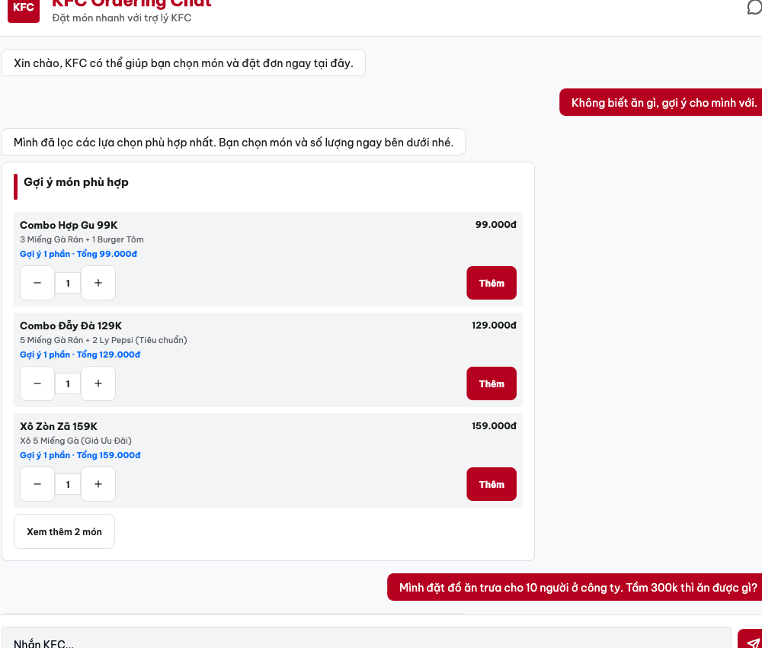
03 / PRODUCT BEHAVIOR
One conversation.
One completed order.
01
UNDERSTAND GOAL
Loose items, group size, budget
02
DECIDE NEXT STEP
Compare basket with relevant combos
03
ACT
Update cart only after approval
04
VERIFY
Confirm price, fulfillment, order state
MAIN STORY / THE AGENT IS VISIBLE THROUGH THE OUTCOME

Slide 4
04 / WHY IT WINS
It doesn't just take the order.
It improves it.
LOOSE ITEMS
BETTER-FIT ORDER
10 pieces
+ 4 medium Pepsi
→
2 relevant combos
+ 4 large Pepsi
Relevant suggestion
Customer-approved change
Verified final price
The customer stays in control of every change.
PRODUCT VALUE / CUSTOMER CONTROL STAYS EXPLICIT

Slide 5
05 / EVIDENCE + IMPACT
9
Representative test scenarios
Summarized across the complete customer journey
ORDERING
FULFILLMENT
PAYMENT
RECOVERY
01 Clear order + confirmation
03 Inventory + address + store
08 Payment failure + anomaly
04 Post-order support
02 Combo recommendation + upsell
05 Complaint + human handoff
09 Payment method
06 Natural-language safety
07 Personalization + loyalty
Each scenario evaluates a complete customer outcome.
Target: more conversations converted into completed orders.
TEAM BRAISE / KFC COMMERCE AGENT

Slide 6
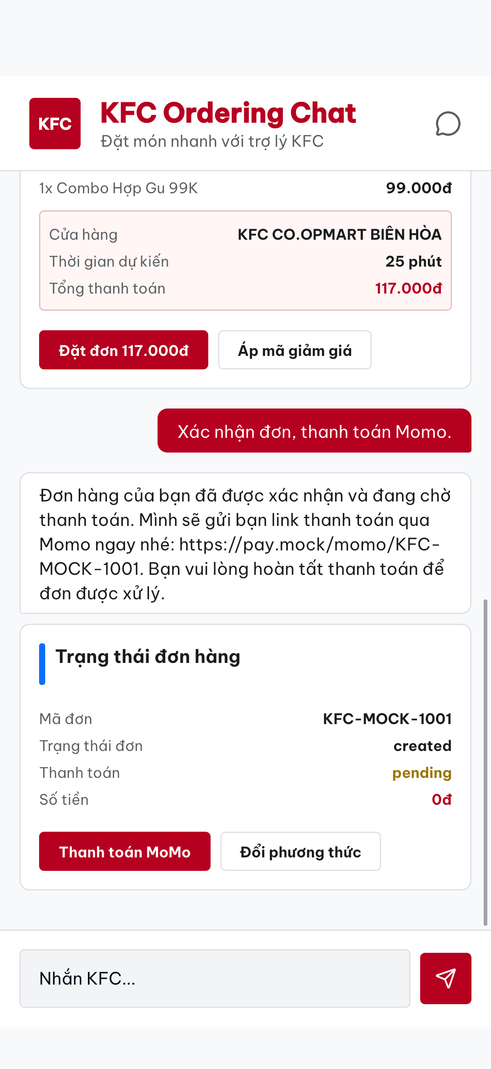
06 / LIVE DEMO
Let's complete
an order
Loose items → better-fit combo → size upgrade → confirmed order
Choose Team Braise to turn KFC conversations into completed orders.
DEMO ENDS ON THE VERIFIED CUSTOMER OUTCOME

Slide 7
A1 / RUNTIME ARCHITECTURE
One commerce runtime across customer and operator surfaces
CUSTOMER SURFACES
AGENT RUNTIME
COMMERCE ADAPTERS
→
→
KFC Chat • Messenger • Zalo
Plan • policy • tools • verify
Catalog • store • OMS • POS
Durable session state and observable events connect both interfaces.
APPENDIX / SUPPORTING EVIDENCE

Slide 8
A2 / AGENT BEHAVIOR + STATE AUTHORITY
The response follows verified commerce state
01
02
03
04
05
GOAL
→
PLAN
→
TOOLS
→
ACT
→
VERIFY
VERIFIED COMMERCE STATE
Explicit confirmation gates irreversible order creation.
APPENDIX / ONE AGENT, BOUNDED ACTIONS

Slide 9
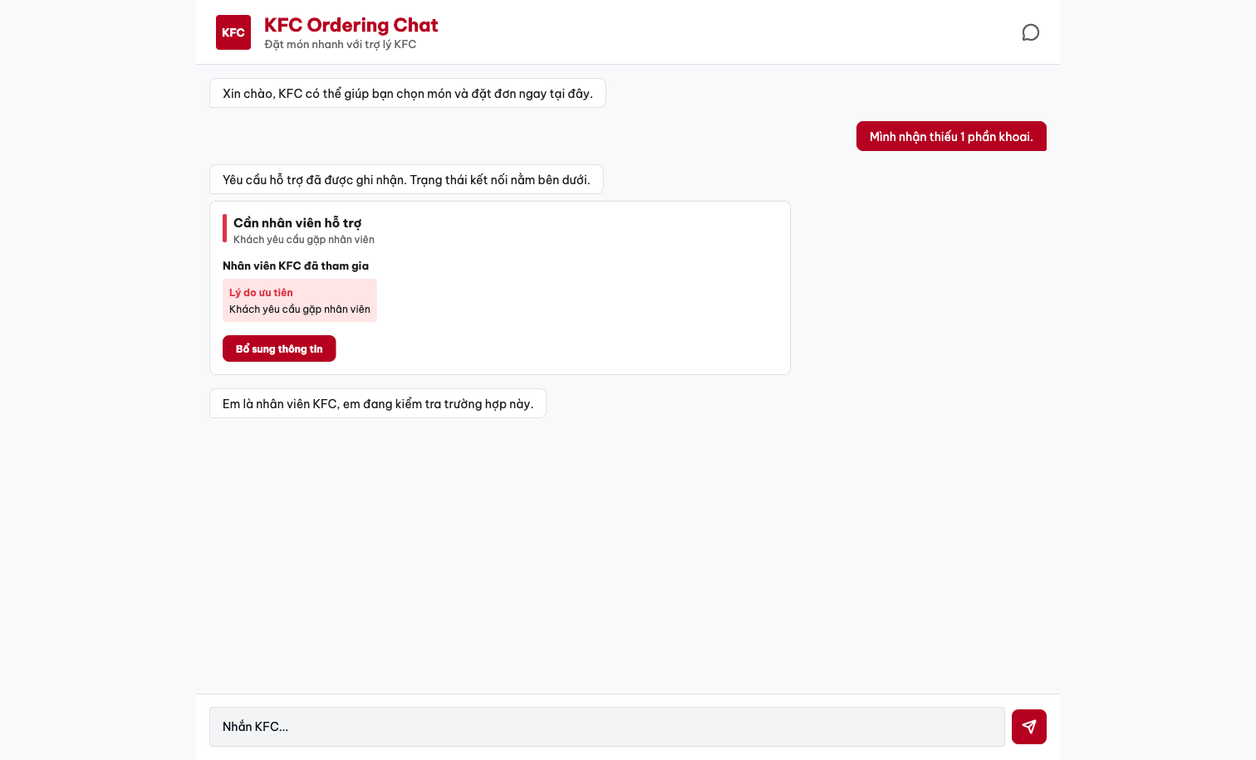
A3 / RELIABILITY + HUMAN OVERSIGHT
Human control without losing the customer context
AI ACTIVE
↓
HUMAN JOINED
↓
AI RESUMED
Dashboard proof is supporting evidence, not part of the 60-second customer demo.
APPENDIX / PAUSE, HAND OVER, RESUME

Slide 10
A4 / EVALUATION + PROOF
Proof must survive a repeatable live run
9
3x
1
→
→
representative test scenarios
clean rehearsals
provenance-bound artifact
Readiness gate
Three clean rehearsals • every response ≤18s • full demo ≤60s • matching recording
APPENDIX / CURRENT LIVE READINESS REMAINS GATED

Slide 11
A5 / OMS + POS ADAPTER CONTRACTS
Reliable adapters connect conversation to order execution
CONFIRMED INTENT
ORDER COMMAND
OMS / POS
VERIFIED RESULT
→
→
→
Cart + fulfillment + approval
Idempotency + correlation
Create + project status
Order IDs + customer state
SIMULATED TODAY
Replaceable contracts isolate KFC- and vendor-specific APIs from the agent workflow.
APPENDIX / HONEST INTEGRATION BOUNDARY

