Slide 1
SKILL SWAP – HYPERLOCAL SKILL EXCHANGE WEB APPLICATION.

Slide 2
TEAM DETAILS: GUIDE NAME : DR.V.VENKATARAMANA.
2403A52260 – VEMULA AKSHAYA REDDY
2403A52267 – GUNDU DEEKSHITHA VARMA
2403A52273 – THANGALAPALLY HASINI
BATCH - 10

Slide 3
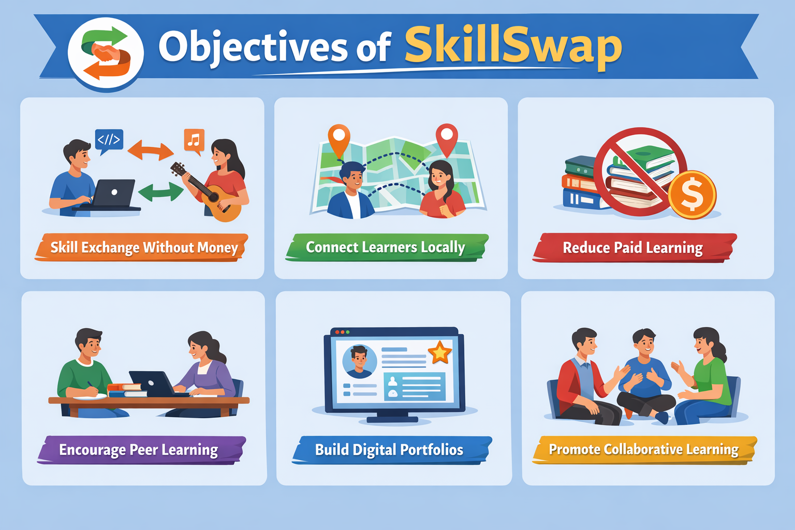
Objectives: ->To create a platform for skill exchanging without money. -> To encourage peer-to-peer learning. ->To connect students and local community members based on skills. ->To provide a digital portfolio for users. ->To promote collaborative learning in local areas. ->To reduce dependency on paid learning platforms.

Slide 4
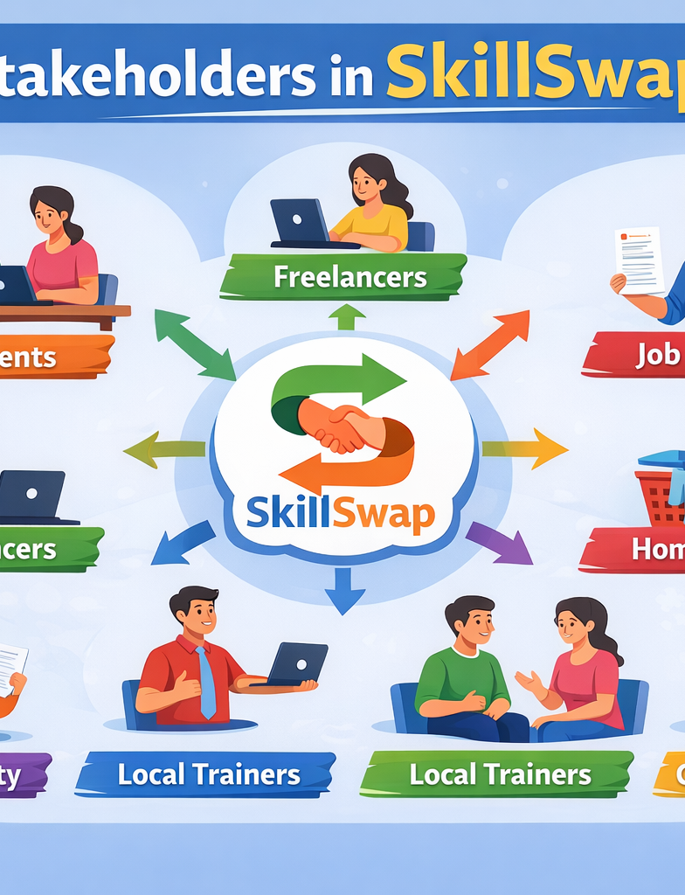
Stakeholders:
Students
2) Homemakers
3) Job seekers
4) College faculty
5)Local trainers
6)Community- learners

Slide 5
Programming Languages, Tools & Software:
Frontend:
HTML
CSS
JavaScript
React.js (Optional Advanced)
Bootstrap
Backend:
Python (Flask / Django) OR
Node.js

Slide 6
Database:
MySQL OR
MongoDB
Tools:
VS Code
GitHub
Figma (UI design)
Postman (API testing)
Deployment:
Render / Netlify / Heroku

Slide 7
Front-End View (Web Application)
1️⃣ Home Page
Logo: SkillSwap
Search skills
Register / Login button
Featured skills section
2️⃣ User Dashboard
Profile picture
Skills I Can Teach
Skills I Want to Learn
Match Suggestions
Exchange Requests
3️⃣ Skill Matching Page
Skill Name
Nearby Users
Rating
Request Exchange Button
4️⃣ Exchange Tracker
Ongoing Exchanges
Completed Exchanges
Reviews
Feedback.

Slide 8
Thank you.

