Slide 1
Financial Loan Risk Detection

Slide 2
Problem Statement:
Overview of the lending industry and its challenges in assessing creditworthiness. Importance of accurate risk assessment to mitigate loan defaults and financial risks for lending institutions
The goal of this project is to develop a data-driven model that classifies the loan risk of lending institutions based on relevant features. By analyzing historical loan data and borrower attributes, the model aims to provide accurate predictions of loan default risk

Slide 3
Tools Used:
Python
Numpy
Pandas
Matplotlib
Seaborn
Scikit-learn

Slide 4
Approaches to completing the project:
Data Pre-processing:
Handling Null Values:
High percentages of null values may indicate data quality issues . Dropping such columns can help maintain data integrity
2.Exploratory Data Analysis (EDA):
EDA to gain insights into the distribution of loan default instances and the relationship between borrower features and loan default. Visualize key findings to aid in understanding and decision-making.
3. Feature Selection With PCA:
PCA, is a dimensionality reduction technique employed to transform a dataset with numerous correlated features into a set of linearly uncorrelated variables known as principal components.

Slide 5
4. Handling Data Imbalance:
Encountered data imbalance within the 'Target' feature. To address this issue, we implemented the SMOTETomek oversampling method.
5. Model Development:
Choose machine learning algorithms for classification tasks, such as logistic regression, and Xgb boosting machines.
Train the model on the cleaned and preprocessed data, using techniques like cross-validation to ensure robustness.
Tune hyper parameters to optimize model performance.
6. Model Evaluation: Evaluate the trained model using metrics such as accuracy, precision, recall, and F1-score.
Utilize techniques like ROC curves and AUC-ROC scores for binary classification evaluation.

Slide 6
Exploratory Data Analysis (EDA) Insights

Slide 7
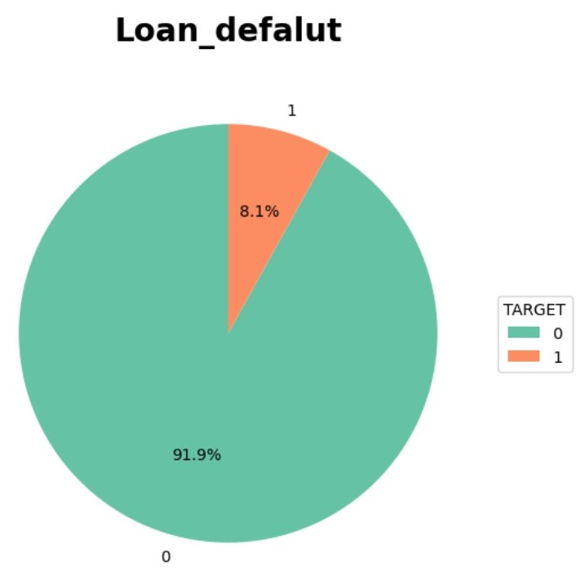

Slide 8
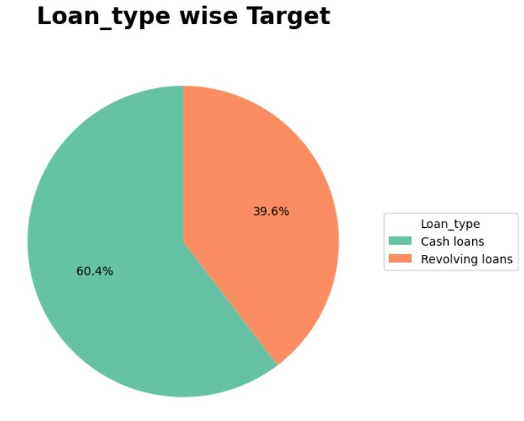

Slide 9
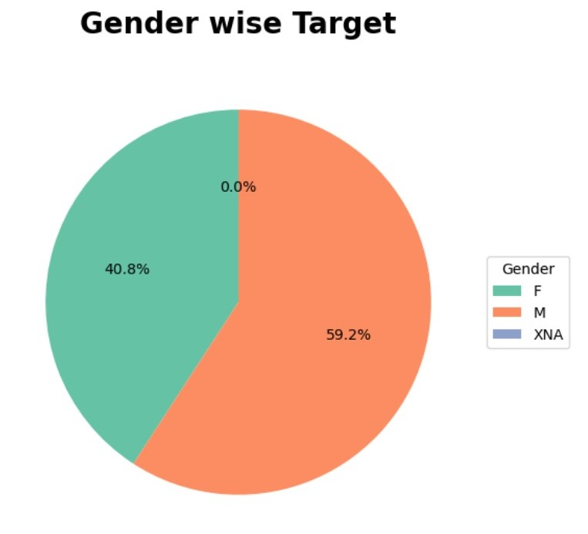

Slide 10
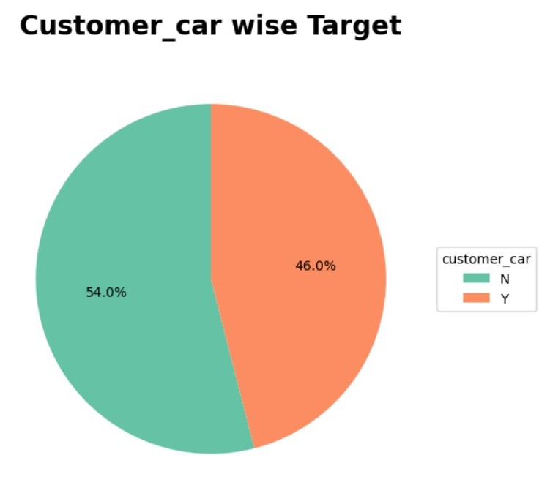

Slide 11
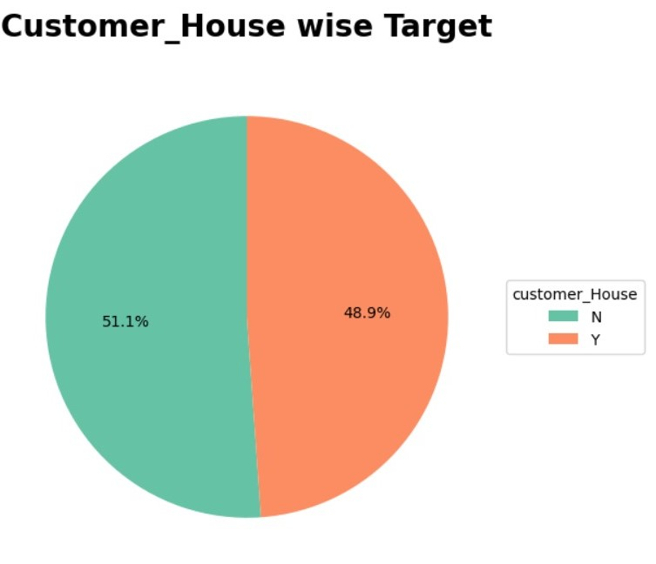

Slide 12
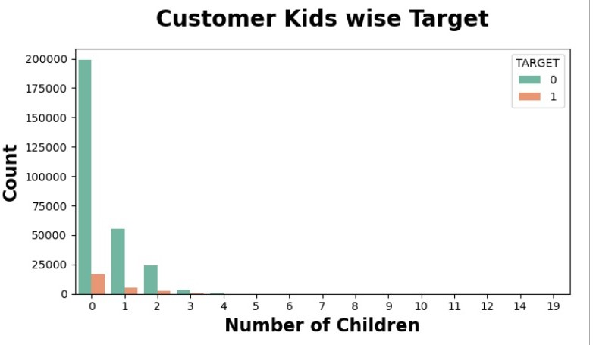

Slide 13
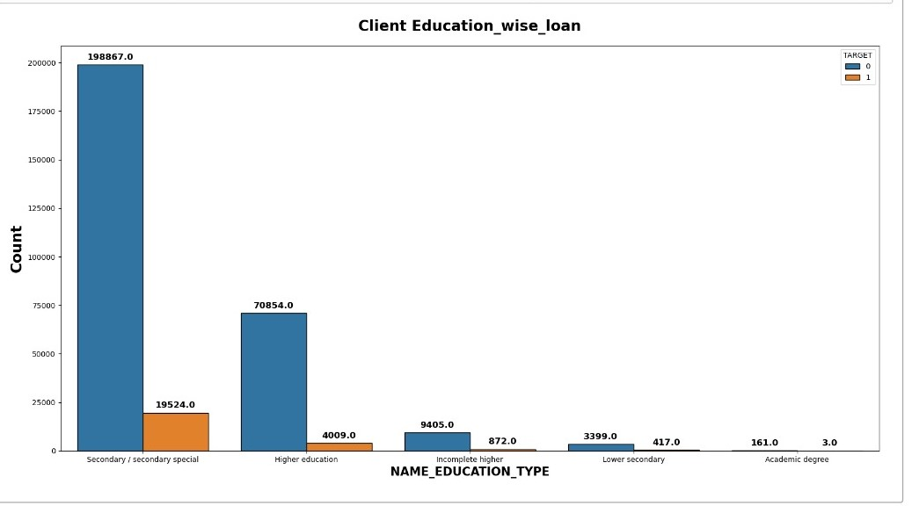

Slide 14
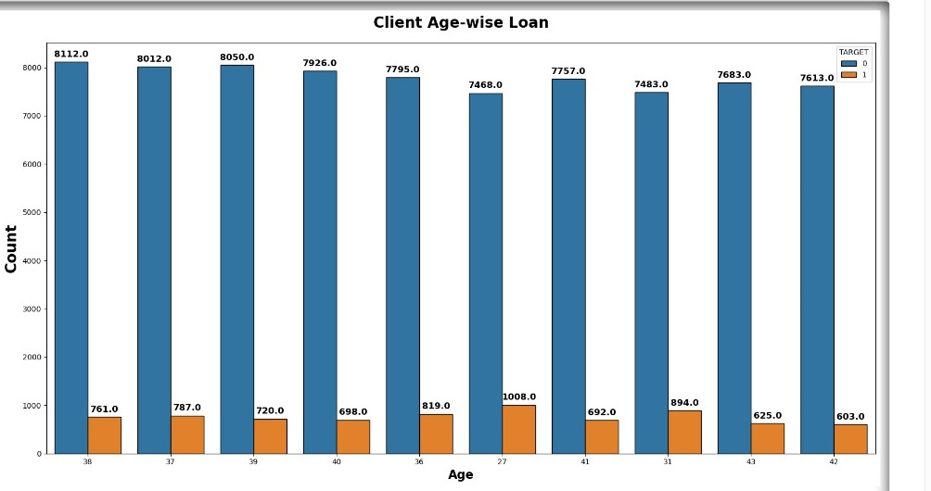

Slide 15
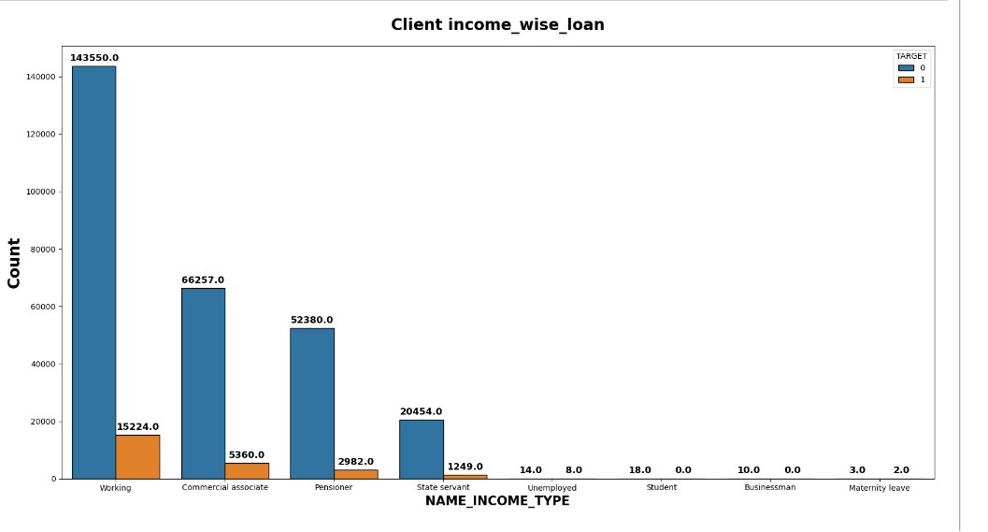

Slide 16
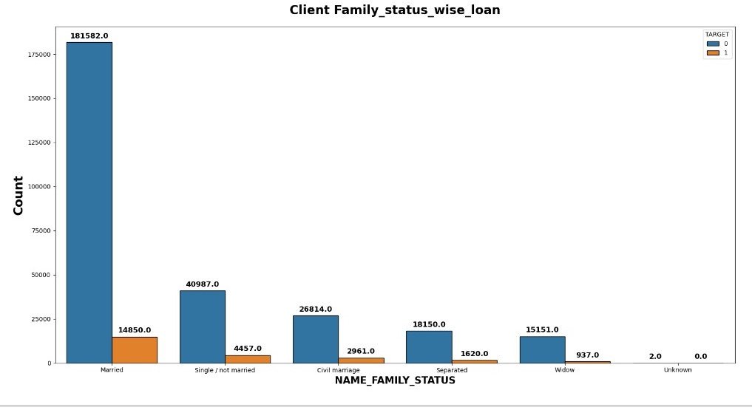

Slide 17
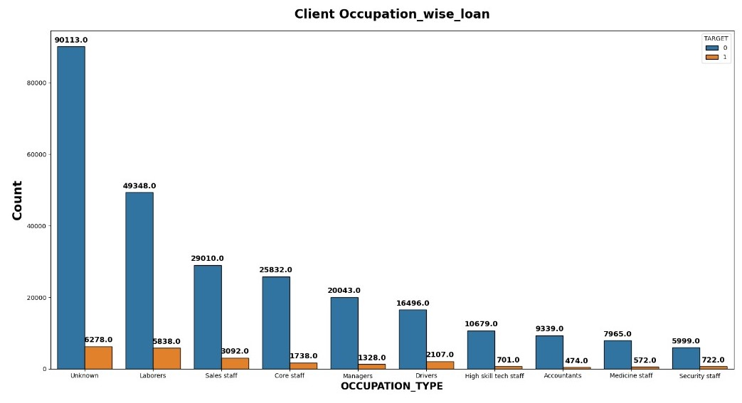

Slide 18
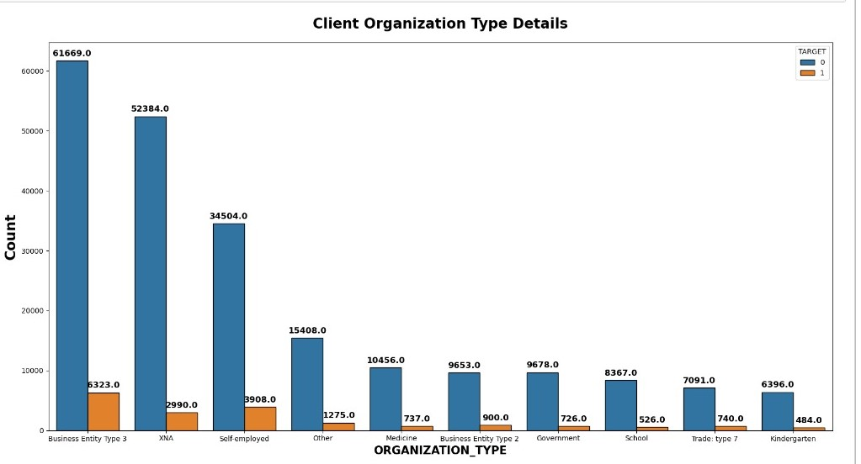

Slide 19
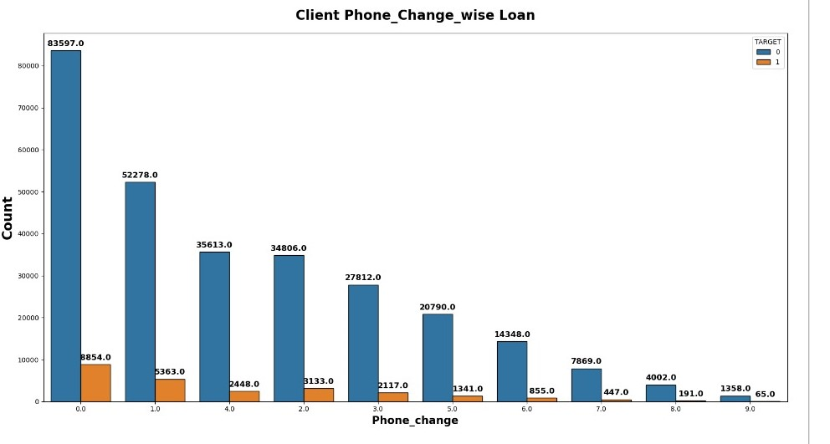

Slide 20
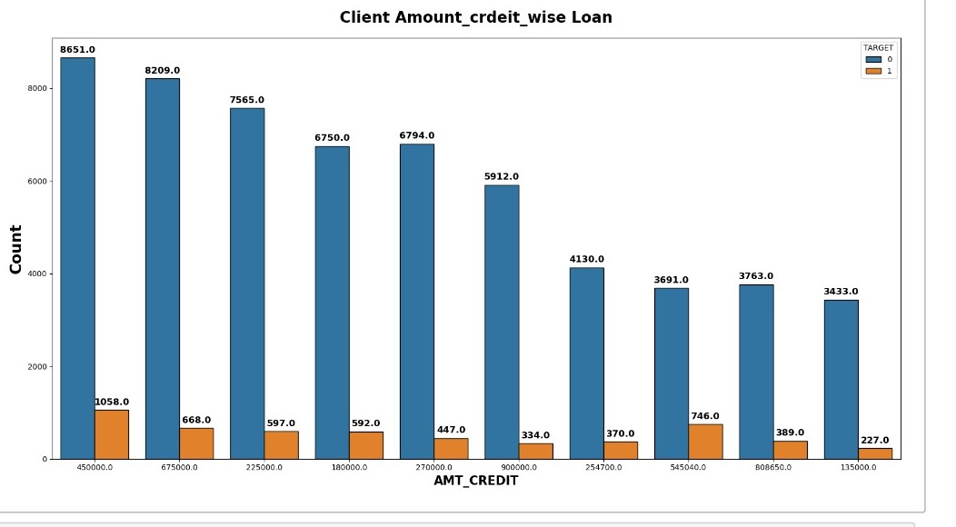

Slide 21
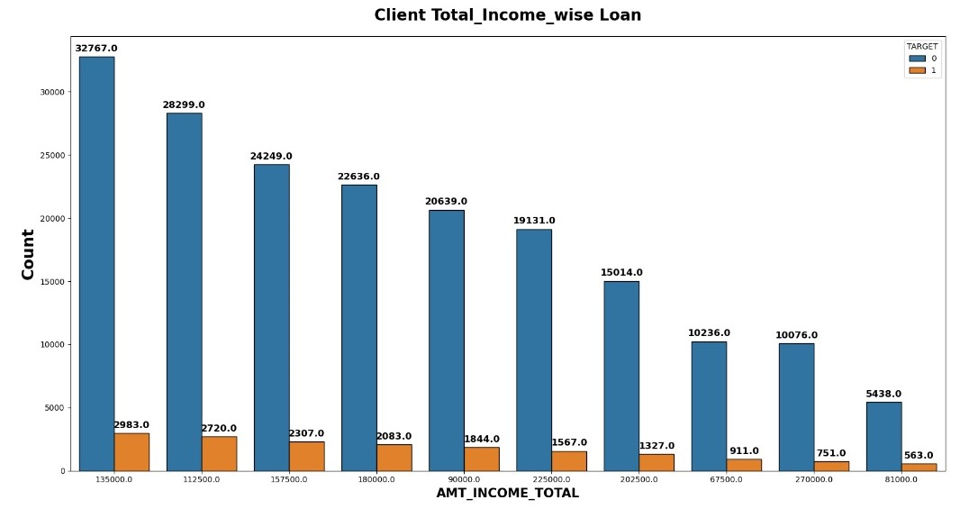

Slide 22
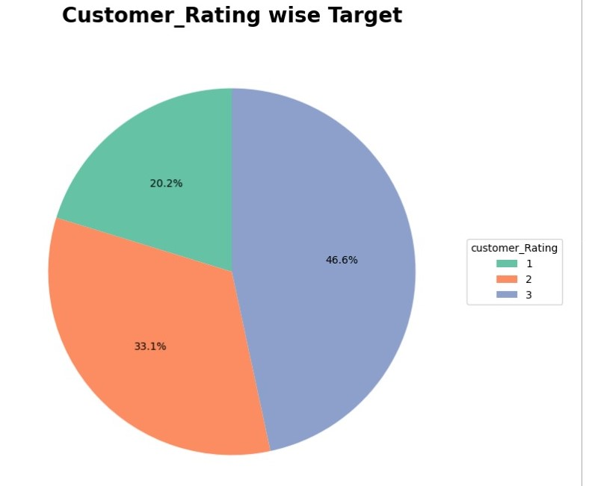

Slide 23
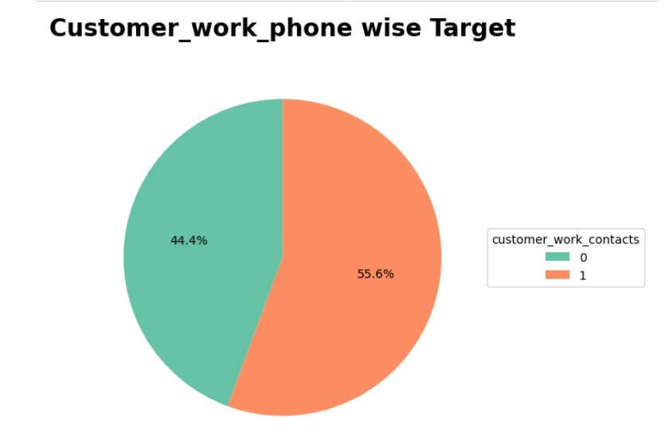

Slide 24
Conclusion:
our project represents a significant step forward in leveraging data-driven approaches to address challenges in the lending industry. By harnessing the power of predictive analytics, we are empowering lending institutions to make informed decisions, mitigate risks, and drive positive outcomes for clients and stakeholders alike.

