Slide 1
PowerShell
Introduction
Day 1

Slide 2
Target Audience
Programmers

Slide 3
Goal
Commandlets
Variables
Pipelining
Loops and conditions
Functions
Exception handling
Regular expressions
Introduction to WMI
Sample scripts
Real-time scenarios (like case study)

Slide 4
01.introduction
A “powerful” App to solve problems.
Scripting environment
Command Line Shell
Engine/Enviroment Brings .NET framework to execute command or write scripts
Improves Management
Automation
Security
Notes:
To empower you.

Slide 5
History – Administrators to Developers
V3
(Workflows)
V2
(Remote capabilities)
V1
(Administrative Automation)
V5
V4
Class development
DSC
Notes:
Save-Help new feature in V4

Slide 6
installation
PowerShell V3 – Windows 8 and Server 2012
PowerShell V2 – Windows 7 and Server 2008
Download the Windows Management Framework 3.0 at
http://www.microsoft.com/en-us/download/details.aspx?id=34595
Windows XP and Server 2003 can run V2

Slide 7
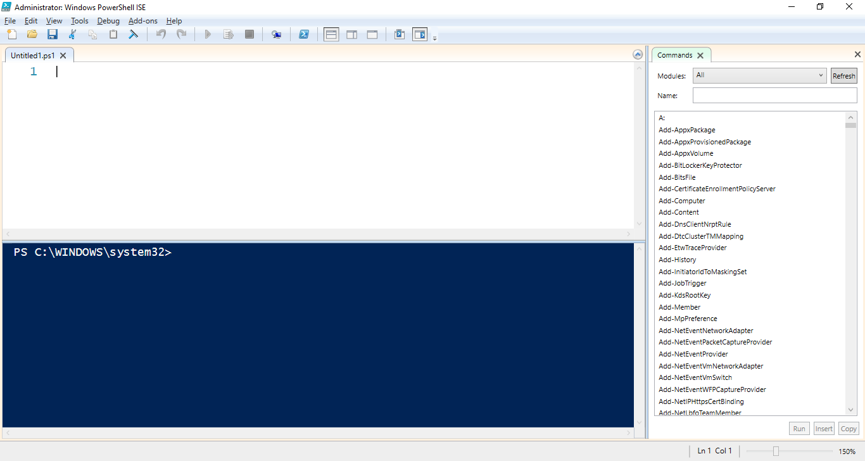
ISE
Script Pane
Command Pane

Slide 8
First hello world
“Hello World”
2+1 > out.txt
23 >> out.txt
4GB / 720MB
Script Automation(*.ps1)
Up Arrow – To get previous command without typing
Tab – To complete command without typing
Q or Cntrl + ‘C’ to quit command execution

Slide 9
System command
Get-Command – Mother of All commandlets
Of format Verb-Noun
Get-Command *<>*
Cls,Dir,Notepad,Exit/quit,Copy-Item,New-Item
Test-Path;
Get-Help(Alias help)[Update]
Get-Verb
Ampersand executes a command
&("note"+"pad")
$name = Read-Host 'What is your username?‘
Notes:
Get-Process | Get-Member –Name WaitForExit
Get-Date

Slide 10
Providers
Lets you access the data
Example , FileSystem provider of all files and folders on your hard drive.
Example, Registery provider for Registry keys
Get-PSPRovider
Set-Location cert:\
Get-ChildItem

Slide 11
GAME TIME
Choose a paper from the box and run the command.

Slide 12
Variables
Store data during the session.Not case sensitive.
Automatic variable: $HOME[Keyword variables]
Environment variables outside session
Dir env:
Always starts with “$” dollar symbol
$a=10;$b=20
${A,’}- Special character in curly braces
Multiple Assignment
$a=$b=$c=1
Results of command can be stored and passed to another command
$sum = $a+$b
$result= Get-ChildItem “d:\”
Wildcard : dir variable:a*
"Result = $(2+2)"

Slide 13
Variables-arrays
A variable that holds > 1 value.Use comma “,”
$ipconfig –is [array]
Create Array
$a=1,2,3;$b=1..5;$mixed=“a”,1,2,(Get-Date)
$a=@();$a=,1
$a[0]; $mixed[1,3]
[int[]]$array = 1,2,3
Add Elements
$a+=5
Hash Table[Key value Pairs]
$FruitsColorPair=@{Orange="Orange";Apple="Red"}
$FruitsColorPair["Orange"]

Slide 14
Variables-enum,structures
Enum – Variable to have constants
$now=Get-Date;$now.DayOfWeek; ($Now.DayOfWeek).GetType()
$dow = [System.DayOfWeek]::Friday
Enum Coordinates { X = 0; Y = 1; Z = 2; } [Coordinates]::X.value__
Add-Type -TypeDefinition "public struct XY{public int x;public int y;}" $xy=New-Object XY;$xy.x=1; $xy.y=1;$xy
Notes:
Add-Type -TypeDefinition "public enum Color{Red,Green,Blue}"
Add-Type -TypeDefinition "public struct XY{public int x;public int y;}"
$xy=New-Object XY;$xy.x=1; $xy.y=1;$xy
[System.Enum]::GetNames( [System.DayOfWeek] )
[System.enum]::GetValues('system.ConsoleCOlor')

Slide 15
GAME TIME
True/False

Slide 16
Pipelining
One command sends result to next command
Dir|sort length|select * (or) Format-List
dir -Path C:\demoPowershell| select Length,@{n='LengthGB';e={$_.Length/ 1GB}}
By Value
<Command>|gm
Get-process notepad| gm
Look at receiving Command help file.Do the parameter have pipeline Input
Get-help dir –full
Get-Process -Name Calculator | dir
By Property
dir -Path (Get-Process -Name Calculator).Path
Get-Process -Name notepad | Get-ChildItem -Path {$_.Path}

Slide 17
Pipelining
Where
Dir | ?{$_.length -gt 100}
Select/Sort/Measure
Get-Process –Name notepad | select Name,@{name="ProcessDate";expression={Get-Date}}
Get-Date | select Date,@{name="Day";expression={$_.DayOfWeek}}
Format
Get-Process | Format-List
Get-Process | Format-Table
Get-Process | Format-Wide
Get-Process | Format-Custom

Slide 18
Loops and Conditions
Conditions
If else
if ($x -gt $y){<code here>}
Switch
switch ($x)
{
'value1' {}
{$_ -in 'A','B','C'} {}
'value3' {}
Default {}
}
Iterations
For while and for each
$i=0;for (;$i -lt 5;) { $i++; $i}
$i=10;while ($i –lt 15) { $i++; $i}
[System.DayOfWeek]$DOW=[System.DayOfWeek]::Monday switch ($DOW) { "Sunday" {"It's Sunday"; continue } "Monday" {"It's Monday"; continue } "Tuesday" {"It's Tuesday"; continue } "Wednesday" {"It's Wednesday"; continue } "Thursday" {"It's Thursday"; continue } "Friday" {"It's Friday"; continue } "Saturday" {"It's Saturday"; continue } }

Slide 19
Game time
Write a code to display A-Z using switch case.

Slide 20
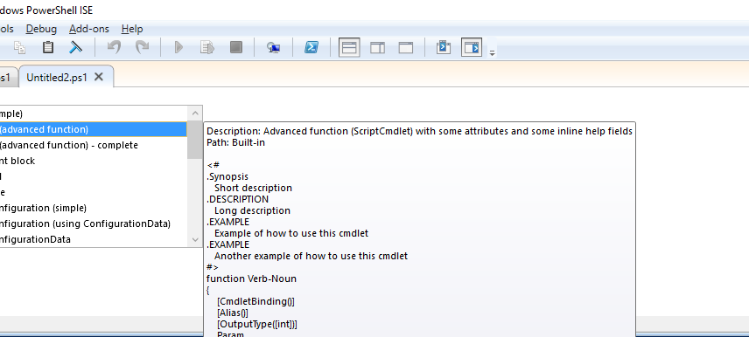
functions
Cntrl+J and Cmdlet(simple)

Slide 21
Functions
Self defined commands
Syntax – Function <FunctionName>{<statements>};
function DisplayABC{"abc“}
Parameters
Args - function myPing{ping $args};
Myping www.microsoft.com
Named-function addNumbers($a,$b){$a+$b};
Predefined- function addNumbers($a=10,$b=10){$a+$b};
Typed- function addNumbers([int]$a=10,[int]$b=10){$a+$b};
addNumbers 1,2
Switch - function SwitchON([switch]$a){if($a){"ON"}}
SwitchON -a

Slide 22
Functions
Function template
ISE->Cntrl+J [Advanced Function]
Functions call by value and reference
$original = 10;
Write-Host "Original Value is $original"
function CallByValue($a){$a=$a*10;$a}
CallByValue($original)
Write-Host "After call by value, Original Value is $original"
function CallByRef([REF]$a){$a.value=$a.value*10;$a}
CallByRef([REF]$original)
Write-Host "After call by reference, Original Value is $original”

Slide 23
Functions
Writing functions using DLL(Load dll)
[Reflection.Assembly]::LoadWithPartialName($customDll)
[System.Console]::WriteLine("Amazing")
Add-Type –Path “$customDll”;$a=new-object custom.type;[custom]::method()
Add-PSSnapIN “$customDll”
Built functions
Dir function:
Library functions
Get-Module -ListAvailable
Import-Module,SnapIn
System functions
Math’s and other special functions
[System.Math]::PI;

Slide 24
Game time
Create simple function with name “Speak-Text”
Parameters – goodQualities
Code Logic – The computer should speak the following content.
“ You are $goodQualities”
Example :
Speak-Text “courageuous”,”calm”,brilliant”
Output:Your hear following
“You are courageous,calm,brilliant”

Slide 25
References
Microsoft Virtual Academy
http://www.powershell.org/
https://blogs.technet.microsoft.com/heyscriptingguy/2015/08/26/new-powershell-5-feature-enumerations/
https://gallery.technet.microsoft.com/

