Slide 1
PowerShell
Advanced
Day 3

Slide 2
Target Audience
Programmers/IT Pro

Slide 3
Goal
Graphics
Workflow

Slide 4
graphics
PowerShell and User Interface or UI. This is possible with WPF
Simple WinForm WPF
$window = New-Object Windows.Window $window.Title = $window.Content = “Hello World. Check out PowerShell and WPF Together.” $window.SizeToContent = “WidthAndHeight” $null = $window.ShowDialog()
Notes:
Why? Script to the End User is annoying
[Reflection.Assembly]::LoadWithPartialName(“System.Windows.Forms”)
$windows= new-object Windows.Forms.Form
$windows.text ="ABC"
$button=new-object Windows.Forms.Button
$button.text = "Click"
$windows.Controls.Add($button)
$windows.ShowDialog()

Slide 5
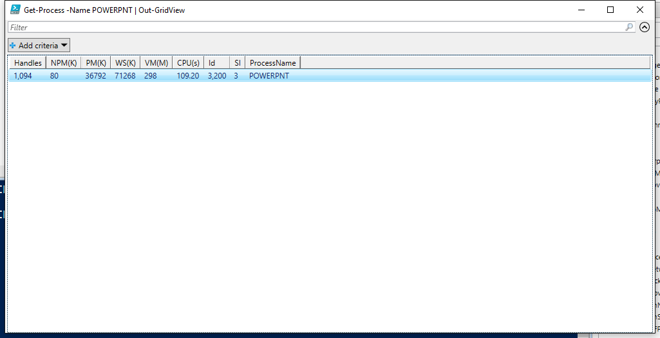
graphics
Out-GridView
Convert To HTML
Get-Process -Name POWERPNT | Out-GridView
Get-Process | select * -First 10| ConvertTo-Html -Property Name,Path -Body "Process Details"-Title "Process Details" | Set-Content htmldata.htm

Slide 6
Visual studio
New WPF Application
Add Few Controls from ToolBox
Make changes to XAML
Remove x:,X:
xmlns:d="http://schemas.microsoft.com/expression/blend/2008"
xmlns:mc="http://schemas.openxmlformats.org/markup-compatibility/2006"
xmlns:local="clr-namespace:PowerShellGUISample"
mc:Ignorable="d“
Scripts in PowerShell to LoadDialog and XAML
Notes:
xmlns:d="http://schemas.microsoft.com/expression/blend/2008"
xmlns:mc="http://schemas.openxmlformats.org/markup-compatibility/2006"
xmlns:local="clr-namespace:PowerShellGUISample"
mc:Ignorable="d"

Slide 7
workflow
Sequence of steps/activities
Declared with workflow keyword
Similar to functions running outside PowerShell in WWF
Notes:
A workflow is a sequence of programmed, connected steps that perform long-running tasks or require the coordination of multiple steps across multiple devices or managed nodes. Windows PowerShell Workflow lets IT pros and developers author sequences of multi-device management activities, or single tasks within a workflow, as workflows. By design, workflows can be long-running, repeatable, frequent, parallelizable, interruptible, stoppable, and restartable. They can be suspended and resumed; they can also continue after an unexpected interruption, such as a network outage or computer restart.

Slide 8
workflow
Function | Workflow
Executed by PowerShell | Executed by workflow engine
Logging and retry attempts through complicated coding | Logging and retry attempts part of the workflow engine
Single-action processing | Supports parallelism
Runs to completion | Can run, pause, and restart
Data loss possible during network problems | Data can persist during network problems
Full language set and syntax | Limited language set and syntax
Runs cmdlets | Runs activities

Slide 9
steps
Import-module PSWorkflow
Do-Something –AsJob
Parameters-PSComputerName,PSParameterCollection,PSCredential,PSPersist
Suspend,Resume Workflow
InlineScripts for commands like format-list
Notes:
https://blogs.technet.microsoft.com/heyscriptingguy/2012/12/26/powershell-workflows-the-basics/
Visual Studio Tip
%WINDIR%\Microsoft.NET\assembly\GAC_MSIL\Microsoft.PowerShell.Core.Activities\v4.0_3.0.0.0__31bf3856ad364e folder and double-click Microsoft.PowerShell.Core.Activities.dll
Adding Windows PowerShell Activities to the Toolbox
Create a new Workflow console application project in Visual Studio.
On the View menu, click Toolbox.
Add a new tab in the Toolbox by right-clicking inside the Toolbox and clicking Add Tab, and give the new tab a name such as “PowerShell Activities”.
Adding a tab allows you to group the PowerShell Activities separate from other tools in the Toolbox.
On the new Toolbox tab, click Choose Items…. The Choose Toolbox Items dialog appears.
In the Choose Toolbox Items dialog, click the System.Activities tab.
Click Browse.
Navigate to the %WINDIR%\Microsoft.NET\assembly\GAC_MSIL\Microsoft.PowerShell.Core.Activities\v4.0_3.0.0.0__31bf3856ad364e folder and double-click Microsoft.PowerShell.Core.Activities.dll.
Click OK. The activities defined by the Microsoft.PowerShell.Core.Activities assembly are now available in the toolbox.

Slide 10
Parallel workflow
Workflow Test-Workflow { "This will run first" parallel { "Command 1" "Command 2" sequence { "Command A" "Command B" } } }
Notes:
Workflow Test-Workflow {
Foreach –parallel ($computer in $computerName) {
Do-Something –computerName $computer
}
}

Slide 11
Game time
A simple workflow to send Greeting to your friend.
Create a simple WPF application to display your name in a label on click of a button
Do the same in PowerShell

Slide 12
References
Microsoft Virtual Academy
http://www.powershell.org/
PowerShell Gallery
http://www.powershellmagazine.com/2012/11/14/powershell-workflows/

