Slide 1
PowerShell
Advanced Scripting
Day 5

Slide 2
Target Audience
Programmers/IT Pro

Slide 3
Goal
Advanced Scripting
Become a toolmaker,not just solve problem
Turning codes to tools for others to use.

Slide 4
External system admin
PowerShell is used to administer many Server Products of Microsoft like SharePoint,SQL,Active Directory
Steps
Load the external module

Slide 5
Sharepoint
Load the snapin
Call the SharePoint Commandlets
Add-PSSnapIn “Microsoft.SharePoint.PowerShell” Get-Command –Verb Get –Noun “sp*” Get-SPWebApplication

Slide 6
sql
Import-Module sqlps
Invoke-SQlCmd –ServerInstance Server1 –Database TestDB –Query “select GetDate()”

Slide 7
Active directory
Get-Module –ListAvailable
Import-Module ActiveDirectory
Get-Command “*AD*”
Get-ADDomain
Get-ADUSer “garthf”
-Filter {Surname “hess”}
New-ADUSer –Name
Notes:
https://technet.microsoft.com/en-us/library/ee617195.aspx
http://www.tomsitpro.com/articles/powershell-active-directory-cmdlets,2-801.html

Slide 8
01.dsc[Desired state config)
Why
Plug and Play –for PowerShell
Automate- Repeat stuff
Taking control of your environment.
Heterogeneous-
Not only Microsoft. Anybody can manage Microsoft/Linx/Cloud using Standard Based Management
Any product print to a printer [Story]
Notes:
Windows success because processor/word could print to any printer. Platform Independence.

Slide 9
01.dsc[Desired state config)
What
Declarative scripting
PowerShell 4 and Windows Server 2012 R2
Manage and deploy software services
Examples-Deploy new software,IIS website,running PowerShell Scripts,manage groups and user accounts
Consistent and standardized configuration
Requirements
PowerShell
WMF
Remoting On
Notes:
Windows success because processor/word could print to any printer.Platform Independence.

Slide 10
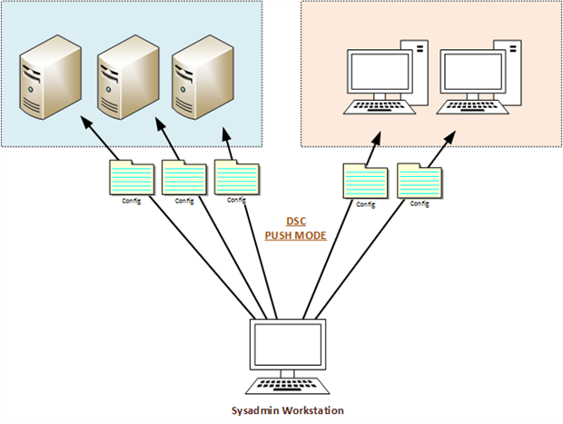
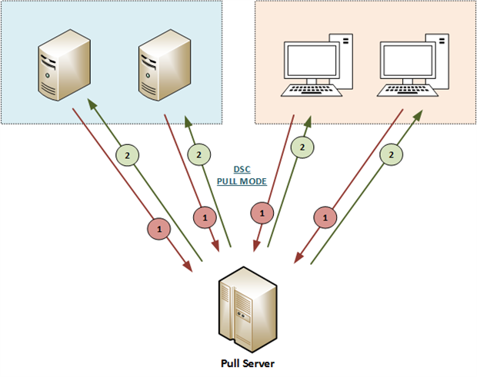
PUSH/PULL
Notes:
File: Manages files and folders on a node
Archive: Decompresses an archive in the .zip format
Environment: Manages system environment variables.
Log: Writes a message in the DSC event log
Package: installs or removing a package
Registry: Manages registry key of a node (except HKEY Users)
Script: Executes several PowerShell commands on a node
Service: Manages Windows services (State, Startup Type)
User: Manages local users on a node
WindowsFeature: Adds or removes a role/feature on a node
WindowsOptionalFeature: Adds or removes an optional role/feature
WindowsProcess: Manages a Windows process
WaitForAll / WaitForAny / WaitForSome: Available with PowerShell WMF 5 Production Preview. Cross-computer synchronisation allows us to use the dependency between machines during the deployment of their configuration. When there is a change in the status of a resource, another machine may be able to execute its configuration.

Slide 11
resource
Get-DscResource
Example: File: Manages files and folders on a node
Notes:
File: Manages files and folders on a node
Archive: Decompresses an archive in the .zip format
Environment: Manages system environment variables.
Log: Writes a message in the DSC event log
Package: installs or removing a package
Registry: Manages registry key of a node (except HKEY Users)
Script: Executes several PowerShell commands on a node
Service: Manages Windows services (State, Startup Type)
User: Manages local users on a node
WindowsFeature: Adds or removes a role/feature on a node
WindowsOptionalFeature: Adds or removes an optional role/feature
WindowsProcess: Manages a Windows process
WaitForAll / WaitForAny / WaitForSome: Available with PowerShell WMF 5 Production Preview. Cross-computer synchronisation allows us to use the dependency between machines during the deployment of their configuration. When there is a change in the status of a resource, another machine may be able to execute its configuration.

Slide 12
parts
Configuration ConfigName # PART1 { param( # PART2 [Parameter(Mandatory=$true)] ) Node $Servers # PART3 { File ResName # PART4 { ... # PART5 } } Node $Servers # PART3 bis { WindowsFeature ResName2 # PART4 bis { ... # PART5 bis } } }
Notes:
Part 1: the key word “Configuration” is followed by the name of the configuration. You are free to write what you wish.
Part 2: This block contains the parameters that are used in the configuration
Part 3: The block node indicates to DSC to deploy this configuration on these machines
Part 4: It is the resource that you want to configure. Here, I point to the resource “File” and “WindowsFeature” followed by a friendly name.
Part 5: Contains properties of the resource as “key=value” pairs

Slide 13
Example
# Define a configuration Configuration ABCConfig { Node localhost { File TestFile { Ensure = "Present" DestinationPath = "C:\demo\DSC\source\abc.txt" Contents = "ABC" } } } # Apply configuration ABCConfig Start-DscConfiguration -Wait -Verbose -Path .\ABCConfig

Slide 14
demo
Configuration Test
{
GetScript={@{}}
TestScript={@{}}
SetScript={Write-Verbose “Good”}
}
Test
Start-DscConfiguration
Resources
Get-Test-Set
Configuration
Notes:
Import-Module PowerShellGet –Verbose
Find-Module –Name xDscResourceDesigner[Install-Module]

Slide 15
Properties
Define Property
$msgProp = New-xDscResourceProperty –Name msg –Type String –Attribute Key
Define Resource
New-xDSCResource –ModuleName SayResource –Name SayResource –Property $msgProp –Path ‘c:\Program Files\Windows PowerShell\Modules\SayResource\DSCResources

Slide 16
steps
Write config script
What-Decide the elements
How – To configure
Get MOF
Get MOF
Distribute MOF to machines
Push-manual file copy
Pull-Automatic

Slide 17
dsc
Get/Find DscResource
X=> Experiemental[Gets Feedback and may require change]
C=> Community Resources
Start-DscConfiguration
Test-DscConfiguration

Slide 18
Best practices & tips
Comment #.(Use Cntrl+J).#requires
User Confirm or WhatIf if not sure of a command
Remove-Item c:\demo\abc.ppt –Confirm
Remove-Item c:\demo\abc.ppt –WhatIf
Set-ExecutionPolicy –Scope User –ExecutionPolicy AllSigned
Write-Warning,Write-Verbose,Write-Debug,Write-Error for logging
No alias. Use Full Name for Cmdlets.
Write-Output better than Write-Host
Test in test environment before release.

Slide 19
References
Microsoft Virtual Academy
http://www.powershell.org/
PowerShell Gallery
http://www.powershellmagazine.com/2012/11/14/powershell-workflows/
https://www.pluralsight.com/courses/powershell-desired-state-configuration-fundamentals
https://www.simple-talk.com/sysadmin/powershell/powershell-desired-state-configuration-the-basics/
https://blogs.technet.microsoft.com/pstips/2014/06/17/powershell-scripting-best-practices/

