Slide 1
SharePoint
SEARCH

Slide 2
goal
To discuss Search feature of SharePoint

Slide 3

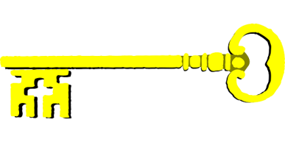


Real life example
I forgot book @home
Source Of Lost Item
Keyword=?
?
SharePoint ? Service
Notes:
What is Search?
What are you searching for ?
What tools do you use for SEARCH
Students possible answers: Find something lost,Information,Internet

Slide 4
Real life example
I forgot book @home
Source Of Lost Item
Keyword=Book
Content Sources
SharePoint Search Service
Database
Content Source
Index
Notes:
What is Search?
What are you searching for ?
What tools do you use for SEARCH
Students possible answers: Find something lost,Information,Internet

Slide 5
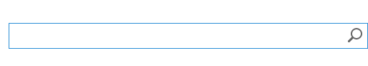
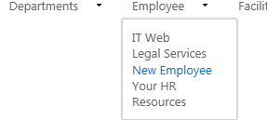
Type of search
Keyword
Navigation/Tree(Top Navigation)
Right IN FRONT
Notes:
Keyword – You do not know where the data is.
Navigation Tree – Data is well organized and easy for your notice
Right in Front – Minimal Search effort. Single click.

Slide 6
Sharepoint search ARCHITECTURE
Analytics
SharePoint
Client App
Search Page
CRAWL
Mails
INDEX
Query/
Search
CRAWL
DB
External...
Link
Content Source(S)
Notes:
New Continuous Crawl in SharePoint 2013
New Analytics and Link database in SharePoint 2013

Slide 7
Content sources
Example:SharePoint sites or external
Defined in Central Administration
Application Management -> Manage Service Application -> Search Service Application
Full Crawl, Incremental(only new items) or Continous crawl(new in 2013)
Crawl Rules- Example : Rules to exclude items of search from a path.
Notes:
Demo Crawl

Slide 8
Search page
An end user can type the keyword to be searched in the Search page
Go to the site Home page and Click “Search” type a word to Search
Observe the Results
What are the groupings you see?
What are some cool features you like?
Thumbnail and Previews
Sort
Search Page can be modified to show “Advanced” search options
Search with better rules like “Author contains”
Notes:
Demo
If no results are found, a suggestion is provided , “Did you mean” ..
Top Groups – Everything, People,Community,Video
Filter options – Author, Content Type, Size

Slide 9
Result sources
The results of a search stored in Result Source
Example Docs,
Defined at Site Collection not Central Admin
Naming changed from “search scope” of previous version.
Query Rule - A rule to show frequently used content than the actual keyword search
Best Bets – replaced by promoted results
Manages Meta Data
Notes:
Demo
Query Rule

Slide 10
no more ifilters
Replaced by Parsers and Format Handlers
Parsers - Finding the type of document based on content.
Format Handlers - Extracting metadata like Deep Links,Visual Metadata(˘Title,Author...)

Slide 11
CPES and MANAGED PROPERTIES
ContentProcessing Enrichment Service
Properties => Microsoft,MSFT, Microsoft Corporation referring to the same property.
SETTINGS->SEARCH SCHEMA
Searchable=>Training
Queryable -> Title:Training
Retrievale -> In Search Results
Refinable -> Viewed in Refiner Section

Slide 12
NEW FEATURES
Fast Search now part of SharePoint 2013
NEW Content Search Web Part,Refinement webpart
No need to know XSL,XSLT needed on Search results webpart in 2010
New Hover feature
Result Block
PPT1 ppt1 pp3
.. ...
Notes:
Can remove items only using crawl logs and not Search Result Removal

Slide 13
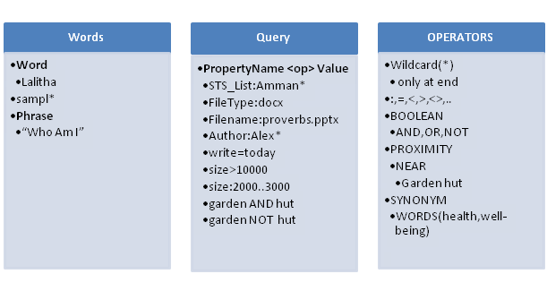

Slide 14
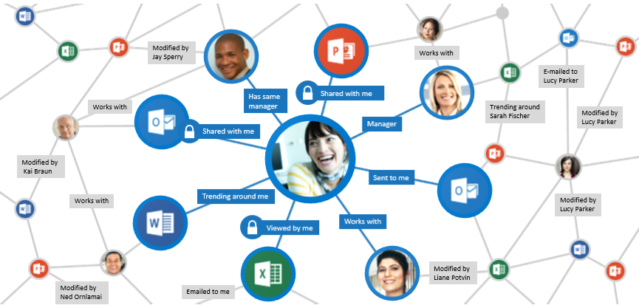
DELVE

Slide 15
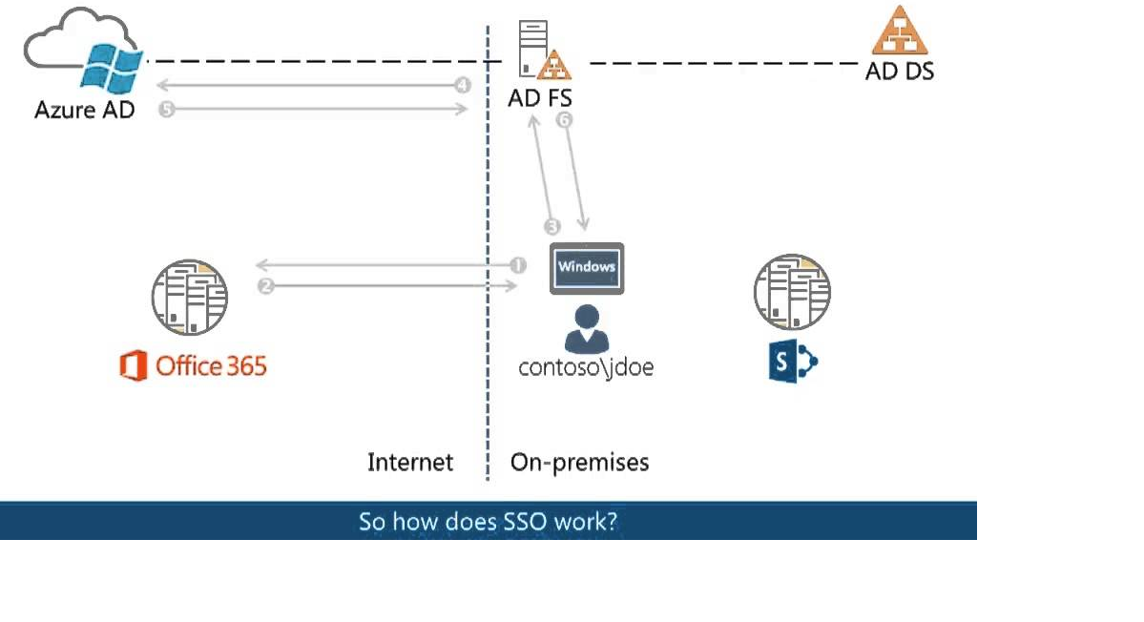
hybrid

Slide 16
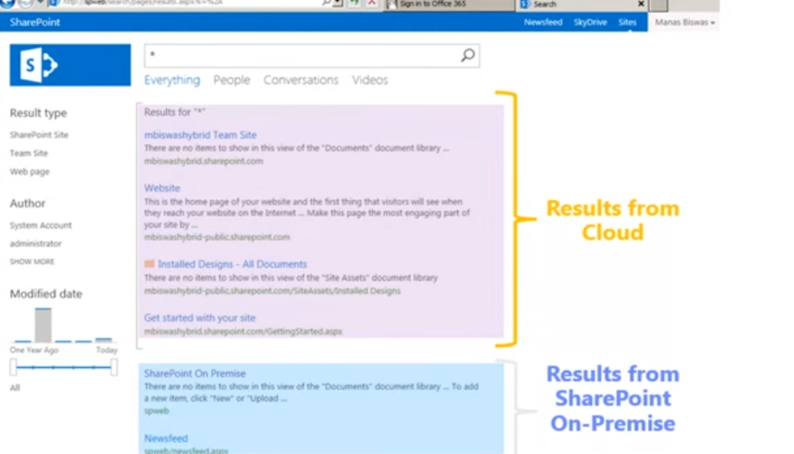
Federated Search

Slide 17
References
https://msdn.microsoft.com/en-us/library/office/dn833469.aspx
https://technet.microsoft.com/en-us/virtuallabs

