Slide 1
SharePoint

Slide 2
CHECKLIST
Audio
Can you all hear me?
Video
Can you see the screen?
Free to enter or leave the classroom anytime without permission

Slide 3
ABOUT YOURSELF
LOCATION
EXPERIENCE -
ROLE- DEVELOPER, ADMINISTRATOR, BUSINESS ANALYST,ARCHITECT...
TECHNICAL SKILLS - .NET,C#,SQL,MICROSOFT OFFICE
EXPERIENCE IN SHAREPOINT -
WHICH VERIONS OF SHAREPOINT?
2001,2007,2010,2013,2016,Online
EXPECTATION FROM COURSE -
DO YOU HAVE SHAREPOINT SETUP READY?
Have time for doing Hands On /Assignment?

Slide 4

ABOUT ME
MOSS 2007[2007]
SharePoint 2010
SharePoint 2013(Online)
SharePoint 2016
Thangeswari
Alias:Thangu
Lover,Learner,Trainer of Microsoft technologies like SharePoint and PowerShell
Corporate Trainer cum Consultant and Speaker in International tech conferences
Playing with Microsoft technologies since 1995 as a kid and Microsoft technologies is bread and butter for me since 2006.
Hobbies - Watching cartoon and out of box well made movies and admiring nature.
Blog:https://www.blogger.com/profile/17880351325996067507

Slide 5

Goal
The goal is to give you more Power, more confidence and skilled in SharePoint.
Advanced features
Get more wealthy and healthy.Get the 6 hour work done in 2 hours with skills and live your life.
Guidelines to avoid mistakes

Slide 6
introduction
SINGLE SECURE POINT TO STORE,SHARE,SEARCH DATA
SharePoint is a wonderful platform
from Microsoft providing lots of
services. With least effort.
Quick site/web creation[CLICK AND DONE]
Content Organisation(Google Drive/Office Drive/File Share)
Social Networking (Facebooking)
Search(Google)
Automate the manual big process.(Like Long Queues?)

Slide 7
why
Millions of users for SharePoint(INCLUDING YOU SOON), need for SharePoint Developers, Admins.
Search better than Google Search
Independence using App Model
You might need a SharePoint site for your personal use!
Notes:
Common Problems
You have content.
Can you view the content outside Office?
Is your data backed up?
Can you find your data easily?
Do you have multiple copies of file in different places?
Is security a concern?
Are you tired of developing complex .NET projects?

Slide 8
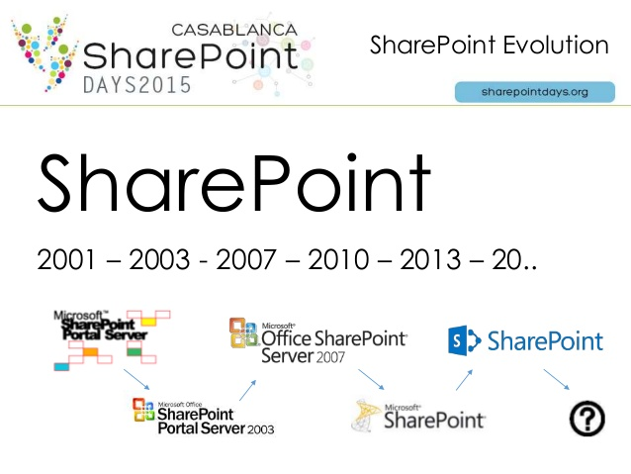
History(15 years)(JEFF TEPER 1998)
Notes:
2001- SharePoint Portal Server
2003- SharePoint Portal Server 2003
2007- Windows SharePoint Services and MOSS 2007
2010 - SharePoint Foundation 2010 and SHarePoint Server 2010

Slide 9
infrastructure
SharePoint Online(Cloud)
SharePoint Server
(Standard and Enterprise)
SharePoint Foundation
.NET Framework and ASP.NET
IIS
Windows Server
Notes:
Mostly a Free Foundation Server
Another Software on top of free server providing services which is charged
For example, walking on the road is not charged. As you use more and more services, the charges are more.Example, using car is similar to SharePoint Standard and Using an Aeroplane similar to SharePoint Enterprise.

Slide 10
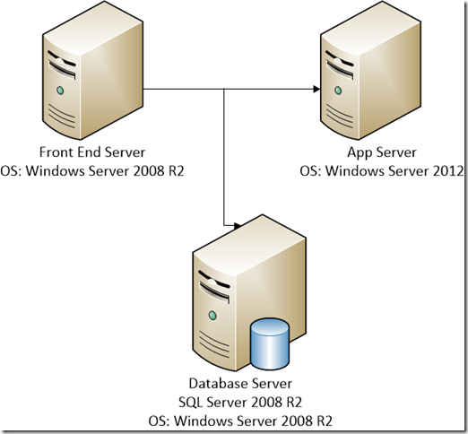
SPFarm
SPService
SPWeb Application
SPSiteCollection
SPSite/SPWEb
SpList
SPFarm
Site Columns,Content Types
Site Template Site definition
Groups and Permission
Application Pages Site Pages
Notes:
The building block of SharePoint is List which is nothing but data in a tabular form with columns and values.

Slide 11
WHAT HAPPENS WHEN YOU REQUEST A SP SITE?
https://xxx.sharepoint.com
Request sent to IP address of server
Request passed to IIS
Request passed to Application pool(Reserved memory space)
Request processed by w3wp process.

Slide 12
roles
SP Users
SP Administrator
SP Developer
The users using the SharePoint website
Administer SharePoint environment
A coder developing custom solutions

Slide 13
INSTALLATION
MICROSOFT TO THE RESCUE(free and risk free)
TechNet Virtual Labs
https://technet.microsoft.com/en-us/virtuallabs
Search for “SharePoint”
Office 365
Office 365
Testing new SharePoint Online Office 365 Account - https://products.office.com/en-us/business/office-365-business-premium
Click Free Trail

Slide 14
COMPARISION
On Premise | Online
Admins take care of instllation. | Microsoft takes control
Exprensive.
Full Features
Effort needed to install | Quick
SharePoint Online

Slide 15
onpremise
8-32 gm ram
Hyperv VMWare
Prerequisites of SharePoint
SQL Server
Visual Studio
Office Developer

Slide 16
SUMMARY
Getting Ready
Installation
SharePoint Introduction

Slide 17
resources
https://technet.microsoft.com/fr-fr/library/jj984298.aspx
https://mva.microsoft.com/
https://www.blogger.com/profile/17880351325996067507

