Slide 1
SharePoint
02.Features

Slide 2
goal
To discuss the famous features of SharePoint available in all versions starting from 2001 to 2013

Slide 3
site
Site Provisioning or creating a site with single click.
SharePoint Team Site is the most famous feature.
STS#1 – Template Type

Slide 4
list
Building block of SharePoint.
Lowest level content of SharePoint.
Document Libraries are special types of Lists storing Files.
File sharing better in Sharepoint 2016 on any device.Documents come in search of you at your doorstep.You donot go in search of documents.
Title/Name | Created

Slide 5
security
Reader – Only read- Viewers
Write – Update or add – Members /Contributors
Full – Can View, Edit, Update, Create or delete, assign roles- Full Control /Owner

Slide 6
Web parts
Reusable parts now called App part
Drag the parts and place the part on the zone you want.
Chrome Type
Size

Slide 7
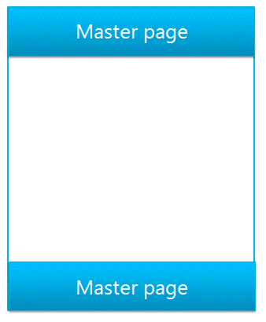
Master page
Common layout for pages.Consistance layout
Logo,Title,
V4.master;default.master;minimal.master
New feature to convert HTML to master pages.

Slide 8
workflow
Help to automate manual process requiring paperwork
Approval and Feedback Workflow

Slide 9
search
Helps to search information fast.
Notes:
Silverlight CSOM
Microsoft.SharePoint.Client.Search.Silverlight.dll %ProgramFiles%\Common Files\Microsoft Shared\web server extensions\15\TEMPLATE\LAYOUTS\ClientBin
JavaScript CSOM
SP.search.js %ProgramFiles%\Common Files\Microsoft Shared\web server extensions\15\TEMPLATE\LAYOUTS

Slide 10
references
https://msdn.microsoft.com/en-us/library/office/jj163300.aspx
Microsoft Virtual Academy

