Slide 1
SharePoint
07.App Security

Slide 2
Target audience
.NET Developer

Slide 3
why
Target content to specific audience.
Understanding App Authentication in Provider Hosted App

Slide 4
introduction
Authentication – Who can access data?
App ID
App Secret
Context Token(App Launch)
Access Token(Access SharePoint API)

Slide 5
app manifest-static(not dynamic)
<AppPermissionRequests>
<AppPermissionRequest Scope="http://sharepoint/content/sitecollection/web"
Right="FullControl" />
</AppPermissionRequests>
Two pieces of information are needed in a permissions request:
➤ Scope
➤ Right

Slide 6
app manifest-static(not dynamic)
The scope defi nes what component the permission request is for. It is not a URL although it looks
like one. These components (also referred to as a permissions provider) are from a defi ned list. They
cover various aspects of SharePoint such as sites, lists, and libraries. Some example scopes include
the following:
➤ http://sharepoint/search
➤ http://sharepoint/content/sitecollection/web
➤ http://sharepoint/content/sitecollection/web/list
➤ http://sharepoint/projectserver
➤ http://sharepoint/social/microfeed
➤ http://sharepoint/taxonomy

Slide 7
dynamic
TokenHelper.GetAuthorizationUrl(sharePointSiteUrl.ToString(),
"Web.Read List.Write",
"https://myapp.com/RedirectAccept.aspx"));

Slide 8
User information list
http://[sitecol]/_catalogs/users/simple.aspx
Login names and display names of list
Access to site collection administrators.
Updated through Active Directory/manually through User Profile Synchronization.
On Premises – updated every night
Online – Only on weekends Saturdays.
SPSecurity.RunWithElevatedPrivileges- Escalate the privilege. SPSecurity.RunWithElevatedPrivileges(delegate{ // Code runs as the SHAREPOINT\SYSTEM user});

Slide 9
policy
User
App+User
App only
User needs access to the list
If User does not have access to list, no access
Similar to Elevated Priveliges

Slide 10
CODE
//Server-Side Object Model
SPUser currentUser = SPContext.Current.Web.CurrentUser;
//JavaScript Client Object Model
var ctx = new SP.ClientContext.get_current();
var user = ctx.get_web().get_currentUser();ctx.load(user);ctx.executeQueryAsync(success, failure);
//REST Interface
$.ajax({ url: _spPageContextInfo.webServerRelativeUrl + "/_api/web/currentUser", type: "GET", headers: { "accept": "application/json;odata=verbose", }});

Slide 11
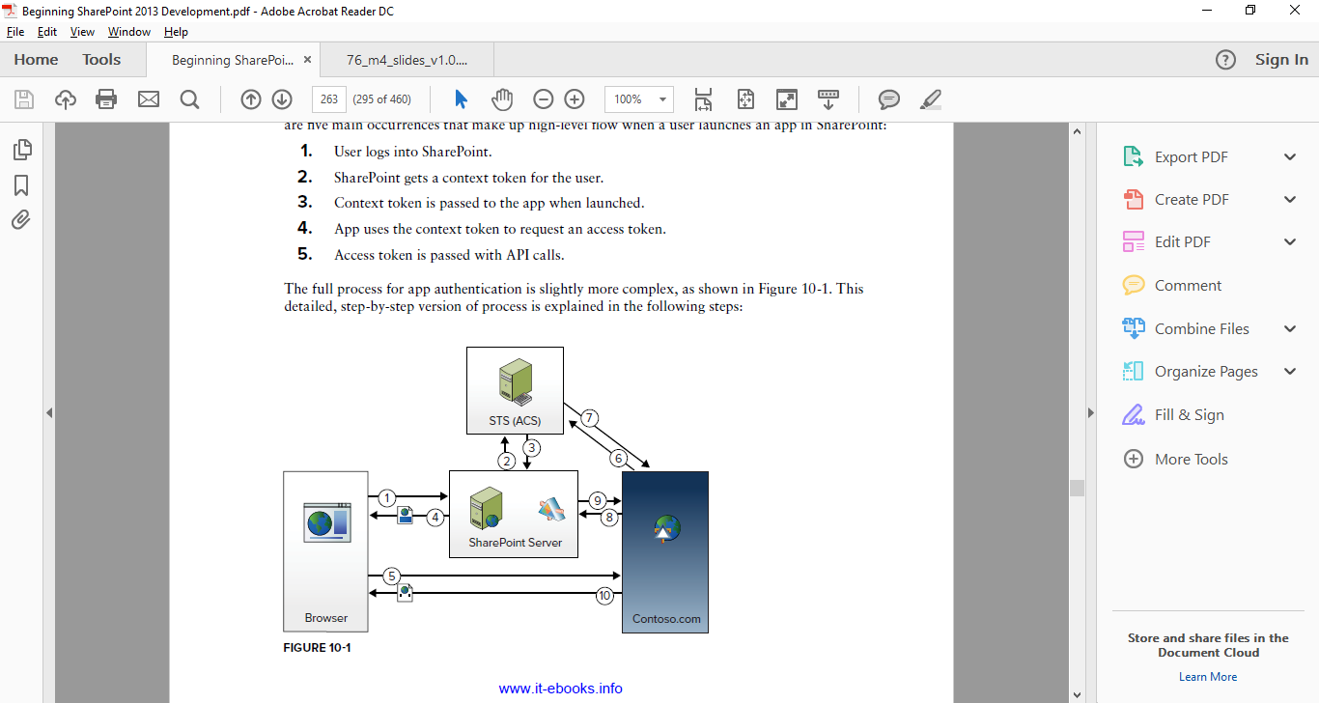
APP FLOW
1.User requests a SharePoint page with an App Part included.

Slide 12
APP FLOW
2.SharePoint requests a context token from ACS for the user, including context information about the user and a refresh token that can be used for requesting access tokens

Slide 13
APP FLOW
3.ACS returns the signed context token to SharePoint.

Slide 14
APP FLOW
4.SharePoint returns the page with an iFrame for the App Part, including the content token as
a query string parameter on the URL for the iFrame source.

Slide 15
APP FLOW
5.
The browser renders the page and iFrame, and a request to the remote app is made to render the App Part iFrame contents. The context token is passed on the URL..

Slide 16
APP FLOW
5.
6.The app code validates the content token to ensure its authenticity using a shared secret that
only the app and SharePoint/ACS know. The app then uses the refresh token to request an
access token from ACS.

Slide 17
APP FLOW
5.
7.ACS returns an access token. These can be cached and used multiple times. The expiry time
is provided in the token so the app knows when to request

Slide 18
APP FLOW
5.
8.ACS returns an access token. These can be cached and used multiple times. The expiry time
is provided in the token so the app knows when to request

Slide 19
APP FLOW
5.
9.The SharePoint API call returns the data requested

Slide 20
APP FLOW
5.
10.The app renders the page content and the result is returned.

Slide 21
references
https://en.wikipedia.org/wiki/SharePoint#Intranet_.26_Corporate_Social_Network
Microsoft Virtual Academy

