Slide 1
SharePoint
06.Apps

Slide 2
goal
To discuss the Apps for SharePoint development

Slide 3
topics
Introduction
Installation
Architecture
Types
Deploy and Package
Best Practices

Slide 4
Sharepoint APP(*.app)
A FILE like winzip/cab which contains the codes,images,files to install custom Features.
Reusable codes written by developers for features not provided by SharePoint running outside the SharePoint environment.
Types-
Autohosted – Office 365
Provider – Azure/Third Party
SharePoint- Fully in SharePoint.

Slide 5
APP Contents
AppManifest.xml
AppIcon.png
App Web Solution
SharePoint Hosted Apps
WebParts,Scripts etc
Remote Web and Data
Remote Hosted Apps
Manifest.xml
WSP
Files(Images)

Slide 6
Where?
Office Store
Global Access
App Catalog
Web Application

Slide 7
installation
Office 365
Install Visual Studio
Community 2015-https://www.visualstudio.com/en-us/products/visual-studio-community-vs.aspx
Premium/Professional/Ultimate
Office Dev Tools for Visual Studio
On-Premise- Site Subscription Service
Note: If you want to learn without installing , try https://technet.microsoft.com/en-us/virtuallabs/bb467605.aspx

Slide 8
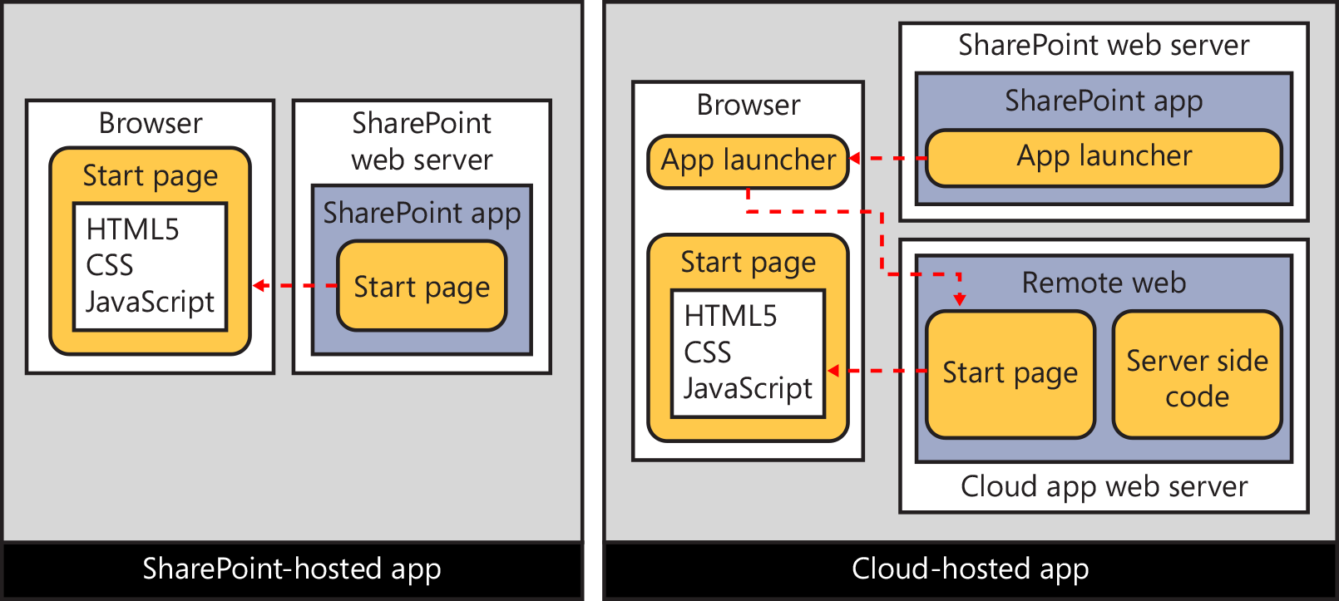
architecture

Slide 9
TYPES
SHAREPOINT HOSTED
SHAREPOINT HOSTED
CLOUD HOSTED
REMOTE WEB/PROVIDER HOSTED
AUTOHOSTED(NOW DEPRECATED)

Slide 10
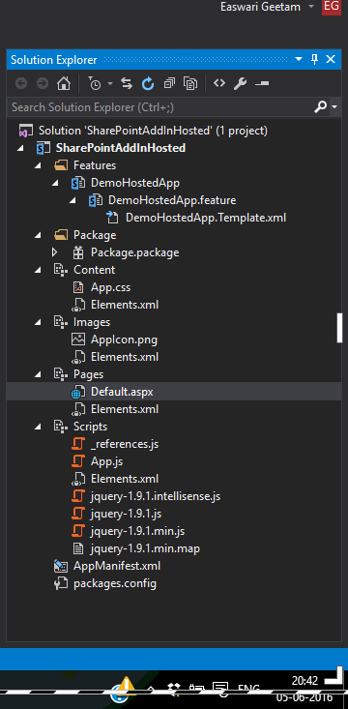
SHAREPOINT HOSTED
An App hosted in SharePoint
No Server Side coding using C#
Only JSOM or REST API calls
Similar look and feel of SharePoint

Slide 11
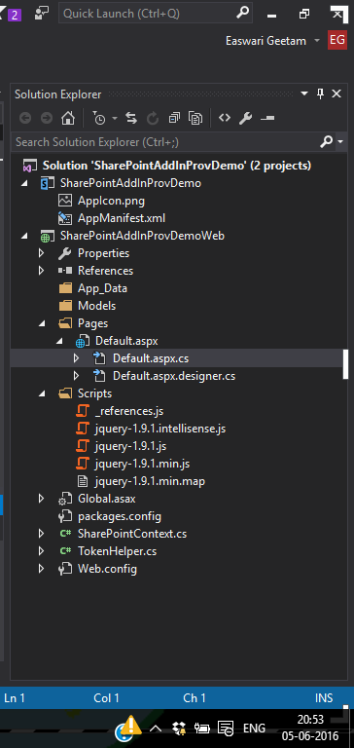
Provider/remote HOSTED
An app with business logic written in a remote host/separate server
Allows server side coding
Has two parts: SharePoint and Other Web Related

Slide 12
Deploy & Publish
Publish from Visual Studio/NAPA
ID and Secret[_appregnew.aspx]
Admin->Apps->App Catalog[Site Collection]
Apps for SharePoint
[OR]
Seller Dashboard
Notes:
http://bhanuprakashbysani.blogspot.in/2014/11/how-to-publish-provider-hosted-app-in.html-Publish Provider Hosted App

Slide 13
Publishing apps
Dashboard Seller Account
Upload apps
Title,description,category,version,logo,screenshot
Microsoft tests and approves the code.
Notes:
Scope -> Web Application or All

Slide 14
Best practices
Rename all the Project Items to meaningful names.
Example: Feature1 to SharePoint Hosted App Demo
Always check if SharePoint out of box features can fulfil your business needs, before going for any complex coding.
Do the coding DEV. Test in UAT before deploying in Production.

Slide 15
references
Microsoft Virtual Academy
Inside Microsoft SharePoint 2013 book.
https://technet.microsoft.com/en-us/library/fp161231.aspx

