Slide 1
SharePoint
07.Page Design

Slide 2
Target audience
.NET Developer

Slide 3
why
Everyday you are viewing web pages either on PC,laptop,tablet or mobile
SharePoint customisations is one of the high profile topics in the real time SharePoint implementations.

Slide 4
goal
To discuss SharePoint Customisations for designing custom web pages
Easy reading and navigation with minimum scrolling
Responsive Page Design

Slide 5
introduction
SharePoint itself provides a very good interface and mobile support.
SharePoint has two major types of page
Application pages - /layouts/.
Site Pages - SitePages/
Pages are used for presenting information
SharePoint pages are amazing. You drag and drop the parts you want and your site is ready
Built on ASP.NET – UI and Code Behind

Slide 6
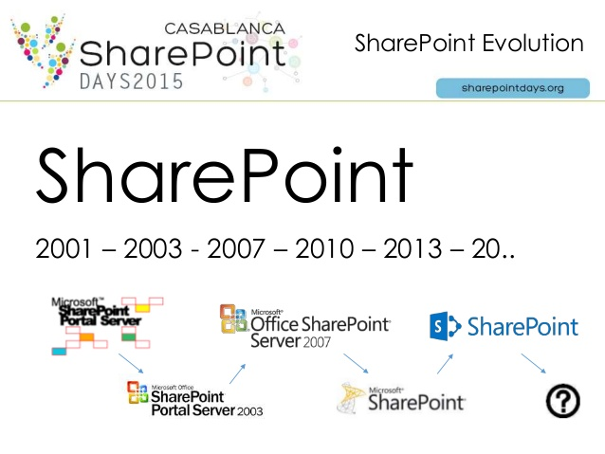
history
2003 | 2007 | 2010 | 2013
FrontPage UnGhosting problem | SharePoint Designer Safe mode | Theme from Powerpoint | Custom master page from HTML

Slide 7
gather the requirements
Design the wireframe - How will you want the page to look like?
Either draw on paper and scan
Create a wireframe using PowerPoint
Design the site in SharePoint without breaking the site using SharePoint Designer using Out Of Box features.Web Parts/App Parts. Page
Create a simple Master Page from existing SharePoint Page or from HTML.

Slide 8
discussion
Quick Launch
Top Navigation Link
App Launcher(New)
Share,Follow,Edit,Content
Search Box
Recent

Slide 9
add a page dynamically to site
Console App
// write out new page in memory stream
MemoryStream stream = new MemoryStream();
StreamWriter writer = new StreamWriter(stream);
writer.WriteLine("<html><body>");
writer.WriteLine("Hello, World");
writer.WriteLine("</body></html>");
writer.Flush();
// add new page to site
SPWeb site = SPContext.Current.Web;
site.Files.Add("hello.htm", stream);

Slide 10
Master page
Outline of Page with .master extention
Standard layout for Header, Footer and other parts reused across various pages
Content inside ContentPlaceHolderMain
Outline of Page with .master extention
Standard layout for Header, Footer and other parts reused across various pages
Content inside ContentPlaceHolderMain

Slide 11
types
Template Files –
Uncustomised or like original hair.
Only one copy of file to maintain,update in file server like master page.
Stored in file server.
Only server side or full trust solutions
No problems during migration
Unghosted page
Stored in content database =>
Customised or unghosted like giving styles to your hair.
Notes:
Application page -/_layouts/viewlsts.aspx
Reside in file path template\layouts folder in SharePoint Hive
Delegate Controls
Minimum Download Strategy
SharePoint Ribbon

Slide 12
page template
simple page template
<%@ Page MasterPageFile="~masterurl/default.master"
meta:progid="SharePoint.WebPartPage.Document" %>
<asp:Content runat="server" ContentPlaceHolderID="PlaceHolderMain">
<h3>Hello World</h3>
A simple page template used to create site pages
</asp:Content>

Slide 13
Best practices
Never use web.config for configuration settings. Instead, use SharePoint lists,property bags, custom configuration settings.
Oh my page is gone-> Open SharePoint Designer-> Reset to Site Definition

Slide 14
references
https://en.wikipedia.org/wiki/SharePoint#Intranet_.26_Corporate_Social_Network
Microsoft Virtual Academy

