Slide 1
SharePoint
Content Management

Slide 2
Target audience
.NET Developer
Power Users

Slide 3
why
Everyday you are using documents either on PC,laptop,tablet or mobile
To share / store feelings and ideas - Blogs
To share the updated news in technology or in other areas
Information has grown to a massive level and easy access to the information you need at the right time is important.

Slide 4
goal
To discuss how SharePoint helps in Document management.

Slide 5
introduction
SharePoint helps in document management
Document Library - Document storage, versioning,workflow capabilities
Managed Metada Service
Term store - Collection of commonly used terms(People,Search,System groups)
Content Type syndication - Share content type across site collections
eDiscovery - A special site for handling legal cases

Slide 6
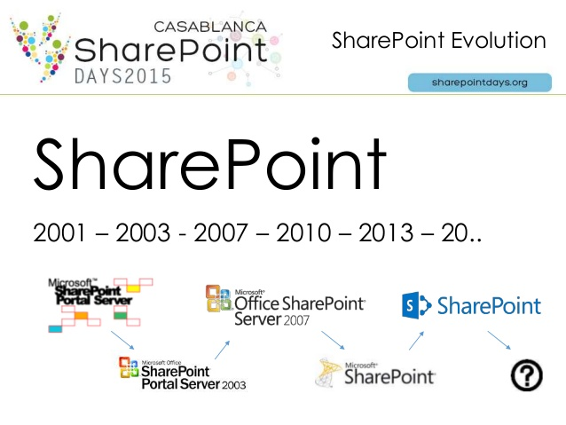
history
2003 | 2007 | 2010 | 2013
Document Library | Content Types | Managed Metadata | Site Mailbox

Slide 7
data about data
WHAT ARE THE DIFFERENT METADATA?
Site Columns
Site Content Types
Terms
Employee ID
Promotion Policy
Leave
Notes:
SITE COLUMNS,CONTENT TYPES

Slide 8
MANAGED METADATA
TERM SET
TERM GROUP(PEOPLE,SYSTEM,SEARCH)
TERM

Slide 9
concepts
Terms - Apple
Keyword
Person/People
System
Term Set - Fruits,Employee
Term Group - Food
Scope
Global
Local

Slide 10
code
GET TAXONOMY SESSION
GET TERM STORE
DO THE CRUD

Slide 11
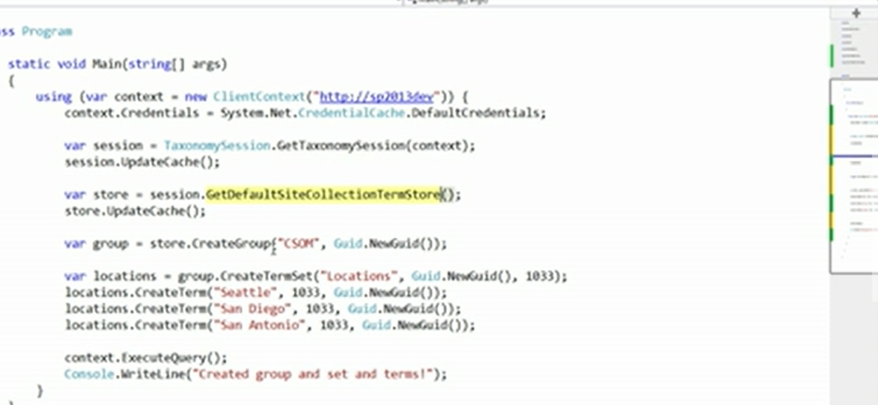
code

Slide 12
eDiscovery
Discover an preserver electronic info like email or documents from laptop,fileshare,Sharepoint.

Slide 13
references
https://en.wikipedia.org/wiki/SharePoint#Intranet_.26_Corporate_Social_Network
Microsoft Virtual Academy

