Slide 1
SharePoint
01.Basics
Quiz

Slide 2
Target audience
Software Engineer

Slide 3
what role have you played in microsoft technology?
Business Analysts
Administrator
Developer

Slide 4
list some features of sharepoint
Fantastic Search capabilities
Reporting
Site Creation
...

Slide 5
can you explain a project done on sharepoint?
Created a Site <> to fufill the business requirement in a very short span of time.
Fixed a broken page by removing the unwanted web parts
Did backup and restore of lists/site collection using stsadm/PowerShell.
Granted permission to users.

Slide 6
WHAT VERSIONS OF SHAREPOINT HAVE YOU WORKED ON?
2003
2007
2010
2013
2016
ONLINE

Slide 7
SHAREPOINT IS BUILT ON TOP OF .NET FRAMEWORK
TRUE
FALSE

Slide 8
have you completed any certification in microsoft?
TRUE
FALSE

Slide 9
what is the building block of sharepoint?
list
site
web application
farm

Slide 10
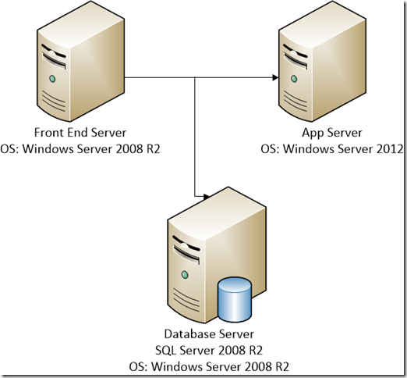
how many servers are in the farm below?

