Slide 1
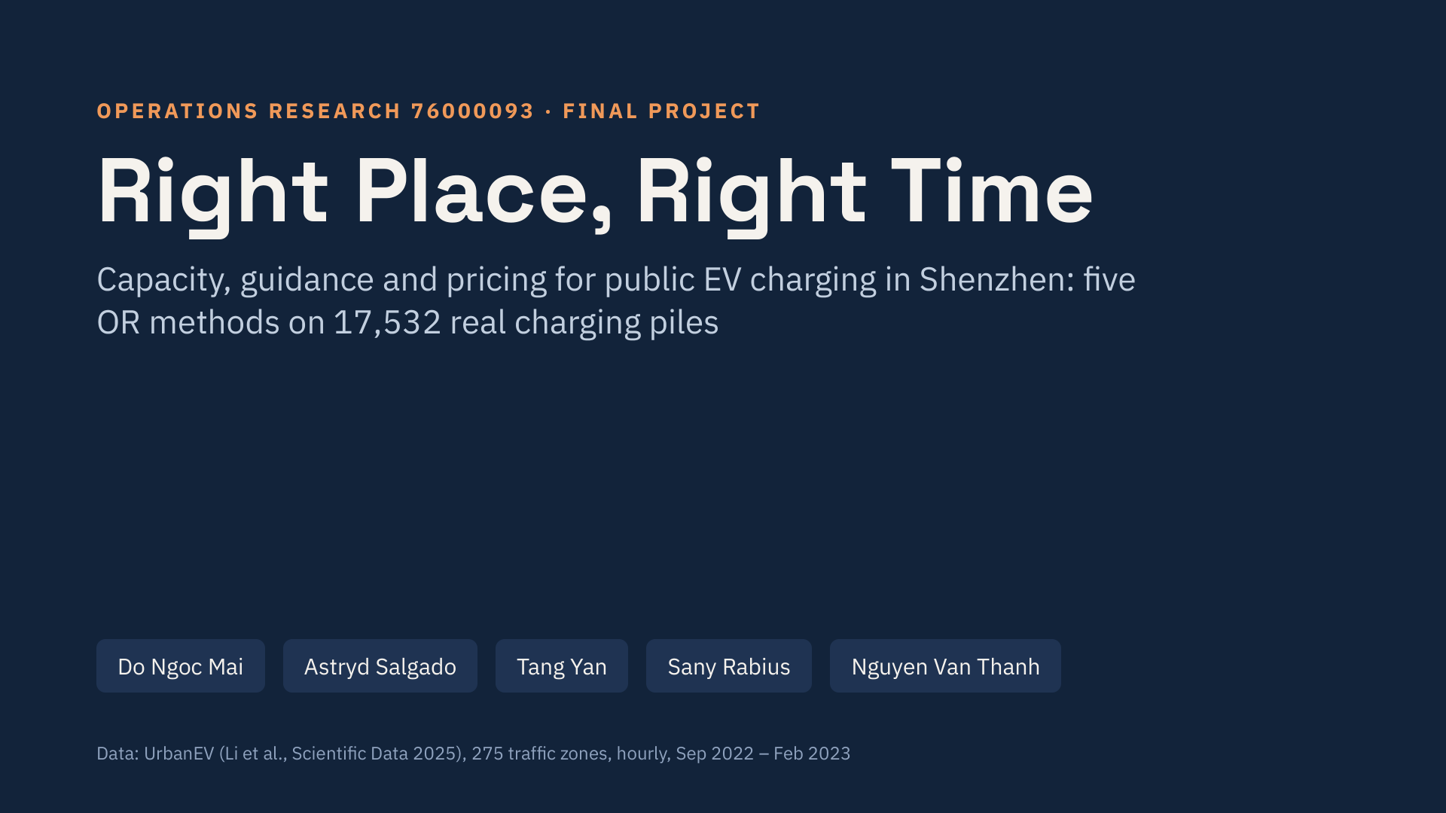
Notes:
Good morning. Our project asks whether Shenzhen's public charging network can absorb the rapid growth of electric vehicles, and how to fix it at the lowest cost. We used a real, open dataset covering every public charging pile in 275 zones of the city, and five different OR methods, one per team member.

Slide 2
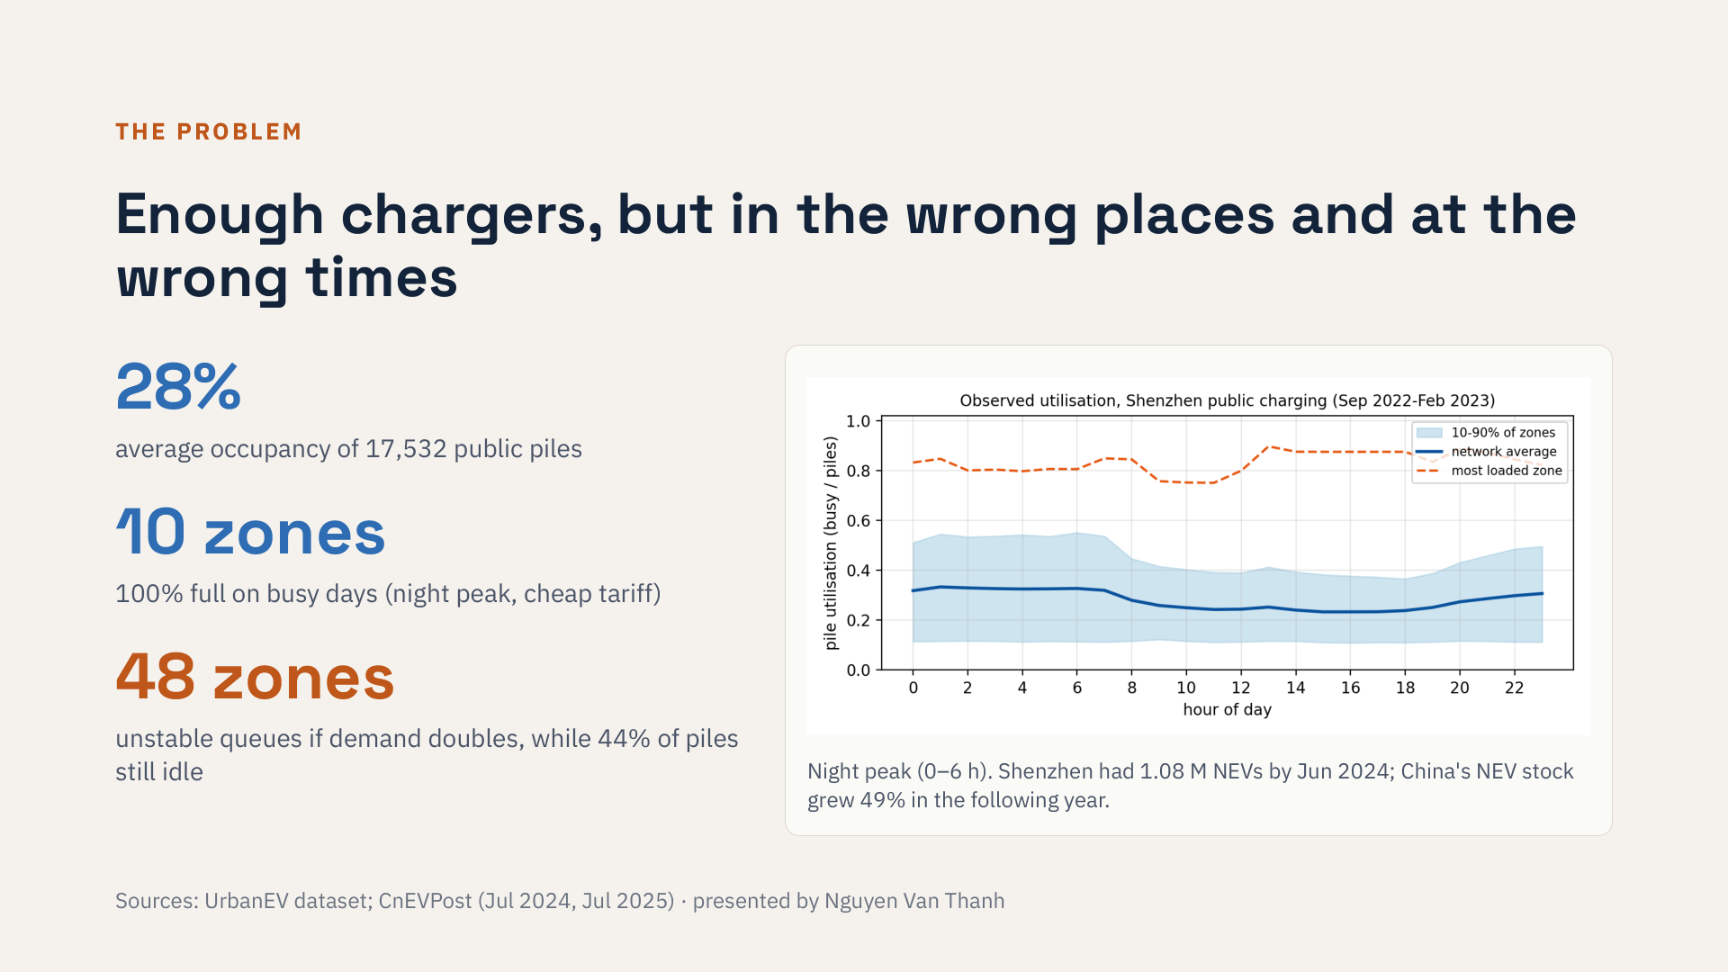
Notes:
The data show a paradox. On average only 28 percent of piles are occupied, but ten zones are completely full on busy days, mostly at night when electricity is cheap. Electric vehicles are growing fast: China's stock grew by half in one year. If charging demand doubles, 48 zones will have queues that never clear, even though almost half of all piles would still be idle. So the question is not only how many piles, but where and when.

Slide 3
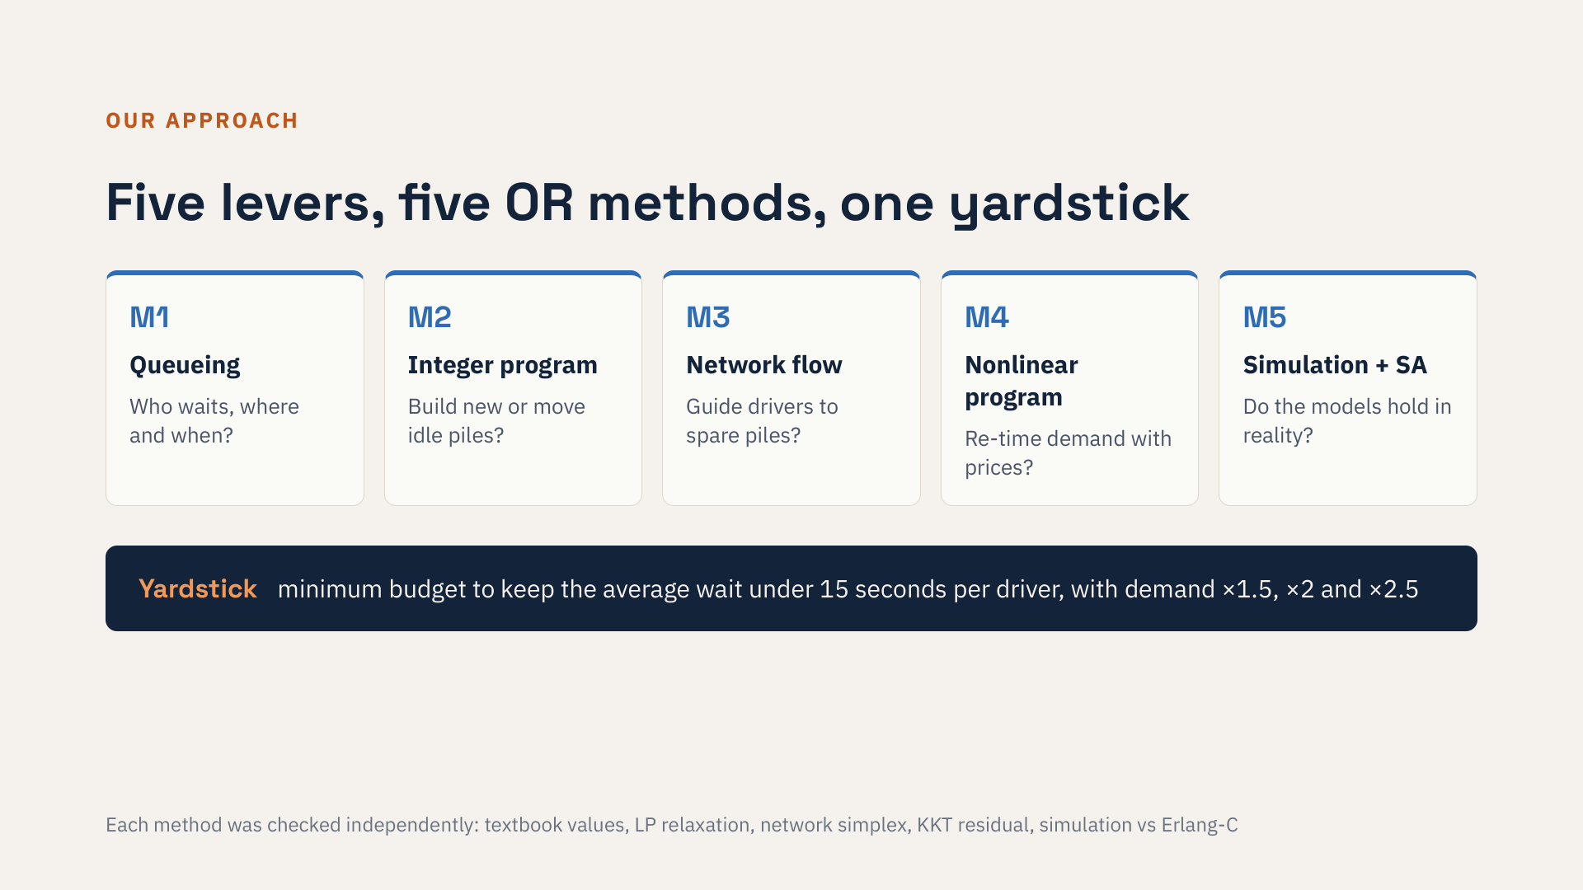
Notes:
We have four levers: new piles, moving idle piles, guiding drivers, and time-of-use prices. Each team member built one model. The queueing model measures waiting. The integer program decides where to build or move piles. The network flow model routes drivers. The nonlinear program designs prices. The simulation checks whether the analytical models hold. At the end we compare every lever on the same yardstick: the budget needed to keep the average wait under fifteen seconds.

Slide 4
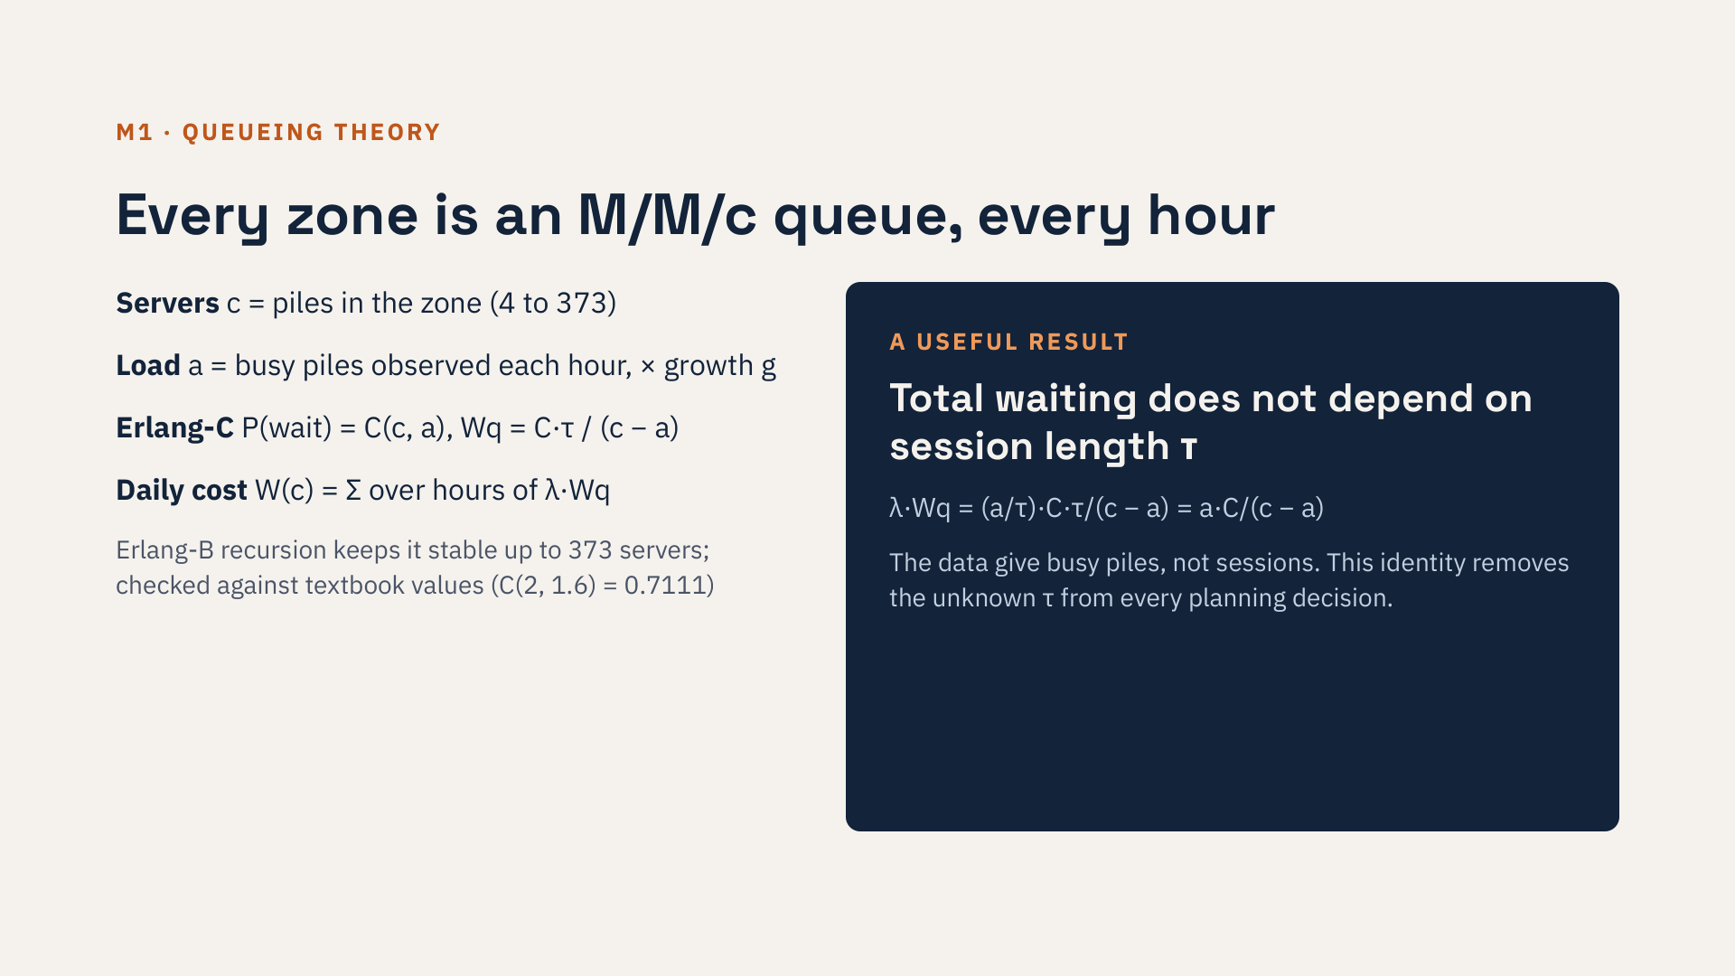
Notes:
Each zone is a queue with c servers, the piles. The load is the number of busy piles we observe each hour, scaled by a growth factor. Erlang-C gives the probability of waiting and the mean wait. One detail made the whole project possible: the data tell us busy piles, not the number of sessions, so the session length is unknown. But the total waiting time turns out not to depend on it: tau cancels out. So none of our decisions depend on that unknown.

Slide 5
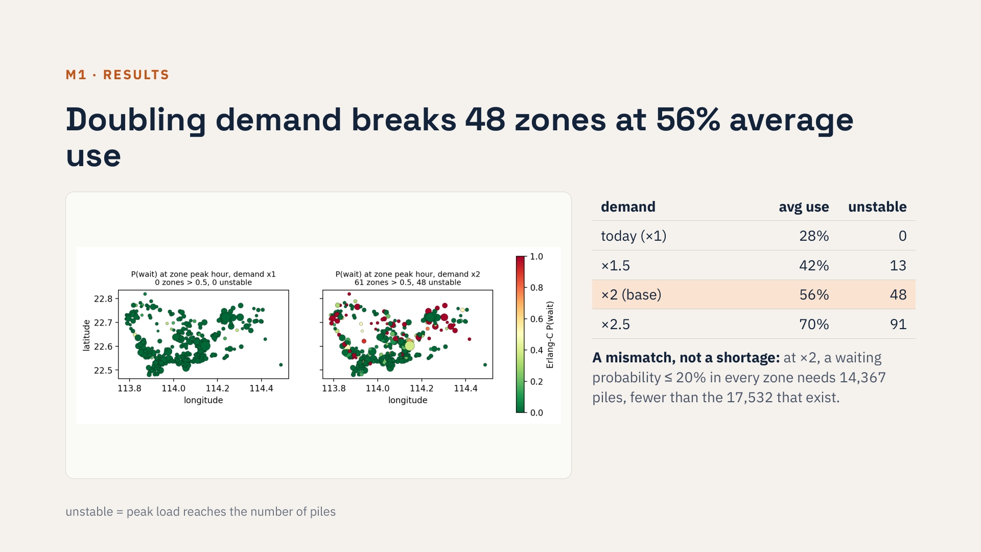
Notes:
Today the network works. But as demand grows, zones fail fast: 13 at one and a half times today's demand, 48 at double, 91 at two and a half. And they fail while average use is still low: at double demand, 44 percent of piles are idle on average. The map shows where: the outer north-west and north-east are red, while the centre has spare capacity. That is the spatial mismatch the next two methods attack. Queueing theory also tells us how many piles each zone needs for a given service level. At double demand, keeping the chance of waiting below 20 percent everywhere needs 14,367 piles in total, fewer than the 17,532 that exist. So the city does not lack piles yet; they are in the wrong places. Only at two and a half times demand does the total become too small.

Slide 6

Notes:
Now the budget question. The planner can buy new piles at cost one, or move an idle pile from another zone at cost 0.35. We minimise total waiting under the budget, with every zone stable. The waiting function is nonlinear, but it is convex in the number of piles, which we checked in all 275 zones. So we can write each additional pile as a zero-one increment, and the MILP is exact, not an approximation. It solves in seconds.

Slide 7
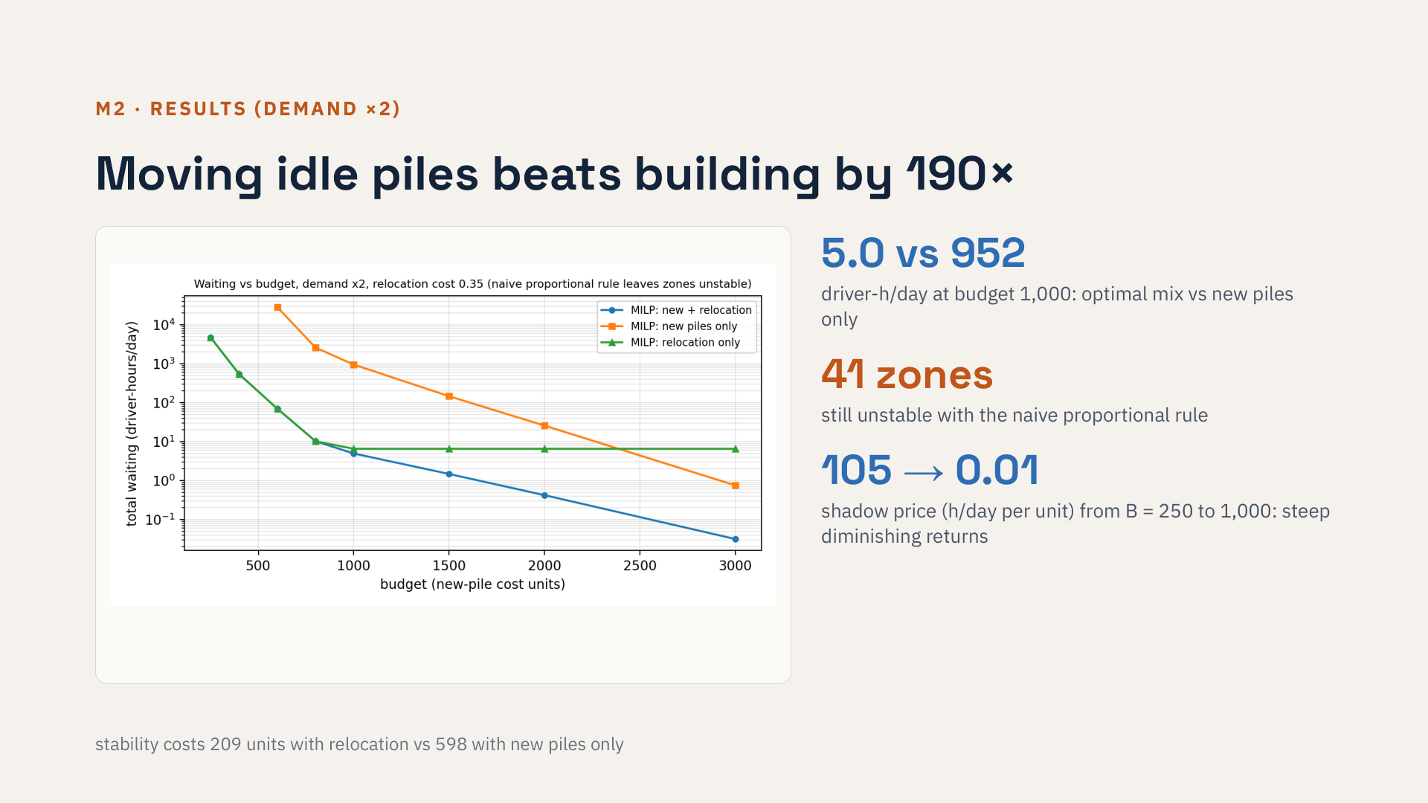
Notes:
The answer is clear. At a budget of one thousand, the optimal plan uses 151 new piles and 2,425 relocated piles and leaves five driver-hours of waiting per day. With new piles only, the waiting is 952 hours. The common fair-share rule, adding piles in proportion to what zones already have, still leaves 41 zones unstable. The dual price of the budget falls from 105 hours per unit to almost zero, which gives the city a rational stopping rule. Relocation stays optimal unless moving a pile costs as much as a new one.

Slide 8
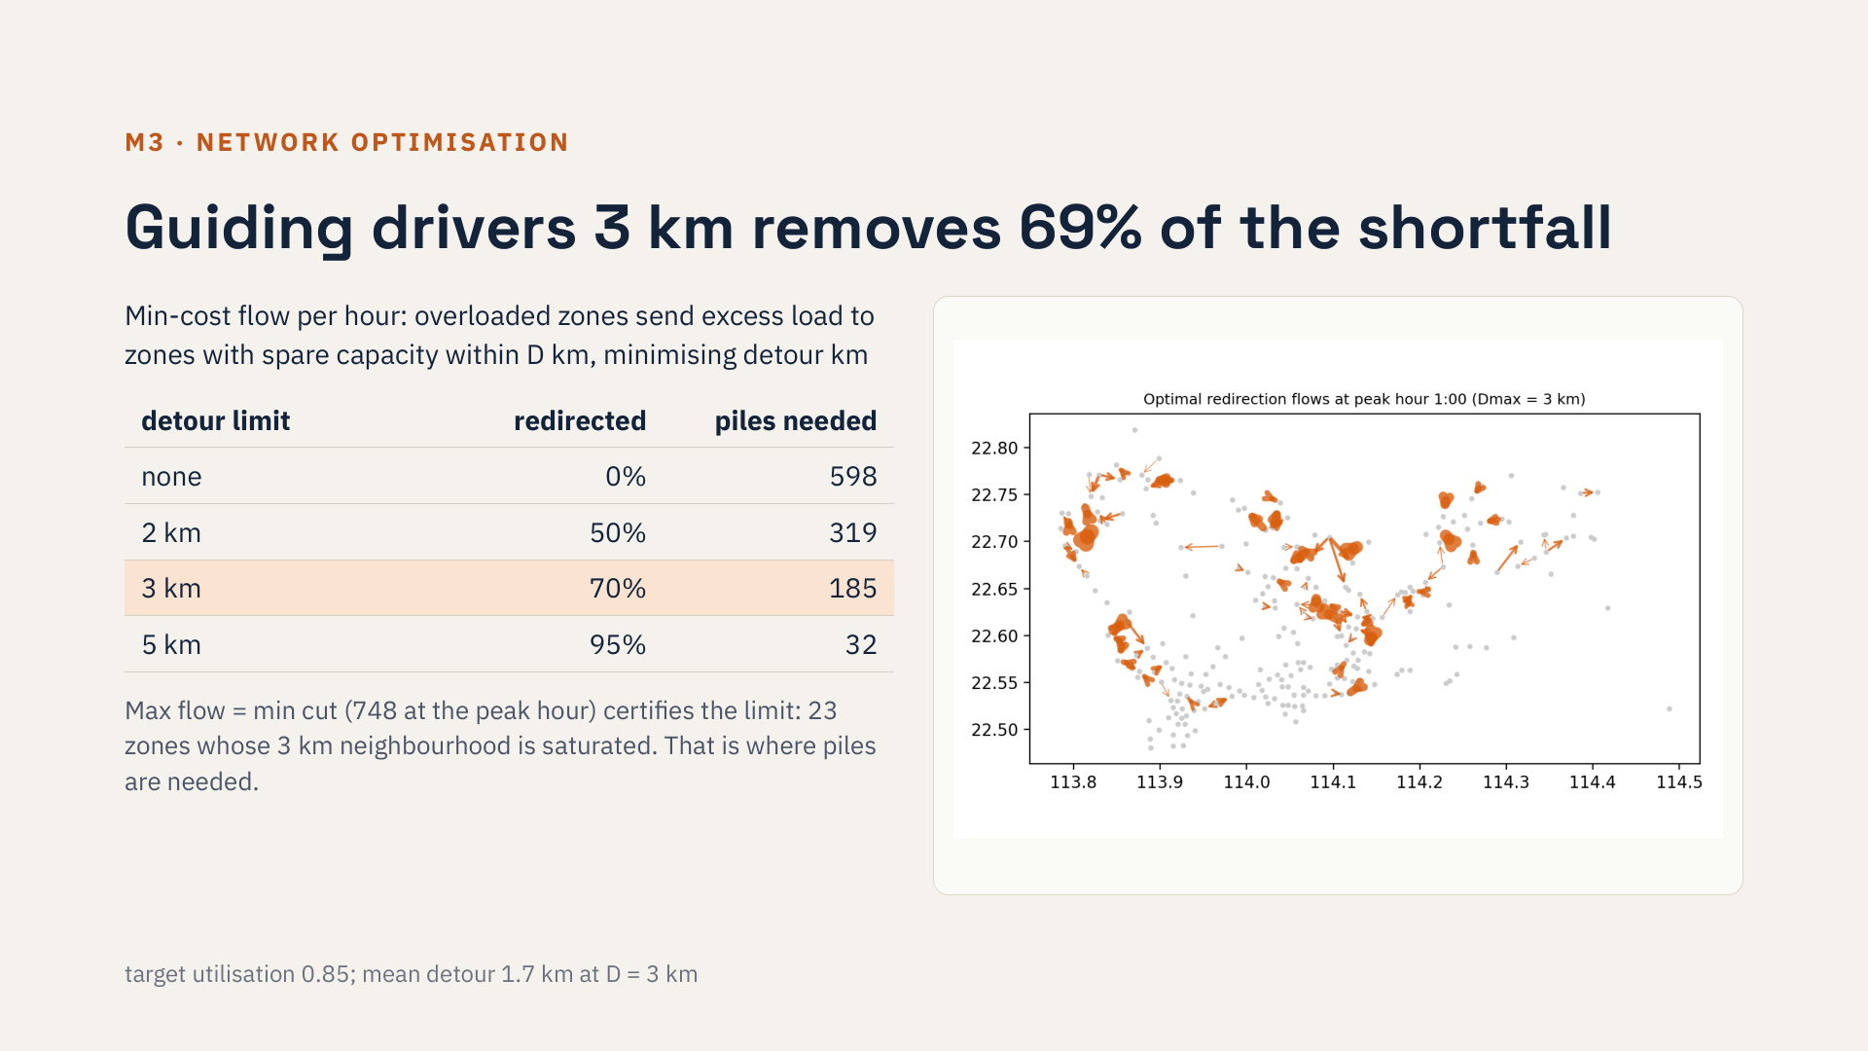
Notes:
Before building anything, can software help? We model navigation guidance as a min-cost flow: overloaded zones send drivers to nearby zones with spare piles, minimising detour distance. With a three-kilometre limit, seventy percent of the excess is absorbed, with an average detour of 1.7 kilometres, and the piles needed for stability fall from 598 to 185. The matrix is totally unimodular, so flows are integer, and LP and network simplex agree. Why can guidance not do more? The max-flow min-cut theorem answers it: the minimum cut shows 23 overloaded zones whose total excess is larger than all the spare capacity within three kilometres. Those zones and their 18 saturated neighbours are exactly where new or relocated piles should go. The result holds for target utilisations from 0.75 to 0.95.

Slide 9
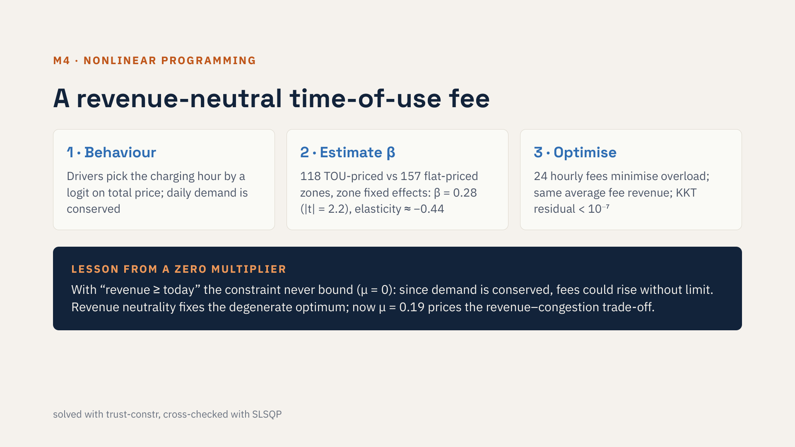
Notes:
The third lever is price. We model drivers choosing their charging hour with a logit on the total price. We estimated price sensitivity from the data by comparing zones with time-of-use prices to zones with flat prices: beta is 0.28, significant at five percent. Then we optimise 24 hourly fees. We learned a lesson here: our first constraint said revenue at least as high as today, and the multiplier was zero. Because demand only shifts in this model, the optimiser could raise every fee without losing customers. Requiring revenue neutrality fixed that.

Slide 10
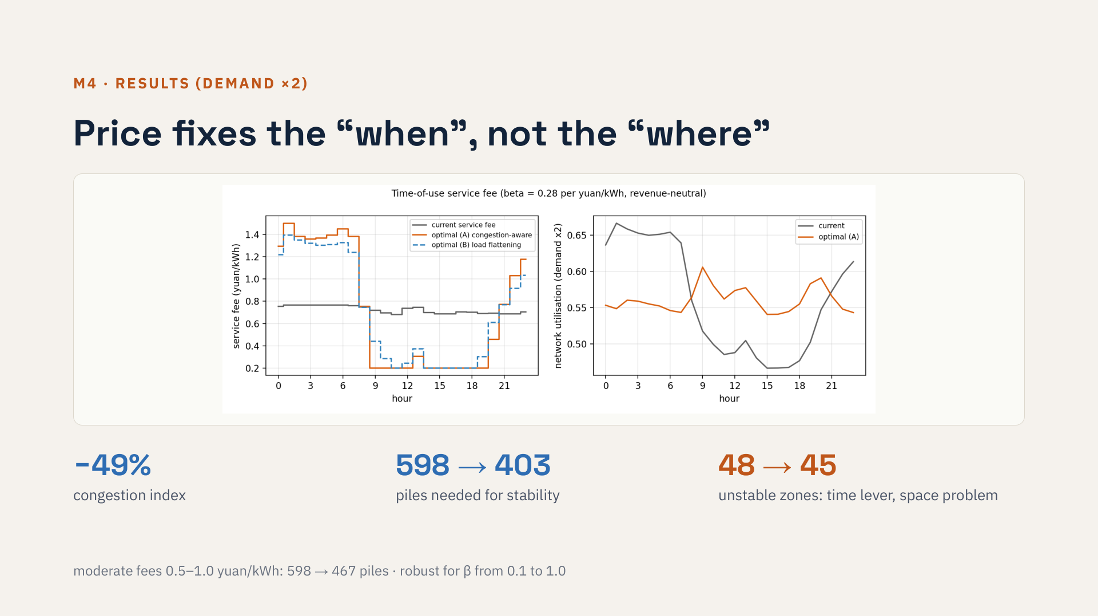
Notes:
The optimal fee is high at night, when zones are congested, and low during the day. It halves the congestion index and cuts the piles needed for stability by a third, with the same average fee. But the number of failing zones barely moves, from 48 to 45. Price moves demand in time, while Shenzhen's main problem is in space. So pricing complements relocation and guidance; it cannot replace them. The result holds for a moderate fee range too.

Slide 11
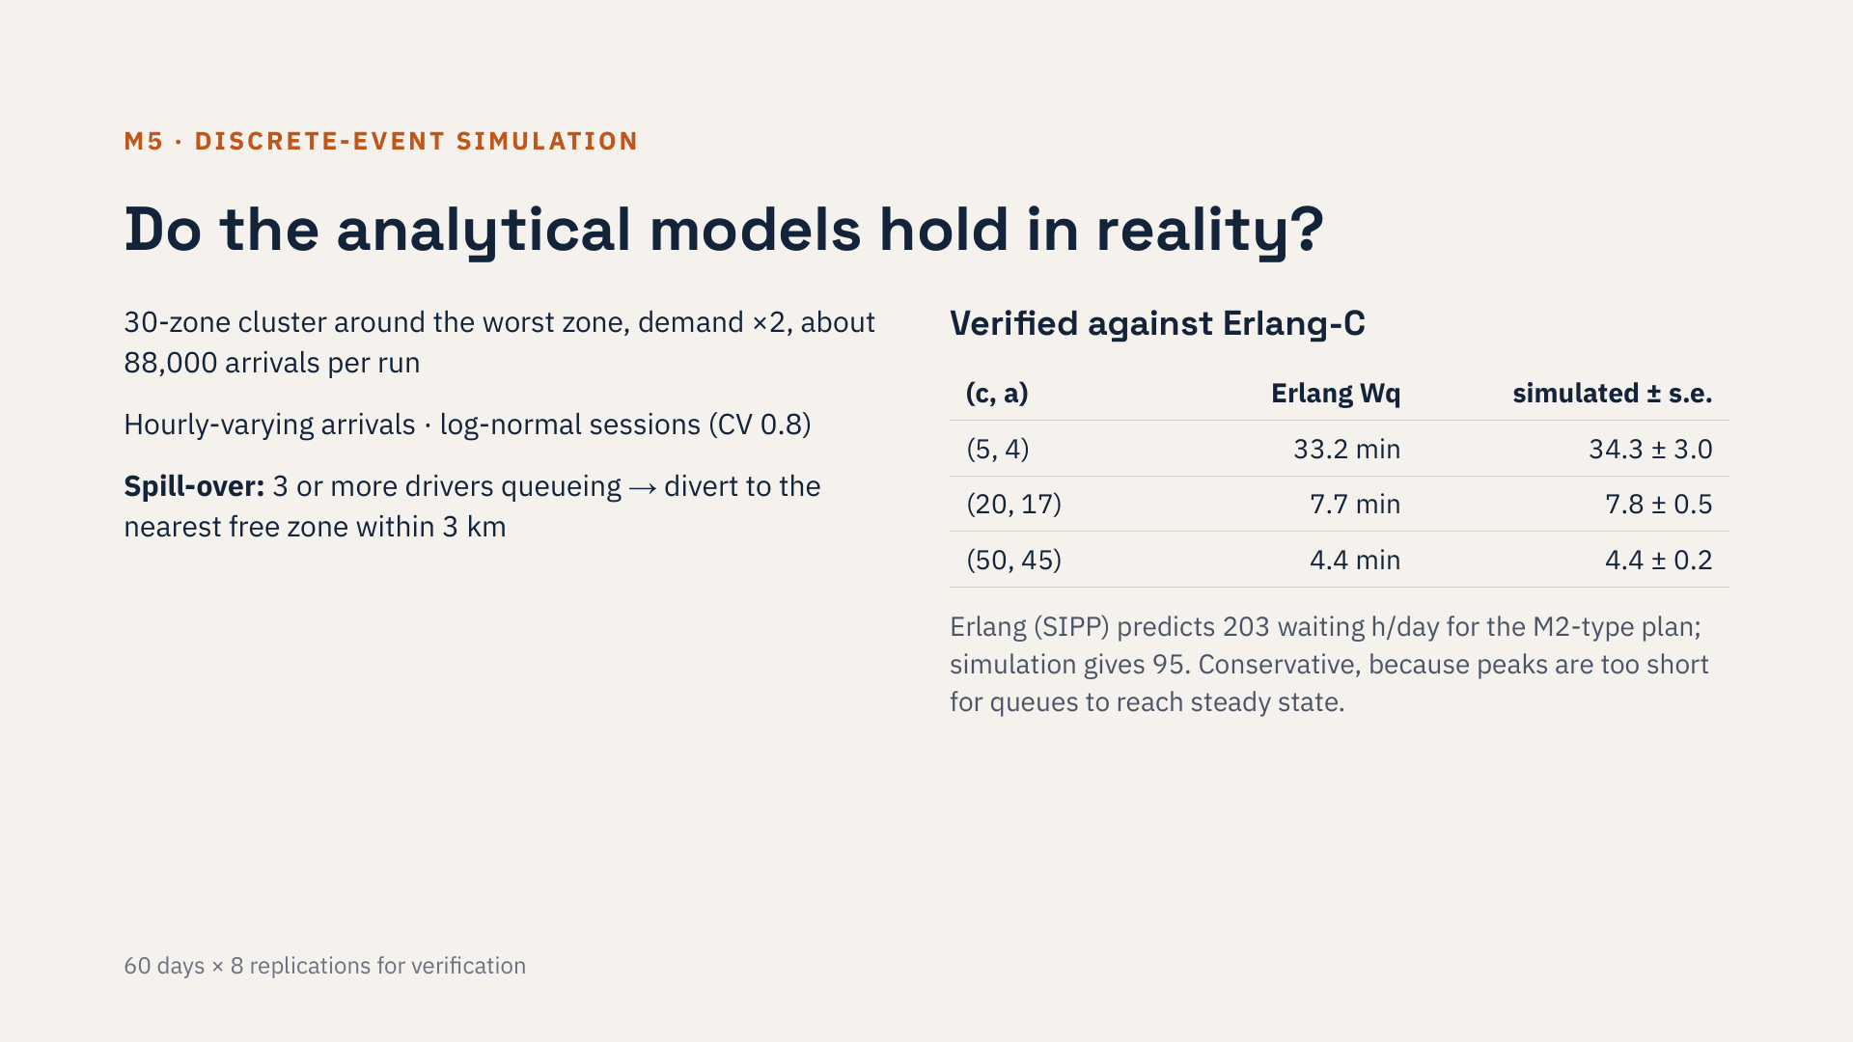
Notes:
Our models so far assume steady demand within each hour and independent zones. Real drivers arrive at changing rates and move to a neighbouring zone when the queue is long. We built a discrete-event simulation of a 30-zone cluster with these effects. First we verified it: with the textbook assumptions it reproduces Erlang-C within a fraction of a standard error. Then we found that the analytical model is conservative, predicting about twice the waiting of the simulation, so plans based on it err on the safe side. Why? Not because of session variability: even very variable sessions give only 119 hours. When we stretch the day so that every hour lasts longer, the simulation climbs to 188 hours, close to the 203 predicted. The peaks are simply too short for queues to reach their steady state.

Slide 12
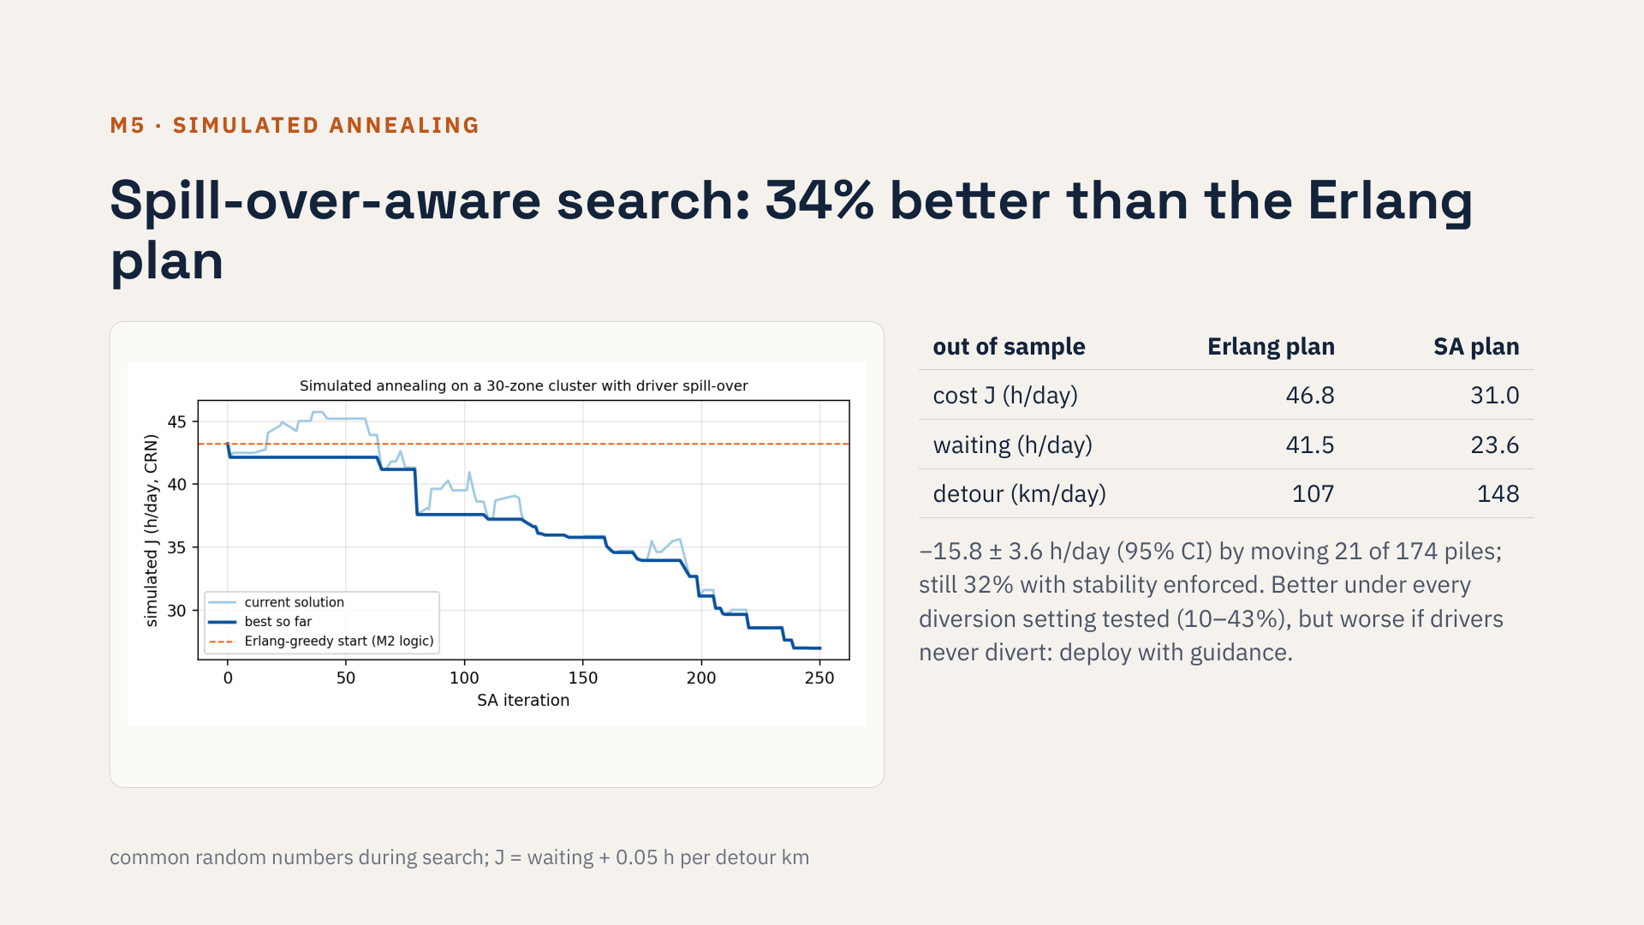
Notes:
Then we asked whether simulation can find a better plan. We start simulated annealing from the Erlang-optimal allocation, which is what the MILP would choose, and move one pile at a time, evaluating with common random numbers. On ten fresh replications, the annealing plan reduces cost by a third, and the confidence interval excludes zero. It works by taking piles from busy zones whose overflow can go to idle piles next door, and giving them to zones whose drivers have nowhere else to go, an interaction the separable model cannot see. So MILP at city scale, simulation refinement in dense clusters. We also stress-tested the plan. When we force every zone to stay stable, the gain is still 32 percent. Whatever diversion threshold, radius or session variability we assume, the annealing plan stays better, by 10 to 43 percent. But if drivers never divert, it is worse, because it counts on neighbours to catch the overflow. So it should go together with guidance.

Slide 13
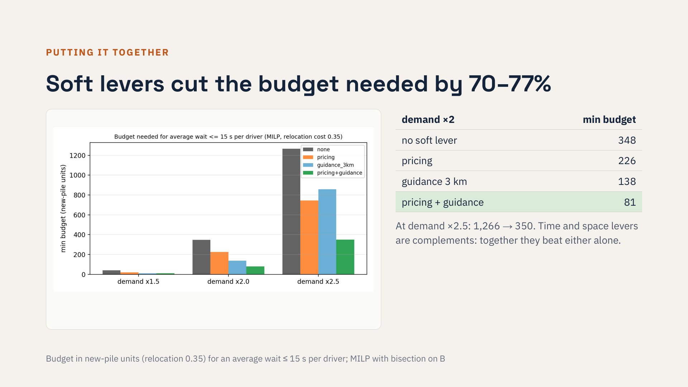
Notes:
Now we combine everything on one yardstick: the minimum investment needed to keep the average wait under fifteen seconds. With doubled demand, doing nothing smart requires 348 units. Pricing brings it to 226, guidance to 138, and both together to 81, a cut of more than three quarters. At two and a half times demand the saving is 72 percent. Pricing works on time and guidance on space, so they are complements, not substitutes.

Slide 14
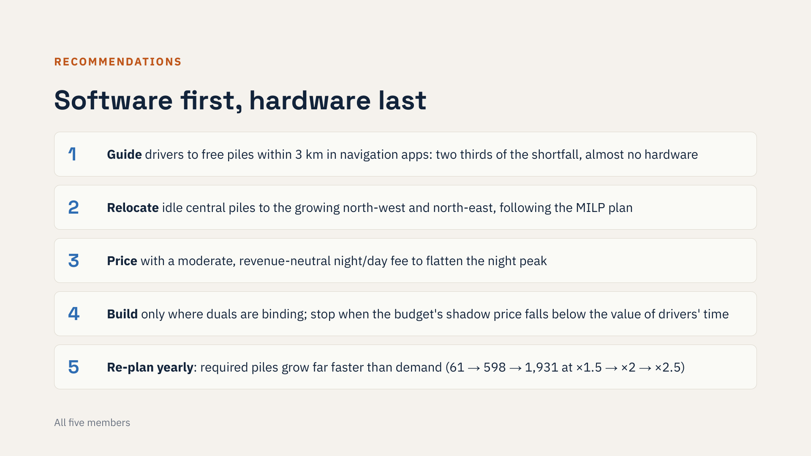
Notes:
Our recommendations follow the cost order. First, guidance in navigation apps: it removes about two thirds of the shortfall with almost no hardware. Second, relocate idle piles from the centre to the growing outer districts. Third, a moderate revenue-neutral time-of-use fee. Fourth, build new piles only where the duals say capacity is binding, and stop when the shadow price falls below the value of drivers' time. Finally, re-plan every year, because the piles needed grow much faster than demand.

Slide 15
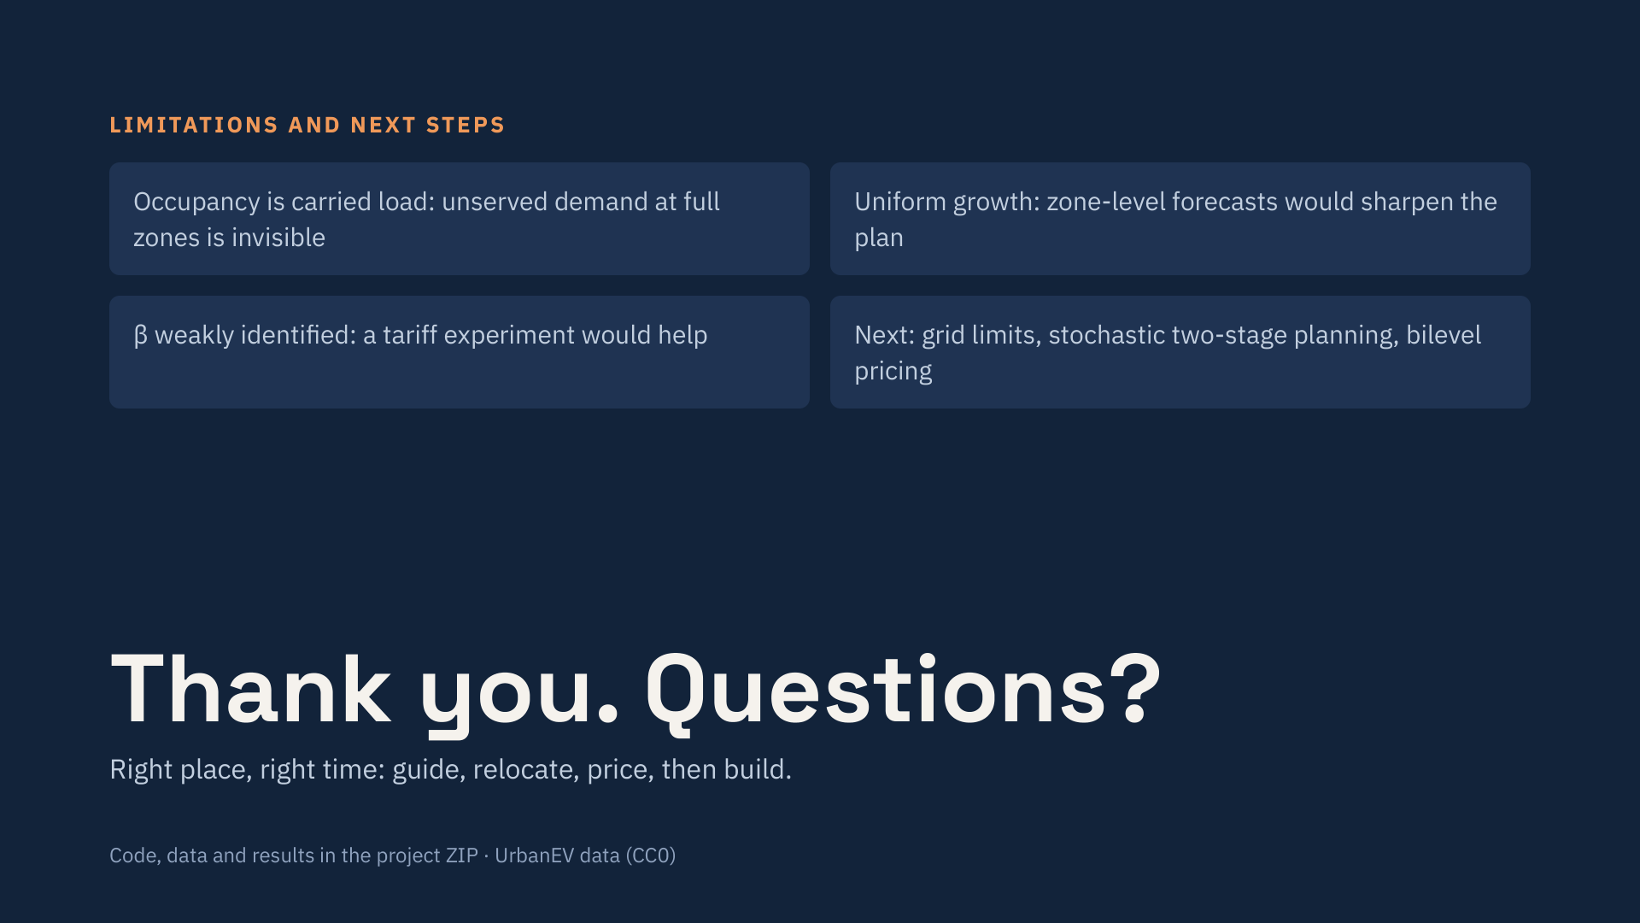
Notes:
Some limitations. The data show carried load, so demand at full zones is underestimated. We assumed uniform growth. Our price sensitivity is weakly identified. Natural next steps are grid constraints, stochastic planning over growth scenarios, and a bilevel pricing model. To summarise: right place, right time. Guide, relocate, price, and only then build. Thank you, we are happy to take questions.

