Slide 1
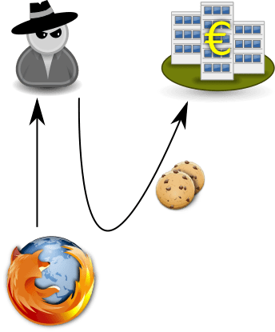
Cross Site Request Forgery
(CSRF)

Slide 2
Outline
Cross-Site Requests and Its Problems
Cross-Site Request Forgery Attack
CSRF Attacks on HTTP GET
CSRF Attacks on HTTP POST
Countermeasures

Slide 3

Infamous CSRF attacks
The 2007 Gmail Email-Forwarding CSRF Attack
    Attackers exploited a CSRF bug in Gmail that allowed a malicious website to secretly set the victim’s Gmail forwarding rule.
    Anyone who visited the attacker’s website while logged into Gmail would have their incoming emails forwarded to the attacker.

Slide 4




Infamous CSRF attacks
The 2006–2007 “Bank Transfer CSRF” Vulnerabilities
      Attackers could craft hidden forms that automatically triggered wire transfers when a victim visited a malicious site.
      ING Direct (Netherlands) — The Classic “Automatic Transfer” CSRF (2006–2007), ABN AMRO (Netherlands) — Silent Fund Transfer CSRF (2006), Citibank Australia — Fund Transfer CSRF (2009), HSBC — Payee Addition + Transfer CSRF (2011)

Slide 5


Infamous CSRF attacks
Netflix CSRF (2010) — Account Takeover via Simple GET Requests to change the shipping address
<img src="https://netflix.com/changeAddress?addr=attackerAddress">
Code Astro Internet Banking System v2.0.0 – CVE-2024-56924
  An open source Internet Banking System which uses PHP Language with MySQL Database.

Slide 6
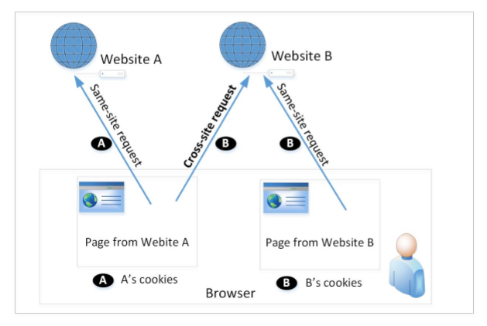
Cross-Site Requests and Its Problems
When a page from a website sends an HTTP request back to the website, it is called same-site request.
If a request is sent to a different website, it is called cross-site request because where the page comes from and where the request goes are different.
Eg : A webpage (not Facebook) can include a Facebook link, so when users click on the link, HTTP request is sent to Facebook.

Slide 7
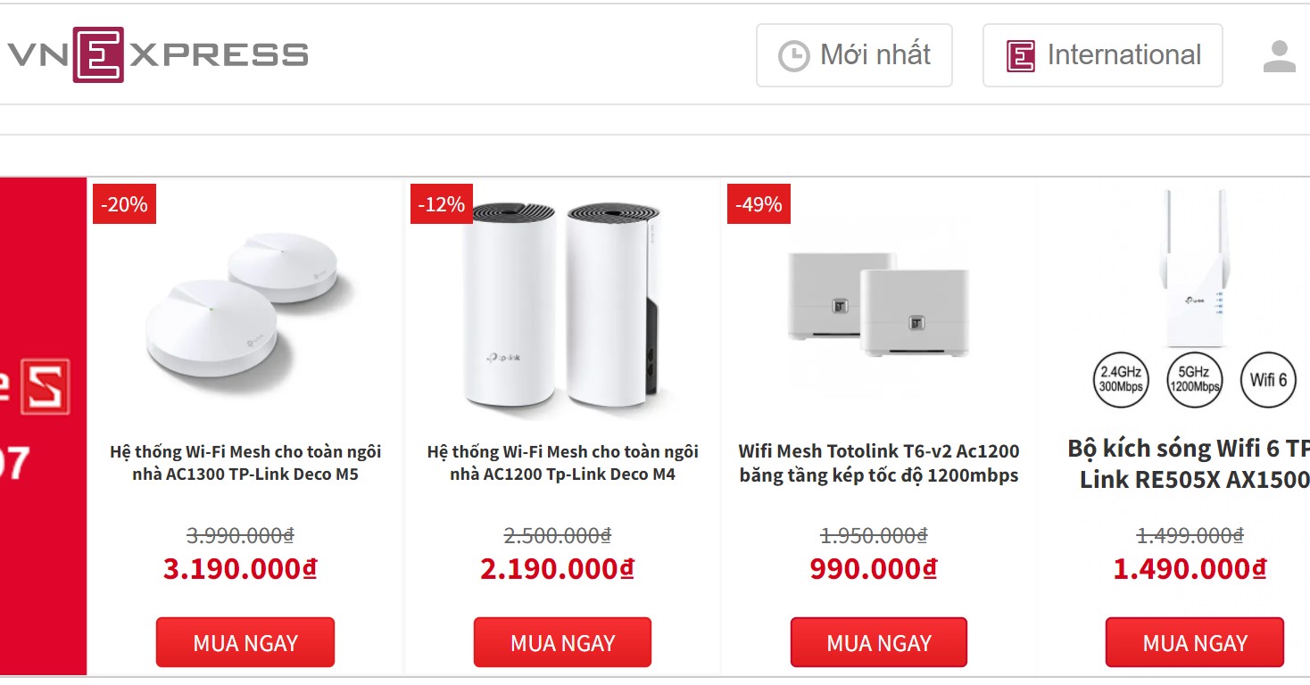

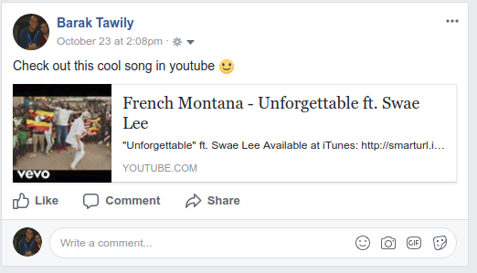
Examples of cross-site requests
External links on a web page
Online advertisement
Links to different sites from a web portal
Embedded youtube link on a facebook post

Slide 8

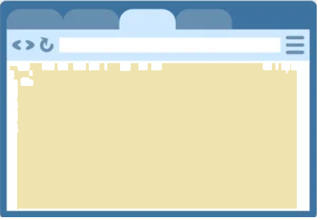
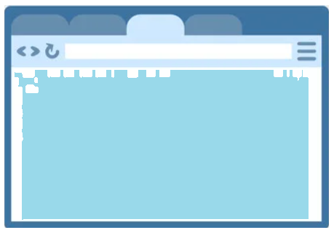
Cross-Site Requests and Its Problems
When a request is sent to example.com from a page coming from example.com, the browser attaches all the cookies belonging to example.com.
Now, when a request is sent to example.com from another site (different from example.com), the browser will attach the cookies too.
Because of above behaviour of the browsers, the server cannot distinguish between the same-site and cross-site requests
It is possible for third-party websites to forge requests that are exactly the same as the same-site requests.
This is called Cross-Site Request Forgery (CSRF).
Same site
Or
Cross site?
HTTP req + cookies
badsite.com
HTTP req + cookies
example.com
example.com
Browser

Slide 9
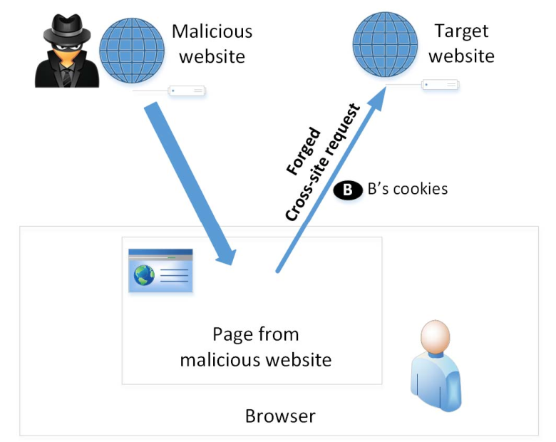
Cross-Site Request Forgery Attack
Environment Setup:
Target website
Victim user who has an active session on the target website
Malicious website
Steps:
The victim is logged into the targeted website.
The attacker needs to attract the victim user to visit the malicious website.
The malicious webpage forges a cross-site request to the targeted website.
Currently logged in the target website

Slide 10
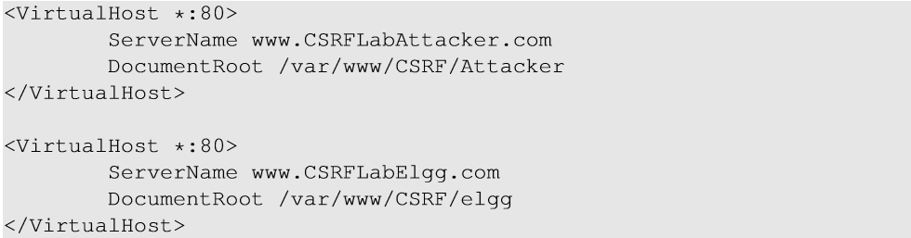
Environment Setup
Elgg: open-source web application for social networking
Countermeasures for CSRF is disabled by us in the VM
Target website: http://www.csrflabelgg.com
Attacker’s website: http://www.csrflabattacker.com
These websites are hosted on localhost via Apache’s Virtual Hosting, defined in /etc/apache2/sites-available/000-default.conf

Slide 11
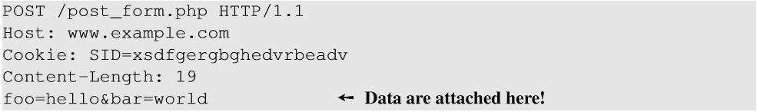
HTTP GET and POST Services
foo
hello
bar
world
Submit
HTTP GET requests: data (foo and bar) are attached in the URL.
HTTP POST requests: data (foo and bar) are placed inside the data field of the HTTP request.

Slide 12
CSRF Attack on GET Requests - Basic Idea
Consider an online banking web application www.husbank.com which allows users to transfer money from their accounts to other people’s accounts.
A user is logged in into the bank web application and has a session cookie which uniquely identifies the authenticated user.
HTTP request to transfer $500 from his/her account to account 3220:
http://www.husbank.com/transfer.php?to=3220&amount=500
In order to perform the attack, the attacker needs to send out the forged request from the victim’s machine so that the browsers will attach the victim’s session cookies with the requests.
Forged HTTP GET +
authentication cookies
transfer.php?
to=3220&
amount=500
badsite.com
husbank.com
Logged in with
authentication cookies
husbank.com
Browser

Slide 13
CSRF Attack on GET Requests - Basic Idea
The attacker can place a piece of code (to trigger request) in the form of Javascript code in the attacker’s web page.
HTML tags like img and iframe can trigger GET requests to the URL specified in src attribute. Response for this request will be an image/webpage.
supposed to be the URL to an image
<img src=“http://www.husbank.com/transfer.php?to=3220&amount=500”?>
<iframe
src=“http://www.husbank.com/transfer.php?to=3220&amount=500”?>
</iframe>
supposed to be the URL to a web page

Slide 14
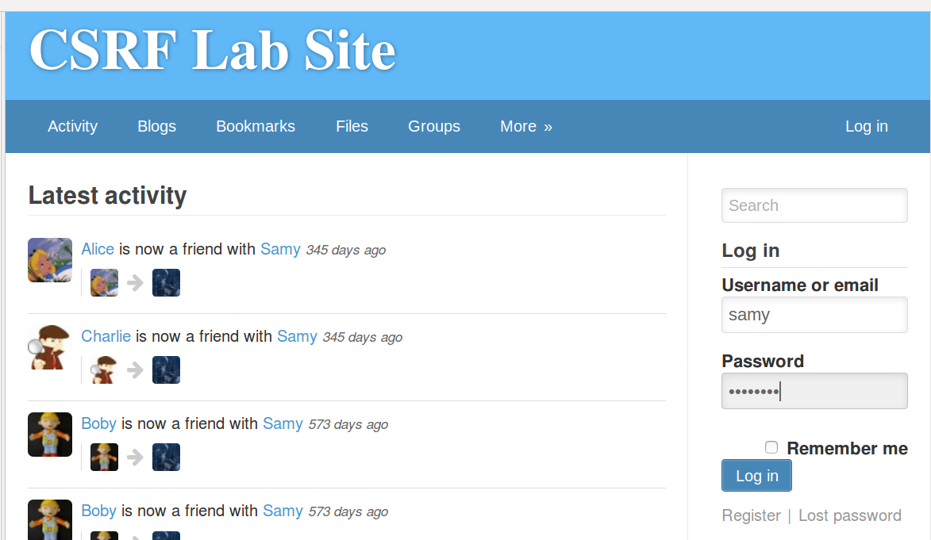
CSRF Attack on Elgg

Slide 15

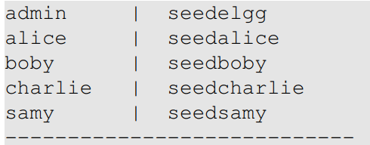
CSRF Attack on Elgg
Elgg’s countermeasure on CSRF has been disabled for the experiment purpose
Elgg is running at http://www.csrflabelgg.com/ , installed on the local machine
Accounts already created for the experiment
Alice is the victim
Boby is Alice’s friend
Charlie is a dummy user created by Samy
Samy is the attacker

Slide 16
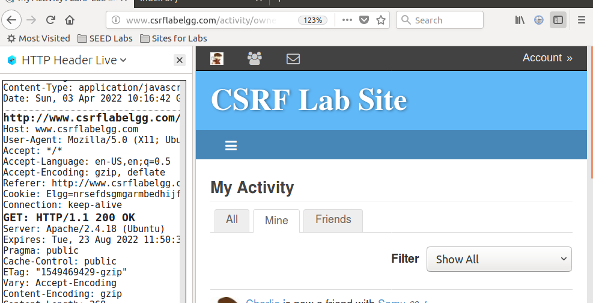

Install HTTP Header Live add-on
The tool captures live HTTP traffic
Search for ‘HTTP Header Live’ add-on and install it
Click on the ‘Show sidebars’ icon on the top right corner of your browser
File is saved in Downloads folder

Slide 17
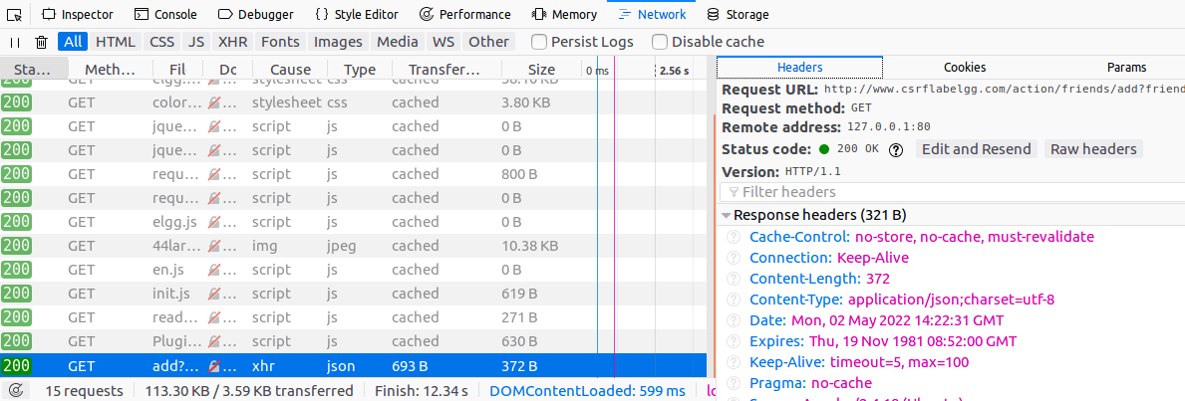
Firefox network monitor
Another way is to use Firefox network monitor
  Goto Firefox top right menu => Web Developer => Network
  Choose the HTTP request, details are displayed on the right panes

Slide 18
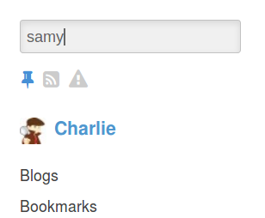
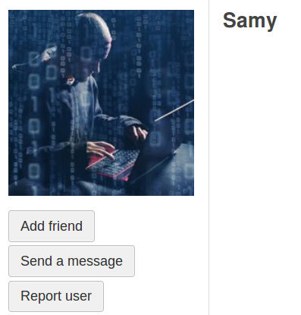
Attack on Elgg’s Add-Friend Service
Search for samy
Goal : Add yourself to the victim’s friend list without his/her consent by sending a fake add-friend request.
Investigation taken by the attacker Samy:
Creates an Elgg account using Charlie as the name.
In Charlie’s account, he clicks add-friend button to add himself to Charlie’s friend list. Using FireFox LiveHTTPHeaders extension to capture the add-friend HTTP request.

Slide 19
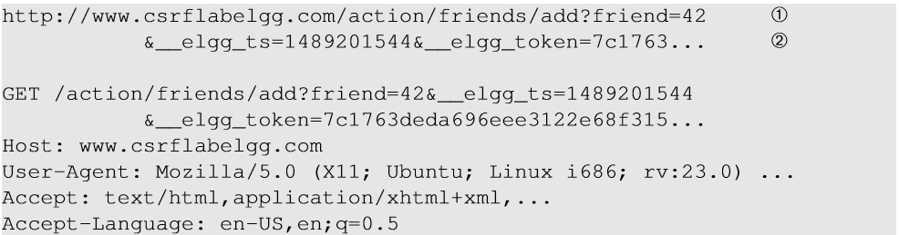
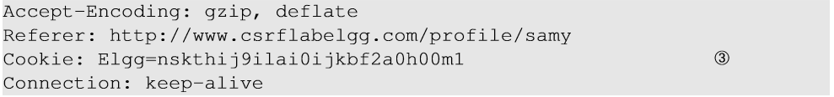
Captured HTTP Header
Line ① : URL of Elgg’s add-friend request. UserID of the user to be added to the friend list is used. Here, Samy’s UserID (GUID) is 42.
Line ② : Elgg’s countermeasure against CSRF attacks which are disabled.
Line ③ : Session cookie which is unique for each user. It is automatically sent by the browser.

Slide 20
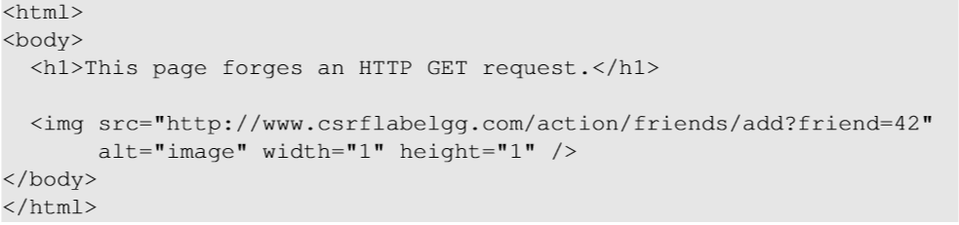


Create the malicious web page
1. The img tag will trigger an HTTP GET request. When browsers render a web page and sees an img tag, it sends an HTTP GET request to the URL specified in the src attribute.
The attacker uses add-friend URL along with friend parameter. The size of the image is very small so that the victim is not suspicious about the broken image synbol.
3. The crafted web page is placed in the malicious website www.csrflabattacker.com (inside the /var/www/CSRF/Attacker folder).

Slide 21
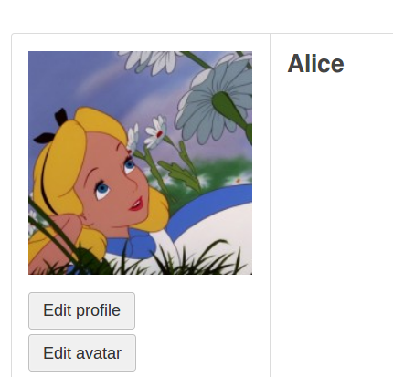

Launching the attack
For the attack to be successful, Samy has to lure Alice to visit the malicious page while Alice is having an active session with Elgg at www.csrflabelgg.com
Using Elgg, Samy can send a private message to Alice with the link to the malicious web page www.csrflabattack.com
If Alice clicks the link, Samy’s malicious web page will be loaded into Alice’s browser and a forged add-friend request will be sent to the Elgg server.
On success, Samy will be added to Alice’s friend list.

Slide 22
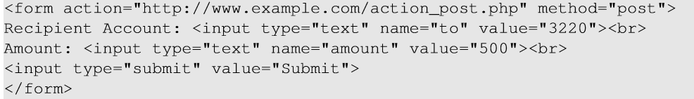
CSRF Attacks on HTTP POST Services
Constructing a POST Request Using JavaScript
Recipient account:
3220
Amount:
500
Submit
POST requests can be generated using HTML forms. The above form has two text fields and a Submit button.
When the user clicks on the Submit button, POST request will be sent out to the URL specified in the action field with to and amount fields included in the body.
Attacker’s job is to click on the button without the help from the user.

Slide 23
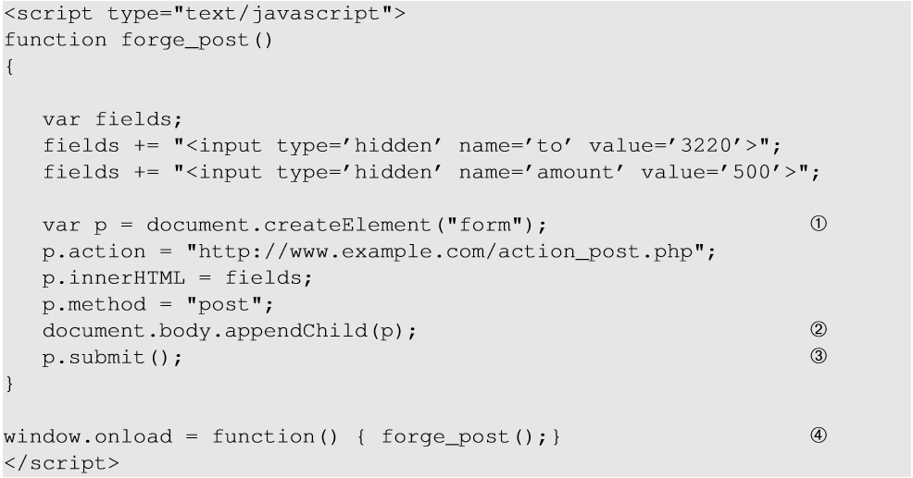
CSRF Attacks on HTTP POST Services
Line ①: Creates a form dynamically; request type is set to “POST”
Line ②: The fields in the form are “hidden”. Hence, after the form is constructed, it is added to the current web page.
Line ③: Submits the form automatically.
Line ④: The JavaScript function “forge_post()” will be invoked automatically once the page is loaded.

Slide 24
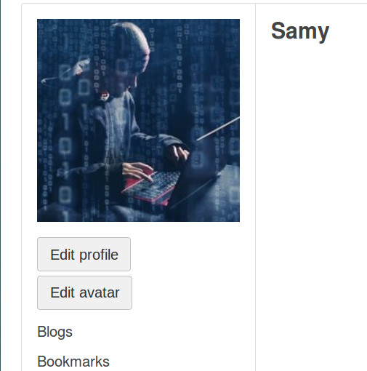
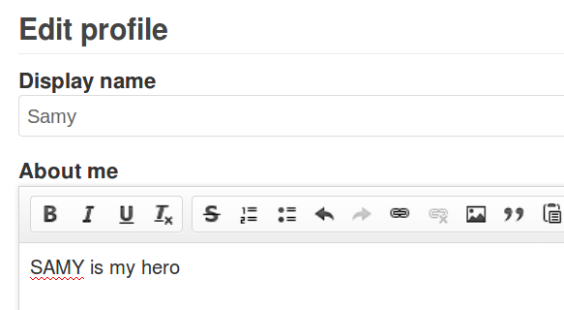
Attack on Elgg’s Edit-Profile Service
Goal : Putting a statement “SAMY is MY HERO” in the victim’s profile without consent from the victim.
Investigation by the attacker Samy
Samy clicks to edit his own profile, types in “SAMY is MY HERO” in the description field, then clicks Save
Samy captures an edit-profile request of himself using LiveHTTPHeader extension

Slide 25
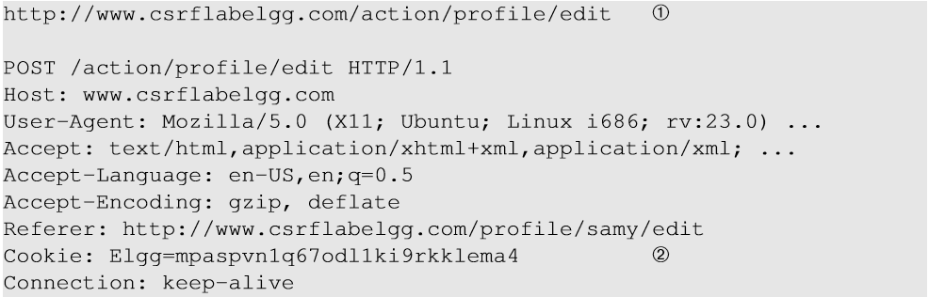
Attack on Elgg’s Edit-Profile Service
Line ① : URL of the edit-profile service.
Line ②: Session cookie (unique for each user). It is automatically set by browsers.
Line ③: CSRF countermeasures, which are disabled

Slide 26
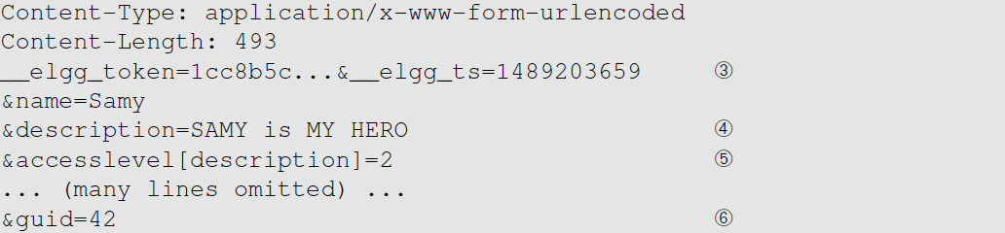
Attack on Elgg’s Edit-Profile Service
Replace this with the victim’s id
Line ④: Description field with text “SAMY is MY HERO”
Line ⑤: Access level of each field : 2 means viewable by everyone
Line ⑥: To be replaced with user Id (GUID) of the victim (Alice). This can be obtained by visiting victim’s profile page source, looking for the following:
Elgg.page_owner={“guid”:39,”type”:”user”,...}

Slide 27
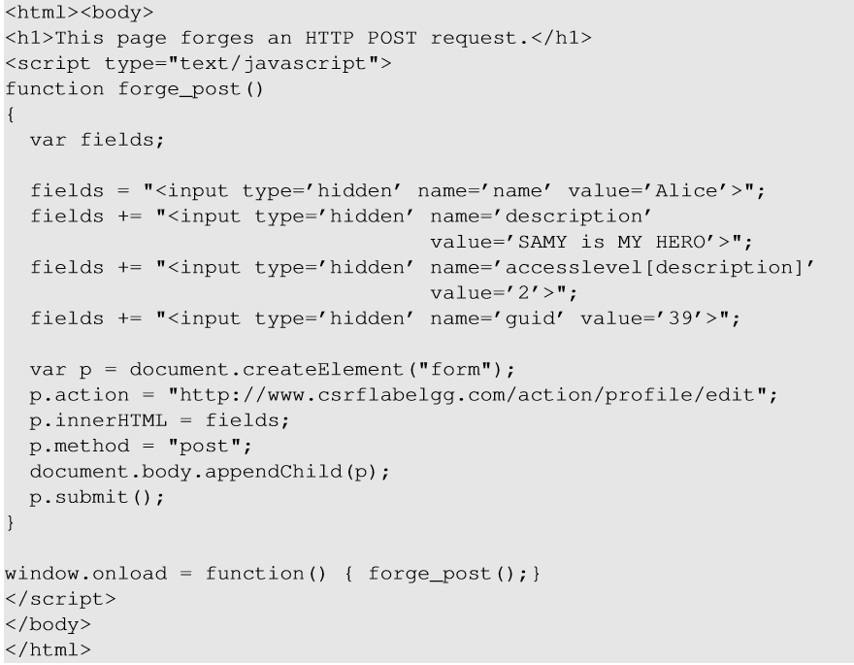
Craft the Malicious Web Page
The JavaScript function creates a hidden form with the description entry as our text.
When the victim visits this page, the form will be automatically submitted (POST request) from the victim’s browser to the edit-profile service at “http://www.csrflabelgg.com/action/profile/edit” causing the message to be added to the victim’s profile.

Slide 28
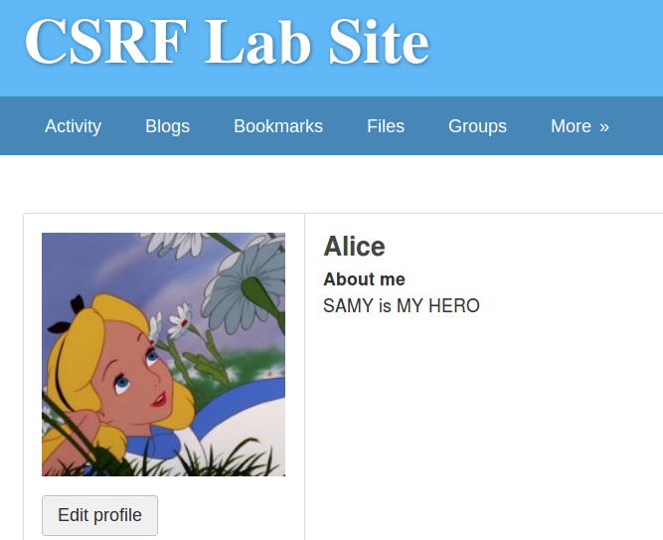
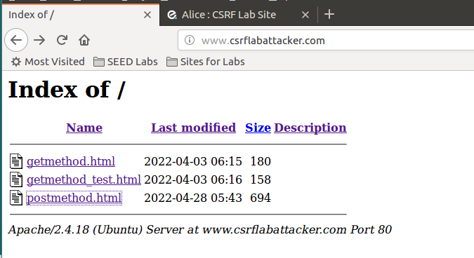
Launching the attack
Put the malicious website on /var/www/CSRF/Attacker folder
Alice logs in Elgg at http://www.csrflabelgg.com and visits the Attacker’s website http://www.csrflabattacker.com/

Slide 29
Fundamental Causes of CSRF
The server cannot distinguish whether a request is cross-site or same-site
  Same-site request: coming from the server’s own page. Trusted.
  Cross-site request: coming from other site’s pages. Untrusted.
  We should not treat these two types of requests the same.
Does the browser know the difference?
  Of course. The browser knows from which page a request is generated.
  Can browser help?
How to help the server?
  Referer header, i.e referrer (browser’s help)
  Same-site cookie (browser’s help)
  Secret token (the server helps itself to defend against CSRF)

Slide 30
Countermeasures: Referer Header
HTTP header field identifying the address of the web page from where the request is generated.
A server can check whether the request is originated from its own pages or not.
This field reveals part of browsing history causing privacy concern and hence, this field is mostly removed from the header.
The server cannot use this unreliable source.
Referer: http://attacker.com/badpage.html
attacker.com
Referer: http://elgg.com/addfriend.php
ellg.com
elgg.com
Browser

Slide 31
Countermeasures: Same-Site Cookies
A special type of cookie in browsers like Chrome and Opera, which provide a special attribute to cookies called SameSite.
This attribute is set by the server and it tells the browser whether a cookie should be attached to a cross-site request or not.
Cookies with this attribute are always sent along with same-site requests, but with cross-site requests, it depends on the value of this attribute:
  Strict (Not sent along with cross-site requests)
  Lax (Sent with cross-site requests iff it’s a top-level navigation)
HTTP req + optional cookie
attacker.com
HTTP req + SameSite cookie
ellg.com
elgg.com
Browser
Notes:
* Top-level navigation: the user navigates to another URL (i.e the URL address bar is changed), not another webpage is loaded into an iframe of the current page (URL bar doesn’t change).

Slide 32
Countermeasures: Secret Token
The server embeds a random secret value inside each web page.
When a request is initiated from this page, the secret value is included with the request.
The server checks this value to see whether a request is cross-site or not.
Pages from a different origin will not be able to access the secret value. This is guaranteed by browsers (the same origin policy)
The secret is randomly generated and is different for different users. So, there is no way for attackers to guess or find out this secret.
HTTP req
attacker.com
Secret value
ellg.com
HTTP req + Secret value
elgg.com
Browser

Slide 33
Elgg’s Countermeasure
Uses secret-token approach : _elgg_ts and _elgg_token.
The values are stored inside two JavaScript variables and also in all the forms where user action is required.
  elgg.security.token.__elgg_ts
  elgg.security.token.__elgg_token
var elgg = {
"config":{"lastcache":1549469429,"viewtype":"default","simplecache_enabled":1},
"security":{
"token":{
"__elgg_ts":1733490106,
"__elgg_token":"tsVeNoB4XKtojLtSbh81zw“
}
}
…

Slide 34
Elgg’s Countermeasure
The two hidden parameters are added to the form so that when the form is submitted via an HTTP request, these two values are included in the request.
These two hidden values are generated by the server and added as a hidden field in each page.

Slide 35

Elgg’s Countermeasure
JavaScript variables to access using JavaScript code.
The values in __elgg_ts and __elgg_token are generated by /var/www/CSRF/ Elgg/vendor/elgg/elgg/engine/classes/Elgg/ActionsService.php
Elgg’s security token is a MD5 digest of four pieces of information :
Site secret value
Timestamp
User session ID
Randomly generated session string

Slide 36
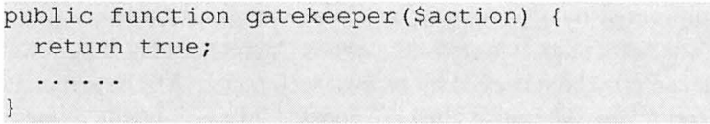
Turn Elgg’s CSRF countermeasure back on
For the sake of experiment, we have turned off Elgg’s CSRF countermeasure
  Goto folder /var/www/CSRF/Elgg/vendor/elgg/elgg/engine/classes/Elgg
  Open ActionsService.php, look for function gatekeeper() and comment out “return true”
  We force gatekeeper to always “return true” to pass the CSRF check. Now we need to take it out.

Slide 37
Summary
Cross-site requests v.s. same-site requests.
Why cross-site requests should be treated differently.
How to conduct CSRF attack
The fundamental cause of the CSRF vulnerability
How to defend against CSRF attack

