Slide 1


BUILD Information Systems for Agents’ Retail Stores
Guid by :
Pham Thai Ky Trung

Slide 2
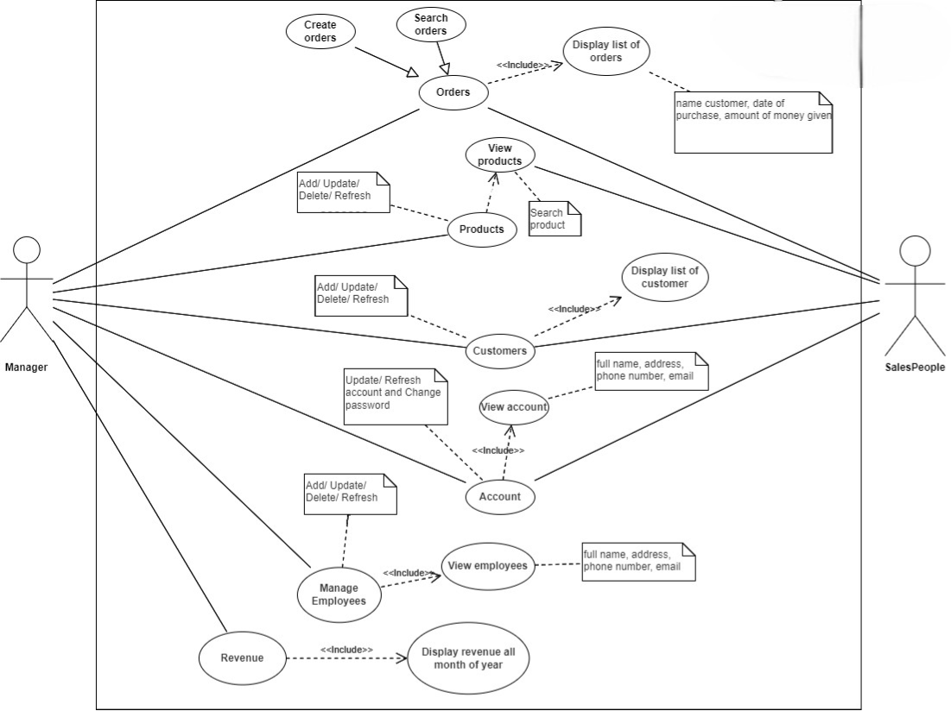
USE CASE

Slide 3
USE CASE: PRODUCT

Slide 4
LAYOUT
01
02
03
04
ANALYZE
DESIGN PHASE
Build system
Conclusion and development direction

Slide 5
01
ANALYZE

Slide 6
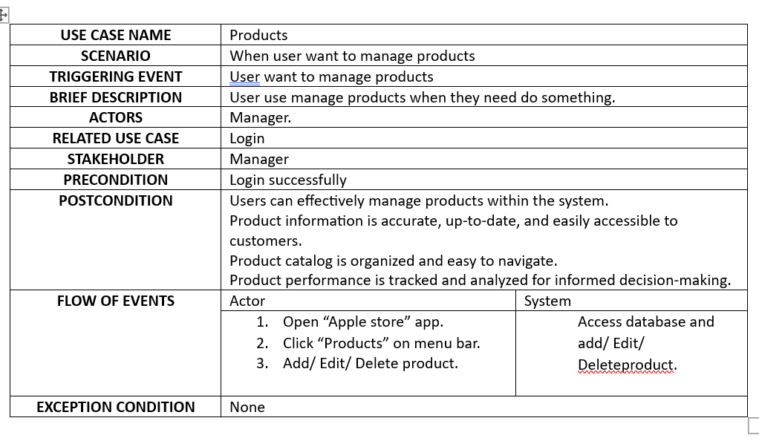
USE CASE: PRODUCTS

Slide 7
Activity diagram: add item

Slide 8
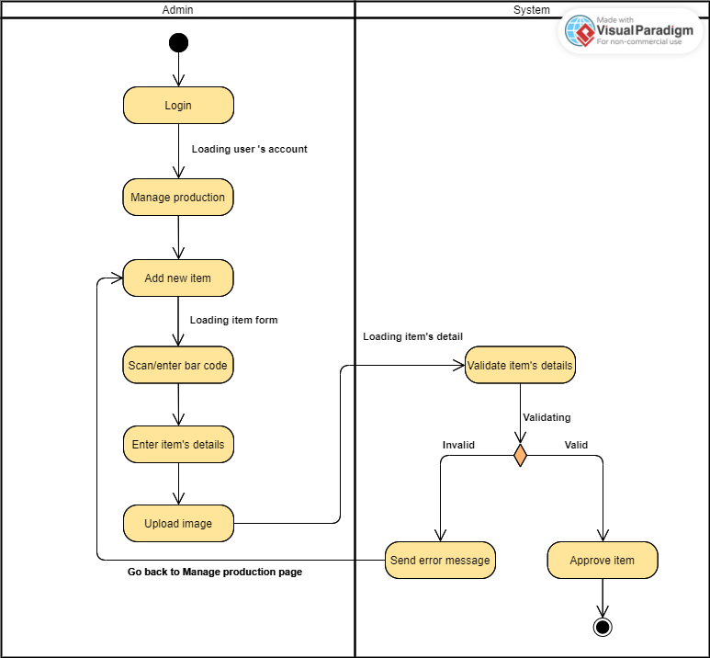
ANALYZE: USE CASE DESCIPTION

Slide 9
Activity diagram: edit item

Slide 10
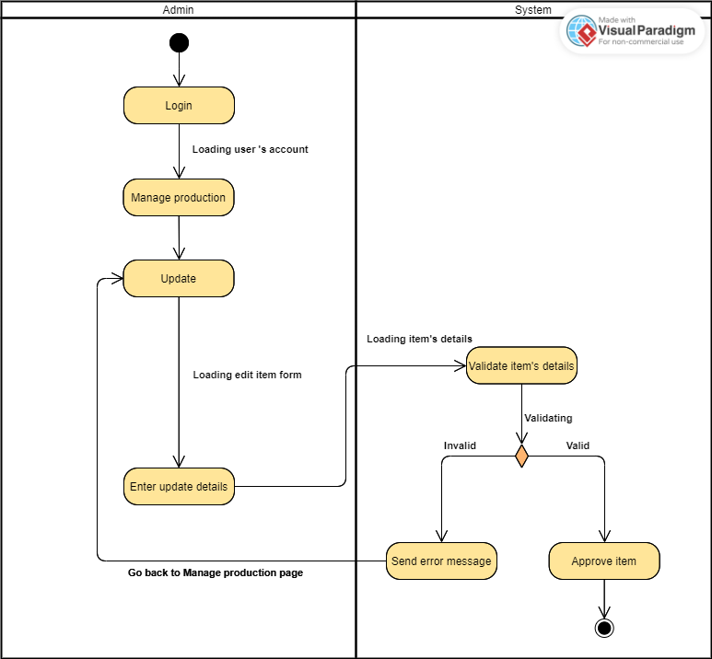
Activity diagram: edit item

Slide 11
Activity diagram: delete item

Slide 12
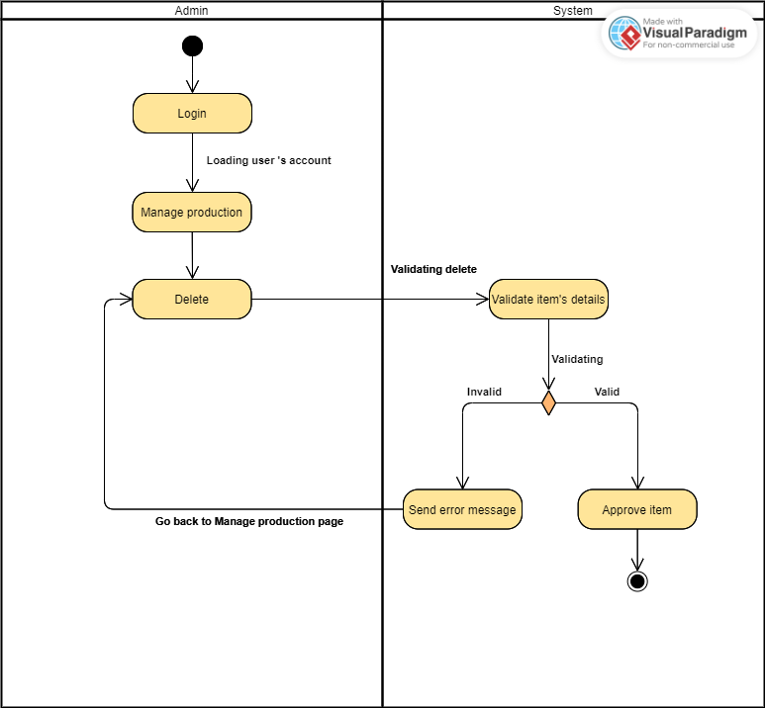
Activity diagram: delete item

Slide 13
Sequence diagram: add item

Slide 14
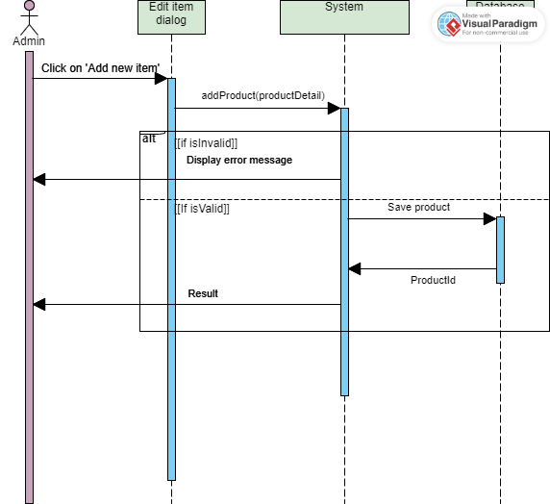
Activity diagram: delete item

Slide 15
Sequence diagram: update item

Slide 16
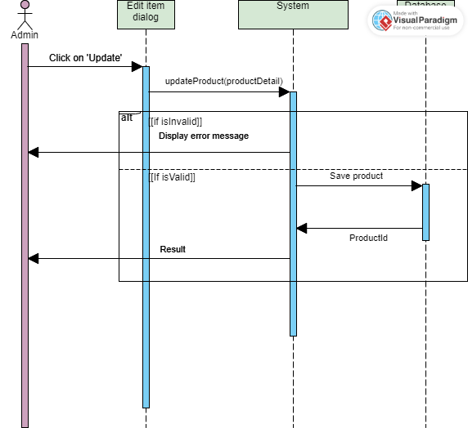
Sequence diagram: delete item

Slide 17
Sequence diagram: delete item

Slide 18

Sequence diagram: delete item

Slide 19
02
Build database

Slide 20
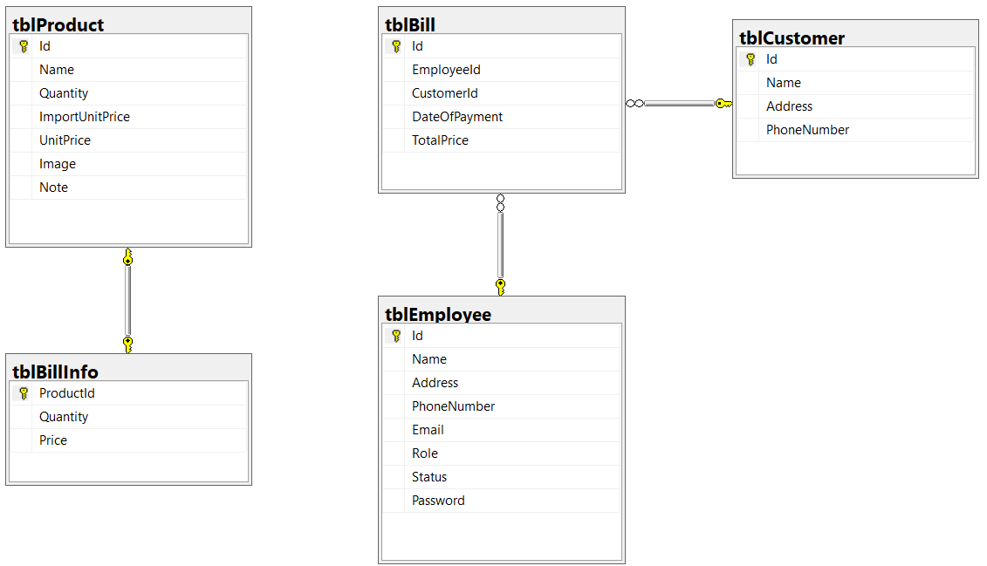

Slide 21
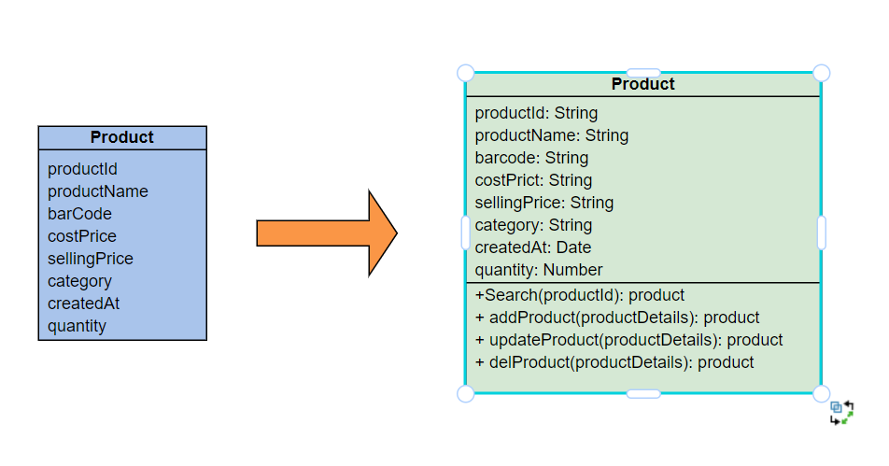
Design Classes in Detailed Design

Slide 22
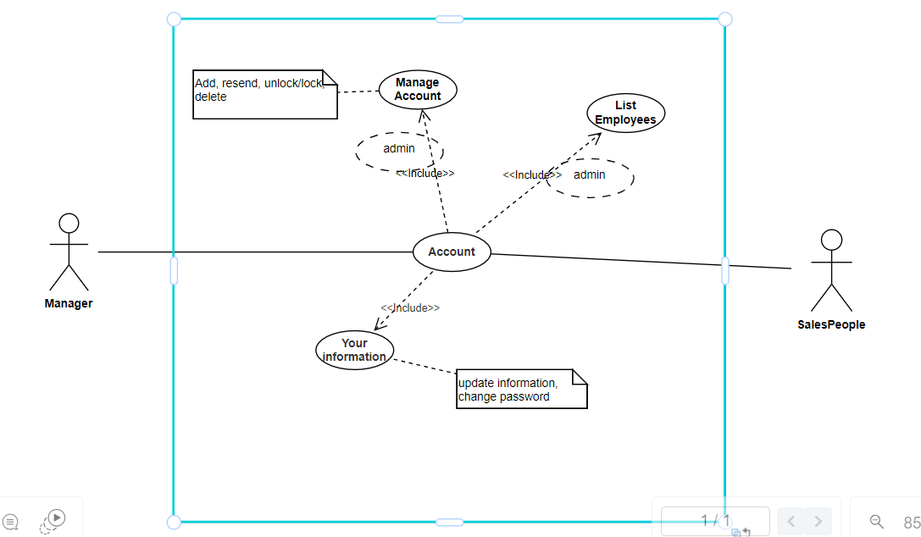
Use Case: Account

Slide 23
Use case description

Slide 24
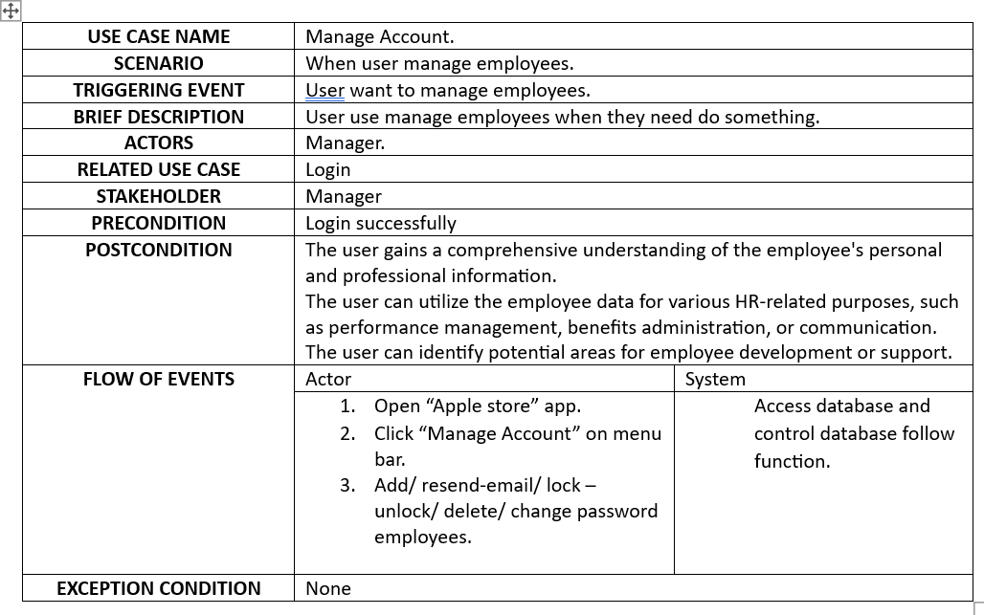
Use Case description:

Slide 25
Domain class Diagram

Slide 26
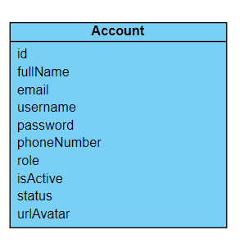
Domain class diagram:

Slide 27
Actvity Diagram

Slide 28
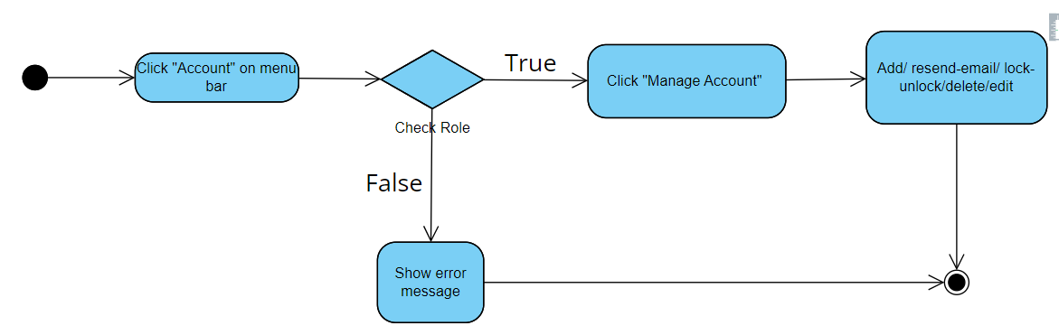
Activity diagram 1:

Slide 29
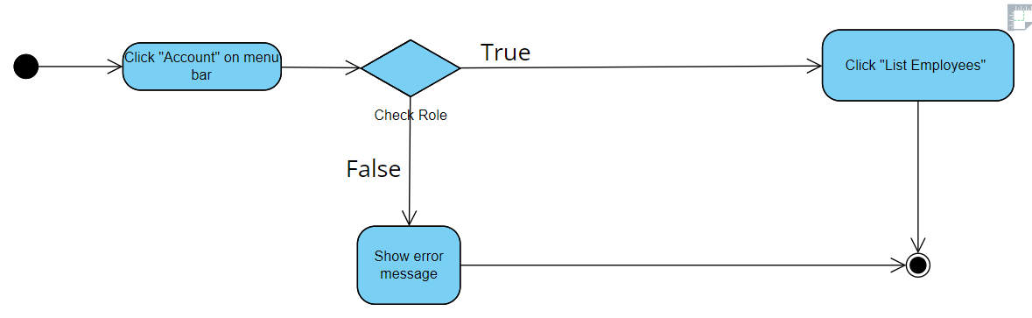
Activity diagram 2:

Slide 30
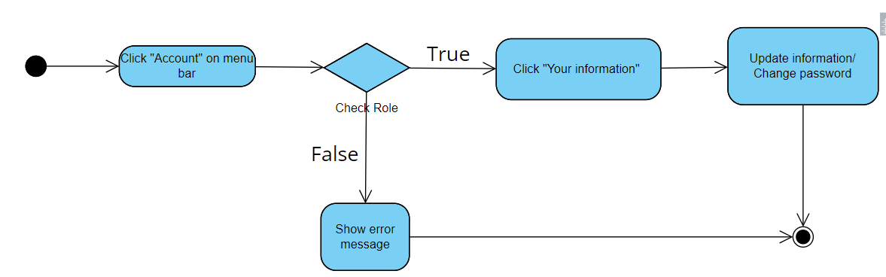
Activity diagram 3:

Slide 31
System Sequence Diagram

Slide 32
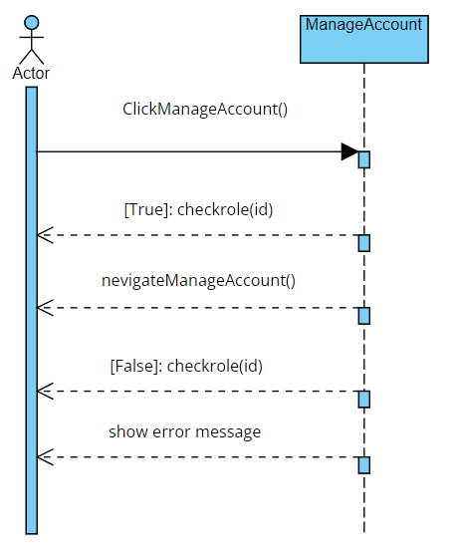
System sequence diagram 1:

Slide 33
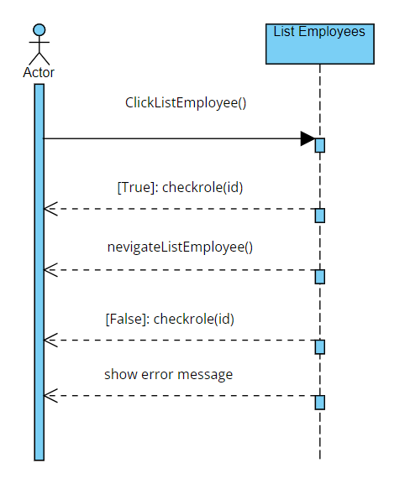
System sequence diagram 2:

Slide 34
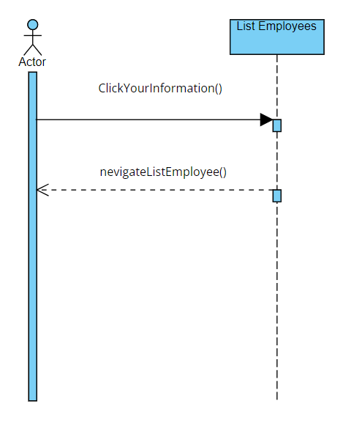
System sequence diagram 3:

Slide 35
2
Design phase

Slide 36
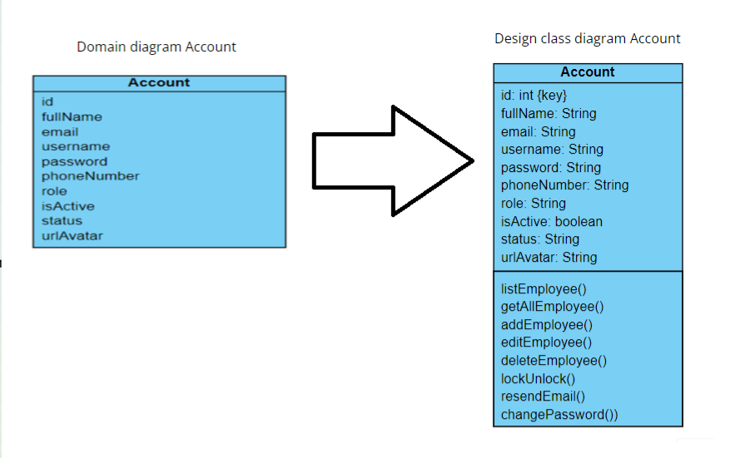

Slide 37
03
Buil test

Slide 38
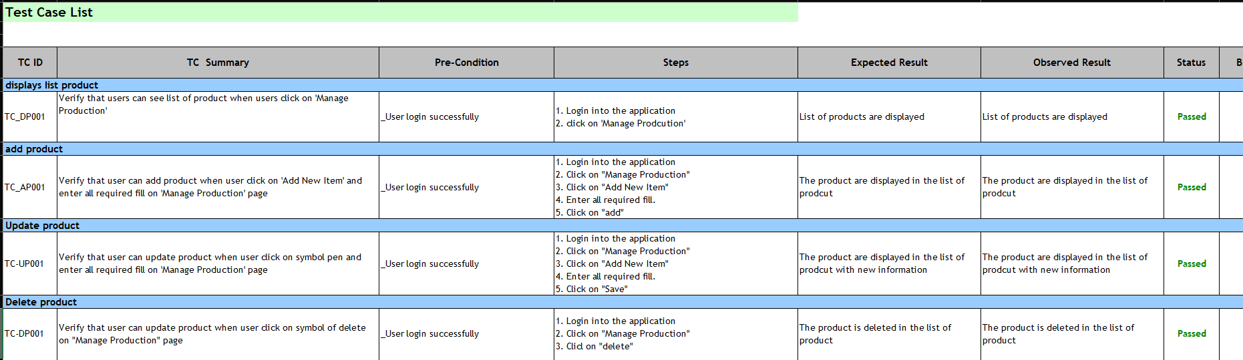
Form login

Slide 39
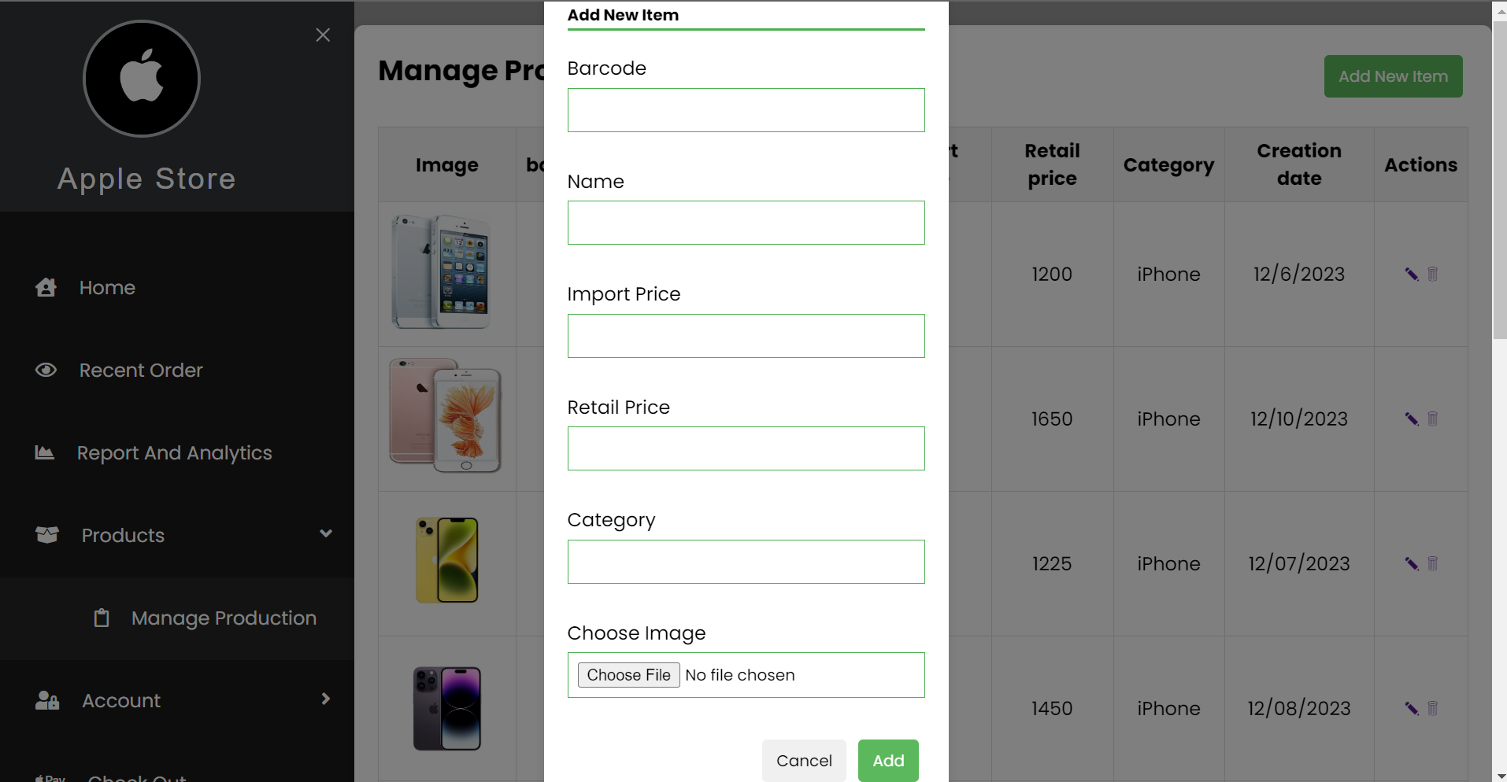
Form product

Slide 40
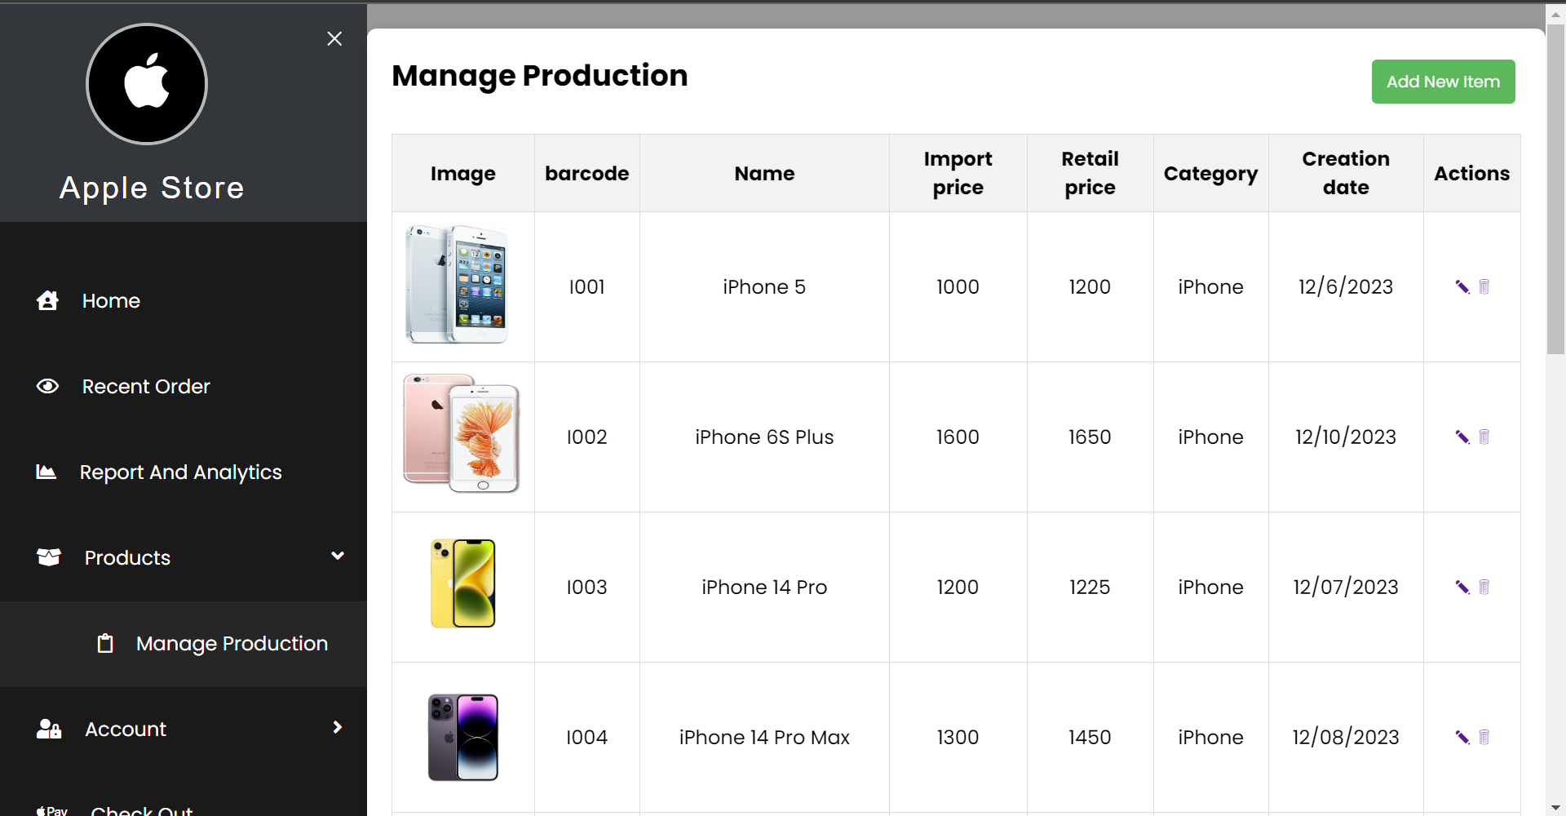
Form add product

Slide 41
THANKS !
Please keep this slide as attribution.

