Slide 1
SQL
FR
FABRIKAM RESIDENCES

Slide 2
Database
Data is a collection of a distinct small unit of information. It can be used in a variety of forms like text, numbers, media, bytes, etc. it can be stored in pieces of paper or electronic memory, etc.
A database is an organized collection of data, so that it can be easily accessed and managed.
A database is a container that holds tables and other SQL structures related to those tables.

Slide 3
Table
The information inside the database is organized into tables.
A table is the structure inside your database that contains data, organized in columns and rows
A column is a piece of data stored by your table. A row is a single set of columns that describe attributes of a single thing.

Slide 4
What is SQL
SQL stands for Structured Query Language.
It is designed for managing data in a relational database management system (RDBMS).
It is pronounced as S-Q-L or sometime See-Qwell.
SQL is a database language, it is used for database creation, deletion, fetching rows, and modifying rows, etc.
All DBMS like MySQL, Oracle, MS Access, Sybase, Informix, Postgres, and SQL Server use SQL as standard database language.

Slide 5
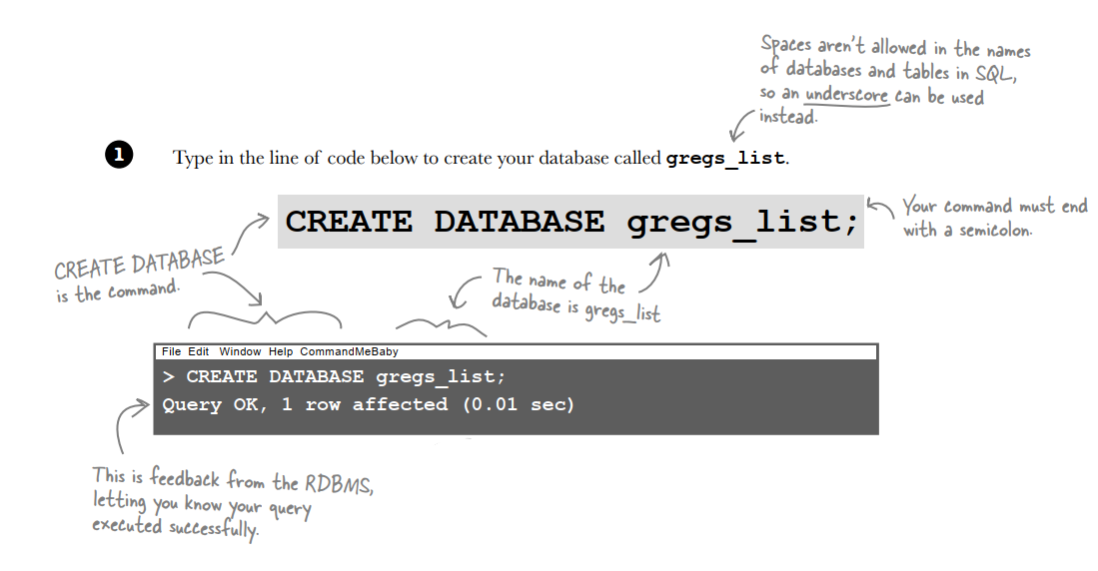
Create Database

Slide 6
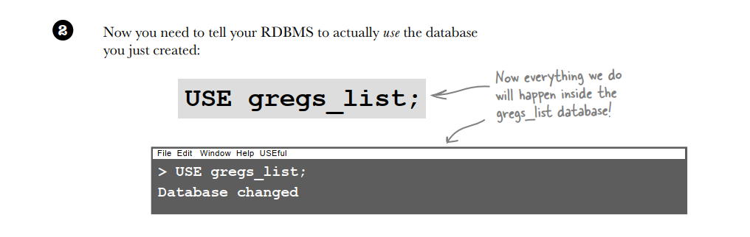
Create Database

Slide 7
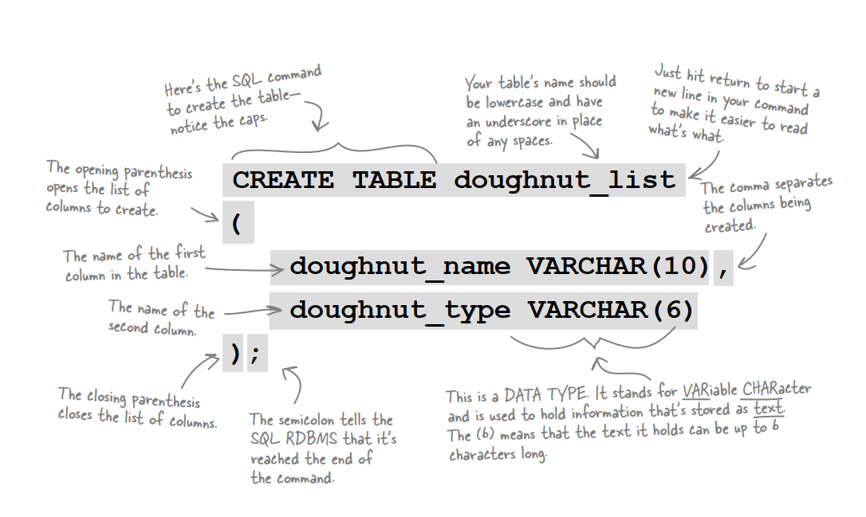
Create Table

Slide 8
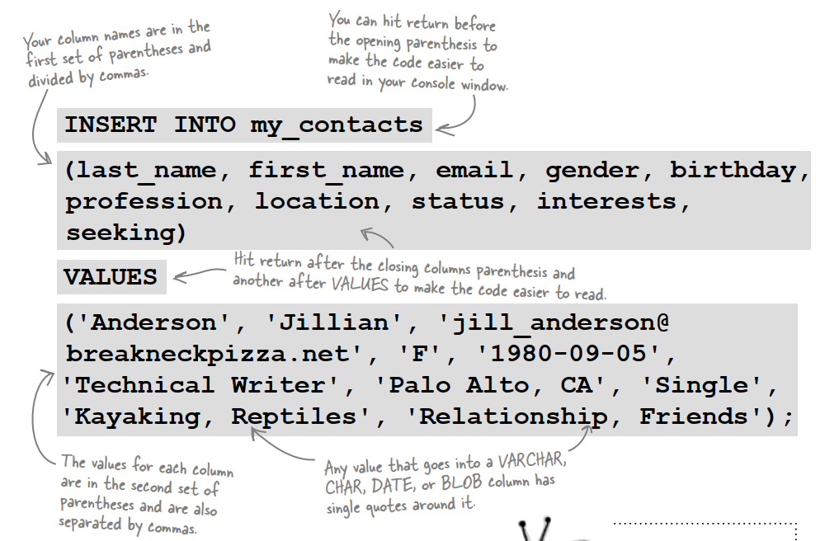
Create Table

Slide 9
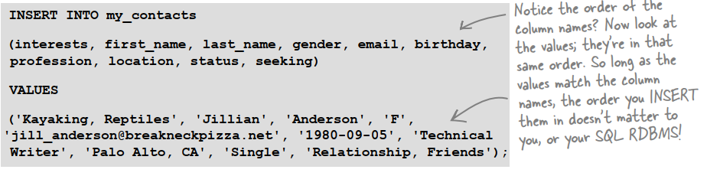
Variations on an INSERT statement
Changing the order of columns
You can change the order of your column names, as long as the matching values for each column come in that same order!

Slide 10
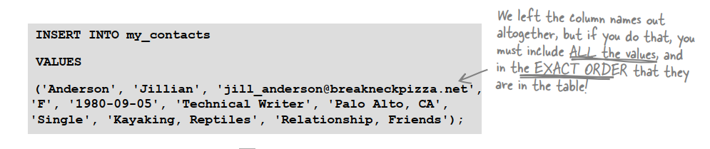
Variations on an INSERT statement
Omitting column names
You can leave out the list of column names, but the values must be all there, and all in the same order that you added the columns in

Slide 11
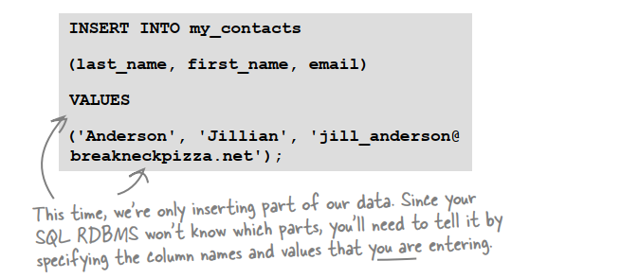
Variations on an INSERT statement
Leaving some columns out
You can insert a few columns and leave some out

Slide 12
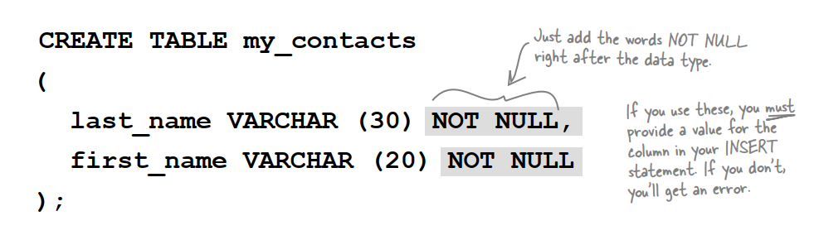
Controlling your inner NULL
There are certain columns in your table that should always have values.

Slide 13
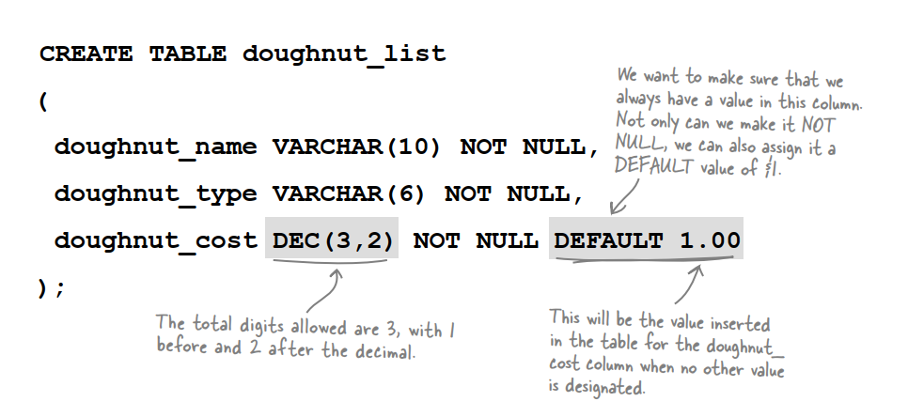
Fill in the blanks with DEFAULT
The value that follows the DEFAULT keyword is automatically inserted into the table each time a row is added if no other value is specified.

Slide 14
TABLE DELETE
You can’t use DELETE to delete the value from a single column or tableful of columns.
You can use DELETE to delete a single row or multiple rows, depending on the WHERE clause.
And, watch out for this one, you can delete every row from a table with: DELETE FROM your_table

Slide 15
TABLE UPDATE
You can use UPDATE to change the value of a single column or tableful of columns. Add more column = value pairs to the SET clause, and put a comma after each: UPDATE your_table SET frst_column = 'newvalue', second_column = 'another_value';
You can use UPDATE to update a single row or multiple rows, depending on the WHERE clause.

Slide 16
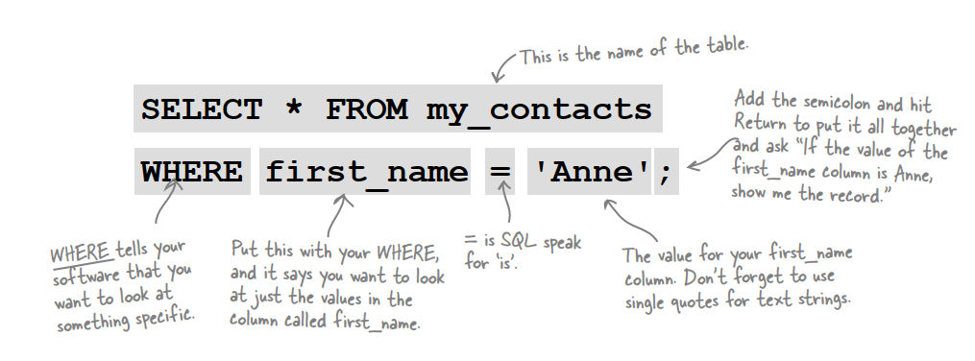
SELECT
The most commonly used SQL command is SELECT statement. It is used to query the database and retrieve selected data that follow the conditions we want.

Slide 17
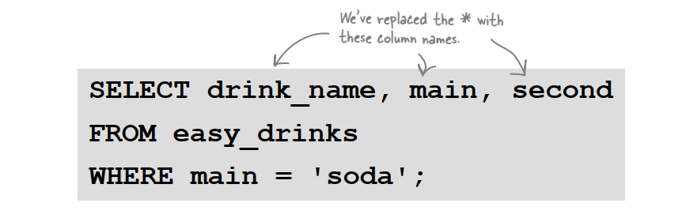
SELECT specific data
By specifying which columns we want returned by our query, we can choose only the column values we need.
SELECT specific columns for faster results

Slide 18
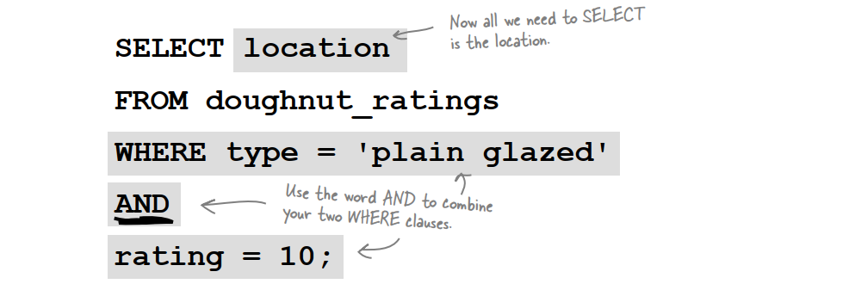
Combining your WHERE clause
The SQL AND condition is used in SQL query to create two or more conditions to be met.
The SQL OR condition is used in a SQL query to create a SQL statement where records are returned when any one of the condition met.

Slide 19
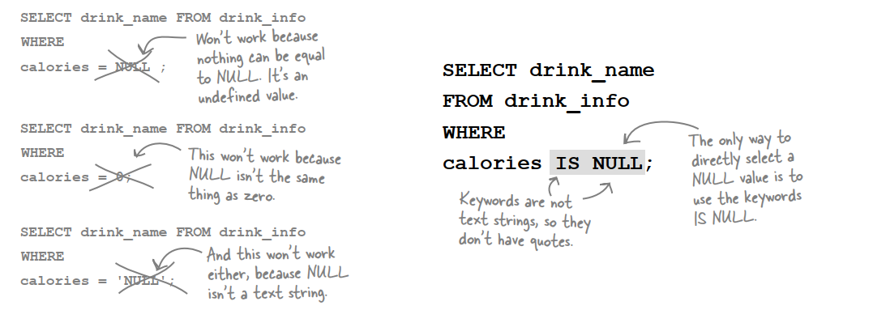
Use IS NULL to find NULLs
You can’t select a NULL value directly
But you can select it using keywords.

Slide 20
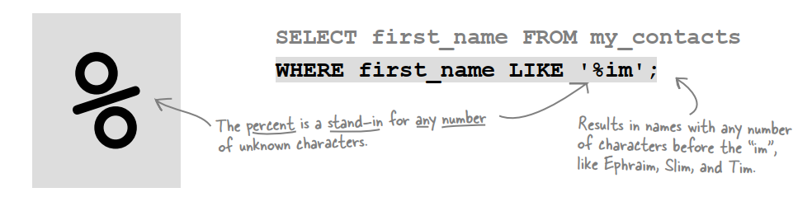
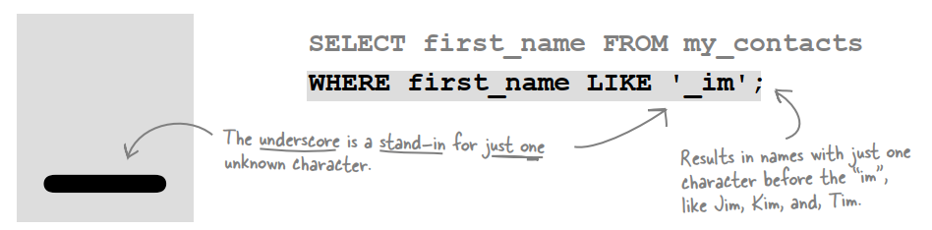
LIKE

Slide 21
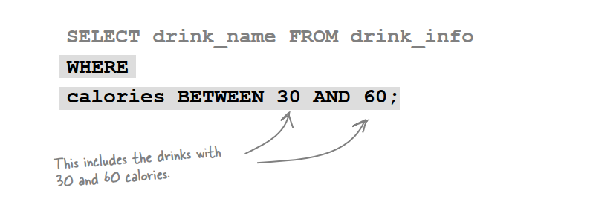
BETWEEN
Just BETWEEN instead of AND and comparison operators
BETWEEN is equivalent to using the <= and >= symbols, but not the < and > symbols

Slide 22
IN need update
Just BETWEEN instead of AND and comparison operators
BETWEEN is equivalent to using the <= and >= symbols, but not the < and > symbols

Slide 23
BETWEEN
Just BETWEEN instead of AND and comparison operators
BETWEEN is equivalent to using the <= and >= symbols, but not the < and > symbols

Slide 24
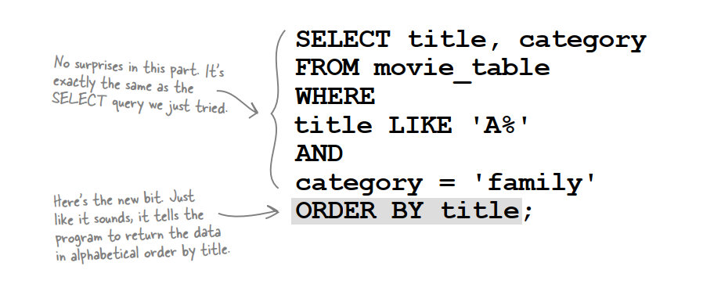
ORDER BY
The SQL ORDER BY clause is used for sorting data in ascending and descending order based on one or more columns.
Some databases sort query results in ascending order by default.

Slide 25
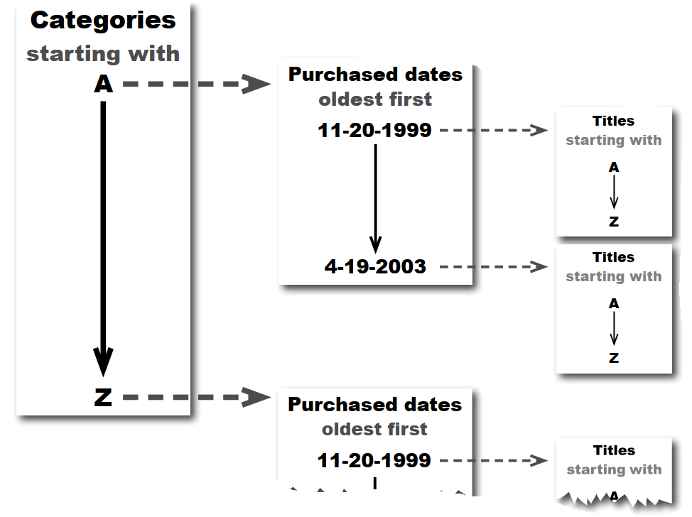
ORDER WITH MULTIPLE COLUMNS

Slide 26
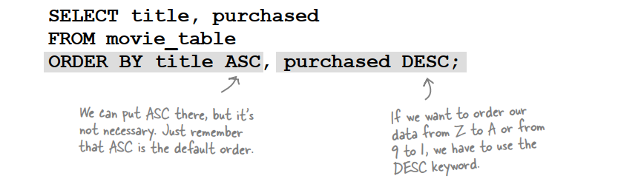
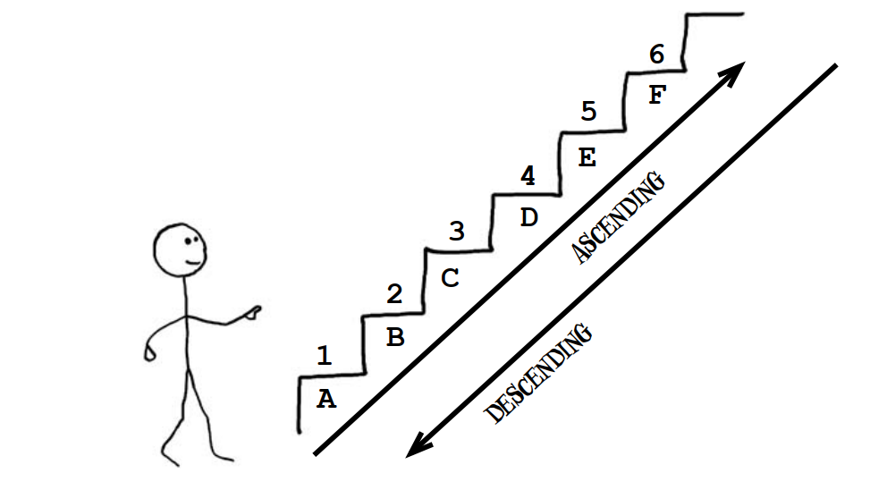
ORDER BY

Slide 27
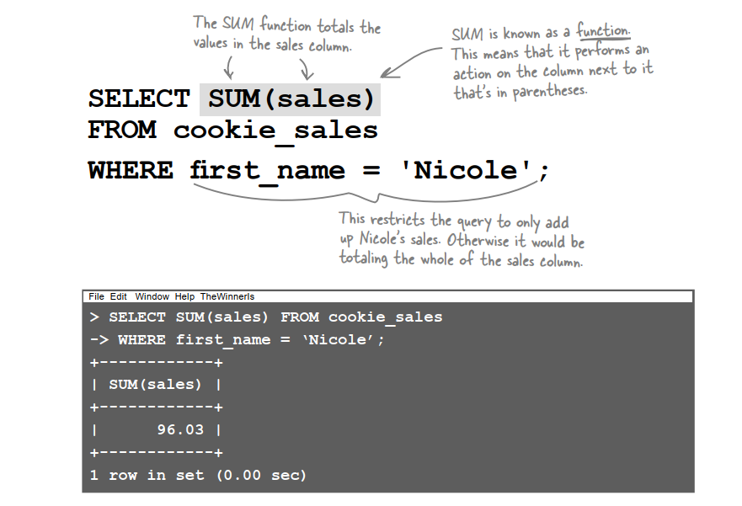
SUM

Slide 28
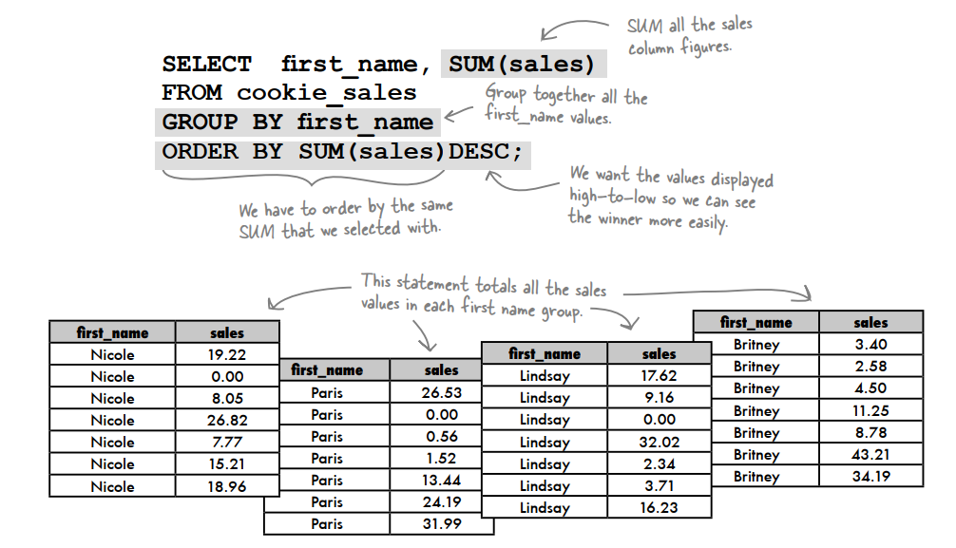
SUM all of them at once with GROUP BY

Slide 29
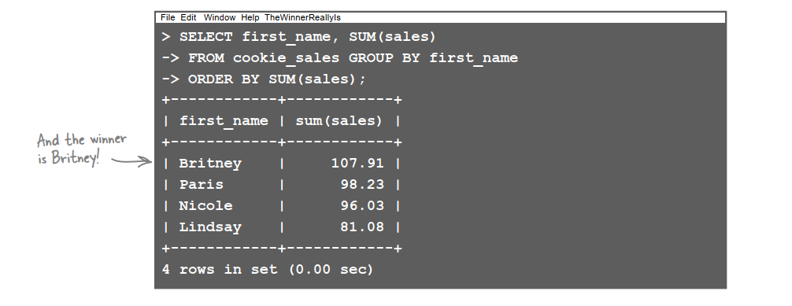
SUM all of them at once with GROUP BY

Slide 30
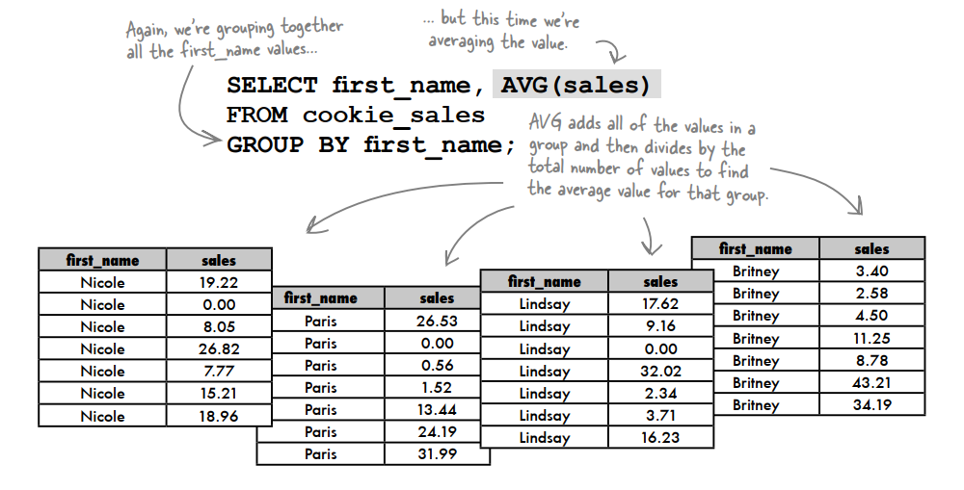
AVG with GROUP BY

Slide 31
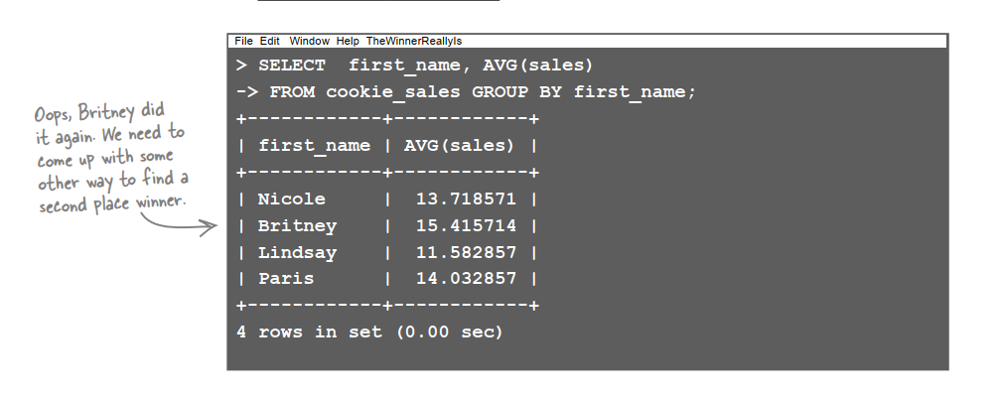
AVG with GROUP BY

Slide 32
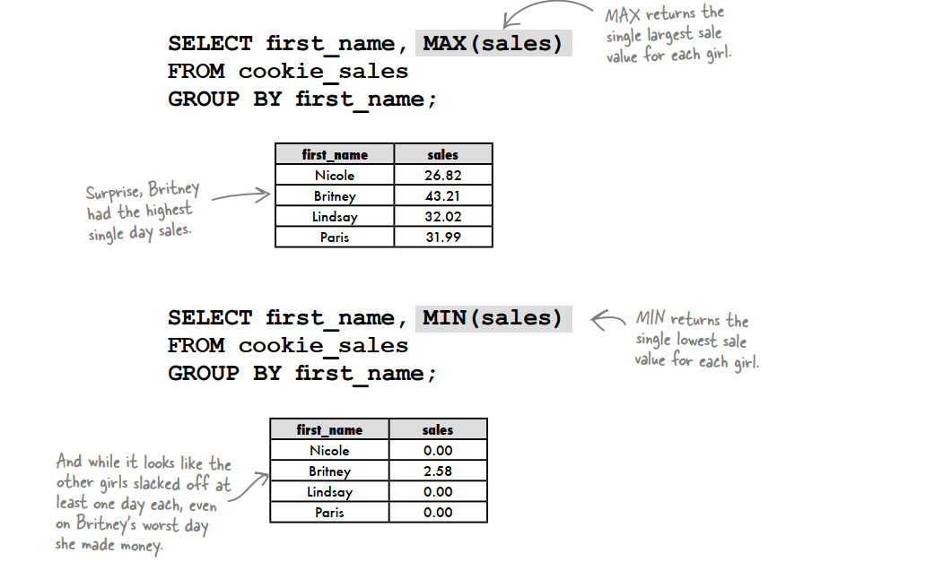
MIN and MAX

Slide 33
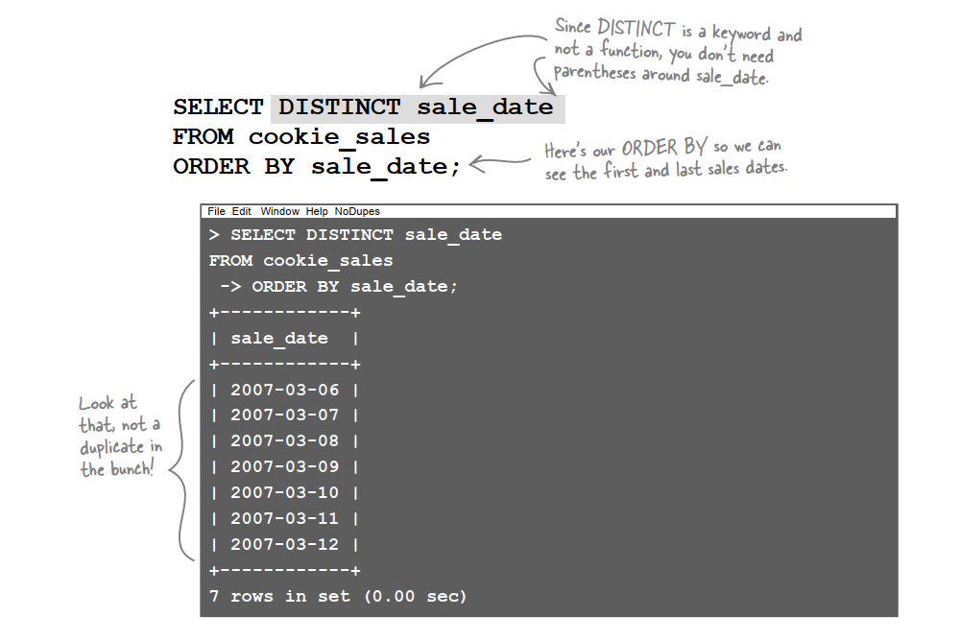
SELECT DISTINCT values

Slide 34
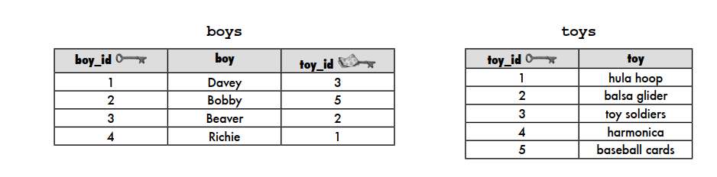
(INNER) JOIN
An INNER JOIN combines the records from two tables using comparison operators in a condition.
Columns are returned only where the joined rows match the condition.

Slide 35
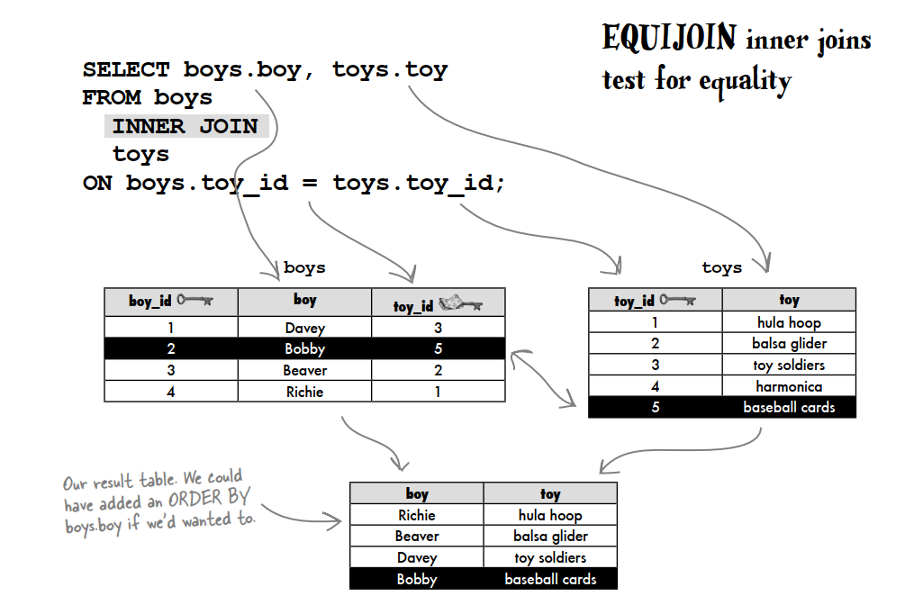
(INNER) JOIN

Slide 36
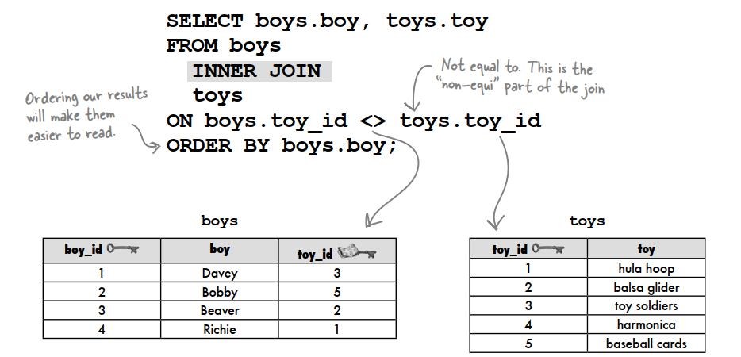
(INNER) JOIN

Slide 37
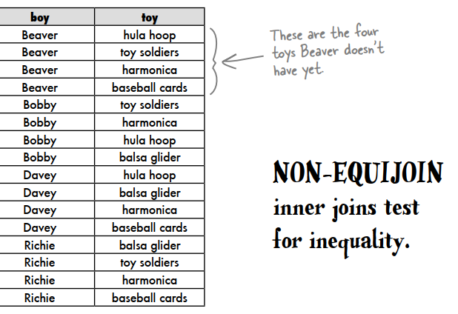
(INNER) JOIN
The non-equijoin returns any rows that are not equal. Consider the same two tables, boys and toys. By using the non-equijoin, we can see exactly which toys each boy doesn’t have

Slide 38
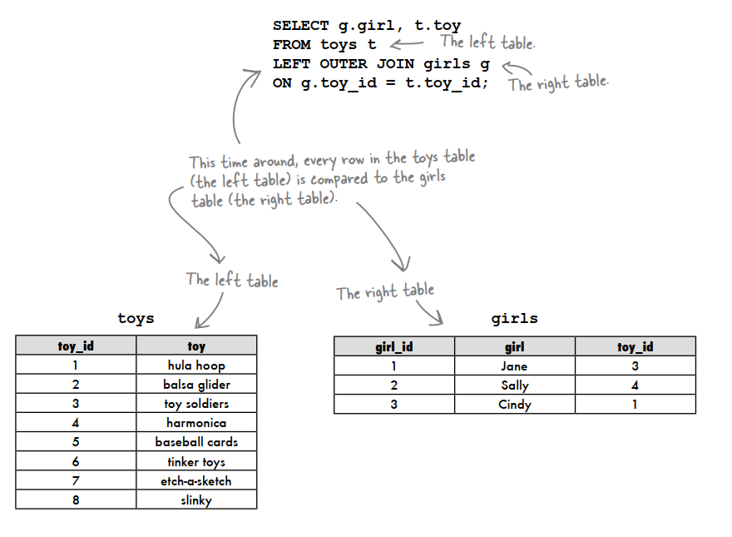
LEFT (OUTER) JOIN

Slide 39
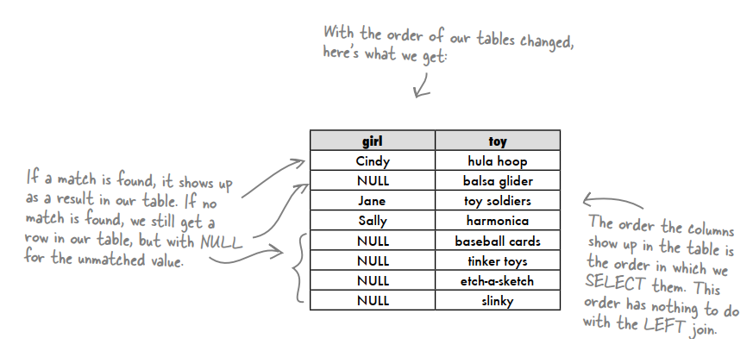
LEFT (OUTER) JOIN
A LEFT OUTER JOIN takes all the rows in the left table and matches them to rows in the RIGHT table.
In a LEFT OUTER JOIN, the table that comes after FROM and BEFORE the join is the LEFT table, and the table that comes AFTER the join is the RIGHT table.
The difference is that an outer join gives you a row whether there’s a match with the other table or not.

Slide 40
THE RIGHT (OUTER) JOIN
The right outer join is exactly the same thing as the left outer join, except it compares the right table to the left one.
It also includes the matched values from left table but if there is no matching in both tables, it returns NULL.

Slide 41
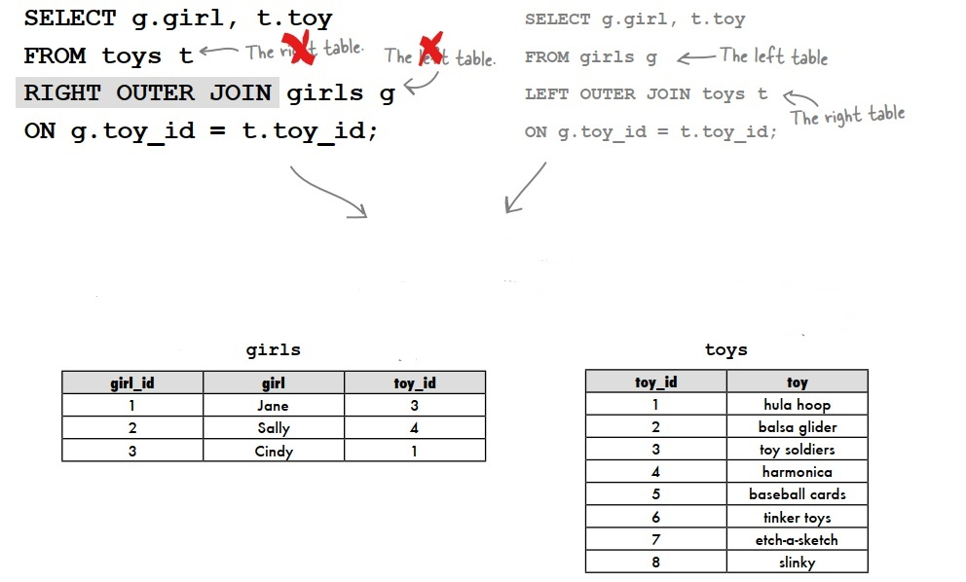
THE RIGHT (OUTER) JOIN

Slide 42

SQL JOIN

Slide 43
True Order of SQL Operations
Reference Data Types
SELECT count(*) FROM customer Yay, we have 200 customers!
SELECT count(*) FROM customer WHERE first_name = 'Steve' So 90 of them are called Steve!

Slide 44
True Order of SQL Operations
Reference Data Types
SELECT first_name, count(*) FROM customer GROUP BY first_name FIRST_NAME COUNT ------------------ Steve 90 Jane 80 Joe 20 Janet 10
SELECT first_name, last_name, count(*) FROM customer GROUP BY first_name Oops! ORA-00979: not a GROUP BY expression

Slide 45
True Order of SQL Operations
FROM
This is actually the first thing that happens, logically. Before anything else, we’re loading all the rows from all the tables and join them. But again, logically, this happens first.
Aall the JOIN clauses are actually part of this FROM clause.

Slide 46
True Order of SQL Operations
WHERE
Once we have loaded all the rows from the tables above, we can now throw them away again using WHERE

Slide 47
True Order of SQL Operations
GROUP BY
If you want, you can take the rows that remain after WHERE and put them in groups or buckets, where each group contains the same value for the GROUP BY expression (and all the other rows are put in a list for that group).
In Java, you would get something like: Map<String, List<Row>>. If you do specify a GROUP BY clause, then your actual rows contain only the group columns, no longer the remaining columns, which are now in that list. Those columns in the list are only visible to aggregate functions that can operate upon that list.

Slide 48
True Order of SQL Operations
aggregations
This is important to understand. No matter where you put your aggregate function syntactically (i.e. in the SELECT clause, or in the ORDER BY clause), this here is the step where aggregate functions are calculated. Right after GROUP BY.
This explains why you cannot put an aggregate function in the WHERE clause, because its value cannot be accessed yet. The WHERE clause logically happens before the aggregation step.
Aggregate functions can access columns that you have put in “this list” for each group, above. After aggregation, “this list” will disappear and no longer be available.
If you don’t have a GROUP BY clause, there will just be one big group without any key, containing all the rows.

Slide 49
True Order of SQL Operations
HAVING
but now you can access aggregation function values. For instance, you can check that count(*) > 1 in the HAVING clause. Because HAVING is after GROUP BY (or implies GROUP BY), we can no longer access columns or expressions that were not GROUP BY columns.

Slide 50
True Order of SQL Operations
SELECT
Finally. We can now use all the rows that are produced from the above clauses and create new rows / tuples from them using SELECT.
We can access all the window functions that we’ve calculated, all the aggregate functions that we’ve calculated, all the grouping columns that we’ve specified, or if we didn’t group/aggregate, we can use all the columns from our FROM clause.
Remember: Even if it looks like we’re aggregating stuff inside of SELECT, this has happened long ago, and the sweet sweet count(*) function is nothing more than a reference to the result.

Slide 51
True Order of SQL Operations
DISTINCT
Yes! DISTINCT happens after SELECT, even if it is put before your SELECT column list, syntax-wise. But think about it. It makes perfect sense. How else can we remove distinct rows, if we don’t know all the rows (and their columns) yet?

Slide 52
True Order of SQL Operations
ORDER BY
It makes total sense to postpone the decision of ordering a result until the end, because all other operations might use hashmaps, internally, so any intermediate order might be lost again. So we can now order the result.
Normally, you can access a lot of rows from the ORDER BY clause, including rows (or expressions) that you did not SELECT.

Slide 53
True Order of SQL Operations
LIMIT

Slide 54
True Order of SQL Operations
Example
SELECT first_name, count(*) FROM customer WHERE count(*) > 1 GROUP BY first_name
Wrong: Because aggregate functions are calculated *after* GROUP BY, and WHERE is applied *before* GROUP BY

Slide 55
True Order of SQL Operations
Example
SELECT first_name, count(*) FROM customer GROUP BY first_name HAVING count(*) > 1
Correct: Because aggregate functions are calculated *after* GROUP BY but *before* HAVING, so they're available to the HAVING clause.

Slide 56
True Order of SQL Operations
Example
SELECT first_name, count(*) FROM customer GROUP BY first_name ORDER BY count(*) DESC
Correct: Both SELECT and ORDER BY are applied *after* the aggregation step, so aggregate function results are available

Slide 57
True Order of SQL Operations
Example
SELECT first_name, last_name, count(*) FROM customer GROUP BY first_name
Wrong: Because the GROUP BY clause creates groups of first names, and all the remaining customer columns are aggregated into a list, which is only visiblbe to aggregate functions

Slide 58
True Order of SQL Operations
Example
SELECT first_name, MAX(last_name), count(*) FROM customer GROUP BY first_name
Correct: Because now, we're using an aggregate function to access one of the columns that have been put into that list of columns that are otherwise no longer available after the GROUP BY clause

Slide 59
True Order of SQL Operations
Example
SELECT MAX(last_name), count(*) FROM customer GROUP BY first_name
Correct

Slide 60
INDEX
Indexes are special lookup tables that the database search engine can use to speed up data retrieval. Simply put, an index is a pointer to data in a table. An index in a database is very similar to an index in the back of a book.
The Data Structure Index is Sorted to optimize query efficiency
An index helps to speed up SELECT queries and WHERE clauses, but it slows down data input, with the UPDATE and the INSERT statements. Indexes can be created or dropped with no effect on the data.
Indexes should not be used on small tables.
For tables that are heavily updated, use as few columns as possible in the index, and don’t over-index the tables.

Slide 61
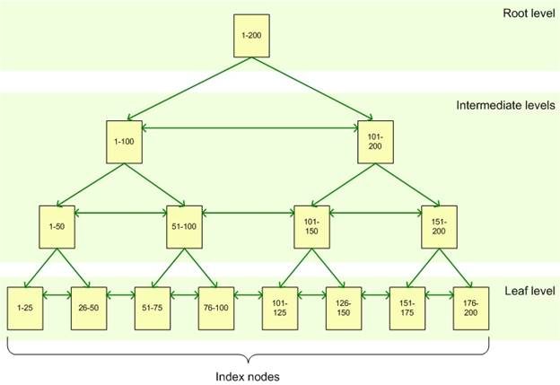
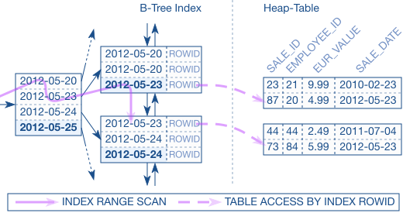
INDEX

Slide 62


