Slide 1
Tasks Manager
Thanh Dung Nguyen - 615724

Slide 2
Problem Statement
Design and develop a software solution for a company to manage the tasks for employees
The system will be used by system administrator, managers and team members
Each employee (admin, manager, team member) is given a unique employee ID, first name, last name, position and email are recorded into the system. Each employee is managed by a direct manager who is also an employee of the company
The managers are responsible for planning the work week as sprints. The manager will list all the required tasks, set the priorities, assign the tasks to appropriate employees, add the most important tasks to current sprint for employees to work on those first, and add the less important tasks to some next sprints to work on them later.
Employees work on their assigned tasks by priorities. Employees need to check the task description to understand the requirements, update the estimated time for manager to update the plan, record the start and finish time for each task.
At the end of the sprint, the manager will summarize the working status of the sprint, identify the unfinished tasks to create new plan for the next sprint

Slide 3
Requirements
Actors
System administrator
Manager
Team member
Features
Users need to login before using the system
System administrator can add new user profile for employees to work with the system
Manager can create sprints, set the start date and end date for the sprints
Manager can add new tasks, enter title, priority and description
Manager can add tasks to existing sprints
Manager can assign tasks to employees
Employees can find the list of tasks which were assigned to them, set the estimated time, record the start time and finish time for each task
Manager can get the list of tasks which were not done for each sprint

Slide 4
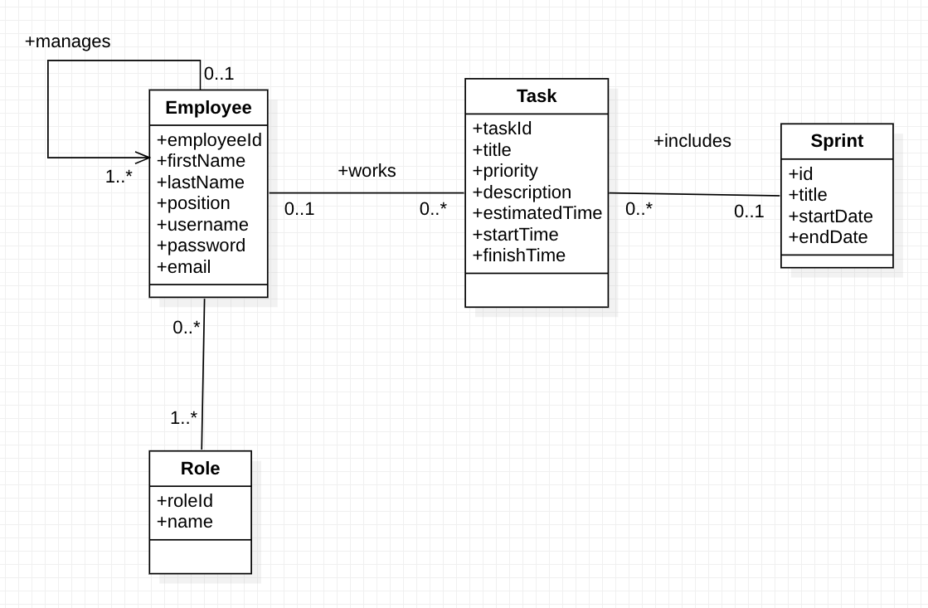
Domain Model Class Diagram

Slide 5
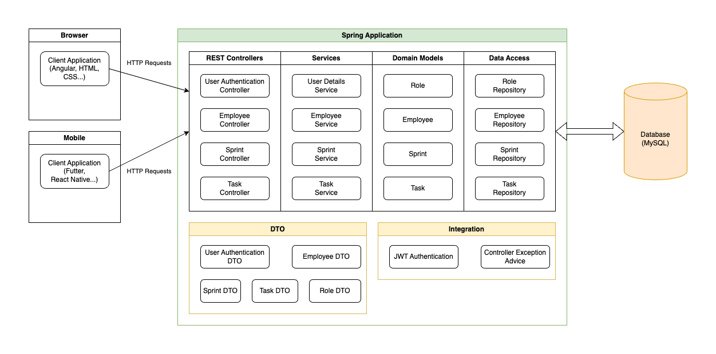
Architecture Diagram

Slide 6
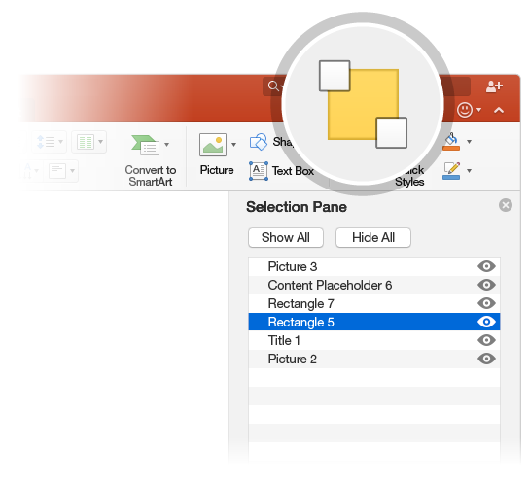

Database Design Model
The Selection Pane is a great tool to organize and manage the objects on a slide, such as images, shapes, and text boxes. The Selection Pane is a subscription-only feature. If you have an Office 365 subscription, you can try it yourself:
Try it:
Go to the Home tab, select Arrange > Selection Pane.
Try renaming an object: Double-click the name “Large grey rectangle” in the Selection Pane and type a new name.
Try changing the order of objects: In the Selection Pane, drag and drop the large grey rectangle so it’s at the top.
To toggle visibility of objects in the Selection Pane, click Show/Hide checkbox.

Slide 7

Demo
SELECT THE ARROW WHEN IN SLIDE SHOW MODE
Find out more at the PowerPoint for Mac Help Center.
Visit the PowerPoint team blog.
Notes:
In Slide Show mode, select the arrows to visit links.

