Slide 1
New Technology in Application Development
02. Scale-Web Application Development in Cloud Computing

Slide 2
Content
Scale-web architecture
Scaling Web applications on the cloud

Slide 3
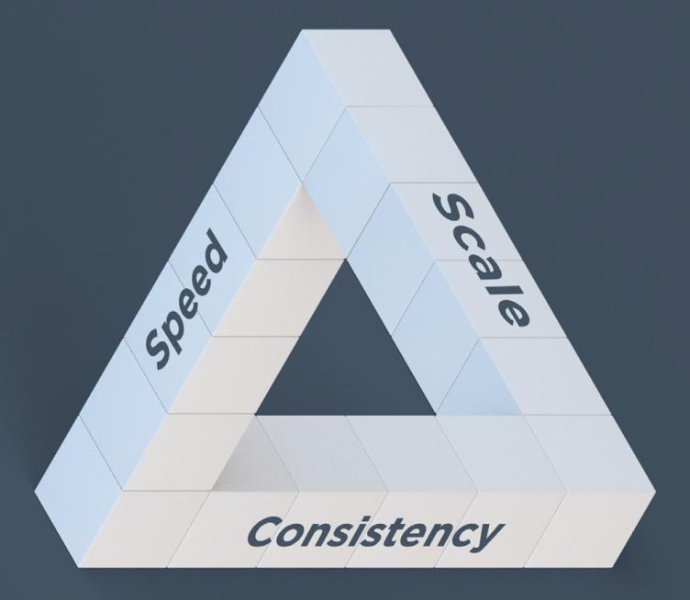
Speed, scale and consistency
Now, all enterprise IT organizations must adopt approaches that enable resilient, flexible infrastructure.
This infrastructure can support the kind of speed, scale and consistency that business demands in the new era of web-scale IT.

Slide 4
Web-scale IT
Customers, whether outside the corporate firewall or behind it, have higher expectations for speed, reliability, and personalized content. They expect fast response times and great customer service.
Fast response to consumer demand requires infrastructure that can react quickly to changing business needs while maintaining its resiliency and reliability. The name for this type of infrastructure is web-scale IT
By 2017, Web-scale IT will be an architectural approach found operating in 50 percent of global enterprises, up from less than 10 percent in 2013.

Slide 5
Defining Web-Scale IT
Scale in this sense has several dimensions. One dimension is size, which is often measured by the number of physical and virtual servers deployed.
A second dimension is complexity, which is defined in terms of the sophistication of the technology stack and the nature of service interdependencies. The number of people required to maintain and support infrastructure is a third dimension of scale.
There are also dimensions for agility and speed. Speed is defined by time to market, and agility is the ability to respond quickly as business needs change.
It’s important to remember that web-scale IT also means web-speed IT. Business agility is a central component. Companies of all sizes can adopt the web-scale principles.

Slide 6
Web-scale IT characteristics
Web-scale IT is characterized by:
The use of open-source software and commodity hardware to create infrastructure that can be completely controlled.
The factoring of applications into resilient, independent services that use web protocols and architectural patterns.
The elimination of the traditional silos of dev and ops.
The adoption of workflows that enable agility and speed.

Slide 7
What is Automation?
Automation is a major underpinning of web-scale IT.
Using an automation platform gives you access to the same patterns of success that the Web innovators had to develop themselves
When you automate your infrastructure, you describe all the tasks you want to perform as executable code.
If you’re not using an automation platform, you may perform this task by hand. If it’s a manual task, imagine what it would be like if you had to do the same procedure for 50 servers, 500 servers or even 50,000 servers. With automation, you simply run the code once and all the servers are configured.
Also, automation platforms can give you a global view of your network, which is important when accounting for dependencies between network components, while scripts can only give you a piecemeal view.

Slide 8
Benefits of automation
Automation enables speed, scale and consistency.
SPEED
Automation increases speed in many ways.
Simply replacing manual procedures with automated ones makes infrastructure management more efficient. However, as your use of automation becomes more sophisticated, you’ll find that you’ll markedly increase your deployment rate and the ease with which you manage all your resources, both on-premises and in the cloud.
An automated infrastructure makes techniques such as A/B testing possible. You can quickly find out what works for your customers before investing huge amounts of time and money.
Quick response to changing business needs is essential. enables speed, scale and consistency.

Slide 9
Benefits of automation (contd.)
SCALE
Automation allows you to scale up (or down) in response to demand.
Automation is a critical component of any strategy that requires dynamic provisioning of infrastructure at scale.
Automation enables elastic scale, whether you’re operating on-premises, in the public cloud, or in a hybrid environment.
CONSISTENCY
Consistency means conformance to your business’s policies. An automation platform checks to make sure that each server is within policy and corrects it if it isn’t.
Consistency makes infrastructure more robust and reduces risk in many ways. The immediate benefit is that you have a standardized process for provisioning servers.

Slide 10
Benefits of automation (contd.)
CONSISTENCY (contd.)
Once you’ve expressed your infrastructure as code, you can test it to make sure it performs as you intended. You can also save it in version control. You’ll be able to keep track of changes and, if one version doesn’t do what you thought, you can rollback to the previous one.
A consistent environment makes it much easier to migrate applications to the cloud. Consistency gives you control and control reduces risk.
With automation, moving legacy applications to the cloud is an orderly process.
Another advantage is that, because your infrastructure is code, you can always recover it. Even if disaster strikes you can recreate your entire infrastructure, from the bare metal up.

Slide 11
Defining the automation platform
To provide the foundation for building and managing web-scale IT infrastructures, a good automation platform has these essential characteristics:
It creates a dependable view of your entire network’s state.
It can handle complex dependencies among the nodes of your network.
It is fault tolerant.
It is secure.
It can handle multiple platforms such as Linux, Ubuntu and Windows Server, as well as legacy systems.
It can manage cloud resources.
It provides a foundation for innovation.

Slide 12
What is scalability?
A desirable property of a system, which indicates its ability to:
Gracefully handle increasing demand.
Increase its capacity (transactions, processing, storage, throughput) proportionally with the addition of more resources (nodes, CPU, storage, bandwidth).
Scaling up
Add resources to a single node in the system.
Pros: transparent to the software, almost “linear” scale, quickly fix performance issues
Cons: risky, may impact on service, can be very expensive, cannot scale “infinitely”

Slide 13
What is scalability? (contd.)
Scaling out
Add more nodes to the system.
Pros: cheap, almost no impact on service, can scale “infinitely”
Cons: the system must be properly designed, could be complex to operate

Slide 14
Elasticity
The ability to quickly and gracefully increase capacity by adding more resources and also to quickly and gracefully release resources when the required capacity decreases.
In a few words: the ability to quickly scale a system capacity up and down based on the demand in an almost real-time fashion

Slide 15
Web Application Components with AWS
Web/Application servers: to serve dynamic pages
Databases: to store user data
File Storage: to store images, videos, documents
Computing nodes: to execute background tasks like image conversion, video transcoding, email delivery
Messaging infrastructure: asynchronous and reliable communication between nodes
Load balancers: distribute requests
Monitoring infrastructure: to check that everything is working well and track the system usage

Slide 16
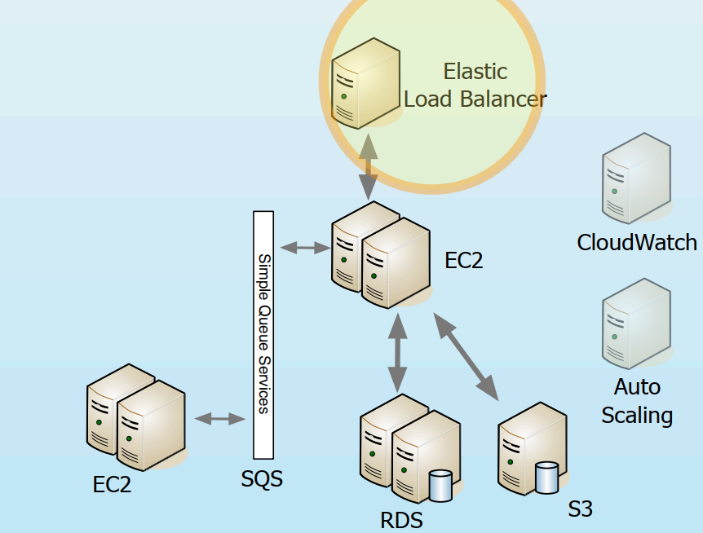
Web Application Components with AWS

Slide 17
Web/Application servers
EC2 is the Elastic Compute Cloud.
Users can launch virtual machines (called instances) with a CLI tool or an API.
They have dynamic IPs but you can reserve fixed IPs and associate them to an instance.
Instances are created from customizable “images” and they come in many sizes (memory and CPU).
You pay for the CPU time and the bandwidth.
When an instance is turned off, you lose the data in it (volatile storage).

Slide 18
Databases
Persistent users’ data
RDS is the Relational Database Service.
It’s a fully managed MySQL database.
You can scale it as needed (CPU and available storage).
It’s automatically patched when needed.
Supports multi-master and replication.
You can create backups periodically or with a single API call.
You pay for CPU usage, dedicated primary storage, backup storage (optional) and bandwidth used.

Slide 19
Databases (contd.)
The NoSQL alternative
DynamoDB is the NoSQL.
It’s a fully managed, scalable “data store”.
Simple Web service API no SQL
No need to define schema in advance.
Scales automatically, you just keep adding data.
You pay for CPU time, used storage and bandwidth.

Slide 20
Others
Storing files and images
S3 is the Simple Storage Service.
Simple API (REST and SOAP) to write objects (files) in buckets (similar to directories)
Scaling out the app
We can distribute the requests with the Elastic Load Balancing service
Monitors the available instances and routes incoming requests to “healthy” instances
Supports sticky sessions and SSL termination.
You pay for the time and the bandwidth transferred.
With RDS we can easily setup read replicas for our database to scale the read capacity.

Slide 21
Others (contd.)
Enabling elasticity
With AWS CloudWatch we can monitor our servers’ usage in real time: CPU, Disk and Network for EC2 instances and databases.
This information can be used to enable Auto Scaling: automatically scale your Amazon EC2 capacity up or down according to conditions you define (based on average CPU utilization, network activity or disk utilization).
New EC2 instances get automatically added to or removed from the Elastic Load Balancer

Slide 22


