Slide 1
New Technology in Application Development
04. DynamoDB and RDS

Slide 2
Content
DynamoDB
Definitions
Data type
Operation with item
RDS
Microsoft SQL Server
MySQL
Oracle Database

Slide 3







DynamoDB
Amazon DynamoDB
attribute
attributes
global secondary index
item
items
table

Slide 4
DynamoDB - Overview
Amazon DynamoDB is a fully managed NoSQL service that works on key-value pair and other data structure documents provided by Amazon.
It requires only a primary key and doesn’t require a schema to create a table. It can store any amount of data and serve any amount of traffic.
With DyanmoDB, you can expect a good performance even when it scales up. It is a very simple and small API that follows key-value method to store, access and perform advanced data retrieval.
DynamoDB comprises of three fundamental units known as table, attribute, and items. A table holds a set of items, an attribute is the simplest element that stores data without any further division and item holds a set of attributes.

Slide 5
DynamoDB – Overview (contd.)
Managed NoSQL database service
Supports both document and key-value data models
Highly scalable
Consistent, single-digit millisecond latency at any scale
Highly available - 3x replication
Simple and powerful API

Slide 6
Basic Concepts
Table, Items, and Attributes
A table can be visualized as a group of items. Taking an example of Employee records, you will have Employee Name, Employee ID, Address and Phone Number all such items will be stored in a table.
An item is a set of attributes in a table. You can also understand an item as a set of attributes that can uniquely define your entry in a table. For example, an item in Employee records will identify a single employee.
An attribute is a single field that is attached to an item. E.g. Employee Name.

Slide 7
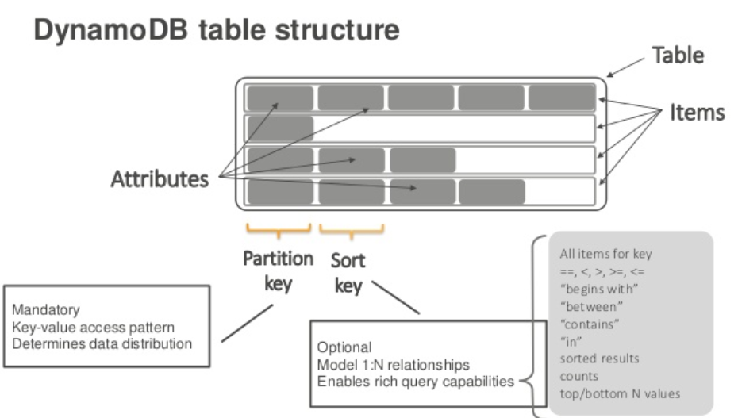
Basic Concepts (contd.)
Table, Items, and Attributes

Slide 8
Basic Concepts (contd.)
Primary Key
A primary key is a unique attribute that is necessary while creating a table, it cannot be null at any given point. Hence, while inserting an item into the table, a primary key attribute is a must. Two items cannot have a similar primary key. DynamoDB supports two types of Primary key.
Simple Primary Key
A simple primary key is also known as Partition key, this is basically a single attribute. DynamoDB uses Partition key’s value to distinguish items in a table.
Composite Primary Key
A composite primary key is also known as Partition key and Sort key. This type of key is generally made up of two items. The primary component is the Partition key and the secondary component is the Sort key.

Slide 9
Basic Concepts (contd.)
Secondary Index
A secondary index can be understood as the attribute that lets you query the data, with or without the help of a Primary key.
These indexes allow you to query table data with an alternate key. Though DynamoDB does not force their use, they optimize querying.
DynamoDB uses two types of secondary indexes
Global Secondary Index − This index possesses partition and sort keys, which can differ from table keys.
Local Secondary Index − This index possesses a partition key identical to the table, however, its sort key differs.

Slide 10
Basic Concepts (contd.)
DynamoDB Streams
This is an additional/optional feature provided by DynamoDB to keep a track of data modification events in a table.
Here, each event is represented by a stream record and if this service is enabled, then you get a new event every time when there is a new item created, an item is updated or an item is deleted.

Slide 11
Accessing Amazon DynamoDB
Accessing DynamoDB is very easy and can be done using the following methods:
Console
CLI (Command Line Interface)
Using API
Using AWS SDKs you can make the most of DynamoDB. AWS SDK supports a variety of languages like Java, JavaScript, .NET, Python, PHP etc. For more details, click here.

Slide 12
DynamoDB - Environment
Local Install
The AWS (Amazon Web Service) provides a version of DynamoDB for local installations. It supports creating applications without the web service or a connection.
It also reduces provisioned throughput, data storage, and transfer fees by allowing a local database.
java -Djava.library.path=./DynamoDBLocal_lib -jar DynamoDBLocal.jar –sharedDb
Default port: 8000
Use a JavaScript shell: http://localhost/shell

Slide 13
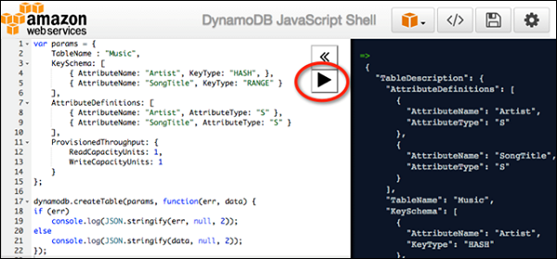
DynamoDB - Environment
Use a JavaScript shell: http://localhost/shell

Slide 14
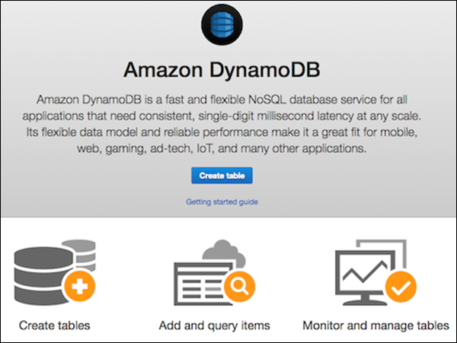
DynamoDB – Environment (contd.)
GUI Console (https://console.aws.amazon.com/dynamodb/home)

Slide 15
DynamoDB data types
Attribute Data Types. DynamoDB supports a large set of data types for table attributes. Each data type falls into one of the three following categories
Scalar − These types represent a single value, and include number, string, binary, Boolean, and null.
Document − These types represent a complex structure possessing nested attributes, and include lists and maps.
Set − These types represent multiple scalars, and include string sets, number sets, and binary sets.
Remember DynamoDB as a schemaless, NoSQL database that does not need attribute or data type definitions when creating a table. It only requires a primary key attribute data types in contrast to RDBMS, which require column data types on table creation.

Slide 16
DynamoDB data types
Scalars
Numbers − They are limited to 38 digits, and are either positive, negative, or zero.
String − They are Unicode using UTF-8, with a minimum length of >0 and maximum of 400KB.
Binary − They store any binary data, e.g., encrypted data, images, and compressed text. DynamoDB views its bytes as unsigned.
Boolean − They store true or false.
Null − They represent an unknown or undefined state.
Document
List − It stores ordered value collections, and uses square ([...]) brackets.
M`ap − It stores unordered name-value pair collections, and uses curly ({...}) braces.
Set
Sets must contain elements of the same type whether number, string, or binary. The only limits placed on sets consist of the 400KB item size limit, and each element being unique.

Slide 17
DynamoDB data types
Action Data Types. DynamoDB API holds various data types used by actions. You can review a selection of the following key types −
AttributeDefinition − It represents key table and index schema.
Capacity − It represents the quantity of throughput consumed by a table or index.
CreateGlobalSecondaryIndexAction − It represents a new global secondary index added to a table.
LocalSecondaryIndex − It represents local secondary index properties.
ProvisionedThroughput − It represents the provisioned throughput for an index or table.
PutRequest − It represents PutItem requests.
TableDescription − It represents table properties.

Slide 18
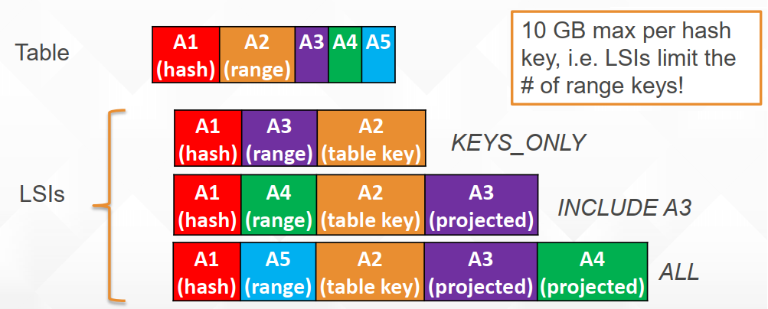
Indexes
Local secondary index (LSI)
Alternate range key attribute
Index is local to a hash key (or partition)

Slide 19
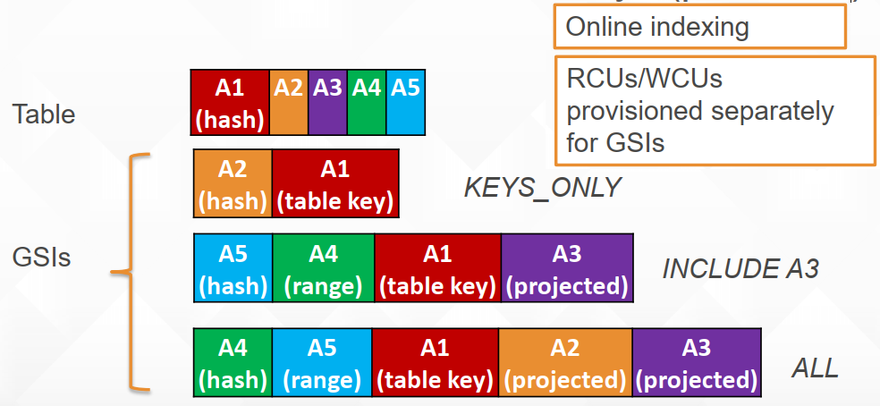
Indexes (contd.)
Global secondary index (GSI)
Alternate hash (+range) key
Index is across all table hash keys (partitions)

Slide 20
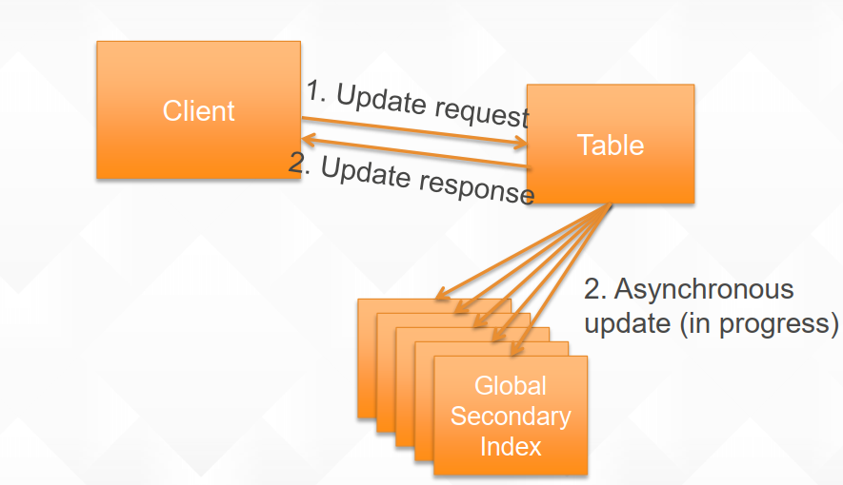
Indexes (contd.)
How do GSI updates work?
If GSIs don’t have enough write capacity, table writes will be throttled!

Slide 21
Indexes (contd.)
LSI or GSI?
LSI can be modeled as a GSI
If data size in an item collection > 10 GB, use GSI
If eventual consistency is okay for your scenario, use GSI!

Slide 22
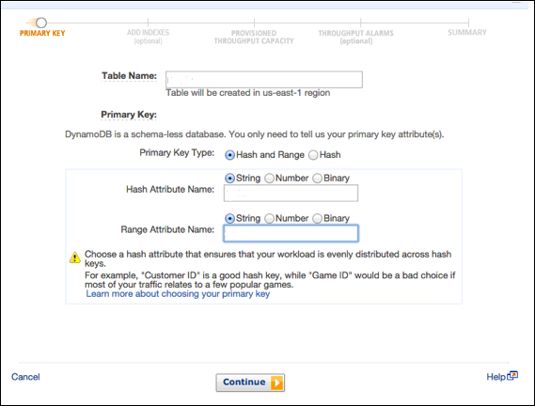
DynamoDB - Create Table

Slide 23
DynamoDB - Load Table
Load Table using GUI Console
aws dynamodb batch-write-item -–request-items file://MyProductData.json

Slide 24
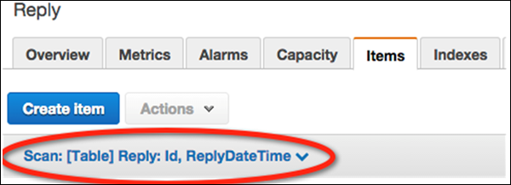
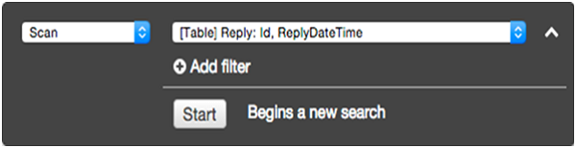
DynamoDB - Query Table

Slide 25
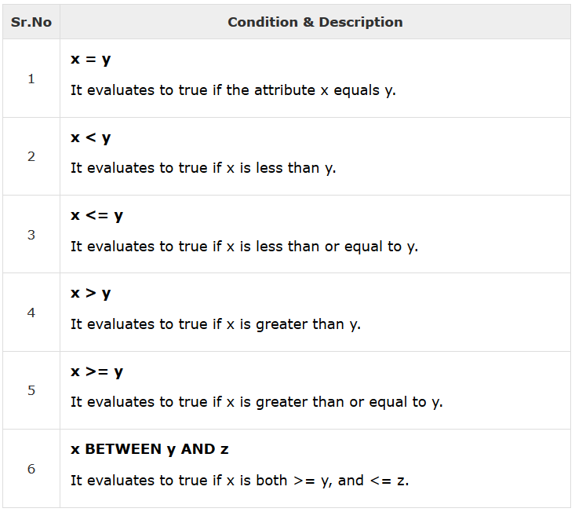
Querying
Queries locate items or secondary indices through primary keys. Performing a query requires a partition key and specific value, or a sort key and value; with the option to filter with comparisons.

Slide 26
DynamoDB - Scan
Scan Operations read all table items or secondary indices. Its default function results in returning all data attributes of all items within an index or table.
Every scan returns a result set, even on finding no matches, which results in an empty set. Scans retrieve no more than 1MB, with the option to filter data.
Types of Scan Operations
Filtering − Scan operations offer fine filtering through filter expressions, which modify data after scans, or queries; before returning results. The expressions use comparison operators. Their syntax resembles condition expressions with the exception of key attributes, which filter expressions do not permit. You cannot use a partition or sort key in a filter expression. (The 1MB limit applies prior to any application of filtering.)
Throughput Specifications − Scans consume throughput, however, consumption focuses on item size rather than returned data.

Slide 27
DynamoDB – Scan (contd.)
Pagination − DynamoDB paginates results causing division of results into specific pages. The 1MB limit applies to returned results, and when you exceed it, another scan becomes necessary to gather the rest of the data.
The Limit Parameter − The limit parameter manages the result size.
Result Count
Consistency − Query results and scan results are eventually consistent reads, however, you can set strongly consistent reads as well.
Performance − Queries offer better performance than scans due to scans crawling the full table or secondary index, resulting in a sluggish response and heavy throughput consumption. Scans work best for small tables and searches with less filters, however, you can design lean scans by obeying a few best practices such as avoiding sudden, accelerated read activity and exploiting parallel scans.

Slide 28
Data Backup/Import
Create an Amazon S3 bucket prior to performing an export (Can export from one or more tables.)
Step 1 − Log in to the AWS Management Console and open the Data Pipeline console located at https://console.aws.amazon.com/datapipeline/
Step 2 − If you have no pipelines in the AWS region used, select Get started now. If you have one or more, select Create new pipeline.
Step 3 − On the creation page, enter a name for your pipeline. Choose Build using a template for the Source parameter. Select Export DynamoDB table to S3 from the list. (s3://nameOfBucket/region/nameOfFolder)
Step 4 − Select Activate after entering all settings.
Note: Can only import one per operation.

Slide 29
DynamoDB - MapReduce
Amazon's Elastic MapReduce (EMR) allows you to quickly and efficiently process big data.
DynamoDB/EMR Integration Prerequisites
Review this checklist of necessary items before using EMR −
An AWS account
A populated table under the same account employed in EMR operations
A custom Hive version with DynamoDB connectivity
DynamoDB connectivity support
An S3 bucket (optional)
An SSH client (optional)
An EC2 key pair (optional)
Utilize Apache Hive to query map reduce job flows through HiveQL, a query language resembling SQL.

Slide 30
DynamoDB SDK
Java and DynamoDB
https://docs.aws.amazon.com/amazondynamodb/latest/developerguide/GettingStarted.Java.html
.NET and DynamoDB
https://docs.aws.amazon.com/amazondynamodb/latest/developerguide/GettingStarted.NET.html
Node.js and DynamoDB
https://docs.aws.amazon.com/amazondynamodb/latest/developerguide/GettingStarted.NodeJs.html
https://docs.aws.amazon.com/AWSJavaScriptSDK/latest/AWS/DynamoDB.html#query-property

Slide 31

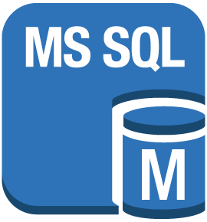

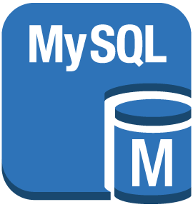
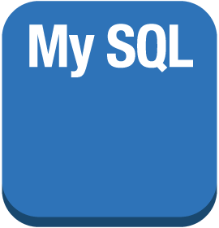



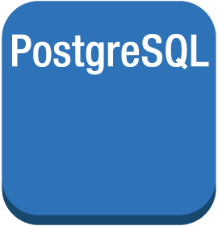





RDS
Amazon RDS
MS SQL instance
MS SQL instance alternate
MySQL DB instance
MySQL instance alternate
Oracle DB instance
Oracle DB instance alternate
PIOP
Postgre SQL instance
RDS DB instance
RDS DB instance standby (multi-AZ)
RDS DB instance read replica
SQL master
SQL slave

Slide 32
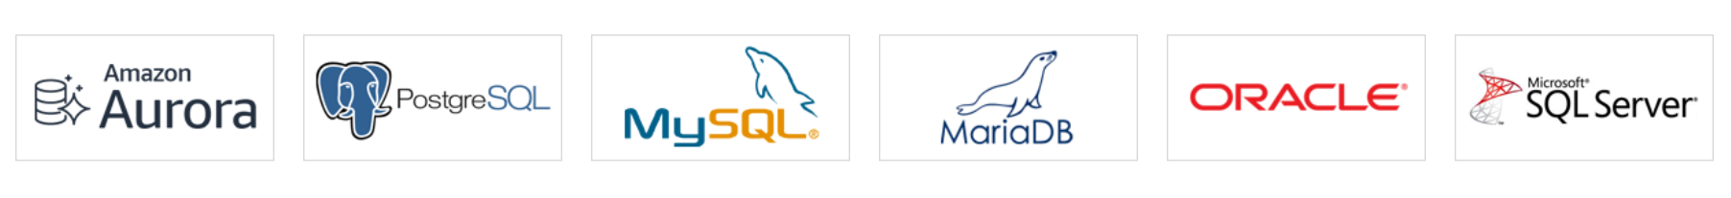
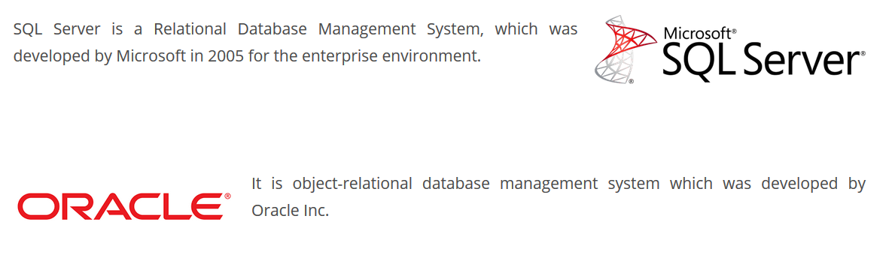
Amazon RDS database engines

Slide 33
What Is Amazon Relational Database Service (Amazon RDS)?
Amazon Relational Database Service (Amazon RDS) is a Web service that makes it easier to set up, operate, and scale a relational database in the cloud.
It provides cost-efficient, resizable capacity for an industry-standard relational database and manages common database administration tasks.

Slide 34
RDS AWS Components
DB Instances
Regions and Availability Zones
Security Groups
VPC Security Group
It controls the DB Instance that is inside a VPC.
EC2 Security Group
It controls access to an EC2 Instance and can be used with a DB Instance.
DB Security Group
It controls the DB Instance that is not in a VPC.
DB Parameter Groups
DB Option Groups

Slide 35
Amazon RDS DB Instances
A DB instance is an isolated database environment running in the cloud. It is the basic building block of Amazon RDS.
A DB instance can contain multiple user-created databases, and can be accessed using the same client tools and applications you might use to access a standalone database instance.
DB instances are simple to create and modify with the Amazon AWS command line tools, Amazon RDS API actions, or the AWS Management Console.

Slide 36
RDS AWS Advantages
Easy to administer
Amazon RDS makes it easy to go from project conception to deployment. Use the Amazon RDS Management Console, the AWS RDS Command-Line Interface, or simple API calls to access the capabilities of a production-ready relational database in minutes.
Highly scalable
You can scale your database's compute and storage resources with only a few mouse clicks or an API call, often with no downtime. Many Amazon RDS engine types allow you to launch one or more Read Replicas to offload read traffic from your primary database instance.
Available and durable
Amazon RDS runs on the same highly reliable infrastructure used by other Amazon Web Services.

Slide 37
RDS AWS Advantages (contd.)
Fast
Amazon RDS supports the most demanding database applications. You can choose between two SSD-backed storage options: one optimized for high-performance OLTP applications, and the other for cost-effective general-purpose use.
Secure
Amazon RDS makes it easy to control network access to your database. Amazon RDS also lets you run your database instances in Amazon Virtual Private Cloud (Amazon VPC), which enables you to isolate your database instances and to connect to your existing IT infrastructure through an industry-standard encrypted IPsec VPN. Many Amazon RDS engine types offer encryption at rest and encryption in transit.
Inexpensive

Slide 38
Microsoft SQL Server on Amazon RDS
Amazon RDS supports DB instances running several versions and editions of Microsoft SQL Server.
The most recent supported version of each major version:
SQL Server 2017 RTM (CU13) 14.00.3049.1, (January 01, 2019).
SQL Server 2016 SP2 (CU3) 13.00.5216.0, (September 20, 2018).
SQL Server 2014 SP2 CU10 12.00.5571.0, (January 16, 2018).
SQL Server 2012 SP4 GDR 11.00.7462.6, (January 12, 2017).
SQL Server 2008: It is no longer possible to provision new instances in any region. Amazon RDS is actively migrating existing instances off this version.

Slide 39
Common Management Tasks for Microsoft SQL Server on Amazon RDS
Instance Classes, Storage, and PIOPS
Multi-AZ Deployments
Amazon Virtual Private Cloud (VPC)
Security Groups
Backup and Restore
Monitoring
Log Files

Slide 40
MySQL on Amazon RDS
Amazon RDS supports DB instances running several versions of MySQL. You can use the following major versions:
MySQL 8.0
MySQL 5.7
MySQL 5.6
MySQL 5.5

Slide 41
MySQL Features Not Supported By Amazon RDS
Authentication Plugin
Error Logging to the System Log
Group Replication Plugin
InnoDB Tablespace Encryption
MariaDB Audit Plugin (not supported for Amazon RDS MySQL version 8.0 only)
The MariaDB Audit Plugin is supported for Amazon RDS MySQL version 5.5, 5.6, and 5.7.
Password Strength Plugin
Persisted system variables
Replication filters
Semisynchronous replication
Transportable tablespace
X Plugin

Slide 42
Oracle on Amazon RDS
Amazon RDS supports DB instances running several versions and editions of Oracle Database.
Oracle 12c, Version 12.2.0.1
Oracle 12c, Version 12.1.0.2
Oracle 11g, Version 11.2.0.4

Slide 43


