Slide 1
New Technology in Application Development
05. Node.js

Slide 2
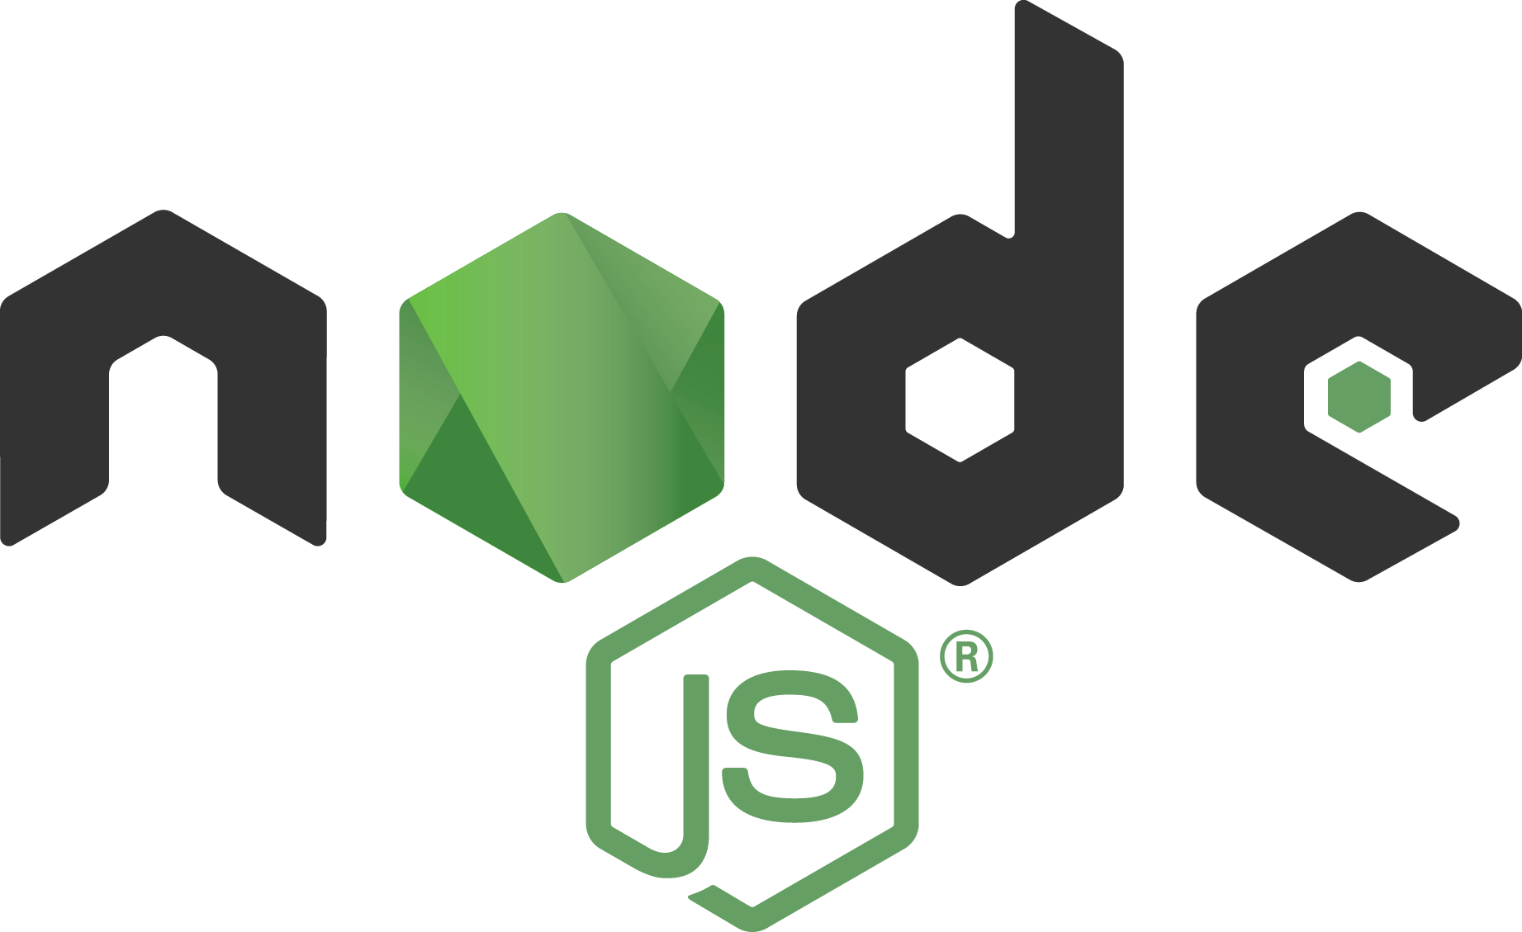
Content
Node concepts
JavaScript Engines
Node.js – NPM
Node.js - Utility Modules
Node.js - Express Framework
RESTful API

Slide 3
Node.js
Code once, deploy anywhere
Vibrant Community
More than 1,21,943 packages
Re-inventing the wheel every year
Open source obsessive
Desktop
IOT Smart Devices
Browser
Web Server

Slide 4
The World Of Node.JS
+
Community Code
+
Node
Libraries
Your Code
+
Service
Architecture
+
Web
Framework
+
Testing
+
Production Setup
+
Node Engine

Slide 5
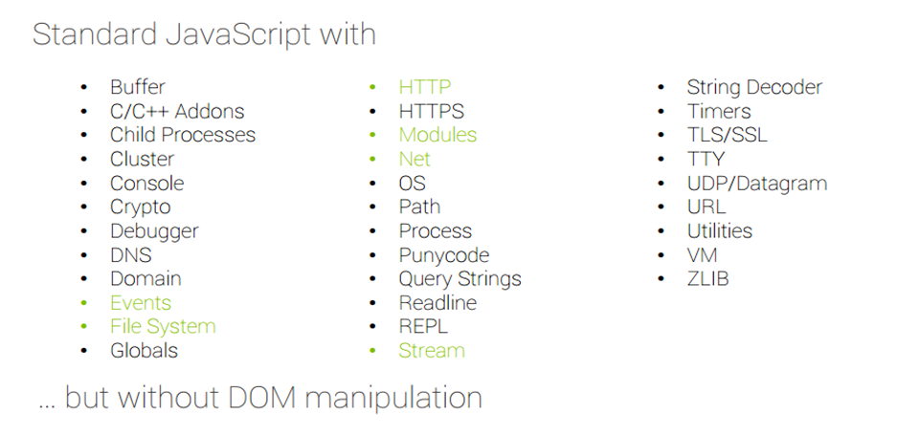
Why Use Node.js ?
Node's goal is to provide an easy way to build scalable network programs.

Slide 6
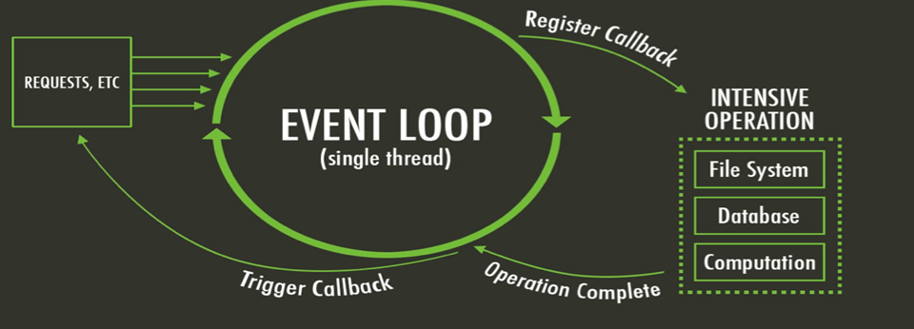
What is unique about Node.js?
JavaScript on server-side thus making communication between client and server will happen in same language
Servers normally thread based but Node.JS is “Event” based. Node.JS serves each request in a Evented loop that can handle simultaneous requests.

Slide 7
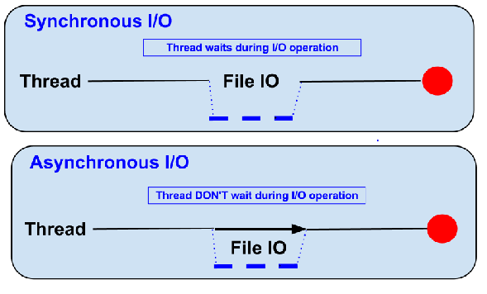
Blocking vs Non-Blocking
Ex: Read data from file and show data
Blocking
Read data from file
Show data
Do other tasks
Non-Blocking
Read data from file
When read data completed, show data
Do other tasks

Slide 8
What can you do with Node?
It lets you Layered on top of the TCP library is a HTTP and HTTPS client/server.
The JS executed by the V8 JavaScript engine (the thing that makes Google Chrome so fast)
Node provides a JavaScript API to access the network and file system.
Cannot do with Node?
Node is a platform for writing JavaScript applications outside web browsers. This is not the JavaScript we are familiar with in web browsers. There is no DOM built into Node, nor any other browser capability.
Node can’t run on GUI, but run on terminal

Slide 9
Threads VS Event-driven
Threads | Asynchronous Event-driven
Lock application / request with listener-workers threads | Only one thread, which repeatedly fetches an event
Using incoming-request model | Using queue and then processes it
multithreaded server might block the request which might involve multiple events | Manually saves state and then goes on to process the next event
Using context switching | No contention and no context switches
Using multithreading environments where listener and workers threads are used frequently to take an incoming-request lock | Using asynchronous I/O facilities (callbacks, not poll/select or O_NONBLOCK) environments

Slide 10
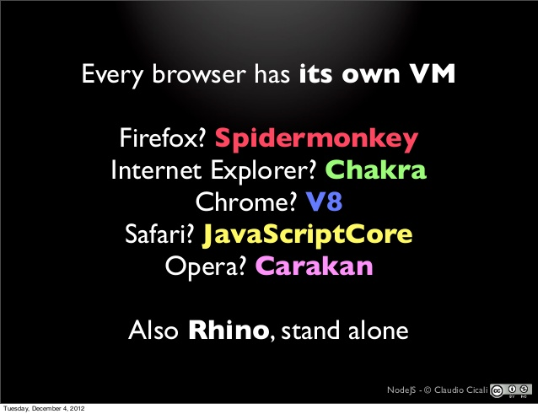
JavaScript Engines
A JavaScript engine is a computer program that executes JavaScript (JS) code.

Slide 11
Node.js for
Web application
Websocket server
Ad server
Proxy server
Streaming server
Fast file upload client
Any Real-time data apps
Anything with high I/O

Slide 12
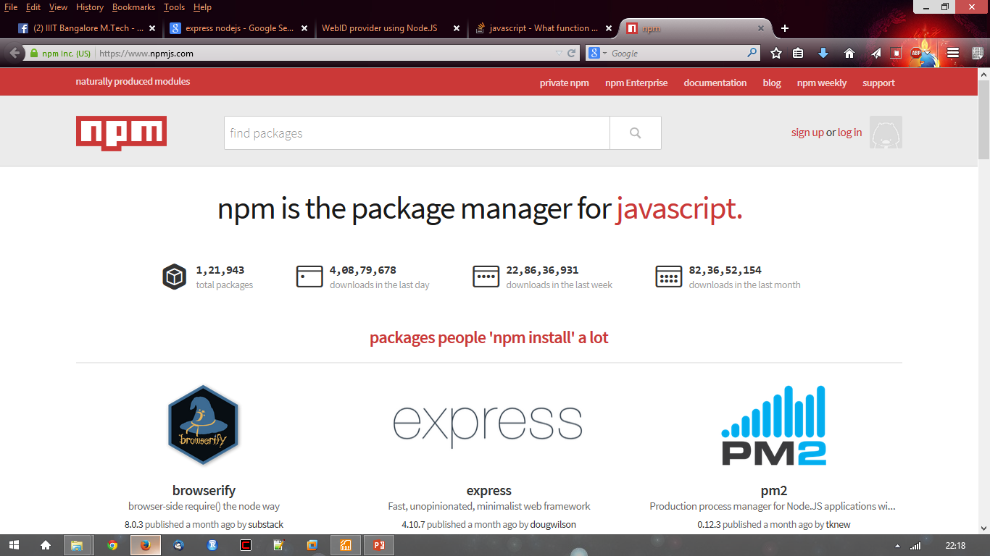
Working with Node.js
{
"name": "node-js-getting-started",
"version": "0.2.5",
"description": "A sample Node.js app using Express 4",
"engines": {
"node": "5.9.1"
},
"main": "index.js",
"scripts": {
"start": "node index.js"
},
"dependencies": {
"body-parser": "^1.16.1",
"cookie-parser": "^1.4.3",
"cool-ascii-faces": "1.3.4",
"ejs": "2.4.1",
"express": "^4.13.3",
"express-session": "^1.15.1",
"mongodb": "^2.2.24",
"multer": "^1.3.0",
"pg": "4.x",
"pug": "^2.0.0-beta11"
},
"repository": {
"type": "git",
"url": "https://github.com/heroku/node-js-getting-started"
},
"keywords": [
"node",
"heroku",
"express"
],
"license": "MIT"
}
http://nodejs.org/ and Download tar.gz
File package.json: Project informations
• Name
• Version
• Dependencies
• Licence
• Main file
Node.js Modules
https://npmjs.org/

Slide 13
Node.js - NPM
Node Package Manager (NPM) provides two main functionalities
Online repositories for node.js packages/modules which are searchable on search.nodejs.org
Command line utility to install Node.js packages, do version management and dependency management of Node.js packages.
Installing Modules using NPM
$ npm install <Module Name>

Slide 14
Node.js - NPM (contd.)
Using package.json
package.json is present in the root directory of any Node application/module and is used to define the properties of a package.
Attribute of Package.json for NPM
dependencies − list of dependencies. NPM automatically installs all the dependencies mentioned here in the node_module folder of the package.

Slide 15
Node.js - NPM (contd.)
Uninstalling a Module
$ npm uninstall <Module Name>
Updating a Module
Update package.json and change the version of the dependency to be updated and run the following command.
$ npm update <Module Name>

Slide 16
Callbacks Concept
Callback is an asynchronous equivalent for a function.
A callback function is called at the completion of a given task. Node makes heavy use of callbacks.
All the APIs of Node are written in such a way that they support callbacks.
For example,
A function to read a file may start reading file and return the control to the execution environment immediately so that the next instruction can be executed.
Once file I/O is complete, it will call the callback function while passing the callback function, the content of the file as a parameter. So there is no blocking or wait for File I/O.
This makes Node.js highly scalable, as it can process a high number of requests without waiting for any function to return results.

Slide 17
Event Loop
Node.js is a single-threaded application, but it can support concurrency via the concept of event and callbacks.
Every API of Node.js is asynchronous and being single-threaded, they use async function calls to maintain concurrency. Node uses observer pattern.
Node thread keeps an event loop and whenever a task gets completed, it fires the corresponding event which signals the event-listener function to execute.

Slide 18
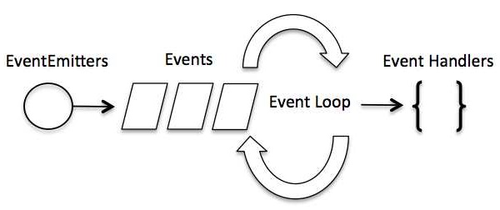
Event Loop (contd.)
Event-Driven Programming
Node.js uses events heavily and it is also one of the reasons why Node.js is pretty fast compared to other similar technologies. As soon as Node starts its server, it simply initiates its variables, declares functions and then simply waits for the event to occur.
In an event-driven application, there is generally a main loop that listens for events, and then triggers a callback function when one of those events is detected.

Slide 19
Node.js - Global Objects
__filename
The __filename represents the filename of the code being executed. This is the resolved absolute path of this code file.
For a main program, this is not necessarily the same filename used in the command line. The value inside a module is the path to that module file.
__dirname
The __dirname represents the name of the directory that the currently executing script resides in.
setTimeout(cb, ms)
The setTimeout(cb, ms) global function is used to run callback cb after at least ms milliseconds. The actual delay depends on external factors like OS timer granularity and system load. This function returns an opaque value that represents the timer which can be used to clear the timer.

Slide 20
Node.js - Global Objects (contd.)
clearTimeout(t)
The clearTimeout(t) global function is used to stop a timer that was previously created with setTimeout().
Here t is the timer returned by the setTimeout() function.
setInterval(cb, ms)
The setInterval(cb, ms) global function is used to run callback cb repeatedly after at least ms milliseconds. The actual delay depends on external factors like OS timer granularity and system load. A timer cannot span more than 24.8 days.
This function returns an opaque value that represents the timer which can be used to clear the timer using the function clearInterval(t).

Slide 21
Node.js - Global Objects (contd.)
Global Objects
Console
Used to print information on stdout and stderr.
Process
Used to get information on current process. Provides multiple events related to process activities.

Slide 22
Node.js - Utility Modules
Sr.No. | Module Name & Description
1 | OS Module Provides basic operating-system related utility functions.
2 | Path Module Provides utilities for handling and transforming file paths.
3 | Net Module Provides both servers and clients as streams. Acts as a network wrapper.
4 | DNS Module Provides functions to do actual DNS lookup as well as to use underlying operating system name resolution functionalities.
5 | Domain Module Provides ways to handle multiple different I/O operations as a single group.

Slide 23
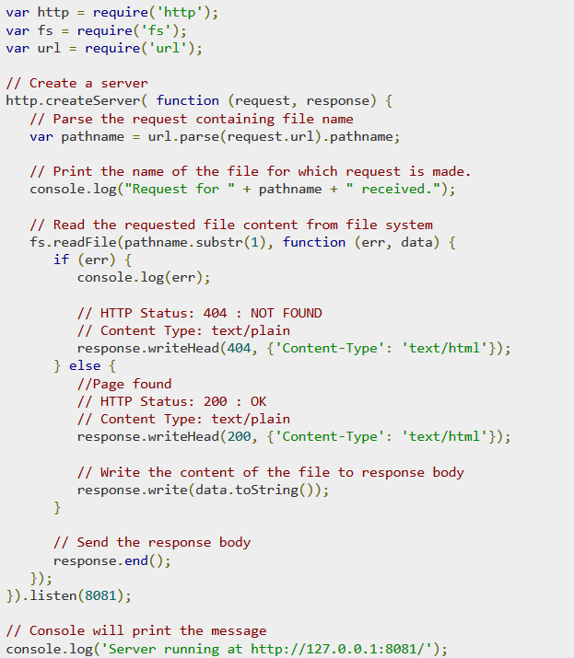
Web Module
Node.js provides an http module which can be used to create an HTTP client of a server.
Following is the bare minimum structure of the HTTP server which listens at 8081 port.

Slide 24
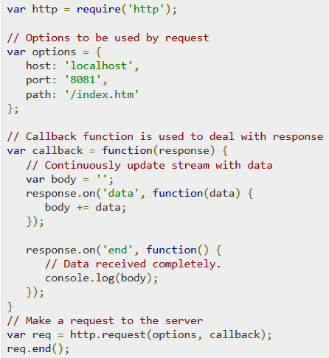
Web Module
A web client can be created using http module.

Slide 25
Node.js - Express Framework
Express is a minimal and flexible Node.js web application framework that provides a robust set of features to develop web and mobile applications.
It facilitates the rapid development of Node based Web applications. Following are some of the core features of Express framework −
Allows to set up middlewares to respond to HTTP Requests.
Defines a routing table which is used to perform different actions based on HTTP Method and URL.
Allows to dynamically render HTML Pages based on passing arguments to templates.

Slide 26
Node.js - Express Framework (contd.)
Installing Express
$ npm install express –save
Should install the following important modules along with express
body-parser − This is a node.js middleware for handling JSON, Raw, Text and URL encoded form data.
cookie-parser − Parse Cookie header and populate req.cookies with an object keyed by the cookie names.
multer − This is a node.js middleware for handling multipart/form-data.

Slide 27
Node.js - Express Framework (contd.)
Request & Response
Express application uses a callback function whose parameters are request and response objects.
Request Object − The request object represents the HTTP request and has properties for the request query string, parameters, body, HTTP headers, and so on.
Response Object − The response object represents the HTTP response that an Express app sends when it gets an HTTP request.

Slide 28
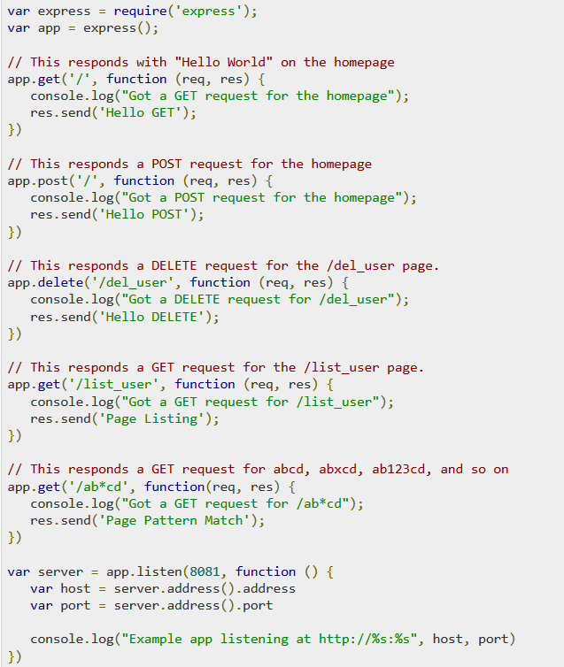
Node.js - Express Framework (contd.)
Basic Routing
Routing refers to determining how an application responds to a client request to a particular endpoint, which is a URI (or path) and a specific HTTP request method (GET, POST, and so on).
http://127.0.0.1:8081/list_user

Slide 29
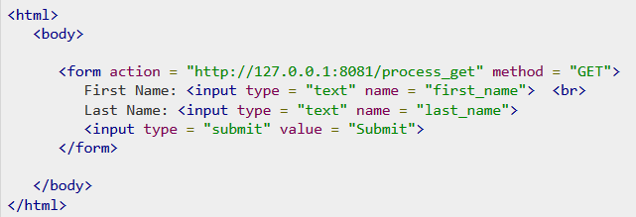
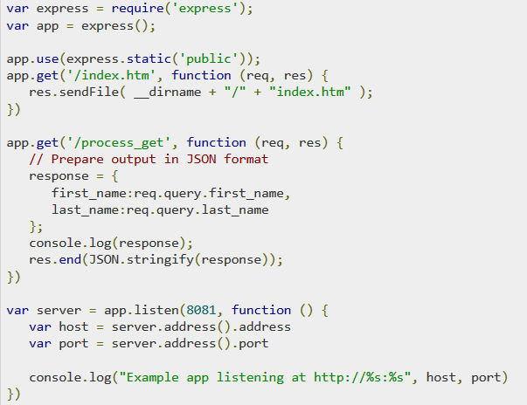
Node.js - Express Framework (contd.)
GET Method

Slide 30
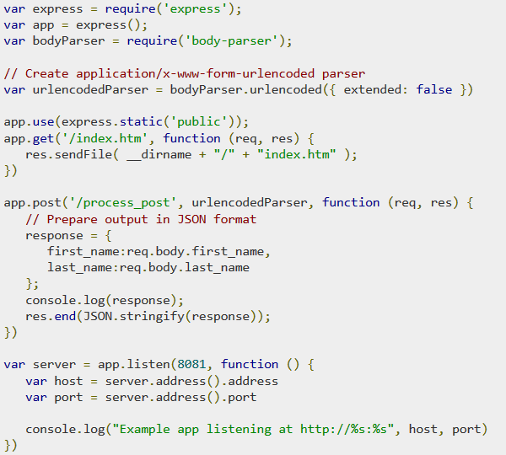
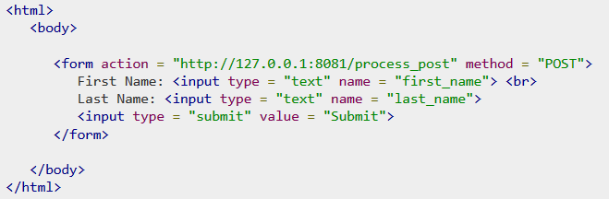
Node.js - Express Framework (contd.)
POST Method

Slide 31
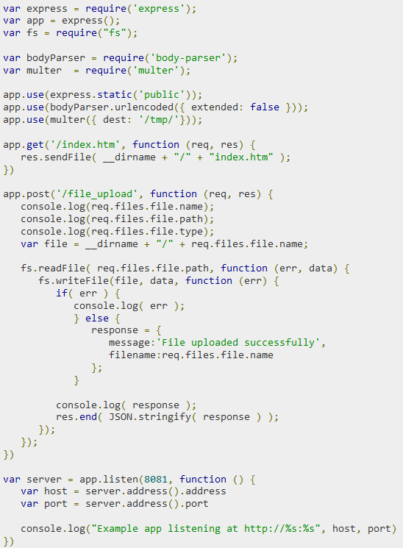
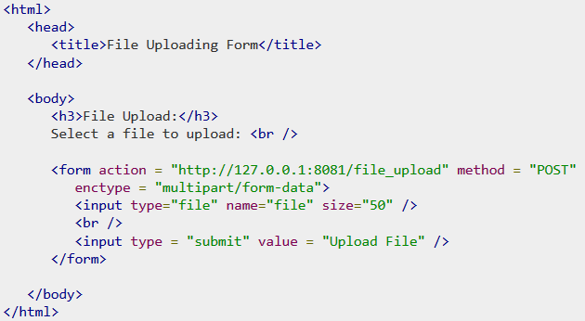
Node.js - Express Framework (contd.)
File Upload

Slide 32
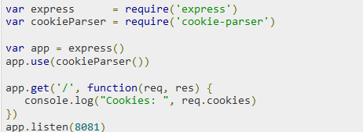
Node.js - Express Framework (contd.)
Cookies Management
Can send cookies to a Node.js server which can handle the same using the following middleware option.

Slide 33
RESTful API
REST stands for REpresentational State Transfer.
REST is web standards based architecture and uses HTTP Protocol. It revolves around resource where every component is a resource and a resource is accessed by a common interface using HTTP standard methods.
A REST Server simply provides access to resources and REST client accesses and modifies the resources using HTTP protocol. Here each resource is identified by URIs/ global IDs.
REST uses various representation to represent a resource like text, JSON, XML but JSON is the most popular one.

Slide 34
RESTful API (contd.)
RESTful Web Services
A Web service is a collection of open protocols and standards used for exchanging data between applications or systems.
Software applications written in various programming languages and running on various platforms can use Web services to exchange data over computer networks like the Internet in a manner similar to inter-process communication on a single computer. This interoperability is due to the use of open standards.
Web services based on REST Architecture are known as RESTful Web services.
These Web services uses HTTP methods to implement the concept of REST architecture.
A RESTful web service usually defines a URI, Uniform Resource Identifier a service, which provides resource representation such as JSON and set of HTTP Methods.

Slide 35
RESTful API (contd.)
Example:
Node.js RESTful API with DynamoDB Local

Slide 36
RESTful API (contd.)
HTTP methods
Following four HTTP methods are commonly used in REST based architecture.
GET − This is used to provide a read only access to a resource.
PUT − This is used to create a new resource.
DELETE − This is used to remove a resource.
POST − This is used to update a existing resource or create a new resource.

Slide 37
Node.js - Scaling Application
Node.js runs in a single-thread mode, but it uses an event-driven paradigm to handle concurrency. It also facilitates creation of child processes to leverage parallel processing on multi-core CPU based systems.
Child processes always have three streams child.stdin, child.stdout, and child.stderr which may be shared with the stdio streams of the parent process.
Node provides child_process module which has the following three major ways to create a child process.
exec − child_process.exec method runs a command in a shell/console and buffers the output.
spawn − child_process.spawn launches a new process with a given command.
fork − The child_process.fork method is a special case of the spawn() to create child processes.

Slide 38
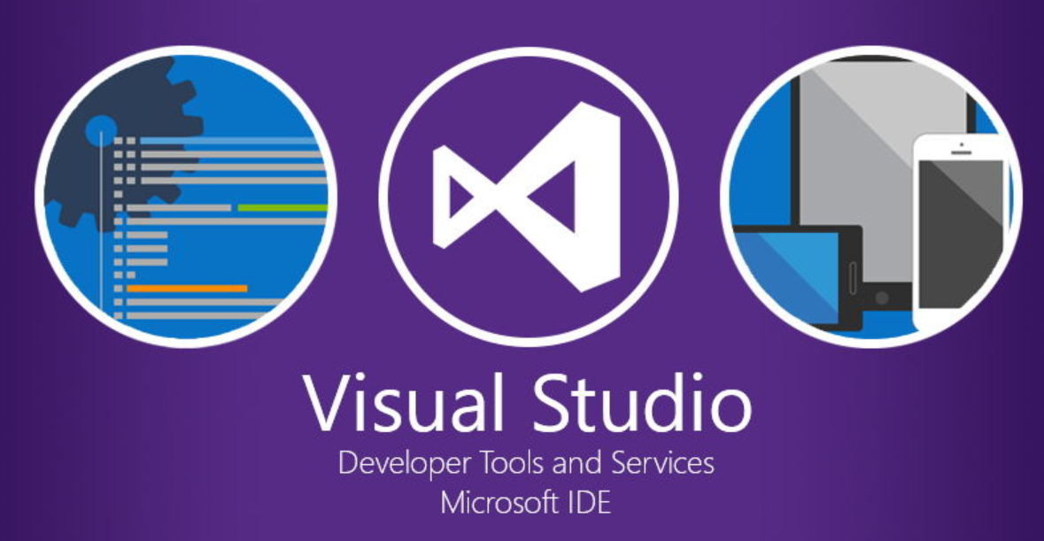
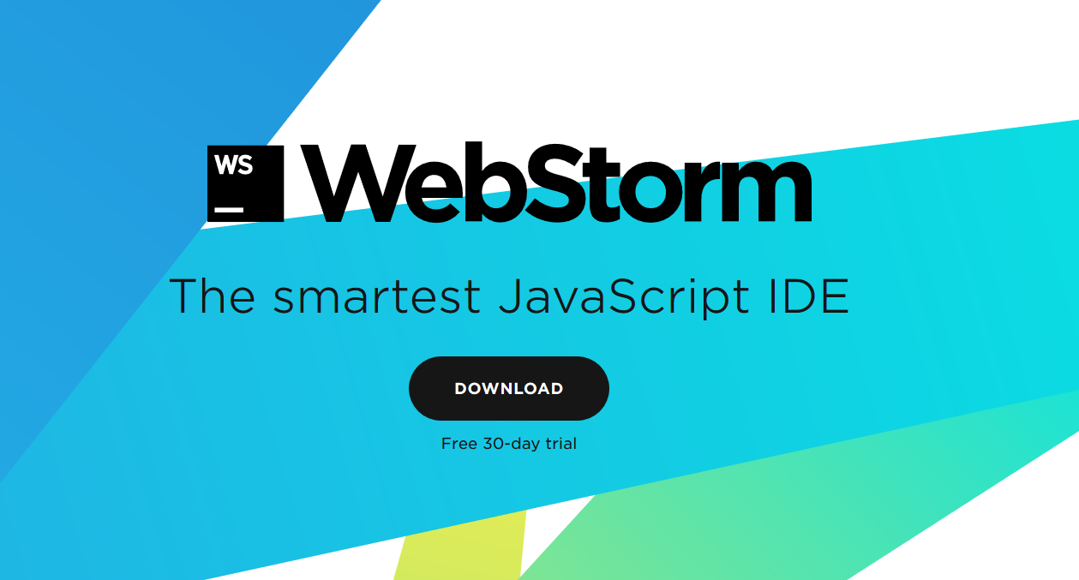
IDE for Node.js
Visual Studio Code
WebStorm

Slide 39
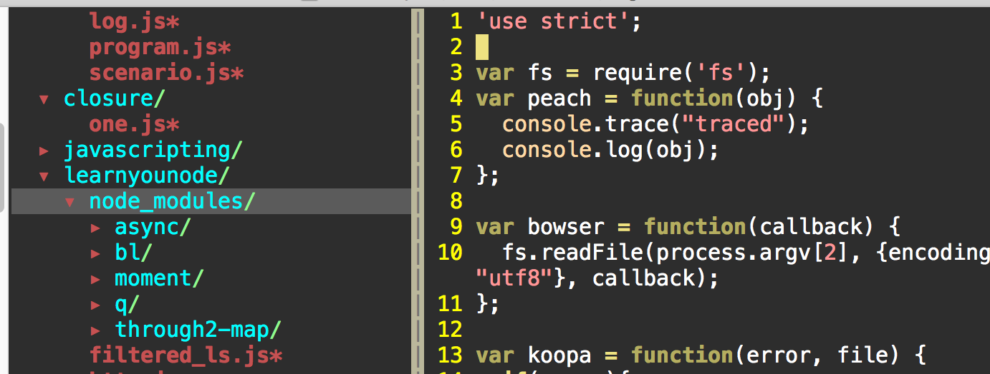

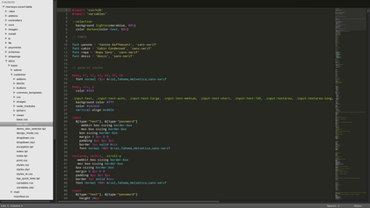
IDE for Node.js (contd.)
Vim - JavaScript IDE
Sublime Text

Slide 40
IDE for Node.js (contd.)
Atom
NetBeans
Notepad++
Gitpod
IntelliJ IDEA
Komodo IDE
Brackets
CodeLite IDE
Eclipse with JSDT
Komodo IDE
CodeLite IDE
Visual Studio Community Edition
…

Slide 41


