Slide 1
New Technology in Application Development
06. Deploy Applications on Cloud Services

Slide 2
Content
Deploying Java Web Applications (AWS Toolkit for Eclipse)
Deploying .NET Web Applications (AWS Toolkit for .NET)
Deploying Node.js Web Applications

Slide 3
AWS SDK for Java
The SDK helps take the complexity out of coding by providing Java APIs for AWS services including Amazon S3, Amazon ECS, DynamoDB, AWS Lambda, and more.
The single, downloadable package includes the AWS Java library, code samples, and documentation.
The official AWS SDK for Java - Version 2: https://github.com/aws/aws-sdk-java-v2
AWS Toolkit for Eclipse – an open-source plugin for developing, deploying, and managing AWS applications. https://github.com/aws/aws-toolkit-eclipse

Slide 4
Key Features of AWS SDK for Java 1.11
Client-Side Data Encryption for Amazon S3
This easy-to-use, client-side encryption mechanism helps improve the security of storing application data in Amazon S3. Since encryption and decryption is performed client side, the private encryption keys never leave the application.
Amazon DynamoDB Object Mapper
The DynamoDBMapper eliminates the need for application-level data conversions and custom middleware solutions by using Plain Old Java Objects (POJOs) to store and retrieve Amazon DynamoDB data.

Slide 5
Key Features of AWS SDK for Java 1.11 (contd.)
Amazon S3 Transfer Manager
Through a simple API, the Amazon S3 TransferManager achieves enhanced throughput, performance, and reliability by making extensive use of multi-threaded Amazon S3 multipart uploads.
Amazon SQS Client-Side Buffering
Client-side buffering collects and sends SQS requests in asynchronous batches, improving application and network performance.

Slide 6
Key Features of AWS SDK for Java 2.0
Nonblocking I/O
The AWS SDK for Java 2.0 utilizes a new, nonblocking SDK architecture built on Netty to support true nonblocking I/O.
Automatic pagination
To maximize availability and minimize latency, many AWS APIs break up a result across multiple “pages” of responses. In 2.0, the SDK can handle this automatically.
Pluggable HTTP layer
Version 2.0, like 1.11, continues to ship Apache as the default synchronous HTTP client, but you can replace it with another implementation that better suits your use-case.

Slide 7
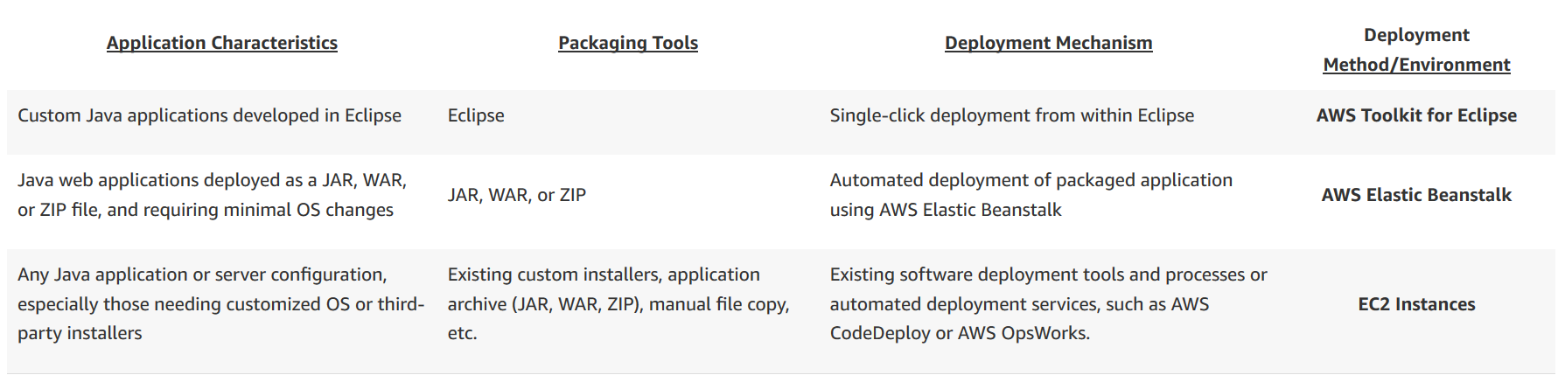
Deploying Java Web Applications
AWS offers several tools and services to enable both AWS-managed and customer-managed Java application deployment.
Notes:
https://aws.amazon.com/answers/web-applications/aws-web-app-deployment-java/
https://docs.aws.amazon.com/amazondynamodb/latest/developerguide/GettingStarted.Java.html

Slide 8
AWS Toolkit for Eclipse
Install the AWS Toolkit
Open Help → Install New Software….
Enter https://aws.amazon.com/eclipse in the text box labeled “Work with” at the top of the dialog.
Select the required "AWS Core Management Tools" and other optional items from the list below.
Click “Next.” Eclipse guides you through the remaining installation steps.
Note: The toolkit requires Eclipse 4.4 (Luna) or higher
The AWS Toolkit for Eclipse is an open source plug-in for the Eclipse integrated development environment (IDE) that makes it easier for developers to develop, debug, and deploy Java applications that use Amazon Web Services.

Slide 9
AWS Toolkit for Eclipse (contd.)
It enhances the Eclipse IDE with additional features:
The AWS SDK for Java is included and managed by Maven when you create a new AWS project using the AWS Toolkit for Eclipse
AWS Explorer, an interface to Amazon Web Services that allows you to manage your AWS resources from within the Eclipse environment.
AWS Lambda Java project and Serverless Application Model (SAM) project blueprint creation, deployment and debugging
AWS CodeCommit repository cloning
Integration with AWS CodeStar
AWS Elastic Beanstalk deployment and debugging
An AWS CloudFormation template editor
Support for multiple AWS accounts
Notes:
http://d1un85p0f2qstc.cloudfront.net/eclipse/ec2/index.html
https://d1un85p0f2qstc.cloudfront.net/eclipse/elasticbeanstalk/index.html

Slide 10
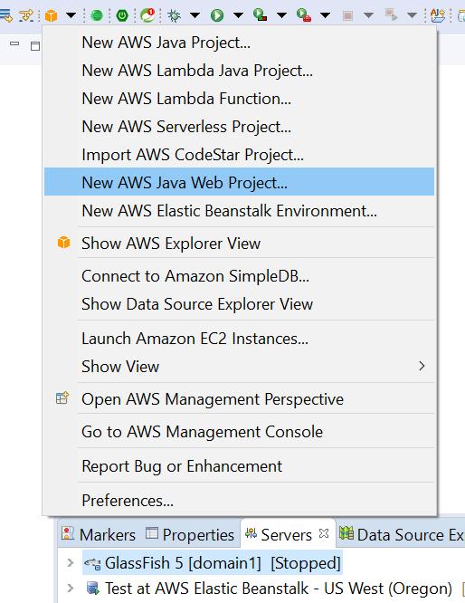
AWS Toolkit for Eclipse (contd.)
Notes:
http://d1un85p0f2qstc.cloudfront.net/eclipse/ec2/index.html
https://d1un85p0f2qstc.cloudfront.net/eclipse/elasticbeanstalk/index.html

Slide 11
AWS SDK for .NET
The AWS SDK for .NET makes it easier for Windows developers to build .NET applications that tap in to the cost-effective, scalable, and reliable AWS infrastructure services such as Amazon Simple Storage Service, Amazon Elastic Compute Cloud, AWS Lambda, and more.
The AWS SDK for .NET supports development on any platform that supports the .NET Framework 3.5 or later.
The AWS SDK for .NET targets .NET Standard 1.3. You can use it with .NET Core 1.x or .NET Core 2.0.

Slide 12
Setting Up the AWS Toolkit for Visual Studio
To install and configure the Toolkit for Visual Studio, you must:
Have an AWS account. This account enables you to use AWS services.
Run a supported operating system: Windows 10, Windows 8, or Windows 7.
Visual Studio 2013 or later (including Community editions).
Notes:
https://docs.aws.amazon.com/amazondynamodb/latest/developerguide/GettingStarted.NET.html

Slide 13
Install the Toolkit for Visual Studio
The Toolkit for Visual Studio for Visual Studio 2013 and Visual Studio 2015 are part of the AWS Tools for Windows.
Navigate to the page AWS Toolkit for Visual Studio.
In the Download section, choose Toolkit for Visual Studio 2013-2015 to download the installer.
To start the installation, run the downloaded installer and follow the instructions.
The Toolkit for Visual Studio for Visual Studio 2017 and Visual Studio 2019 is distributed in the Visual Studio Marketplace. You can also install and update the toolkit within Visual Studio by using Tools ≫ Extensions and Updates (Visual Studio 2017) or Extensions ≫ Manage Extensions (Visual Studio 2019).

Slide 14
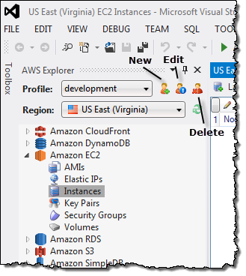
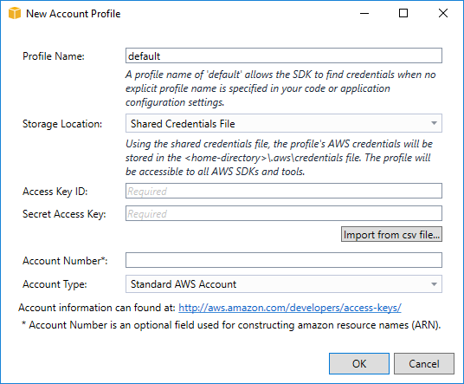
Adding a profile to the SDK Credential Store or the Shared AWS Credentials File
To add a profile to the SDK Credential Store or the shared AWS credentials file:
Open AWS Explorer in Visual Studio (View ≫ AWS Explorer).
Choose the New Account Profile icon to the right of the Profile: list.

Slide 15
Adding a profile to the SDK Credential Store or the Shared AWS Credentials File (contd.)
Manually Adding a Profile to the Shared AWS Credentials File
Set your credentials in the shared AWS credentials file on your local system. On Windows, this file is called C:\Users\USERNAME\.aws\credentials.
This file should contain lines in the following format:
[default]
aws_access_key_id = YOUR_ACCESS_KEY_ID
aws_secret_access_key = YOUR_SECRET_ACCESS_KEY
Use a role by creating a profile for the role. The following example shows a role profile named assumed-role that is assumed by the default profile.
[assume-role-test]
role_arn = arn:aws:iam::123456789012:role/assumed-role
source_profile = default

Slide 16
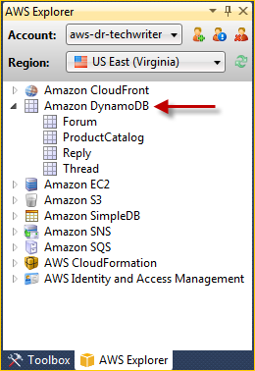
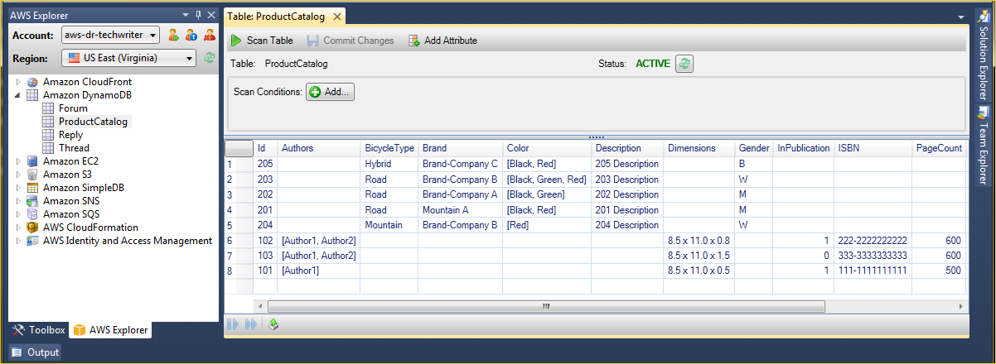
Using DynamoDB from AWS Explorer
In the Toolkit for Visual Studio, AWS Explorer displays all of the DynamoDB tables associated with the active AWS account.

Slide 17
Amazon RDS from AWS Explorer
Amazon Relational Database Service (Amazon RDS) is a service that enables you to provision and manage SQL relational database systems in the cloud. Amazon RDS supports three types of database systems:
MySQL Community Edition
Oracle Database Enterprise Edition
Microsoft SQL Server (Express, Standard, or Web Editions)

Slide 18
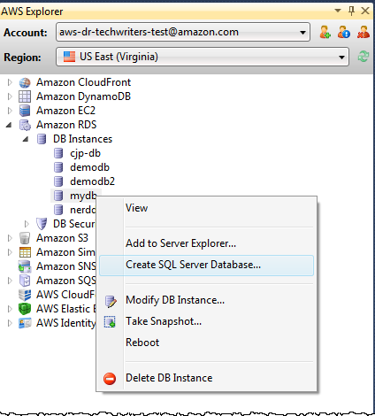
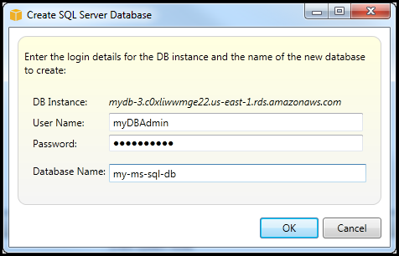
Create a Microsoft SQL Server Database in an RDS Instance
To create a Microsoft SQL Server database
In AWS Explorer, open the context (right-click) menu for the node that corresponds to your RDS instance for Microsoft SQL Server, and choose Create SQL Server Database.
In the Create SQL Server Database dialog box, type the password you specified when you created the RDS instance, type a name for the Microsoft SQL Server database, and then choose OK.
The Toolkit for Visual Studio creates the Microsoft SQL Server database and adds it to the Visual Studio Server Explorer.

Slide 19
Deploy a .NET Sample Application Using AWS Elastic Beanstalk
Deployment Steps:
From ElasticBeanstalk console, use the "Create New Environment" wizard to create a "Web Server Environment" and select platform as "IIS".
Follow the wizard instructions on every step, in the "Additional Resources" step, select "Create an RDS DB Instance with this environment"
In "RDS Configuration" step, change "DB engine" to "sqlserver-ex" and increase the "Allocated storage" to 20 GB.
After environment created successfully, open BeanstalkDotNetSample solution in visual.
Right click on the solution name from the "Solution Explorer" and click "Publish to AWS" then follow the instructions, this requires AWS SDK for .NET to be installed.
Notes:
https://docs.aws.amazon.com/elasticbeanstalk/latest/dg/create_deploy_NET.quickstart.html

Slide 20
AWS SDK for JavaScript in Node.js
Step 1: Configure Your Credentials
Step 2: Create the Package JSON for the Project
Step 3: Install the SDK and Dependencies
Step 4: Write the Node.js Code
Step 5: Run the Sample

Slide 21
Step 1: Configure Your Credentials
You need to provide credentials to AWS so that only your account and its resources are accessed by the SDK. For more information about obtaining your account credentials, see Getting Your Credentials.
To hold this information, we recommend you create a shared credentials file. To learn how, see Loading Credentials in Node.js from the Shared Credentials File.
[default]
aws_access_key_id = YOUR_ACCESS_KEY_ID
aws_secret_access_key = YOUR_SECRET_ACCESS_KEY

Slide 22
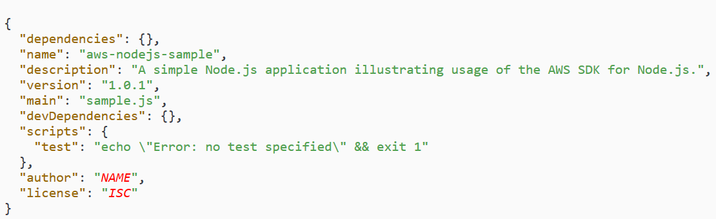
Step 2: Create the Package JSON for the Project
Step 3: Install the SDK and Dependencies
npm install aws-sdk
npm install uuid (https://www.npmjs.com/package/uuid)

Slide 23
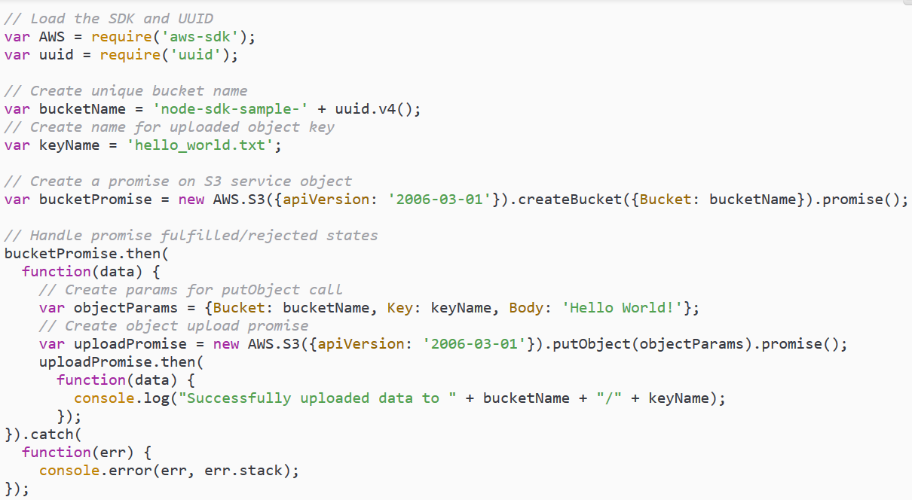
Step 4: Write the Node.js Code
Create a promise object to call the createBucket method of the AWS.S3 service object.
On a successful response, create the parameters needed to upload text to the newly created bucket.
Using another promise, call the putObject method to upload the text object to the bucket.

Slide 24
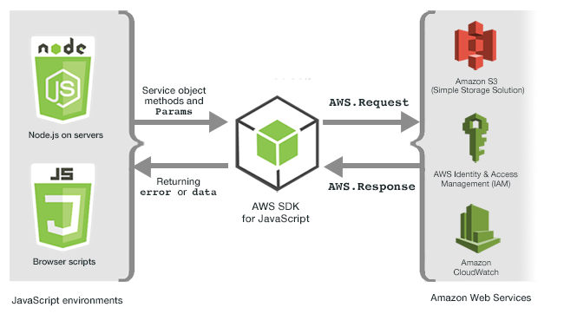
Working with Services in the SDK for JavaScript

Slide 25
Node.js and DynamoDB
Use the AWS SDK for JavaScript to write simple programs to perform the following Amazon DynamoDB operations:
Create a table called Movies and load sample data in JSON format.
Perform create, read, update, and delete operations on the table.
Run simple queries.
https://docs.aws.amazon.com/amazondynamodb/latest/developerguide/GettingStarted.NodeJs.html
Notes:
https://docs.aws.amazon.com/amazondynamodb/latest/developerguide/GettingStarted.NodeJs.html

Slide 26
Node.js and DynamoDB (contd.)
Step 1: Create a Table. Create a table named Movies. The primary key for the table is composed of the following attributes: year – The partition key. The AttributeType is N for number, title – The sort key. The AttributeType is S for string.
Step 2: Load Sample Data
Step 3: Create, Read, Update, and Delete an Item
Step 3.1: Create a New Item
Step 3.2: Read an Item
Step 3.3: Update an Item
Step 3.4: Increment an Atomic Counter
Step 3.5: Update an Item (Conditionally)
Step 3.6: Delete an Item
Step 4: Query and Scan the Data
Step 5: Delete the Table

Slide 27


