Slide 1
New Technology in Application Development
07. Cloud Computing Deployment and Management Tools

Slide 2
Content
AWS Developer Tools
Management Tools

Slide 3
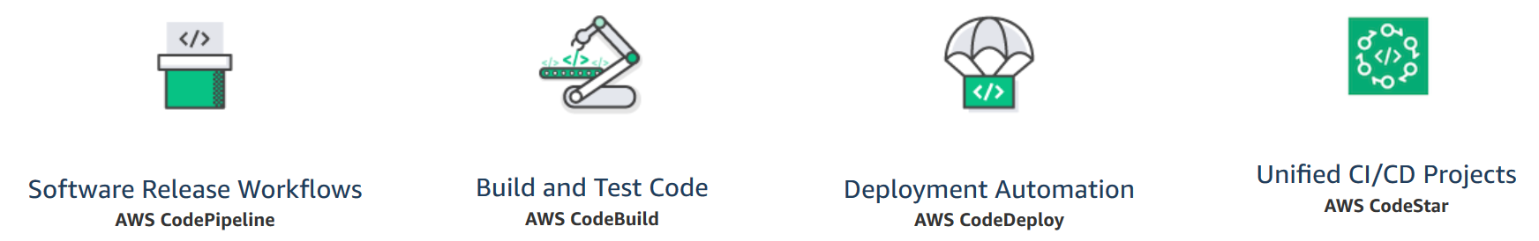
AWS Developer Tools
The AWS Developer Tools help you securely store and version your application's source code and automatically build, test, and deploy your application to AWS or your on-premises environment.

Slide 4
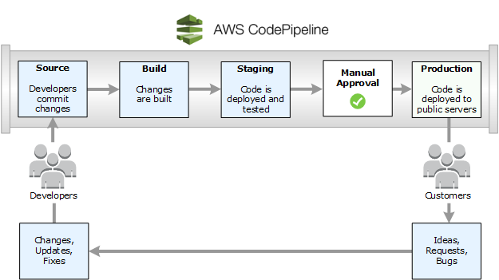
AWS CodePipeline

Slide 5
AWS CodePipeline (contd.)
AWS CodePipeline is a fully managed continuous delivery service that helps you automate your release pipelines for fast and reliable application and infrastructure updates.
CodePipeline automates the build, test, and deploy phases of your release process every time there is a code change, based on the release model you define. This enables you to rapidly and reliably deliver features and updates.
You can easily integrate AWS CodePipeline with third-party services such as GitHub or with your own custom plugin.
With AWS CodePipeline, you only pay for what you use. There are no upfront fees or long-term commitments.

Slide 6
AWS CodePipeline Benefits
Rapid delivery
Automates your software release process, allowing you to rapidly release new features to your users. Allows you to quickly and easily test each code change and catch bugs.
Get started fast
Can immediately begin to model your software release process.
Configurable workflow
Allows you to model the different stages of your software release process using the console interface, the AWS CLI, AWS CloudFormation, or the AWS SDKs.
Easy to integrate
Can easily be extended to adapt to your specific needs. You can use our pre-built plugins or your own custom plugins in any step of your release process.

Slide 7
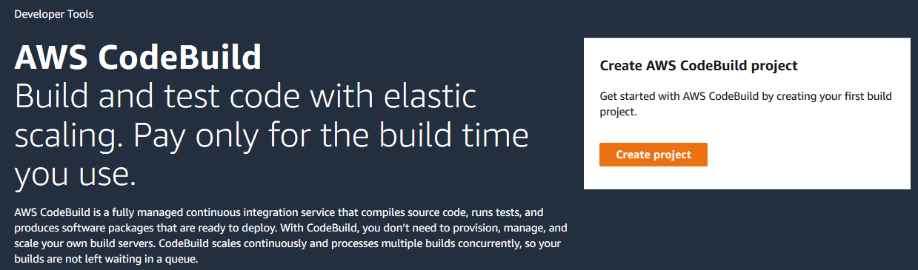
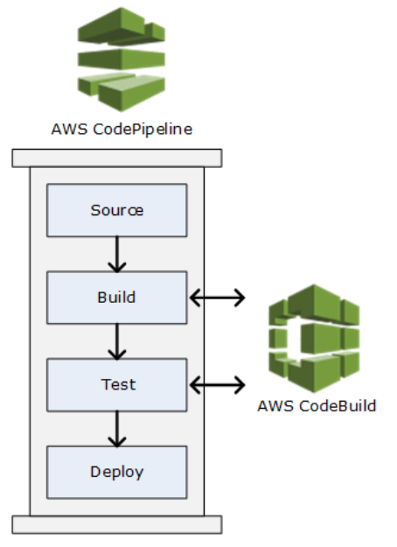
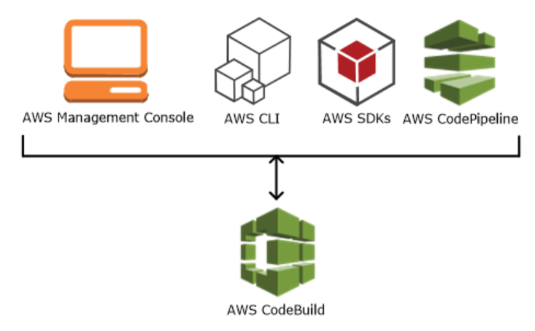
AWS CodeBuild

Slide 8
AWS CodeBuild (contd.)
AWS CodeBuild is a fully managed continuous integration service that compiles source code, runs tests, and produces software packages that are ready to deploy.
With CodeBuild, you don’t need to provision, manage, and scale your own build servers. CodeBuild scales continuously and processes multiple builds concurrently, so your builds are not left waiting in a queue.
You can get started quickly by using prepackaged build environments, or you can create custom build environments that use your own build tools.
You are charged by the minute for the compute resources you use.

Slide 9
AWS CodeBuild Benefits
Fully managed build service
AWS CodeBuild eliminates the need to set up, patch, update, and manage your own build servers and software. There is no software to install or manage.
Continuous scaling
Pay as you go
Extensible
Enables continuous integration and delivery
AWS CodeBuild belongs to a family of AWS Code Services, which you can use to create complete, automated software release workflows for continuous integration and delivery (CI/CD).
Secure

Slide 10
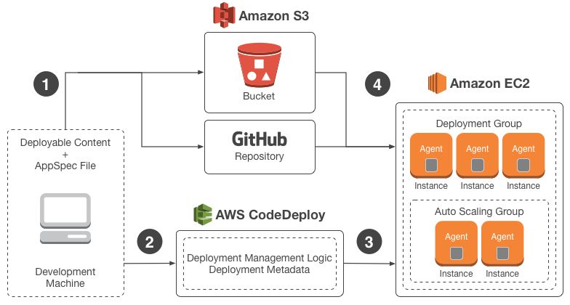
AWS CodeDeploy

Slide 11
AWS CodeDeploy (Contd.)
AWS CodeDeploy is a fully managed deployment service that automates software deployments to a variety of compute services such as Amazon EC2, AWS Fargate, AWS Lambda, and your on-premises servers.
AWS CodeDeploy makes it easier for you to rapidly release new features, helps you avoid downtime during application deployment, and handles the complexity of updating your applications.
You can use AWS CodeDeploy to automate software deployments, eliminating the need for error-prone manual operations. The service scales to match your deployment needs.

Slide 12
AWS CodeDeploy Benefits
Automated deployments
AWS CodeDeploy fully automates your software deployments, allowing you to deploy reliably and rapidly. You can consistently deploy your application across your development, test, and production environments whether deploying to Amazon EC2, AWS Fargate, AWS Lambda, or your on-premises servers. The service scales with your infrastructure.
Minimize downtime
AWS CodeDeploy helps maximize your application availability during the software deployment process. It introduces changes incrementally and tracks application health according to configurable rules. Software deployments can easily be stopped and rolled back if there are errors.
Centralized control
Easy to adopt

Slide 13
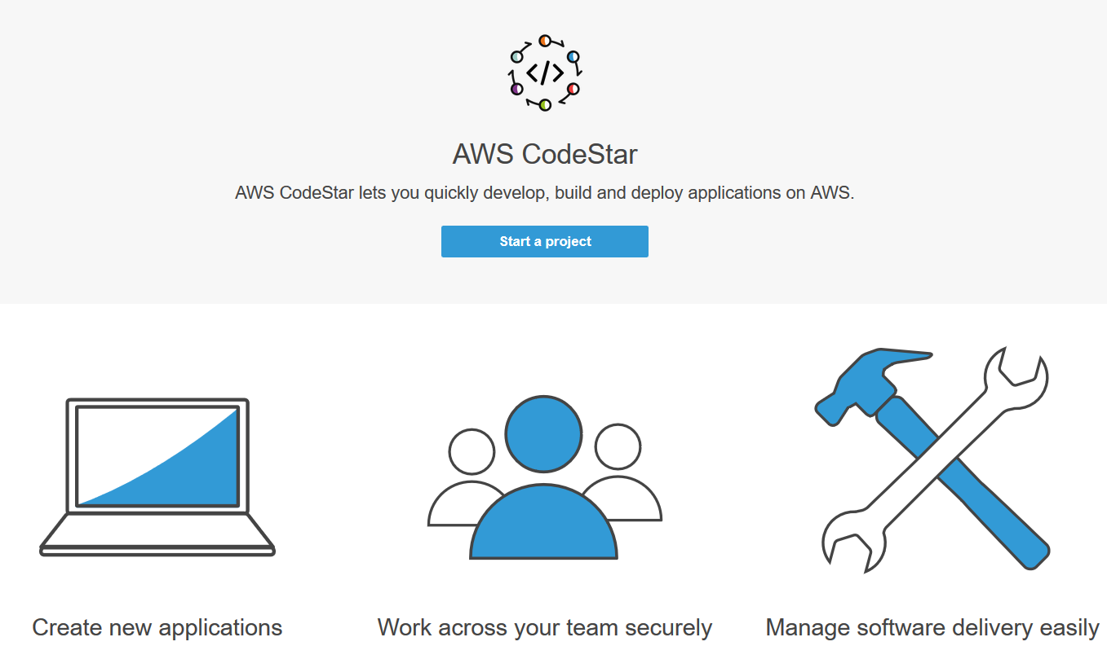
AWS CodeStar

Slide 14
AWS CodeStar (contd.)
AWS CodeStar enables you to quickly develop, build, and deploy applications on AWS.
AWS CodeStar provides a unified user interface, enabling you to easily manage your software development activities in one place.
With AWS CodeStar, you can set up your entire continuous delivery toolchain in minutes, allowing you to start releasing code faster.
AWS CodeStar makes it easy for your whole team to work together securely, allowing you to easily manage access and add owners, contributors, and viewers to your projects.
There is no additional charge for using AWS CodeStar. You only pay for the AWS resources that you provision for developing and running your application (for example, Amazon EC2 instances).

Slide 15
Management Tools
AWS Auto Scaling
AWS Formation
Amazon CloudWatch

Slide 16
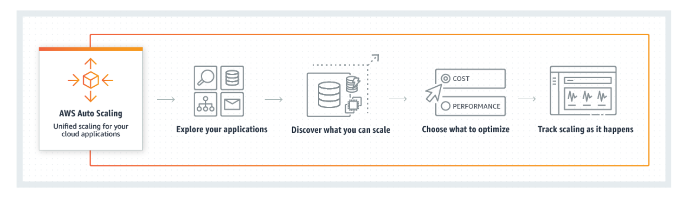
AWS Auto Scaling

Slide 17
AWS Auto Scaling (contd.)
AWS Auto Scaling monitors your applications and automatically adjusts capacity to maintain steady, predictable performance at the lowest possible cost. Using AWS Auto Scaling, it’s easy to setup application scaling for multiple resources across multiple services in minutes. T
he service provides a simple, powerful user interface that lets you build scaling plans for resources including Amazon EC2 instances and Spot Fleets, Amazon ECS tasks, Amazon DynamoDB tables and indexes, and Amazon Aurora Replicas.
AWS Auto Scaling makes scaling simple with recommendations that allow you to optimize performance, costs, or balance between them.
If you’re already using Amazon EC2 Auto Scaling to dynamically scale your Amazon EC2 instances, you can now combine it with AWS Auto Scaling to scale additional resources for other AWS services.

Slide 18
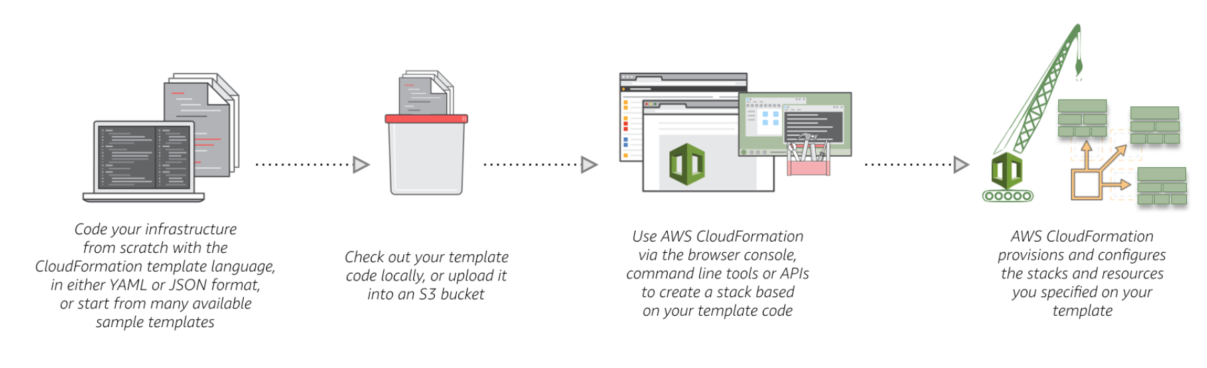
AWS Formation

Slide 19
AWS Formation
Model it all
AWS CloudFormation allows you to model your entire infrastructure in a text file. This template becomes the single source of truth for your infrastructure.
Automate and deploy
AWS CloudFormation provisions your resources in a safe, repeatable manner, allowing you to build and rebuild your infrastructure and applications, without having to perform manual actions or write custom scripts. CloudFormation takes care of determining the right operations to perform when managing your stack, and rolls back changes automatically if errors are detected.
It's just code
Codifying your infrastructure allows you to treat your infrastructure as just code.

Slide 20
Amazon CloudWatch
Amazon CloudWatch is a monitoring and management service built for developers, system operators, site reliability engineers (SRE), and IT managers.
CloudWatch provides you with data and actionable insights to monitor your applications, understand and respond to system-wide performance changes, optimize resource utilization, and get a unified view of operational health.
CloudWatch collects monitoring and operational data in the form of logs, metrics, and events, providing you with a unified view of AWS resources, applications and services that run on AWS, and on-premises servers.

Slide 21
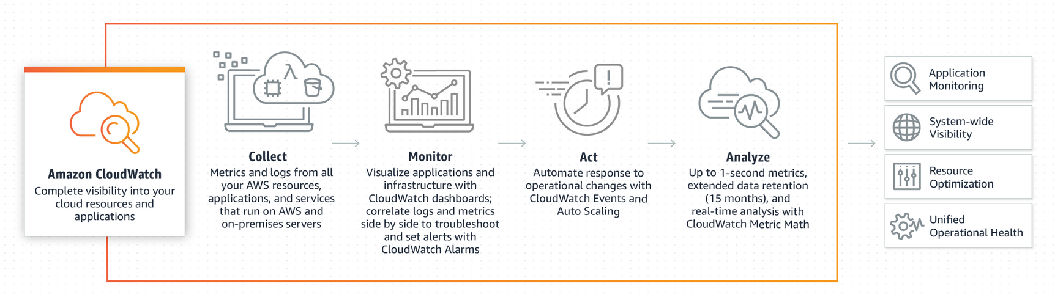
Amazon CloudWatch (contd.)

Slide 22


