Slide 1
MACHINE LEARNING Multivariate Linear Regression
HueAI – April 2019

Slide 2
CONTENT
Multiple Features
Gradient Descent for Multiple Variables
Gradient Descent: Feature Scaling
Gradient Descent: Learning Rate
Features and Polynomial Regression
Normal Equation

Slide 3
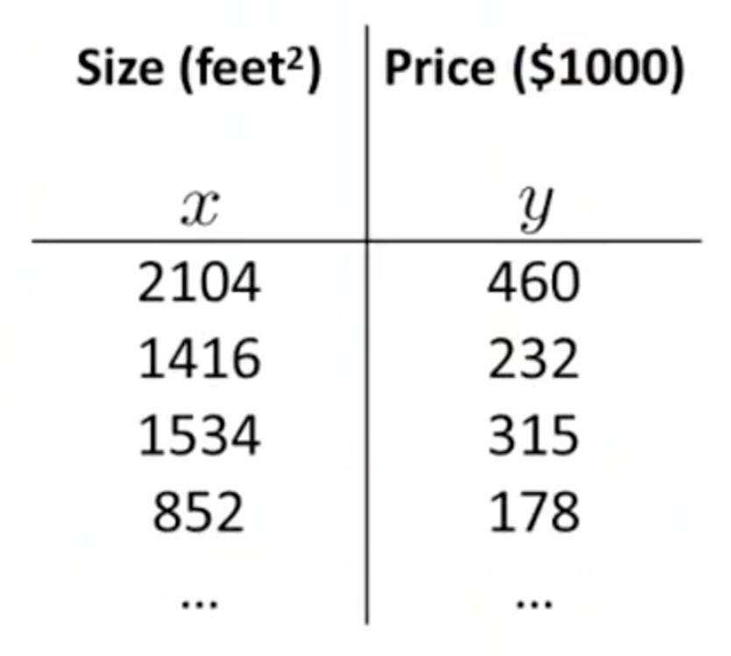

MULTIPLE FEATURES
$$h_{θ}\left(x\right)=θ_{0}+θ_{1}x$$

Slide 4
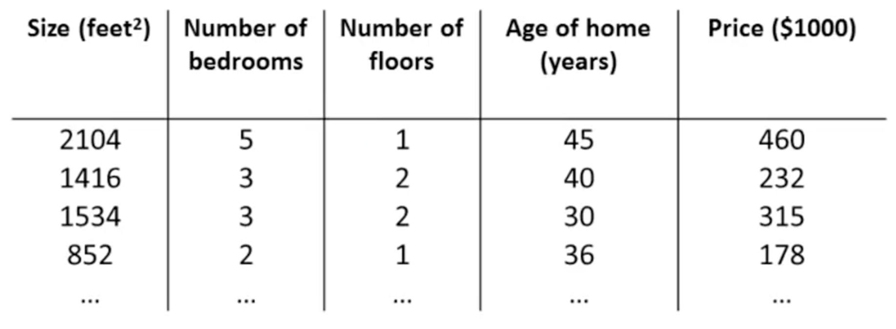
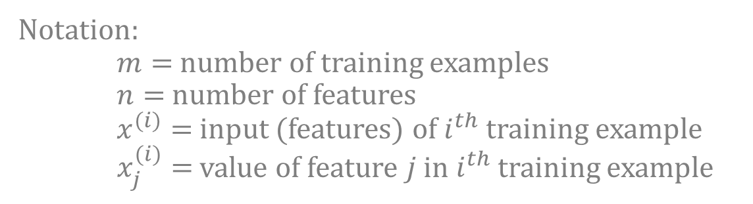
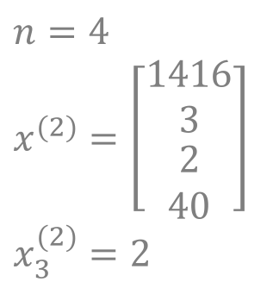
MULTIPLE FEATURES
$$n=4$$
$$x^{(2)}=\left[\begin{matrix}\begin{matrix}1416 \\ 3\end{matrix} \\ 2 \\ 40\end{matrix}\right]$$
$$x_{3}^{(2)}=2$$
Notation:
$m=$ number of training examples
$n=$ number of features
$x^{(i)}=$ input (features) of $i^{th}$ training example
$x_{j}^{(i)}=$ value of feature $j$ in $i^{th}$ training example

Slide 5

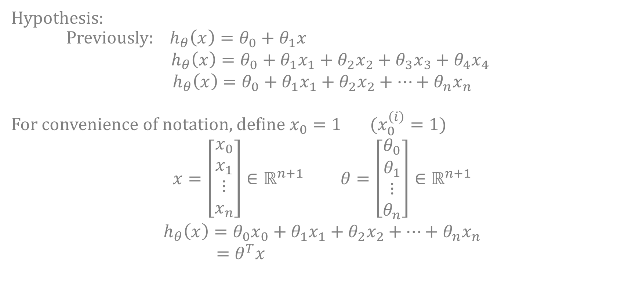
MULTIPLE FEATURES
Hypothesis:
Previously: $h_{θ}\left(x\right)=θ_{0}+θ_{1}x$
$$h_{θ}\left(x\right)=θ_{0}+θ_{1}x_{1}+θ_{2}x_{2}+θ_{3}x_{3}+θ_{4}x_{4}$$
$$h_{θ}\left(x\right)=θ_{0}+θ_{1}x_{1}+θ_{2}x_{2}+⋯+θ_{n}x_{n}$$
For convenience of notation, define $x_{0}=1 (x_{0}^{\left(i\right)}=1)$
$$x=\left[\begin{matrix}\begin{matrix}x_{0} \\ x_{1}\end{matrix} \\ ⋮ \\ x_{n}\end{matrix}\right]∈ℝ^{n+1} θ=\left[\begin{matrix}\begin{matrix}θ_{0} \\ θ_{1}\end{matrix} \\ ⋮ \\ θ_{n}\end{matrix}\right]∈ℝ^{n+1}$$
$$h_{θ}\left(x\right)=θ_{0}x_{0}+θ_{1}x_{1}+θ_{2}x_{2}+⋯+θ_{n}x_{n}$$
$$=θ^{T}x$$
$$θ^{T}=\left[\begin{matrix}\begin{matrix}θ_{0} & θ_{1}\end{matrix} & ⋯ & θ_{n}\end{matrix}\right]$$

Slide 6
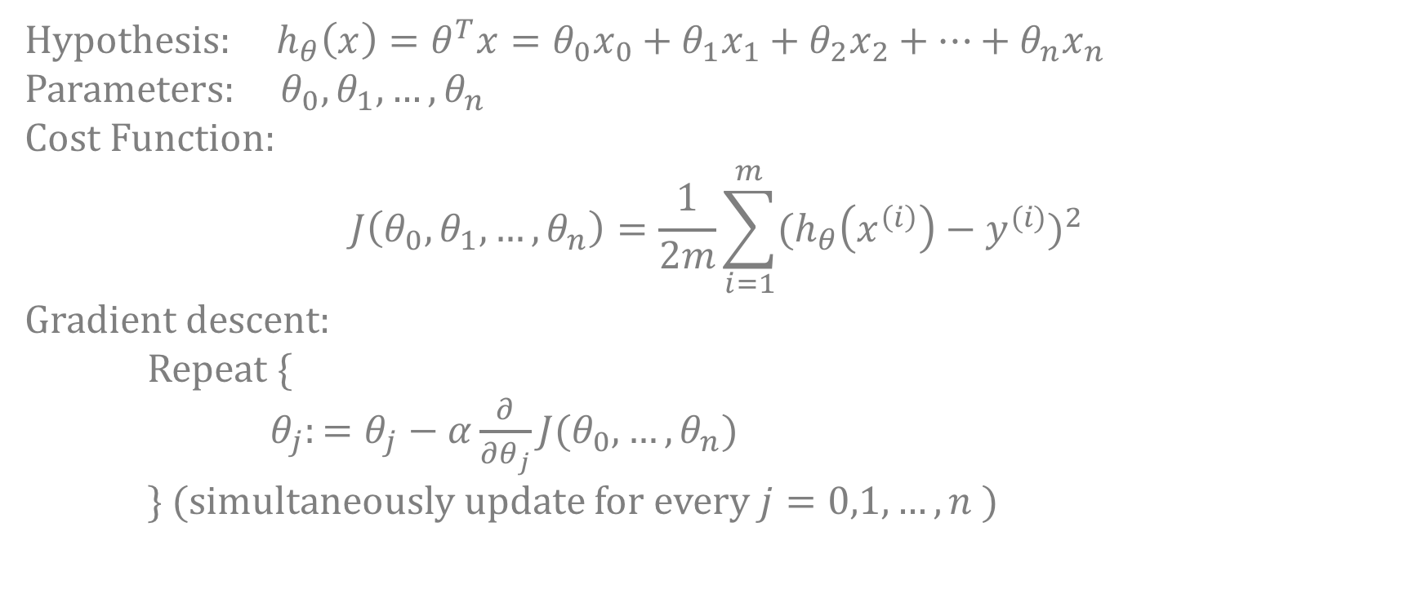
GRADIENT DESCENT FOR MULTIPLE VARIABLES
Hypothesis: $h_{θ}\left(x\right)=θ^{T}x=θ_{0}x_{0}+θ_{1}x_{1}+θ_{2}x_{2}+⋯+θ_{n}x_{n}$
Parameters: $θ_{0},θ_{1},…,θ_{n}$
Cost Function:
$$J\left(θ_{0},θ_{1},…,θ_{n}\right)=\frac{1}{2m}\sum_{i=1}^{m}{{(h_{θ}\left(x^{\left(i\right)}\right)−y^{(i)})}^{2}}$$
Gradient descent:
Repeat {
$θ_{j}:=θ_{j}−α\frac{∂}{∂θ_{j}}J(θ_{0},…,θ_{n})$
} (simultaneously update for every $j=0,1,…,n$ )

Slide 7
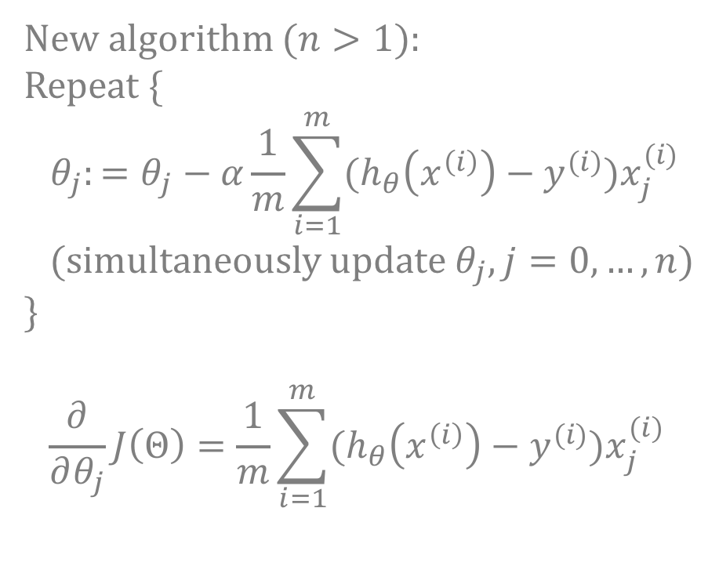
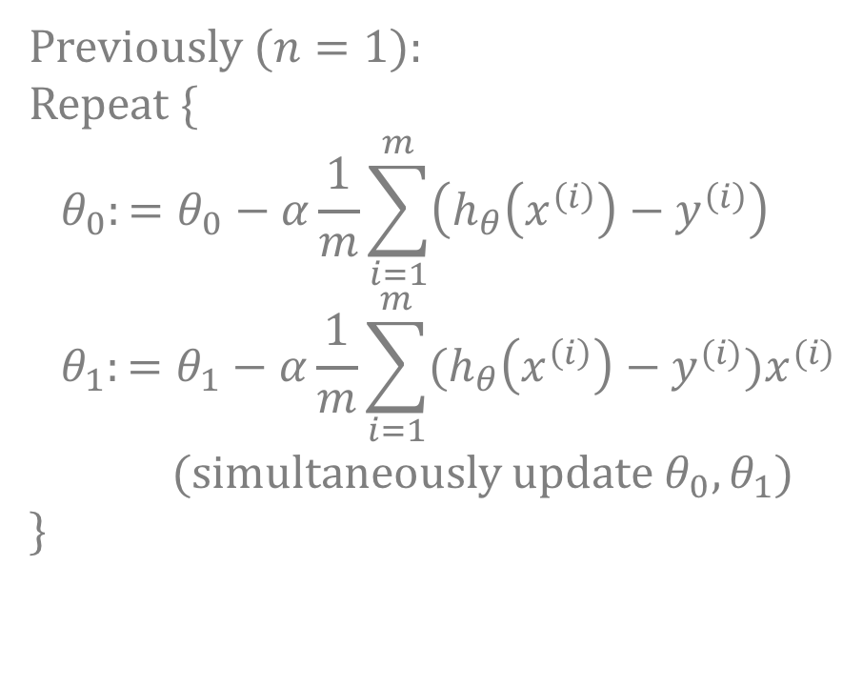
GRADIENT DESCENT FOR MULTIPLE VARIABLES
Previously $(n=1)$:
Repeat {
$$θ_{0}:=θ_{0}−α\frac{1}{m}\sum_{i=1}^{m}{\left(h_{θ}\left(x^{\left(i\right)}\right)−y^{\left(i\right)}\right)}$$
$$θ_{1}:=θ_{1}−α\frac{1}{m}\sum_{i=1}^{m}{(h_{θ}\left(x^{\left(i\right)}\right)−y^{(i)})x^{(i)}}$$
(simultaneously update $θ_{0},θ_{1}$)
}
New algorithm $(n>1)$:
Repeat {
$$θ_{j}:=θ_{j}−α\frac{1}{m}\sum_{i=1}^{m}{(h_{θ}\left(x^{\left(i\right)}\right)−y^{(i)})x_{j}^{(i)} }$$
(simultaneously update $θ_{j}, j=0,…,n$)
}
$$\frac{∂}{∂θ_{j}}J\left(Θ\right)=\frac{1}{m}\sum_{i=1}^{m}{(h_{θ}\left(x^{\left(i\right)}\right)−y^{(i)})x_{j}^{(i)} }$$

Slide 8
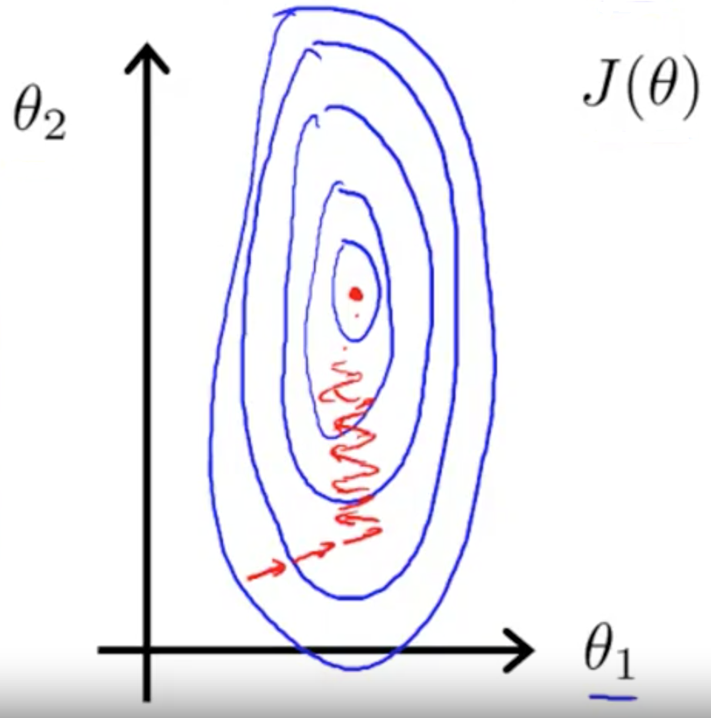
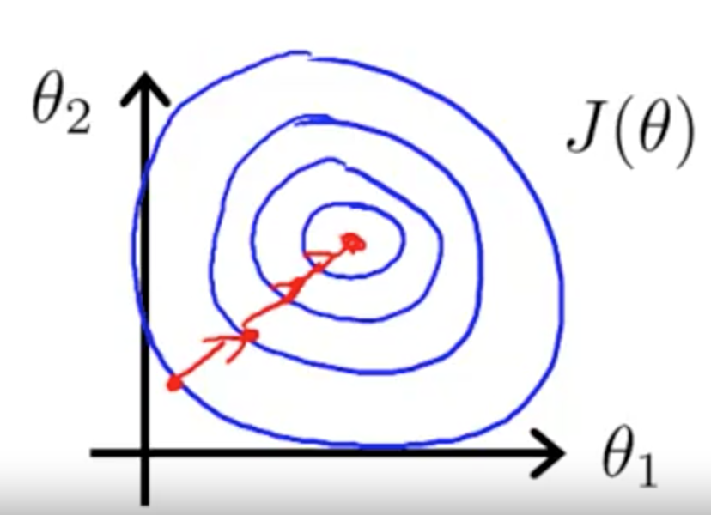
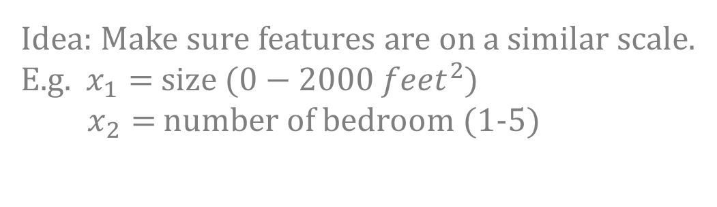
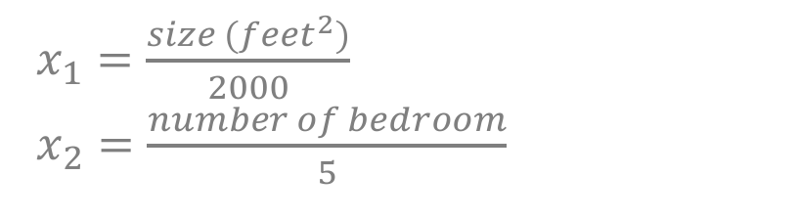
FEATURE SCALING
Idea: Make sure features are on a similar scale.
E.g. $x_{1}=$ size ($0−2000 {feet}^{2}$)
$x_{2}=$ number of bedroom (1-5)
$x_{1}=\frac{size ({feet}^{2})}{2000}$
$x_{2}=\frac{number of bedroom}{5}$

Slide 9

FEATURE SCALING
Get every feature into approximately a $−1≤x_{i}≤1$ range.
$x_{0}=1$
$0≤x_{1}≤3$ - ok
$−2≤x_{2}≤0.5$ - ok
$−100≤x_{3}≤100$ - not ok
$−0.001≤x_{4}≤0.001$ - not ok

Slide 10

MEAN NORMALIZATION
Replace $x_{i}$ with $x_{i}−μ_{i}$ to make features have approximatively zero mean.
Do not apply to $x_{0}=1$
E.g. $x_{1}=\frac{size−1000}{2000}$
$x_{2}=\frac{\#bedrooms−2}{5}$
$−0.5≤x_{1}≤0.5$
$−0.5≤x_{2}≤0.5$

Slide 11
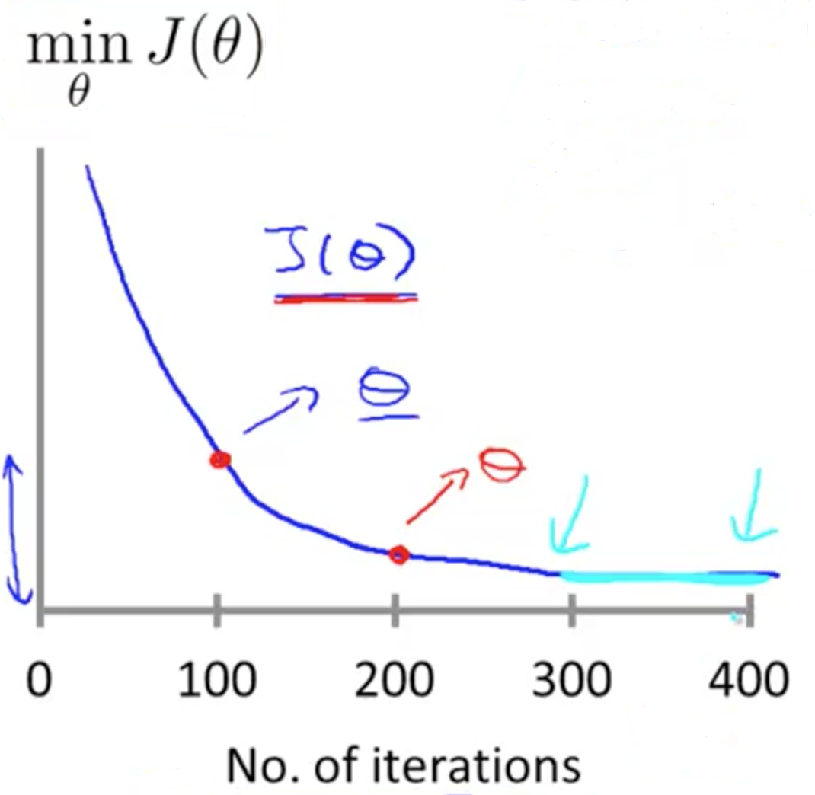
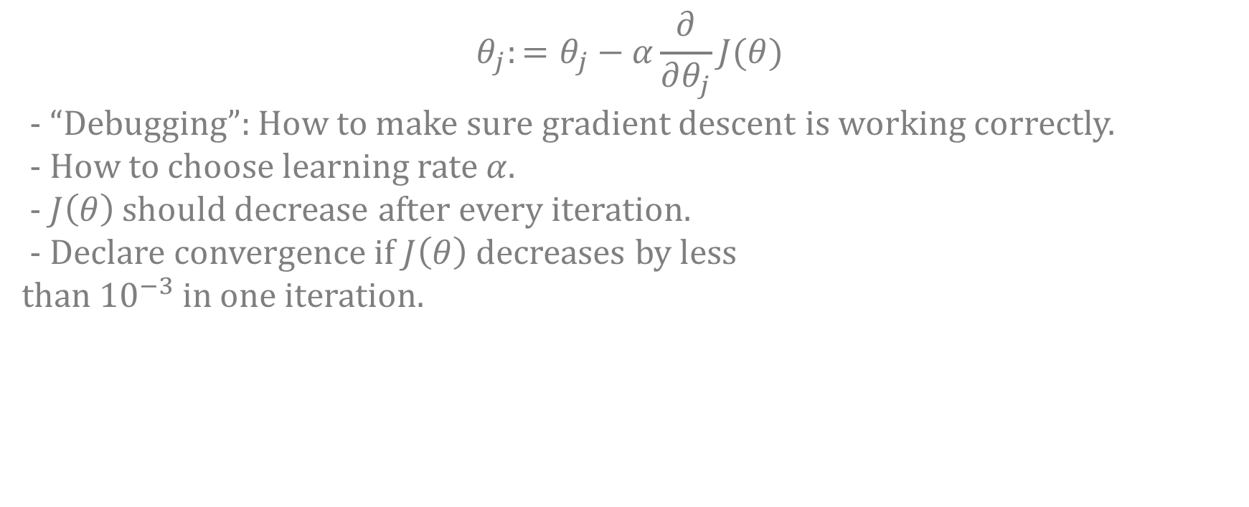
LEARNING RATE
$$θ_{j}:=θ_{j}−α\frac{∂}{∂θ_{j}}J(θ)$$
- “Debugging”: How to make sure gradient descent is working correctly.
- How to choose learning rate $α$.
- $J\left(θ\right)$ should decrease after every iteration.
- Declare convergence if $J\left(θ\right)$ decreases by less
than ${10}^{−3}$ in one iteration.

Slide 12
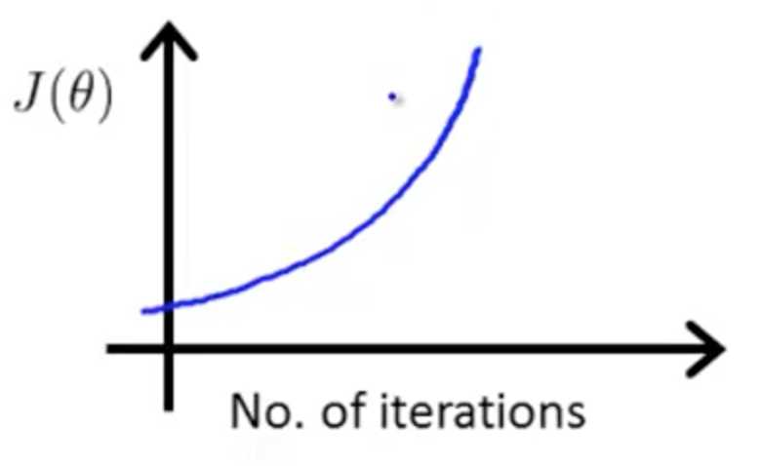
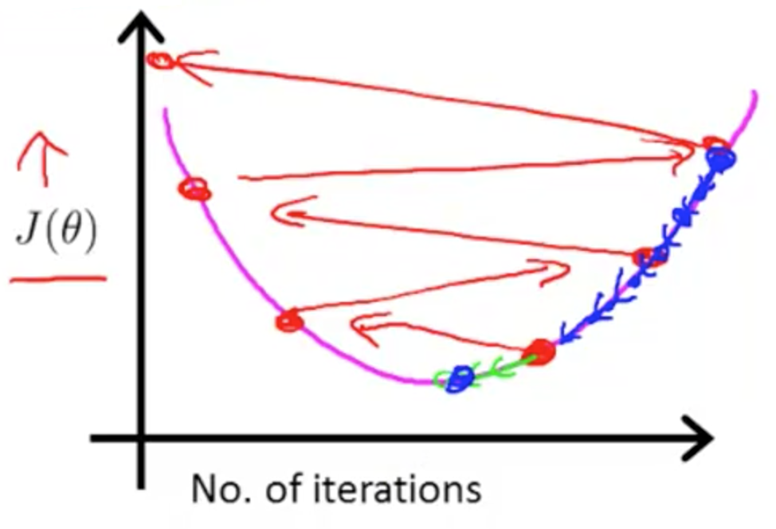
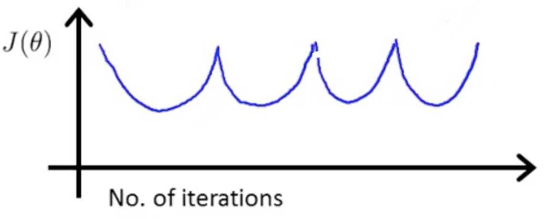

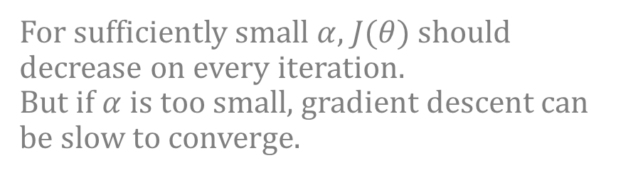
LEARNING RATE
Gradient descent not working.
Use smaller $α$.
For sufficiently small $α$, $J(θ)$ should decrease on every iteration.
But if $α$ is too small, gradient descent can be slow to converge.

Slide 13

LEARNING RATE
Summary:
- If $α$ is too small: slow convergence.
- If $α$ is too large: $J(θ)$ may not decrease on every iteration; may not converge.

Slide 14
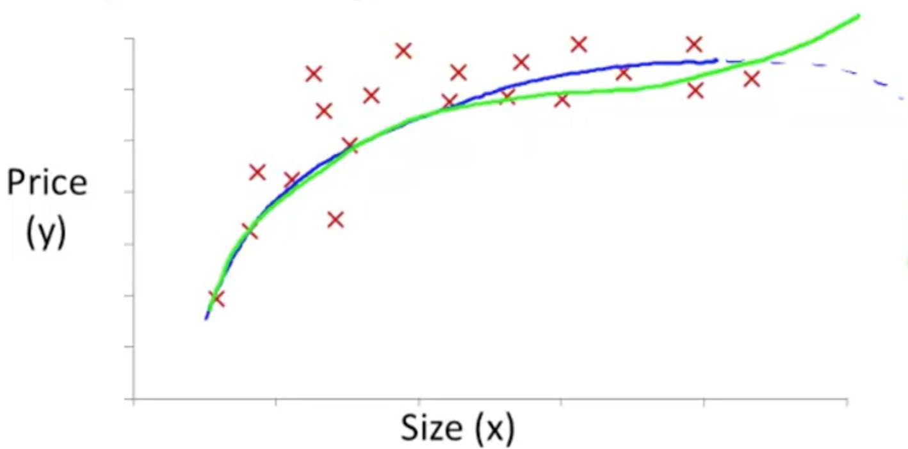
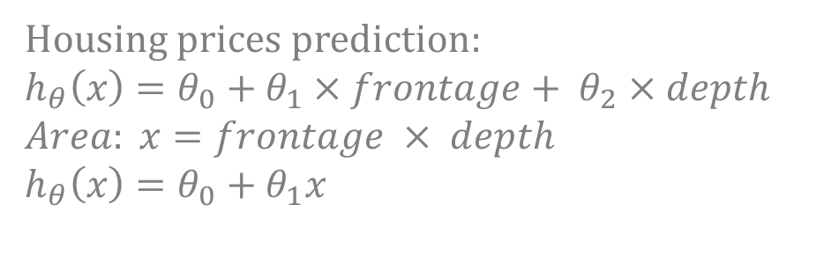
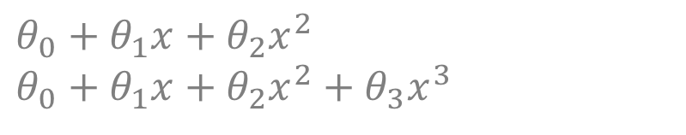
FEATURES AND POLYNOMIAL REGRESSION
Housing prices prediction:
$$h_{θ}\left(x\right)=θ_{0}+θ_{1}×frontage+ θ_{2}×depth$$
$$Area: x=frontage × depth$$
$$h_{θ}\left(x\right)=θ_{0}+θ_{1}x$$
$$θ_{0}+θ_{1}x+θ_{2}x^{2}$$
$$θ_{0}+θ_{1}x+θ_{2}x^{2}+θ_{3}x^{3}$$

Slide 15
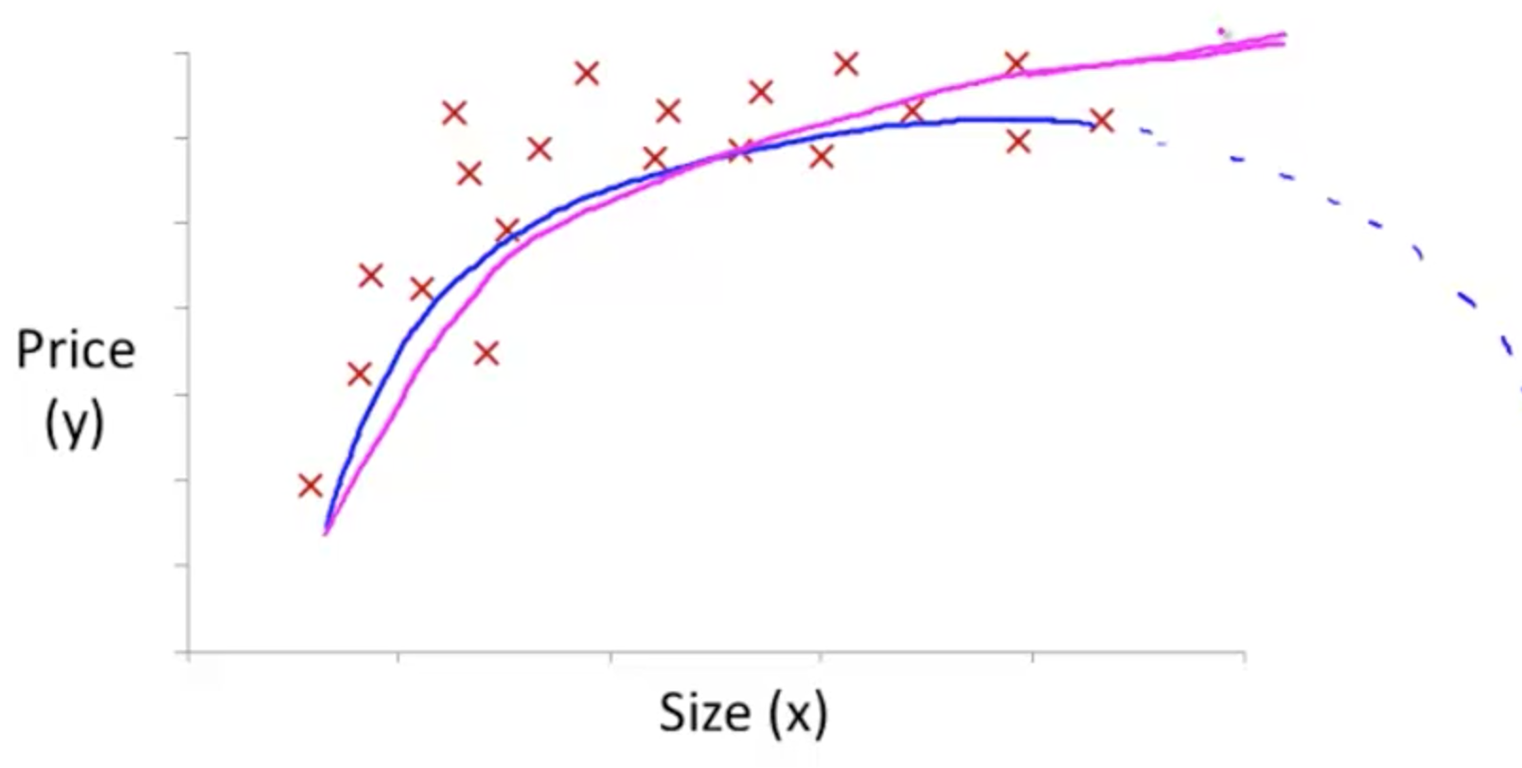

POLYNOMIAL REGRESSION
$$h_{θ}\left(x\right)=θ_{0}+θ_{1}\left(size\right)+ θ_{2}{\left(size\right)}^{2}$$
$$h_{θ}\left(x\right)=θ_{0}+θ_{1}(size)+ θ_{2}\sqrt{(size)}$$

Slide 16
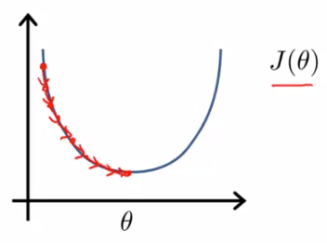
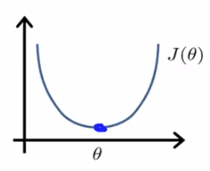
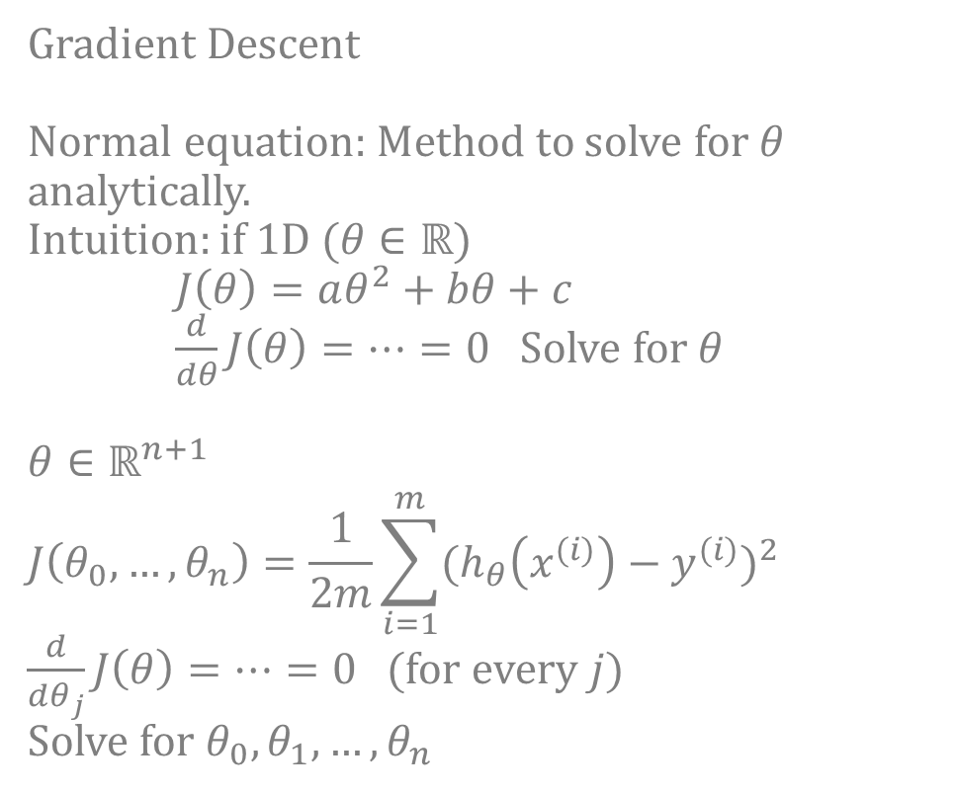
NORMAL EQUATION
Gradient Descent
Normal equation: Method to solve for $θ$ analytically.
Intuition: if 1D $(θ∈ℝ)$
$J\left(θ\right)=aθ^{2}+bθ+c$
$\frac{d}{dθ}J\left(θ\right)=…=0$ Solve for $θ$
$$θ∈ℝ^{n+1}$$
$$J\left(θ_{0},…,θ_{n}\right)=\frac{1}{2m}\sum_{i=1}^{m}{{(h_{θ}\left(x^{(i)}\right)−y^{(i)})}^{2}}$$
$\frac{d}{dθ_{j}}J\left(θ\right)=…=0$ (for every $j$)
Solve for $θ_{0},θ_{1},…,θ_{n}$

Slide 17

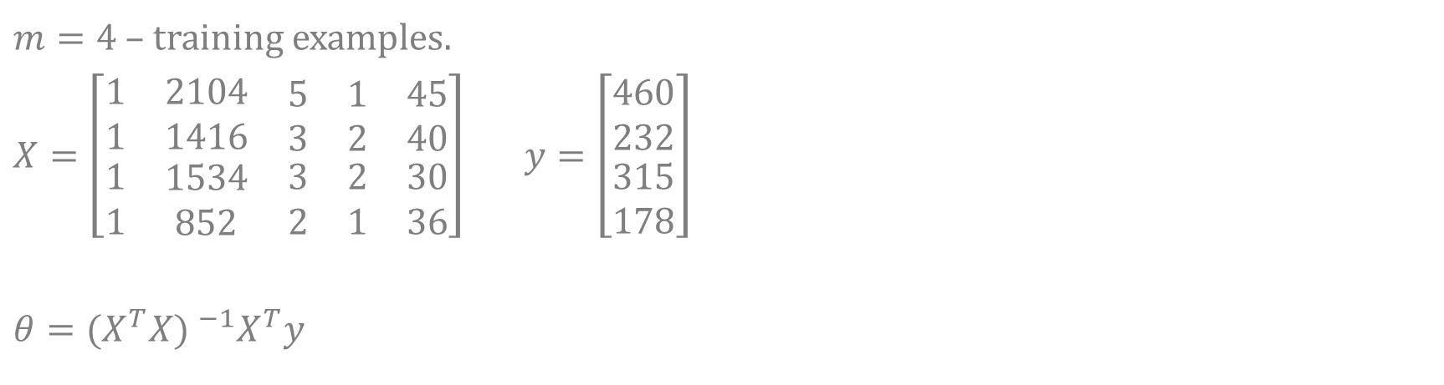


NORMAL EQUATION: EXAMPLES
$m=4$ – training examples.
$X=\left[\begin{matrix}1 & 2104 & \begin{matrix}5 & 1 & 45\end{matrix} \\ 1 & 1416 & \begin{matrix}3 & 2 & 40\end{matrix} \\ \begin{matrix}1 \\ 1\end{matrix} & \begin{matrix}1534 \\ 852\end{matrix} & \begin{matrix}\begin{matrix}3 \\ 2\end{matrix} & \begin{matrix}2 \\ 1\end{matrix} & \begin{matrix}30 \\ 36\end{matrix}\end{matrix}\end{matrix}\right]$ $y=\left[\begin{matrix}460 \\ 232 \\ \begin{matrix}315 \\ 178\end{matrix}\end{matrix}\right]$
$$θ={(X^{T}X) }^{−1}X^{T}y$$
$$m×(n+1)$$
$m$ – dimension vector

Slide 18

NORMAL EQUATION
$m$ examples $\left(x^{\left(1\right)},y^{\left(1\right)}\right),…,(x^{\left(m\right)},y^{\left(m\right)})$.
$n$ features.
$$x^{(i)}=\left[\begin{matrix}x_{0}^{(i)} \\ x_{1}^{(i)} \\ \begin{matrix}⋮ \\ x_{n}^{(i)}\end{matrix}\end{matrix}\right]∈ℝ^{n+1} X=\left[\begin{matrix}⋯ & {(x^{(1)})}^{T} & ⋯ \\ ⋯ & {(x^{(2)})}^{T} & ⋯ \\ \begin{matrix}⋮ \\ ⋯\end{matrix} & \begin{matrix}⋮ \\ {(x^{(m)})}^{T}\end{matrix} & \begin{matrix}⋮ \\ ⋯\end{matrix}\end{matrix}\right]$$
E.g. If $x^{(i)}=\left[\begin{matrix}1 \\ x_{1}^{(i)}\end{matrix}\right]$ $X=\left[\begin{matrix}1 & x_{1}^{(1)} \\ 1 & x_{1}^{(2)} \\ \begin{matrix}⋮ \\ 1\end{matrix} & \begin{matrix}⋮ \\ x_{1}^{(m)}\end{matrix}\end{matrix}\right] y=\left[\begin{matrix}y^{(1)} \\ y^{(2)} \\ \begin{matrix}⋮ \\ y^{(m)}\end{matrix}\end{matrix}\right]$
$$θ={(X^{T}X) }^{−1}X^{T}y$$

Slide 19
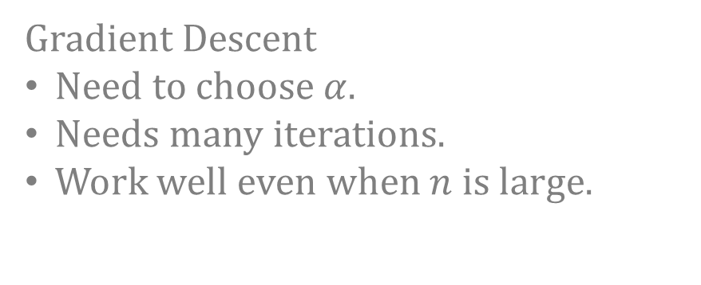
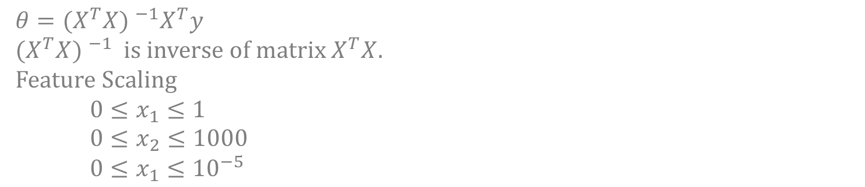
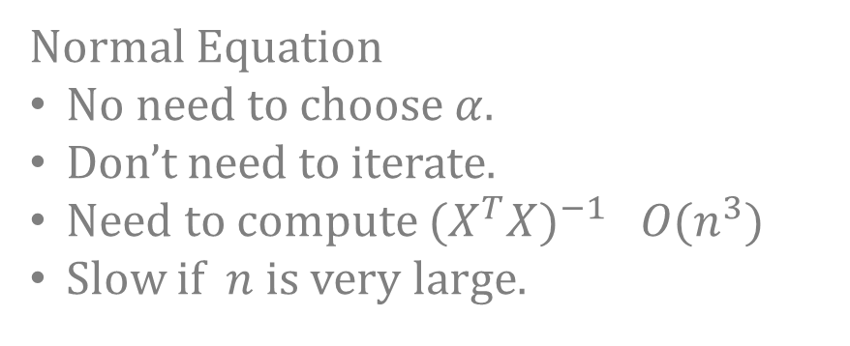
NORMAL EQUATION
$$θ={(X^{T}X) }^{−1}X^{T}y$$
${(X^{T}X) }^{−1}$ is inverse of matrix $X^{T}X$.
Feature Scaling
$0≤x_{1}≤1$
$0≤x_{2}≤1000$
$0≤x_{1}≤{10}^{−5}$
Gradient Descent
Need to choose $α$.
Needs many iterations.
Work well even when $n$ is large.
Normal Equation
No need to choose $α$.
Don’t need to iterate.
Need to compute ${(X^{T}X)}^{−1} O(n^{3})$
Slow if $n$ is very large.

