Slide 1
MACHINE LEARNING Logistic Regression
HueAI – April 2019

Slide 2
CONTENT
Classification and Representation
Classification
Hypothesis Representation
Decision Boundary
Logistic Regression Model
Cost Function
Simplified Cost Function and Gradient Descent
Multiclass Classification
One-vs-all
Regularization
The Problem of Overfitting
Cost Function
Regularized Linear Regression
Regularized Logistic Regression

Slide 3

CLASSIFICATION
Classification
Email: Spam / Not Spam?
Tumor: Malignant / Benign?
$y∈\{0,1\}$ 0: “Negative Class” (benign tumor)
1: “Positive Class” (malignant tumor)
$$y∈\{0,1,2,3\}$$

Slide 4
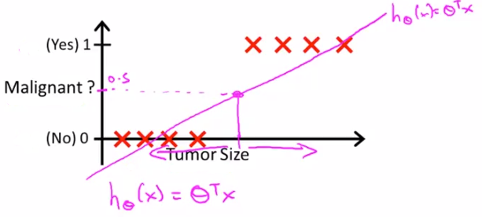
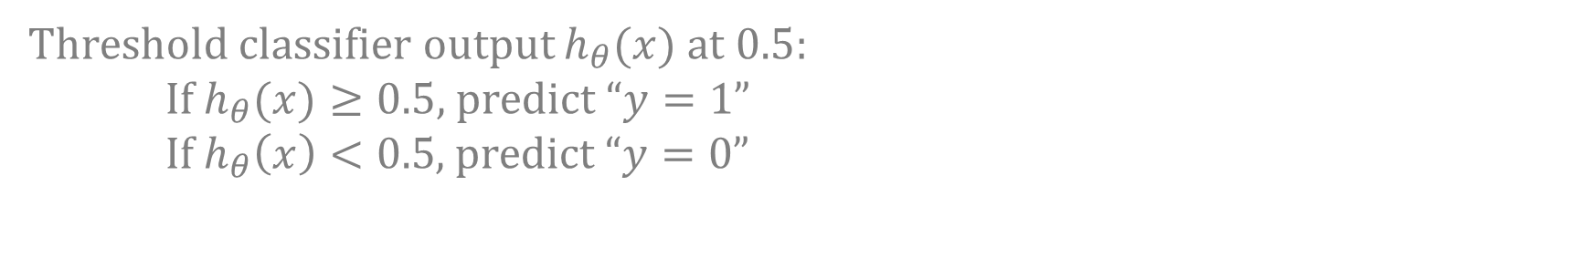
CLASSIFICATION
Threshold classifier output $h_{θ}(x)$ at 0.5:
If$h_{θ}(x)≥0.5$, predict “$y=1$”
If$h_{θ}\left(x\right)<0.5$, predict “$y=0$”

Slide 5
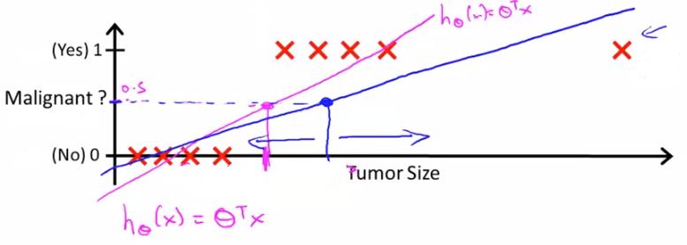
CLASSIFICATION
Result seem not good for linear regression.
Apply linear regression to a classification problem often isn’t a great idea.

Slide 6

CLASSIFICATION
Classification:
$y∈\left\{0,1\right\}$
$h_{θ}(x)$ can be > 1 or <0
Logistic Regression:
$0≤h_{θ}(x)≤1$

Slide 7
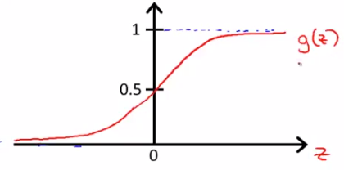

HYPOTHESIS REPRESENTATION
Logistic Regression Model:
Want: $0≤h_{θ}(x)≤1$
$h_{θ}\left(x\right)=g(θ^{T}x)$
$g\left(z\right)=\frac{1}{1+e^{−z}}$
$h_{θ}\left(x\right)=\frac{1}{1+e^{−θ^{T}x}}$
Sigmoid function
Logistic function

Slide 8
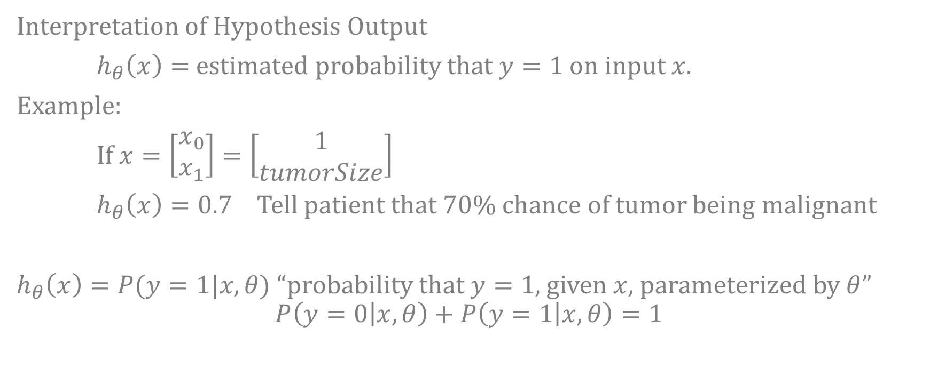
HYPOTHESIS REPRESENTATION
Interpretation of Hypothesis Output
$h_{θ}\left(x\right)=$ estimated probability that $y=1$ on input $x$.
Example:
If $x=\left[\begin{matrix}x_{0} \\ x_{1}\end{matrix}\right]=\left[\begin{matrix}1 \\ tumorSize\end{matrix}\right]$
$h_{θ}\left(x\right)=0.7$ Tell patient that 70% chance of tumor being malignant
$h_{θ}\left(x\right)=P(y=1|x,θ)$ “probability that $y=1$, given $x$, parameterized by $θ$”
$$P\left(y=0 | x,θ\right)+P\left(y=1 | x,θ\right)=1$$

Slide 9
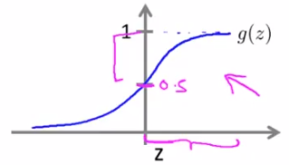
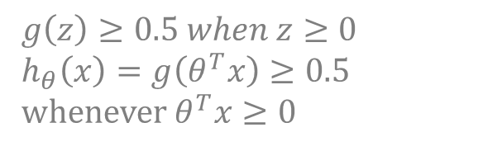

DECISION BOUNDARY
Logistic regression
$h_{θ}\left(x\right)=g\left(θ^{T}x\right)=P(y=1|x,θ)$
$g\left(z\right)=\frac{1}{1+e^{−z}}$
Suppose predict “$y=1$” if $h_{θ}\left(x\right)≥0.5$
$θ^{T}x≥0$
predict “$y=$0” if $h_{θ}\left(x\right)<0.5$
$θ^{T}x<0$
$$g\left(z\right)≥0.5 when z≥0$$
$$h_{θ}\left(x\right)=g\left(θ^{T}x\right)≥0.5$$
whenever$θ^{T}x≥0$

Slide 10
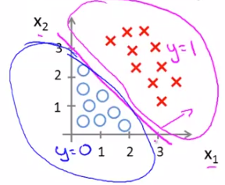
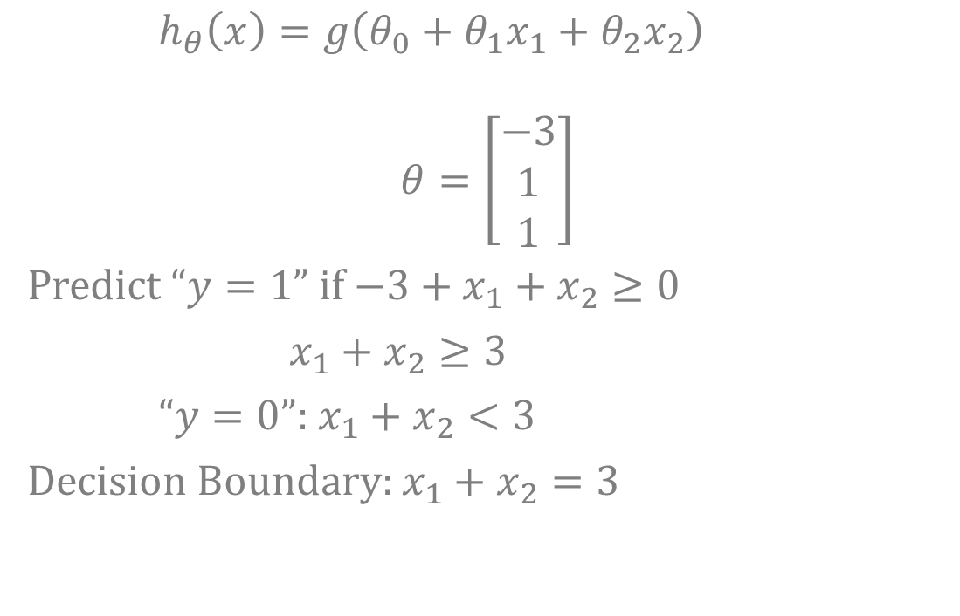
DECISION BOUNDARY
$h_{θ}\left(x\right)=g\left(θ_{0}+θ_{1}x_{1}+θ_{2}x_{2}\right)$
$$θ=\left[\begin{matrix}−3 \\ 1 \\ 1\end{matrix}\right]$$
Predict “$y=1$” if $−3+x_{1}+x_{2}≥0$
$x_{1}+x_{2}≥3$
“$y=0$”: $x_{1}+x_{2}<3$
Decision Boundary: $x_{1}+x_{2}=3$

Slide 11
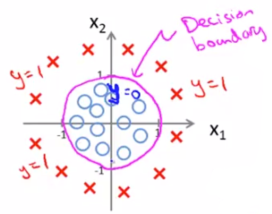
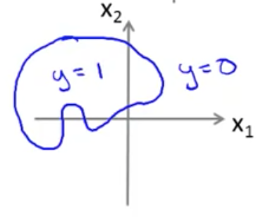
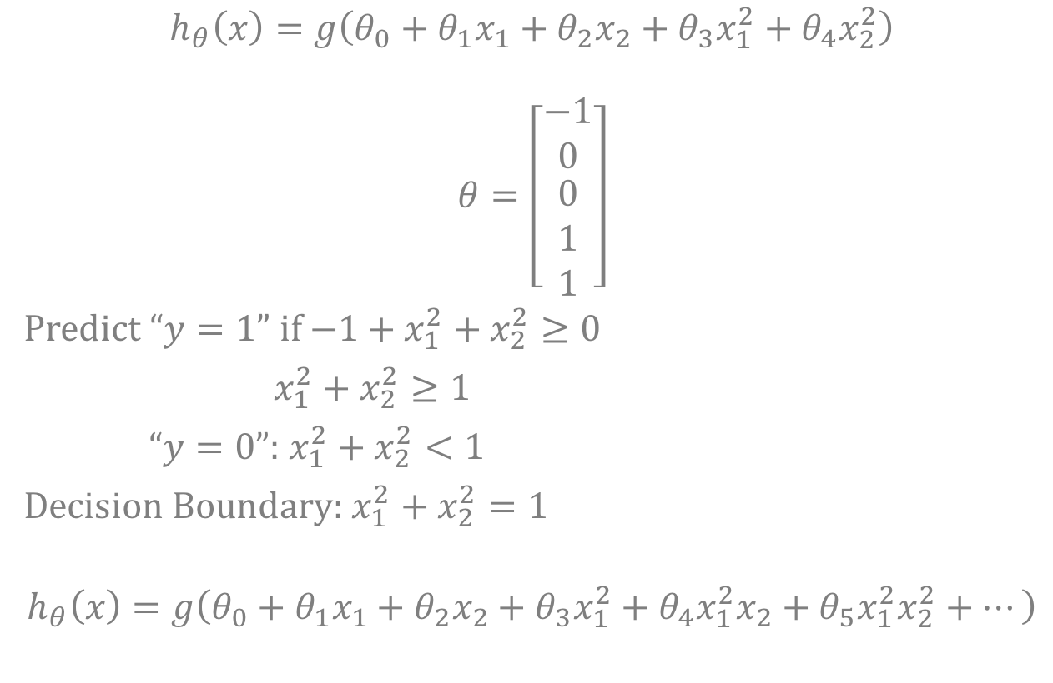
NON-LINEAR DECISION BOUNDARY
$$h_{θ}\left(x\right)=g\left(θ_{0}+θ_{1}x_{1}+θ_{2}x_{2}+θ_{3}x_{1}^{2}+θ_{4}x_{2}^{2}\right)$$
$$θ=\left[\begin{matrix}−1 \\ 0 \\ \begin{matrix}0 \\ 1 \\ 1\end{matrix}\end{matrix}\right]$$
Predict “$y=1$” if $−1+x_{1}^{2}+x_{2}^{2}≥0$
$x_{1}^{2}+x_{2}^{2}≥1$
“$y=0$”:$x_{1}^{2}+x_{2}^{2}<1$
Decision Boundary: $x_{1}^{2}+x_{2}^{2}=1$
$$h_{θ}\left(x\right)=g\left(θ_{0}+θ_{1}x_{1}+θ_{2}x_{2}+θ_{3}x_{1}^{2}+θ_{4}x_{1}^{2}x_{2}+θ_{5}x_{1}^{2}x_{2}^{2}+…\right)$$

Slide 12

LOGISTIC REGRESSION MODEL COST FUNCTION
Training set: $\{(x^{\left(1\right)},y^{\left(1\right)}),(x^{\left(2\right)},y^{\left(2\right)}),…,(x^{(m)},y^{(m)})\}$
$m$ examples
$$x=\left[\begin{matrix}x_{0} \\ x_{1} \\ \begin{matrix}x_{2} \\ ⋯ \\ x_{n}\end{matrix}\end{matrix}\right] x_{0}=1, y∈\{0,1\}$$
$$h_{θ}\left(x\right)=\frac{1}{1+e^{−θ^{T}x}}$$
How to choose parameters $θ$?

Slide 13
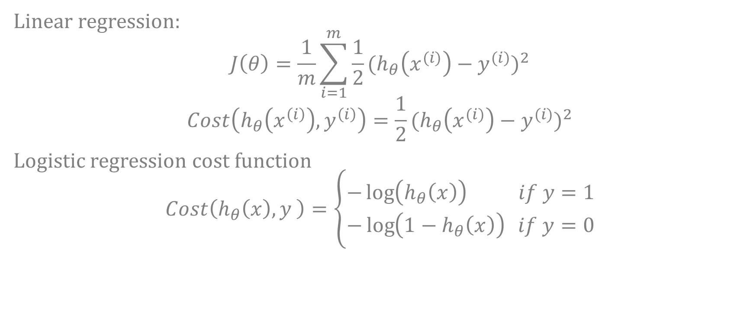
COST FUNCTION
Linear regression:
$$J\left(θ\right)=\frac{1}{m}\sum_{i=1}^{m}{\frac{1}{2}{(h_{θ}\left(x^{(i)}\right)−y^{(i)})}^{2}}$$
$$Cost\left(h_{θ}\left(x^{\left(i\right)}\right),y^{\left(i\right)}\right)=\frac{1}{2}{(h_{θ}\left(x^{(i)}\right)−y^{(i)})}^{2}$$
Logistic regression cost function
$$Cost\left(h_{θ}\left(x\right),y \right)=\left\{\begin{matrix}−\log\left(h_{θ}\left(x\right)\right) if y=1 \\ −\log\left(1−h_{θ}\left(x\right)\right) if y=0\end{matrix}\right.$$

Slide 14
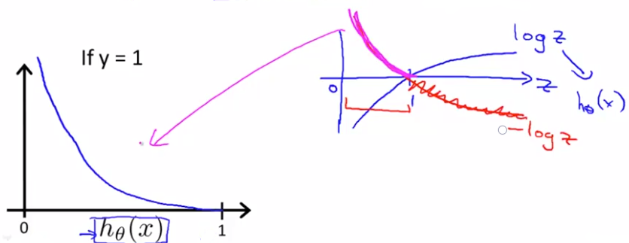

COST FUNCTION
Logistic regression cost function
$$Cost\left(h_{θ}\left(x\right),y \right)=\left\{\begin{matrix}−\log\left(h_{θ}\left(x\right)\right) if y=1 \\ −\log\left(1−h_{θ}\left(x\right)\right) if y=0\end{matrix}\right.$$

Slide 15
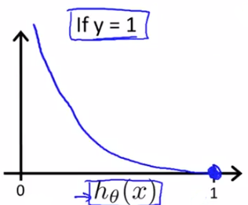
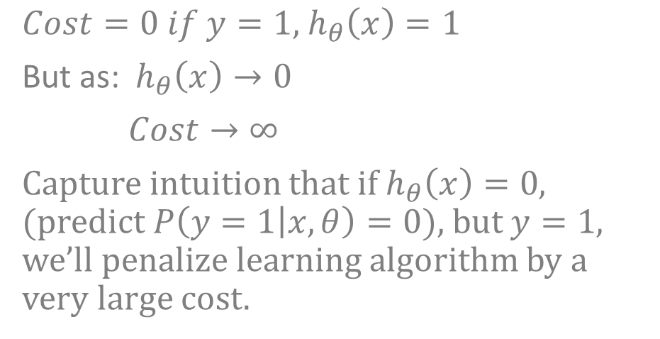
COST FUNCTION
Logistic regression cost function
$$Cost\left(h_{θ}\left(x\right),y \right)=\left\{\begin{matrix}−\log\left(h_{θ}\left(x\right)\right) if y=1 \\ −\log\left(1−h_{θ}\left(x\right)\right) if y=0\end{matrix}\right.$$
$Cost=0 if y=1,$ $h_{θ}\left(x\right)=1$
But as: $h_{θ}\left(x\right)→0$
$Cost→∞$
Capture intuition that if $h_{θ}\left(x\right)=0$, (predict $P\left(y=1 | x,θ\right)=0$), but $y=1$, we’ll penalize learning algorithm by a very large cost.

Slide 16
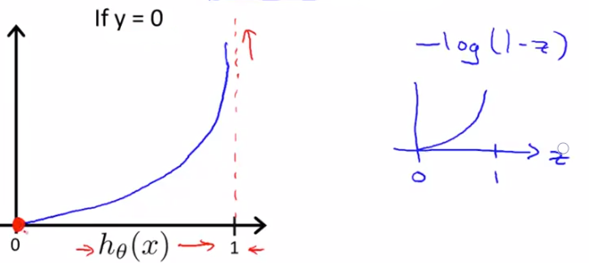
COST FUNCTION
Logistic regression cost function
$$Cost\left(h_{θ}\left(x\right),y \right)=\left\{\begin{matrix}−\log\left(h_{θ}\left(x\right)\right) if y=1 \\ −\log\left(1−h_{θ}\left(x\right)\right) if y=0\end{matrix}\right.$$

Slide 17
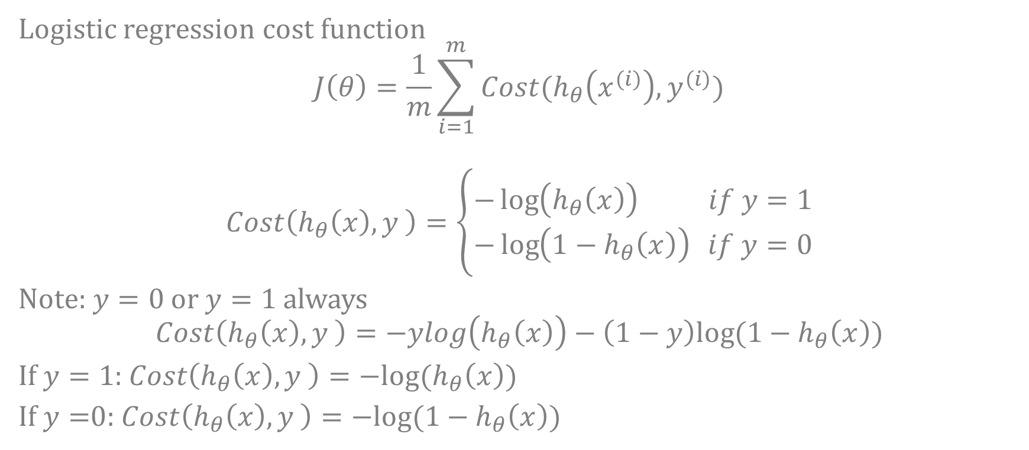
SIMPLIFIED COST FUNCTION AND GRADIENT DESCENT
Logistic regression cost function
$$J\left(θ\right)=\frac{1}{m}\sum_{i=1}^{m}{Cost(h_{θ}\left(x^{(i)}\right),y^{(i)})}$$
$$Cost\left(h_{θ}\left(x\right),y \right)=\left\{\begin{matrix}−\log\left(h_{θ}\left(x\right)\right) if y=1 \\ −\log\left(1−h_{θ}\left(x\right)\right) if y=0\end{matrix}\right.$$
Note: $y=0$ or $y=1$ always
$$Cost\left(h_{θ}\left(x\right),y \right)=−ylog\left(h_{θ}\left(x\right)\right)−\left(1−y\right)log⁡(1−h_{θ}\left(x\right))$$
If $y=1$: $Cost\left(h_{θ}\left(x\right),y \right)=−log⁡(h_{θ}\left(x\right))$
If $y=$0: $Cost\left(h_{θ}\left(x\right),y \right)=−log⁡({1−h}_{θ}\left(x\right))$

Slide 18
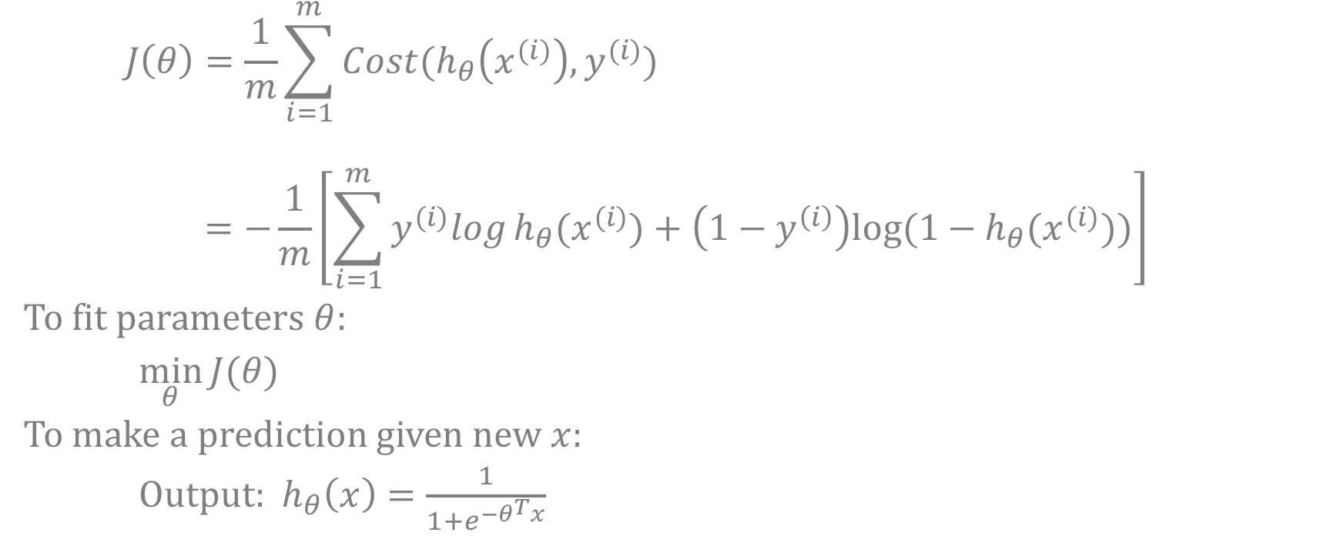
SIMPLIFIED COST FUNCTION AND GRADIENT DESCENT
$$J\left(θ\right)=\frac{1}{m}\sum_{i=1}^{m}{Cost(h_{θ}\left(x^{(i)}\right),y^{(i)})}$$
$$=−\frac{1}{m}\left[\sum_{i=1}^{m}{y^{(i)}log}h_{θ}{(x}^{(i)})+\left(1−y^{\left(i\right)}\right)log⁡(1−h_{θ}{(x}^{(i)}))\right]$$
To fit parameters $θ$:
$\min_{θ}{J(θ)}$
To make a prediction given new $x$:
Output: $h_{θ}\left(x\right)=\frac{1}{1+e^{−θ^{T}x}}$

Slide 19
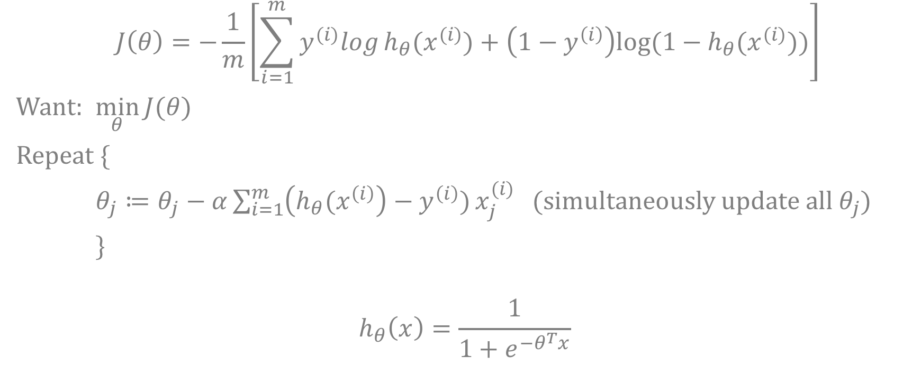
SIMPLIFIED COST FUNCTION AND GRADIENT DESCENT
$$J\left(θ\right)=−\frac{1}{m}\left[\sum_{i=1}^{m}{y^{(i)}log}h_{θ}{(x}^{(i)})+\left(1−y^{\left(i\right)}\right)log⁡(1−h_{θ}{(x}^{(i)}))\right]$$
Want: $\min_{θ}{J(θ)}$
Repeat {
$θ_{j}≔θ_{j}−α\sum_{i=1}^{m}{\left(h_{θ}{(x}^{\left(i\right)}\right)−y^{\left(i\right)})}x_{j}^{(i)}$ (simultaneously update all $θ_{j}$)
}
$$h_{θ}\left(x\right)=\frac{1}{1+e^{−θ^{T}x}}$$

Slide 20
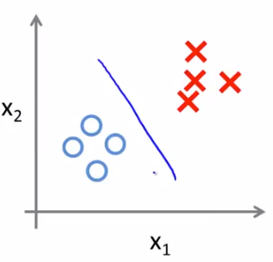
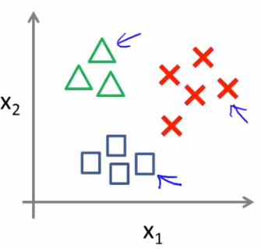
MULTICLASS CLASSIFICATION: ONE-VS-ALL
Email: Work, Friends, Family, Hobby
Weather: Sunny, Cloudy, Rain, Snow
Binary classification Multi-class classification

Slide 21
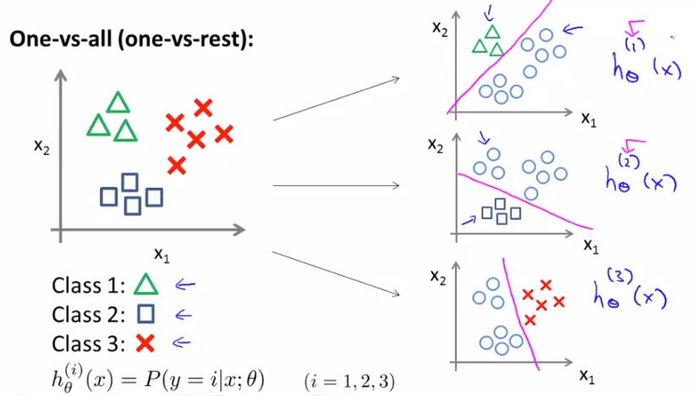
ONE-VS-ALL

Slide 22
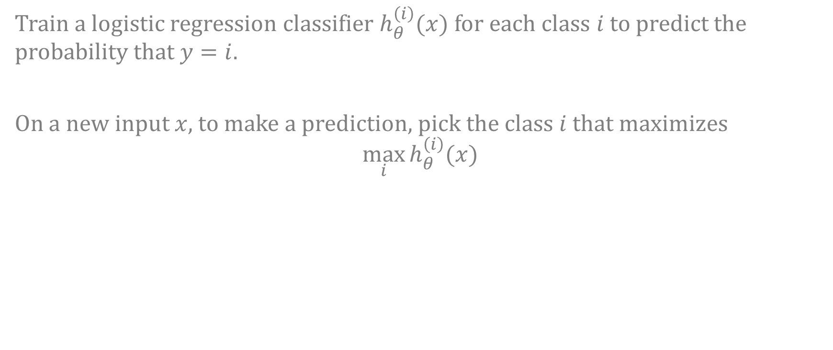
ONE-VS-ALL
Train a logistic regression classifier $h_{θ}^{\left(i\right)}(x)$ for each class $i$ to predict the probability that $y=i$.
On a new input $x$, to make a prediction, pick the class $i$ that maximizes
$$\max_{i}{h_{θ}^{\left(i\right)}(x)}$$

Slide 23
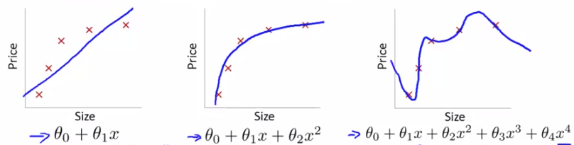
THE PROBLEM OF OVERFITTING
Example: Linear regression (housing prices)
“Underfit - High bias”
“Overfit - High variance”
Overfitting: If we have too many features, the learned hypothesis may fit the training set very well, but fail to generalize to new examples.

Slide 24
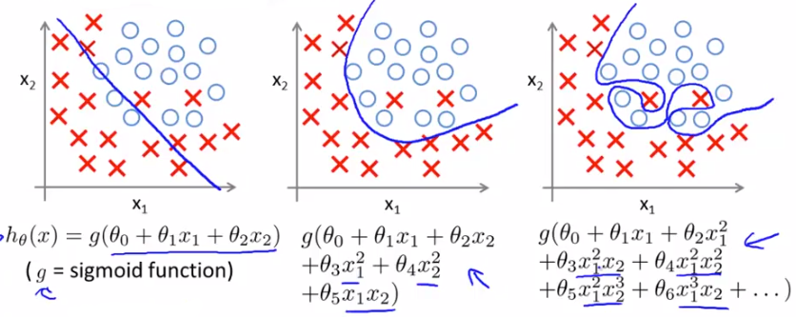
THE PROBLEM OF OVERFITTING
Example: Logistic regression
“Underfit”
“Overfit”

Slide 25
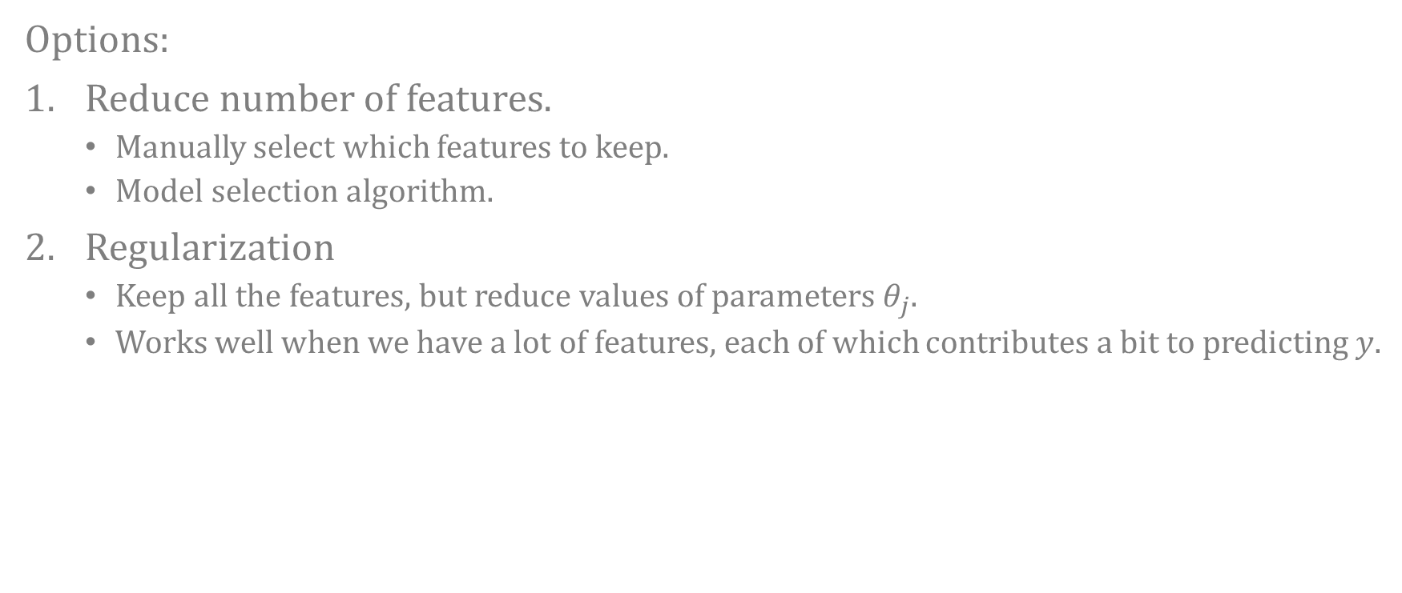
ADDRESSING OVERFITTING
Options:
Reduce number of features.
Manually select which features to keep.
Model selection algorithm.
Regularization
Keep all the features, but reduce values of parameters $θ_{j}$.
Works well when we have a lot of features, each of which contributes a bit to predicting $y$.

Slide 26
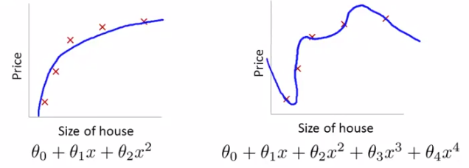

OVERFITTING: COST FUNCTION
Intuition
Suppose we penalize and make $θ_{3},θ_{4}$ really small
$$\min_{θ}{\frac{1}{2m}\sum_{i=1}^{m}{{(h_{θ}\left(x^{(i)}\right)−y^{(i)})}^{2}+1000θ_{3}^{2}+1000θ_{4}^{2}}}$$
$$θ_{3}≈0,θ_{4}≈0$$

Slide 27
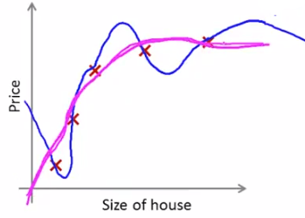

OVERFITTING: COST FUNCTION
Regularization
$J\left(θ\right)=\frac{1}{2m}\left[\sum_{i=1}^{m}{{(h_{θ}\left(x^{(i)}\right)−y^{(i)})}^{2}+λ\sum_{j=1}^{n}{θ_{j}^{2}}}\right]$
$$\min_{θ}{J(θ)}$$
$λ$ – regularization parameter.

Slide 28
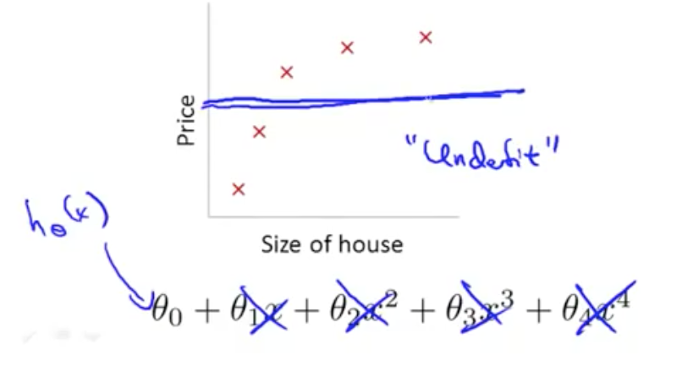


OVERFITTING: COST FUNCTION
Regularization
$J\left(θ\right)=\frac{1}{2m}\left[\sum_{i=1}^{m}{{(h_{θ}\left(x^{(i)}\right)−y^{(i)})}^{2}+λ\sum_{j=1}^{n}{θ_{j}^{2}}}\right]$
If $λ$ is too large? ($λ={10}^{10}$)
$$θ_{1},θ_{2},θ_{3},θ_{4}$$
$$θ_{1}≈0,θ_{2}≈0$$
$$θ_{3}≈0,θ_{4}≈0$$
$$h_{θ}\left(x\right)≈θ_{0}$$

Slide 29
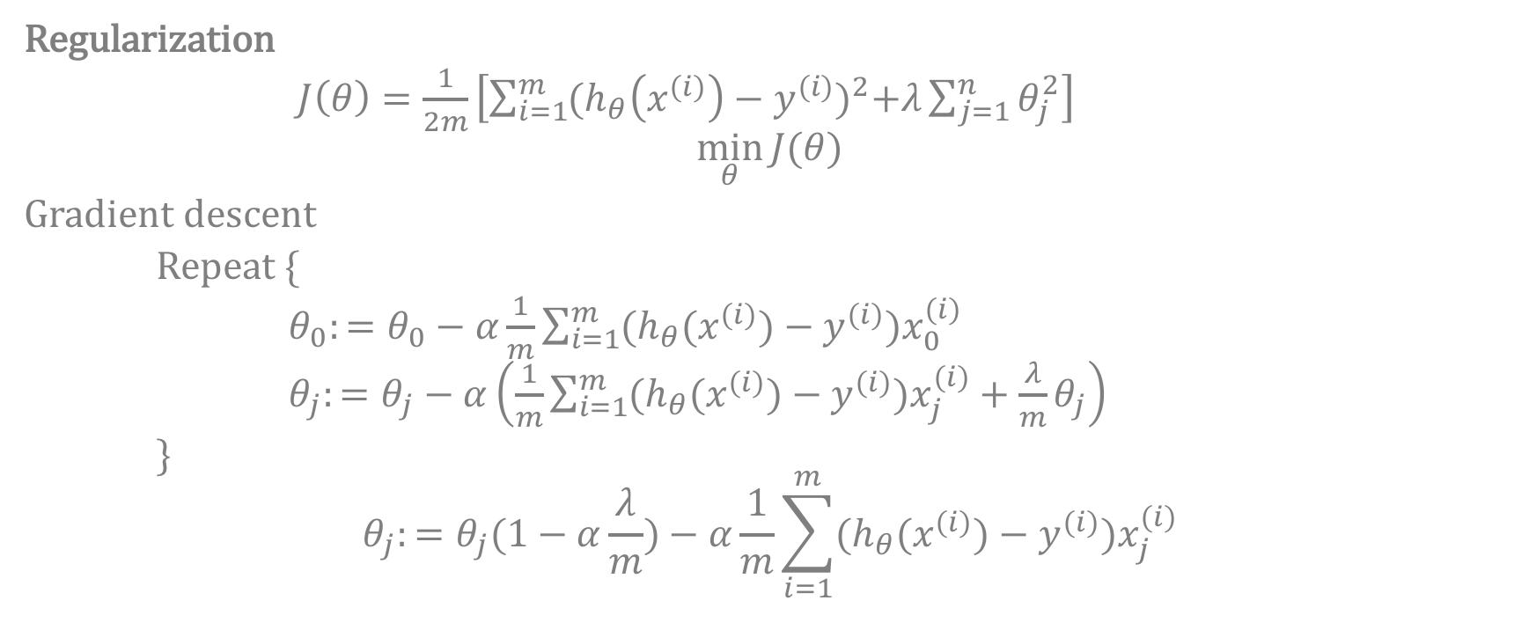
REGULARIZED LINEAR REGRESSION
Regularization
$J\left(θ\right)=\frac{1}{2m}\left[\sum_{i=1}^{m}{{(h_{θ}\left(x^{(i)}\right)−y^{(i)})}^{2}+λ\sum_{j=1}^{n}{θ_{j}^{2}}}\right]$
$$\min_{θ}{J(θ)}$$
Gradient descent
Repeat {
$θ_{0}:=θ_{0}−α\frac{1}{m}\sum_{i=1}^{m}{(h_{θ}{(x}^{\left(i\right)})−y^{\left(i\right)})x_{0}^{\left(i\right)}}$
$θ_{j}:=θ_{j}−α\left(\frac{1}{m}\sum_{i=1}^{m}{(h_{θ}{(x}^{\left(i\right)})−y^{\left(i\right)})x_{j}^{\left(i\right)}+\frac{λ}{m}θ_{j}}\right)$
}
$$θ_{j}:=θ_{j}(1−α\frac{λ}{m})−α\frac{1}{m}\sum_{i=1}^{m}{(h_{θ}{(x}^{\left(i\right)})−y^{\left(i\right)})x_{j}^{\left(i\right)}}$$

