Slide 1


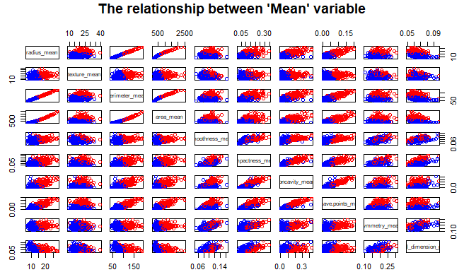
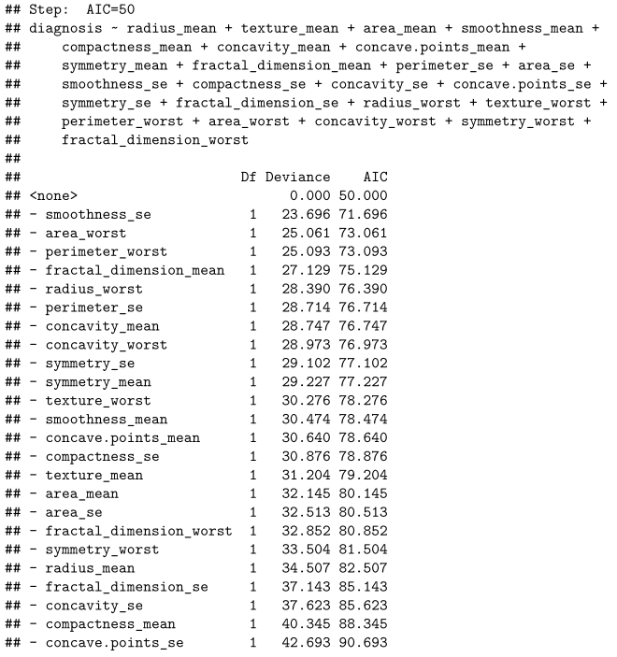
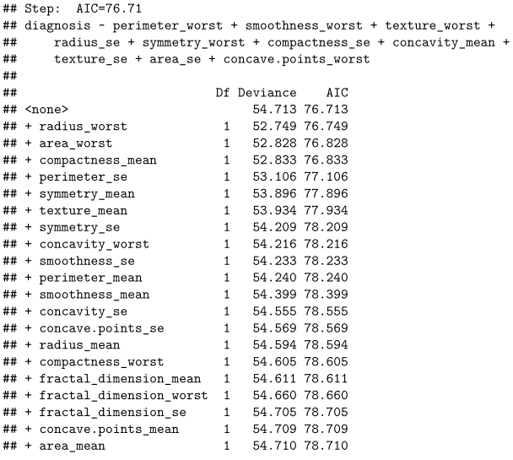
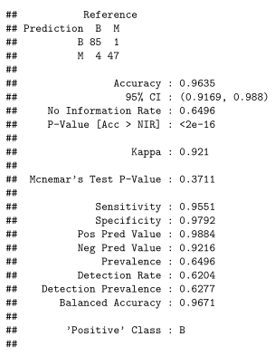
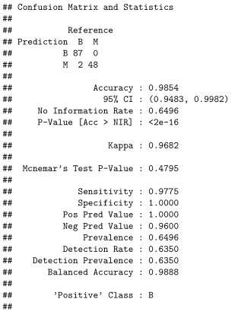
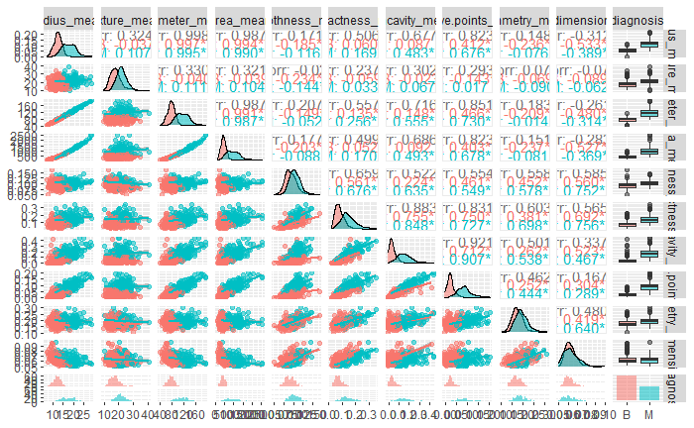
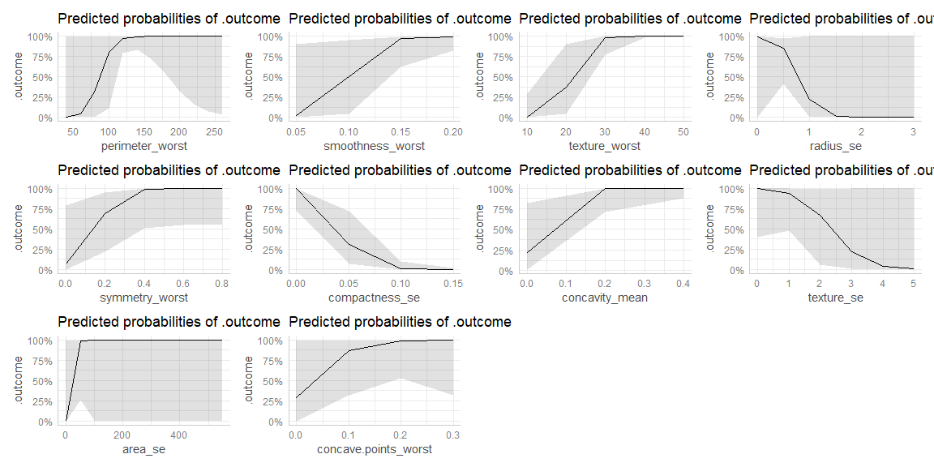
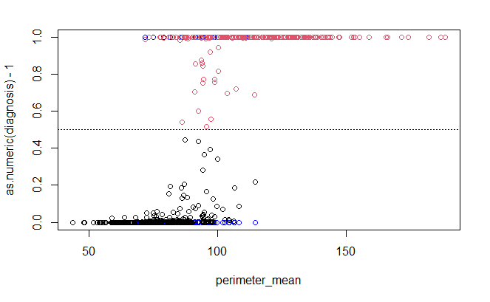
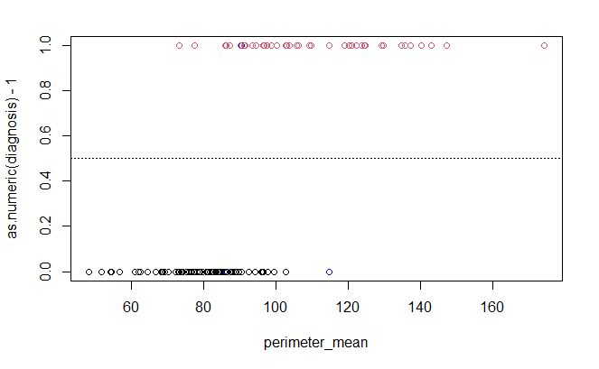
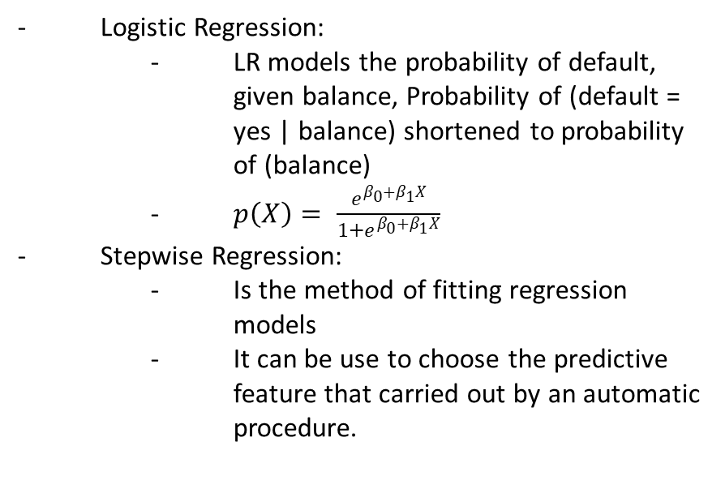
Predicting and Classification
Diagnosis of Breast Cancer in Wisconsin
Thanh La¹, Son Luong¹, Dr. Katherine Shoemaker¹
Abstract
Feature Correlation
Result
Breast cancer is the most common cancer, accounting for approximately 33% of all cancers diagnosed among women in Wisconsin. It has been 40 years since the first case was collected by the Wisconsin Cancer Report system (WCRS). Early detection plays an essential role in breast cancer treatment by boosting the chance for timely intervention. Moreover, the increase in the incidence of this cancer shows no sign of stopping, which is why this topic has received much attention from researchers, including expert systems and machine learning techniques. Therefore, this study aims to predict and detect breast cancer early with non-invasive and technology-involved methods by using one of the most popular machine learning algorithms, which is stepwise logistic regression. Using stepwise regression will help the system remove redundant values and retain valuable values in the data, thereby using the logistic regression system to calculate relevant predictions such as accuracy, AIC, the probability. The study works on the Wisconsin Breast Cancer dataset taken from UCI Machine learning Repository. The outcome of this research shows that the stepwise logistic regression model achieved a classification accuracy of nearly 98%. Furthermore, this research will continue to be developed in terms of accuracy to detect breast cancer for early intervention.
Stepwise Backward Direction
Stepwise Forward Direction
Stepwise Backward Direction
Stepwise Forward Direction
Conclusion
Analysis and Visualization
Stepwise Forward Direction
Stepwise Backward Direction
Method
Logistic Regression:
LR models the probability of default, given balance, Probability of (default = yes | balance) shortened to probability of (balance)
$p\left(X\right)= \frac{e^{β_{0}+β_{1}X}}{1+e^{β_{0}+β_{1}X}}$
Stepwise Regression:
Is the method of fitting regression models
It can be use to choose the predictive feature that carried out by an automatic procedure.
Cái này là predict của whole LR- glm model á
Thành đang tính làm cái ROC plot r để ở đây
Reference

