Slide 1

CHAPTER 2
Number Systems
Notes:
1.#

Slide 2
Objectives
After studying this chapter, the student should be able to:
Understand the concept of number systems.
Distinguish between non-positional and positional number
systems.
Describe the decimal, binary, hexadecimal, and octal system.
Convert a number in binary, octal, or hexadecimal to a
number in the decimal system.
Convert a number in the decimal system to a number in
binary, octal, and hexadecimal.
Convert a number in binary to octal and vice versa.
Convert a number in binary to hexadecimal and vice versa.
Find the number of digits needed in each system to represent
a particular value.

Slide 3
2-1 INTRODUCTION
A number system defines how a number can be represented using distinct symbols. A number can be represented differently in different systems. For example, the two numbers (2A)₁₆ and (52)₈ both refer to the same quantity, (42)₁₀, but their representations are different.
Several number systems have been used in the past and can be categorized into two groups: positional and non-positional systems. Our main goal is to discuss the positional number systems, but we also give examples of non-positional systems.

Slide 4
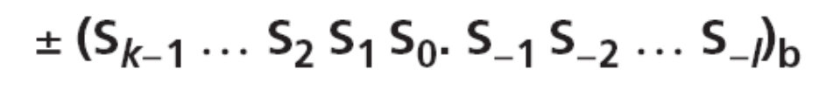
2-2 POSITIONAL NUMBER SYSTEMS
In a positional number system, the position a symbol occupies in the number determines the value it represents. In this system, a number represented as:
has the value of:
To be added later
in which S is the set of symbols, b is the base (or radix).
2.<number>

Slide 5
2.2.1 The decimal system (base 10)
The word decimal is derived from the Latin root decem (ten). In this system the base b = 10 and we use ten symbols
S = {0, 1, 2, 3, 4, 5, 6, 7, 8, 9}
The symbols in this system are often referred to as decimal digits or just digits.
2.<number>

Slide 6
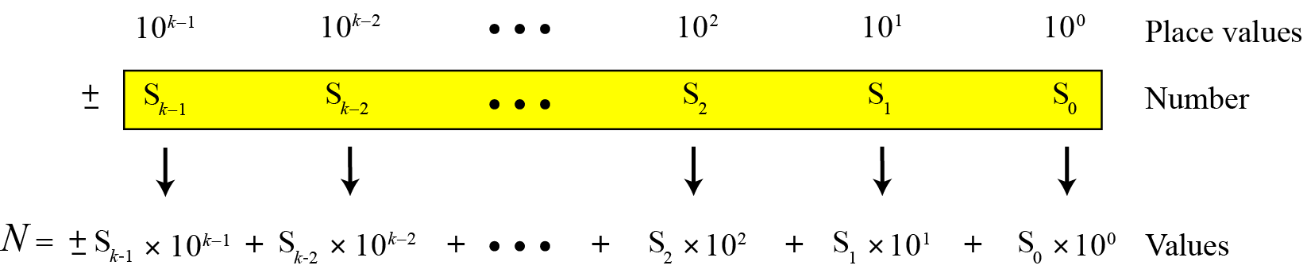
Integers
Figure 2.1 Place values for an integer in the decimal system
2.<number>

Slide 7
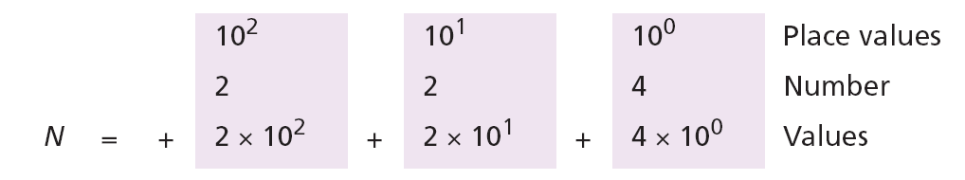
Example 2.1
The following shows the place values for the integer +224 in the decimal system.
Note that the digit 2 in position 1 has the value 20, but the same digit in position 2 has the value 200. Also note that we normally drop the plus sign, but it is implicit.

Slide 8
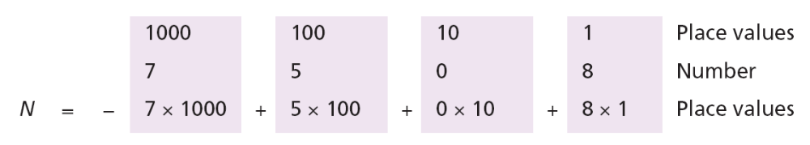
Example 2.2
The following shows the place values for the decimal number −7508. We have used 1, 10, 100, and 1000 instead of powers of 10.
(
)
Values
2.<number>

Slide 9
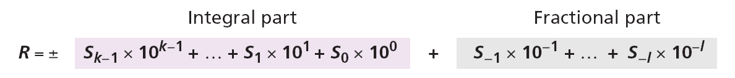
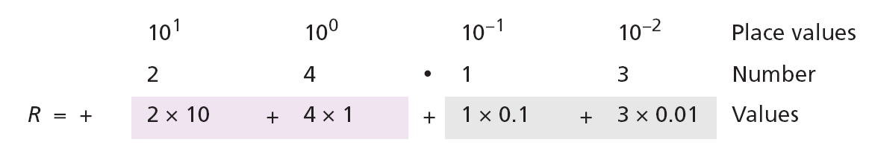
Reals
A real (a number with a fractional part) in the decimal system is also familiar. For example, we use this system to show dollars and cents ($23.40). We can represent a real as
Example 2.3
The following shows the place values for the real number +24.13.

Slide 10
2.2.2 The binary system (base 2)
The word binary is derived from the Latin root bini (or two by two). In this system the base b = 2 and we use only two symbols, S = {1, 2}. The symbols in this system are often referred to as binary digits or bits (binary digit).
2.<number>

Slide 11
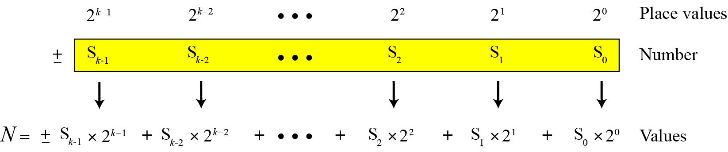
Integers
We can represent an integer as:
Figure 2.2 Place values for an integer in the binary system
2.<number>

Slide 12
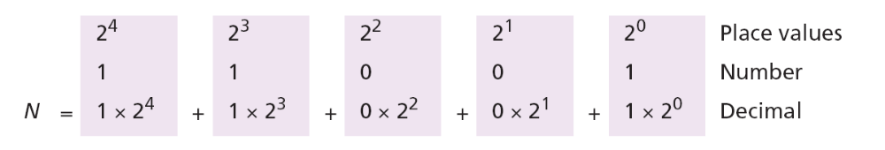
Example 2.4
The following shows that the number (11001)₂ in binary is the same as 25 in decimal. The subscript 2 shows that the base is 2.
The equivalent decimal number is N = 16 + 8 + 0 + 0 + 1 = 25.
2.<number>

Slide 13
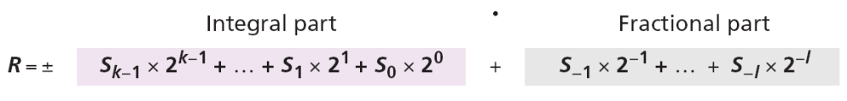
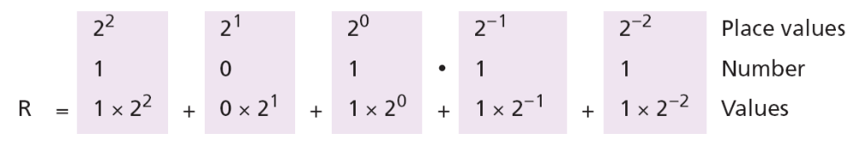
Reals
A real—a number with an optional fractional part—in the binary system can be made of K bits on the left and L bits on the right:
Example 2.5
The following shows that the number (101.11)₂ in binary is equal to the number 5.75 in decimal.
The value in decimal system is R = 4 + 0 + 1 + 0.5 + 0.25 = 5.75

Slide 14
The hexadecimal system (base 16)
The word hexadecimal is derived from the Greek root hex (six) and the Latin root decem (ten). In this system the base
b = 16 and we use sixteen symbols to represent a number. The set of symbols is
S = {0, 1, 2, 3, 4, 5, 6, 7, 8, 9, A, B, C, D, E, F}
Note that the symbols A, B, C, D, E, F are equivalent to 10, 11, 12, 13, 14, and 15 respectively. The symbols in this system are often referred to as hexadecimal digits.

Slide 15
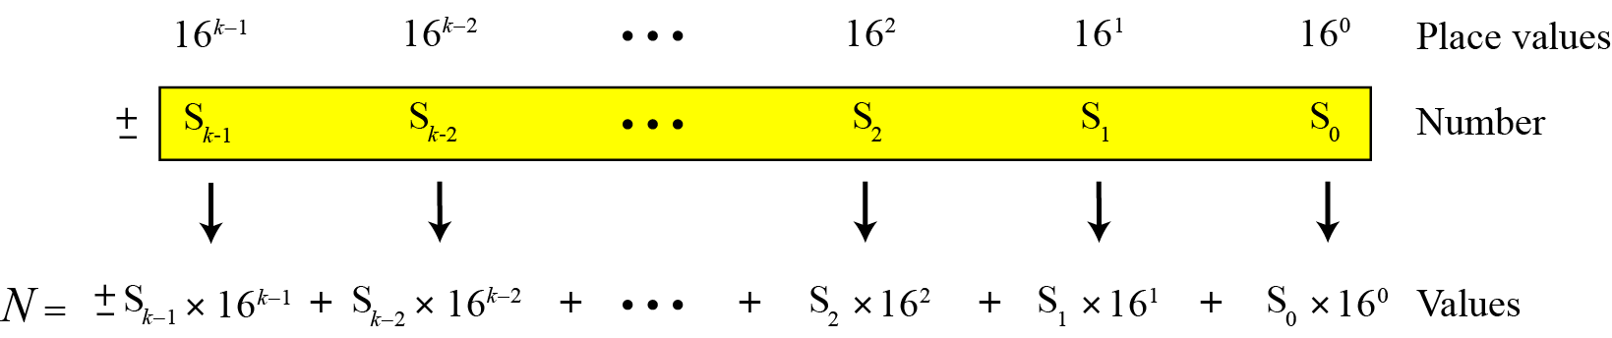
Integers
We can represent an integer as:
Figure 2.3 Place values for an integer in the hexadecimal system
2.<number>

Slide 16
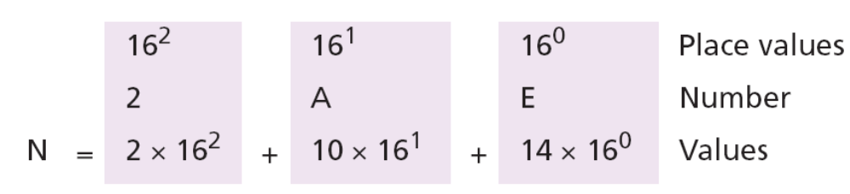
Example 2.6
The following shows that the number (2AE)16 in hexadecimal is equivalent to 686 in decimal.
The equivalent decimal number is N = 512 + 160 + 14 = 686.

Slide 17
2.2.4 The octal system (base 8)
The word octal is derived from the Latin root octo (eight). In this system the base b = 8 and we use eight symbols to represent a number. The set of symbols is
2.<number>

Slide 18
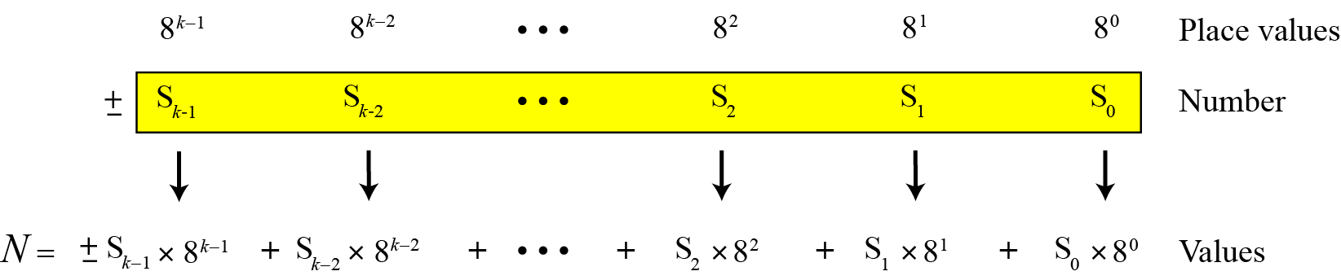
Integers
We can represent an integer as:
Figure 2.3 Place values for an integer in the octal system

Slide 19
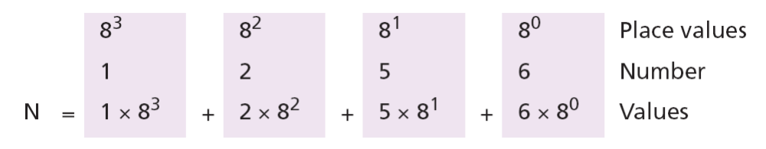
Example 2.7
The following shows that the number (1256)₈ in octal is the same as 686 in decimal.
Note that the decimal number is N = 512 + 128 + 40 + 6 = 686.
2.<number>

Slide 20
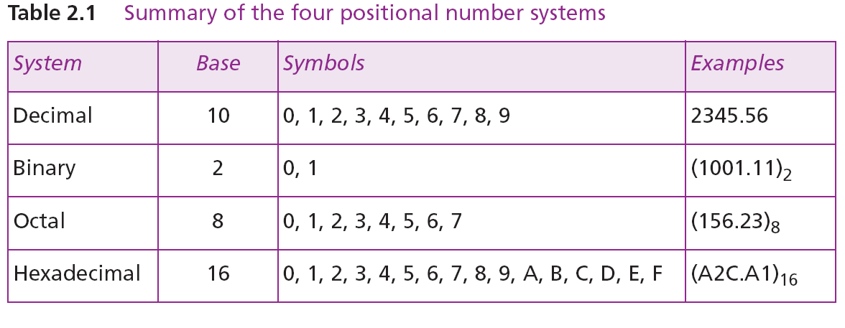
2.2.5 Summary of the four positional systems
Table 2.1 shows a summary of the four positional number systems discussed in this chapter.
2.<number>

Slide 21
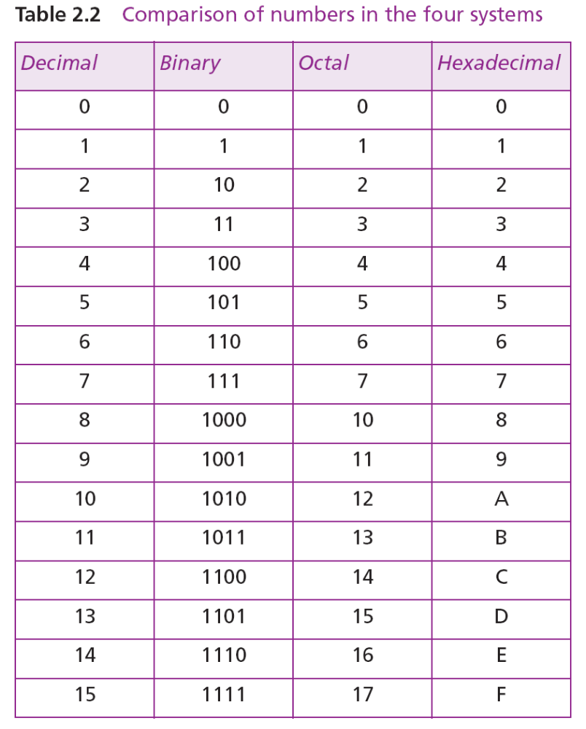
Table 2.2 shows how the number 0 to 15 is represented in different systems.

Slide 22
2.2.6 Conversion
We need to know how to convert a number in one system to the equivalent number in another system. Since the decimal system is more familiar than the other systems, we first show how to covert from any base to decimal. Then we show how to convert from decimal to any base. Finally, we show how we can easily convert from binary to hexadecimal or octal and vice versa.
2.<number>

Slide 23
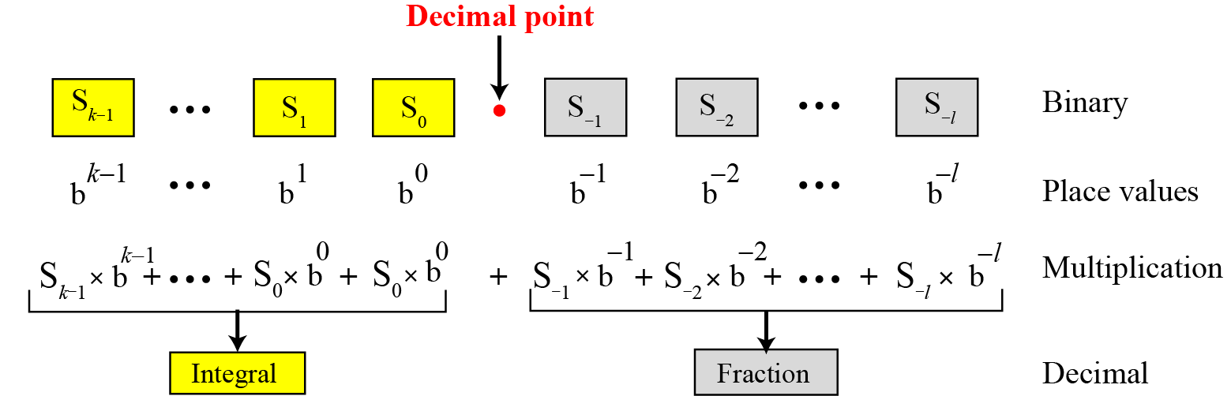
Any base to decimal conversion
Figure 2.5 Converting other bases to decimal

Slide 24
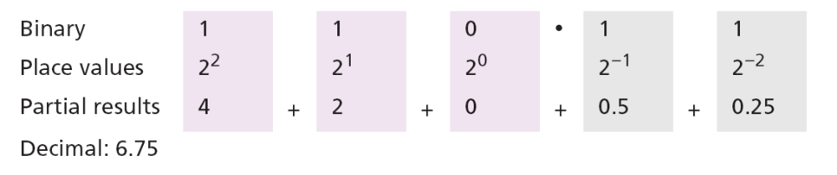
Example 2.8
The following shows how to convert the binary number (110.11)₂ to decimal: (110.11)₂ = 6.75.
2.<number>

Slide 25
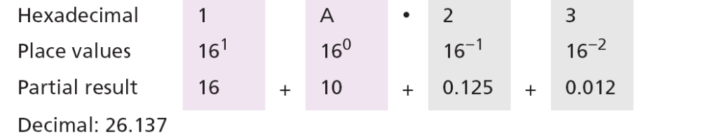
Example 2.9
The following shows how to convert the hexadecimal number (1A.23)₁₆ to decimal.
Note that the result in the decimal notation is not exact, because
3 × 16⁻² = 0.01171875. We have rounded this value to three digits (0.012).
2.<number>

Slide 26
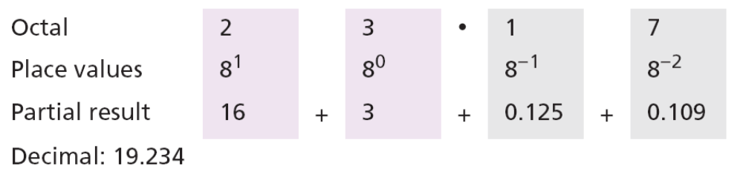
Example 2.10
The following shows how to convert (23.17)₈ to decimal.
This means that (23.17)8 ≈ 19.234 in decimal. Again, we have rounded up 7 × 8⁻² = 0.109375.
2.<number>

Slide 27
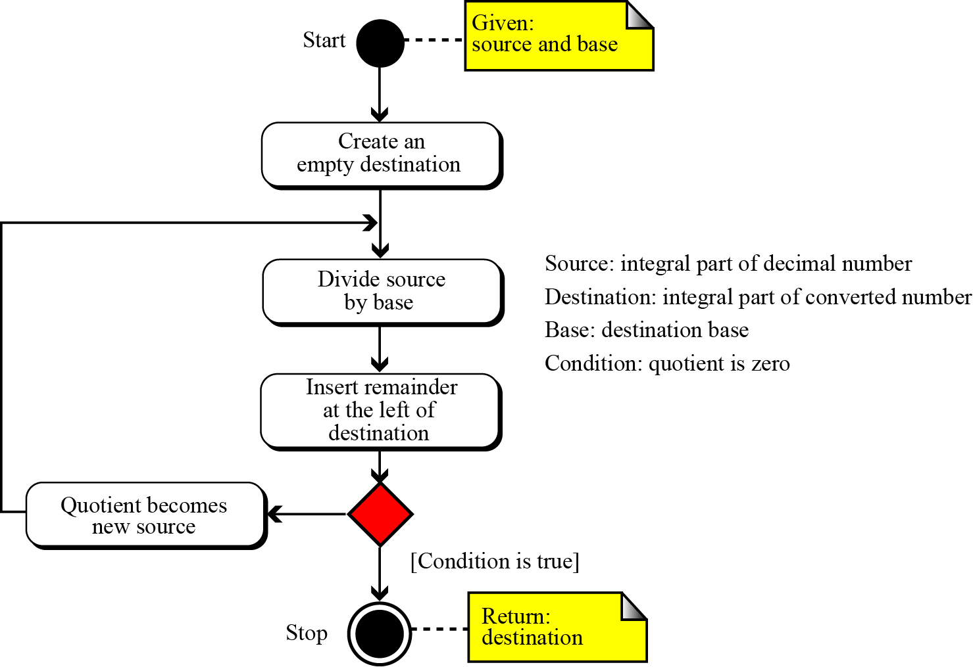
Decimal to any base
Figure 2.6 Converting other bases to decimal (integral part)

Slide 28
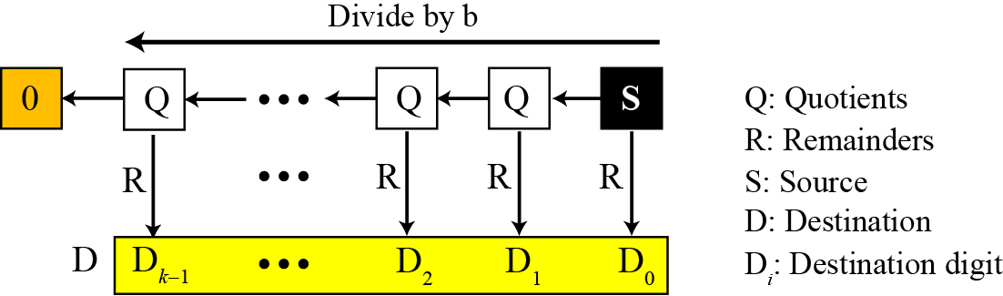
Figure 2.7 Converting the integral part in decimal to other bases
2.<number>

Slide 29
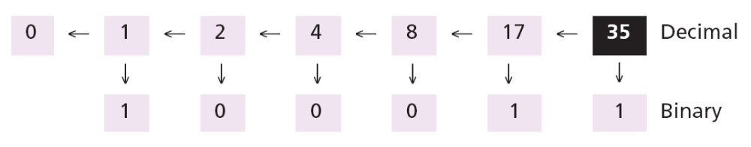
Example 2.11
The following shows how to convert 35 in decimal to binary. We start with the number in decimal, we move to the left while continuously finding the quotients and the remainder of division by 2. The result is 35 = (100011)₂.
2.<number>

Slide 30
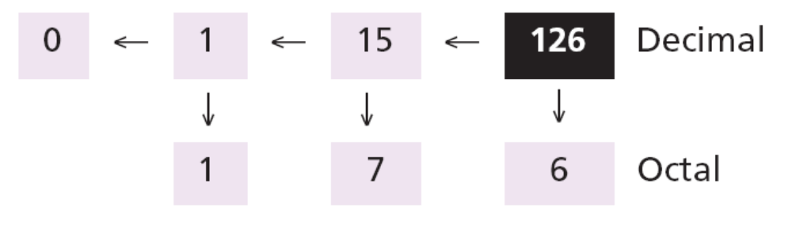
Example 2.12
The following shows how to convert 126 in decimal to its equivalent in the octal system. We move to the right while continuously finding the quotients and the remainder of division by 8. The result is 126 = (176)₈.
2.<number>

Slide 31
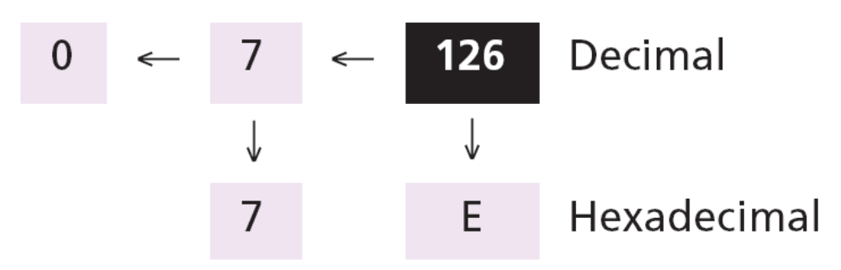
Example 2.13
The following shows how we convert 126 in decimal to its equivalent in the hexadecimal system. We move to the right while continuously finding the quotients and the remainder of division by 16. The result is 126 = (7E)₁₆
2.<number>

Slide 32
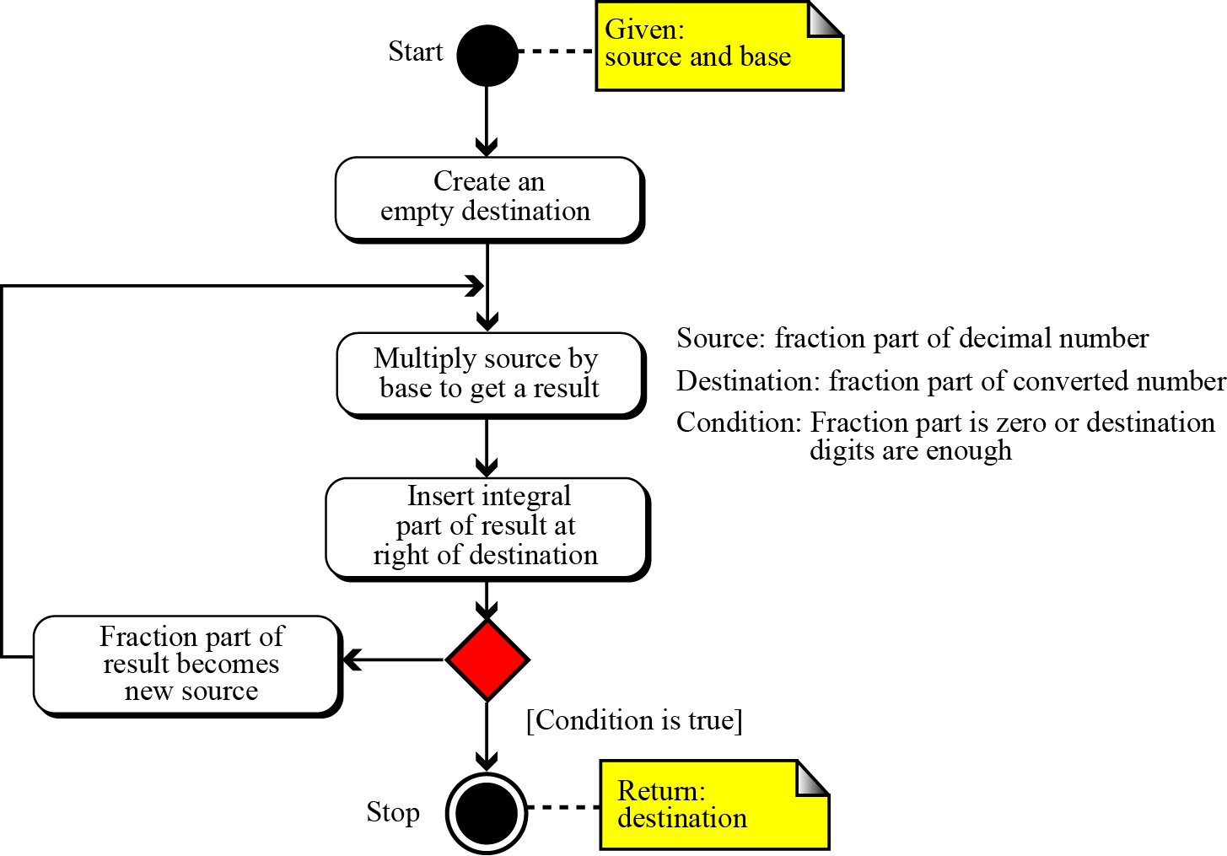
Figure 2.8 Converting fractional part in decimal to other bases

Slide 33
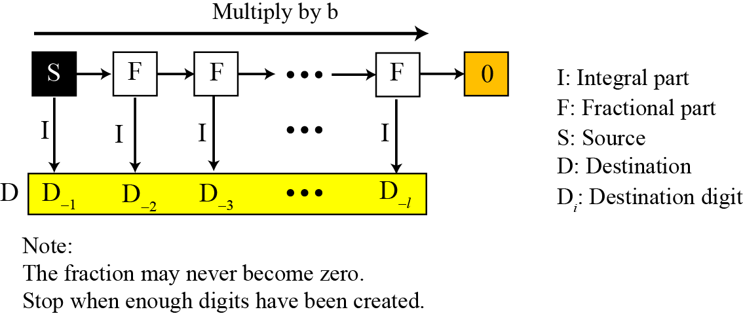
Figure 2.9 Converting fractional part
2.<number>

Slide 34
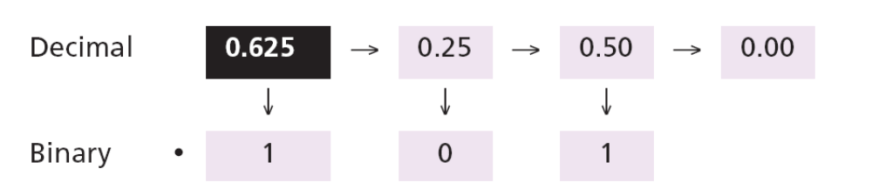
Example 2.14
Convert the decimal number 0.625 to binary.
Since the number 0.625 = (0.101)₂ has no integral part, the example shows how the fractional part is calculated.
2.<number>

Slide 35
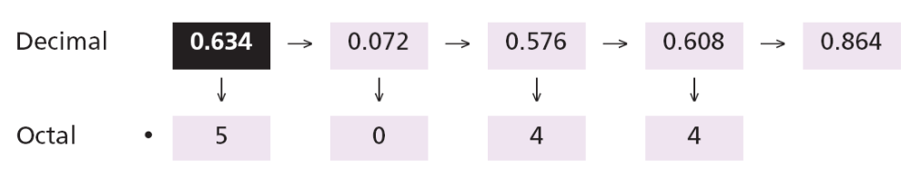
Example 2.15
The following shows how to convert 0.634 to octal using a maximum of four digits. The result is 0.634 = (0.5044)₈. Note that we multiple by 8 (base octal).
2.<number>

Slide 36
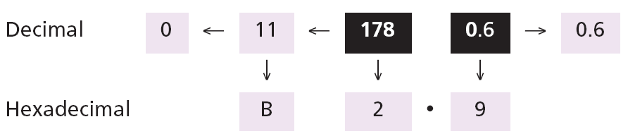
Example 2.16
The following shows how to convert 178.6 in decimal to hexadecimal using only one digit to the right of the decimal point. The result is 178.6 = (B2.9)₁₆ Note that we divide or multiple by 16 (base hexadecimal).
2.<number>

Slide 37
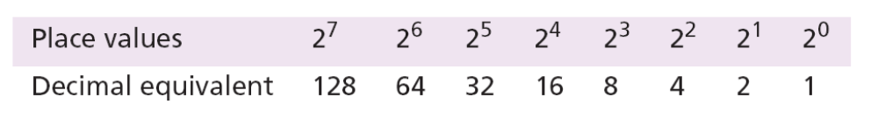
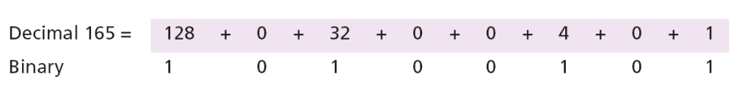
Example 2.17
An alternative method for converting a small decimal integer (usually less than 256) to binary is to break the number as the sum of numbers that are equivalent to the binary place values shows:
2.<number>

Slide 38
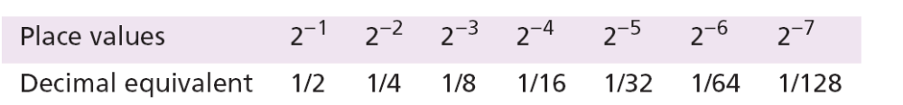
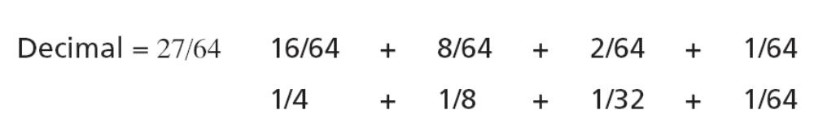
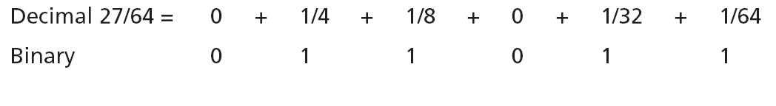
Example 2.18
A similar method can be used to convert a decimal fraction to binary when the denominator is a power of two:
The answer is then (0.011011)₂
2.<number>

Slide 39
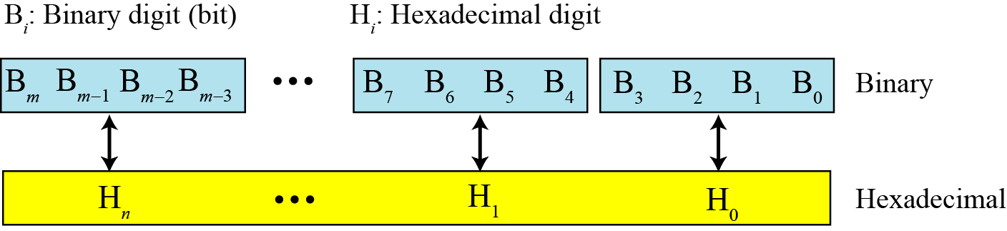
Binary-hexadecimal conversion
Figure 2.10 Binary to hexadecimal and hexadecimal to binary conversion
2.<number>

Slide 40
Example 2.19
Show the hexadecimal equivalent of the binary number (110011100010)₂.
Solution
We first arrange the binary number in 4-bit patterns:
100 1110 0010
Note that the leftmost pattern can have one to four bits. We then use the equivalent of each pattern shown in Table 2.2 on page 25 to change the number to hexadecimal: (4E2)16.
2.<number>

Slide 41
Example 2.20
What is the binary equivalent of (24C)₁₆?
Solution
Each hexadecimal digit is converted to 4-bit patterns:
2 → 0010, 4 → 0100, and C → 1100
The result is (001001001100)₂.
2.<number>

Slide 42
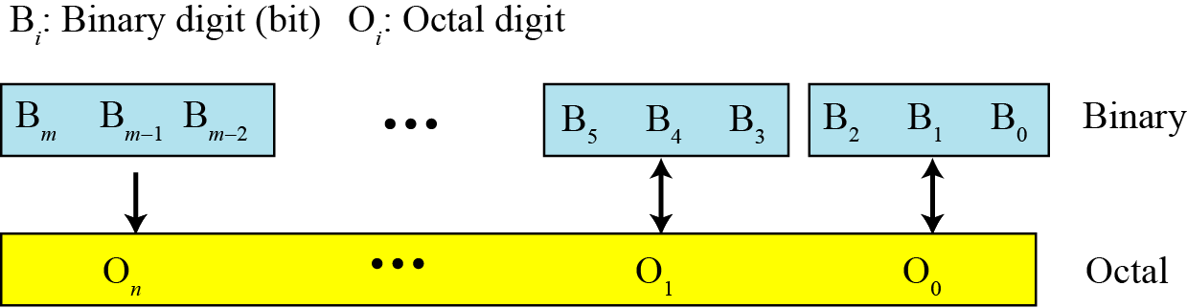
Binary-octal conversion
Figure 2.10 Binary to octal and octal to binary conversion
2.<number>

Slide 43
Example 2.21
Show the octal equivalent of the binary number (101110010)₂.
Solution
Each group of three bits is translated into one octal digit. The equivalent of each 3-bit group is shown in Table 2.2 on page 25.
101 110 010
The result is (562)₈.
2.<number>

Slide 44
Example 2.22
What is the binary equivalent of for (24)₈?
Solution
Write each octal digit as its equivalent bit pattern to get
2 → 010 and 4 → 100
The result is (010100)₂.
2.<number>

Slide 45
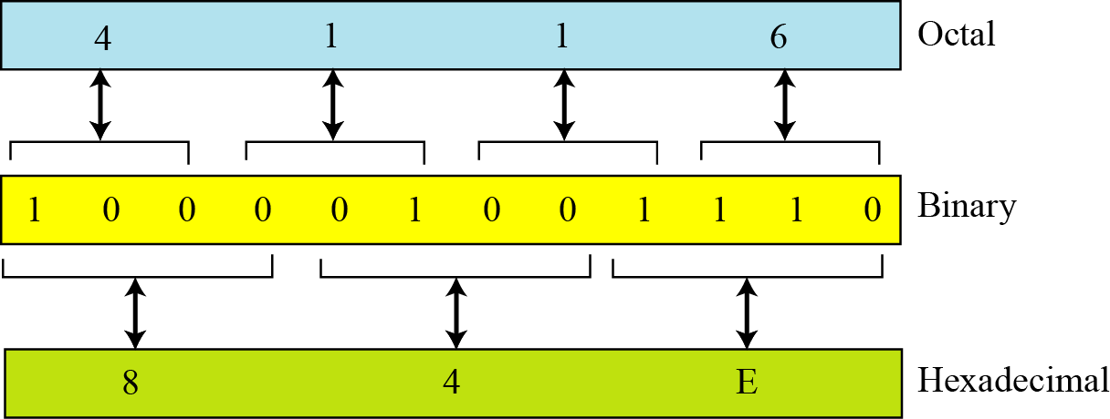
Octal-hexadecimal conversion
Figure 2.12 Octal to hexadecimal and hexadecimal to octal conversion

Slide 46
Example 2.23
Find the minimum number of binary digits required to store decimal integers with a maximum of six digits.
Solution
k = 6, b₁ = 10, and b₂ = 2. Then
x = ⎡k × (logb₁ / logb₂)⎤ = ⎡6 × (1 / 0.30103)⎤ = 20.
The largest six-digit decimal number is 999,999 and the largest 20-bit binary number is 1,048,575. Note that the largest number that can be represented by a 19-bit number is 524287, which is smaller than 999,999. We definitely need twenty bits.
2.<number>

Slide 47
2-3 NONPOSITIONAL NUMBER SYSTEMS
Although non-positional number systems are not used in computers, we give a short review here for comparison with positional number systems. A non-positional number system still uses a limited number of symbols in which each symbol has a value. However, the position a symbol occupies in the number normally bears no relation to its value—the value of each symbol is fixed. To find the value of a number, we add the value of all symbols present in the representation.
2.<number>

Slide 48
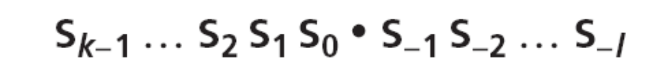
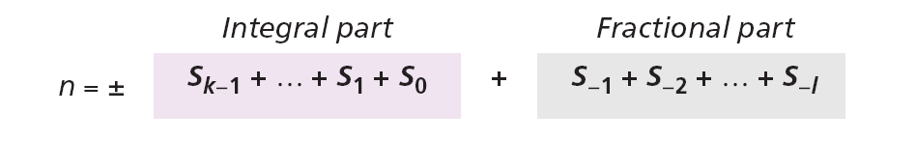
In this system, a number is represented as:
and has the value of:
There are some exception to the addition rule we just mentioned, as shown in Example 2.24.
2.<number>

Slide 49
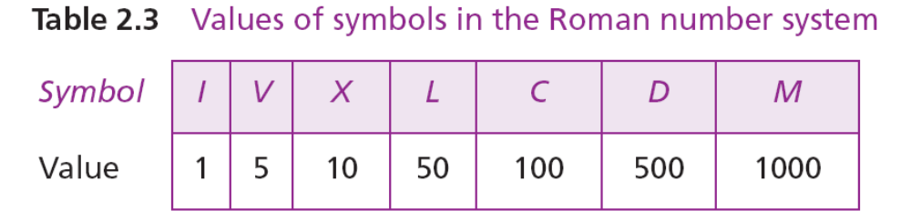
Example 2.24
Roman numerals are a good example of a non-positional number system. This number system has a set of symbols
S = {I, V, X, L, C, D, M}. The values of each symbol is shown in Table 2.3
To find the value of a number, we need to add the value of symbols subject to specific rules (See the textbook).
2.<number>

Slide 50
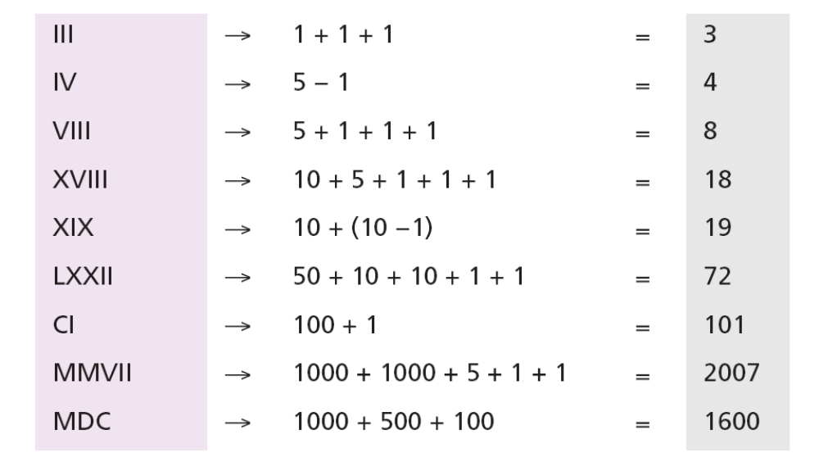
Example 2.24
(Continued)
The following shows some Roman numbers and their values.
2.<number>

