Slide 1
Module-A-Introduction
Programming Computers
Information
Languages and C Compilers
Module A - Introduction
<number>/42

Slide 2
Objectives(1)
Programming Computers
  Accidents
  Software Development
  Hardware
Information
  Fundamental Units
  Representations
  Addressing Information
  Program Instructions
Module A - Introduction
<number>/42

Slide 3
Objectives(2)
Languages and C Compilers
  Programming Languages
  Why C as a First Language?
  Compiling C Programs
  Some Notable Features
Module A - Introduction
<number>/42

Slide 4
Programming Computers
Introduce the art of software development
"The most likely way for the world to be destroyed, most experts agree, is by accident. That's where we come in. We're computer professionals. We cause accidents." Nathaniel Borenstein (1991).
Module A - Introduction
<number>/42

Slide 5
Accidents (1)
  In May 2004, the Royal Bank of Canada informed the public that some of its transactions had not been properly reflected in its client balances. The bank faced a class-action suit for damages of $500 per customer and a possible loss of $165 million in service fees.
  In July 2004, the Canadian Imperial Bank of Commerce reported that its computer system had been affected by glitches. The system had double dipped about 60,000 personal lines of credit.
Module A - Introduction
<number>/42

Slide 6
Accidents (2)
  In June 1996, the European Space Agency Ariane 5 maiden rocket self-destructed after going out of control because of a software error.
  In October 1992, the computer aided dispatch system of the London Ambulance Service started malfunctioning. In one case, the ambulance arrived 11 hours late at a stroke victim's house - 5 hours after the caller had made their own way to the hospital.
Module A - Introduction
<number>/42

Slide 7
Accidents (3)
To minimize such accidents, we build quality into the software that we develop. We design it for, amongst other features:
  Usability
  Correctness
  Maintainability
    Understandability
    Modifiability
  Portability
Module A - Introduction
<number>/42

Slide 8
Accidents (4)
We achieve quality through
  robust and user-friendly interfaces
  structured programming
  comprehensive testing
  internal documentation
  standards compliance
Module A - Introduction
<number>/42

Slide 9
Software Development (1)
The programs that we develop are simulations of solutions to stated problems.
The process includes problem analysis, algorithm design, program coding, program testing and program maintenance.
A program is a set of instructions that computer hardware will execute.
Module A - Introduction
<number>/42

Slide 10
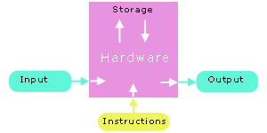
Software Development (2)
Module A - Introduction
<number>/42

Slide 11
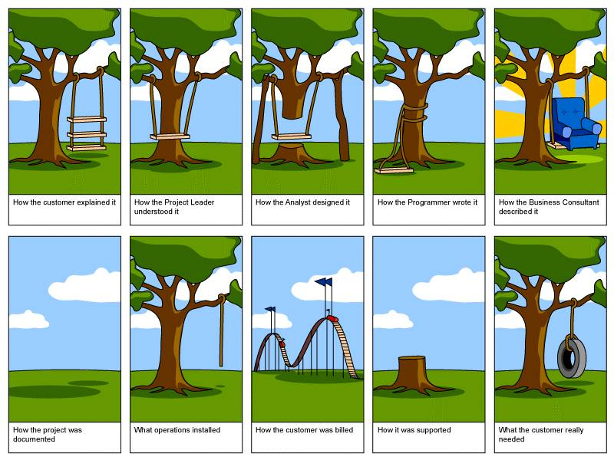
Software Development Caricatures
Module A - Introduction
<number>/42

Slide 12
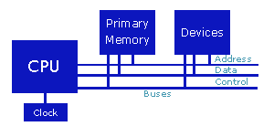
Hardware (1)
The components of a modern computer include a central processing unit (CPU), primary memory (RAM) and a set of devices. These elements are interconnected by 2 buses - an address bus and a data bus.
Module A - Introduction
<number>/42

Slide 13
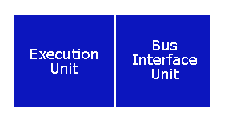
Hardware (2)
Central Processing Unit
We can divide the Central Processing Unit (CPU) into two logical units:
the execution unit (EU) and the bus interface unit (BIU).
CPU memory is volatile - the contents of the registers are lost as soon as power is turned off.
The EU executes the instructions one at a time.
The BIU manages the transfer of information along the data bus to and from the EU.
Module A - Introduction
<number>/42

Slide 14
Hardware (3)
Primary Memory
  Primary memory holds the information accessed by the CPU.
  Primary memory is also volatile.
  The popular term for primary memory is RAM (Random Access Memory).
Module A - Introduction
<number>/42
Notes:
Volatile: Thay đổi

Slide 15
Hardware (4)
Devices
  Include I/O devices such as a keyboard, a monitor and a mouse…
  Storage devices such as a floppy drive, a hard drive and a CD-ROM drive (secondary storage).
  Each device interfaces with the system buses through a device controller.
Module A - Introduction
<number>/42

Slide 16
Hardware (5)
The most expensive and fastest memory - registers - is reserved for the CPU.
  CPU transfers information at less than 10 nanoseconds (nano = 1/ (1 billion))
  primary memory transfers information at about 60 nanoseconds
  a hard disk transfers information at about 12,000,000 nanoseconds
Module A - Introduction
<number>/42

Slide 17
Summary
Programming Computers
  Accidents
  Software Development
  Hardware
Q&A
Module A - Introduction
<number>/42

Slide 18
Information
Summarize the low-level features of programming.
Program information consists of instructions and data.
How is this information stored?
What does a program instruction look like?
How do we make program instructions readable?
Module A - Introduction
<number>/42

Slide 19
Von Neumann’s stored-program computer
n 1945, John von Neumann proposed a new computer - the EDVAC. At the time, computers accepted instructions either on paper tape or from pre-wired plugboards. In both cases, data was stored in memory. In other words, instructions and data were stored separately. Von Neumann noted that instructions, regardless of the device on which they were stored, were simply pieces of information. He proposed that they be stored alongside data in memory. This came to be known as the stored-program concept. All modern computers are designed as stored-program computers.
Von Neumann chose binary (base 2) rather than decimal (base 10) digits as the EDVAC's fundamental unit, since elementary operations are simpler to perform in binary. Modern computers process and store information in binary digits or bits.
A bit is either off or on. Off represents the value 0; on represents the value 1.
Module A - Introduction
<number>/42

Slide 20
Fundamental Units (1)
John von Neumann selected binary (base 2) digits as the EDVAC's fundamental unit.
The vast majority of modern computers process and store information in binary digits.
We call a binary digit a bit.
Module A - Introduction
<number>/42

Slide 21
Fundamental Units (2)
The fundamental addressable unit of primary memory is the byte.
One byte consists of 2 nibbles. One nibble consists of 4 consecutive bits.
Byte
Nibble |  |  |  | Nibble
Bit | Bit | Bit | Bit | Bit | Bit | Bit | Bit
00000000 <- possibility 0 00000001 <- possibility 1 00000010 <- possibility 2 00000011 <- possibility 3 00000100 <- possibility 4 ... 00111000 <- possibility 104 ... 11111111 <- possibility 255
Module A - Introduction
<number>/42

Slide 22
Fundamental Units (3)
The natural unit of the CPU is a word. A word is the size of the general registers - the unit of memory within the CPU.
Module A - Introduction
<number>/42

Slide 23
Representations (1)
Hexadecimal Representation
  Base 16: 0,1,..,9, A, B, C, D, E, F
  Each hexadecimal digit represents 4 bits of information.
  The 0x prefix identifies the number as a hexadecimal number: 0x5C
Module A - Introduction
<number>/42

Slide 24
Representations (2)
Octal Representation
  Base 8: 0,1,2,..,7
  Set of 3 consecutive bits forms an octal digit
  The prefix 0 identifies the number as an octal number: 031
Module A - Introduction
<number>/42
Notes:
Consecutive: Liên tiếp

Slide 25
Addressing Information (1)
Each byte of primary memory has a unique address. Addressing starts at zero, is sequential and ends at the size of primary memory less 1 (i.e. addressing interval is [0,n-1], where n is the size of primary memory).
Note that each byte, and not each bit, has its own address. We refer to large blocks of primary memory using size qualifiers:
  Kilo or k (=1024): 1 Kilobyte = 1024 bytes
  Mega or M (=1024k)
  Giga or G (=1024M)
  Tera or T (=1024G)
  Peta or P (=1024T)
  Exa or E (=1024P)
Module A - Introduction
<number>/42

Slide 26
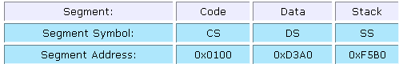
Addressing Information (2)
The maximum size of addressable primary memory depends upon the size of the address registers.
When we start executing a program, the operating system loads it into primary memory (from one of the devices). The operating system stores each segment of program information in a dedicated area.
We express the address of a byte of the loaded program in segment:offset notation, e.g. 0100:006A
The BIU holds the segment addresses in the CS, DS, ES, ... registers. The EU holds the offset of the next instruction to be executed in the EIP register.
Module A - Introduction
<number>/42

Slide 27
Program Instructions (1)
Each program instruction consists of an operation and operands, if any.
The CPU performs the operation on the values stored as operands or on the values stored in the operand addresses.
The addresses are either register names or primary memory addresses
Module A - Introduction
<number>/42

Slide 28
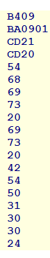
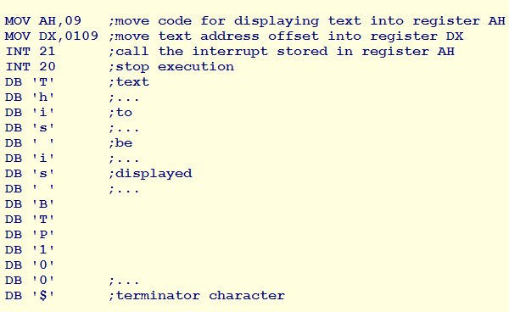
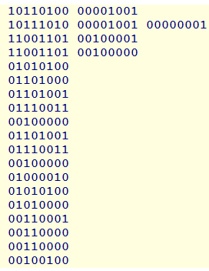
Program Instructions (2)
Let us write a machine language program that displays the sentence "This is BTP100" on a Windows XP machine.
The hexadecimal representation of this program is
The machine language program looks like:
The assembly language version of our program looks like
Module A - Introduction
<number>/42

Slide 29
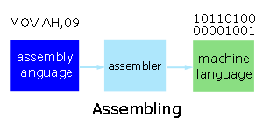
Program Instructions (3)
Assemblers
We use an operating system program called an assembler to convert the assembly language program into its machine language equivalent:
Module A - Introduction
<number>/42

Slide 30
Summary
Information
  Fundamental Units
  Representations
  Addressing Information
  Program Instructions
Q&A
Module A - Introduction
<number>/42

Slide 31
Languages and C Compilers
Use operating system utilities to edit, compile and run programs
Programs that perform relatively simple tasks and are written in assembly language contain a large number of statements.
Assembly language is a low-level language, close to the hardware.
To make our programs shorter, we use higher-level languages.
Module A - Introduction
<number>/42

Slide 32
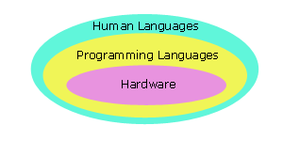
Programming Languages (1)
Module A - Introduction
<number>/42

Slide 33
Programming Languages (2)
5 generations:
  Machine languages.
  Assembly languages.
  Third-generation languages. These are languages with instructions that describe how a result is to be obtained (C, Pascal, C++, Java…).
  Fourth-generation languages. These are languages with instructions that describe what is to be done without specifying how it is to be done (eg:SQL).
  Fifth-generation languages are the closest to human languages. They are used for artificial intelligence, fuzzy sets, and neural networks (eg: Prolog, Matlab)
Module A - Introduction
<number>/42

Slide 34
Programming Languages (3)
The higher the level, the closer to the human languages and the further from native machine languages
  Each third generation language statement ~ 5-10 machine language statements.
  Each fourth generation language ~ 30-40 machine language statements.
Module A - Introduction
<number>/42

Slide 35
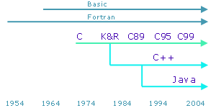
Programming Languages (4)
Popular third generation languages over the years have been Fortran, Cobol, Algol, Visual Basic, Pascal, C, C++ and Java. C++ and Java are built upon C syntax.
Popular fourth generation languages include SQL, Prolog and Matlab.
Module A - Introduction
<number>/42

Slide 36
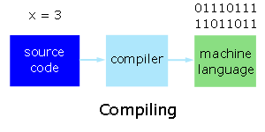
Interpreters and Compilers
When we code a program in a high level language, we write source code. We translate this code into machine language statements using either
  an interpreter, or
  a compiler.
Interpreters translate and execute each high level statement, one statement at a time. Interpreters execute the corresponding set of machine language statements immediately upon translation.
Compilers are more complicated. They translate the entire set of high level statements into an equivalent set of machine language statements (without executing any of the statements) and produce a separate executable file.
Module A - Introduction
<number>/42

Slide 37
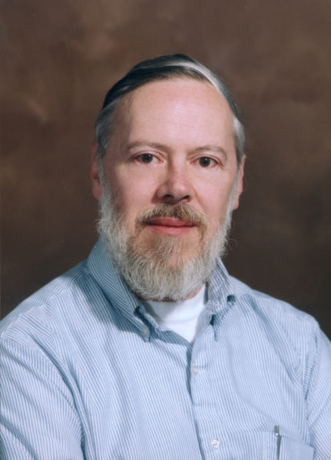

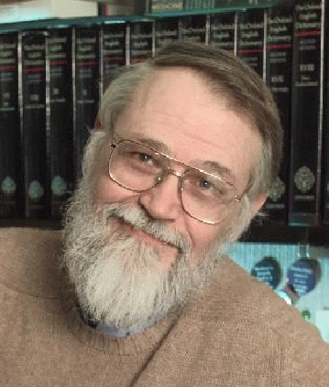
History of C
In 1970 Ken Thompson of Bell Lab developed B language (BCPL -Basic Combined Programming Language) used in UNIX operating system on DEC PD-7 computer.
1972 Dennis Ritchie and Ken Thompson developed C language from B language.
At the same time, Unix operating system was designed at Bell Lab and C was quickly used to re-write Unix (originally written in Assembly).
“The C Programming Language” was first published in 1978
Unix and C has become so popular till then.
Module A - Introduction
<number>/42

Slide 38

Objective-C & C++
Objective-C is an extension of C to support OOP programming paradigm.
Objective-C was developed by Brad Cox and Tom Love of StepStone company in early 1980s
Objective-C was used to develop NeXTStep operating system, which later became Mac OS X at Apple
C++ was developed by Bjarne Stroustrup between 1983-1986 at Bell Lab
C++ adds Object-Oriented Programming (OOP) support to C (i.e., preserving legacy C syntax) but now becomes a quite different programming language.
C++ becomes one of the most popular programming language today.
Module A - Introduction
<number>/42

Slide 39
C versus JAVA
 | C | JAVA
DoB | 1972 | 1995
Programming Paradigm | Procedural | OOP
Memory Management | Programmer | Compiler
Standard Library | Limited | Huge
Portability | Good | Excellent*
Speed | Fast | Slow (run via JVM)**
Availability of Compiler | Free/Open-source | Free
Supported OS | Almost All | Limited (depend on Sun)
*Java source code is translated to Java Bytecode by Java compiler
**JVM is Java Virtual Machine which can run Java Bytecode
Module A - Introduction
<number>/42

Slide 40
So Why Learning C first?
C is very efficient, both in terms of speed and memory
  Better control of low-level mechanisms
  More predictable and faster than Java
  Small footprint: Ideal for embedded systems, portable devices
Lots of legacy code in C
  Many great programs have been written in C: BSD Unix, Linux kernel, vi, etc.
But great power comes with great responsibility
  Programmer has to be careful in using C as it is easy to make serious mistake which can result in insecure systems and programs.
Module A - Introduction
<number>/42

Slide 41
Some Notable Features (1)
Comments
  /* */
  We use comments to document our programs and to enhance their readability. C compilers ignore all comments.
  // ....
  C++ compilers ignore the rest of current line after //.
Whitespace
  We use whitespace to improve program readability and to display the structure of our program's logic. C compilers ignore all whitespace
Module A - Introduction
<number>/42

Slide 42
Some Notable Features (2)
Case Sensitivity
  C language is case sensitive.
  C compilers treat the character 'A' as different from the character 'a'
Module A - Introduction
<number>/42

Slide 43
Summary
Languages and C Compilers
  Programming Languages
  Why C as a First Language?
  Compiling C Programs
  Some Notable Features
Q&A
Module A - Introduction
<number>/42

