Slide 1
Module G-Strings
Strings
String Input
String Functions and Arrays of Strings
Module-G- Strings-Session8
<number>/29

Slide 2
Session Objectives
Strings in C
Null Byte Terminator
Declaration
Output
Module-G- Strings-Session8
<number>/29

Slide 3
Null Byte Terminator
The null byte is the character with the value (code) 0.
We refer to the null byte using the escape sequence '\0'.
Module-G- Strings-Session8
<number>/29

Slide 4
String (1)
We use the null byte to locate the last meaningful element in a string.
We store the null byte immediately after the last meaningful element.
Module-G- Strings-Session8
<number>/29

Slide 5
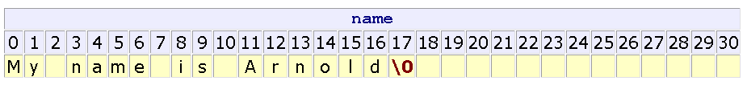
String (2)
The number of elements occupied by a string is one byte more than the number of non-null characters in the string.
Module-G- Strings-Session8
<number>/29

Slide 6
Declaration
Declare a string in the same way that we declare a character array, except that we allocate space for the terminator null byte.
char name[31]; /* room for 30 characters */
or
char name[31] = "My name is Arnold";
or
char name[31] = {'M','y',' ','n','a','m','e',' ','i','s',' ', 'A','r','n','o','l','d','\0'};
Module-G- Strings-Session8
<number>/29

Slide 7
Output
printf uses the conversion specifier %s to process strings
For example:
  char name[31] = "My name is Arnold";
  printf("%s\n", name );
Module-G- Strings-Session8
<number>/29

Slide 8
Summary
Strings
Null Byte Terminator
Declaration
Output
Q&A
Module-G- Strings-Session8
<number>/29

Slide 9
Session Objectives
String Input
  scanf
  gets
  using getchar()
String Functions and Arrays of Strings
Functions
  strlen
  strcpy
  strcmp
  strcat
Arrays of Strings
  Input and Output
  Passing to Functions
  Sorting an Array of Names
In Class Practice
Module-G- Strings-Session8
<number>/29

Slide 10
scanf (1)
scanf accepts two conversion specifiers in the format string:
  %s
  %[ ]
Module-G- Strings-Session8
<number>/29

Slide 11
scanf (2)
The %s conversion specifier
reads all characters until the first whitespace character,
stores the characters read in memory locations starting with the address passed to scanf,
stores the null byte in the memory byte following the last character accepted and
leaves the delimiting whitespace plus any subsequent characters in the input buffer,
ignores any leading whitespace characters.
Module-G- Strings-Session8
<number>/29

Slide 12
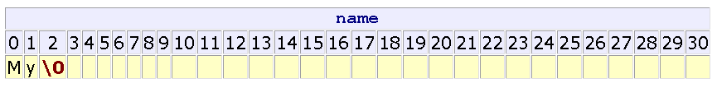
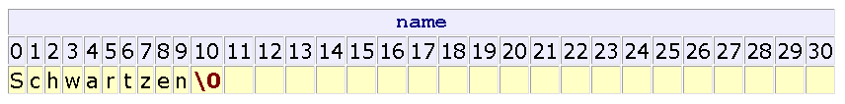
scanf example (1)
char name[31];
scanf("%s", name );
Enter: My name is Arnold
char name[31];
scanf("%10s", name );
Enter: Schwartzenegger
Module-G- Strings-Session8
<number>/29

Slide 13
scanf (3)
The %[^\n] conversion specifier
reads all characters until the newline ('\n'),
stores the characters read in memory locations starting with the address passed to scanf,
stores the null byte in the byte following that where scanf stored the last character and
leaves the delimiting character (here, '\n') in the input buffer.
Module-G- Strings-Session8
<number>/29

Slide 14
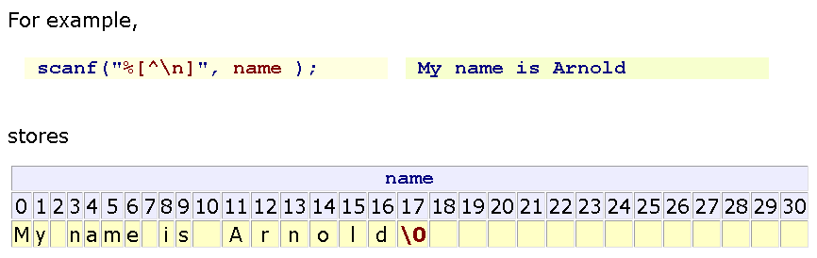
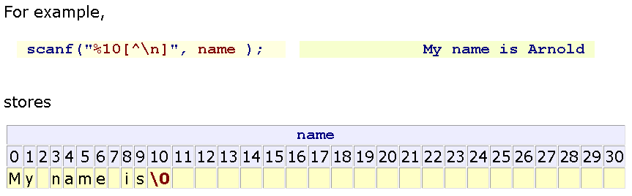
scanf example (2)
Module-G- Strings-Session8
<number>/29
Notes:
trước khi nhập tiếp 1 xâu, trong stdin vẫn còn kí tự '\n‘, phải
fflush(stdin); xóa vùng nhơ đệm

Slide 15
gets
gets is a standard library function that
  accepts an empty string
  uses the '\n' as the delimiter
  throws away the delimiter after accepting the string
  appends the null byte to the end of the set stored
The prototype for gets is
char* gets(char [ ]);
(gets is dangerous. It can fill beyond the memory that allocated for the string)
Module-G- Strings-Session8
<number>/29
Notes:
puts(str)

Slide 16
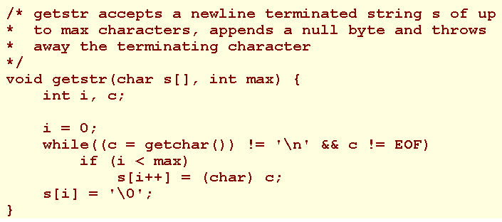
String input using getchar()
Module-G- Strings-Session8
<number>/29

Slide 17

String operators
String is an array of char. Array names alone refer to addresses rather than the values stored in the array elements. Accordingly, we cannot apply the operators:
The string library <string.h> contains the functions for string manipulation
Module-G- Strings-Session8
<number>/29

Slide 18
strlen
unsigned int strlen(char []);
strlen returns the number of characters in the string excluding the null byte terminator.
Module-G- Strings-Session8
<number>/29

Slide 19
strcpy
char* strcpy(char destination[ ], char source[ ]);
strcpy copies source into destination and returns the address of destination.
Ensure that there is sufficient space in destination to hold
Module-G- Strings-Session8
<number>/29

Slide 20
strcmp
int strcmp(char s1[ ], char s2[ ]);
strcmp returns:
0 if s1 and s2 are identical,
a negative value if s1 less than s2 a positive value if s1 greater than s2
Module-G- Strings-Session8
<number>/29

Slide 21
strcat
char* strcat(char destination[ ], char source[ ]);
strcat appends source to destination and returns the address of destination.
Ensure that there is sufficient space in destination to include both the original string and the appended source.
Module-G- Strings-Session8
<number>/29

Slide 22
Arrays of Strings
A string array declaration takes the form
  char identifier[NO_OF_STRINGS][NO_OF_BYTES_PER_STRING];
For example, to declare an array of 5 names, where each name holds up to 30 characters, we write
char names[5][31];
Module-G- Strings-Session8
<number>/29

Slide 23
Arrays of strings example
char names[5][31] = { "Harry", "Jean", "Jessica", "Irene", "Jim" };
Module-G- Strings-Session8
<number>/29

Slide 24
Input and Output
  char identifier[NO_OF_STRINGS][NO_OF_BYTES_PER_STRING];
The address of a string in an array of strings is
identifer[string index]
Module-G- Strings-Session8
<number>/29

Slide 25
Passing to functions
To pass an array of strings to a function, we specify the array name as the argument.
To receive an array of strings as a function parameter, we use the form
dataType functionIdentifier (
dataType identifier[ ][NO_OF_BYTES_PER_STRING], ... )
For example:
void foo (name[][31], int a){ ... }
Module-G- Strings-Session8
<number>/29

Slide 26
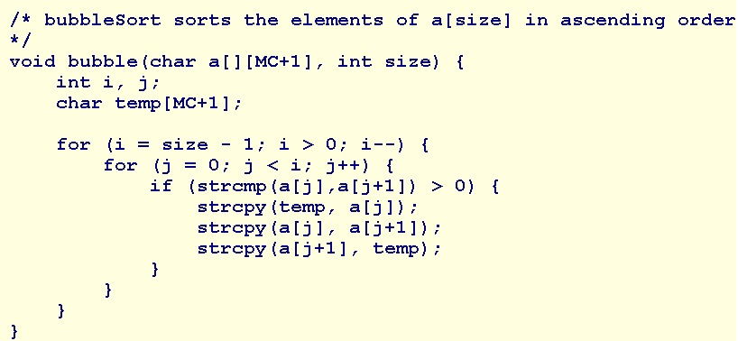
Sorting an Array of Names
Module-G- Strings-Session8
<number>/29

Slide 27
Summary
String Input
  scanf
  gets
  using getchar()
String Functions and Arrays of Strings
Functions
  strlen
  strcpy
  strcmp
  strcat
Arrays of Strings
  Input and Output
  Passing to Functions
  Sorting an Array of Names
Q&A
Module-G- Strings-Session8
<number>/29

Slide 28
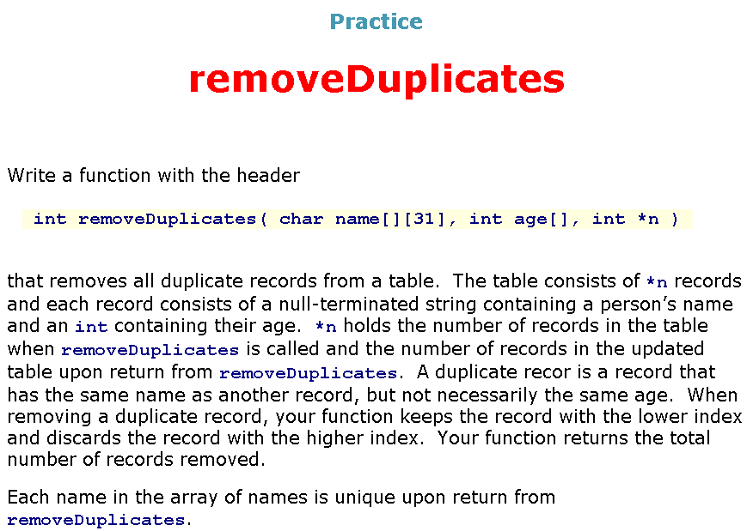
Module-G- Strings-Session8
<number>/29

Slide 29
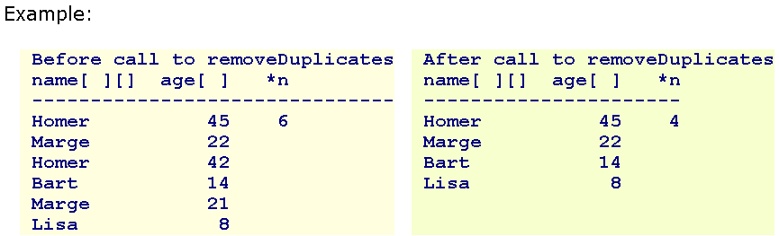
removeDuplicates
Module-G- Strings-Session8
<number>/29

