Slide 1
Azure Workshop
Deploy App Service Container with Azure Pipeplines
Thanh Nguyen & Ryan Nguyen Microsoft Azure Việt Nam Community Group – Aug, 1st 2020

Slide 2


Slide 3
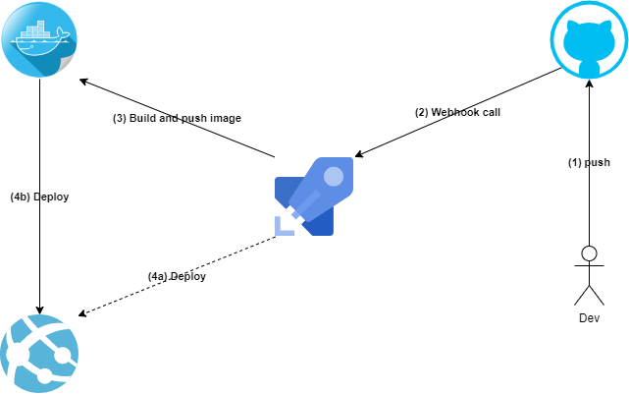
Architect

Slide 4
Pre-Workshop preparation
GitHub account (free)
Azure DevOps account (free)
Azure Subscription (free new account with $200 credit)
Notes:
Azure free account with $200 credit

Slide 5
Setup GitHub project
Create
Create a simple web application on GitHub, or
Clone
Clone pre-created repo (https://github.com/btnguyen2k/azworkshop-azpipelines-dockerimg-appservice)

Slide 6
Create Azure DevOps project
Create Azure DevOps project to host the pipeline

Slide 7
Setup Azure DevOps project
Create pipeline
Create Service Connector (DockerHub & Azure)
Setup pipeline variable group

Slide 8
Start coding
Code will be shown in live demo

Slide 9
Thank you
Question?

