Slide 1
Unit Testing with Junit 5
Hoa Van Huong – PSE
Do Xuan Toai – SSE
Do Le Thanh - SSE
Oct 2021

Slide 2
Agenda
Unit testing
JUnit 5
Introduction
Modules
Junit Platform
Junit Jupiter
Junit Vintage
API
Test Method
Test Fixture
Test Case
Test Suite
Test Runner
Assumption
Assertion
Life Cycle
Test Instance per method (default)
Test Instance per class

Slide 3
Agenda
JUnit 5
Writing tests by example
Display Names
Assertions
Assumption
Condition Tests
Tagging
Test Execution Order
Repeated Test
Parameterized Test
Dynamic Test
Timeout

Slide 4
Developer’s working process

Slide 5
Unit testing

Slide 6
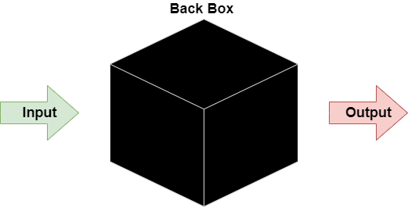
Unit testing
Black Box Testing is a software testing method in which the functionalities of software applications are tested without having knowledge of internal code structure, implementation details and internal paths. Black Box Testing mainly focuses on input and output of software applications and it is entirely based on software requirements and specifications. It is also known as Behavioral Testing.
Black

Slide 7
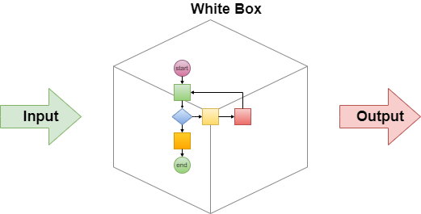
Unit testing
White Box Testing is software testing technique in which internal structure, design and coding of software are tested to verify flow of input-output and to improve design, usability and security. In white box testing, code is visible to testers so it is also called Clear box testing, Open box testing, Transparent box testing, Code-based testing and Glass box testing.

Slide 8
Unit testing
Unit Tests is a type of software testing where individual units or components of a software are tested. The purpose is to validate that each unit of the software code performs as expected. Unit Testing is done during the development (coding phase) of an application by the developers. Unit Tests isolate a section of code and verify its correctness. A unit may be an individual function, method, procedure, module, or object.
Integration Testing is a type of software testing which individual software modules are combined and tested as a group. It is done after unit testing.
Acceptance testing is a testing technique performed to determine whether or not the software system has met the requirement specifications.

Slide 9
Unit testing
Unit testing is particularly important when software requirements change frequently
Code often has to be refactored to incorporate the changes
Unit testing helps us ensure that the refactored code continues to work.
Reduce code complexity.
It increases the productivity of the programmer and the stability, quality of program code, which in turn reduces the stress on the programmer and the time spent on debugging.
What make a good unit test :
Easy to write
Readable
Reliable
Fast
Isolation

Slide 10
Junit 5
Introduction

Slide 11
Junit 5 - Introduction
JUnit is unit testing for java programing language , it has been important in the development of test-driven development, and is one of a family of unit testing frameworks collectively known as xUnit, that originated with JUnit.
Junit was designed by Kent Beck, Erich Gamma.
Junit 5 Supported java version : java 8 or higher

Slide 12
Why Junit 5?
Junit 4: > 10 years old
Test pattern change
New language features
Junit 4: monolithic
Junit 4: open source

Slide 13
Junit 5
Modules

Slide 14
Junit 5 - Modules
JUnit 5 = JUnit Platform + JUnit Jupiter + JUnit Vintage
The JUnit Platform serves as a foundation for launching testing frameworks on the JVM.
JUnit Jupiter is the combination of the new programming model and extensionmodel for writing tests and extensions in JUnit 5. The Jupiter sub-project provides a TestEngine for running Jupiter based tests on the platform.
JUnit Vintage provides a TestEngine for running JUnit 3 and JUnit 4 based tests on the platform.

Slide 15
Junit 5
API

Slide 16
Junit 5 API
Test Method : a method in test class which annotated with @Test, @RepeatedTest, @ParameterizedTest or @TestFactory annotation.
Test Fixture : The set of common resources or data that you need to run one or more test methods.
Test Case : Group of one or more related test methods, a test case usually shares test fixture between test methods.
Test Suite : a java class which contains many test cases or java classes to test together in a single run.

Slide 17
Junit 5 API
Test Runner : to run Junit test and report test result.
Assumption : Assumptions helps us in skipping a test for some specific scenario such as inputs, operating system or any third party data ...

Slide 18
Junit 5 API
Assertion : Used to determine the matching of actual output with expected value, used to detect test case is pass or failed.
Method | Description
assertTrue | Asserts that condition is true.
assertFalse | Asserts that condition is false.
assertEquals | Asserts two objects are equal.
assertNotEquals | Asserts two objects are NOT equal.
assertNull | Asserts an object is null.
assertNotNull | Asserts an object is NOT null.
assertSame | Asserts two objects refer to same the object.
assertNotSame | Asserts two objects do NOT refer to same the object.

Slide 19
Junit 5
Life Cycle

Slide 20
Junit 5 Life Cycle
@Test : Denote that a method is a test method. Unlike junit 4’s @Test annotation, this annotation does not declare any attributes.
@BeforeEach : Denote that annotated method should be executed before each test method in current class.
@AfterEach : Denote that annotated method should be executed after test method in current class.
@BeforeAll : Denote that annotated method should be executed before all test method in current class.
@AfterAll: Denote that annotated method should be executed after all test method in current class.

Slide 21
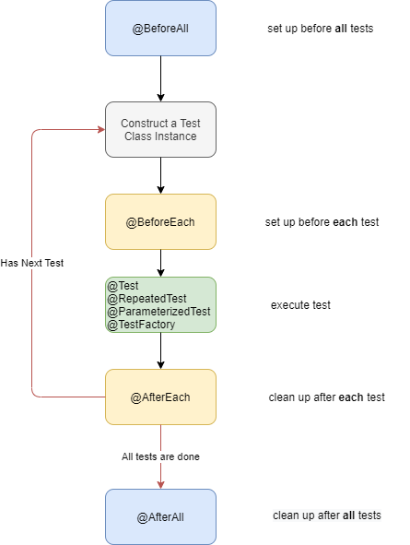
Life Cycle – Instance per method (default)

Slide 22
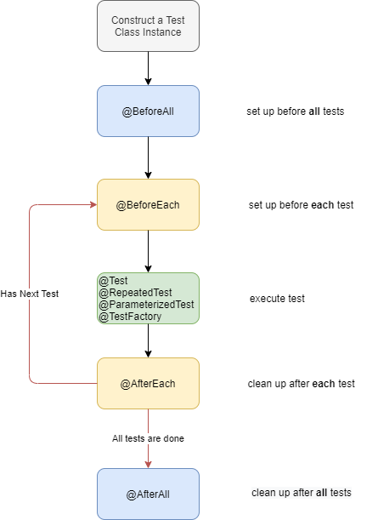
Life Cycle – Instance per class

Slide 23
JUnit
Writing tests by example

Slide 24
Writing tests by example
Source code :
git clone https://kakama89@bitbucket.org/kakama89/junit5.git

