Slide 1
Expansion: Where is the next restaurant?
Capstone Project - The Battle of Neighborhoods
Thanh Phu NGUYEN
HCMC, 20 Apr 2019

Slide 2
Content
Problem statement
Dataset
Methodology
Results, discussion and conclusion

Slide 3
Problem statement
My friend has a Vietnamese restaurant – SaiGon Snack in Manhattan, NY
The restaurant has long legendary of success
He wants to expand his business to Toronto
By his experience, right location is the most importance in restaurant industry
= > By data science approach, I advise him where is the best location in Toronto in term of venues allocation similarity

Slide 4
Dataset
Data frame of Toronto and New Yord neighborhood (Wikipedia)
Geospatial_data package
Foursquare API

Slide 5
Methodology
1. Explore venue allocation of SaiGon Snack's Location
2. Explore Toronto neigborhood and cluster its neighborhood
3. Find the most similar place by re-cluster with new data frame adding SaiGon Snack's vector

Slide 6
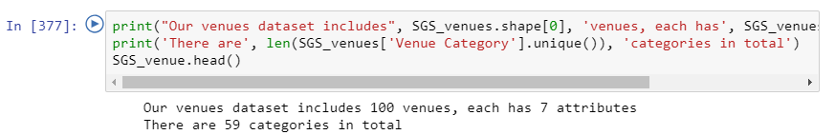
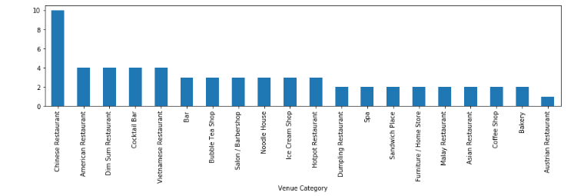
Methodology
1. Explore venue allocation of SaiGon Snack's Location
SaiGon Snack located in China Town, Manhattan
100 venues with 59 categories
Vietnamese restaurant:
* Top 5 popular
* 5 Restaurants in area

Slide 7
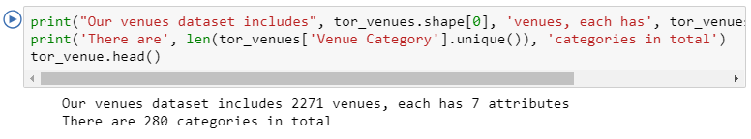
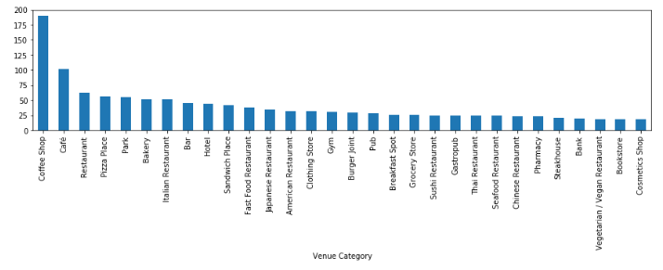
Methodology
2. Explore Toronto neighborhood and cluster its neighborhood
2271 venues with 280 categories
Vietnamese restaurant:
* Not very popular in general
* 13 Restaurants in area

Slide 8
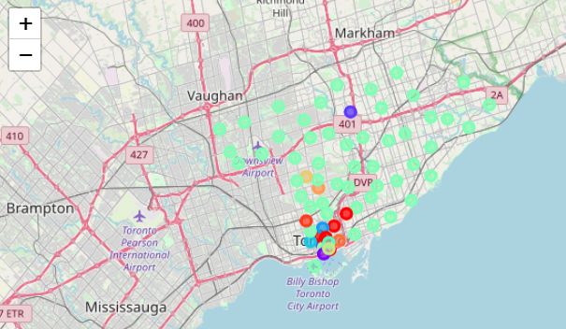
Methodology
2. Explore Toronto neighborhood and cluster its neighborhood
Merging data from Wiki and Geospatial => build df for Toronto
Pull venue allocation from Foursquare API
One hot encoding and Normalize data technique applied
Ensure vector of df has the same dimension with SaiGon Snack vector dimension
Clustering neighborhood with K = 20

Slide 9
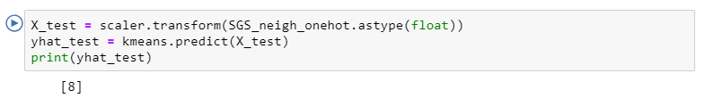
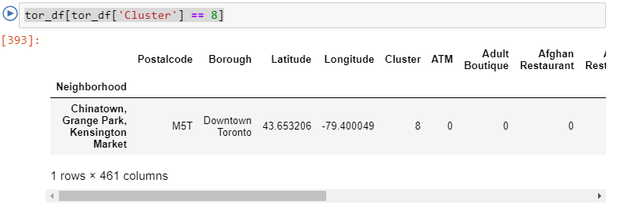
Methodology
Find the most similar place with SaiGon Snack in Toronto
Re-cluster with new data frame adding SaiGon Snack
Cluster 08
It is China Town, Toronto

Slide 10
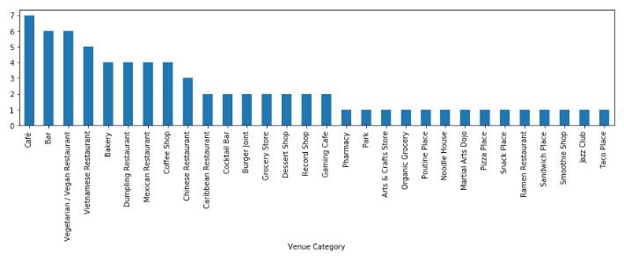
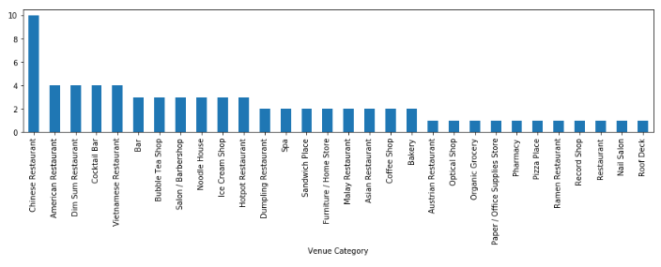
Results, discussion and conclusion
China Town - Toronto
Vietnamese restaurant:
* 05/13 Restaurants in area
* Top 04 popular
* More popular than other Asian one
China Town - Manhattan, NY
Vietnamese restaurant:
* Top 5 popular
* 5 Restaurants in area

Slide 11
Results, discussion and conclusion
China Town – Toronto is a good place to start a new Vietnamese in both the results and practical view.
The research is limit to “venue allocation” only which could be considered as factors had relationship with customer behavior and competiveness of the market. Further assessment needed for the relationship of “venue allocation”.
Research should take the Asia Community Allocation and the success of current restaurant into consideration.

Slide 12
Thank you!

