Slide 1
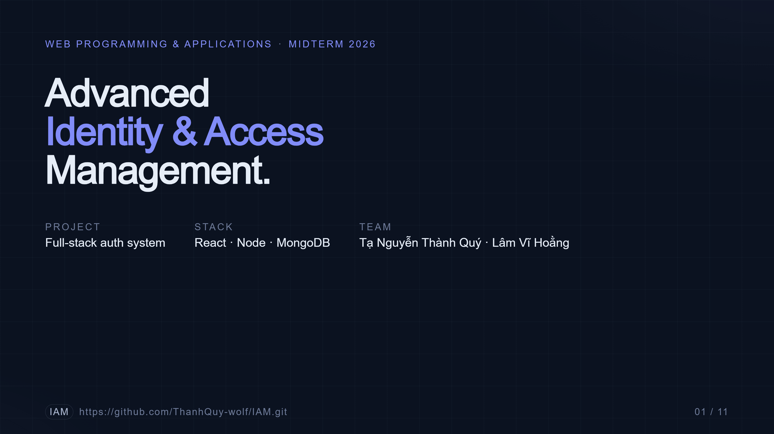
Notes:
Good morning. Today we're presenting our Web Programming midterm project — Advanced Identity and Access Management. The goal was to build, from scratch, an authentication system that goes beyond a simple email-and-password form. We added four modern authentication pillars on top of a React, Node, and MongoDB stack. I'm Member A, and Member B will walk you through the architecture and demo. Together it's about fifteen minutes.

Slide 2
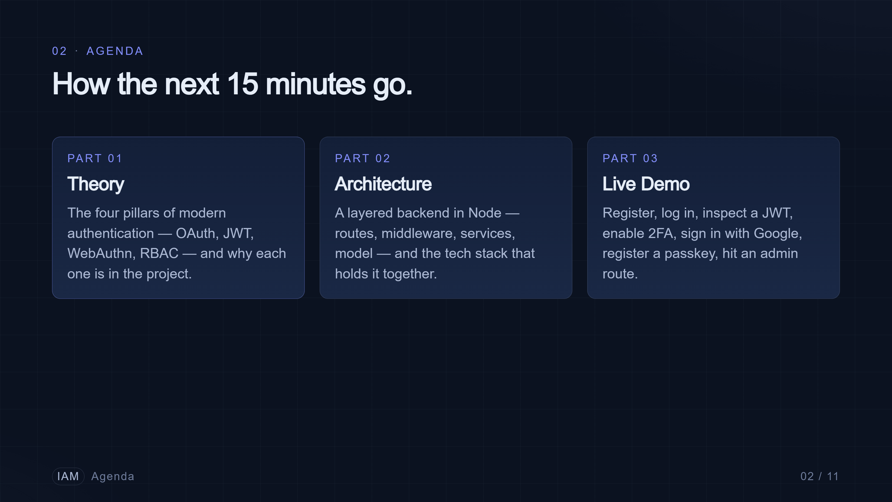
Notes:
Here's the plan. First, the theory — the four pillars that make up our IAM stack, why we chose each one, and how they fit together. Then a quick tour of the backend architecture and the tech stack. And we'll close with a live demo: registration, login, two-factor, OAuth, a passkey, and an admin route. Let's get into pillar one.

Slide 3
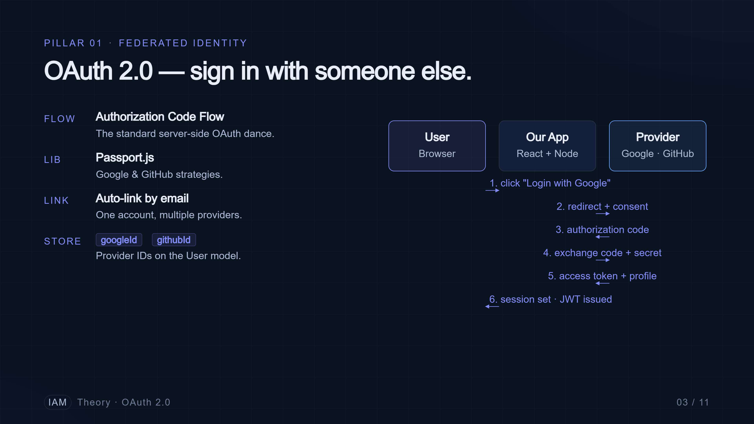
Notes:
Pillar one is OAuth 2.0. We use Passport.js to implement the standard Authorization Code Flow with two providers, Google and GitHub. The user clicks Login with Google, gets redirected to Google to consent, Google sends us back an authorization code, and our server exchanges that code for the user's profile. The detail we want to highlight is account linking — if a user signs up with Google and later with GitHub using the same email, we link both providers to one account instead of creating duplicates.

Slide 4
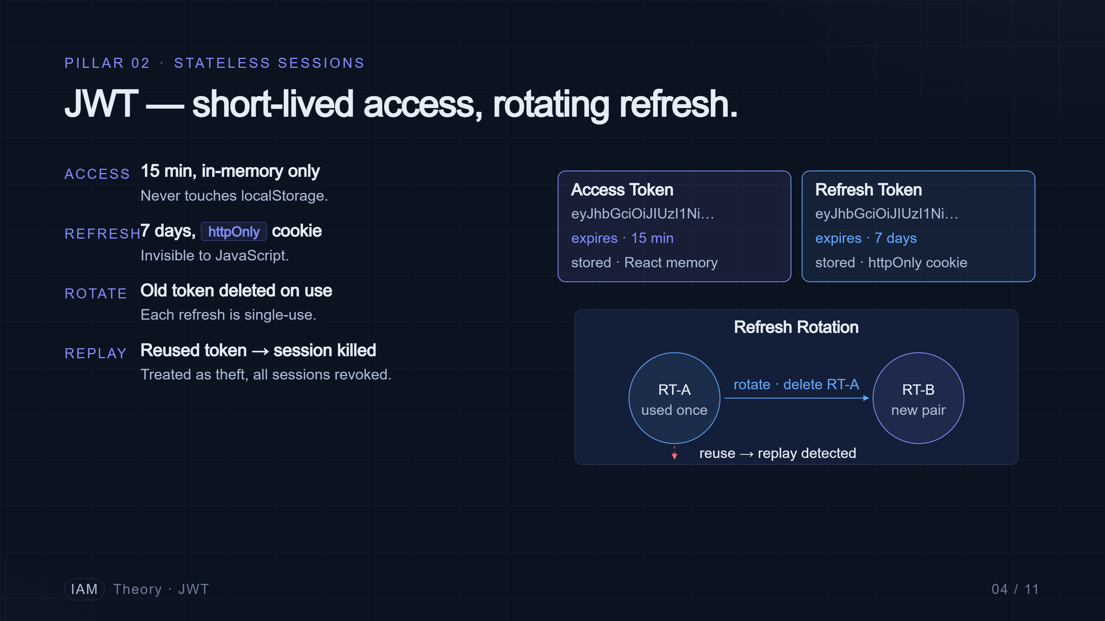
Notes:
Pillar two is JSON Web Tokens. We use a token pair. The access token is short-lived — fifteen minutes — and lives only in memory in the React app, so it can't be stolen from local storage. The refresh token is long-lived — seven days — and lives in an HTTP-only cookie that JavaScript can't read. The interesting part is rotation: every time a refresh token is used, we delete it and issue a new one. If we ever see a deleted refresh token being used again, that's a replay attack, and we invalidate the whole session.

Slide 5
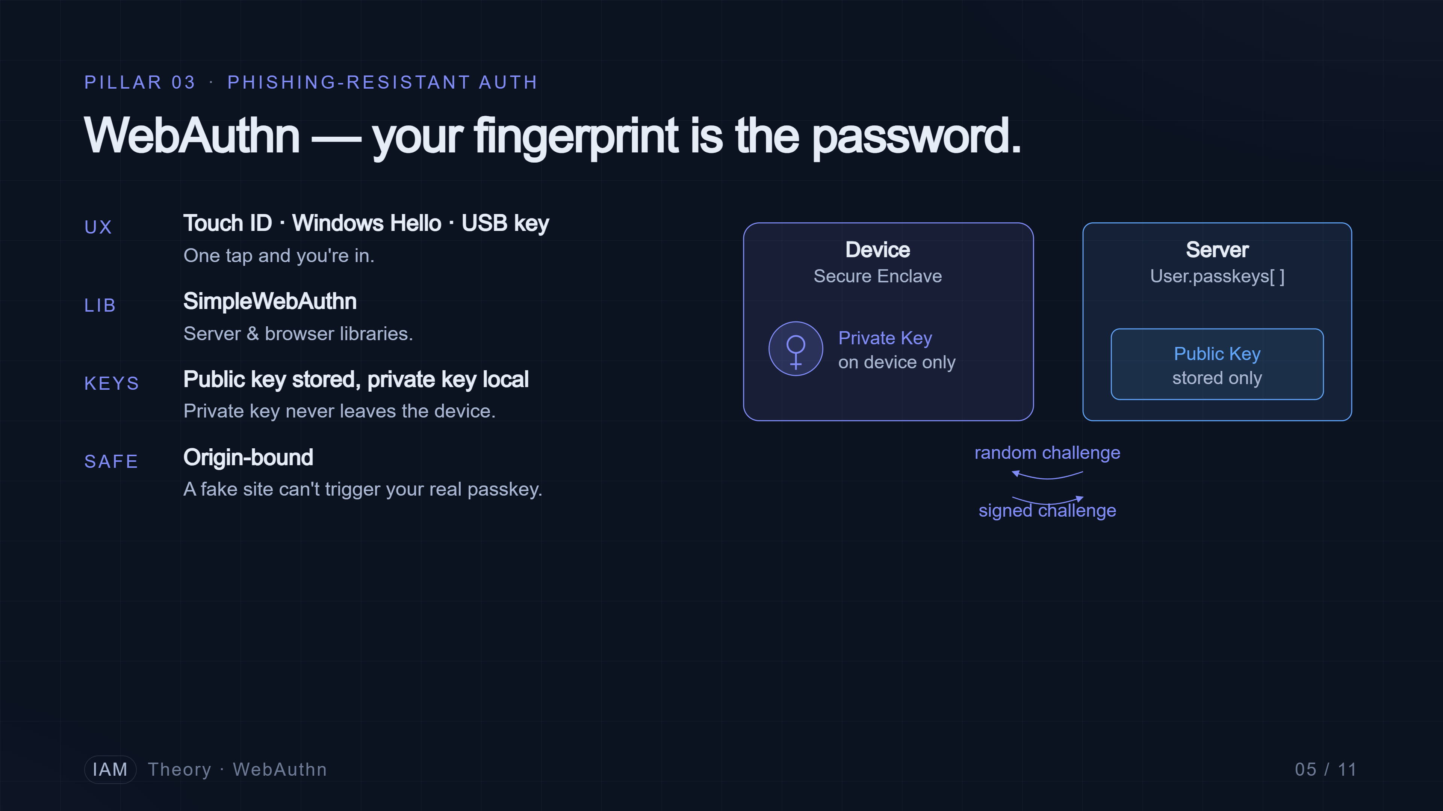
Notes:
Pillar three is WebAuthn — passkeys. This is the modern, phishing-resistant alternative to passwords. The browser, using SimpleWebAuthn on our side, generates a public-private key pair tied to our domain. The private key never leaves the device — it's stored in the secure enclave, Touch ID, Windows Hello, or a hardware key. We only store the public key. Because the credential is bound to the origin, it cannot be phished — a fake site can't trigger your real passkey.

Slide 6
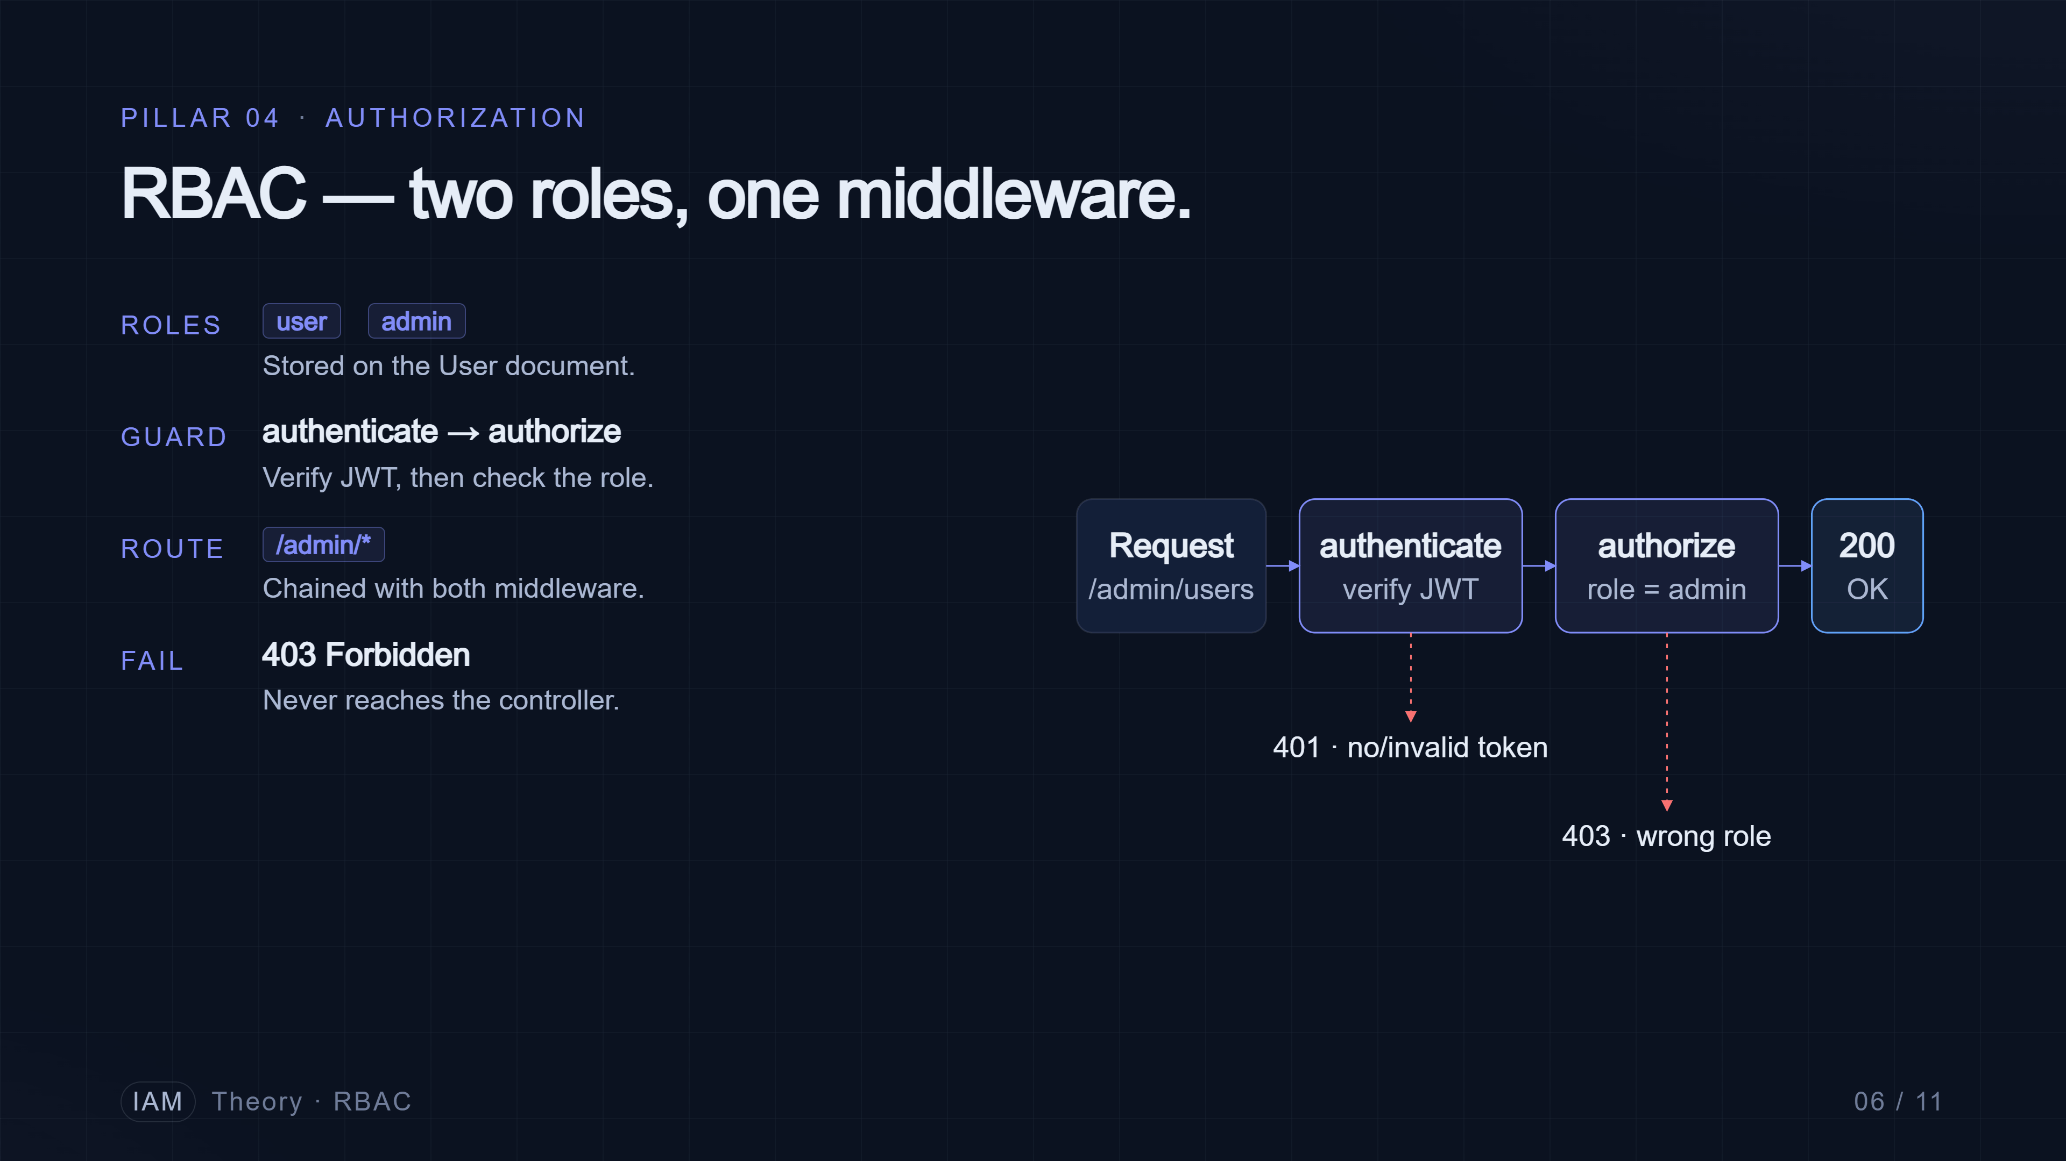
Notes:
Pillar four is Role-Based Access Control. We keep it deliberately simple — two roles, user and admin. The role lives on the user document. On the server, we have one middleware called authenticate that verifies the JWT, and another called authorize that checks the role. Admin routes are guarded by chaining them — authenticate, then authorize admin. It's a small amount of code that protects the whole admin surface.

Slide 7
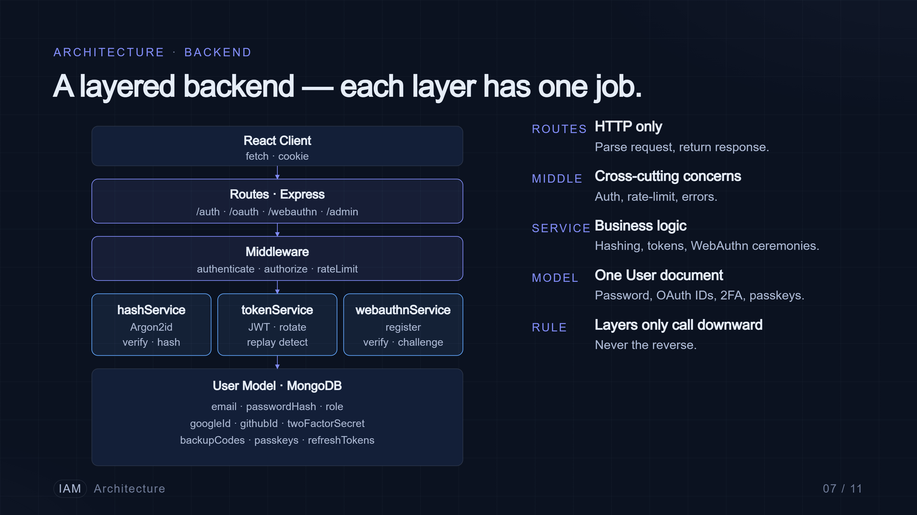
Notes:
Now the architecture. The backend is layered. Routes only handle HTTP — parsing requests, returning responses. They call into services, which hold the business logic: hashService wraps Argon2id, tokenService issues and rotates JWTs, webauthnService handles passkey registration and assertion. Middleware sits between routes and services for cross-cutting concerns like authentication and authorization. And one User model in MongoDB carries everything — email, password hash, role, the OAuth provider IDs, the 2FA secret, and the array of registered passkeys.

Slide 8
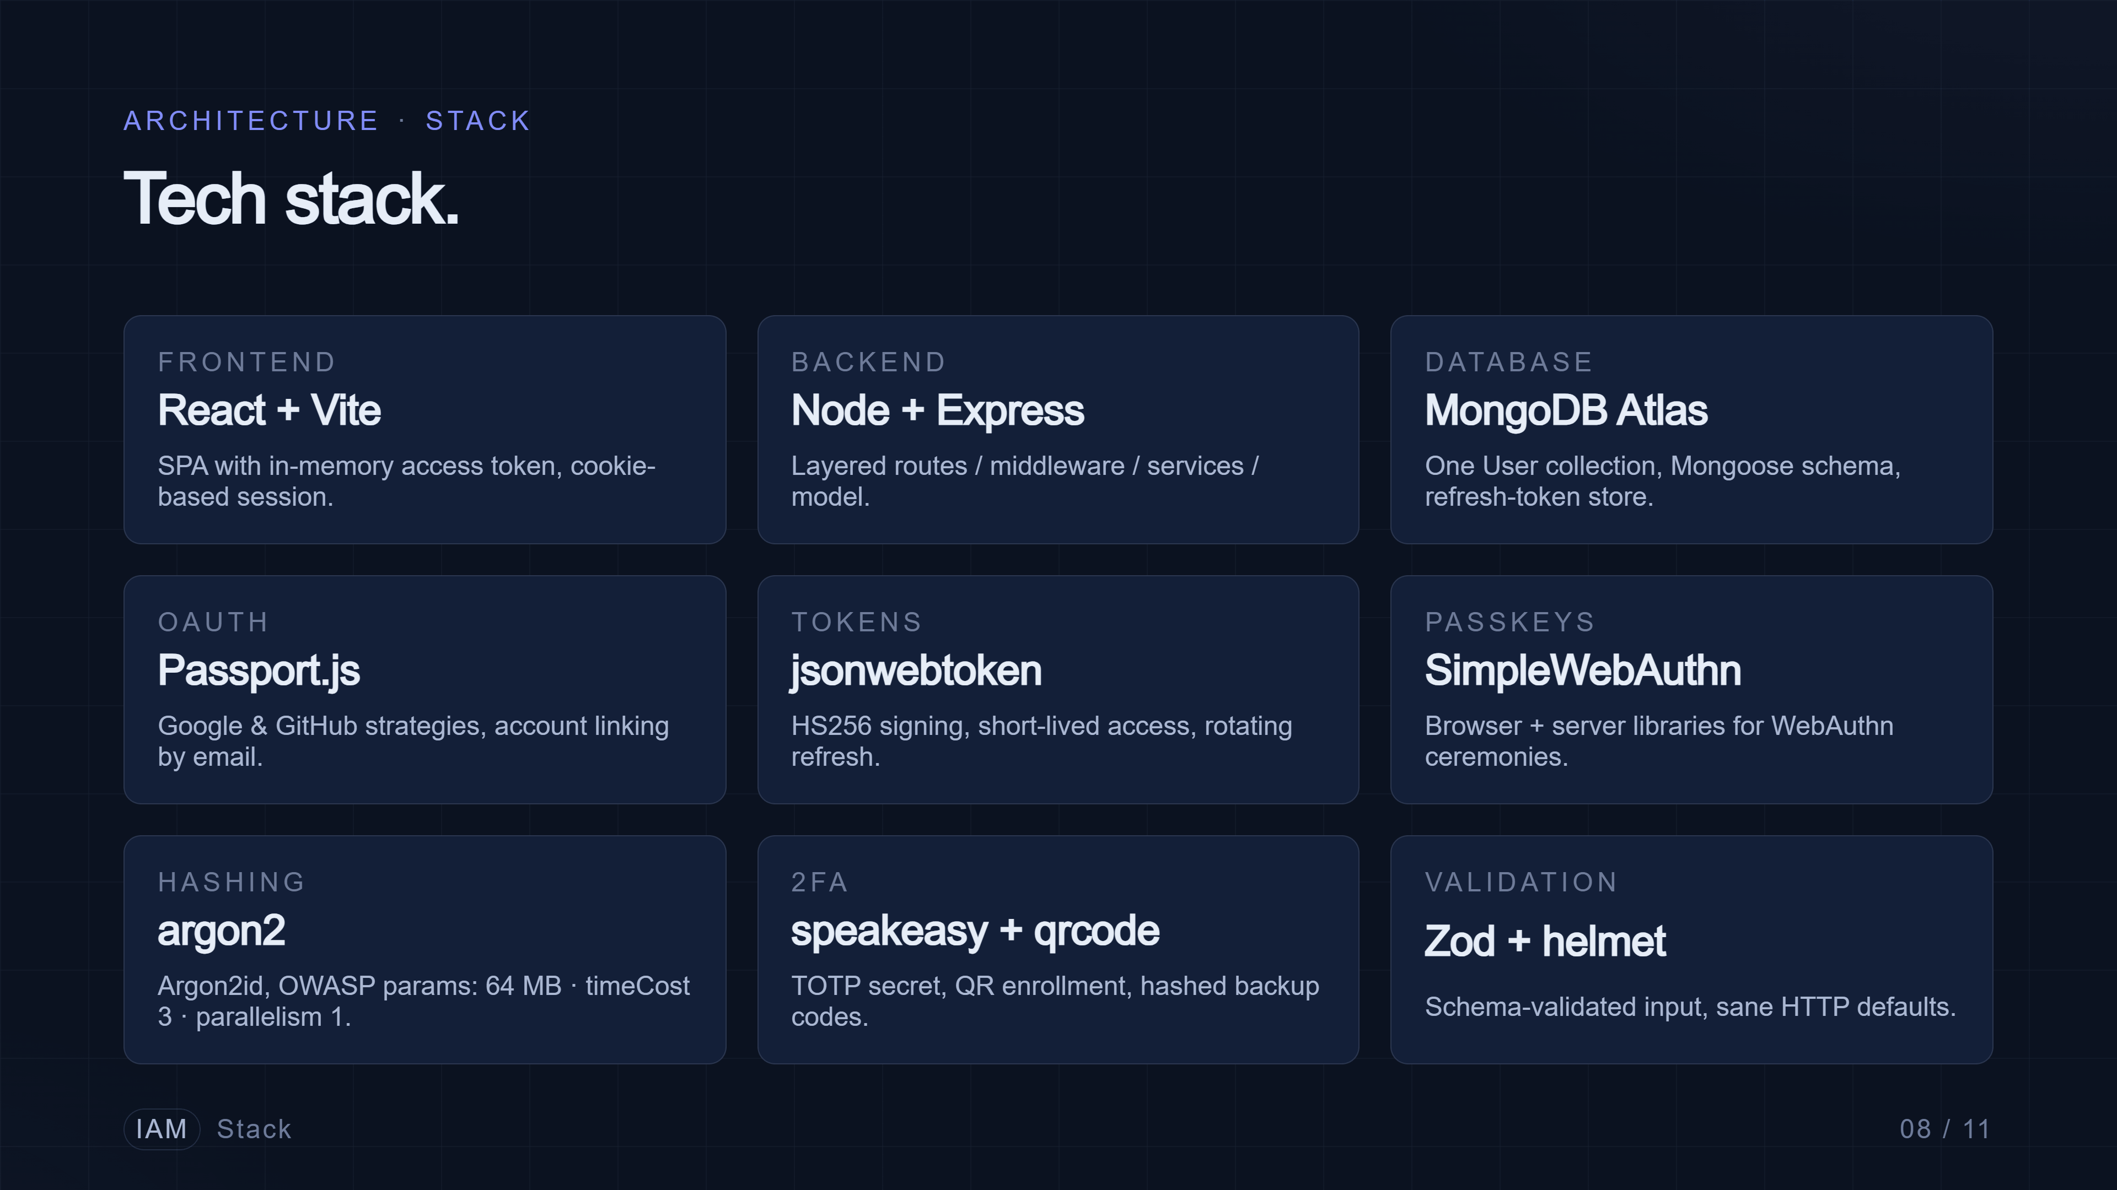
Notes:
On the stack itself — React with Vite on the frontend for fast iteration, Node and Express on the backend, MongoDB Atlas for the database. The four libraries that do the heavy lifting are Passport for OAuth, jsonwebtoken for JWT, SimpleWebAuthn for passkeys, and argon2 for password hashing. Everything runs locally with no build step beyond Vite.

Slide 9
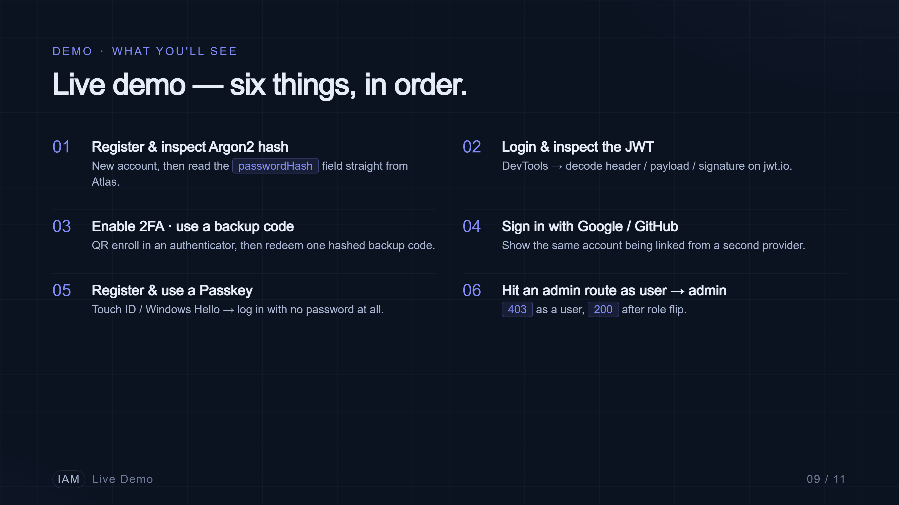
Notes:
For the live demo, we'll move through six things in order. First, register a new account and show the Argon2 hash that's actually stored in the database. Then log in and inspect the JWT in the browser dev tools. Third, enable two-factor authentication and use a backup code. Fourth, log in again with Google OAuth and show the account linking. Fifth, register a passkey on this laptop and log in with just a fingerprint. And finally, hit an admin-only route as a user, get rejected, then as an admin, succeed.

Slide 10
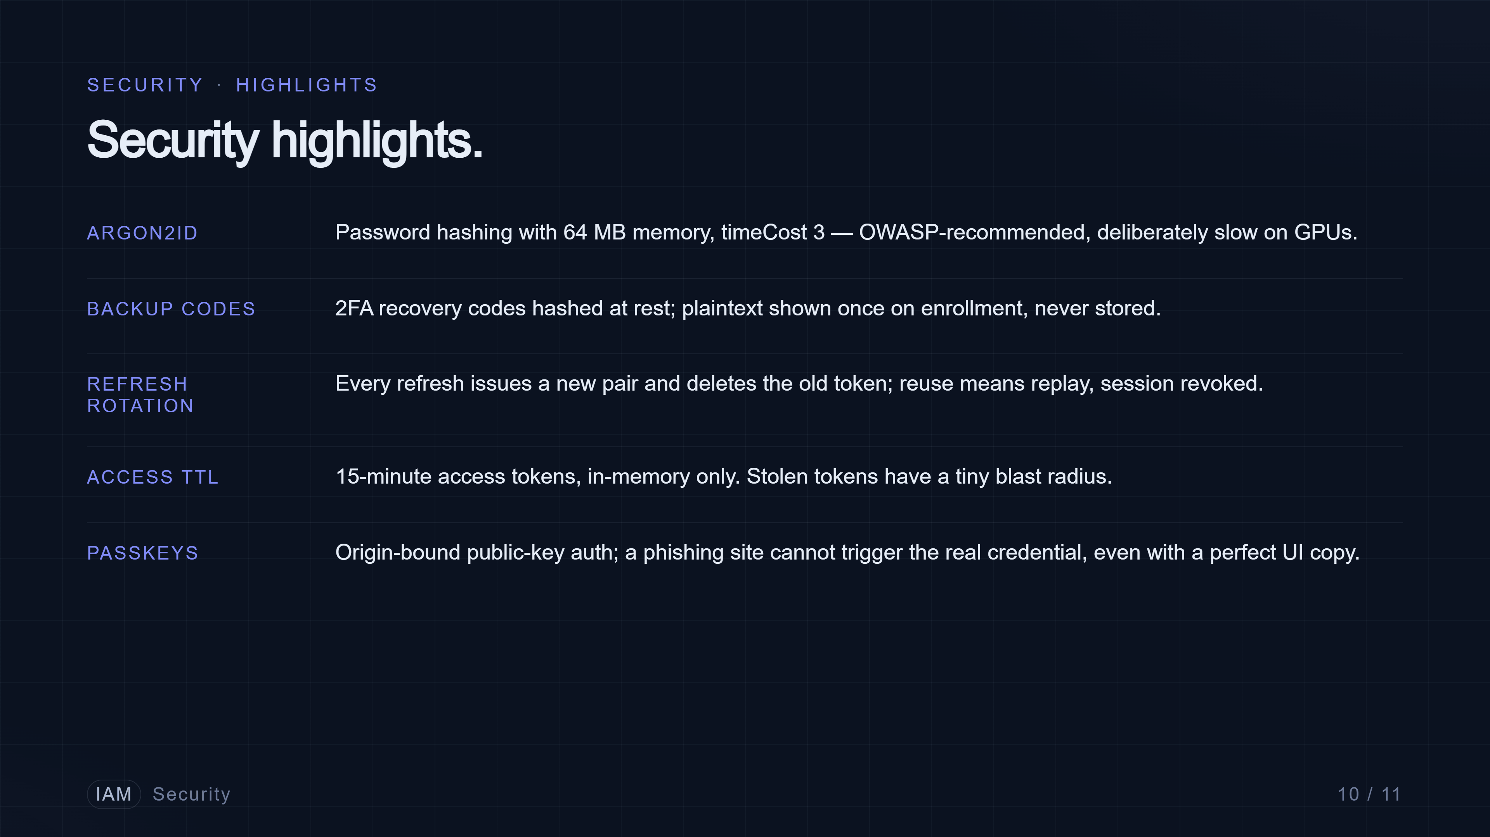
Notes:
Quick security recap before we close. Passwords are hashed with Argon2id, the OWASP-recommended algorithm, with sixty-four megabytes of memory and a time cost of three — deliberately slow to defeat GPU cracking. Two-factor backup codes are themselves hashed, not stored in plain text. Refresh tokens rotate on every use, so a stolen one is single-use. Access tokens are short-lived to limit blast radius. And passkeys are phishing-resistant by design. None of these are exotic — they're current best practice, and we wanted the project to reflect that.

Slide 11
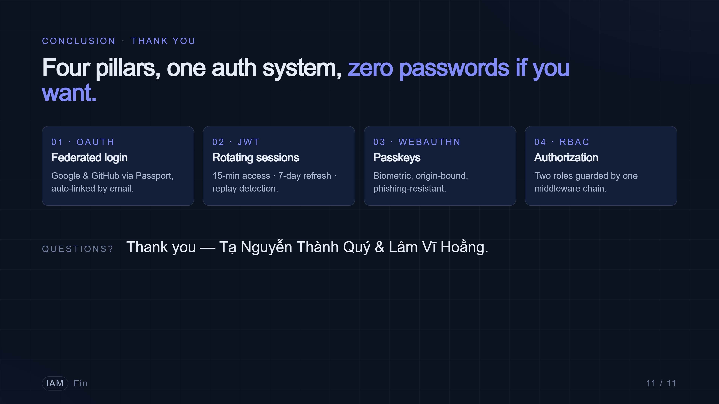
Notes:
To wrap up — four pillars: OAuth for federated login, JWT for stateless sessions with rotation, WebAuthn for phishing-resistant biometric login, and RBAC for authorization. Layered backend, modern hashing, and a working demo. Thank you — we're happy to take questions.

