Slide 1
WEB PROGRAMMING & APPLICATIONS · MIDTERM 2026
Advanced Identity & Access Management.
PROJECT
STACK
TEAM
Full-stack auth system
React · Node · MongoDB
Member A · Member B
IAM
github.com/team/iam
01 / 11
Notes:
Good morning. Today we're presenting our Web Programming midterm project — Advanced Identity and Access Management. The goal was to build, from scratch, an authentication system that goes beyond a simple email-and-password form. We added four modern authentication pillars on top of a React, Node, and MongoDB stack. I'm Member A, and Member B will walk you through the architecture and demo. Together it's about fifteen minutes.

Slide 2
02 · AGENDA
How the next 15 minutes go.
PART 01
PART 02
PART 03
Theory
Architecture
Live Demo
The four pillars of modern authentication — OAuth, JWT, WebAuthn, RBAC — and why each one is in the project.
A layered backend in Node — routes, middleware, services, model — and the tech stack that holds it together.
Register, log in, inspect a JWT, enable 2FA, sign in with Google, register a passkey, hit an admin route.
IAM
Agenda
02 / 11
Notes:
Here's the plan. First, the theory — the four pillars that make up our IAM stack, why we chose each one, and how they fit together. Then a quick tour of the backend architecture and the tech stack. And we'll close with a live demo: registration, login, two-factor, OAuth, a passkey, and an admin route. Let's get into pillar one.

Slide 3
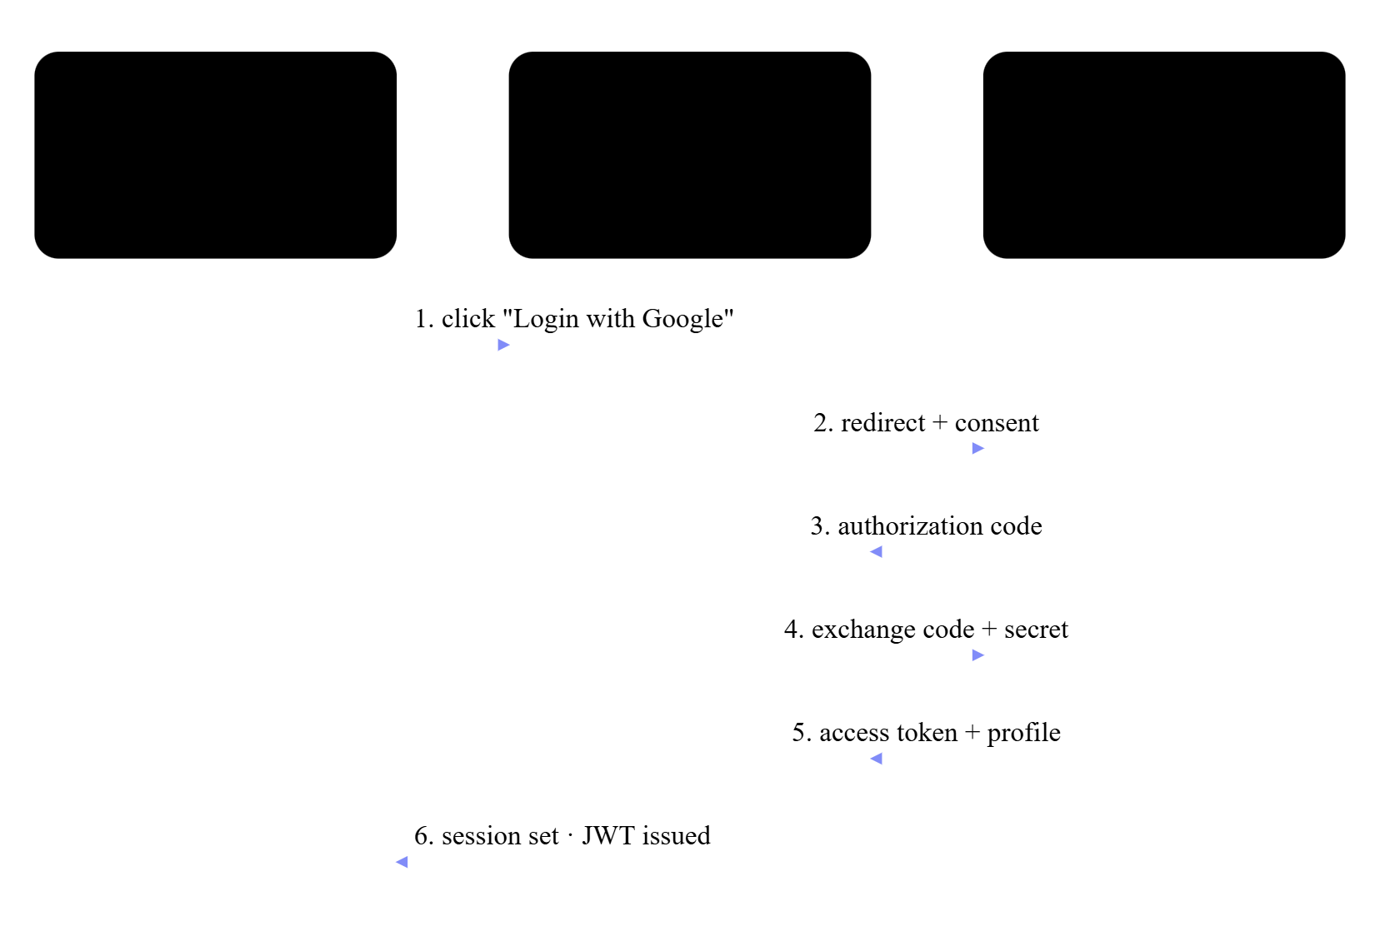
PILLAR 01 · FEDERATED IDENTITY
OAuth 2.0 — sign in with someone else.
FLOW
Authorization Code Flow
The standard server-side OAuth dance.
LIB
Passport.js
Google & GitHub strategies.
LINK
Auto-link by email
One account, multiple providers.
STORE
googleId
githubId
Provider IDs on the User model.
IAM
Theory · OAuth 2.0
03 / 11
Notes:
Pillar one is OAuth 2.0. We use Passport.js to implement the standard Authorization Code Flow with two providers, Google and GitHub. The user clicks Login with Google, gets redirected to Google to consent, Google sends us back an authorization code, and our server exchanges that code for the user's profile. The detail we want to highlight is account linking — if a user signs up with Google and later with GitHub using the same email, we link both providers to one account instead of creating duplicates.

Slide 4
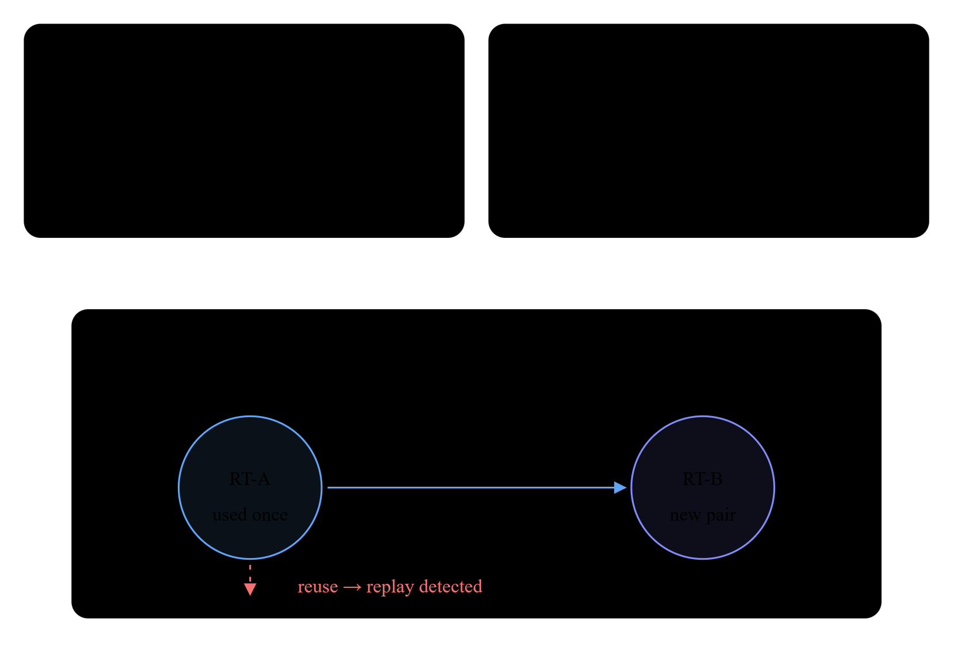
PILLAR 02 · STATELESS SESSIONS
JWT — short-lived access, rotating refresh.
ACCESS
15 min, in-memory only
Never touches localStorage.
REFRESH
7 days, httpOnly cookie
Invisible to JavaScript.
ROTATE
Old token deleted on use
Each refresh is single-use.
REPLAY
Reused token → session killed
Treated as theft, all sessions revoked.
IAM
Theory · JWT
04 / 11
Notes:
Pillar two is JSON Web Tokens. We use a token pair. The access token is short-lived — fifteen minutes — and lives only in memory in the React app, so it can't be stolen from local storage. The refresh token is long-lived — seven days — and lives in an HTTP-only cookie that JavaScript can't read. The interesting part is rotation: every time a refresh token is used, we delete it and issue a new one. If we ever see a deleted refresh token being used again, that's a replay attack, and we invalidate the whole session.

Slide 5
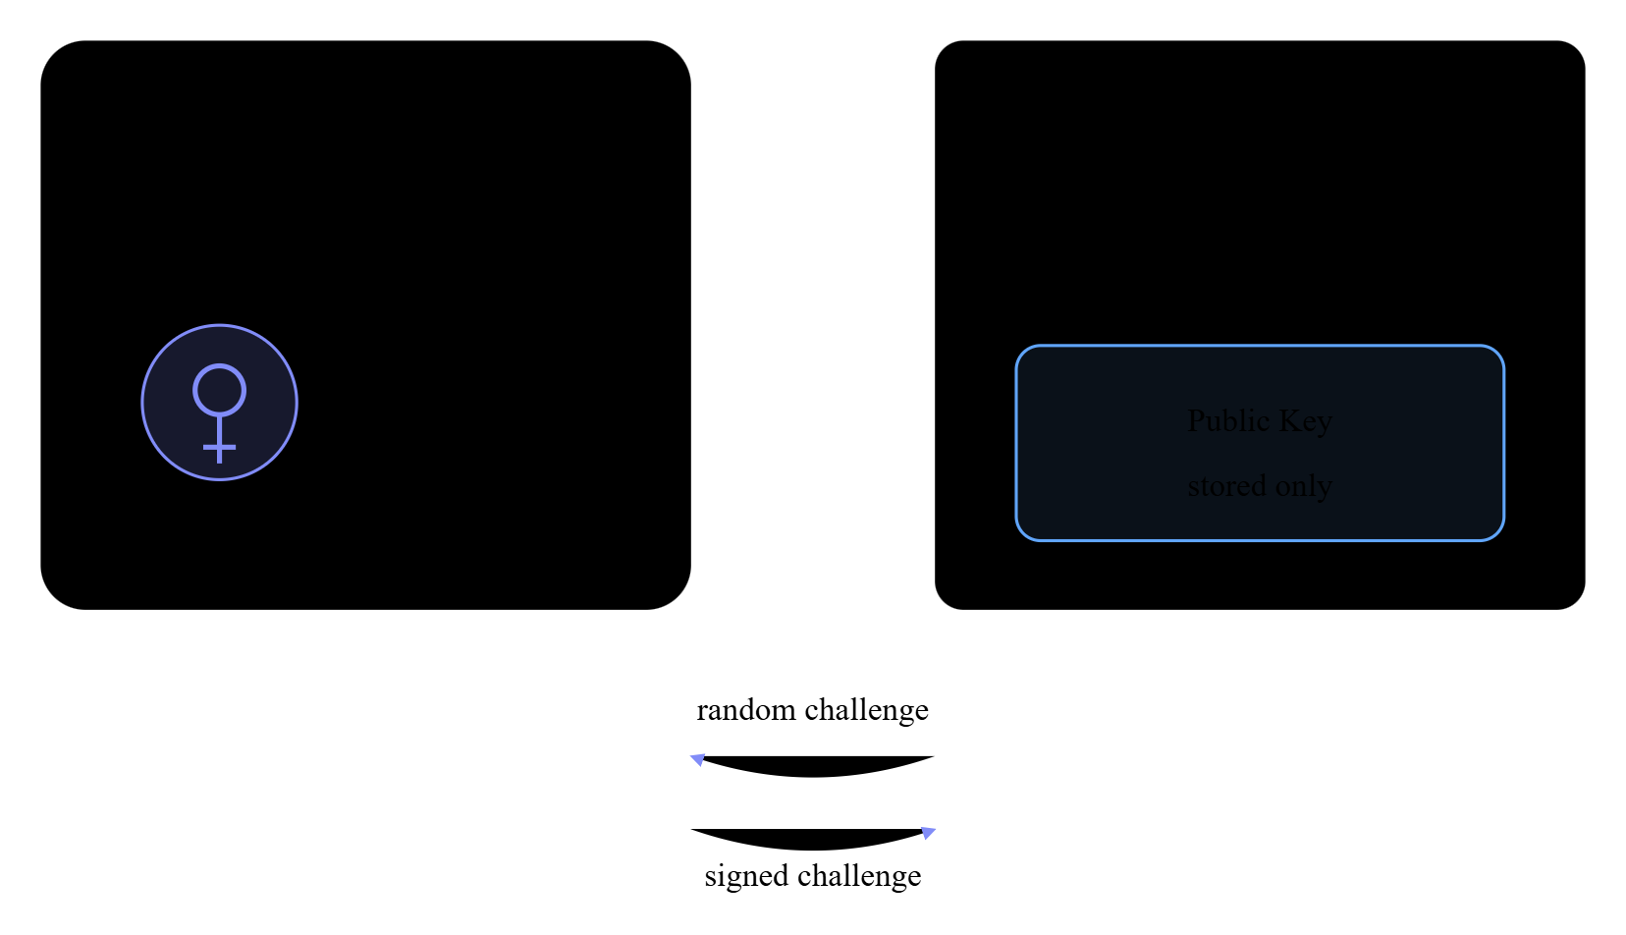
PILLAR 03 · PHISHING-RESISTANT AUTH
WebAuthn — your fingerprint is the password.
UX
Touch ID · Windows Hello · USB key
One tap and you're in.
LIB
SimpleWebAuthn
Server & browser libraries.
KEYS
Public key stored, private key local
Private key never leaves the device.
SAFE
Origin-bound
A fake site can't trigger your real passkey.
IAM
Theory · WebAuthn
05 / 11
Notes:
Pillar three is WebAuthn — passkeys. This is the modern, phishing-resistant alternative to passwords. The browser, using SimpleWebAuthn on our side, generates a public-private key pair tied to our domain. The private key never leaves the device — it's stored in the secure enclave, Touch ID, Windows Hello, or a hardware key. We only store the public key. Because the credential is bound to the origin, it cannot be phished — a fake site can't trigger your real passkey.

Slide 6
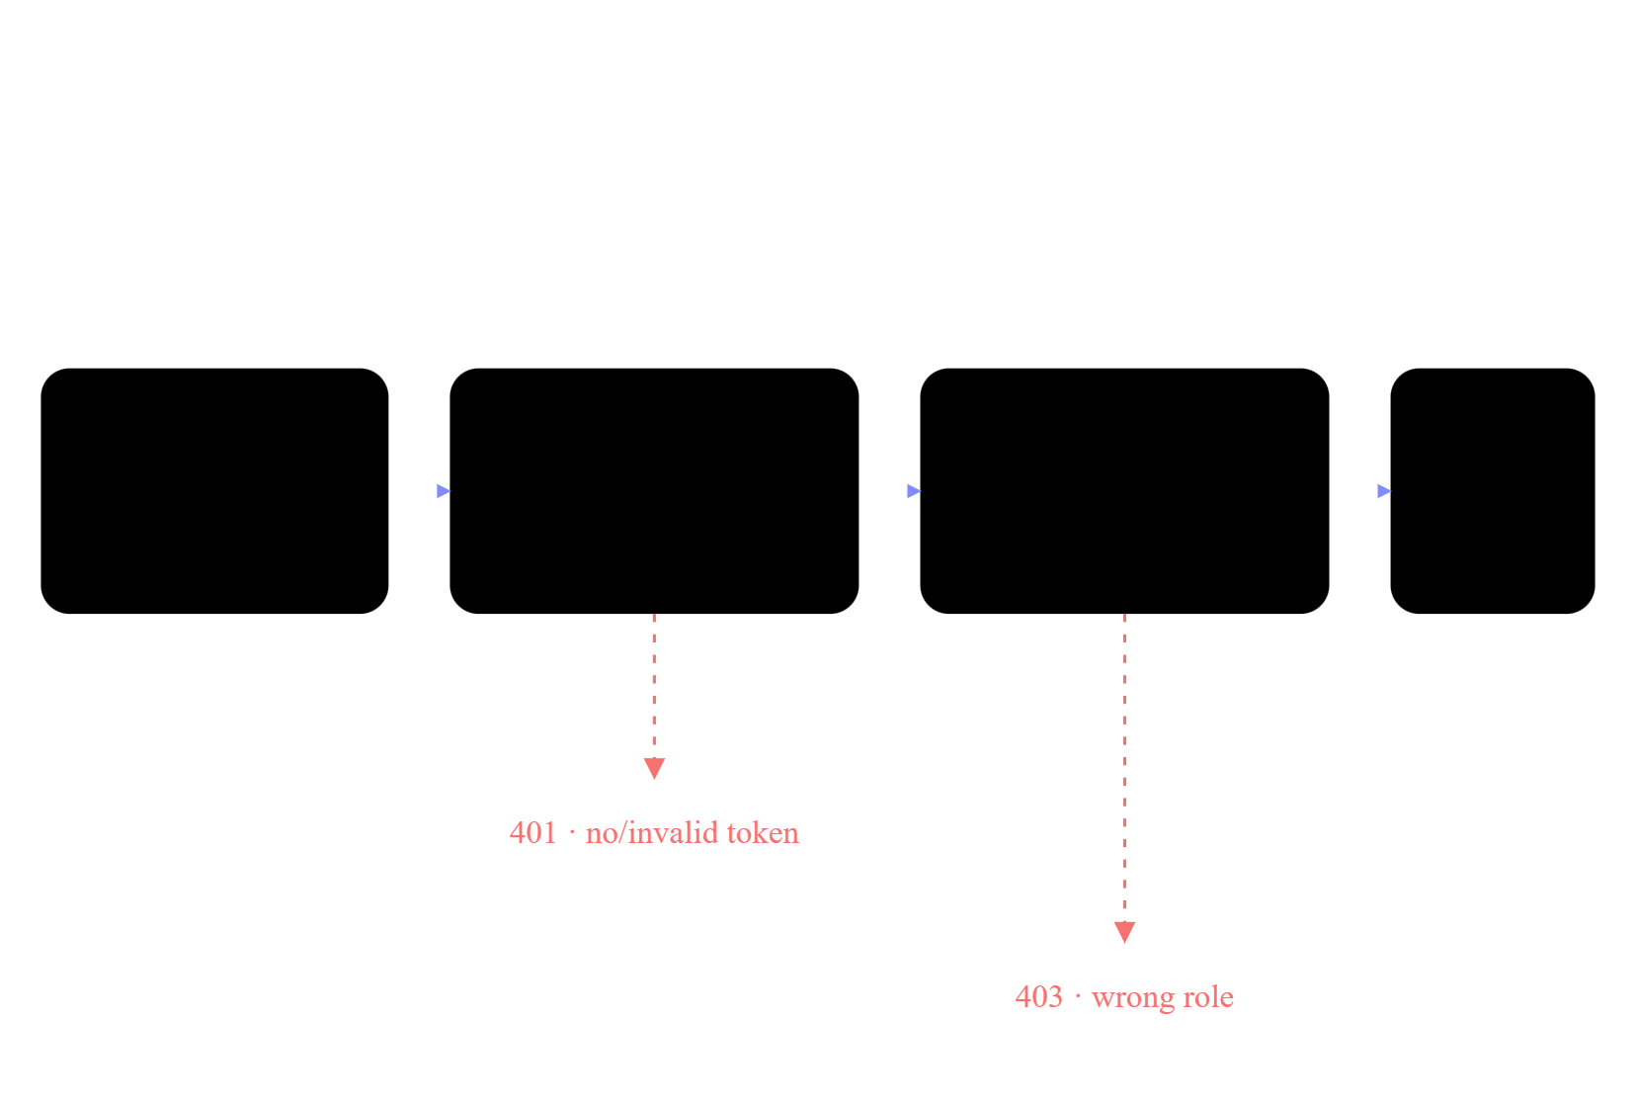
PILLAR 04 · AUTHORIZATION
RBAC — two roles, one middleware.
ROLES
user
admin
Stored on the User document.
GUARD
authenticate → authorize
Verify JWT, then check the role.
ROUTE
/admin/*
Chained with both middleware.
FAIL
403 Forbidden
Never reaches the controller.
IAM
Theory · RBAC
06 / 11
Notes:
Pillar four is Role-Based Access Control. We keep it deliberately simple — two roles, user and admin. The role lives on the user document. On the server, we have one middleware called authenticate that verifies the JWT, and another called authorize that checks the role. Admin routes are guarded by chaining them — authenticate, then authorize admin. It's a small amount of code that protects the whole admin surface.

Slide 7

ARCHITECTURE · BACKEND
A layered backend — each layer has one job.
ROUTES
HTTP only
Parse request, return response.
MIDDLE
Cross-cutting concerns
Auth, rate-limit, errors.
SERVICE
Business logic
Hashing, tokens, WebAuthn ceremonies.
MODEL
One User document
Password, OAuth IDs, 2FA, passkeys.
RULE
Layers only call downward
Never the reverse.
IAM
Architecture
07 / 11
Notes:
Now the architecture. The backend is layered. Routes only handle HTTP — parsing requests, returning responses. They call into services, which hold the business logic: hashService wraps Argon2id, tokenService issues and rotates JWTs, webauthnService handles passkey registration and assertion. Middleware sits between routes and services for cross-cutting concerns like authentication and authorization. And one User model in MongoDB carries everything — email, password hash, role, the OAuth provider IDs, the 2FA secret, and the array of registered passkeys.

Slide 8
ARCHITECTURE · STACK
Tech stack.
FRONTEND
BACKEND
DATABASE
React + Vite
Node + Express
MongoDB Atlas
SPA with in-memory access token, cookie-based session.
Layered routes / middleware / services / model.
One User collection, Mongoose schema, refresh-token store.
OAUTH
TOKENS
PASSKEYS
Passport.js
jsonwebtoken
SimpleWebAuthn
Google & GitHub strategies, account linking by email.
HS256 signing, short-lived access, rotating refresh.
Browser + server libraries for WebAuthn ceremonies.
HASHING
2FA
VALIDATION
argon2
speakeasy + qrcode
Zod + helmet
Argon2id, OWASP params: 64 MB · timeCost 3 · parallelism 1.
TOTP secret, QR enrollment, hashed backup codes.
Schema-validated input, sane HTTP defaults.
IAM
Stack
08 / 11
Notes:
On the stack itself — React with Vite on the frontend for fast iteration, Node and Express on the backend, MongoDB Atlas for the database. The four libraries that do the heavy lifting are Passport for OAuth, jsonwebtoken for JWT, SimpleWebAuthn for passkeys, and argon2 for password hashing. Everything runs locally with no build step beyond Vite.

Slide 9
DEMO · WHAT YOU'LL SEE
Live demo — six things, in order.
01
Register & inspect Argon2 hash
02
Login & inspect the JWT
New account, then read the passwordHash field straight from Atlas.
DevTools → decode header / payload / signature on jwt.io.
03
Enable 2FA · use a backup code
04
Sign in with Google / GitHub
QR enroll in an authenticator, then redeem one hashed backup code.
Show the same account being linked from a second provider.
05
Register & use a Passkey
06
Hit an admin route as user → admin
Touch ID / Windows Hello → log in with no password at all.
403 as a user, 200 after role flip.
IAM
Live Demo
09 / 11
Notes:
For the live demo, we'll move through six things in order. First, register a new account and show the Argon2 hash that's actually stored in the database. Then log in and inspect the JWT in the browser dev tools. Third, enable two-factor authentication and use a backup code. Fourth, log in again with Google OAuth and show the account linking. Fifth, register a passkey on this laptop and log in with just a fingerprint. And finally, hit an admin-only route as a user, get rejected, then as an admin, succeed.

Slide 10
SECURITY · HIGHLIGHTS
Security highlights.
ARGON2ID
Password hashing with 64 MB memory, timeCost 3 — OWASP-recommended, deliberately slow on GPUs.
BACKUP CODES
2FA recovery codes hashed at rest; plaintext shown once on enrollment, never stored.
REFRESH ROTATION
Every refresh issues a new pair and deletes the old token; reuse means replay, session revoked.
ACCESS TTL
15-minute access tokens, in-memory only. Stolen tokens have a tiny blast radius.
PASSKEYS
Origin-bound public-key auth; a phishing site cannot trigger the real credential, even with a perfect UI copy.
IAM
Security
10 / 11
Notes:
Quick security recap before we close. Passwords are hashed with Argon2id, the OWASP-recommended algorithm, with sixty-four megabytes of memory and a time cost of three — deliberately slow to defeat GPU cracking. Two-factor backup codes are themselves hashed, not stored in plain text. Refresh tokens rotate on every use, so a stolen one is single-use. Access tokens are short-lived to limit blast radius. And passkeys are phishing-resistant by design. None of these are exotic — they're current best practice, and we wanted the project to reflect that.

Slide 11
CONCLUSION · THANK YOU
Four pillars, one auth system, zero passwords if you want.
01 · OAUTH
02 · JWT
03 · WEBAUTHN
04 · RBAC
Federated login
Rotating sessions
Passkeys
Authorization
Google & GitHub via Passport, auto-linked by email.
15-min access · 7-day refresh · replay detection.
Biometric, origin-bound, phishing-resistant.
Two roles guarded by one middleware chain.
QUESTIONS?
Thank you — Member A & Member B.
IAM
Fin
11 / 11
Notes:
To wrap up — four pillars: OAuth for federated login, JWT for stateless sessions with rotation, WebAuthn for phishing-resistant biometric login, and RBAC for authorization. Layered backend, modern hashing, and a working demo. Thank you — we're happy to take questions.

