Slide 1
Chapter 7: Synchronization Examples

Slide 2
Chapter 7: Synchronization Examples
Explain the bounded-buffer, readers-writers, and dining philosophers synchronization problems
Describe the tools used by Linux and Windows to solve synchronization problems
Illustrate how POSIX and Java can be used to solve process synchronization problems

Slide 3
Classical Problems of Synchronization
Classical problems used to test newly-proposed synchronization schemes
Bounded-Buffer Problem
Readers and Writers Problem
Dining-Philosophers Problem

Slide 4
Bounded-Buffer Problem
n buffers, each can hold one item
Semaphore mutex initialized to the value 1
Semaphore full initialized to the value 0
Semaphore empty initialized to the value n

Slide 5
Bounded Buffer Problem (Cont.)
The structure of the producer process
while (true) {
... /* produce an item in next_produced */
...
wait(empty);
wait(mutex);
... /* add next produced to the buffer */
...
signal(mutex);
signal(full);
}
Semaphore mutex = 1
Semaphore full = 0
Semaphore empty = n

Slide 6
Bounded Buffer Problem (Cont.)
The structure of the consumer process
while (true) {
wait(full);
wait(mutex);
... /* remove an item from buffer to next_consumed */
...
signal(mutex);
signal(empty);
... /* consume the item in next consumed */
... }
Semaphore mutex = 1
Semaphore full = 0
Semaphore empty = n

Slide 7
Readers-Writers Problem
A data set is shared among a number of concurrent processes
Readers – only read the data set; they do not perform any updates
Writers – can both read and write
Problem – allow multiple readers to read at the same time
Only one single writer can access the shared data at the same time
Several variations of how readers and writers are considered – all involve some form of priorities
Shared Data
Data set
Semaphore rw_mutex initialized to 1
Semaphore mutex initialized to 1
Integer read_count initialized to 0

Slide 8
Readers-Writers Problem (Cont.)
The structure of a writer process
while (true) { wait(rw_mutex);
... /* writing is performed */
...
signal(rw_mutex);
}
Semaphore rw_mutex = 1
Semaphore mutex = 1
Integer read_count = 0

Slide 9
Readers-Writers Problem (Cont.)
The structure of a reader process
while (true){ wait(mutex); read_count++; if (read_count == 1)
wait(rw_mutex);
signal(mutex);
... /* reading is performed */
...
wait(mutex); read count--; if (read_count == 0)
signal(rw_mutex);
signal(mutex);
}
Semaphore rw_mutex = 1
Semaphore mutex = 1
Integer read_count = 0
while (true) { wait(rw_mutex);
... /* writing is performed */
...
signal(rw_mutex);
}

Slide 10
Readers-Writers Problem Variations
First variation – no reader kept waiting unless writer has permission to use shared object
Second variation – once writer is ready, it performs the write ASAP
Both may have starvation leading to even more variations
Problem is solved on some systems by kernel providing reader-writer locks
Notes:
The readers–writers problem has several variations, all involving priori- ties. The simplest one, referred to as the rst readers – writers problem, requires that no reader be kept waiting unless a writer has already obtained permission to use the shared object. In other words, no reader should wait for other read- ers to nish simply because a writer is waiting. The second readers–writers problem requires that, once a writer is ready, that writer perform its write as soon as possible. In other words, if a writer is waiting to access the object, no new readers may start reading.
A solution to either problem may result in starvation. In the rst case, writers may starve; in the second case, readers may starve. For this reason, other variants of the problem have been proposed. Next, we present a solution to the rst readers–writers problem. See the bibliographical notes at the end of the chapter for references describing starvation-free solutions to the second readers–writers problem.

Slide 11

Dining-Philosophers Problem
Philosophers spend their lives alternating thinking and eating
Don’t interact with their neighbors, occasionally try to pick up 2 chopsticks (one at a time) to eat from bowl
Need both to eat, then release both when done
In the case of 5 philosophers
Shared data
Bowl of rice (data set)
Semaphore chopstick [5] initialized to 1

Slide 12
Dining-Philosophers Problem Algorithm
Semaphore Solution
The structure of Philosopher i:
while (true){
wait (chopstick[i] );
wait (chopStick[ (i + 1) % 5] );
/* eat for awhile */
signal (chopstick[i] );
signal (chopstick[ (i + 1) % 5] );
/* think for awhile */
}
What is the problem with this algorithm?

Slide 13
Monitor Solution to Dining Philosophers
monitor DiningPhilosophers {
enum { THINKING, HUNGRY, EATING) state [5] ;
condition self [5];
void pickup (int i) {
state[i] = HUNGRY;
test(i);
if (state[i] != EATING) self[i].wait;
}
void putdown (int i) {
state[i] = THINKING;
// test left and right neighbors
test((i + 4) % 5);
test((i + 1) % 5);
}
}

Slide 14
Solution to Dining Philosophers (Cont.)
void test (int i) {
if ((state[(i + 4) % 5] != EATING) &&
(state[i] == HUNGRY) &&
(state[(i + 1) % 5] != EATING) ) {
state[i] = EATING ;
self[i].signal () ;
}
}
initialization_code() {
for (int i = 0; i < 5; i++)
state[i] = THINKING;
}
}

Slide 15
Solution to Dining Philosophers (Cont.)
Each philosopher i invokes the operations pickup() and putdown() in the following sequence:
DiningPhilosophers.pickup(i);
/** EAT **/
DiningPhilosophers.putdown(i);
No deadlock, but starvation is possible

Slide 16
Kernel Synchronization - Windows
Uses interrupt masks to protect access to global resources on uniprocessor systems
Uses spinlocks on multiprocessor systems
Spin locking-thread will never be preempted
Also provides dispatcher objects user-land which may act mutexes, semaphores, events, and timers
Events
An event acts much like a condition variable
Timers notify one or more thread when time expired
Dispatcher objects either signaled-state (object available) or non-signaled state (thread will block)

Slide 17
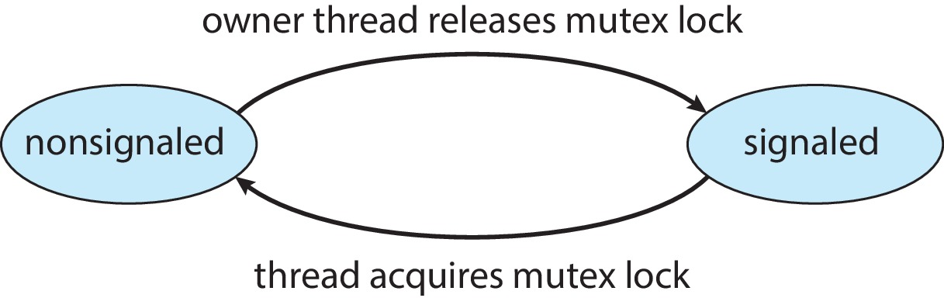
Kernel Synchronization - Windows
Mutex dispatcher object

Slide 18
Linux Synchronization
Linux:
Prior to kernel Version 2.6, disables interrupts to implement short critical sections
Version 2.6 and later, fully preemptive
Linux provides:
Semaphores
atomic integers
spinlocks
reader-writer versions of both
On single-CPU system, spinlocks replaced by enabling and disabling kernel preemption

Slide 19
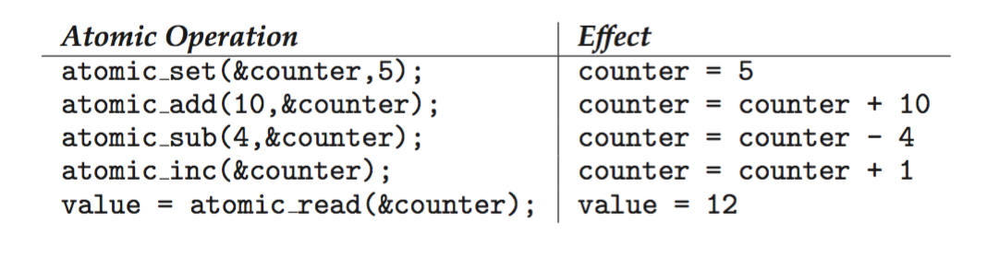
Linux Synchronization
Atomic variables
atomic_t is the type for atomic integer
Consider the variables
atomic_t counter; int value;

Slide 20
POSIX Synchronization
POSIX API provides
mutex locks
semaphores
condition variable
Widely used on UNIX, Linux, and macOS

Slide 21
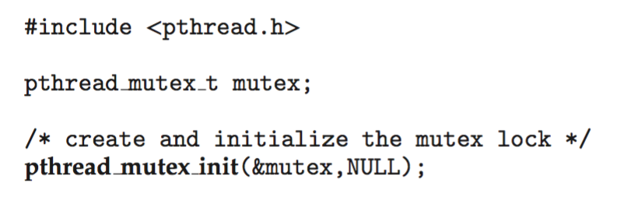
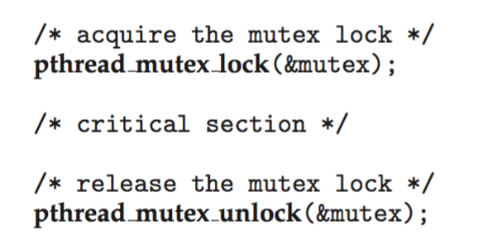
POSIX Mutex Locks
Creating and initializing the lock
Acquiring and releasing the lock

Slide 22
POSIX Semaphores
POSIX provides two versions – named and unnamed
Named semaphores can be used by unrelated processes, unnamed cannot

Slide 23
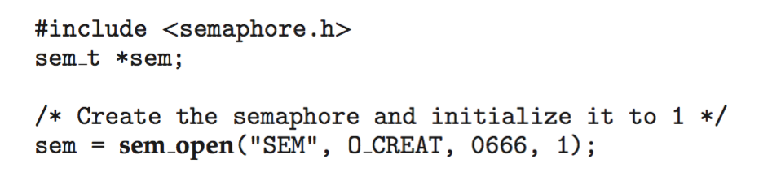
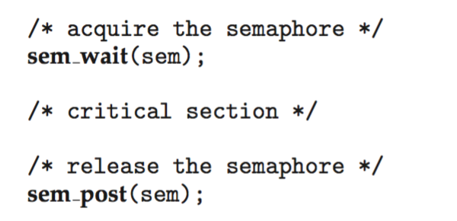
POSIX Named Semaphores
Creating an initializing the semaphore:
Another process can access the semaphore by referring to its name SEM.
Acquiring and releasing the semaphore:

Slide 24
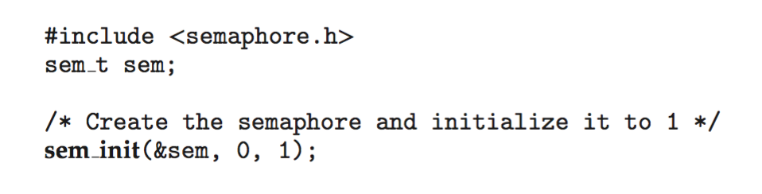
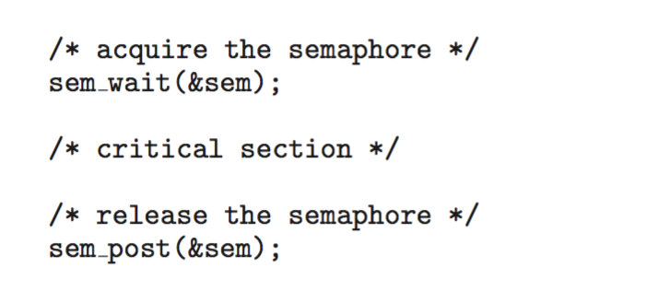
POSIX Unnamed Semaphores
Creating an initializing the semaphore:
Acquiring and releasing the semaphore:

Slide 25
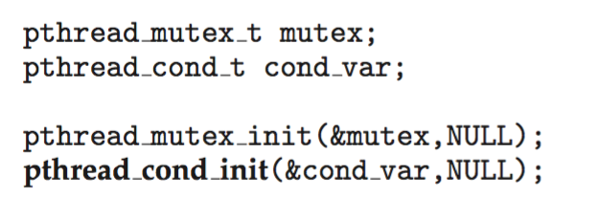
POSIX Condition Variables
Since POSIX is typically used in C/C++ and these languages do not provide a monitor, POSIX condition variables are associated with a POSIX mutex lock to provide mutual exclusion: Creating and initializing the condition variable:

Slide 26
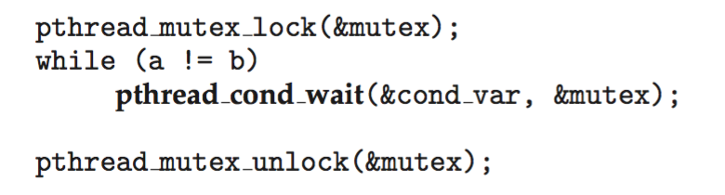
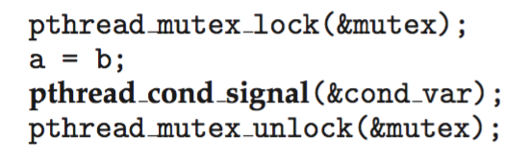
POSIX Condition Variables
Thread waiting for the condition a == b to become true:
Thread signaling another thread waiting on the condition variable:

Slide 27
Java Synchronization
Java provides rich set of synchronization features:
Java monitors
Reentrant locks
Semaphores
Condition variables

Slide 28
Java Monitors
Every Java object has associated with it a single lock.
If a method is declared as synchronized, a calling thread must own the lock for the object.
If the lock is owned by another thread, the calling thread must wait for the lock until it is released.
Locks are released when the owning thread exits the synchronized method.

Slide 29
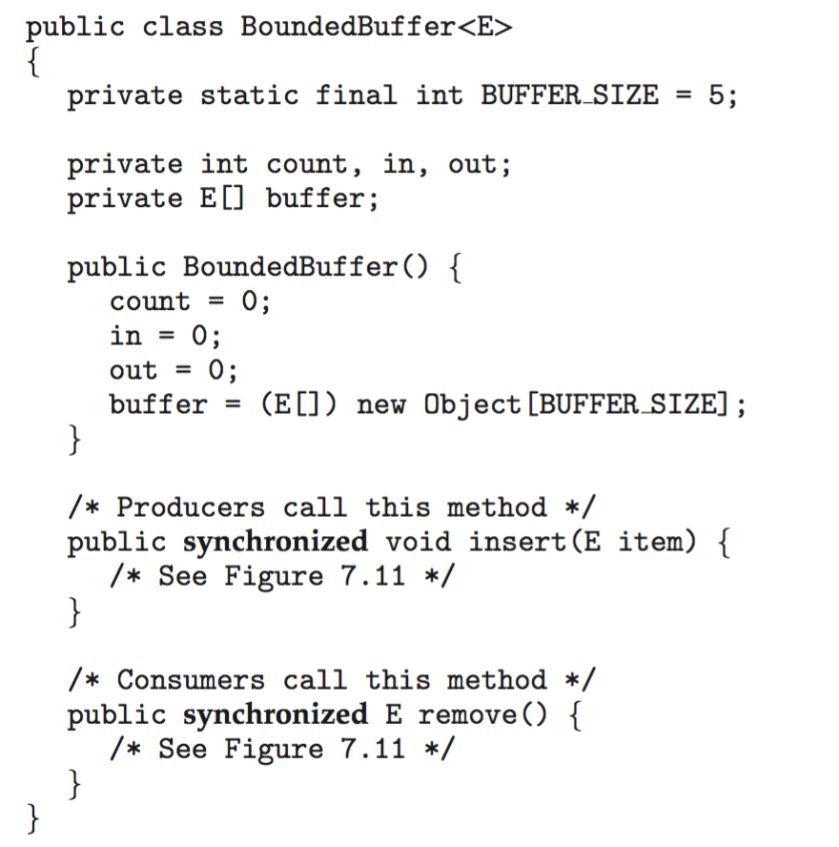
Bounded Buffer – Java Synchronization

Slide 30
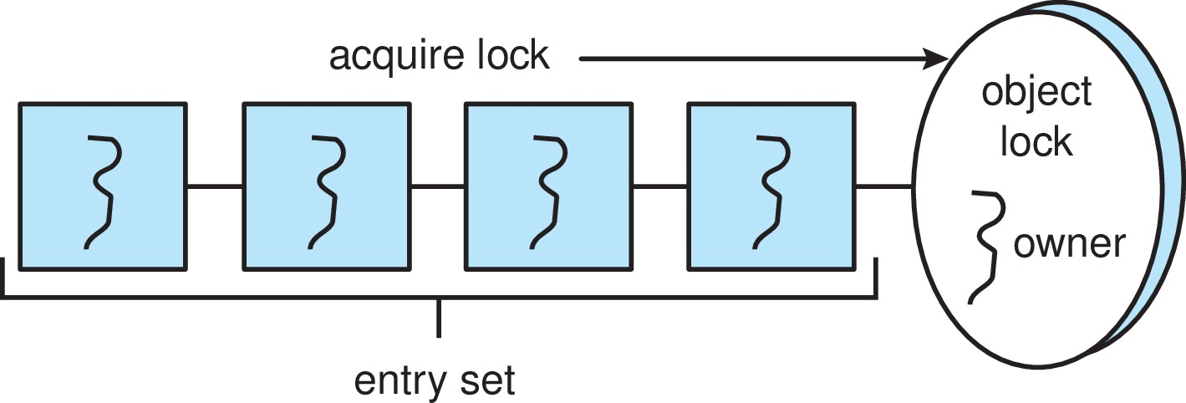
Java Synchronization
A thread that tries to acquire an unavailable lock is placed in the object’s entry set:

Slide 31
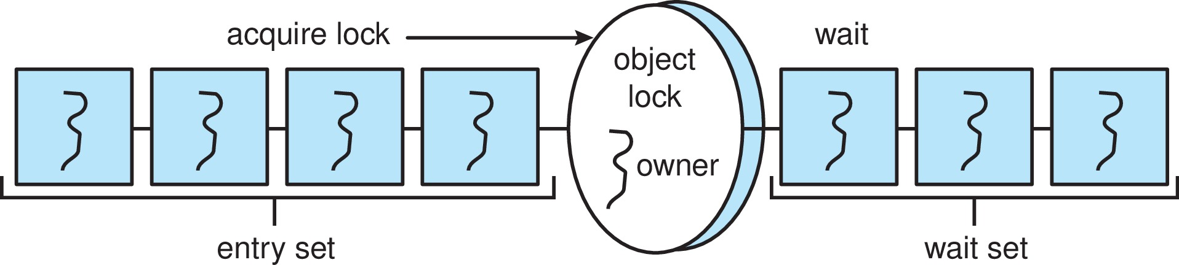
Java Synchronization
Similarly, each object also has a wait set.
When a thread calls wait():
It releases the lock for the object
The state of the thread is set to blocked
The thread is placed in the wait set for the object

Slide 32
Java Synchronization
A thread typically calls wait() when it is waiting for a condition to become true.
How does a thread get notified?
When a thread calls notify():
An arbitrary thread T is selected from the wait set
T is moved from the wait set to the entry set
Set the state of T from blocked to runnable.
T can now compete for the lock to check if the condition it was waiting for is now true.

Slide 33
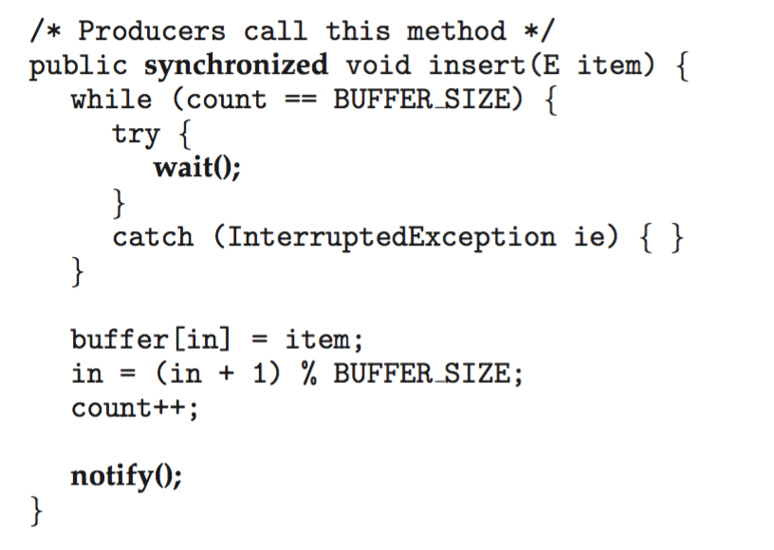
Bounded Buffer – Java Synchronization

Slide 34
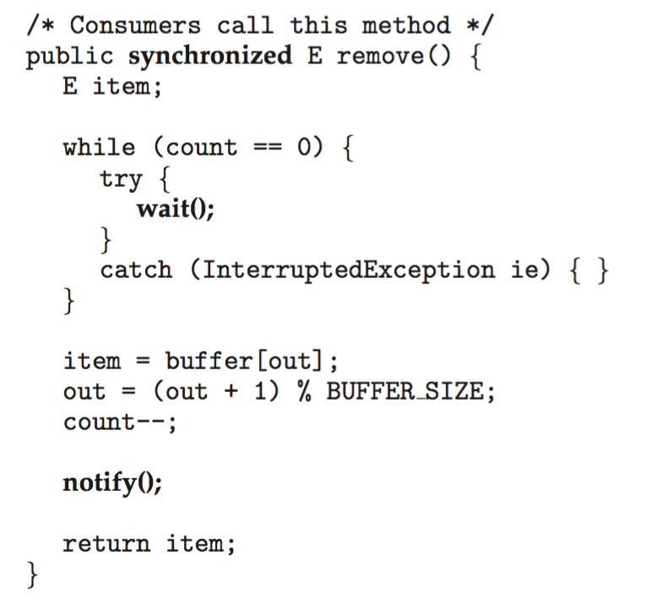
Bounded Buffer – Java Synchronization

Slide 35
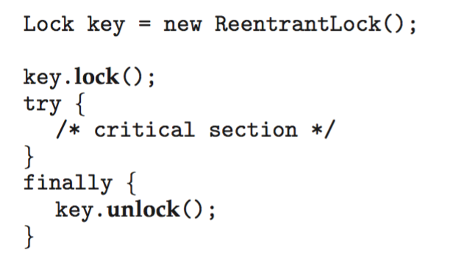
Java Reentrant Locks
Similar to mutex locks
The finally clause ensures the lock will be released in case an exception occurs in the try block.

Slide 36

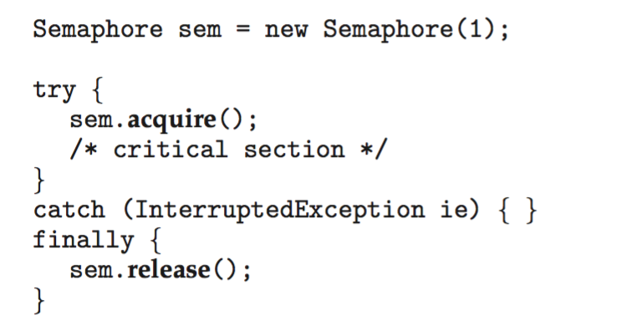
Java Semaphores
Constructor:
Usage:

Slide 37

Java Condition Variables
Condition variables are associated with an ReentrantLock.
Creating a condition variable using newCondition() method of ReentrantLock:
A thread waits by calling the await() method, and signals by calling the signal() method.

Slide 38
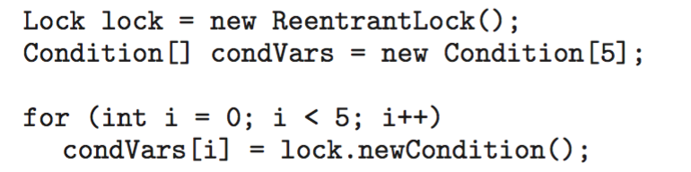
Java Condition Variables
Example:
Five threads numbered 0 .. 4
Shared variable turn indicating which thread’s turn it is.
Thread calls doWork() when it wishes to do some work. (But it may only do work if it is their turn.
If not their turn, wait
If their turn, do some work for awhile …...
When completed, notify the thread whose turn is next.
Necessary data structures:

Slide 39
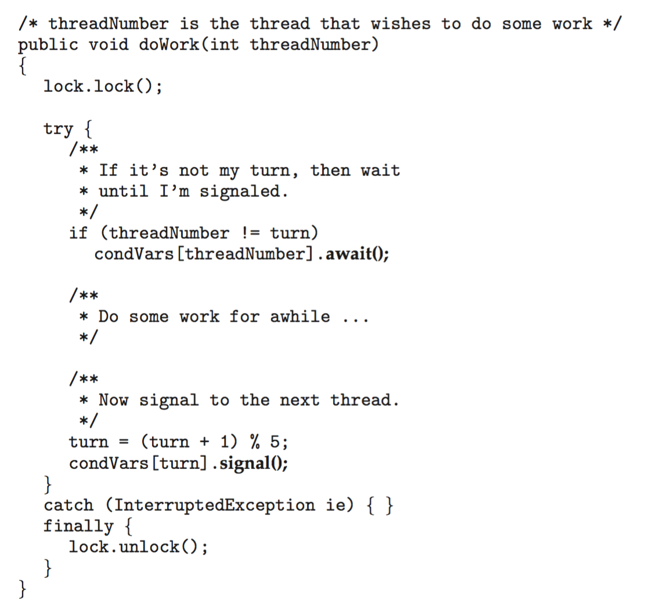
Java Condition Variables

Slide 40
Alternative Approaches
Transactional Memory
OpenMP
Functional Programming Languages

Slide 41
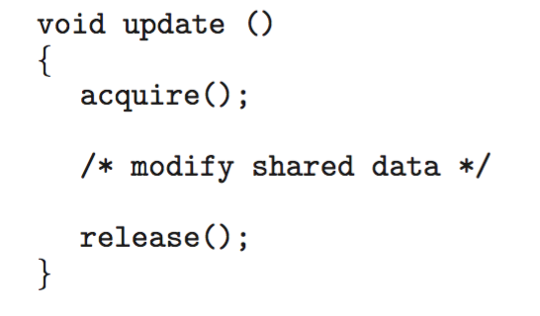
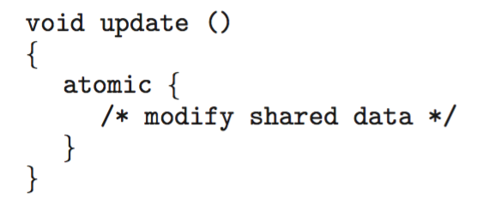
Transactional Memory
Consider a function update() that must be called atomically. One option is to use mutex locks:
A memory transaction is a sequence of read-write operations to memory that are performed atomically. A transaction can be completed by adding atomic{S} which ensure statements in S are executed atomically:

Slide 42
OpenMP
OpenMP is a set of compiler directives and API that support parallel programming.
void update(int value)
{
#pragma omp critical
{
count += value
}
}
The code contained within the #pragma omp critical directive is treated as a critical section and performed atomically.

Slide 43
Functional Programming Languages
Functional programming languages offer a different paradigm than procedural languages in that they do not maintain state.
Variables are treated as immutable and cannot change state once they have been assigned a value.
There is increasing interest in functional languages such as Erlang and Scala for their approach in handling data races.

Slide 44
Summary
Classic problems of process synchronization include the bounded-buffer, readers–writers, and dining-philosophers problems. Solutions to these problems can be developed using the tools presented in Chapter 6, including mutex locks, semaphores, monitors, and condition variables.
Windows uses dispatcher objects as well as events to implement process synchronization tools.
Linux uses a variety of approaches to protect against race conditions, including atomic variables, spinlocks, and mutex locks.
The POSIX API provides mutex locks, semaphores, and condition variables. POSIX provides two forms of semaphores: named and unnamed. Several unrelated processes can easily access the same named semaphore by sim- ply referring to its name. Unnamed semaphores cannot be shared as easily, and require placing the semaphore in a region of shared memory.

Slide 45
Summary (Cont.)
Java has a rich library and API for synchronization. Available tools include monitors (which are provided at the language level) as well as reentrant locks, semaphores, and condition variables (which are supported by the API).
Alternative approaches to solving the critical-section problem include transactional memory, OpenMP, and functional languages. Functional languages are particularly intriguing, as they offer a different programming paradigm from procedural languages. Unlike procedural languages, functional languages do not maintain state and therefore are generally immune from race conditions and critical sections.

Slide 46
End of Chapter 7

