Slide 1
Chapter 6: Synchronization Tools

Slide 2
Chapter 6: Outline
Background
The Critical-Section Problem
Peterson’s Solution
Hardware Support for Synchronization
Mutex Locks
Semaphores
Monitors
Liveness
Evaluation

Slide 3
Objectives
Describe the critical-section problem and illustrate a race condition
Illustrate hardware solutions to the critical-section problem using memory barriers, compare-and-swap operations, and atomic variables
Demonstrate how mutex locks, semaphores, monitors, and condition variables can be used to solve the critical-section problem
Evaluate tools that solve the critical-section problem in low-, moderate-, and high-contention scenarios

Slide 4
Background
Processes can execute concurrently (or in parallel)
May be interrupted at any time, partially completing execution
Concurrent access to shared data may result in data inconsistency
Maintaining data consistency requires mechanisms to ensure the orderly execution of cooperating processes
Illustration of the problem:
Suppose that we wanted to provide a solution to the consumer-producer problem that fills all the buffers. We can do so by having an integer counter that keeps track of the number of full buffers. Initially, counter is set to 0. It is incremented by the producer after it adds a new item to the buffer and is decremented by the consumer after it consumes an item from the buffer
#define BUFFER_SIZE 8 /* 8 buffers */
typedef struct { . . .
} item;
item buffer[BUFFER_SIZE];
int in = 0;
int out = 0;
int counter = 0;

Slide 5
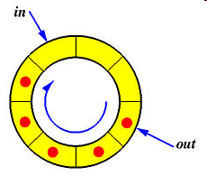
Producer
while (true) {
/* produce an item in next produced */
while (counter == BUFFER_SIZE)
; /* do nothing */
buffer[in] = next_produced;
in = (in + 1) % BUFFER_SIZE; /* pointer in to buffer */
counter++;
}

Slide 6
Consumer
while (true) {
while (counter == 0)
; /* do nothing */
next_consumed = buffer[out];
out = (out + 1) % BUFFER_SIZE;/* pointer out from buffer */
counter--;
/* consume the item in next_consumed */
}

Slide 7
Race Condition
counter++; could be implemented as register1 = counter register1 = register1 + 1 counter = register1
counter--; could be implemented as register2 = counter register2 = register2 - 1 counter = register2
Consider this execution interleaving with “counter = 5” initially:
S0: producer execute register1 = counter {register1 = 5}
S1: producer execute register1 = register1 + 1 {register1 = 6}
S2: consumer execute register2 = counter {register2 = 5}
S3: consumer execute register2 = register2 – 1 {register2 = 4}
S4: producer execute counter = register1 {counter = 6 }
S5: consumer execute counter = register2 {counter = 4}
=> Data inconsistency

Slide 8
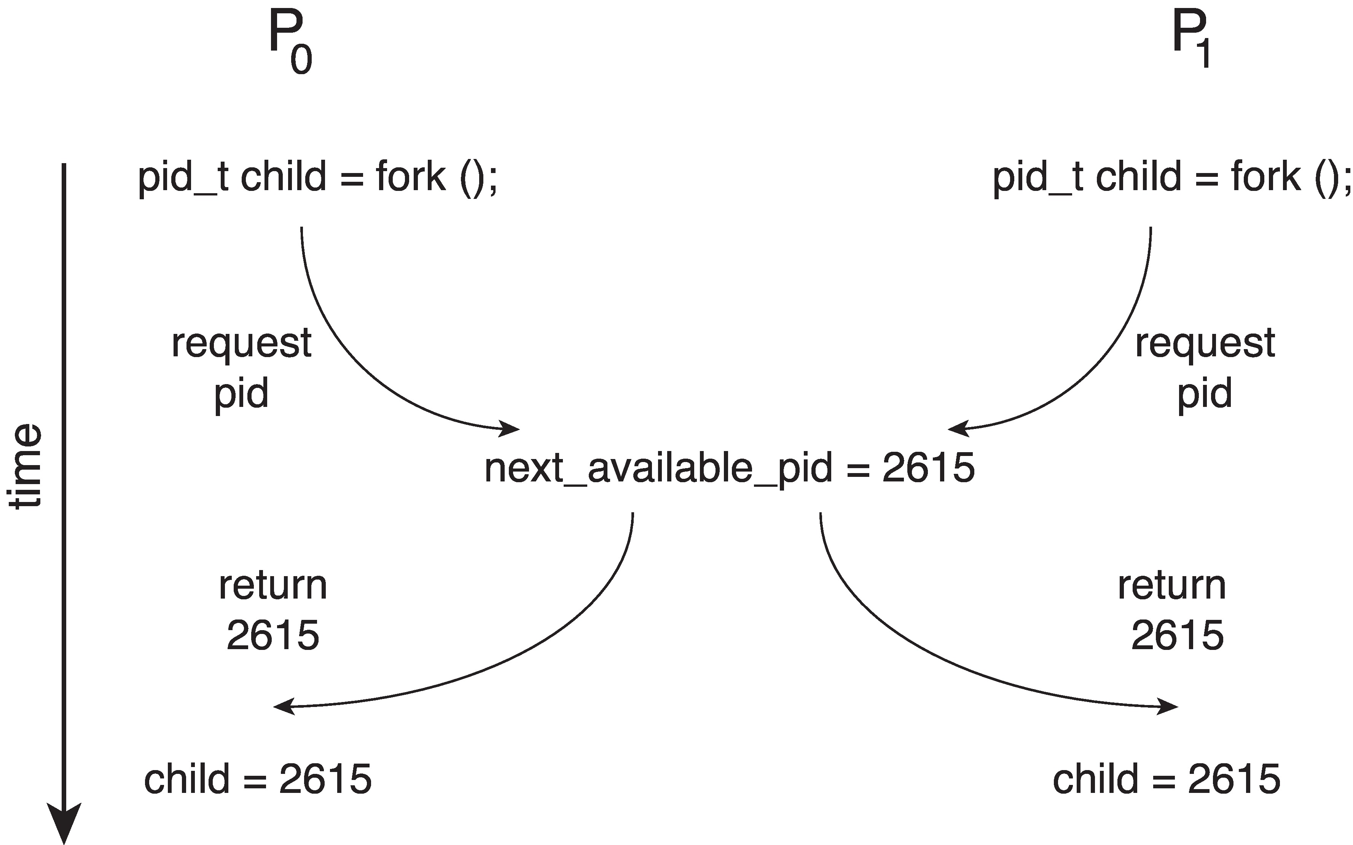
Race Condition (Cont.)
Processes P₀ and P₁ are creating child processes using the fork() system call
Race condition on kernel variable next_available_pid which represents the next available process identifier (pid)
Unless there is mutual exclusion, the same pid could be assigned to two different processes!

Slide 9
Critical-Section Problem
Consider system of n processes {P₀, P₁, … P_{n-1}}
Each process has critical section (i.e., segment of code)
Process may be changing common variables, updating table, writing file, etc.
When one process in critical section, no other may be in its critical section
Critical-section problem needs to design a protocol to solve this
Each process must
ask permission to enter critical section in entry section,
may follow critical section with exit section,
then remainder section
do {
entry section
critical section
exit section
remainder section
} while(true);

Slide 10
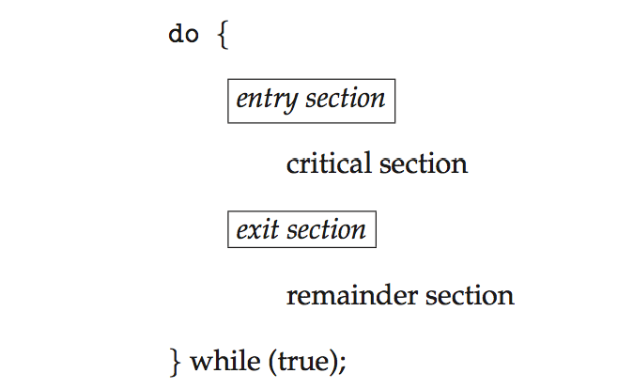
Critical Section (CS)
General structure of the process P_{i}

Slide 11
Solution to Critical-Section Problem
Mutual Exclusion – If process P_{i} is executing in its critical section, then no other processes can be executing in their critical sections
Progress – If no process is executing in its critical section and there exist some processes that wish to enter their critical section, then the selection of process that will enter the critical section next cannot be postponed indefinitely
Bounded Waiting – A bound must exist on the number of times that other processes are allowed to enter their critical sections after a process has made a request to enter its critical section and before that request is granted
Assume that each process executes at a nonzero speed
No assumption concerning relative speed of the n processes

Slide 12
Critical-Section Handling in OS
Two approaches depending on if kernel is preemptive or non- preemptive
Preemptive – allows preemption of process when running in kernel mode
Non-preemptive – runs until exits kernel mode, blocks, or voluntarily yields CPU
Essentially free of race conditions in kernel mode

Slide 13
Proposal solution 1 (1/2)
Shared variable
int turn; /* initialize turn = 0 */
If turn = i then P_{i} is permitted to enter CS
Process P_{i}
do {
while (turn != i);
critical section
turn = j;
remainder section
} while (1);

Slide 14
Proposal solution 1 (2/2)
Process P0
do {
while (turn != 0);
critical section
turn := 1;
remainder section
} while (1);
Process P1
do {
while (turn != 1);
critical section
turn := 0;
remainder section
} while (1);
Achievemutual exclusion (1),
Violate condition of progress (2).

Slide 15
Proposal solution 2 (1/2)
Shared variable
boolean flag[ 2 ]; /* initialize flag[0] = flag[1] = false */
flag[i] = true notice that P_{i} want to enter CS
Process P_{i}
do {
flag[ i ] = true;
while (flag[ j ]);
critical section
flag[ i ] = false;
remainder section
} while (1);
Achievemutual exclusion (1),
Violate condition of progress (2).

Slide 16
Proposal solution 2 (2/2)
Process P₀
do {
flag[ 0 ] = true;
while (flag[ 1 ]);
critical section
flag[ 0 ] = false;
remainder section
} while (1);
Process P₁
do {
flag[ 1 ] = true;
while (flag[ 0 ]);
critical section
flag[ 1 ] = false;
remainder section
} while (1);
Achievemutual exclusion (1),
Violate condition of progress (2).

Slide 17
Peterson’s Solution
Not guaranteed to work on modern architectures!
(But good algorithmic description of solving the problem)
Two-processes solution
Assume that the load and store machine-language instructions are atomic; that is, it cannot be interrupted
The two processes share two variables:
int turn;
boolean flag[i]
The variable turn indicates whose turn it is to enter the critical section
The flag[] array is used to indicate if a process is ready to enter the critical section
flag[i] = true implies that process P_{i} is ready!

Slide 18
Algorithm for Process P_{i}
while (true){
flag[i] = true;
turn = j;
while (flag[j] && turn == j)
; /* do nothing */
/* critical section */
flag[i] = false;
/* remainder section */
}

Slide 19
Peterson’s Solution (Cont.)
Provable that the three CS requirement are met:
Mutual exclusion is preserved
P_{i} enters CS only if: either flag[j] = false or turn = i
Progress requirement is satisfied
Bounded-waiting requirement is met

Slide 20
Remarks on Peterson’s Solution
Although useful for demonstrating an algorithm, Peterson’s Solution is not guaranteed to work on modern architectures
Understanding why it will not work is also useful for better understanding race conditions
To improve performance, processors and/or compilers may reorder operations that have no dependencies
For single-threaded, this is ok as the result will always be the same.
For multithreaded, the reordering may produce inconsistent or unexpected results!

Slide 21
Example of Peterson’s Solution
Two threads share the data:
boolean flag = false; int x = 0;
Thread 1 performs
while (!flag) ; print x
Thread 2 performs
x = 100; flag = true
What is the expected output?

Slide 22
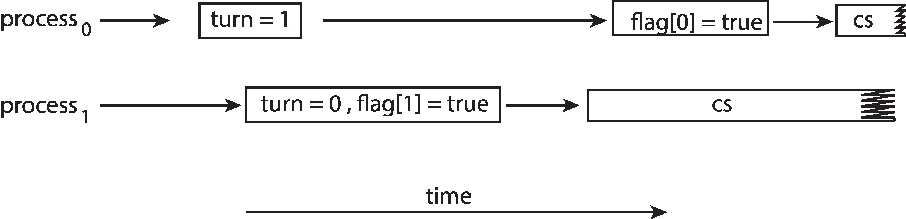
Example of Peterson’s Solution
100 is the expected output.
However, the operations for Thread 2 may be reordered:
flag = true; x = 100;
If this occurs, the output may be 0!
The effects of instruction reordering in Peterson’s Solution
This allows both processes to be in their critical section at the same time!

Slide 23
Synchronization Hardware
Many systems provide hardware support for implementing the critical-section code.
Uniprocessors – could disable interrupts
Currently running code would execute without preemption
Generally too inefficient on multiprocessor systems
Operating systems using this are not broadly scalable
We will look at three forms of hardware support:
Memory barriers
Hardware instructions
Atomic variables

Slide 24
Memory Barriers
Memory model is the memory guarantee that a computer architecture makes to application programs.
Memory models may be either:
Strongly ordered – where a memory modification of one processor is immediately visible to all other processors.
Weakly ordered – where a memory modification of one processor may not be immediately visible to all other processors.
A memory barrier is an instruction that forces any change in memory to be propagated (made visible) to all other processors.

Slide 25
Example of Memory Barrier
We could add a memory barrier to the following instructions to ensure Thread 1 outputs 100:
Thread 1 now performs
while (!flag) memory_barrier(); print x;
Thread 2 now performs
x = 100; memory_barrier(); flag = true;

Slide 26
Hardware Instructions
Special hardware instructions that allow us to either test-and-modify the content of a word, or to swap the contents of two words atomically (uninterruptedly.)
Test-and-Set() instruction
Compare-and-Swap() instruction

Slide 27
test_and_set Instruction
Definition:
boolean test_and_set(boolean *target)
{
boolean rv = *target;
*target = true;
return rv:
}
Executed atomically
Returns the original value of passed parameter (i.e., *target)
Set the new value of passed parameter to true (i.e., *target=true)

Slide 28
Solution using test_and_set()
Shared Boolean variable lock, initialized to false
Solution:
do { while (test_and_set(&lock))
; /* do nothing */
/* critical section */
lock = false;
/* remainder section */
} while (true);

Slide 29
compare_and_swap Instruction
Definition:
int compare_and_swap(int *value, int expected,
int new_value) {
int temp = *value;
if (*value == expected)
*value = new_value;
return temp;
}
Executed atomically
Returns the original value of passed parameter value
Set the variable value the value of the passed parameter new_value but only if *value == expected is true. That is, the swap takes place only under this condition.

Slide 30
Solution using compare_and_swap
Shared integer lock initialized to 0;
Solution:
while (true){ while (compare_and_swap(&lock, 0, 1) != 0)
; /* do nothing */
/* critical section */
lock = 0;
/* remainder section */
}

Slide 31
Bounded-waiting Mutual Exclusion with compare-and-swap
while (true) { waiting[i] = true; key = 1; while (waiting[i] && key == 1)
key = compare_and_swap(&lock,0,1);
waiting[i] = false;
/* critical section */
j = (i + 1) % n;
while ((j != i) && !waiting[j])
j = (j + 1) % n;
if (j == i)
lock = 0;
else
waiting[j] = false;
/* remainder section */
}

Slide 32
Atomic Variables
Typically, instructions such as compare-and-swap are used as building blocks for other synchronization tools.
One tool is an atomic variable that provides atomic (uninterruptible) updates on basic data types such as Integers and Booleans.
For example, the increment() operation on the atomic variable sequence ensures sequence is incremented without interruption:
increment(&sequence);

Slide 33
Atomic Variables (Cont.)
The increment() function can be implemented as follows:
void increment(atomic_int *v) { int temp; do { temp = *v; } while
(temp != compare_and_swap(v,temp,temp+1));
}

Slide 34
Mutex Locks
Previous solutions are complicated and generally inaccessible to application programmers
OS designers build software tools to solve critical section problem
Simplest is mutex lock
Protect a critical section by first acquire() a lock then release() the lock
Boolean variable indicating if lock is available or not
Calls to acquire() and release() must be atomic
Usually implemented via hardware atomic instructions such as compare-and-swap
But this solution requires busy waiting
This lock therefore called a spinlock

Slide 35
Solution to Critical-section Problem using Locks
while (true) {
acquire lock;
critical section;
release lock;
remainder section;
}

Slide 36
Mutex Lock Definitions
acquire() { while (!available)
; /* busy wait */
available = false;;
}
release() {
available = true;
}
These two functions must be implemented atomically
Both test-and-set and compare-and-swap can be used to implement these functions

Slide 37
Semaphore
Synchronization tool that provides more sophisticated ways (than mutex locks) for process to synchronize their activities.
Semaphore S is an integer variable
Can only be accessed via two indivisible (atomic) operations
wait() and signal()
(Originally called P() and V())
Definition of the wait() operation
wait(S) {
while (S <= 0)
; // busy wait
S--;
}
Definition of the signal() operation
signal(S) {
S++;
}

Slide 38
Semaphore Usage
Counting semaphore – integer value can range over an unrestricted domain
Binary semaphore – integer value can range only between 0 and 1
Same as a mutex lock
Can solve various synchronization problems
Can implement a counting semaphore S as a binary semaphore
Consider P₁ and P₂ that require S₁ to happen before S₂
Create a semaphore “synch” initialized to 0
P1:
S₁;
signal(synch);
P2:
wait(synch);
S₂;

Slide 39
Semaphore Implementation
Must guarantee that no two processes can execute the wait() and signal() on the same semaphore at the same time
Thus, the implementation becomes the critical-section problem where the wait() and signal() code are placed in the critical section
Could now have busy waiting in critical-section implementation
But implementation code is short
Little busy waiting if critical section rarely occupied
Note that applications may spend lots of time in critical sections and therefore this is not a good solution

Slide 40
Semaphore Implementation with no Busy waiting
With each semaphore there is an associated waiting queue
Each entry in a waiting queue has two data items:
value (of type integer)
pointer to next record in the list
Two operations:
block – place the process invoking the operation on the appropriate waiting queue
wakeup – remove one of processes in the waiting queue and place it in the ready queue
typedef struct {
int value;
struct process *list;
} semaphore;

Slide 41
Implementation with no Busy waiting (Cont.)
wait(semaphore *S) {
S->value--;
if (S->value < 0) { add this process to S->list;
block();
}
}
signal(semaphore *S) {
S->value++;
if (S->value <= 0) { remove a process P from S->list;
wakeup(P);
}
}

Slide 42
Problems with Semaphores
Incorrect use of semaphore operations:
signal(mutex) …. wait(mutex)
wait(mutex) … signal(mutex)
Omitting of wait(mutex) and/or signal(mutex)
These – and others – are examples of what can occur when semaphores and other synchronization tools are used incorrectly.

Slide 43
Monitors
A high-level abstraction that provides a convenient and effective mechanism for process synchronization
Abstract data type, internal variables only accessible by code within the procedure
Only one process may be active within the monitor at a time
Pseudocode syntax of a monitor:
monitor monitor-name
{
// shared variable declarations
function P1 (…) { …. }
function P2 (…) { …. }
function Pn (…) {……}
initialization code (…) { … }
}

Slide 44
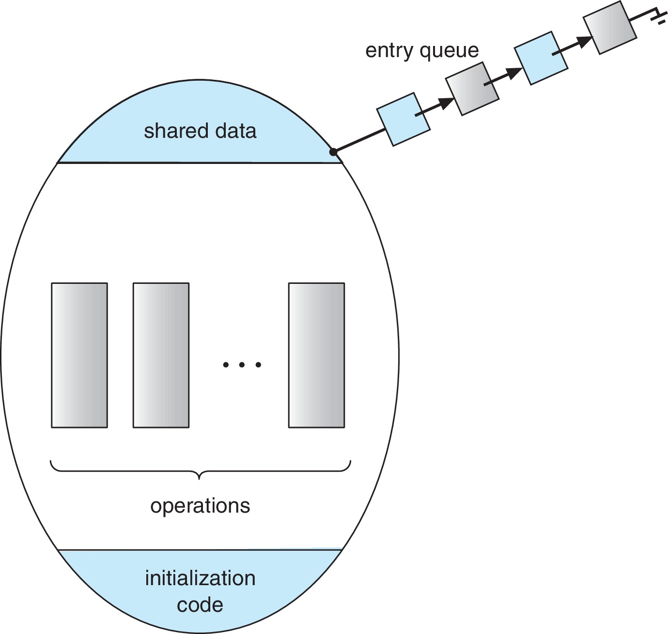
Schematic View of a Monitor

Slide 45
Condition Variables
condition x, y;
Two operations are allowed on a condition variable:
x.wait() – a process that invokes the operation is suspended until x.signal()
x.signal() – resumes one of processes (if any) that invoked x.wait()
If no x.wait() on the variable, then it has no effect on the variable

Slide 46
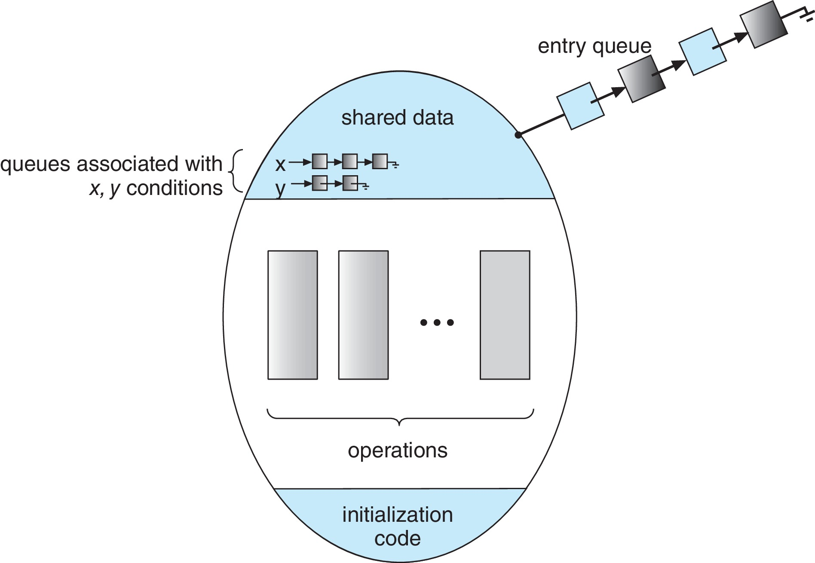
Monitor with Condition Variables

Slide 47
Condition Variables Choices
If process P invokes x.signal(), and process Q is suspended in x.wait(), what should happen next?
Both Q and P can’t execute in parallel. If Q is resumed, then P must wait
Options include
Signal and wait – P waits until Q either leaves the monitor or it waits for another condition
Signal and continue – Q waits until P either leaves the monitor or it waits for another condition
Both have pros and cons – language implementer can decide
Monitors implemented in Concurrent Pascal compromise
P executing signal immediately leaves the monitor, Q is resumed
Implemented in other languages: Mesa, C#, Java

Slide 48
Monitor Implementation using Semaphores
Variables
semaphore mutex; /*(initially = 1)*/
semaphore next; /*(initially = 0)*/
int next_count = 0;
Each function F will be replaced by
wait(mutex);
…
body of F;
…
if (next_count > 0)
signal(next)
else
signal(mutex);
Mutual exclusion within a monitor is ensured

Slide 49
Monitor Implementation – Condition Variables
For each condition variable x, we have:
semaphore x_sem; /*(initially = 0)*/
int x_count = 0;
The operation x.wait() can be implemented as:
x_count++;
if (next_count > 0)
signal(next);
else
signal(mutex);
wait(x_sem);
x_count--;

Slide 50
Monitor Implementation (Cont.)
The operation x.signal() can be implemented as:
if (x_count > 0) {
next_count++;
signal(x_sem);
wait(next);
next_count--;
}

Slide 51
Resuming Processes within a Monitor
If several processes queued on condition variable x, and x.signal() is executed, which process should be resumed?
FCFS frequently not adequate
conditional-wait construct of the form x.wait(c)
Where c is priority number
Process with lowest number (highest priority) is scheduled next

Slide 52
Single Resource allocation
Allocate a single resource among competing processes using priority numbers that specify the maximum time a process plans to use the resource
R.acquire(t);
...
access the resurce;
...
R.release;
Where R is an instance of type ResourceAllocator

Slide 53
A Monitor to Allocate Single Resource
monitor ResourceAllocator {
boolean busy;
condition x;
void acquire(int time) {
if (busy)
x.wait(time);
busy = true;
}
void release() {
busy = FALSE;
x.signal();
}
initialization code() {
busy = false;
}
}

Slide 54
Liveness
Processes may have to wait indefinitely while trying to acquire a synchronization tool such as a mutex lock or semaphore
Waiting indefinitely violates the progress and bounded-waiting criteria discussed at the beginning of this chapter
Liveness refers to a set of properties that a system must satisfy to ensure processes make progress
Indefinite waiting is an example of a liveness failure

Slide 55
Liveness (Cont.)
Deadlock – two or more processes are waiting indefinitely for an event that can be caused by only one of the waiting processes
Let S and Q be two semaphores initialized to 1
P₀ P₁
wait(S); wait(Q);
wait(Q); wait(S);
... ...
signal(S); signal(Q);
signal(Q); signal(S);
Consider if P₀ executes wait(S) and P₁ wait(Q). When P₀ executes wait(Q), it must wait until P₁ executes signal(Q)
However, P₁ is waiting until P₀ execute signal(S)
Since these signal() operations will never be executed, P₀ and P₁ are deadlocked

Slide 56
Liveness (Cont.)
Other forms of deadlock:
Starvation – indefinite blocking
A process may never be removed from the semaphore queue in which it is suspended
Priority Inversion – Scheduling problem when lower-priority process holds a lock needed by higher-priority process
Solved via priority-inheritance protocol

Slide 57
Priority Inheritance Protocol
Consider the scenario with three processes P₁, P₂, and P₃.
P₁ has the highest priority, P₂ the next highest, and P₃ the lowest.
Assume a resource P₃ is assigned a resource R that P₁ wants. Thus, P₁ must wait for P₃ to finish using the resource.
However, P₂ becomes runnable and preempts P₃.
What has happened is that P₂ - a process with a lower priority than P₁ - has indirectly prevented P₃ from gaining access to the resource.
To prevent this from occurring, a priority inheritance protocol is used.
This simply allows the priority of the highest thread waiting to access a shared resource to be assigned to the thread currently using the resource.
Thus, the current owner of the resource is assigned the priority of the highest priority thread wishing to acquire the resource.

Slide 58
Summary
A race condition occurs when processes have concurrent access to shared data and the final result depends on the particular order in which concurrent accesses occur. Race conditions can result in corrupted values of shared data.
A critical section is a section of code where shared data may be manipulated and a possible race condition may occur. The critical-section problem is to design a protocol whereby processes can synchronize their activity to cooperatively share data.
A solution to the critical-section problem must satisfy the following three requirements: (1) mutual exclusion, (2) progress, and (3) bounded waiting. Mutual exclusion ensures that only one process at a time is active in its critical section. Progress ensures that programs will cooperatively determine what process will next enter its critical section. Bounded waiting limits how much time a program will wait before it can enter its critical section.

Slide 59
Summary (Cont.)
Software solutions to the critical-section problem, such as Peterson’s solution, do not work well on modern computer architectures.
Hardware support for the critical-section problem includes memory barriers; hardware instructions, such as the compare-and-swap instruction; and atomic variables.
A mutex lock provides mutual exclusion by requiring that a process acquire a lock before entering a critical section and release the lock on exiting the critical section.
Semaphores, like mutex locks, can be used to provide mutual exclusion. However, whereas a mutex lock has a binary value that indicates if the lock is available or not, a semaphore has an integer value and can therefore be used to solve a variety of synchronization problems.

Slide 60
Summary (Cont.)
A monitor is an abstract data type that provides a high-level form of process synchronization. A monitor uses condition variables that allow processes to wait for certain conditions to become true and to signal one another when conditions have been set to true.
Solutions to the critical-section problem may suffer from liveness problems, including deadlock.
The various tools that can be used to solve the critical-section problem as well as to synchronize the activity of processes can be evaluated under varying levels of contention. Some tools work better under certain contention loads than others.

Slide 61
End of Chapter 6

