Slide 1
Chapter 11
File system

Slide 2
Chapter’s Content
File Concept
Access Methods
Directory Structure
File System Mounting
File Sharing
Protection

Slide 3
File Concept
File with a name is a collection of related information on secondary storage
A smallest portion of logical storage.
Contiguous logical address space
Types of information in a file:
Data
numeric
character
binary
Program

Slide 4
File Attributes
Name – only information kept in human-readable form.
Type – needed for systems that support different types.
Location – pointer to file location on device.
Size – current file size.
Protection – controls who can do reading, writing, executing.
Time, date, and user identification – data for protection, security, and usage monitoring.
Information about files are kept in the directory structure, which is maintained on the disk.

Slide 5
File Operations
A file is an abstract data type, so that operations can be done on file:
Create: search for space; new entry for the file
Write: file name; file write pointer
Read : file name; file read pointer
Reposition within file – file seek
Delete
Truncate: erase the content of file.
Open(F_{i}) – search the directory structure on disk for entry F_{i}, and move the content of entry to memory.
Close (F_{i}) – move the content of entry F_{i} in memory to directory structure on disk.

Slide 6
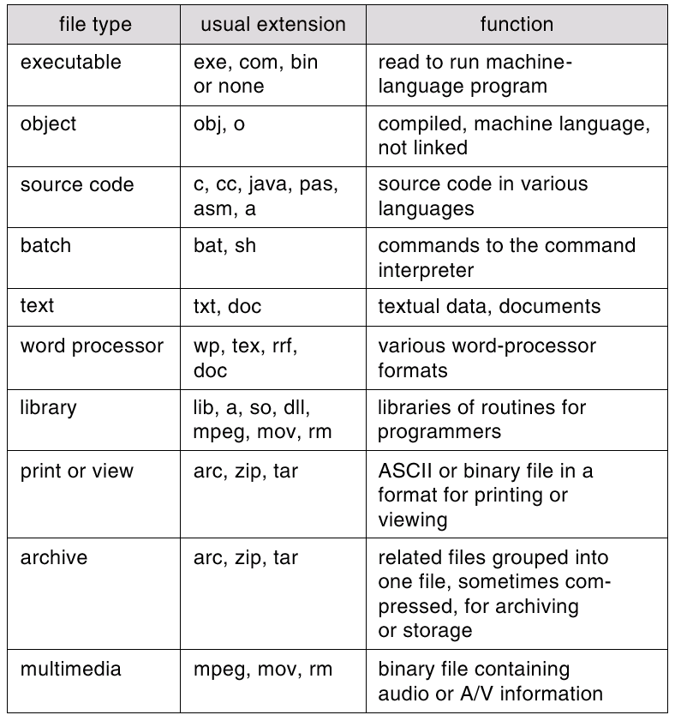
File Types – Name, Extension

Slide 7
File Structure
None - sequence of words, bytes
Simple record structure
Lines
Fixed length
Variable length
Complex Structures
Formatted document
Relocatable load file
Can simulate last two with first method by inserting appropriate control characters.
Who decides:
Operating system
Program

Slide 8
Access Methods
Sequential Access
read next
write next
reset
no read after last write
(rewrite)
Direct Access
read n
write n
position to n
read next
write next
rewrite n
n = relative block number

Slide 9
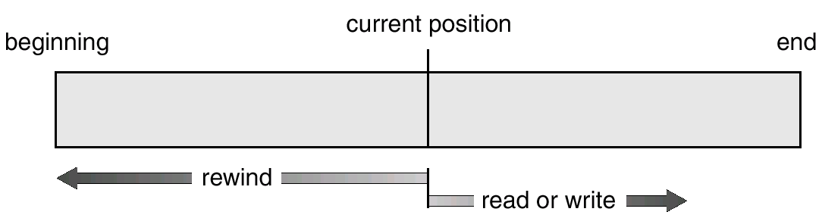
Sequential-access File

Slide 10
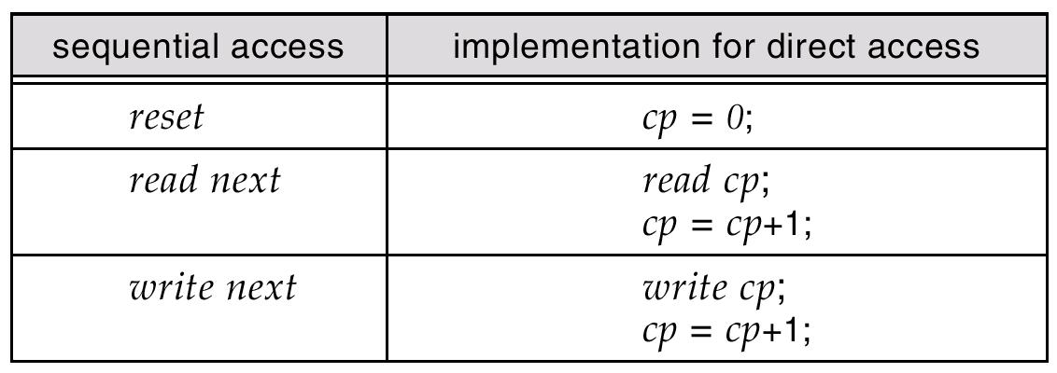
Simulation of Sequential Access on a Direct-access File

Slide 11
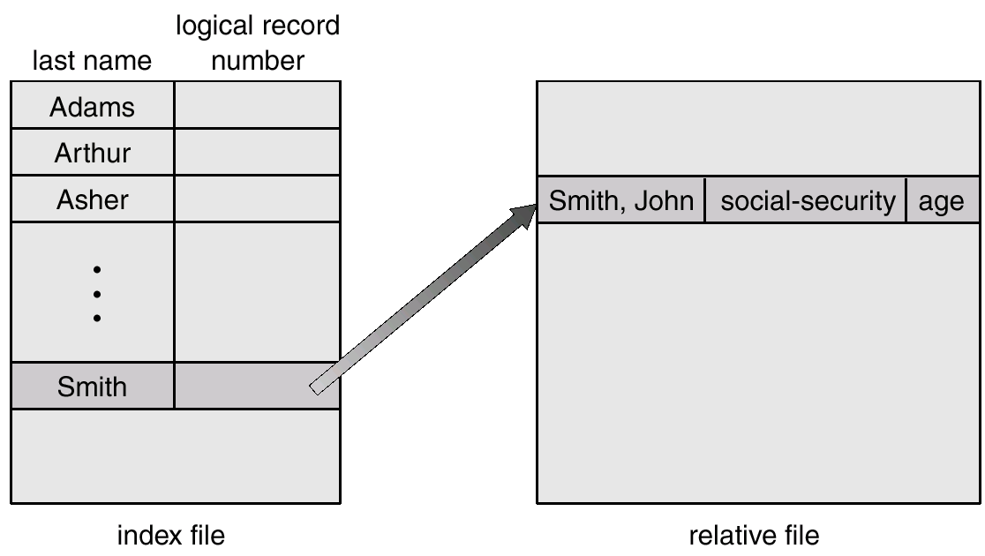
Other Access Methods
Example of Index and Relative Files

Slide 12
Directory Structure
A collection of nodes containing information about all files.
Directory
Files
F 1
F 2
F 3
F 4
F n
Both the directory structure and the files reside on disk.
Backups of these two structures are kept on tapes.

Slide 13
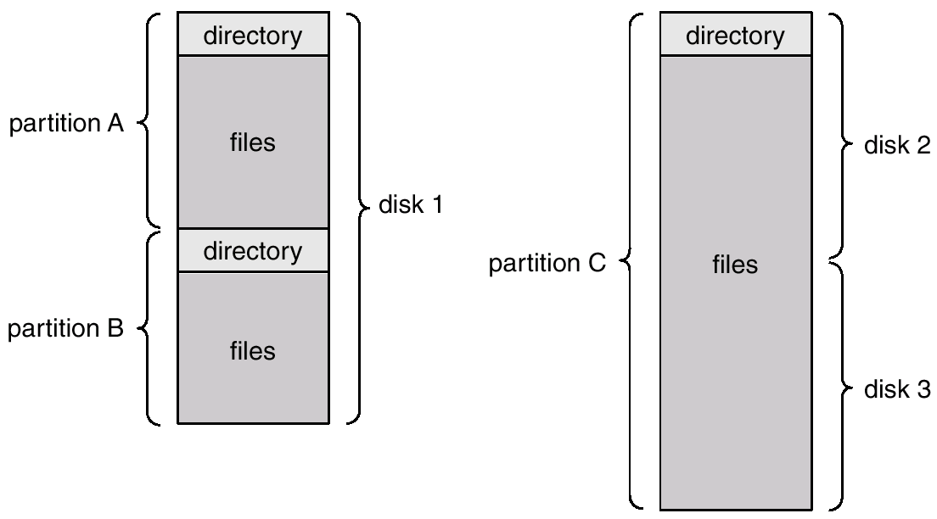
A Typical File-system Organization

Slide 14
Information in a Device Directory
Name
Type
Address
Current length
Maximum length
Date last accessed (for archival)
Date last updated (for dump)
Owner ID (who pays)
Protection information (discuss later)

Slide 15
Operations Performed on Directory
Search for a file
Create a file
Delete a file
List a directory
Rename a file
Traverse the file system

Slide 16
Main Purpose of File Directory
Efficiency – locating a file quickly.
Naming – convenient to users.
Two users can have same name for different files.
The same file can have several different names.
Grouping – logical grouping of files by properties, (e.g., all Java programs, all games, …)

Slide 17
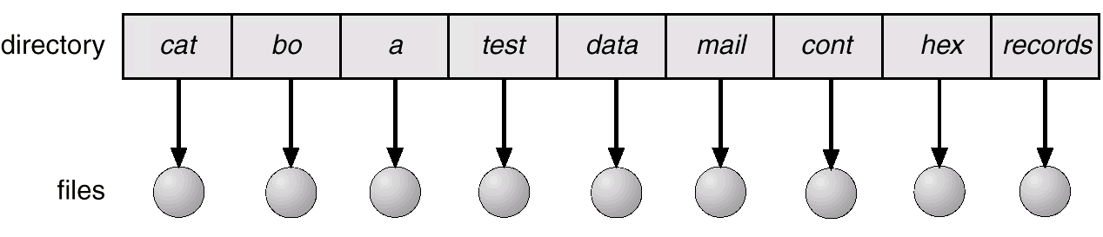
Single-Level Directory
A single directory for all users.
Naming problem
Grouping problem

Slide 18
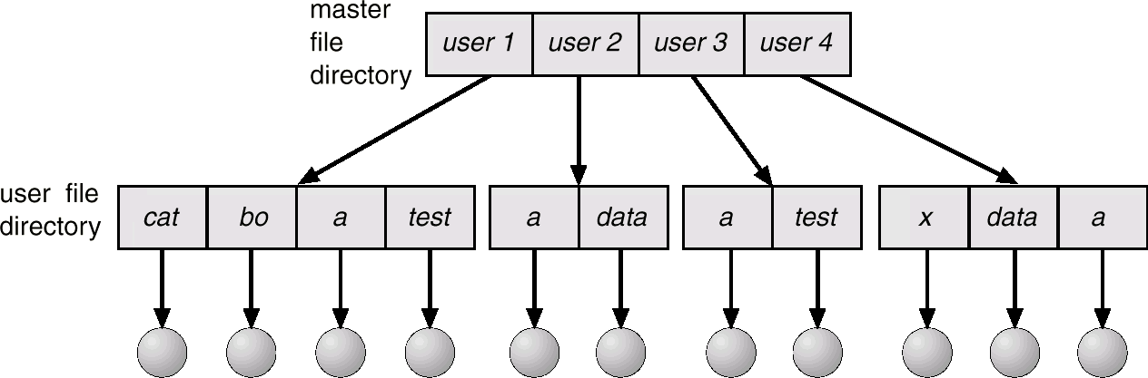
Two-Level Directory
Separate directory for each user.
Path name
Can have the same file name for different user
Efficient searching
No grouping capability

Slide 19
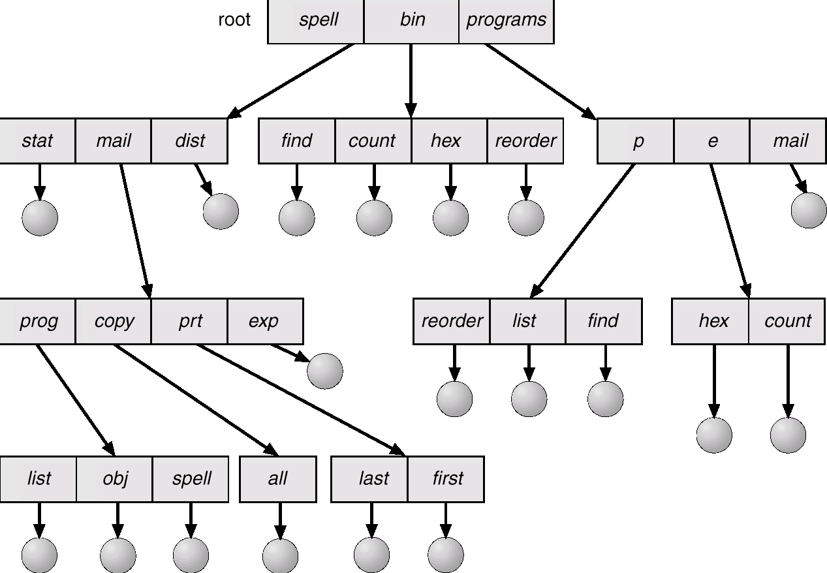
Tree-Structured Directories

Slide 20
Tree-Structured Directories (Cont.)
Efficient searching
Grouping Capability
Current directory (working directory)
cd /spell/mail/prog
type list

Slide 21
Tree-Structured Directories (Cont.)
Absolute or relative path name
Creating a new file is done in current directory.
Delete a file
rm <file-name>
Creating a new subdirectory is done in current directory.
mkdir <dir-name>
Example: if in current directory /mail
mkdir count
mail
prog
copy
prt
exp
count
Deleting “mail” ⇒ deleting the entire subtree rooted by “mail”.

Slide 22
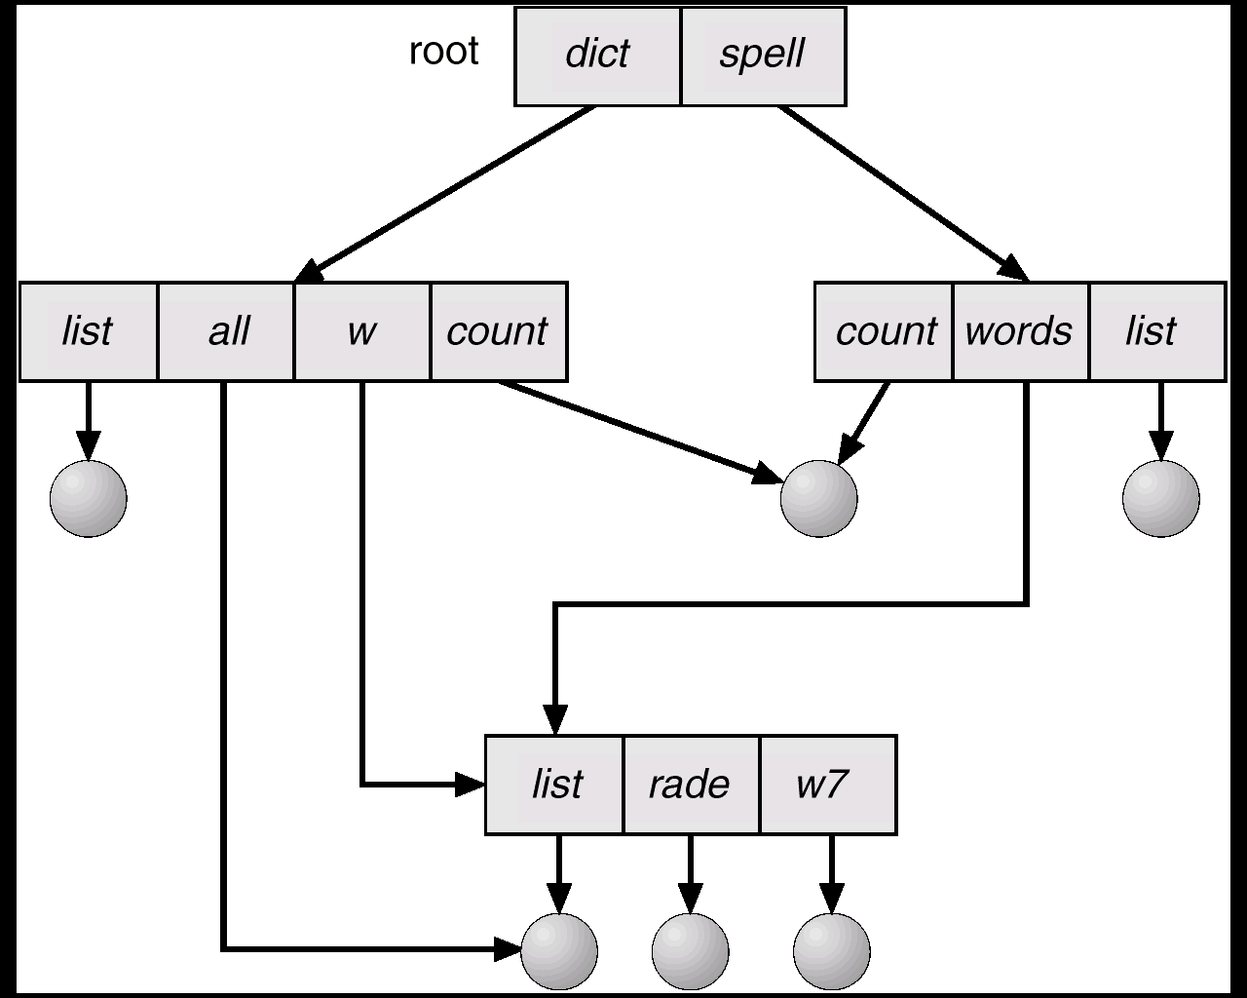
Acyclic-Graph Directories
Have shared subdirectories and files.

Slide 23
Acyclic-Graph Directories (Cont.)
Two different names (aliasing)
If dict deletes list ⇒ dangling pointer.
Solutions:
Backpointers, so we can delete all pointers. Variable size records a problem.
Backpointers using a daisy chain organization.
Entry-hold-count solution.

Slide 24
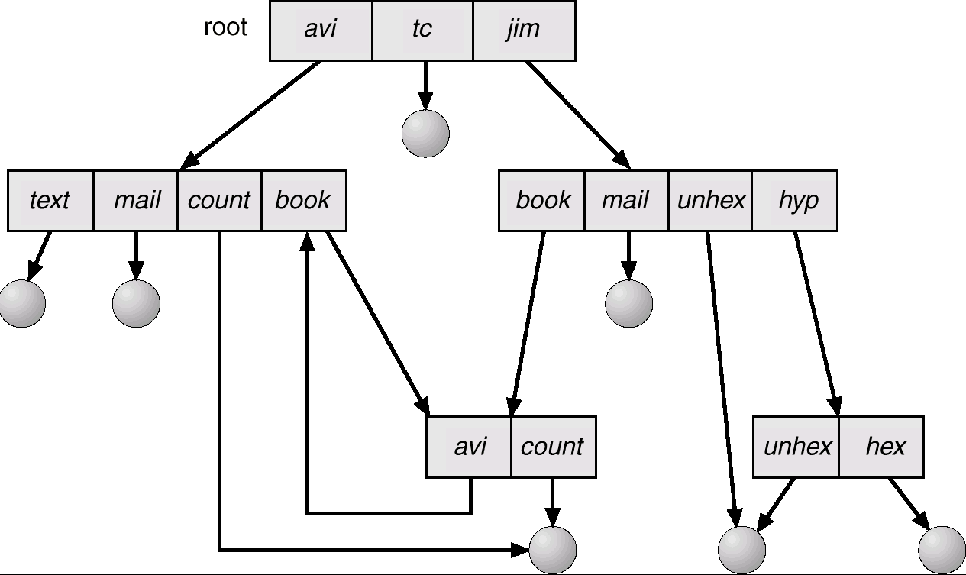
General Graph Directory

Slide 25
General Graph Directory (Cont.)
How do we guarantee no cycles?
Allow only links to file not subdirectories.
Garbage collection.
Every time a new link is added use a cycle detection algorithm to determine whether it is OK.

Slide 26
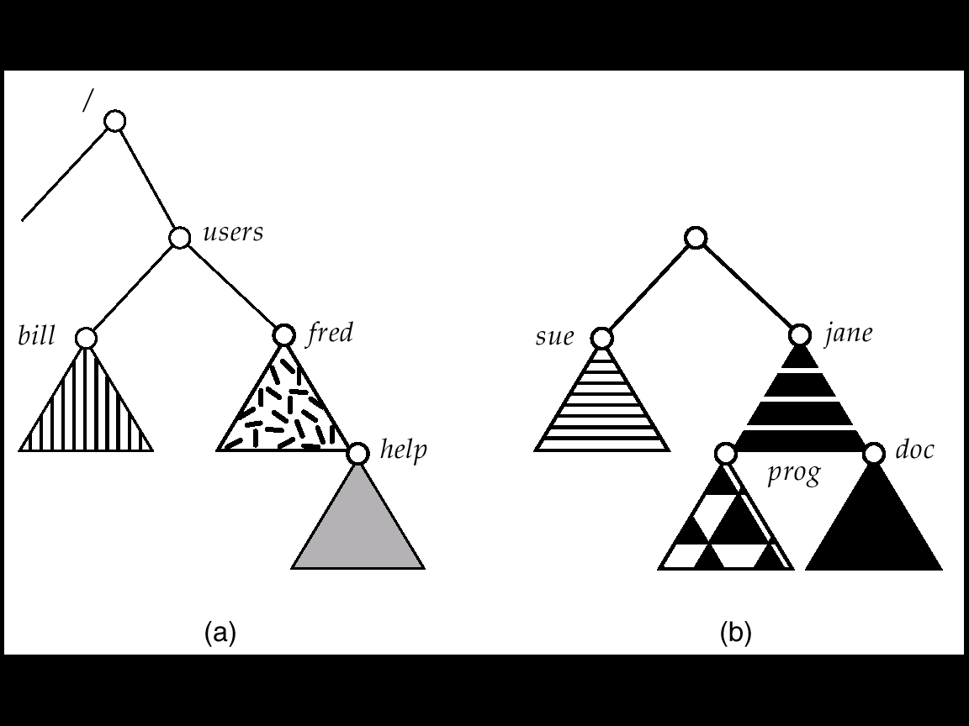
File System Mounting
A file system must be mounted before it can be accessed.
A unmounted file system (I.e. Fig. 11-11(b)) is mounted at a mount point.
(a) Existing.
(b) Unmounted Partition

Slide 27
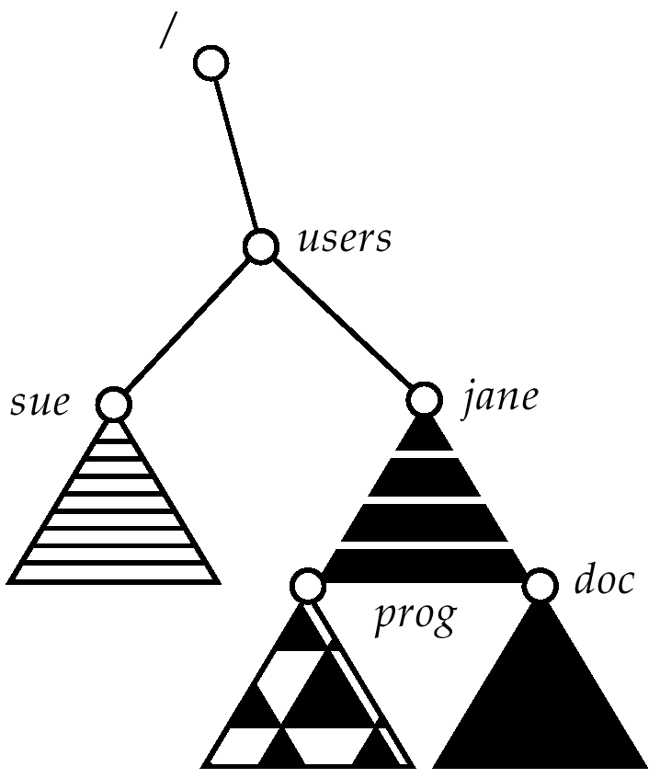
Mount Point

Slide 28
File Sharing
Sharing of files on multi-user systems is desirable.
Sharing may be done through a protection scheme.
On distributed systems, files may be shared across a network.
Network File System (NFS) is a common distributed file-sharing method.

Slide 29
Protection
File owner/creator should be able to control:
what can be done
by whom
Types of access
Read
Write
Execute
Append
Delete
List

Slide 30
Access Lists and Groups
Mode of access: read, write, execute
Three classes of users
RWX
a) owner access 7 ⇒ 1 1 1 RWX
b) group access 6 ⇒ 1 1 0
RWX
c) public access 1 ⇒ 0 0 1
Ask manager to create a group (unique name), say G, and add some users to the group.
For a particular file (say game) or subdirectory, define an appropriate access.
owner
group
public
Attach a group to a file chgrp G game
chmod
761
game

