Slide 1
CO2017
Operating Systems

Slide 2
Course Syllabus
Credits | 3 |  |  | Code |  | CO2017
Credits Hours | Total: 64 | Lecture: 30 |  | Lab: 12 |  | Assignment: 22
Evaluation | Exercise: 10% | Lab: 10% | Midterm: | Assignment: 30% |  | Final exam: 50%
Assessment method | Final exam: Multiple choice questions, ~ 90 minutes
Prerequisites
Co-requisites
Undergraduate Programs | Computer Science and Computer Engineering
Website | http://e-learning.hcmut.edu.vn/
Phone | Phone: (84)(8) 38647256 (Ext. 5840)
Email:

Slide 3
Course Outcomes
L.O.1 | Describe on how to apply fundamental knowledge of computing and mathematics in an operating system
L.O.1.1 | Define the functionality and structures that a modern operating system must deliver to meet a particular need.
L.O.1.2 | Describe main operating system concepts and their aspects that are useful to realize concurrent systems and describe the benefits of each.
L.O.1.3 | Explain virtual memory and its realization in hardware and software.
L.O.2 | Able to report the tradeoffs between the performance and the resource and technology constraints in a design of an operating system.
L.O.2.1 | Compare and contrast common algorithms used for both preemptive and non-preemptive scheduling of tasks in operating systems
L.O.2.2 | Compare and contrast different approaches to file organization, recognizing the strengths and weaknesses of each.

Slide 4
Course Outline
Introduction to Operating systems
Processes/Threads management
Process and Threads
CPU scheduling
Synchronization
Memory management
Main memory
Virtual memory
Storage management
File systems
Advanced topics
Summary

Slide 5
Textbook and References
[1] “Operating System Concepts”, Abraham Silberschatz, Greg Gagne, Peter B. Galvin, 10th Edition, John Wiley & Sons, 2018. ISBN1119439256, 9781119439257, 976 pages.
[2] “Operating Systems: Three Easy Pieces”, Remzi H. Arpaci-Dusseau, Andrea C. Arpaci-Dusseau, CreateSpace Independent Publishing Platform, 2018. ISBN198508659X, 9781985086593, 714 pages.

Slide 6
Acknowledgement
Acknowledgement: The lecture uses mostly slides from “Operating system concepts” copyrighted by Silberschatz, Galvin and Gagne, 2018.

Slide 7
Chapter 1: Introduction

Slide 8
Chapter 1: Outline
What Operating Systems Do
Computer-System Organization
Computer-System Architecture
Operating-System Operations
Resource Management
Security and Protection
Virtualization
Distributed Systems
Kernel Data Structures
Computing Environments
Free/Libre and Open-Source Operating Systems

Slide 9
Objectives
Describe the general organization of a computer system and the role of interrupts
Describe the components in a modern, multiprocessor computer system
Illustrate the transition from user mode to kernel mode
Discuss how operating systems are used in various computing environments
Provide examples of free and open-source operating systems

Slide 10
Computer-System Structure
Computer system can be divided into 4 components:
Hardware (HW) – provides basic computing resources
E.g., Central Processing Unit (CPU), memory, Input/Output (I/O) devices
Operating system (OS) – controls and coordinates use of hardware among various applications and users
E.g., Microsoft Windows, Unix, Linux, Apple MacOS
Application programs – define the ways in which the system resources are used to solve the computing problems of the users
E.g., Compilers, web browsers, development kits, word processors, database systems, video games, multimedia players
Users
E.g., People, machines, other computers

Slide 11
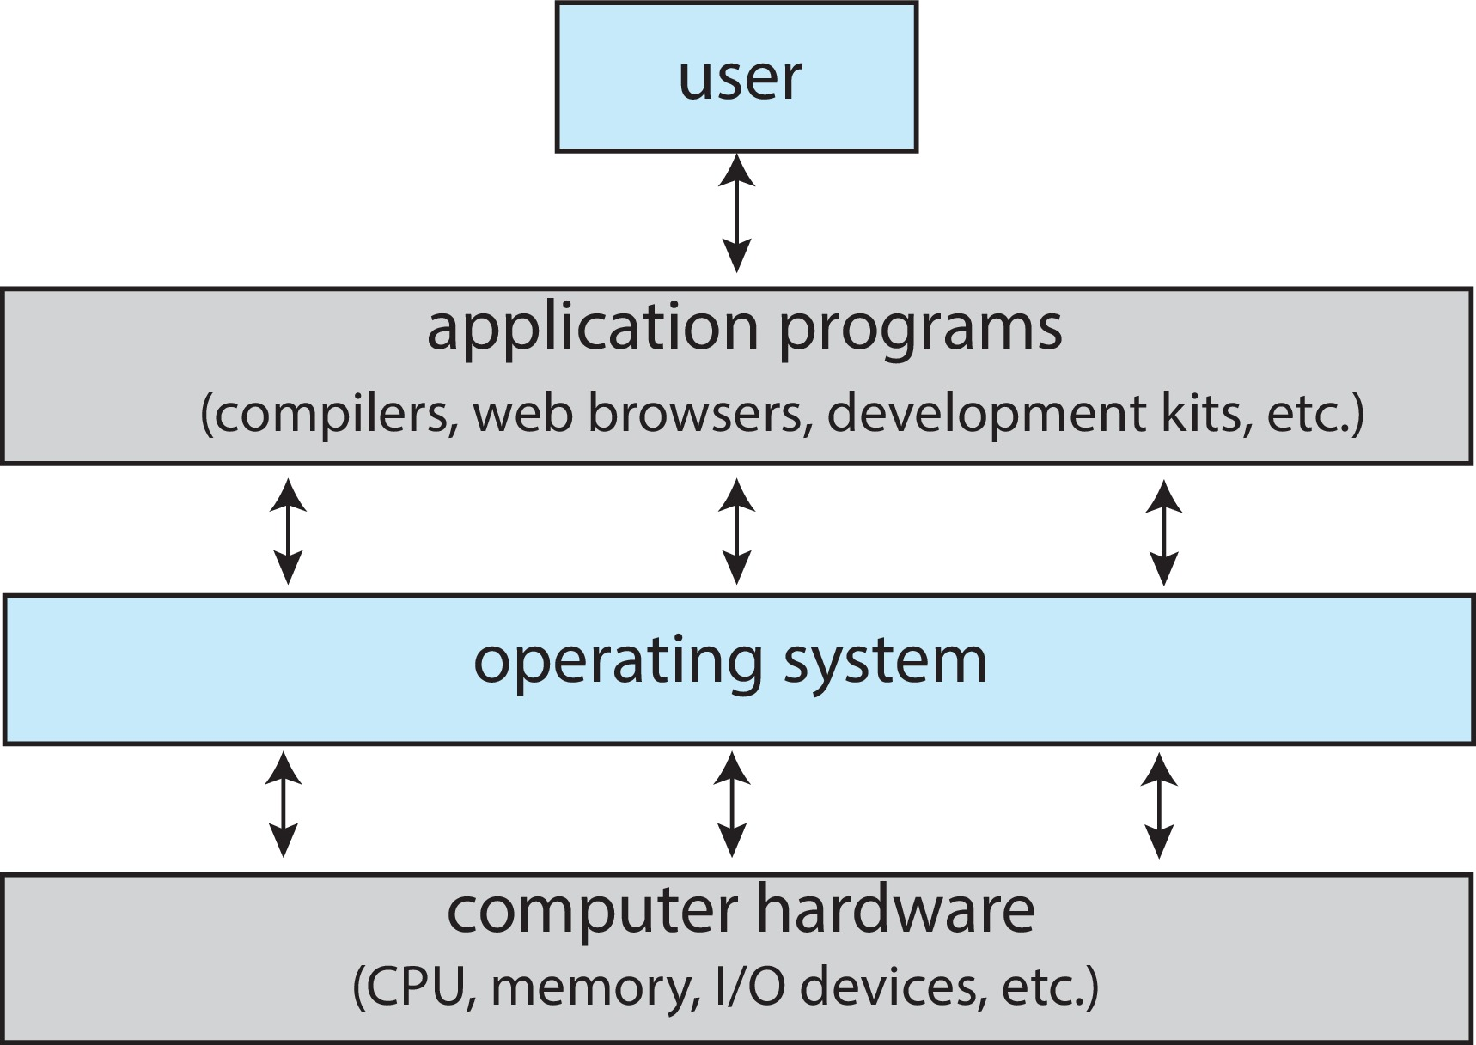
Abstract View of Computer Components

Slide 12
What Operating Systems Do
Users want convenience, ease of use and good performance
But, don’t care about resource utilization
Shared computers (e.g, mainframe or minicomputer) keep all users happy
Operating system is a resource allocator and control program making efficient use of HW and managing execution of user programs
Dedicated systems (e.g, workstations) have dedicated resources but users frequently utilize shared resources from servers
Mobile devices (e.g., smartphones and tablets) are resource poor, have to be optimized for battery life and usability using user interfaces such as touch screens.
Some computers have little or no user interface, such as embedded computers in devices and automobiles
Run primarily without user intervention

Slide 13
Defining Operating Systems
Term OS covers many roles
Because of myriad designs and uses of OSes
OSes present in toasters through ships, spacecraft, game machines, TVs and industrial control systems
OSes were born when fixed use of computers for military became more general purpose and needed resource management and program control
No universally accepted definition

Slide 14
Operating System Definition (Cont.)
“Everything a vendor ships when you order an operating system” is a good approximation (but varies wildly)
“The one program running at all times on the computer” is the kernel, part of the operating system
Everything else is either
a system program (ships with the operating system, but not part of the kernel), or
an application program, all programs not associated with the operating system
Today’s OSes for general purpose and mobile computing also include middleware – a set of software frameworks that provide addition services to application developers such as databases, multimedia, graphics

Slide 15
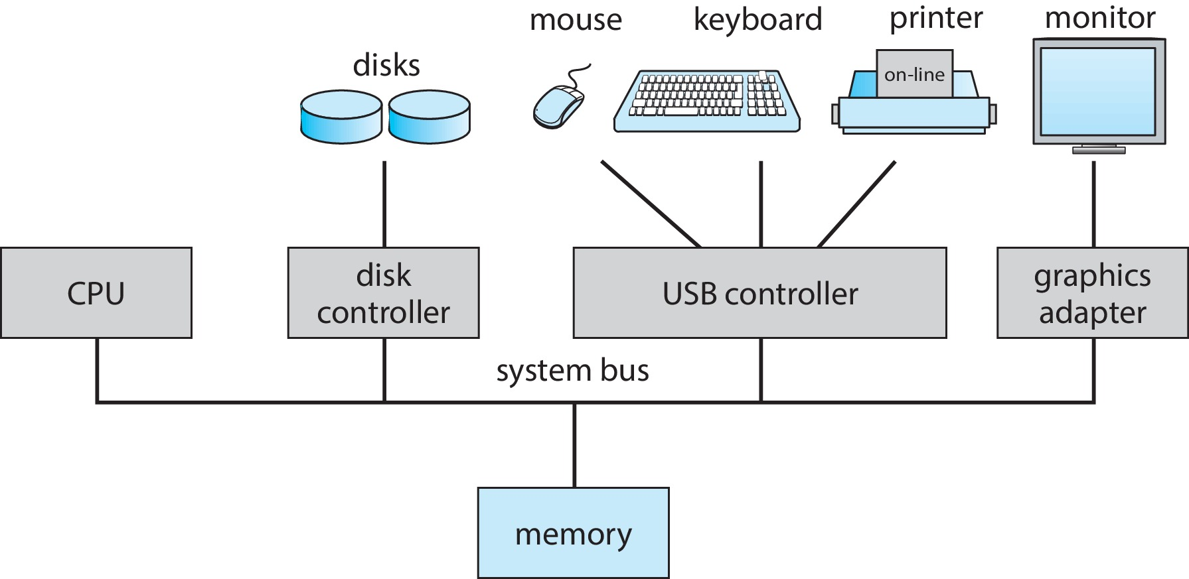
Computer-System Organization
Computer-system organization
One or more CPUs, device controllers connect through common bus providing access to shared memory
Concurrent execution of CPUs and devices competing for memory cycles

Slide 16
Computer-System Operation
I/O devices and the CPUs can execute concurrently
The device controller (on device) determines the logical interaction between the device and the computer
Each device controller is in charge of a particular device type
Each device controller has a local buffer
CPU moves data from/to main memory to/from local buffers, I/O device does from the device to local buffer of controller
Each device controller type has a device driver (installed inside an operating system) to manage I/O operation
Provides uniform interface between controller and kernel

Slide 17
Common Functions of Interrupts
Device controller informs CPU that it has finished its operation by raising an interrupt or CPU has to do a polling for an I/O completion (possibly waste a large number of CPU cycles)
Interrupt transfers control to the interrupt service routine generally, through the interrupt vector, which contains the addresses of all the service routines
Interrupt architecture must save the address and status of the interrupted instruction
A trap (or exception) is a software-generated interrupt caused either by an error or a user request
An operating system is interrupt-driven

Slide 18
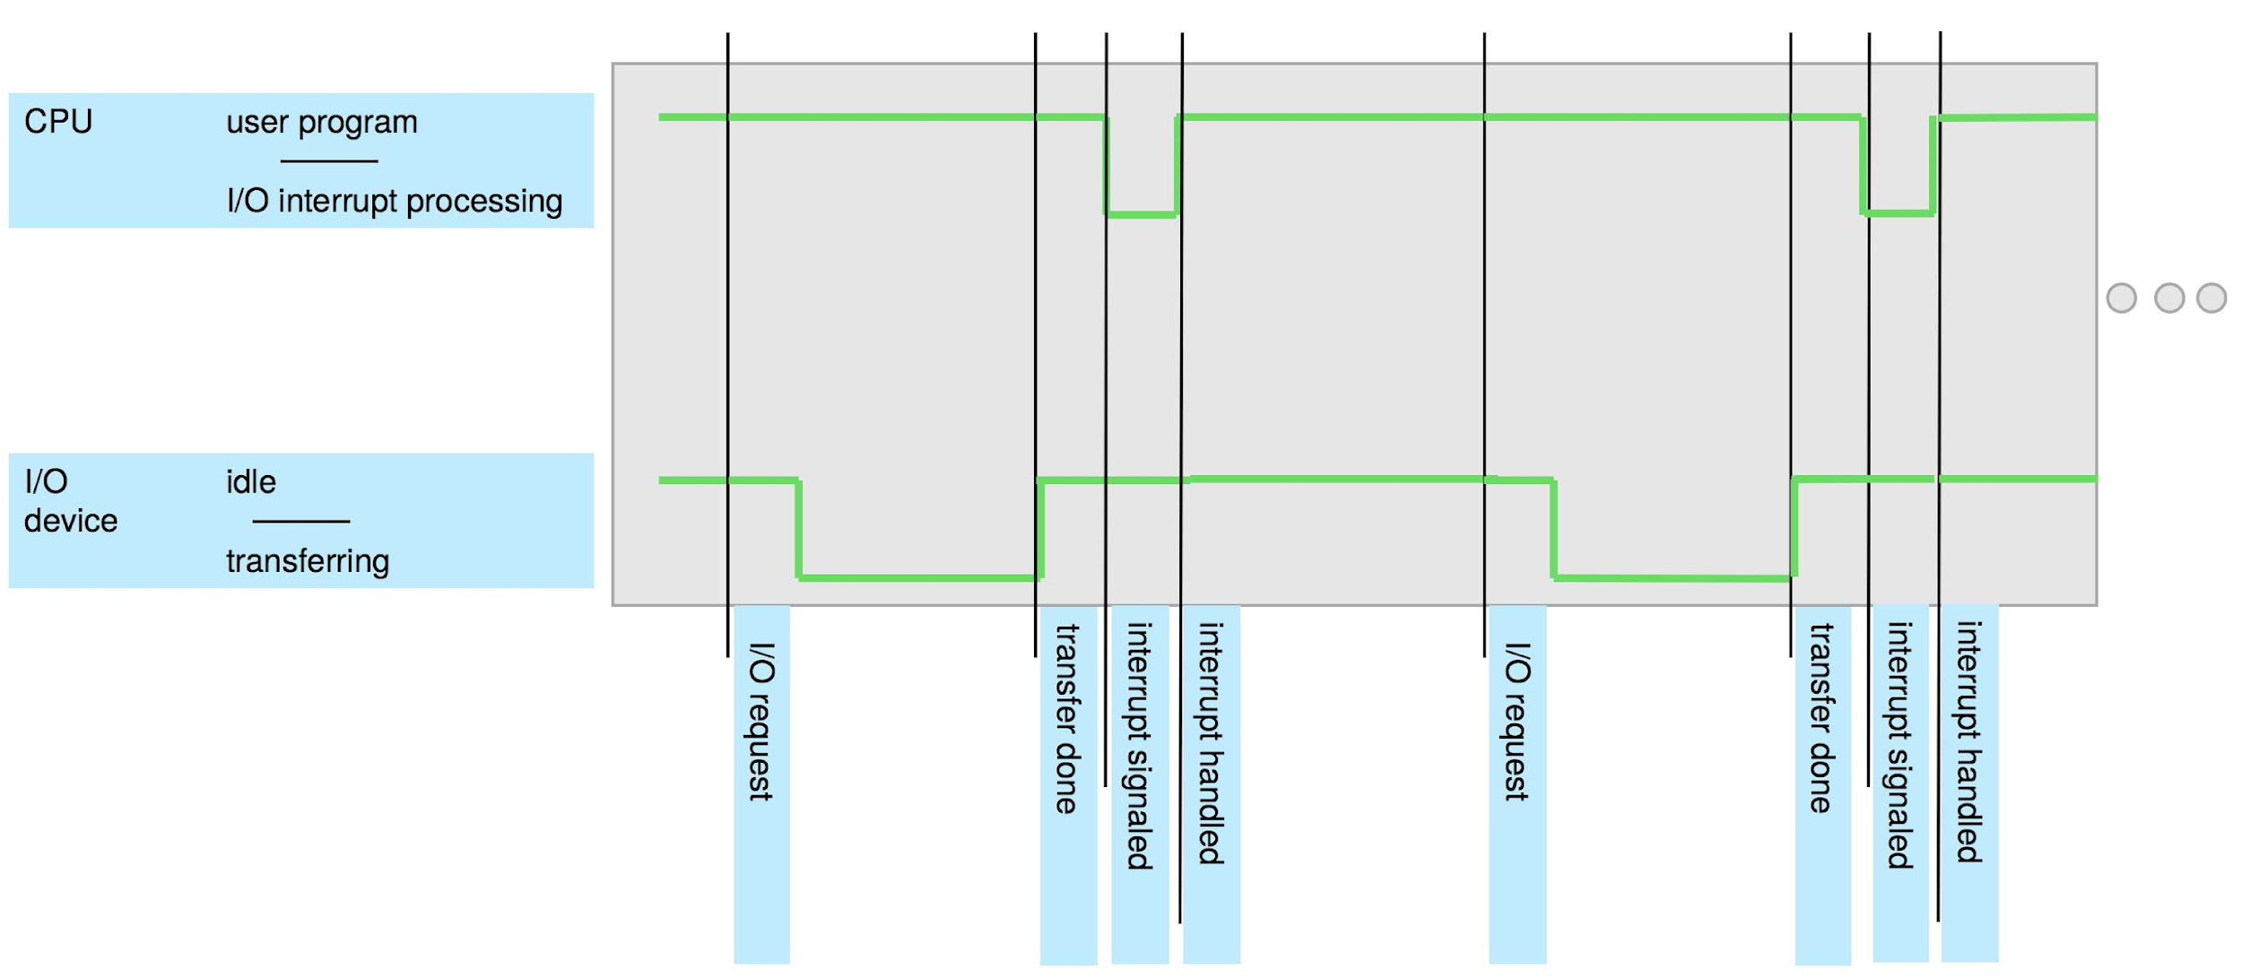
Interrupt Timeline

Slide 19
Interrupt Handling
The operating system preserves the state of the CPU by storing registers and the program counter (PC)
Determines which type of interrupt has occurred:
Vectored interrupt system used to handle asynchronous events and to trap to supervisor-mode routines in the kernel
Separate segments of code determine what action should be taken for each type of interrupt
Some device drivers use interrupts when the I/O rate is low and switch to polling when the rate increases to the point where polling is faster and more efficient.

Slide 20
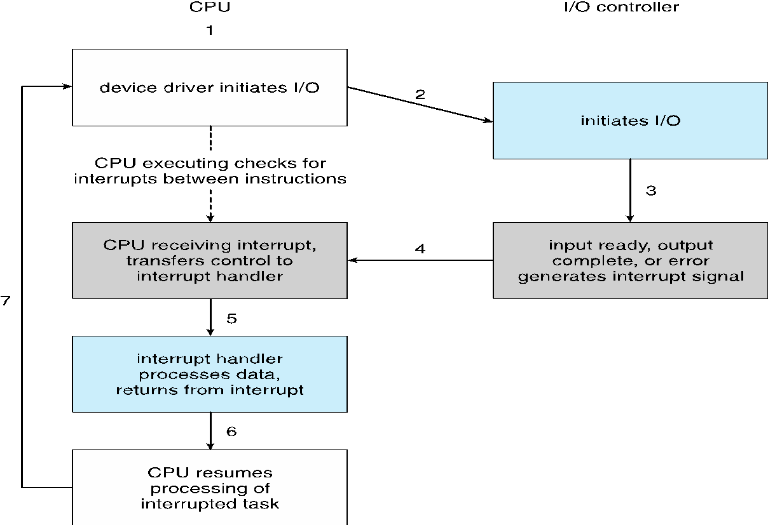
Interrupt-driven I/O Cycle

Slide 21
I/O Structure
After I/O starts, control returns to user program only upon I/O completion
Wait instruction idles the CPU until the next interrupt
Wait loop (e.g., contention for memory access)
At most one I/O request is outstanding at a time, no simultaneous I/O processing
After I/O starts, control returns to user program without waiting for I/O completion
System call – request to the OS to allow user to wait for I/O completion
Device-status table contains entry for each I/O device indicating its type, address, and state
OS indexes into I/O device table to determine device status and to modify table entry to include interrupt

Slide 22
Storage Structure
Main memory – only storage media that the CPU can access directly
Random access, typically in the form of Dynamic Random-Access Memory (DRAM)
Typically volatile
Secondary storage – extension of main memory that provides large nonvolatile storage capacity
Hard Disk Drives (HDD) – rigid metal or glass platters covered with magnetic recording material
Disk surface is logically divided into tracks, which are subdivided into sectors
Non-volatile memory (NVM) devices– faster than hard disks, nonvolatile
Becoming more popular as capacity and performance increases, price drops
Various technologies

Slide 23
Storage Definitions and Notation Review
The basic unit of computer storage is the bit. A bit can contain one of two values, 0 and 1. All other storage in a computer is based on collections of bits. Given enough bits, it is amazing how many things a computer can represent: numbers, letters, images, movies, sounds, documents, and programs, to name a few. A byte is 8 bits, and on most computers it is the smallest convenient chunk of storage. For example, most computers don’t have an instruction to move a bit but do have one to move a byte. A less common term is word, which is a given computer architecture’s native unit of data. A word is made up of one or more bytes. For example, a computer that has 64-bit registers and 64-bit memory addressing typically has 64-bit (8-byte) words. A computer executes many operations in its native word size rather than a byte at a time.
Computer storage, along with most computer throughput, is generally measured and manipulated in bytes and collections of bytes. A kilobyte , or KB , is 1,024 bytes; a megabyte , or MB , is 1,024² bytes; a gigabyte , or GB , is 1,024³ bytes; a terabyte , or TB , is 1,024⁴ bytes; and a petabyte , or PB , is 1,024⁵ bytes. Computer manufacturers often round off these numbers and say that a megabyte is 1 million bytes and a gigabyte is 1 billion bytes. Networking measurements are an exception to this general rule; they are given in bits (because networks move data a bit at a time).

Slide 24
Storage Hierarchy
Storage systems are organized in hierarchy according to
Speed (or access time)
Capacity
Volatility
Cost
Caching – mechanism copying data into faster storage system
Main memory can be viewed as a cache for secondary storage

Slide 25
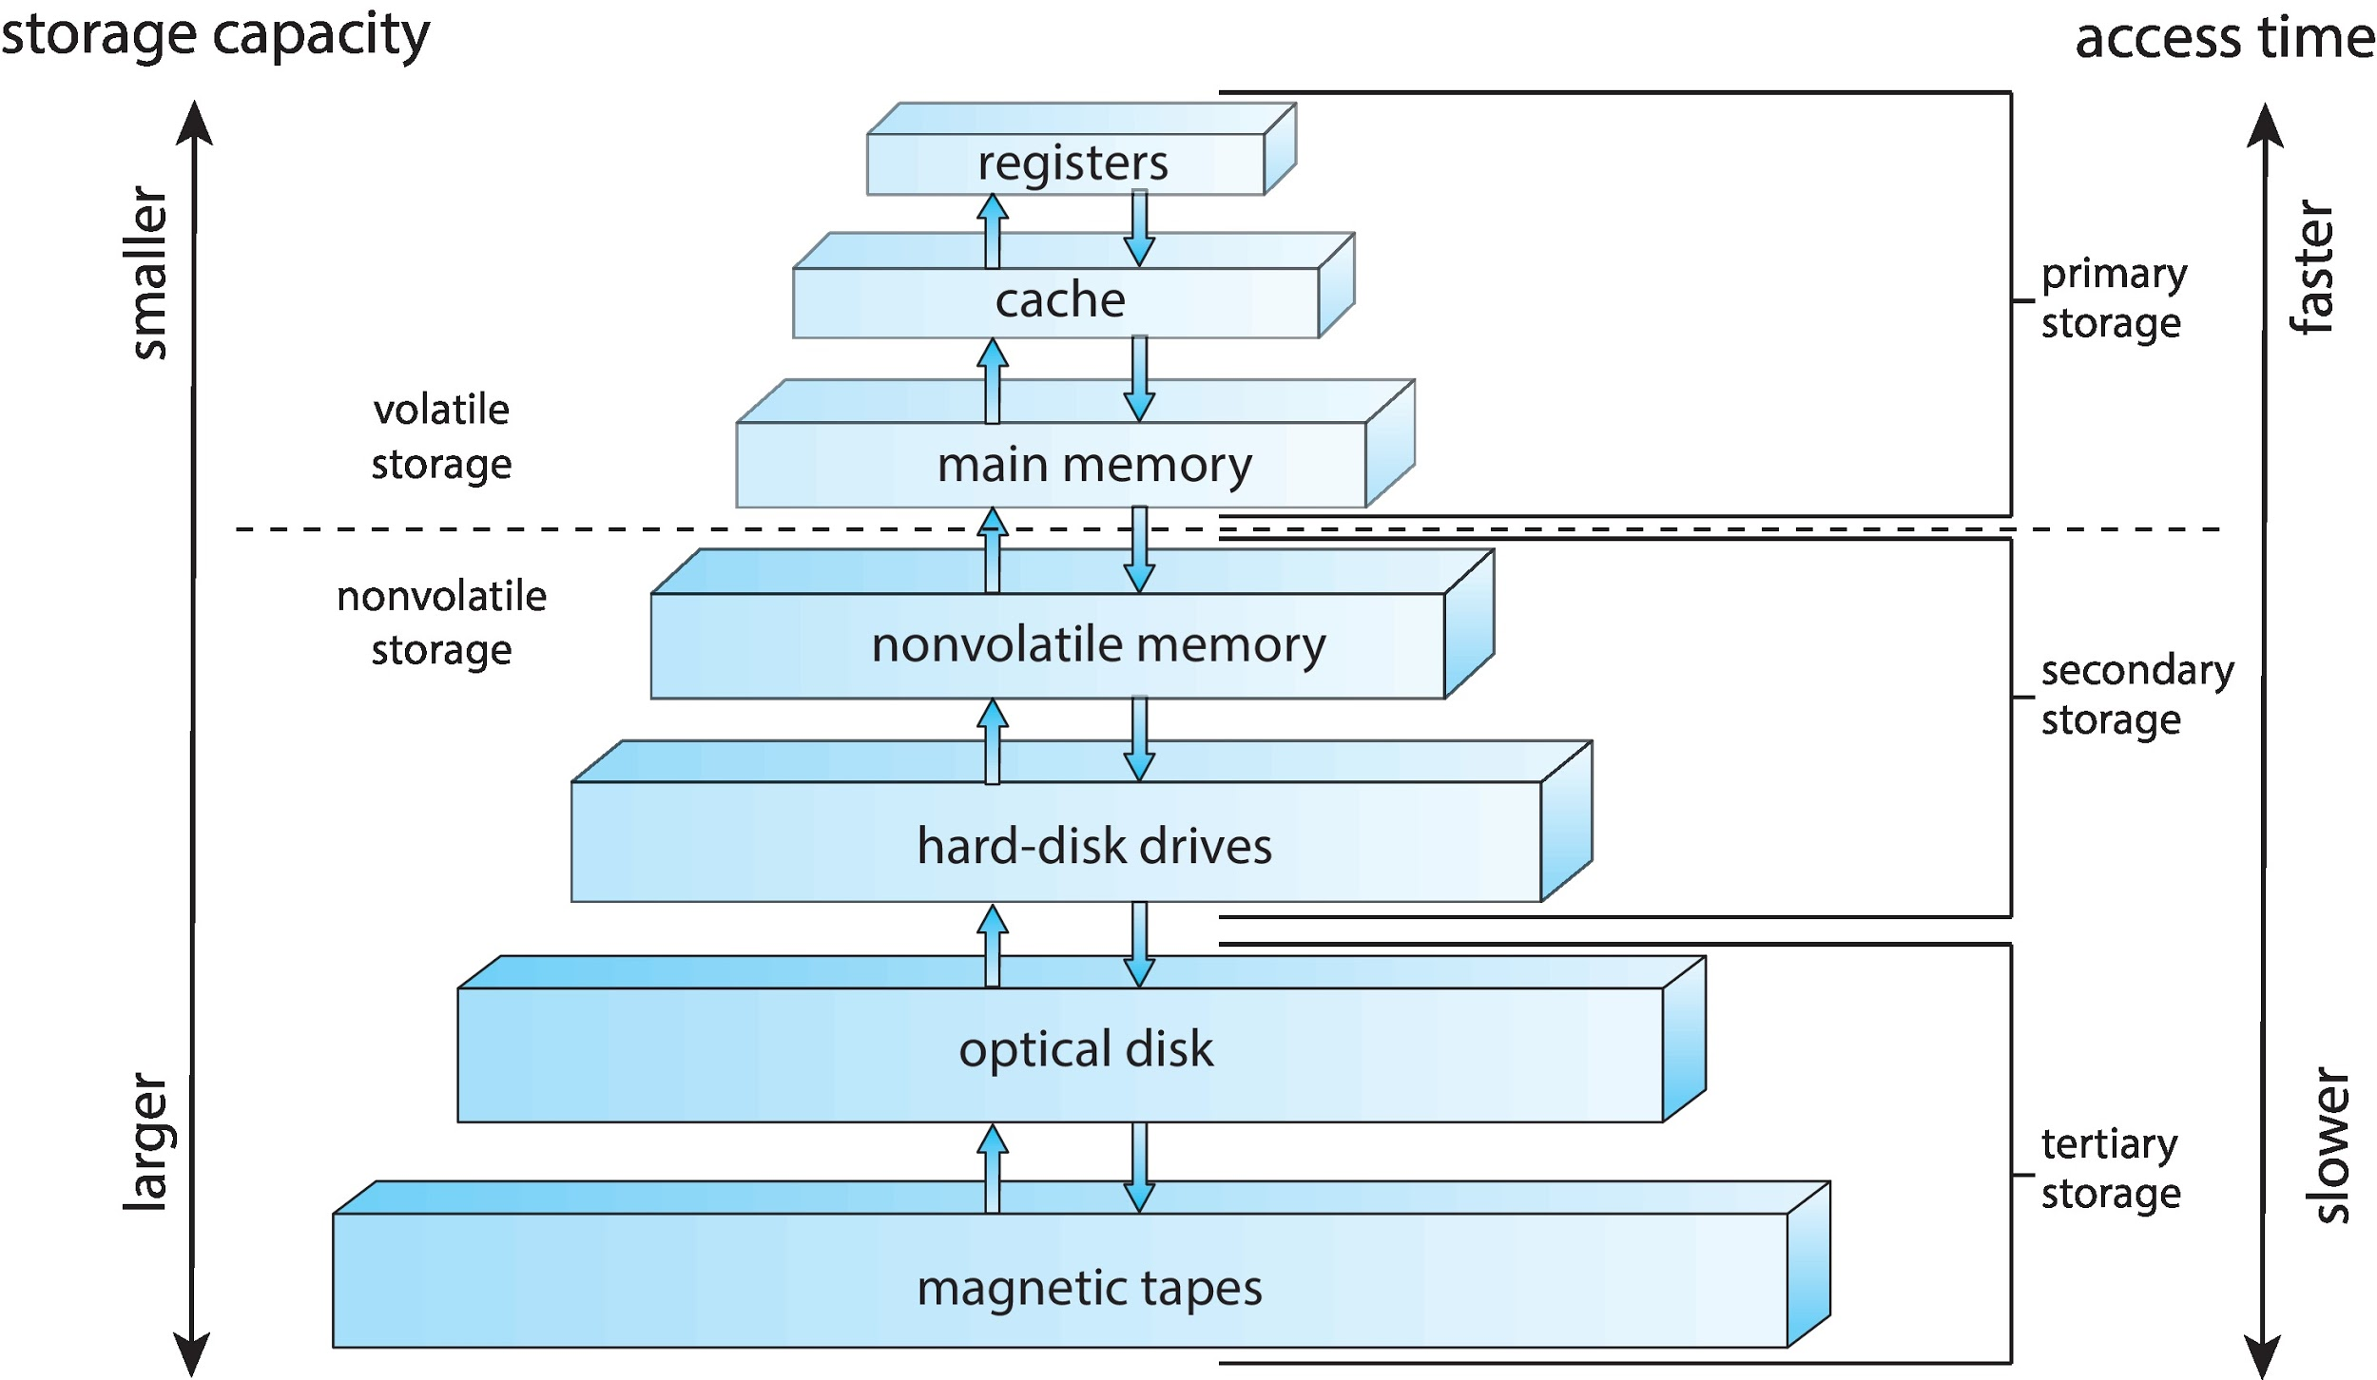
Storage-Device Hierarchy

Slide 26
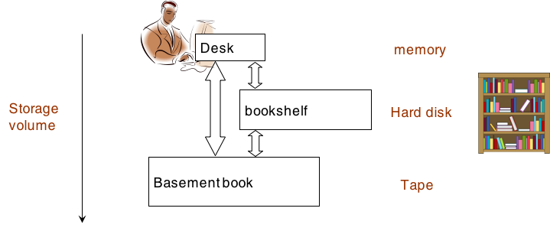
An example of storage hierarchy

Slide 27
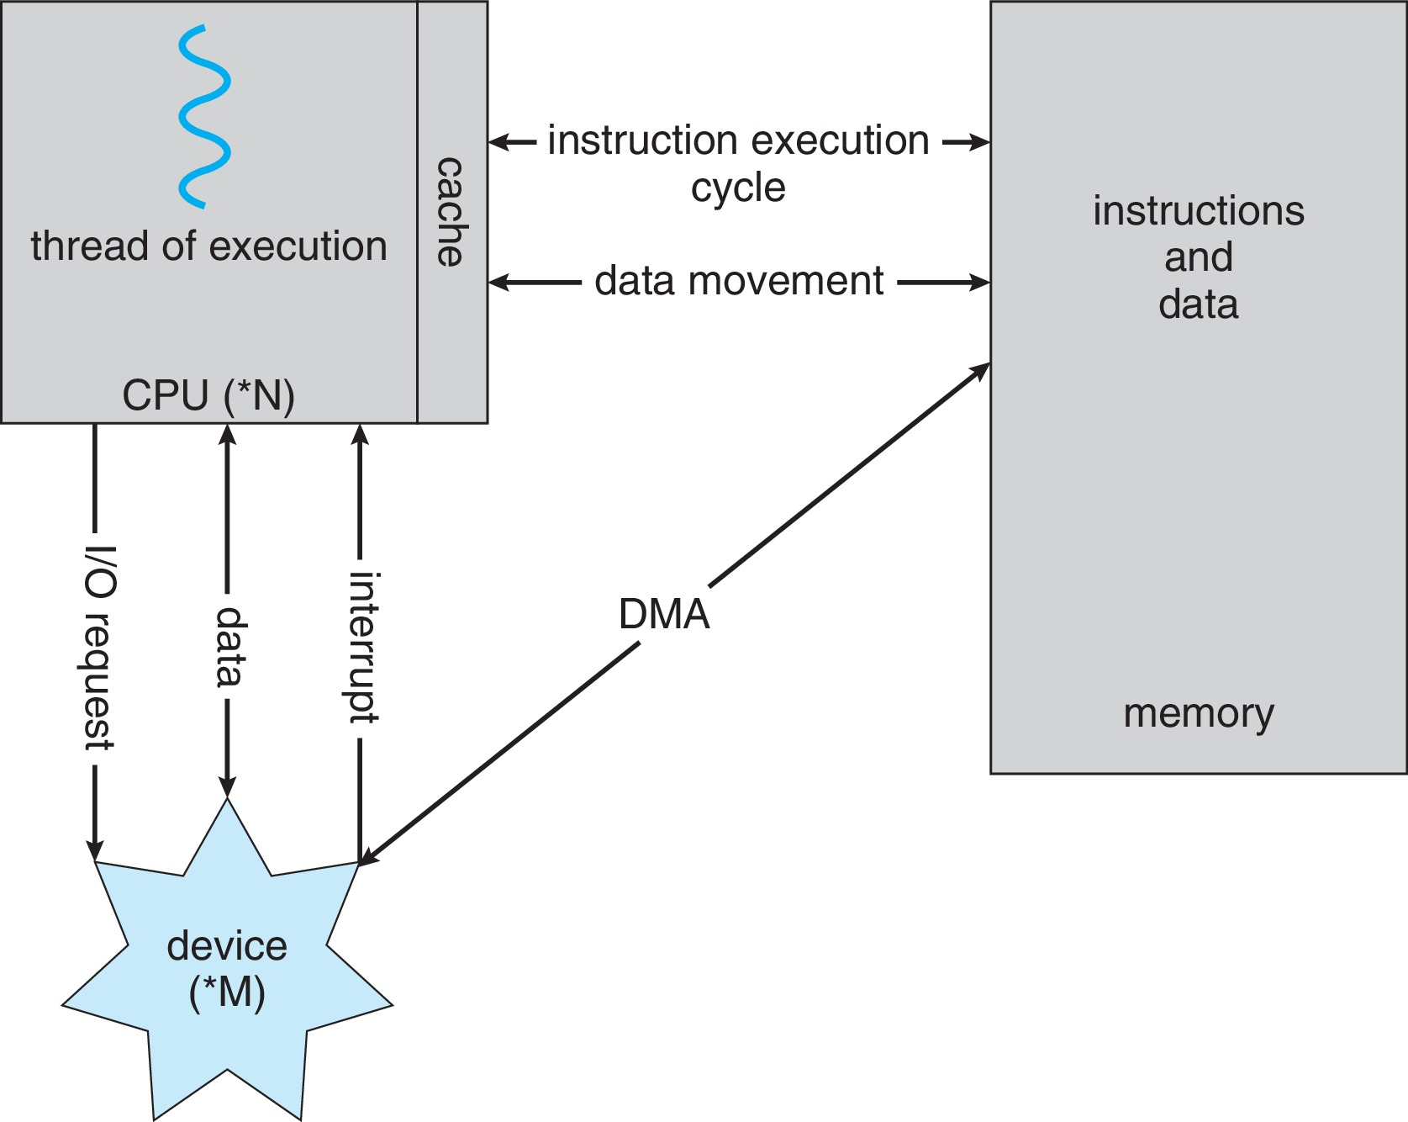
How a Modern Computer Works
Direct Memory Access (DMA)
A von Neumann architecture

Slide 28
Direct Memory Access Structure
Used for high-speed I/O devices able to transmit information at close to memory speeds
Device controller transfers blocks of data from local buffer directly to main memory without CPU intervention
Only one interrupt is generated per block, rather than the one interrupt per byte

Slide 29
Computer-System Architecture
Most older systems use a single general-purpose processor
Most systems have special-purpose processors as well
Multiprocessors systems growing in use and importance
Also known as parallel systems, tightly-coupled systems
Advantages include:
Increased throughput
Economy of scale, increased reliability – graceful degradation or fault tolerance
Two types:
Asymmetric Multiprocessing – each processor is assigned a special task.
Symmetric Multiprocessing – each processor performs all tasks

Slide 30
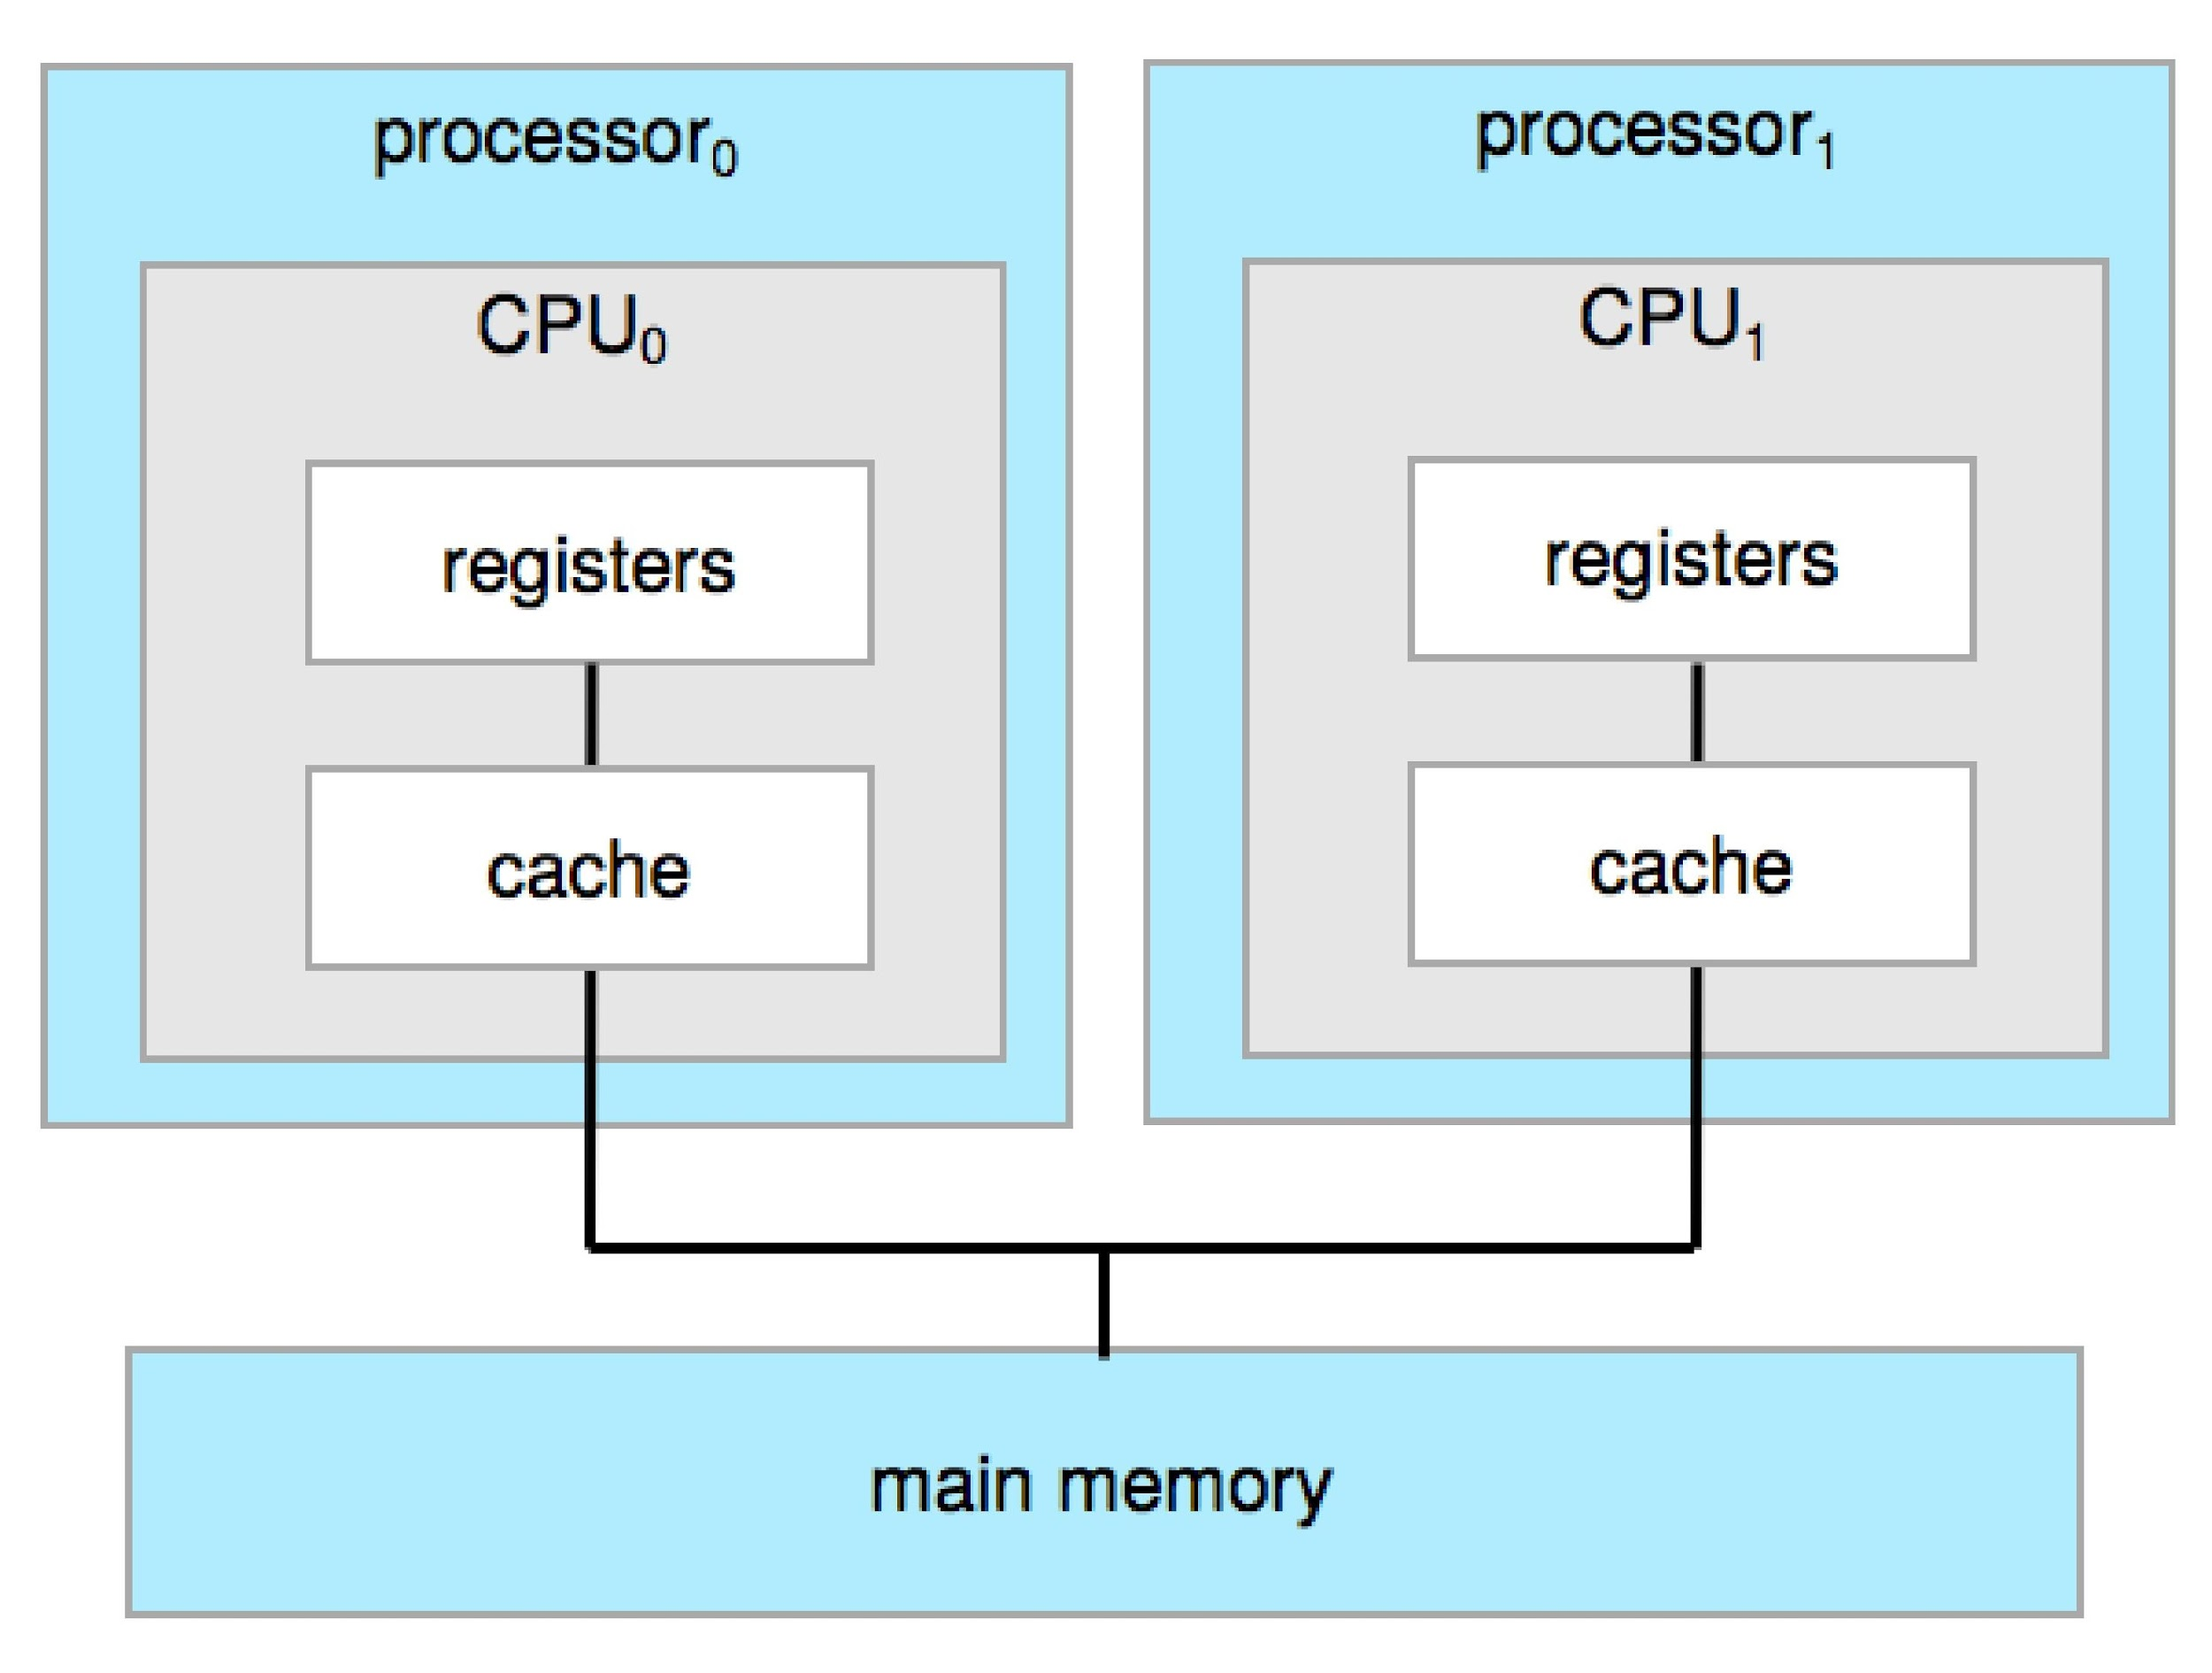
Symmetric Multiprocessing Architecture

Slide 31
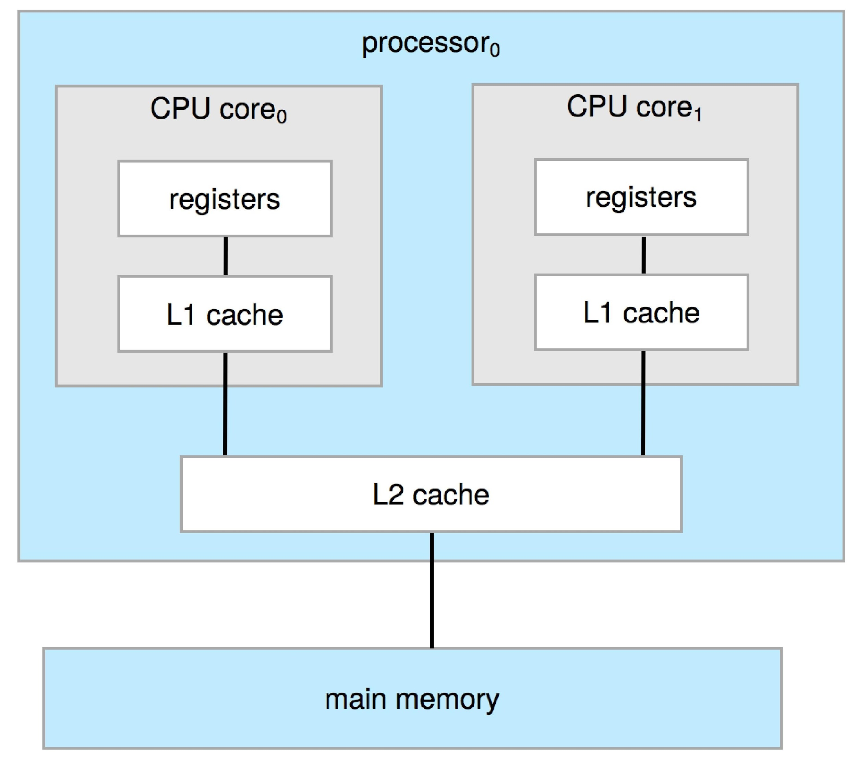
A Dual-Core Design
Multi-chip and multicore
Systems containing all chips
Chassis containing multiple separate systems

Slide 32
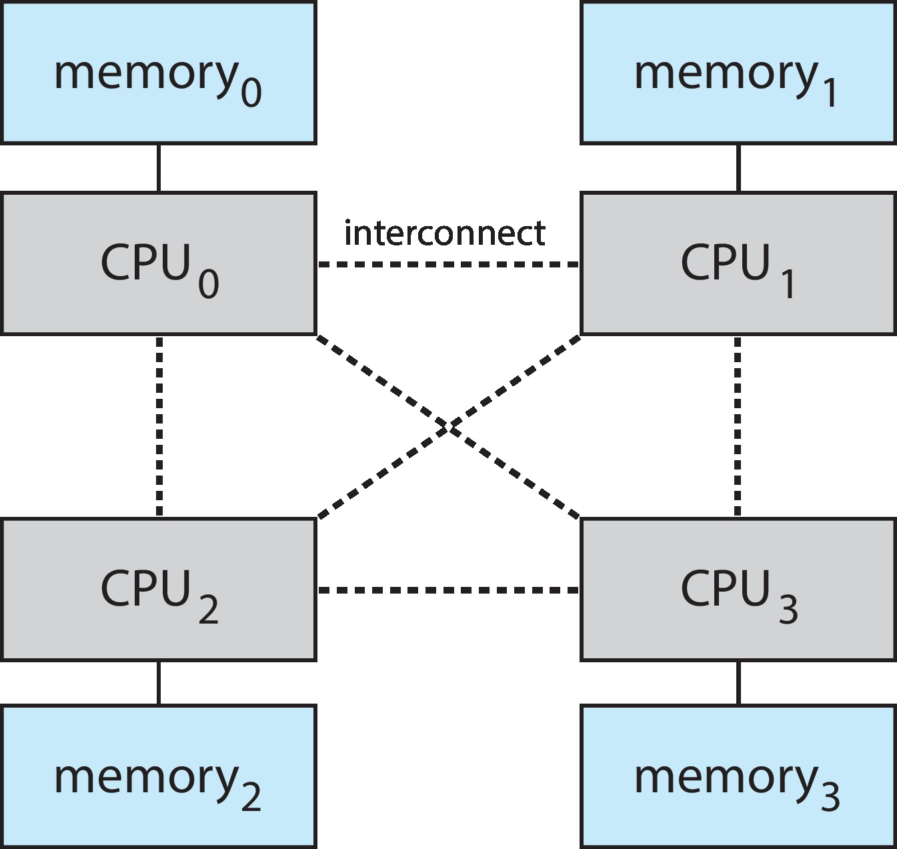
Non-Uniform Memory Access System
Non-Uniform Memory Access (NUMA)

Slide 33
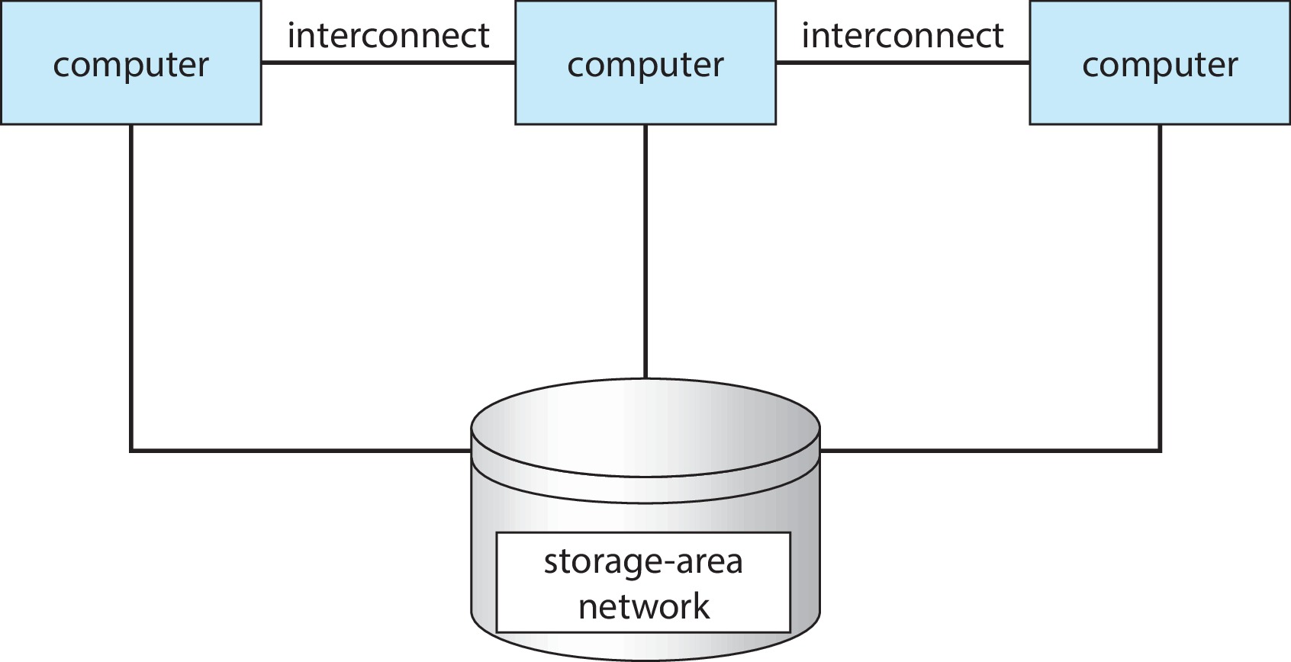
Clustered Systems
Like multiprocessor systems, but multiple systems working together
Usually sharing storage via a Storage-Area Network (SAN)
Provides a high-availability service which survives failures
Asymmetric clustering has one machine in hot-standby mode
Symmetric clustering has multiple nodes running applications
Some clusters are used for High-Performance Computing (HPC)
Applications must be written to use parallelization
Some clusters have Distributed Lock Manager (DLM) to avoid conflicting operations

Slide 34
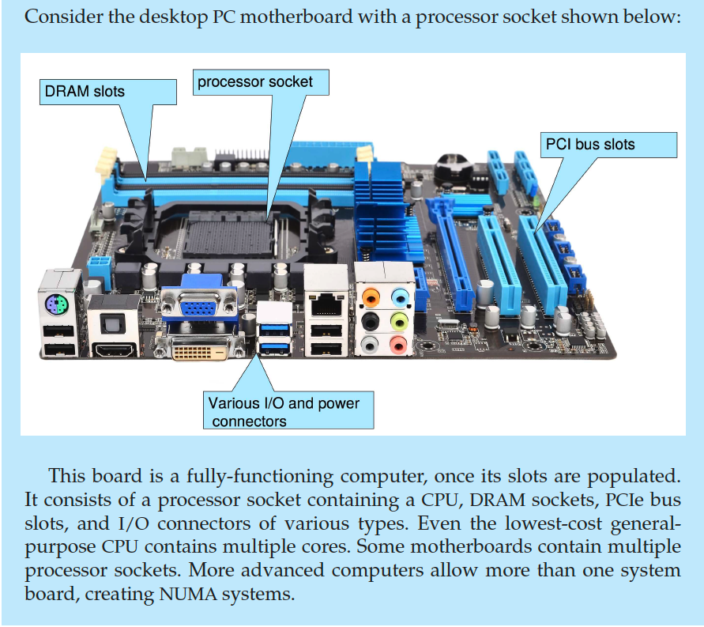
PC Motherboard

Slide 35
Operating-System Operation
Bootstrap program loaded at power-up (or reboot)
Typically stored in ROM or EPROM, generally known as firmware
Initializes all aspects of system
Loads operating system kernel and starts execution
Loads kernel
Kernel is interrupt-driven (hardware and software)
Hardware interrupt by one of the devices
Software interrupt (exception or trap): Software error (e.g., division by zero), request for operating system service (i.e., system call), other process problems include infinite loop, processes modifying each other or modifying the operating system
Starts system daemons (services provided outside of the kernel)

Slide 36
Multiprogramming
Multiprogramming needed for efficiency
Single user cannot keep CPU and I/O devices busy at all times
Multiprogramming organizes jobs (i.e., code and data) so that CPU always has one to execute
A subset of total jobs in system is kept in memory
One job is selected and runs via job scheduling
When it has to wait (e.g., for I/O), OS switches to another job

Slide 37
Multitasking
Time-sharing (multitasking) is a logical extension in which CPU switches jobs so frequently that users can interact with each job while it is running, creating interactive computing
Response time should be < 1 second
Each user has at least one program executing in memory 🢡 process
If several jobs ready to run at the same time 🢡 CPU scheduling
If processes don’t fit in memory, swapping moves them in and out to run
Virtual memory allows execution of processes not completely in memory

Slide 38
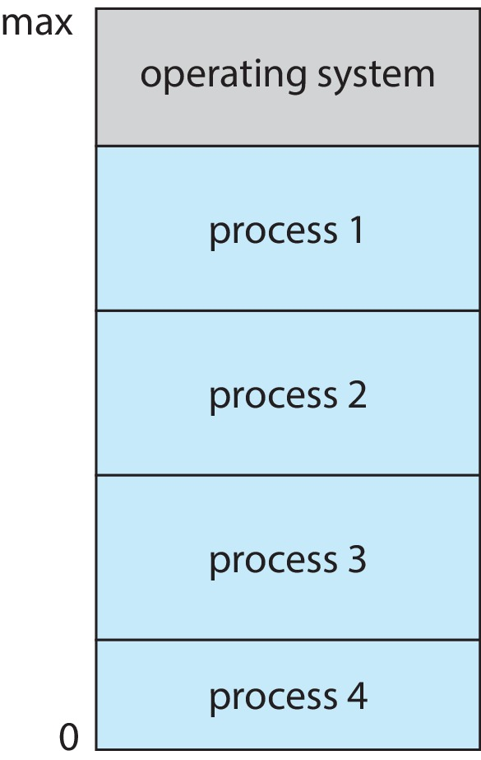
Memory Layout for Multiprogrammed System

Slide 39
Dual-mode and Multimode Operation
Dual-mode operation allows OS to protect itself and other system components
User mode and kernel mode
Mode bit provided by hardware
Provides ability to distinguish when system is running user code or kernel code
Some instructions designated as privileged, only executable in kernel mode
System call changes mode to kernel, return from call resets it to user mode
Increasingly CPUs support multimode operations
e.g., Virtual machine manager (VMM) mode for guest Virtual Machine (VMs)

Slide 40
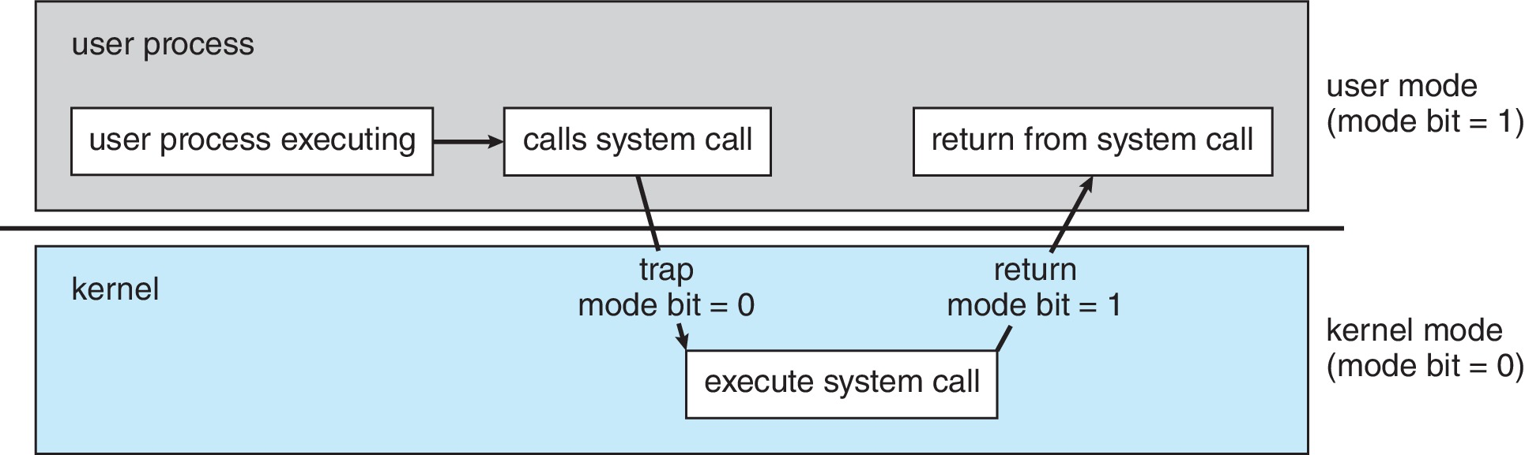
Transition from User to Kernel Mode
Timer to prevent infinite loop / process hogging resources
Timer is set to interrupt the computer after some time period. Operating system sets a counter (privileged instruction), keeps the counter that is decremented by the physical clock, when counter zero generate an interrupt.
Set up before scheduling process to regain control or terminate program that exceeds allotted time.

Slide 41
Process Management
A process is a program in execution. It is a unit of work within the system. Program is a passive entity, process is an active entity.
Process needs resources to accomplish its task
CPU, memory, I/O, files, initialization data
Process termination requires reclaim of any reusable resources
Single-threaded process has one program counter specifying location of next instruction to execute
Process executes instructions sequentially, one at a time, until completion
Multi-threaded process has one program counter per thread
Typically system has many processes (some user & some operating system processes) running concurrently on one or more CPUs
Concurrency by multiplexing the CPUs among the processes / threads

Slide 42
Process Management Activities
The operating system is responsible for the following activities in connection with process management:
Creating and deleting both user and system processes
Suspending and resuming processes
Providing mechanisms for process synchronization
Providing mechanisms for process communication
Providing mechanisms for deadlock handling

Slide 43
Memory Management
To execute a program,
All (or part) of the instructions must be in memory
All (or part) of the data needed by the program must be in memory
Memory management determines what is in memory and when
Optimizing CPU utilization and computer response to users
OS activities
Keeping track of which parts of memory are currently being used and by whom
Deciding which processes (or parts thereof) and data to move into and out of memory
Allocating and deallocating memory space as needed

Slide 44
Filesystem Management
OS provides uniform, logical view of data storage
Abstracts physical properties to logical storage unit - file
Each medium is controlled by device (i.e., disk drive, tape drive)
Varying properties include access speed, capacity, data-transfer rate, access method (sequential or random)
Filesystem management
Files usually organized into directories
Access control on most systems to determine who can access what
OS activities
Creating and deleting files / directories, primitives to manipulate files / directories, to backup files onto stable (non-volatile) storage media
Mapping files onto secondary storage

Slide 45
Mass-Storage Management
Usually disks used to store programs and data that do not fit in main memory or that must be kept for a “long” period of time
Proper management is of central importance
Entire speed of computer operation hinges on disk subsystem and its algorithms
Some storage need not be fast
Tertiary storage includes optical storage, magnetic tape
Still must be managed – by OS or applications
OS activities
Mounting and unmounting
Free-space management
Storage allocation
Disk scheduling
Partitioning
Protection

Slide 46
Caching
Important principle, performed at many levels in a computer (in hardware, operating system, software)
Information in use copied from slower to faster storage temporarily
Faster storage (cache) checked to determine if information is there?
If it is, information used directly from the cache (fast)
If not, data copied to cache and used there
Cache is smaller than storage being cached
Cache management is an important design problem
Cache size and replacement policy

Slide 47
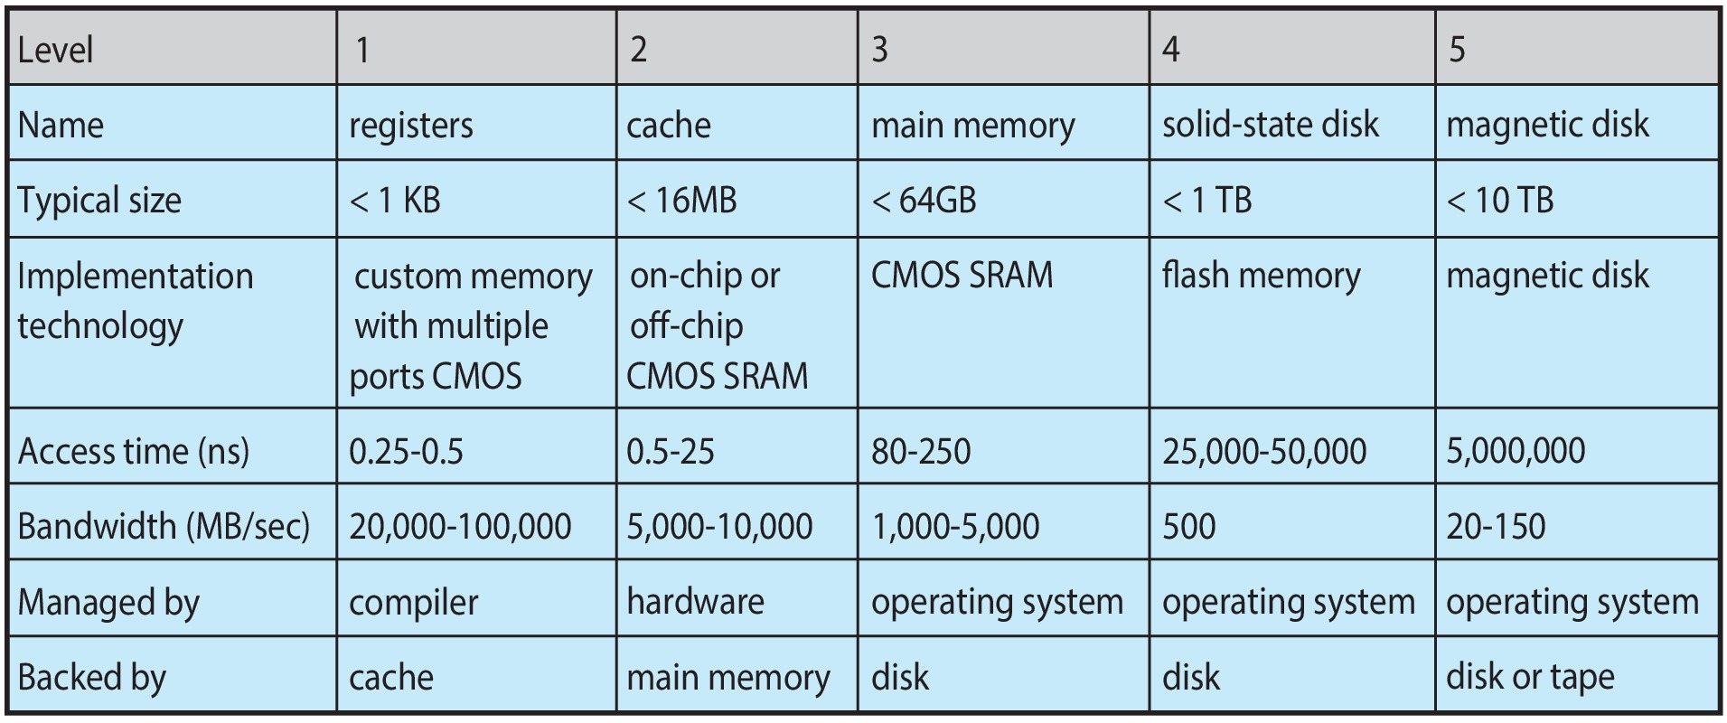
Various Types of Storage
Movement between levels of storage hierarchy can be explicit or implicit

Slide 48
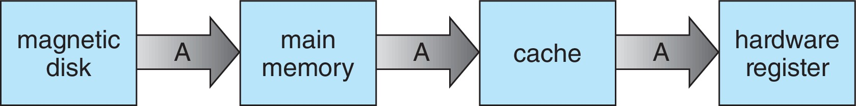
Migration of Data from Disk to Register
Multitasking environment must be careful to use most recent value, no matter where it is stored in the storage hierarchy
Multiprocessor environment must provide cache coherency in hardware such that all CPUs have the most recent value in their cache
In distributed environment, the situation is even more complex
Several copies of a datum can exist
Various solutions

Slide 49
I/O Subsystem
One purpose of OS is to hide peculiarities of hardware devices from the user
I/O subsystem is responsible for
Memory management of I/O including buffering (storing data temporarily while it is being transferred), caching (storing parts of data in faster storage for performance), spooling (the overlapping of output of one job with input of other jobs)
I/O subsystem includes
General device-driver interface
Drivers for specific hardware devices

Slide 50
Protection and Security
Protection – any mechanism for controlling access of processes or users to resources defined by the OS
Security – defense of the system against internal and external attacks
Huge range, including denial-of-service, worms, viruses, identity theft, theft of service
Systems generally first distinguish among users, to determine who can do what
User identity (UID, or security ID) includes name and an associated number. User ID is then associated with all files, processes of that user to determine access control
Group identifier (GID) allows set of users to be defined for access control, then also associated with each process or file
Privilege escalation allows user to change to effective ID with more rights

Slide 51
Virtualization
Allows operating systems to run applications within other OSes
Vast and growing industry
Emulation used when source CPU type different from target CPU type (e.g., PowerPC to Intel x86)
Generally slowest method
When computer language not compiled to native code – Interpretation
Virtualization – OS natively compiled for CPU, running guest OSes also natively compiled
E.g., Consider VMware running WinXP guests, each running applications, all on native WinXP host OS
Virtual Machine Manager (VMM) provides virtualization services
Notes:
Virtualization is a technology that allows us to abstract the hardware of a sin- gle computer (the CPU, memory, disk drives, network interface cards, and so forth) into several different execution environments, thereby creating the illu- sion that each separate environment is running on its own private computer

Slide 52
Virtualization (cont.)
Use cases involve laptops and desktops running multiple OSes for exploration or compatibility
E.g.,
Apple laptop running Mac OS X host, Windows as a guest
Developing apps for multiple OSes without having multiple systems
Q&A testing applications without having multiple systems
Executing and managing computing environments within data centers
VMM can run natively, in which case they are also the host
There is no general purpose host then (e.g., VMware ESX and Citrix XenServer)

Slide 53
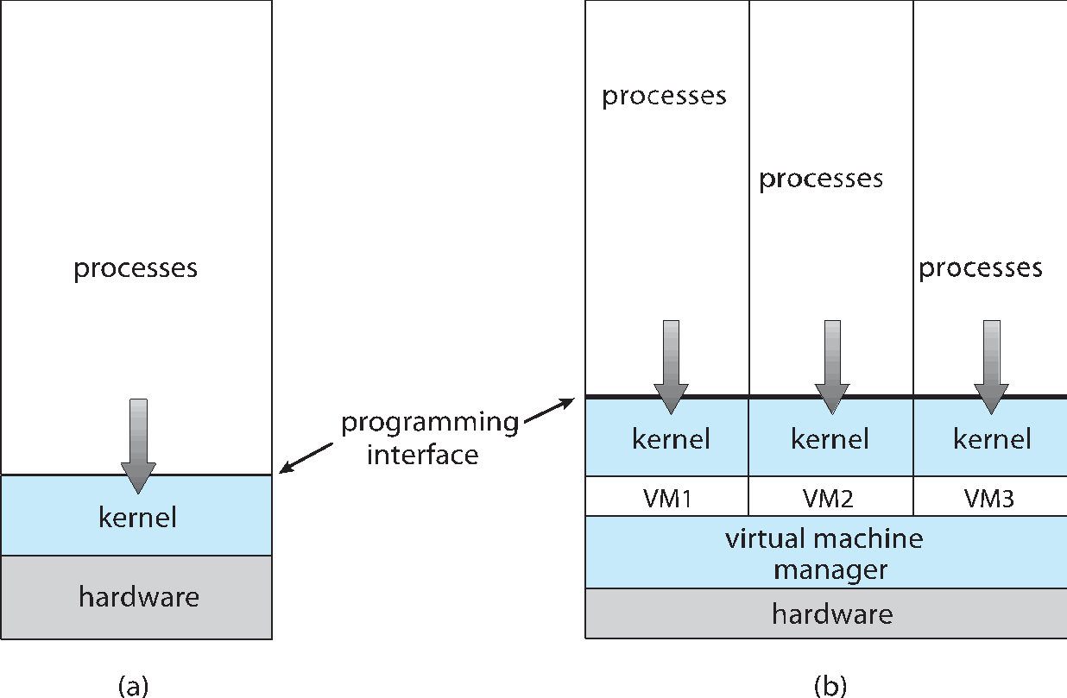
Computing Environments - Virtualization
A single operating system
A virtualization system with 3 OSes

Slide 54
Distributed Systems
Distributed computing
Collection of separate (possibly heterogeneous) systems networked together
Network is communications paths (TCP/IP is most common protocol stack)
Local Area Network (LAN)
Wide Area Network (WAN)
Metropolitan Area Network (MAN)
Personal Area Network (PAN)
Network Operating System (NOS) provides features between systems across network
Communication scheme allows systems to exchange messages
Illusion of a single system

Slide 55
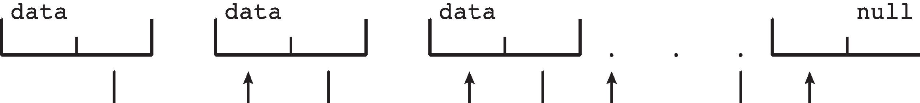
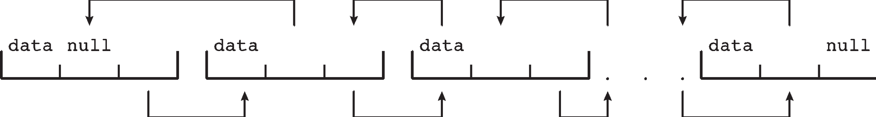
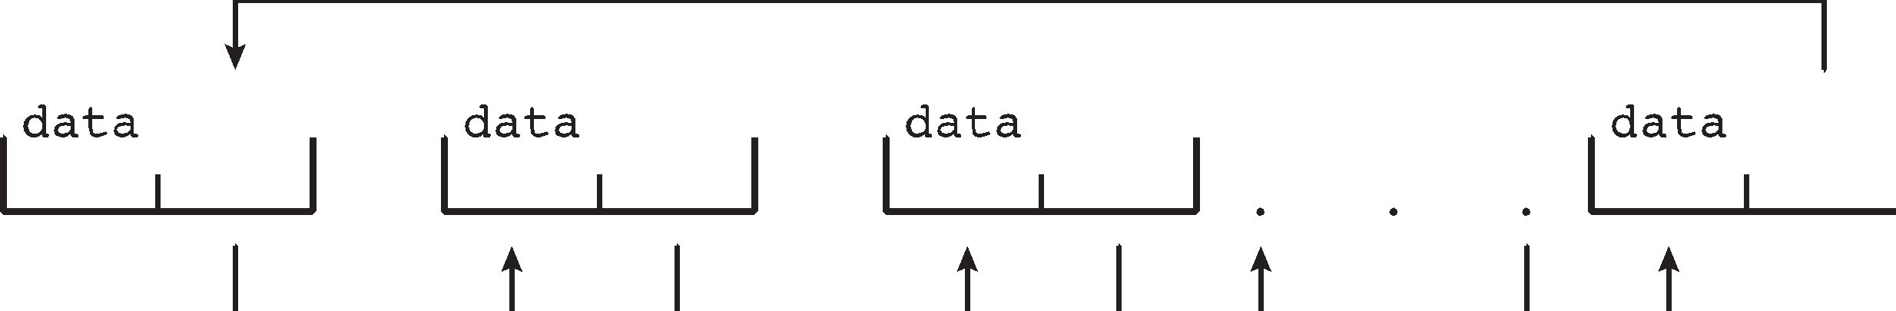
Kernel Data Structures
Many similar to standard programming data structures
Singly linked list
Doubly linked list
Circular linked list

Slide 56
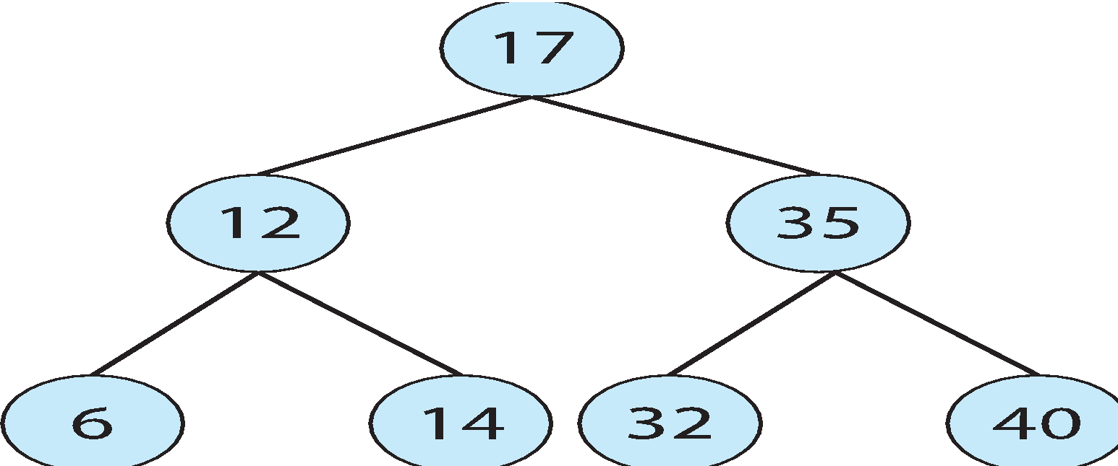
Kernel Data Structures
Binary search tree (left <= right)
Search performance is O(n)
Balanced binary search tree is O(log n)

Slide 57
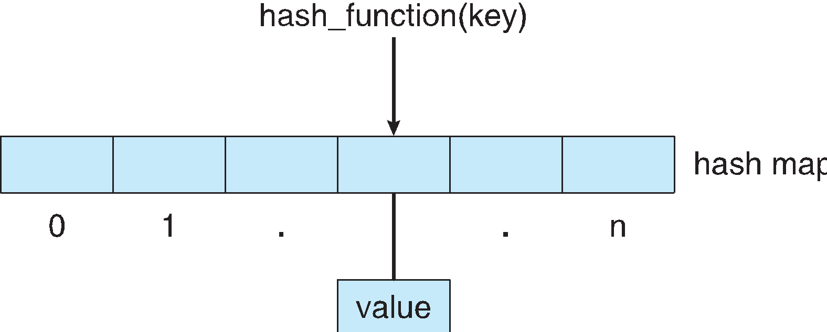
Kernel Data Structures
Hash function can create a hash map
Bitmap – string of n binary digits representing the status of n items
E.g., Linux data structures defined in include files:
<linux/list.h>, <linux/kfifo.h>, <linux/rbtree.h>

Slide 58
Evolution
Mainframe system
Desktop system
Multiprocessor system
Distributed system
Real-time system
Handheld system/mobile system

Slide 59
Computing Environments - Traditional
Stand-alone general purpose machines
But blurred as most systems interconnect with others (i.e., the Internet)
Portals provide web access to internal systems
Network computers (or thin clients) are like Web terminals
Mobile computers interconnect via wireless networks
Networking becoming ubiquitous – even home systems use firewalls to protect home computers from Internet attacks

Slide 60
Computing Environments - Mobile
Such as handheld smartphones, tablets, etc.
What is the functional difference between them and a “traditional” laptop?
Extra feature – more OS features (e.g., GPS, gyroscope)
Allows new types of apps like Augmented Reality (AR)
Use IEEE 802.11 wireless, or cellular data networks for connectivity
Leaders are Apple iOS and Google Android

Slide 61
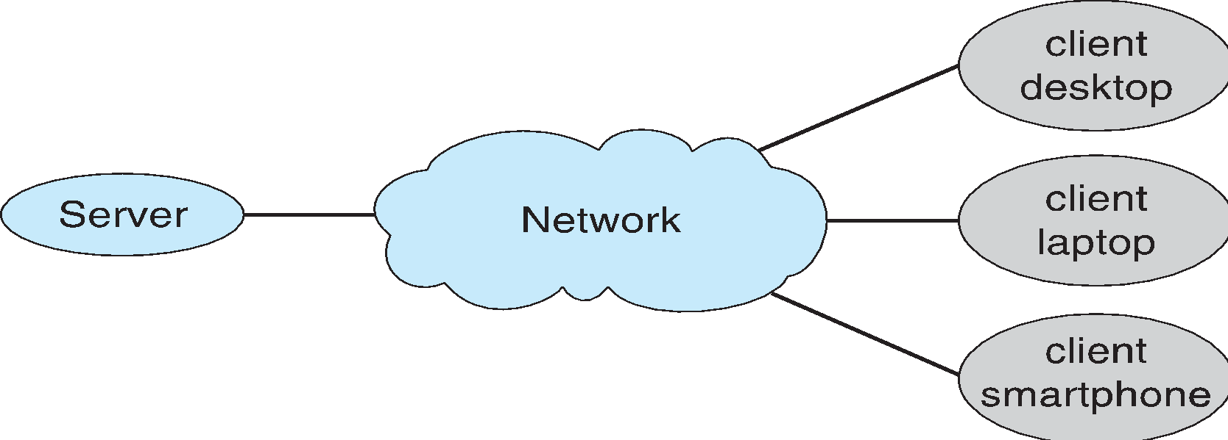
Computing Environments – Client-Server
Client-Server Computing
Dumb terminals supplanted by smart PCs
Many systems now servers, responding to requests generated by clients
Compute-server system provides an interface to client to request services (i.e., database)
File-server system provides interface for clients to store and retrieve files

Slide 62
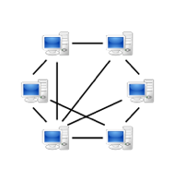
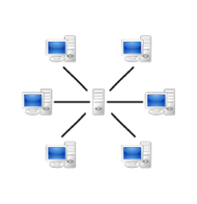
Computing Environments - Peer-to-Peer
Another model of distributed system
P2P does not distinguish clients and servers
Instead all nodes are considered peers
May each act as client, server or both
Node must join P2P network
Registers its service with central lookup service on network, or
Broadcast request for service and respond to requests for service via discovery protocol
Examples include Napster and Gnutella, Voice over IP (VoIP) such as Skype

Slide 63
Computing Environments – Cloud Computing
Delivers computing, storage, apps as a service across a network
Logical extension of virtualization because it uses virtualization as the base for it functionality.
E.g., Amazon EC2 has thousands of servers, millions of virtual machines, petabytes of storage available across the Internet
Many types of services
Software as a Service (SaaS) – one or more applications available via the Internet
Platform as a Service (PaaS) – software stack ready for application use via the Internet
Infrastructure as a Service (IaaS) – servers or storage available over Internet (i.e., storage available for backup use)
Many types of structure
Public cloud – available via Internet to anyone willing to pay
Private cloud – run by a company for the company’s own use
Hybrid cloud – includes both public and private cloud components

Slide 64
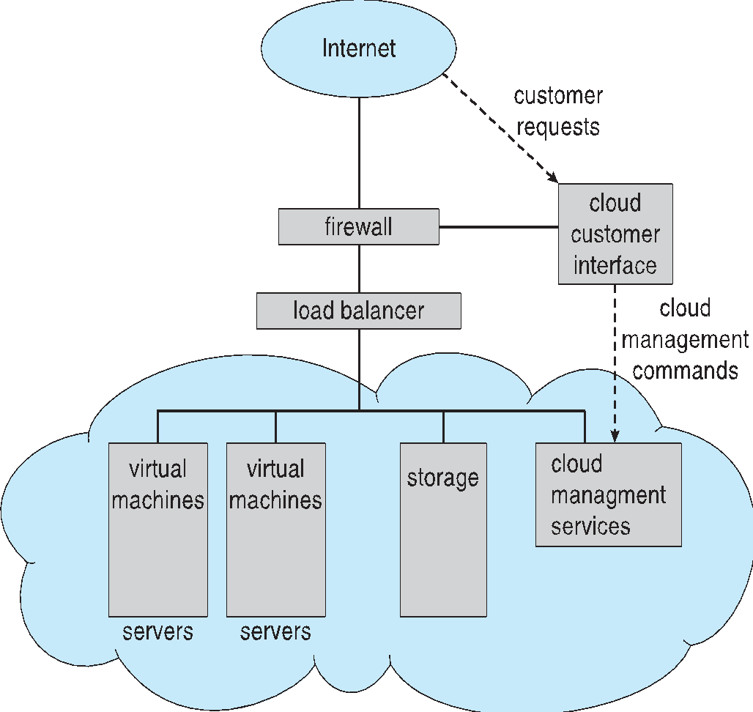
Computing Environments – Cloud Computing
Cloud computing environments composed of traditional OSes, plus VMMs, plus cloud management tools
Internet connectivity requires security like firewalls
Load balancers spread traffic across multiple applications

Slide 65
Computing Environments – Real-Time Embedded Systems
Real-time embedded systems most prevalent form of computers
Vary considerable, special purpose, limited purpose OS, real-time OS
Use expanding
Many other special computing environments as well
Some have OSes, some perform tasks without an OS
Real-time OS has well-defined fixed time constraints
Processing must be done within constraints
Correct operation only if constraints met

Slide 66
Free and Open-Source Operating Systems
Operating systems made available in source-code format rather than just binary closed-source and proprietary
Counter to the copy protection and Digital Rights Management (DRM) movement
Started by Free Software Foundation (FSF), which has “copyleft” GNU Public License (GPL) or Lesser GPL (LGPL)
Free software and open-source software are two different ideas championed by different groups of people
http://gnu.org/philosophy/open-source-misses-the-point.html/
E.g., GNU/Linux and BSD UNIX (including Darwin, core of Mac OS X)
Use VMM like VMware Player (Free on Windows), VirtualBox
Use to run guest operating systems for exploration

Slide 67
The Study of Operating Systems
There has never been a more interesting time to study operating systems, and it has never been easier. The open-source movement has overtaken operating systems, causing many of them to be made available in both source and binary (executable) format. The list of operating systems available in both formats includes Linux, BSD UNIX, Solaris, and part of macOS. The availability of source code allows us to study operating systems from the inside out. Questions that we could once answer only by looking at documentation or the behavior of an operating system we can now answer by examining the code itself.
Operating systems that are no longer commercially viable have been open-sourced as well, enabling us to study how systems operated in a time of fewer CPU, memory, and storage resources. An extensive but incomplete list of open-source operating-system projects is available from https://curlie.org/Computers/Software/Operating_Systems/Open_Source/
In addition, the rise of virtualization as a mainstream (and frequently free) computer function makes it possible to run many operating systems on top of one core system. For example, VMware (http://www.vmware.com) provides a free “player” for Windows on which hundreds of free “virtual appliances” can run. VirtualBox (http://www.virtualbox.com) provides a free, open-source virtual machine manager on many operating systems. Using such tools, students can try out hundreds of operating systems without dedicated hardware.
The advent of open-source operating systems has also made it easier to make the move from student to operating-system developer. With some knowledge, some effort, and an Internet connection, a student can even create a new operating-system distribution. Just a few years ago, it was difficult or impossible to get access to source code. Now, such access is limited only by how much interest, time, and disk space a student has.

Slide 68
Summary
An operating system is software that manages the computer hardware, as well as providing an environment for application programs to run.
Interrupts are a key way in which hardware interacts with the operating system. A hardware device triggers an interrupt by sending a signal to the CPU to alert the CPU that some event requires attention. The interrupt is managed by the interrupt handler.
For a computer to do its job of executing programs, the programs must be in main memory, which is the only large storage area that the processor can access directly.
The main memory is usually a volatile storage device that loses its contents when power is turned off or lost.
Notes:
Summary
Anoperatingsystemissoftwarethatmanagesthecomputerhardware,as
well as providing an environment for application programs to run.
Interrupts are a key way in which hardware interacts with the operating system. A hardware device triggers an interrupt by sending a signal to the CPU to alert the CPU that some event requires attention. The interrupt is managed by the interrupt handler.
Foracomputertodoitsjobofexecutingprograms,theprogramsmustbe in main memory, which is the only large storage area that the processor can access directly.
Themainmemoryisusuallyavolatilestoragedevicethatlosesitscontents when power is turned off or lost.
􏰞􏰁􏰞􏰗 􏰃􏰆􏰜􏰜􏰍􏰅􏰝 􏰢􏰞
􏰢􏰗 􏰘􏰋􏰍􏰖􏰄􏰈􏰅 􏰞 􏰧􏰛􏰄􏰅􏰉􏰕􏰆􏰇􏰄􏰚􏰉􏰛
Nonvolatile storage is an extension of main memory and is capable of
holding large quantities of data permanently.
The most common nonvolatile storage device is a hard disk, which can provide storage of both programs and data.
Thewidevarietyofstoragesystemsinacomputersystemcanbeorganized in a hierarchy according to speed and cost. The higher levels are expensive, but they are fast. As we move down the hierarchy, the cost per bit generally decreases, whereas the access time generally increases.
Moderncomputerarchitecturesaremultiprocessorsystemsinwhicheach CPU contains several computing cores.
TobestutilizetheCPU,modernoperatingsystemsemploymultiprogram- ming, which allows several jobs to be in memory at the same time, thus ensuring that the CPU always has a job to execute.
Multitasking is an extension of multiprogramming wherein CPU schedul- ing algorithms rapidly switch between processes, providing users with a fast response time.
To prevent user programs from interfering with the proper operation of the system, the system hardware has two modes: user mode and kernel mode.
Various instructions are privileged and can be executed only in kernel mode. Examples include the instruction to switch to kernel mode, I/O control, timer management, and interrupt management.
A process is the fundamental unit of work in an operating system. Pro- cess management includes creating and deleting processes and providing mechanisms for processes to communicate and synchronize with each other.
An operating system manages memory by keeping track of what parts of memory are being used and by whom. It is also responsible for dynami- cally allocating and freeing memory space.
Storagespaceismanagedbytheoperatingsystem;thisincludesproviding file systems for representing files and directories and managing space on mass-storage devices.
Operating systems provide mechanisms for protecting and securing the operating system and users. Protection measures control the access of processes or users to the resources made available by the computer system.
Virtualization involves abstracting a computer’s hardware into several different execution environments.
Data structures that are used in an operating system include lists, stacks, queues, trees, and maps.
Computingtakesplaceinavarietyofenvironments,includingtraditional computing, mobile computing, client–server systems, peer-to-peer sys- tems, cloud computing, and real-time embedded systems.
􏰌􏰅􏰍􏰇􏰄􏰚􏰇􏰈 􏰬􏰭􏰈􏰅􏰇􏰚􏰔􏰈􏰔 􏰢􏰒
• Free and open-source operating systems are available in source-code for- mat. Free software is licensed to allow no-cost use, redistribution, and modification. GNU/Linux, FreeBSD, and Solaris are examples of popular open-source systems.

Slide 69
Summary (Cont.)
Nonvolatile storage is an extension of main memory and is capable of holding large quantities of data permanently.
The most common nonvolatile storage device is a hard disk, which can provide storage of both programs and data.
The wide variety of storage systems in a computer system can be organized in a hierarchy according to speed and cost. The higher levels are expensive, but they are fast. As we move down the hierarchy, the cost per bit generally decreases, whereas the access time generally increases.
Modern computer architectures are multiprocessor systems in which each CPU contains several computing cores.

Slide 70
Summary (Cont.)
To best utilize the CPU, modern operating systems employ multiprogramming, which allows several jobs to be in memory at the same time, thus ensuring that the CPU always has a job to execute.
Multitasking is an extension of multiprogramming wherein CPU scheduling algorithms rapidly switch between processes, providing users with a fast response time.
To prevent user programs from interfering with the proper operation of the system, the system hardware has two modes: user mode and kernel mode.
Various instructions are privileged and can be executed only in kernel mode. Examples include the instruction to switch to kernel mode, I/O control, timer management, and interrupt management.

Slide 71
Summary (Cont.)
A process is the fundamental unit of work in an operating system. Process management includes creating and deleting processes and providing mechanisms for processes to communicate and synchronize with each other.
An operating system manages memory by keeping track of what parts of memory are being used and by whom. It is also responsible for dynamically allocating and freeing memory space.
Storage space is managed by the operating system; this includes providing file systems for representing files and directories and managing space on mass-storage devices.
Operating systems provide mechanisms for protecting and securing the operating system and users. Protection measures control the access of processes or users to the resources made available by the computer system.

Slide 72
Summary (Cont.)
Virtualization involves abstracting a computer’s hardware into several different execution environments.
Data structures that are used in an operating system include lists, stacks, queues, trees, and maps.
Computing takes place in a variety of environments, including traditional computing, mobile computing, client-server systems, peer-to-peer systems, cloud computing, and real-time embedded systems.
Free and open-source operating systems are available in source-code format. Free software is licensed to allow no-cost use, redistribution, and modification. GNU/Linux, FreeBSD, and Solaris are examples of popular open-source systems.

Slide 73
End of Chapter 1

