Slide 1
FUNDING FORECAST
FOR A FINANCE COMPANY
The purpose of this presentation is to outline a funding strategy that minimizes the Cost of Funds (COF) while ensuring liquidity and profitability for the finance company
FUNDING FORECAST 2025

Slide 2

DATASET
data | contract_no: product: CD: Certificate of Deposit D: Deposit MM: A Money Market Offshore loan: An Offshore Loan valid_date maturity_date vnd_amount tenor interest_rate segment cus_no
interest_rate | tenor_month interest_rate

Slide 3
ANALYSIS
TỔNG QUAN DANH MỤC AT 31/12/2024
 | Balance | Advantage | Disadvantage
CD/D | 23,795 | Less sensitive to financial market fluctuations Diversification and risk diversification Simpler deposit procedure | The value of deposits is usually low It is difficult for the company to proactively decide on the date of receipt and term
MM | 23,931 | Commitment limits, high reliability can be accessed at any time Lowest cost Proactively receive and send deadlines | Too large proportion = > risk of capital concentration Short Term Inspection risks from the SBV
Offshore | 1,842 | Successful transactions will enhance the company's reputation in the international capital market Large loan capital Diversification of capital sources | Strict covenants required High cost Complicated and lengthy procedures before disbursements can be made

Slide 4
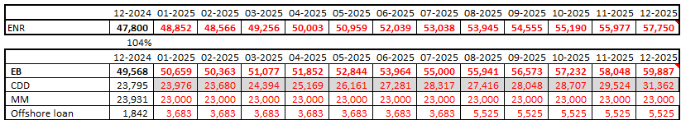

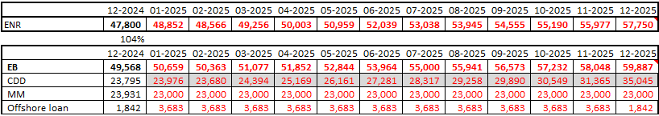
ANALYSIS
Based on the projected Ending Net Receivables (ENR) for lending in 2025 with two scenarios:
Assumption
offshore loan can be rollover and new disbursement 8/2025
MM items will follow with a line of 27.000 billion VND
1
Loan – offshore loan is pre-planned and have large values, so they are fixed
2
• offshore loan can not be rollover and no new disbursement:
CD/D will be calculated by subtracting loans and MM
3
No. | Amount | Currency | Drawdown | Tenor (month) | COF (estimated)
 | 75 | mio USD | 23/12/2024 | 12M | 6.5%
1 | 75 | mio USD | 06/01/2025 | 12M | 6.5%
2 | 75 | mio USD | 23/12/2015 | 12M | 6.5%
3 | 75 | mio USD | 15/08/2025 | 12M | 6.5%

Slide 5

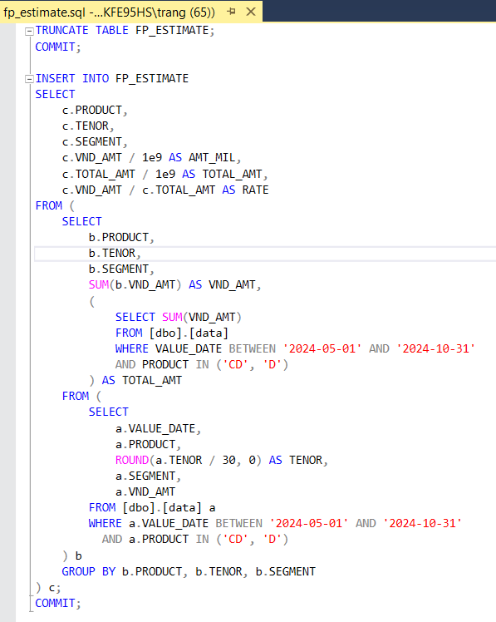
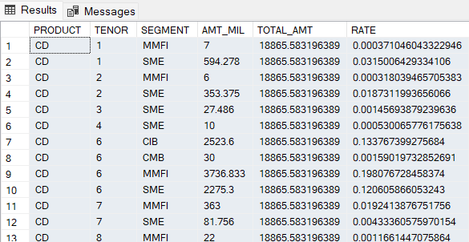
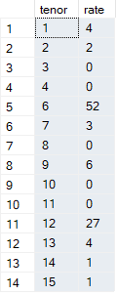
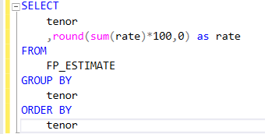
ANALYSIS
create table name 'fp_estimate'
GROUP BY TENOR

Slide 6
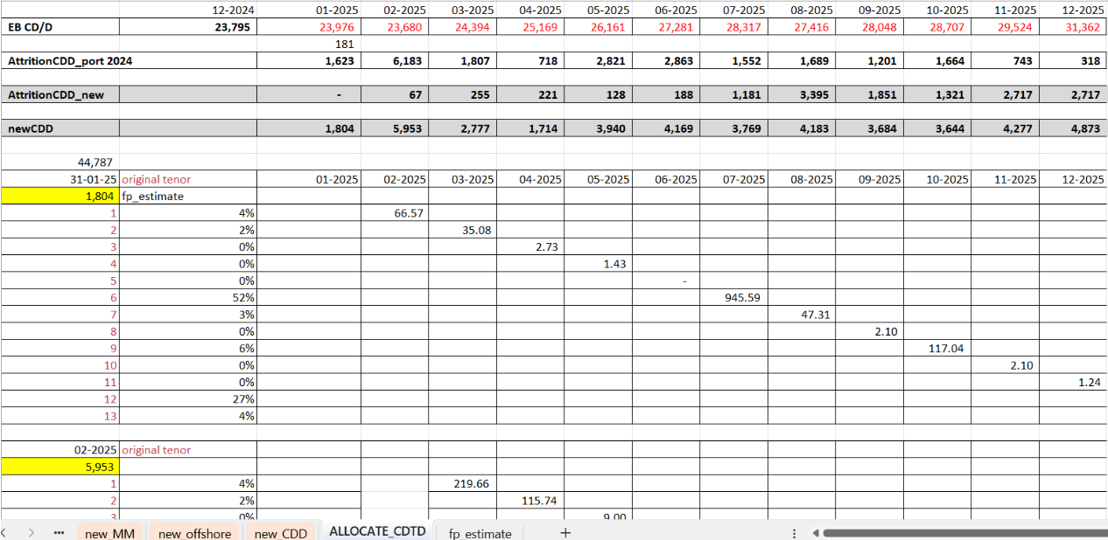
ANALYSIS

Slide 7
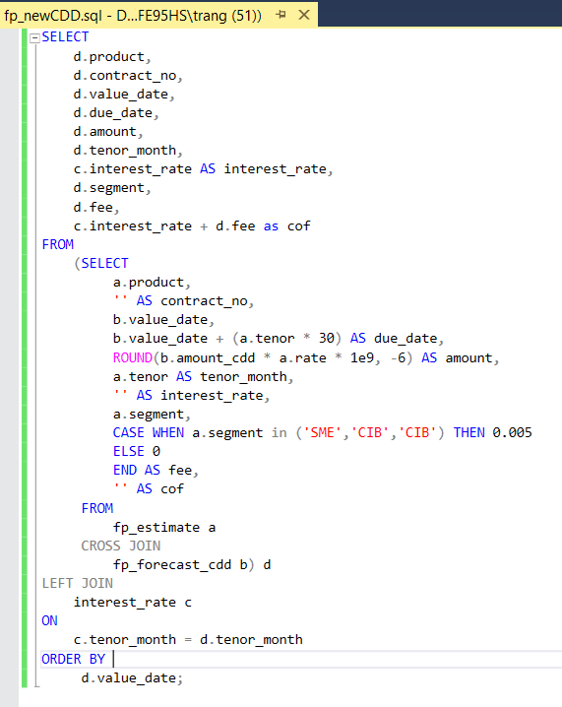
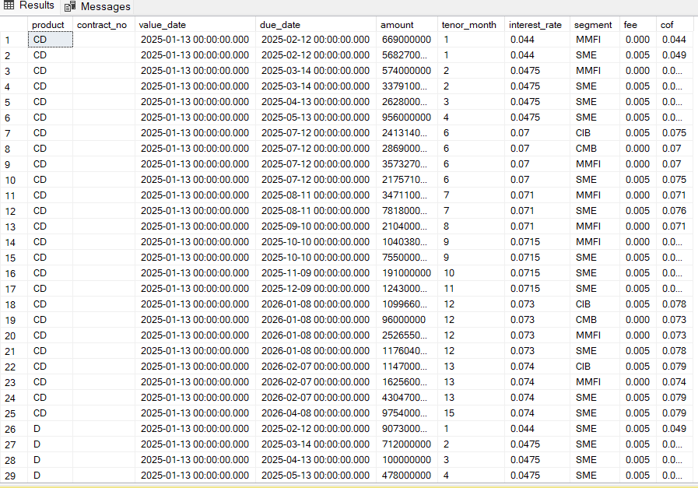
ANALYSIS
create table name 'fp_newCDD’ → linked to sheet ‘new_CDD’

Slide 8
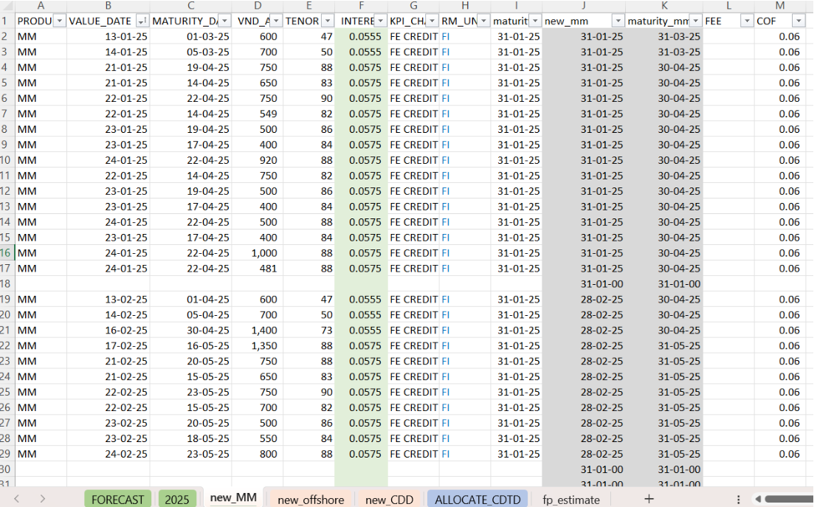
ANALYSIS
sheet ‘new_MM’

Slide 9
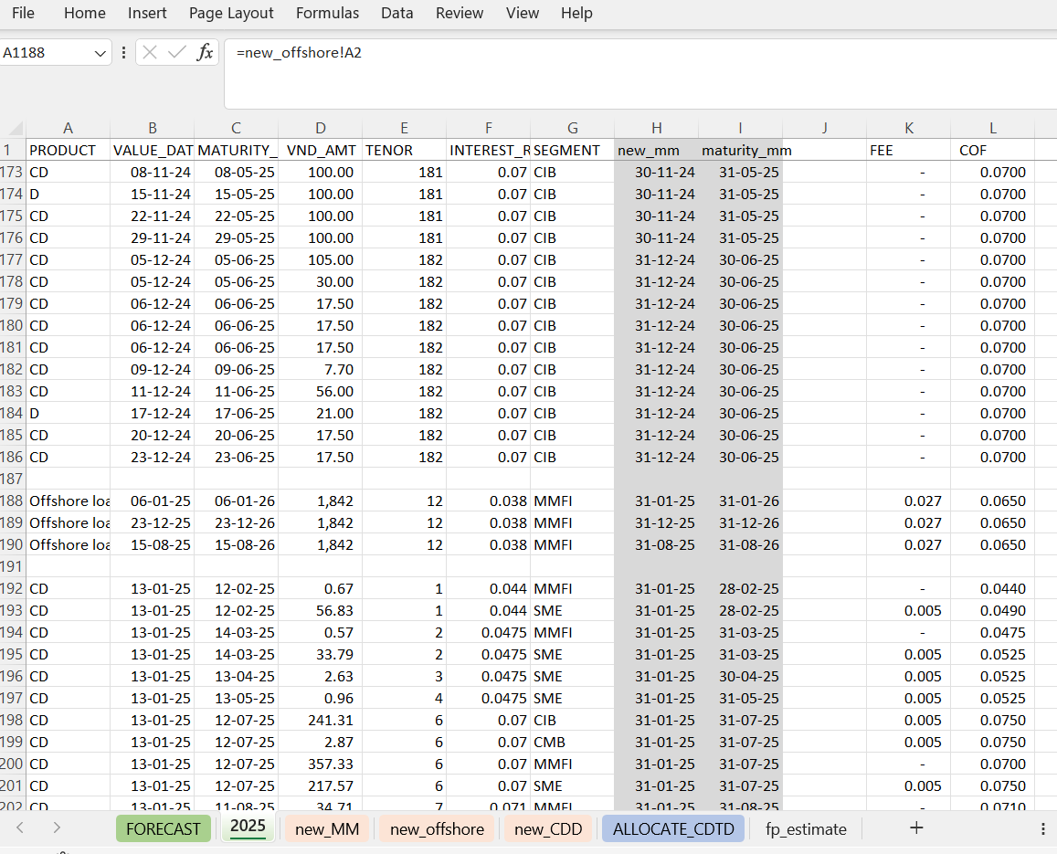
ANALYSIS
sheet ‘2025’

Slide 10
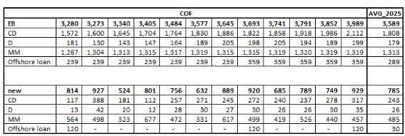
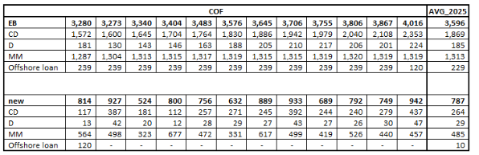
ANALYSIS
sheet ‘FORECAST’
Key insight
offshore loan can be rollover and new disbursement 8/2025
Utilizing offshore loans is expected to reduce costs by an average of 8 billion VND annually.
1
2
Additionally, securing new loans will further lower expenses by 5 billion VND, as the interest rates on foreign loans are currently more favorable than those for issuing certificates of deposit and term deposits.
• offshore loan can not be rollover and no new disbursement:

Slide 11

Advantages: | Disadvantages:
Detailed Forecasting and Planning Flexibility Combining Historical Data and Future Projections | Dependence on Historical Data Inability to Predict All Factors
This approach can yield high effectiveness if properly executed, especially in analyzing data and accurately forecasting key factors. However, if there are unexpected changes in the market or miscalculations, the approach may face risks related to costs or failing to achieve the expected outcomes.

